Slide 1











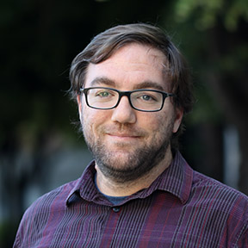
BUILDING A UNIVERSITY OF UTAH GENOMIC DATA SHARING PORTAL
PROJECT MANAGEMENT
RESEARCH PORTAL
Service Desk
New projects
Issues
FAQ
Track outcomes
Diagnoses
Publications
Grants
Administrative
Quote
Timeline
Scope of work
Collaborate
Team
University of Utah
External
UCGD
data cloud
Raw data files
sequence
pedigree
phenotype
Analysis
Launch applications
Gene.iobio
Custom
Track and access
Progress
Data files
Query
Project
Database
Chris Fahim

