Slide 1


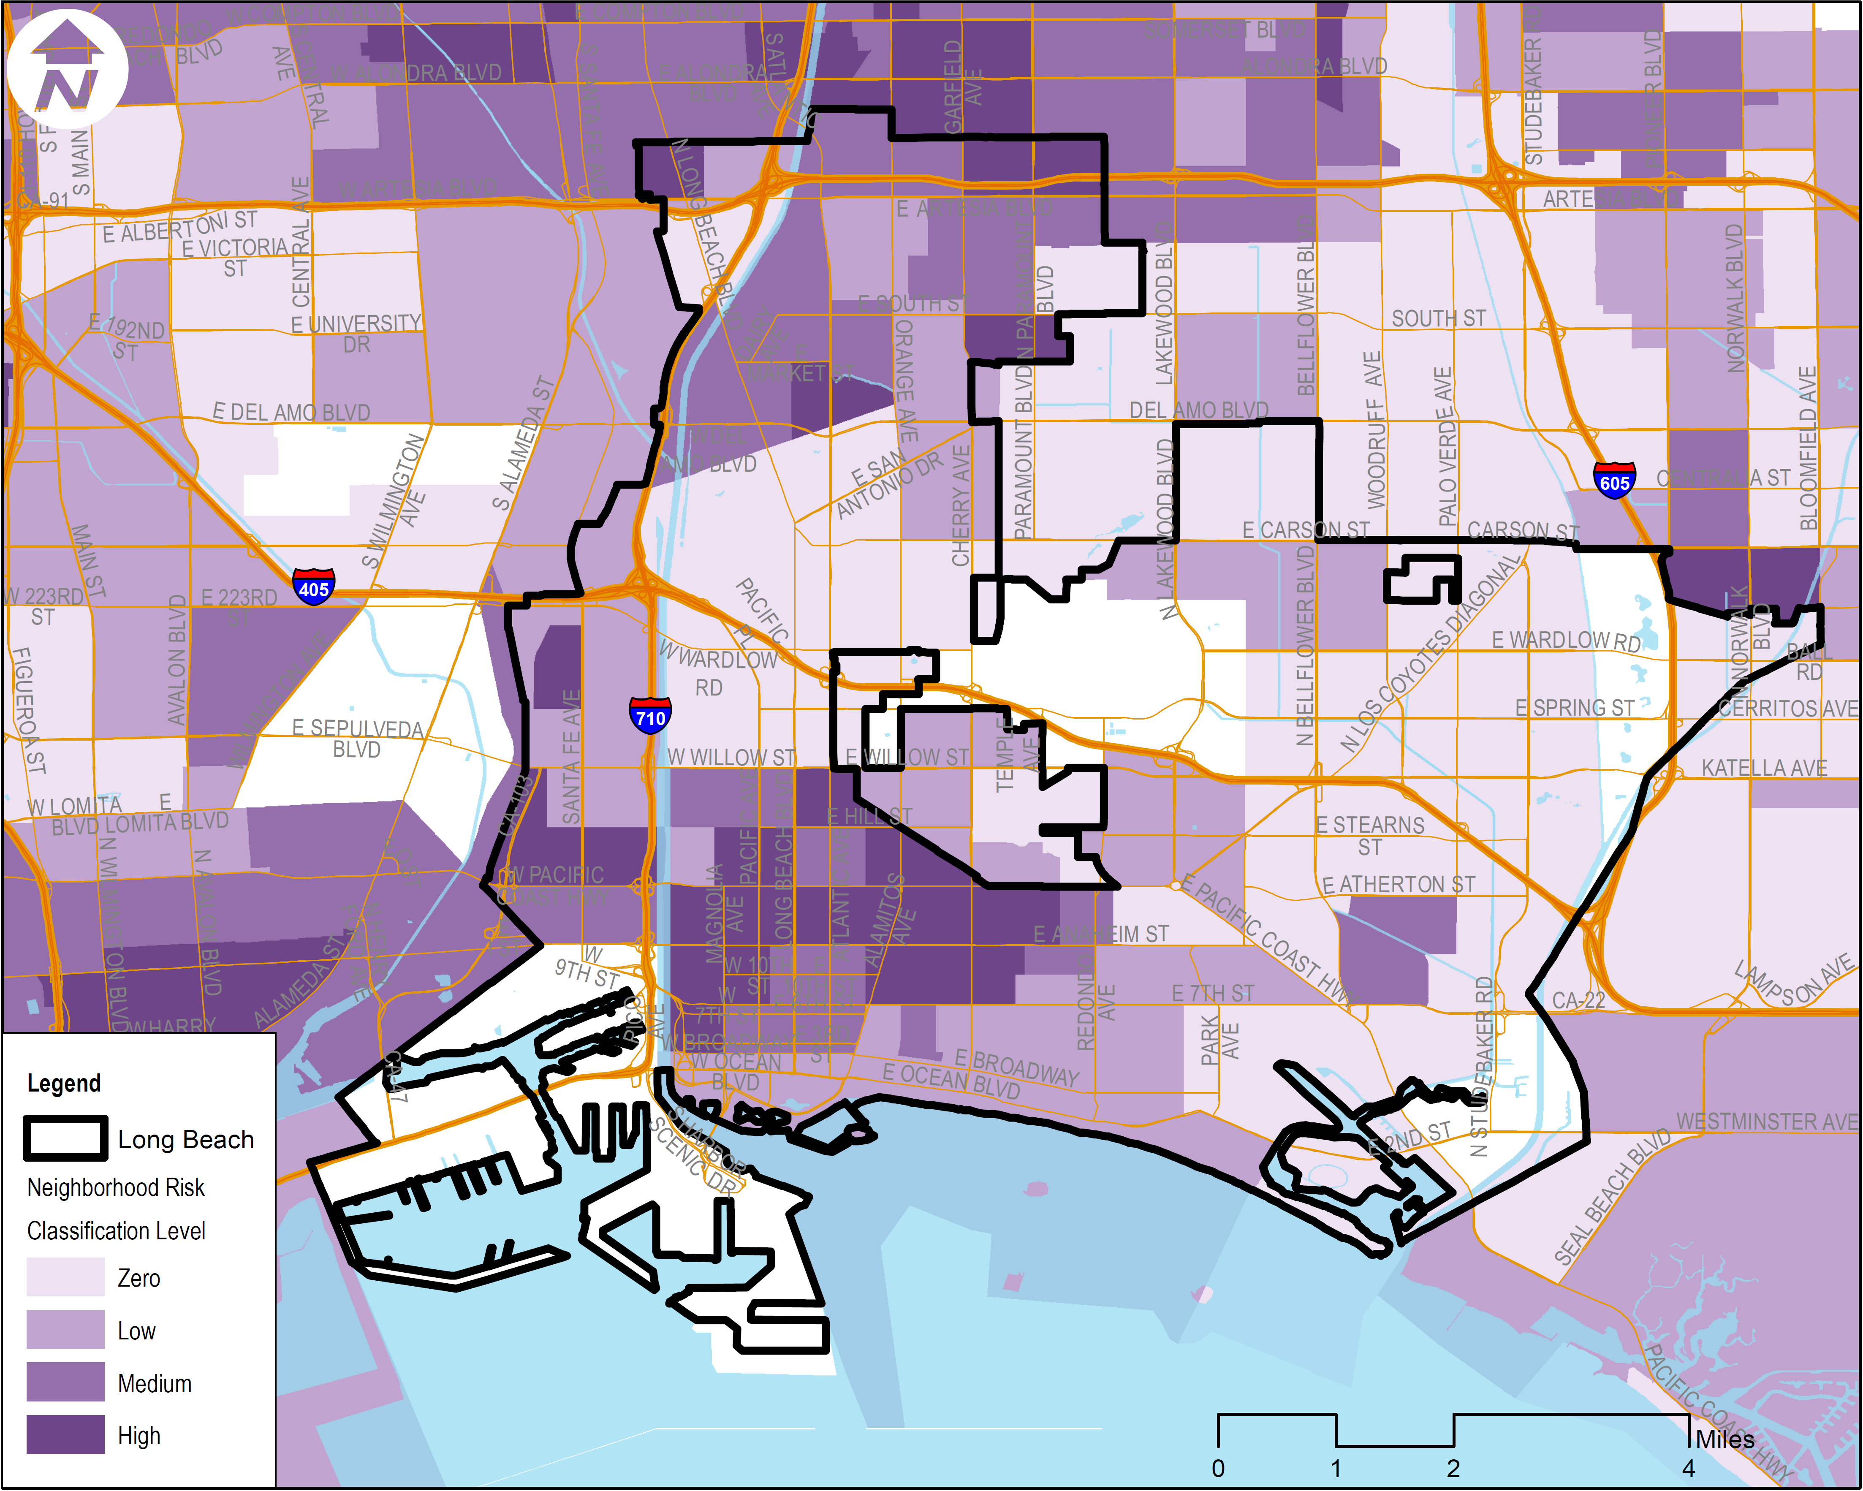
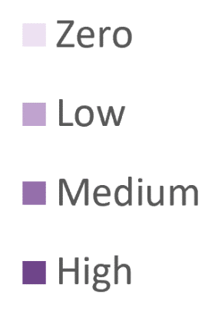
Spatial Equity Mapping: Patterns and Distributions of Neighborhood Risk Nicole Pereira & Jared Schor, UCLA
Background
Conclusions
Long Beach Neighborhood Risk
Identifying clusters of risk factors tell us more about areas of concentrated deprivation within a city. Visually depicting this adds to the discussion on the structural barriers imposed by disproportionate exposure to risk factors.
These maps also allow us to identify areas of opportunity in neighborhoods to positively influence child development and help local communities develop a greater sense of spatial awareness
Snapshots of risk patterns can inform population place-based strategies which can be deployed in conjunction with individual intervention.
Neighborhoods can have a profound impact on early childhood development. Environmental influences include social and physical factors that interact with each other impacting health outcomes for children. Differences in exposure to such factors unfortunately vary by race and ethnicity both between and within neighborhoods. The significance of place and population measures is critical to the goals of achieving equity.
Methods and Approach
Using the Neighborhood Risk Index (NRI), generate one dimensional maps of neighborhood risk levels classified by zero, low, medium, and high risk.
Zero
No Risk
1-2 Risk Factors
3-5 Risk Factors
6-10 Risk Factors
Future Directions
Low
Distribution of Neighborhood Risk by Race (Long Beach)
Ultimately, we aim to work directly with cities sing these maps as both tools and starting points for deeper discussions on child health and development. Our goals in the forthcoming months are:
To help cities explore the histories that underpin the data
Identify strategies to address these patterns of risk
Compile a list of strategies to be shared between participating cities
Develop an online platform using ArcGIS Hub to explore and track city data and dashboards over time
Medium
High
Data was obtained from the American Community Survey at the census tract level. A neighborhood is considered at risk if it is +/- 1 standard deviation from the national mean of the following indicators:
Risk Level
Pct. 25+ with college degree
Pct. 25+ with no diploma
Pct. families with children in poverty
Negative NRI Indicators
Positive NRI Indicators
Pct. single parent families
Pct. owner occupied housing
Pct. head of household with interest, dividend, or rent income
Pct. head of household with wage income
Pct. 18+ with limited English proficiency
Pct. youth not engaged in education or employment
Pct. head of household on public assistance
Acknowledgements
We also thank our colleagues Efren Aguilar, Charlene Choi, and Joshua Bader for their ongoing work on this project.

