Slide 1

40 gal
Currently using 42 gallons/day
30 gal
Shorter Showers save 7 gallons/day
Low Flows save 14 gallons/day
20 gal
Both save 19 gallons/day
10 gal

Slide 2

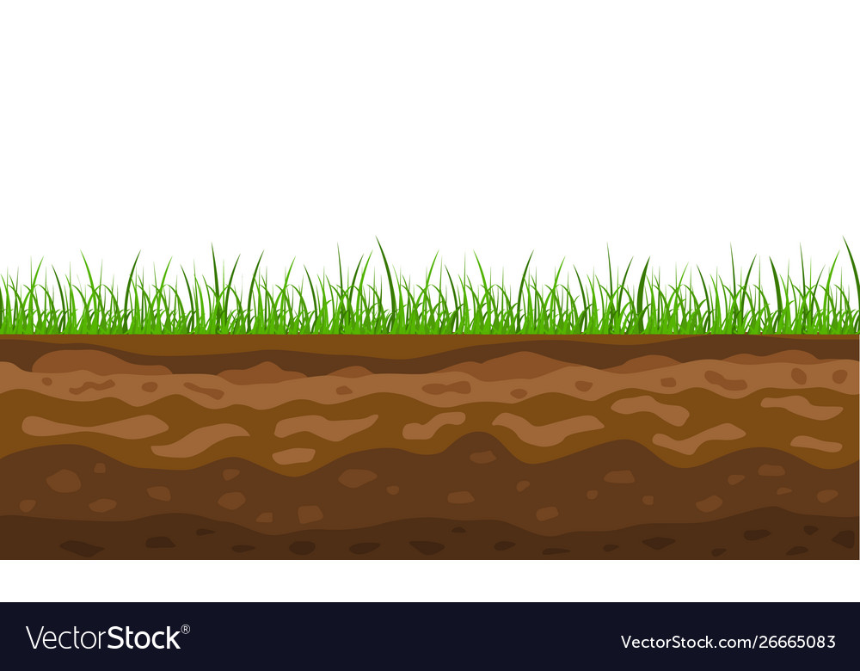

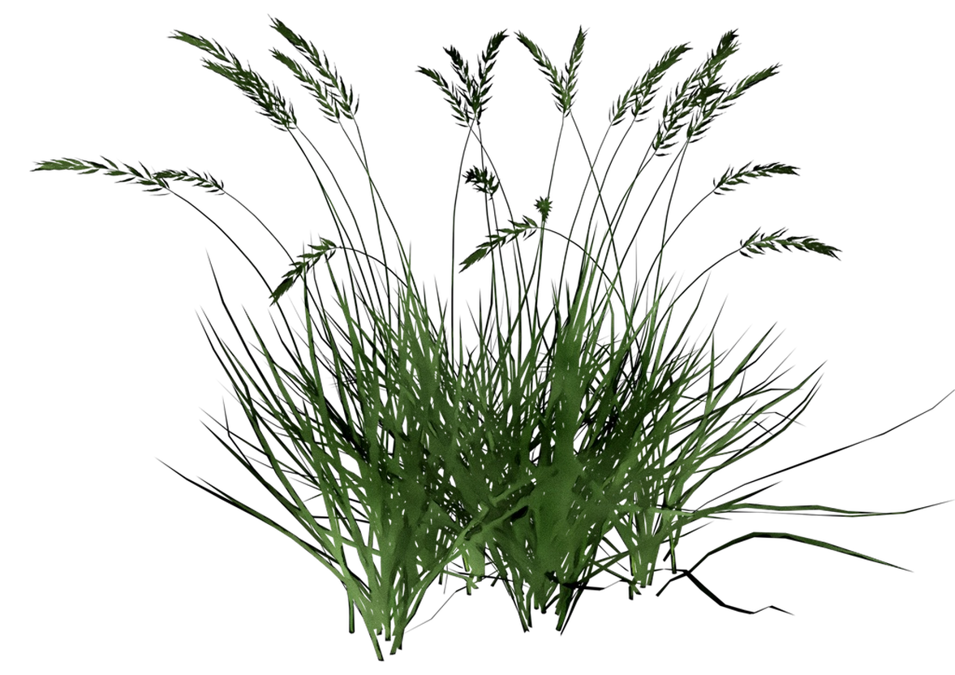
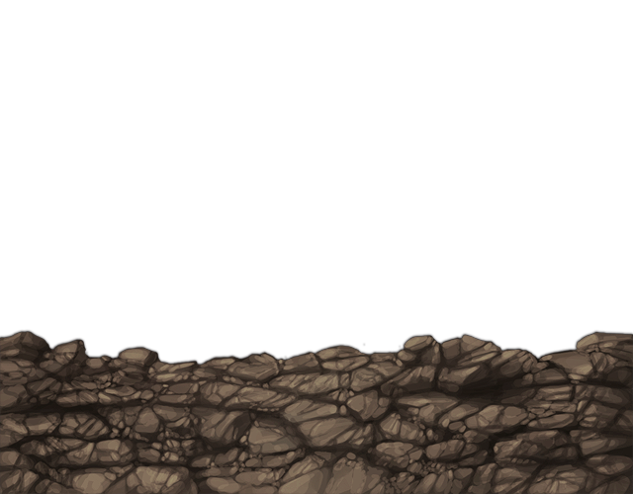
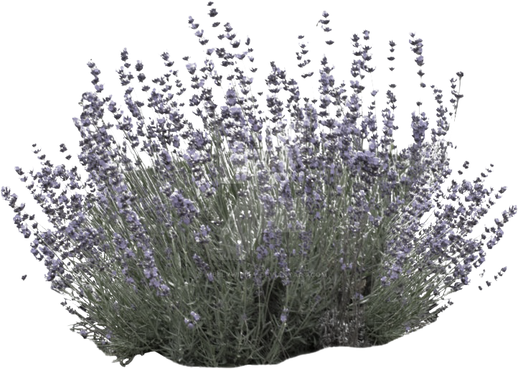
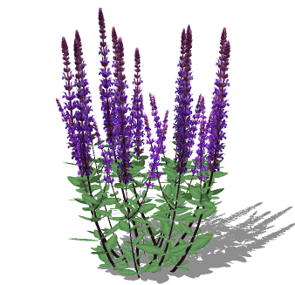
Currently watering
2.18 inches/week
Recommended watering
1 inch/week
Currently watering 0.186 acres
Reduce lawn watering 0.093 acres

