Slide 1
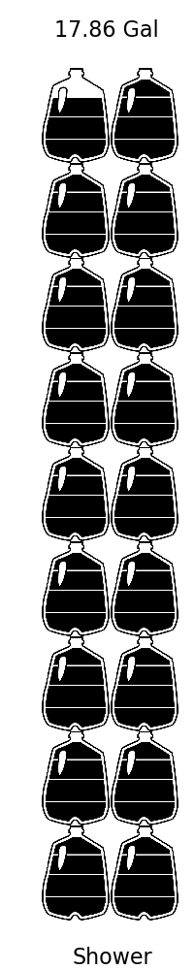
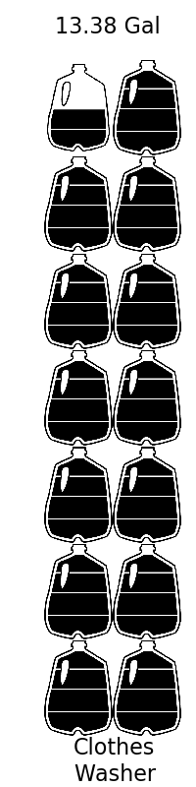
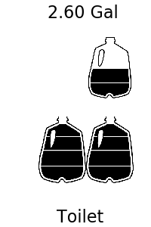
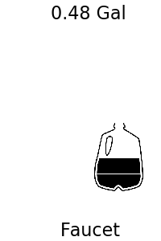
Your Water Usage and You
Here is how much water you use for each of these common tasks.
Conservation Tips
Notice where you are using the most water – these can be easy places to conserve
Try shorter showers or turning the water off when you’re lathering up
Be mindful of how long the sink is running for – every little bit counts!
Consider replacing shower and faucet heads with low flowrate versions
Be aware of leaks and fix them quickly
Run full loads of laundry

Slide 2
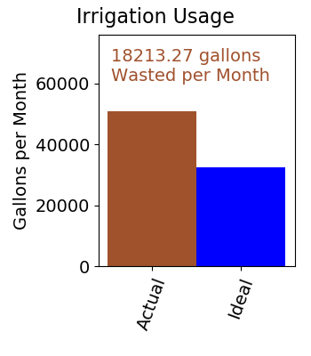
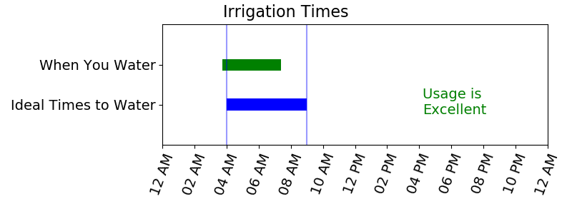
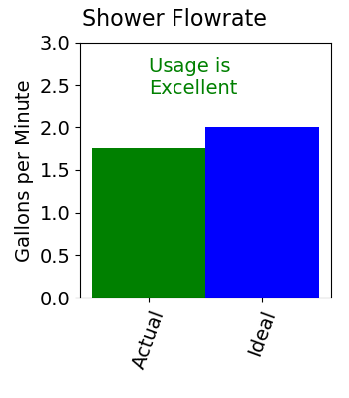
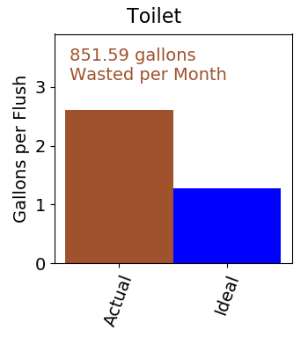
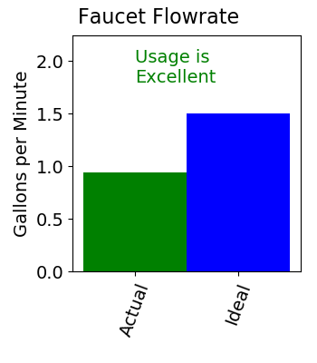
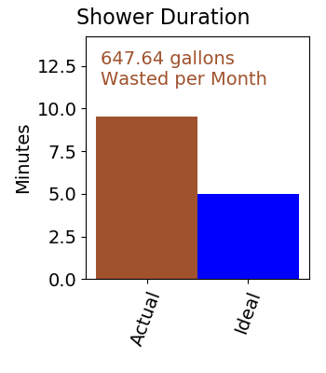
Your Current Conservation Efforts
Irrigation
Watering in the morning is most effective since it reduces how much water is lost to evaporation, but you already seem to know this!
Your lawn may not need as much water as you think. Try adjusting how long you water and see how your lawn responds.
Indoor Usage
You appear to be using low flowrate shower heads. Good job!
You may want to consider using water-conserving toilets.
You appear to be using low flowrate faucets. Good Job!
Reducing shower lengths by just a couple minutes can have a big impact on your water usage.

