Slide 1
(CIWS) Data Visualization Challenge
Household Residential Data
By: Ahmed Gharib

Slide 2
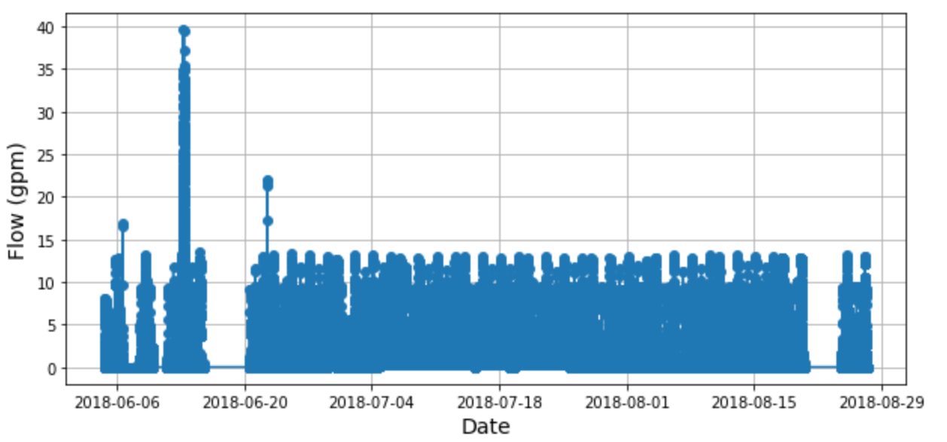
Read and Check data
Start date is 2018-06-04 14:14:39
End date is 2018-08-27 10:58:00
83.86 days in summer season
Number of All Readings is 1,641,706
Time step is 4.9 seconds
Some missing time steps
Volume of 1 pulse is 0.0087 gallons
Maximum Flow is 39.629 gpm
Mean Flow is 0.77 gpm

Slide 3
Audiences
Part 1
consumers
researchers
Part 2
providers
providers
Part 3
researchers
researchers

Slide 4
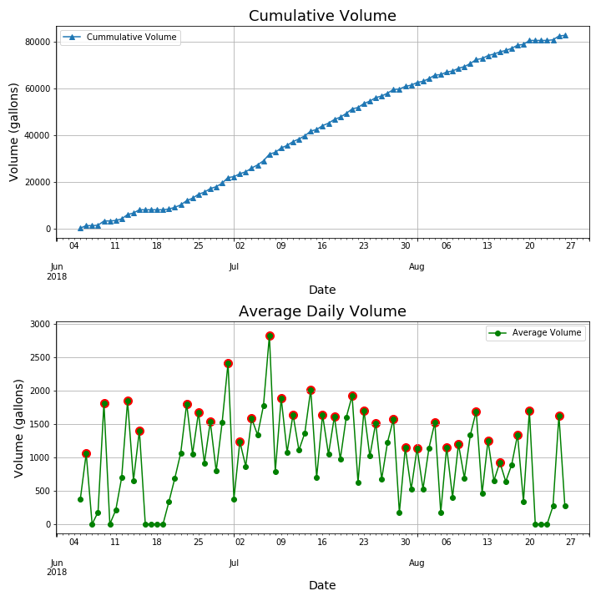
Part 1
2,821
Average Daily Volume is 997.4 gallon

Slide 5
Total Volume is 82,783 gallon

Slide 6
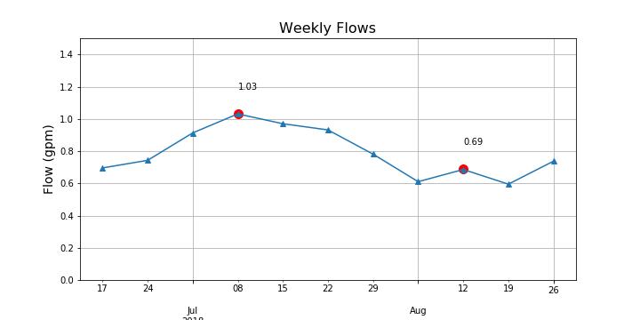
Part 2
(10,395 gallons)
(6,955 gallons)
Mean Flow is 0.79 gpm (7,968 gallons)

Slide 7
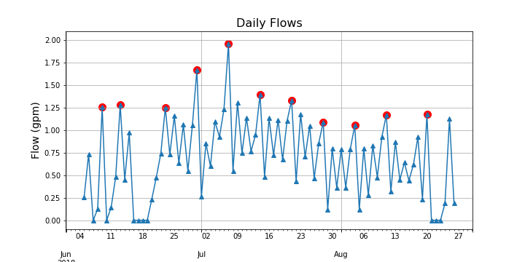
Average Daily Flow is 0.69 gpm (997.4 gallons)
Maximum Daily Flow is 1.96 gpm (2,821.6 gallons)

Slide 8
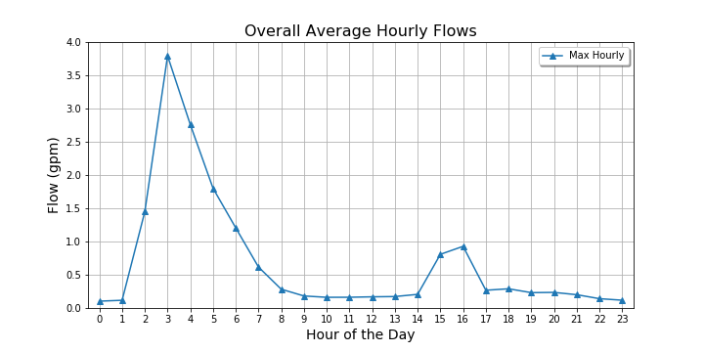

Slide 9
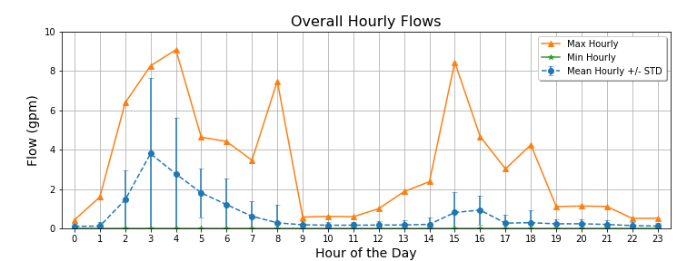
9.07 gpm (544 gallons)

Slide 10
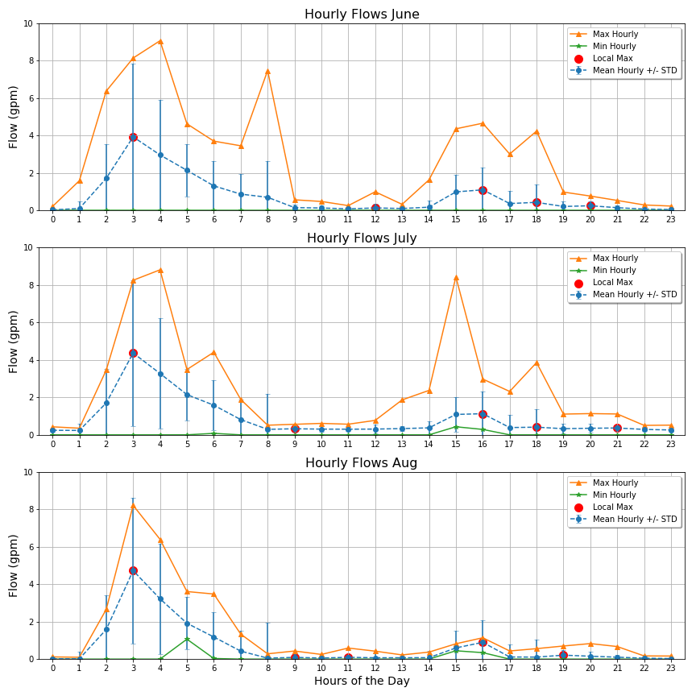

Slide 11
Part 3
Resample data to 5 seconds
Assume the threshold between indoor and outdoor uses is 5 gpm
Total Volume is 82,548 gallons
Indoor Volume is 32,284 gallons
Outdoor Volume is 50,264 gallons
Indoor ratio is 0.39 , And Outdoor ratio is 0.61
Average Daily Volume is 997.4 gallons
>> Utah average per capita (167*4 = 668 gallons)

Slide 12
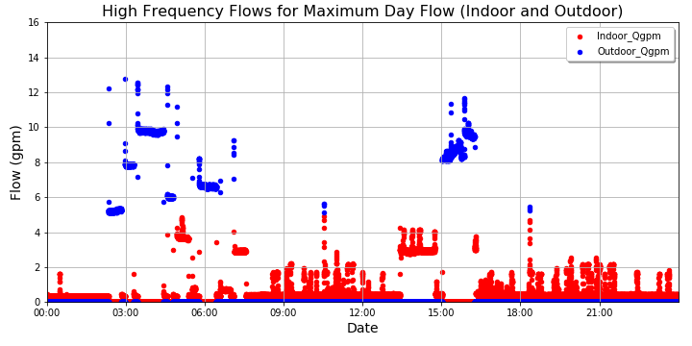
Maximum Day : 2018-07-07
This Day Has NO Zero Reading

Slide 13
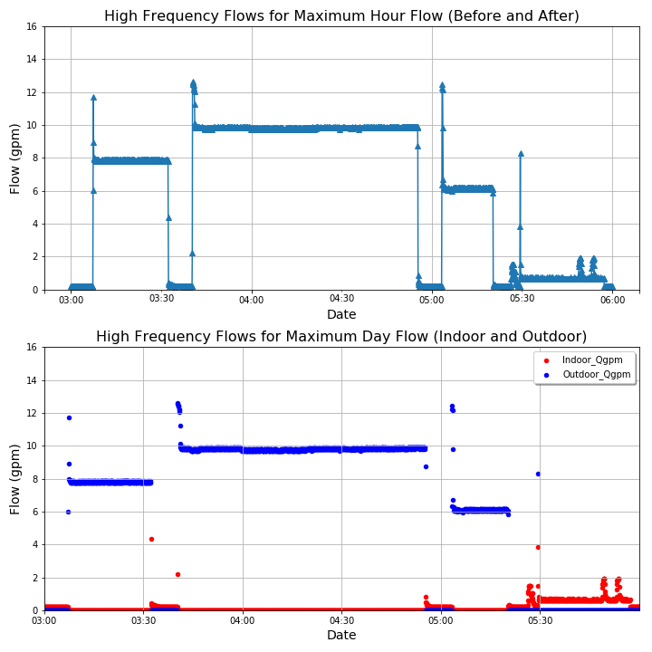
Max Hour 2018-06-30 04-05
These 3 Hours Have NO Zero Reading

Slide 14
Max Hour 2018-06-30 04:00:00

Slide 15
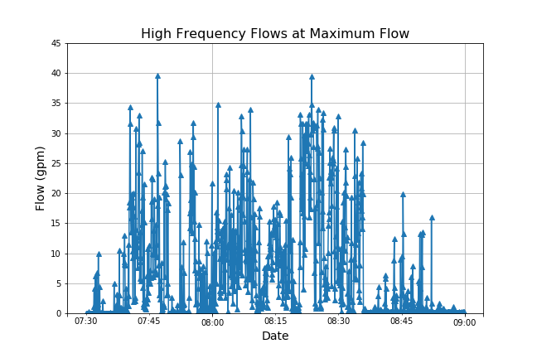
Max Recorded Flow 2018-06-13
Mean 6.89
Max 39.629
Total Volume Passed Trough 90.0 min is 620.1 gallons
So, This may be error in the measuring device

Slide 16


