Slide 1
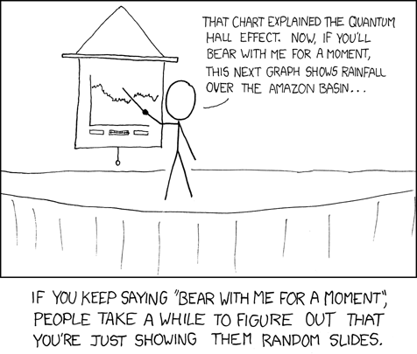
Basilisk
Cyberinfrastructure for Intelligent Water Supply (CIWS) Data Visualization Challenge

Slide 2

Datetime
for row in csv_data:
if line_count > 0:
datetime_obj=datetime.strptime(row[0], … )
#create a datetime object out of the data
self.timestamps.append(datetime_obj)
pulse = int(row[1])
self.pulses.append(pulse)
line_count +=1

Slide 3
Convert CSV to 2 lists:
[Datetime Objects] and [int(Pulse Count)]
Data Set
New Data Set
Use Basilisk
Filter, Average, and Manipulate
Further Analyze Data
Create Graph

Slide 4
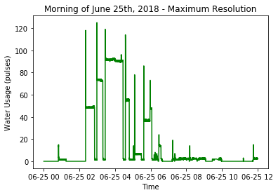
Filtered Graphs
Specified Timeframe
timeframe( '2018-06-25 00:00:00','2018-06-25 11:59:59’ )

Slide 5
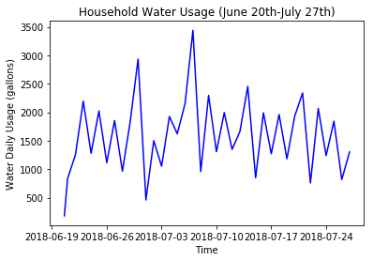
Filtered Graphs
Specified Timeframe
Specified Resolution
timeframe( '2018-06-25 00:00:00','2018-06-25 11:59:59’ )
total_by_unit( unit_time = 'date’ )

Slide 6
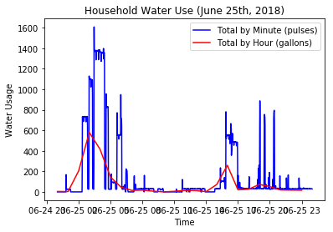
Two Different Resolutions

Slide 7
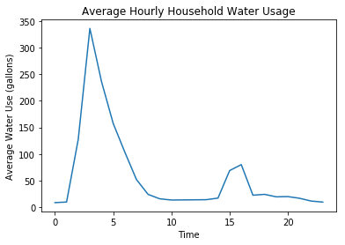
Graphing Averages
By Hour
average_by_unit(unit = 'hr')

Slide 8
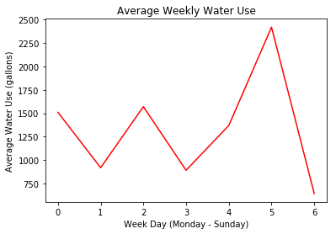
Graphing Averages
By Hour
By Weekday
average_by_unit(unit = 'hr')
average_by_weekday()

Slide 9
1 - Averaging Only
Magikarp = Basilisk('test1.txt’)
#initiate class, read csv file
data = Magikarp.average_by_hour()
data = Magikarp.pulse_to_gallon(data)
title = 'Average Hourly Household Water Usage'
y_axis = 'Average Water Use (gallons)'
x_axis = 'Time’
Magikarp.basic_plot(data, title, y_axis, x_axis)

Slide 10
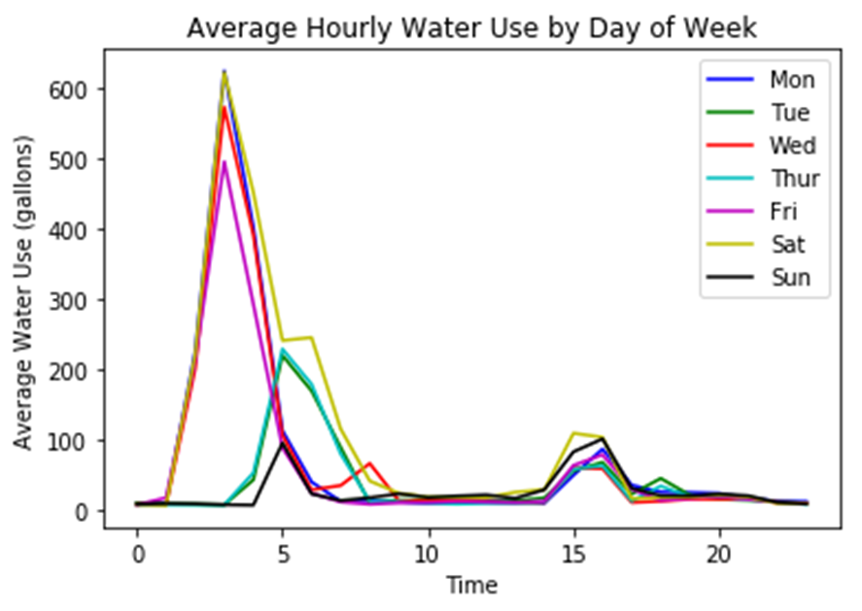

Slide 11
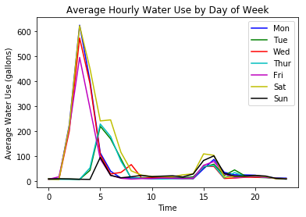
2 - Averaging with Filtering
mon = Magikarp.filter_weekday([0])
tue = Magikarp.filter_weekday([1])
…
sun = Magikarp.filter_weekday([6])
weekday_data = [mon, tue, wed, thur, fri, sat, sun]
colors =['b','g','r','c','m','y','k']
week_hours = [] #for later use
#average_by_hour replaces timestamps with a integer, so do it last
for i in range(7):
hourly_data = Magikarp.average_by_hour(weekday_data[i])
hourly_data = Magikarp.pulse_to_gallon(hourly_data)
for hour in range(len(hourly_data[1])):
week_hours.append(hourly_data[1][hour])
plt.plot(hourly_data[0], hourly_data[1], colors[i])
plt.title('Average Hourly Water Use by Day of Week')
plt.legend(('Mon', 'Tue', 'Wed','Thur', 'Fri','Sat','Sun’))
…
plt.show()

Slide 12
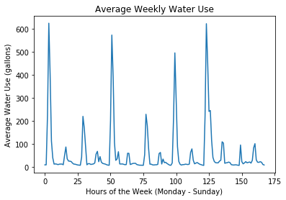

Slide 13
Averaging with Filtering
#Filtered by weekday_data earlier
week_hours = [] #for later use
#average_by_hour replaces timestamps with a integer, so do it last
for i in range(7):
hourly_data = Magikarp.average_by_hour(weekday_data[i])
hourly_data = Magikarp.pulse_to_gallon(hourly_data)
for hour in range(len(hourly_data[1])):
week_hours.append(hourly_data[1][hour])
…
hoursperweek = np.arange(24*7)
#we saved "week_hours" earlier, when comparing days of the week
plt.plot(hoursperweek, week_hours)
…
plt.show()

Slide 14
One Data Set: Two Graphs

Slide 15
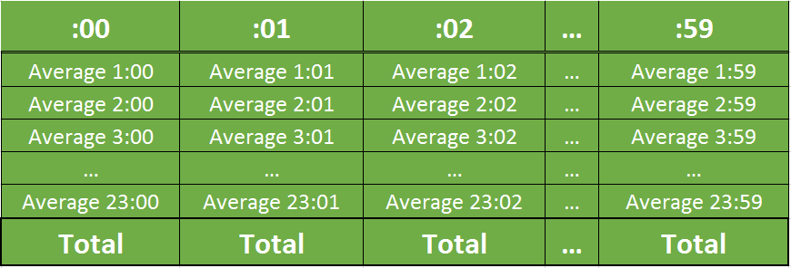
What if you average by the minute stamp?
def average_by_unit(self, unit = 'hr', data = None):
if unit == 'min' or unit == 'minute':
slots = 60 #timestamps to track
water = []
for i in range(slots):
water.append(0)
…
for i in range(len(data[0])):
if unit == 'min' or unit == 'minute':
timestamp = data[0][i].minute #get minute stamp
…
water[timestamp] += data[1][i]
for i in range(slots): #average out everything
water[i] = water[i]/occurrences[i]

Slide 16
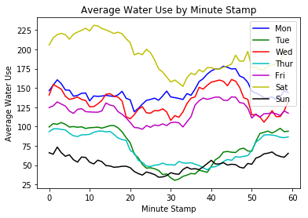
What if you average by the minute stamp?

Slide 17
Compare Weekday Patterns
Mon-Wed-Fri | Tue-Thur | Sat | Sun

Slide 18
Scaffolding for Any Application
Home owners can watch their own water usage
Water providers can find days of highest demand and water use patterns
Researchers can creatively filter, average, and experiment with data

