Slide 1
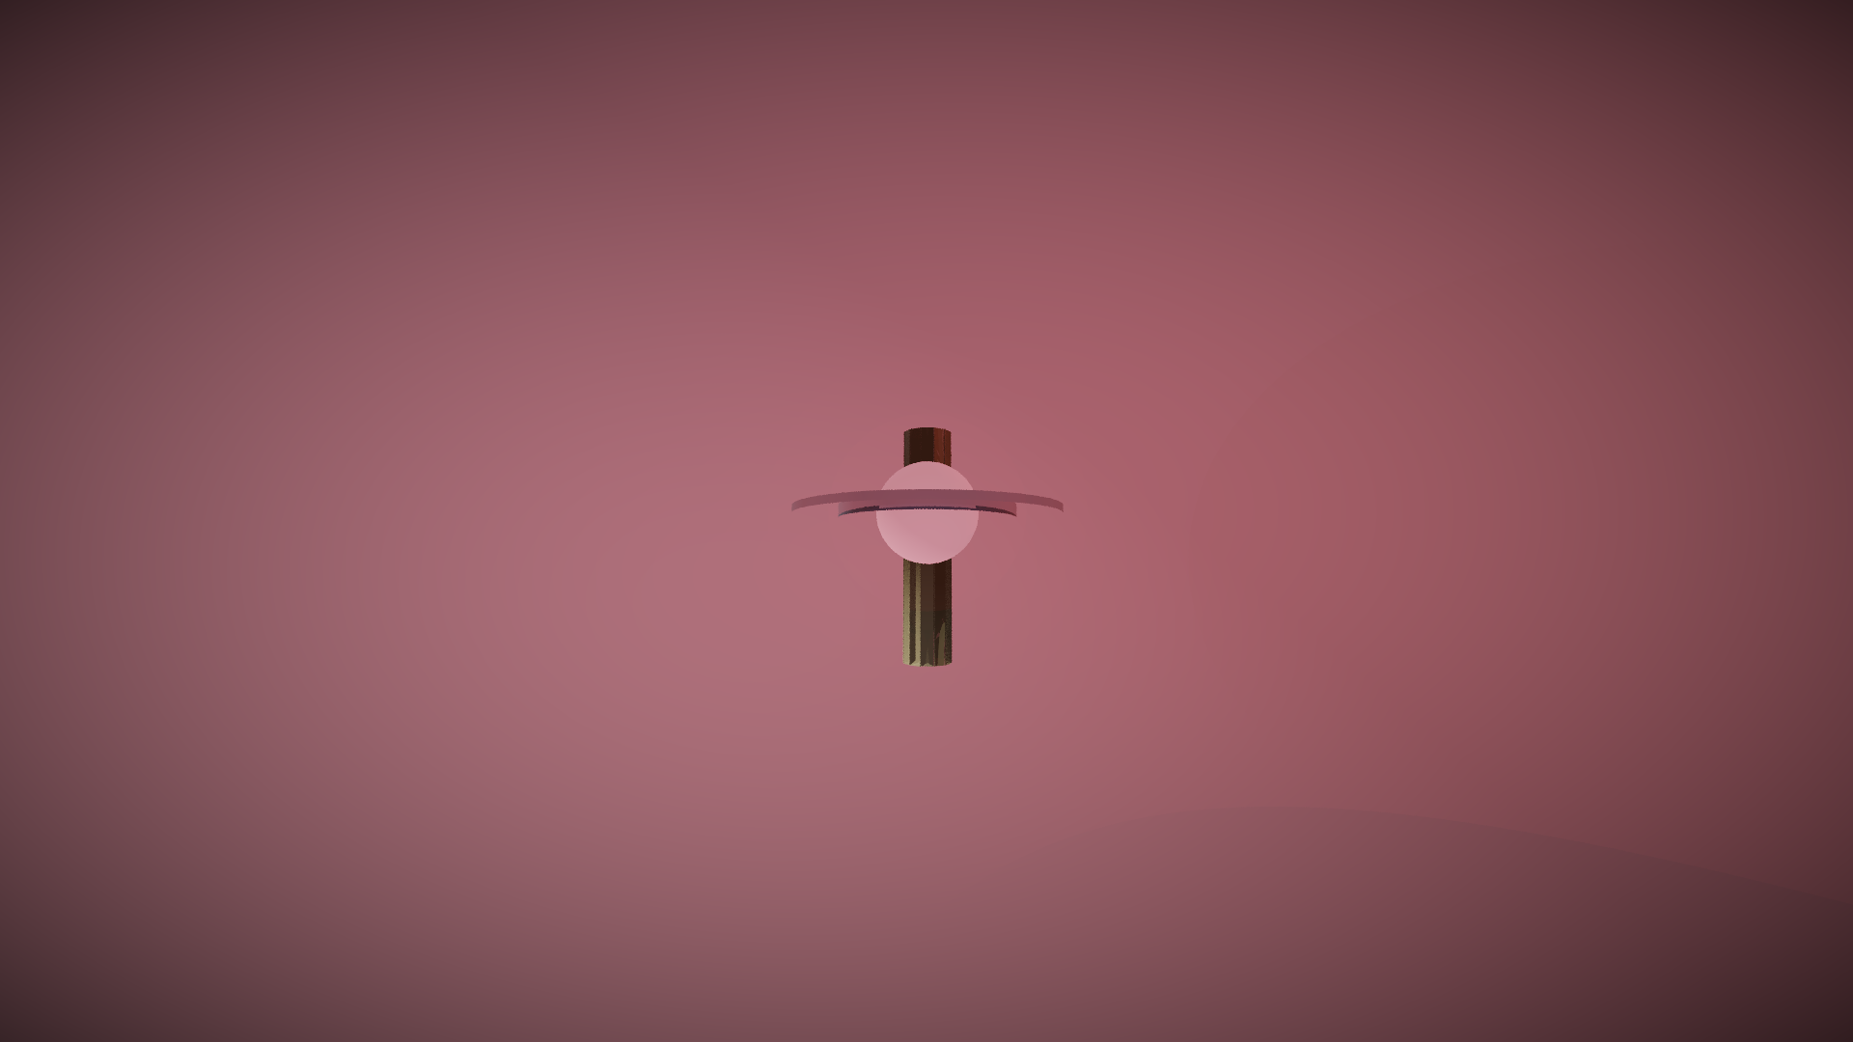
OBSIDIAN
THE EMPIRE'S NERVOUS SYSTEM
A classified command portal for the post-Order-66 hunt
ANUJ PHULERA · AARAV CHOUDHARY · JEEHAAN KWATRA
TS '26 CREATIVE PRELIMS · PATH 2 — THE EMPIRE

Slide 2
THE PROBLEM
The galaxy is
scattered.
Order 66 fell. Hundreds of Jedi survive across a thousand worlds — rebuilding, recruiting, learning to vanish.
EVERY TARGET IN THE FIELD
The Empire has legions — but no eyes.
FRAGMENTED INTEL
ISOLATED HUNTERS
reports filed into a void
six Inquisitors, six hunts
9 targets · 10 sectors · 6 hunters
zero coordination
NO RECRUIT DEFENSE
NO DECISION LAYER
the Order recruits freely
intel never becomes action
OBSIDIAN · PROBLEM
02

Slide 3
THE SOLUTION
One nervous
system.
OBSIDIAN turns a disorganized purge into a single hunting organism — every sector, probe and citizen a sensor in the Emperor's hand.
TRACK
PLAN
COMMAND
DISRUPT
radar, probes, sightings — one grid
intel becomes dispatch in one board
every Inquisitor on one channel
counter-recruitment at broadcast scale
PASSPHRASE GATE → TYPED BOOT → CLEARANCE ALPHA-7 → FULL NETWORK
OBSIDIAN · SOLUTION
03

Slide 4
WHY NOW · THE MOMENT
The window is
open.
The brief hands us the moment: post-Order 66, survivors scattered, Empire uncoordinated. Whoever builds the nervous system first, wins the galaxy.
WHY OBSIDIAN WINS THE WINDOW
✓
Demoable live — judges operate it
THE GALAXY
✓
Original — nothing canon, nothing borrowed
TAM
a thousand worlds, unchecked
✓
Complete — app, deck, film, 3D, design system
SAM
THE EMPIRE
ten sectors, eight legions
✓
Offline-first — runs anywhere, forever
SOM
THE HUNT
nine classified targets, now
OBSIDIAN · WHY NOW
04

Slide 5
THE PRODUCT
Twelve modules.
One hunt.
001 COMMAND DECK
002 GALAXY TRACKER
003 WANTED DOSSIERS
hero status board
radar + probe drops
9 psychoprofiled targets
004 INTELLIGENCE
005 OPERATIONS
006 INTERDICTION
probe/ISB feed
kanban dispatch
propaganda studio
007 INQUISITOR UPLINK
008 IMPERIAL ARCHIVE
009 TERMINAL
encrypted comms
7 lore documents
working mainframe shell
EVERY MODULE IS LIVE AND OPERABLE — NOT A MOCKUP
010 MANIFESTO
011 HUNT METRICS
012 STANDARDS
OBSIDIAN · PRODUCT
05
the Emperor's case
purge completion
in-app design system

Slide 6
THE PRODUCT · JOURNEY
Three minutes to
demonstrate it all.
OBSIDIAN
PAGE TITLE
01 GATE
02 BOOT
click to initialize
typed sequence, beeps
SIGHTING
03 PASSPHRASE
04 DECK
FOR THE EMPIRE
giant hero + HUD
05 TRACKER
06 OPS
click a blip → dossier
drag card to ACTIVE
07 TERMINAL
08 STANDARDS
RADAR SWEEP · LIVE
cat targets.log
the design system
9-STEP DEMO · ~3 MINUTES
OBSIDIAN · PRODUCT
06

Slide 7
PROOF · TRACTION
Built,
not promised.
12
9
8
working modules
original Jedi
3D scenes
one login
psychoprofiled
custom raytracer
62s
100+
0
promo film
intel reports
external assets
original score
generated live
everything in-house
THE TERMINAL RUNS A REAL FILESYSTEM · THE INQUISITORS REPLY IN-CHARACTER · THE BOARD DRAGS
OBSIDIAN · PROOF
07

Slide 8
COMPETITIVE LANDSCAPE
The old way
vs. the network.
THE OLD EMPIRE
OBSIDIAN
✗
reports vanish into ledgers
✓
one live galactic grid
✗
six hunters, six separate hunts
✓
one encrypted channel
✗
recruitment lanes wide open
✓
counter-recruitment broadcasts
✗
sightings never become strikes
✓
intel escalates into hunts
THE EMPIRE DOES NOT COMPETE WITH BETTER LEGIONS — IT COMPETES WITH BETTER COORDINATION
OBSIDIAN · COMPETITION
08

Slide 9
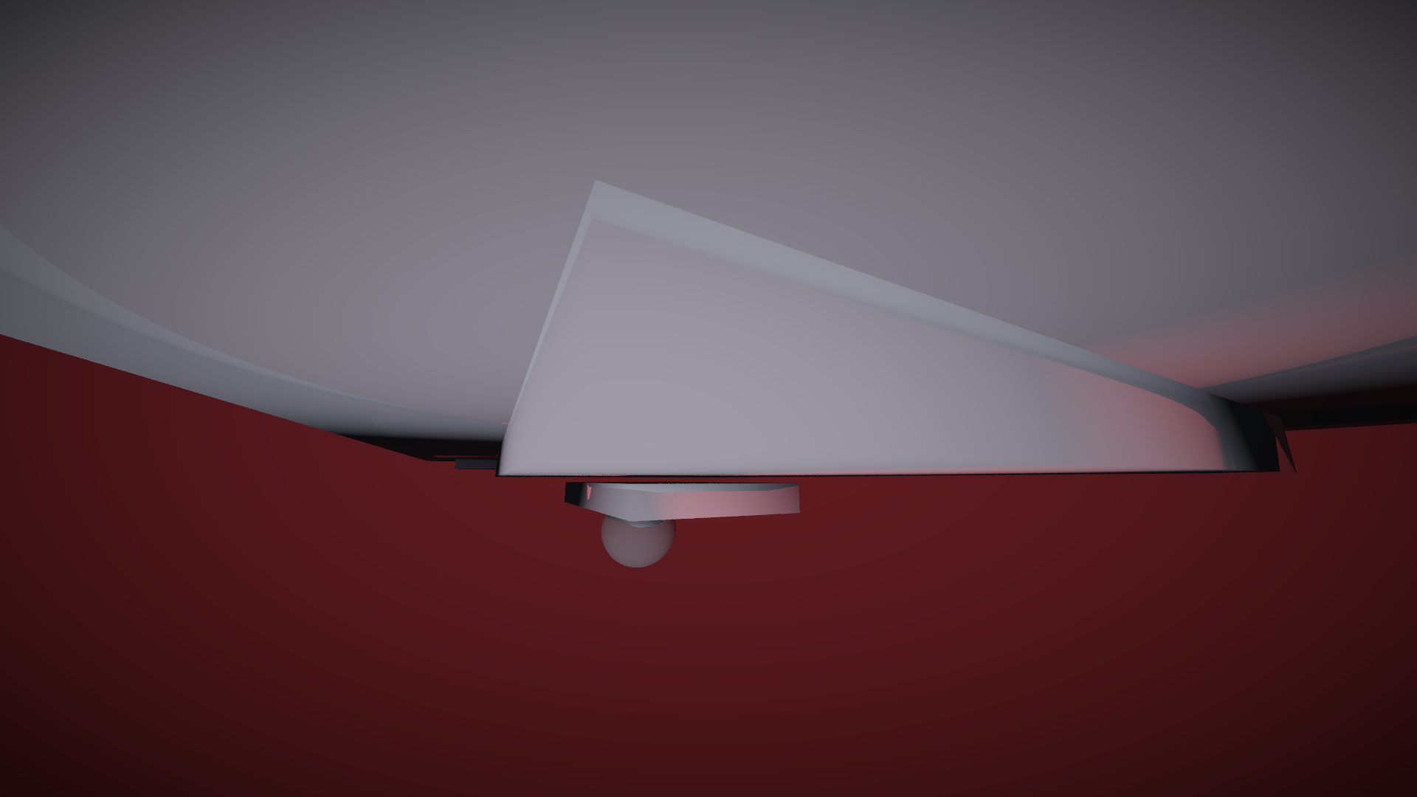
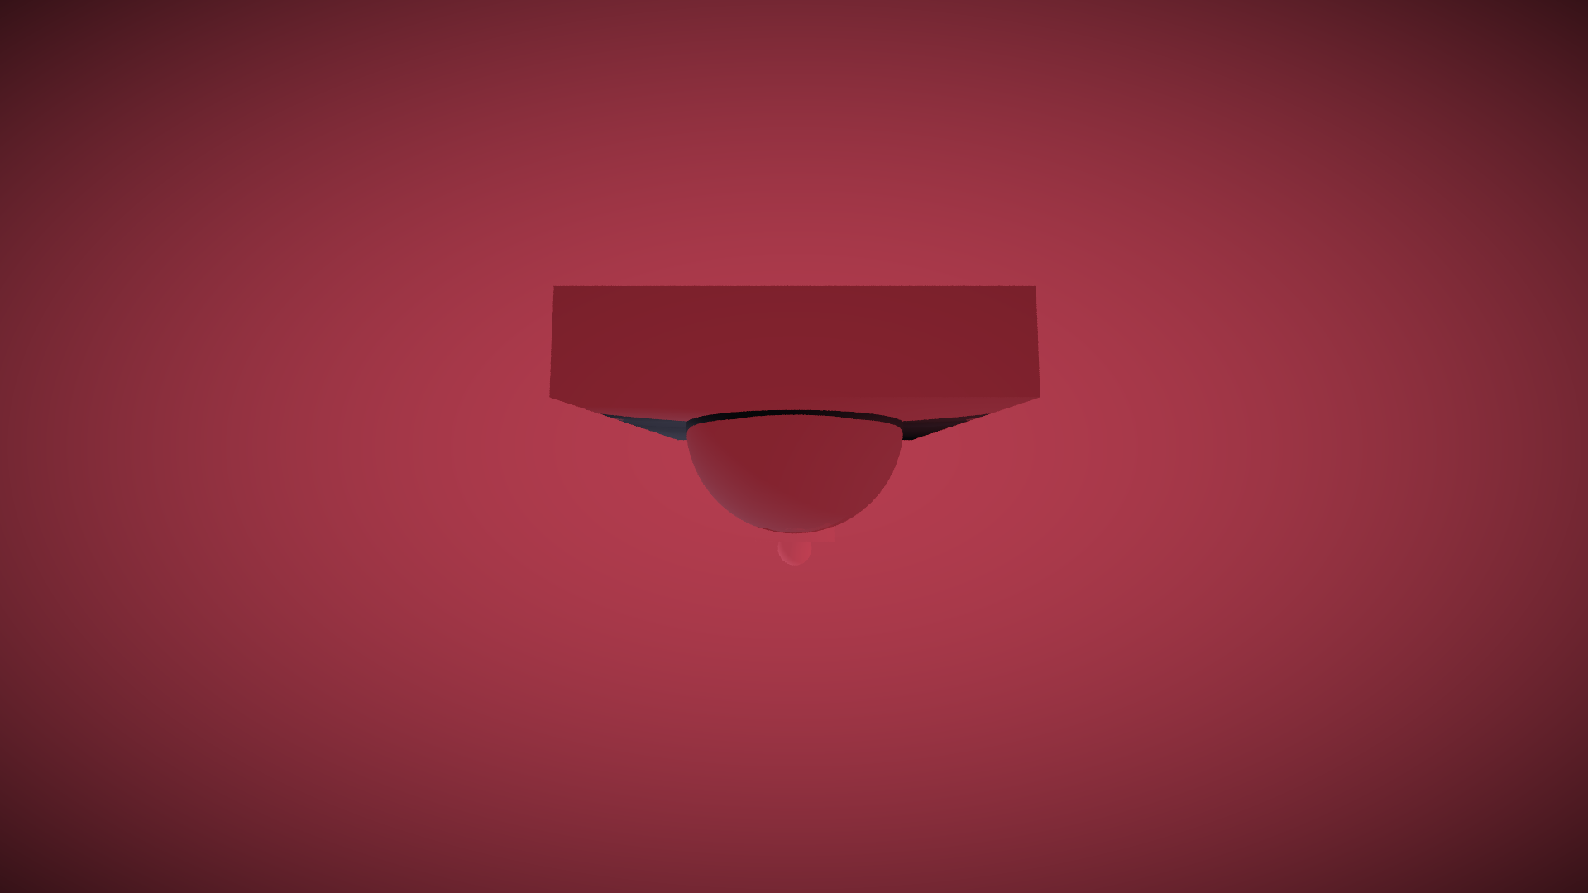

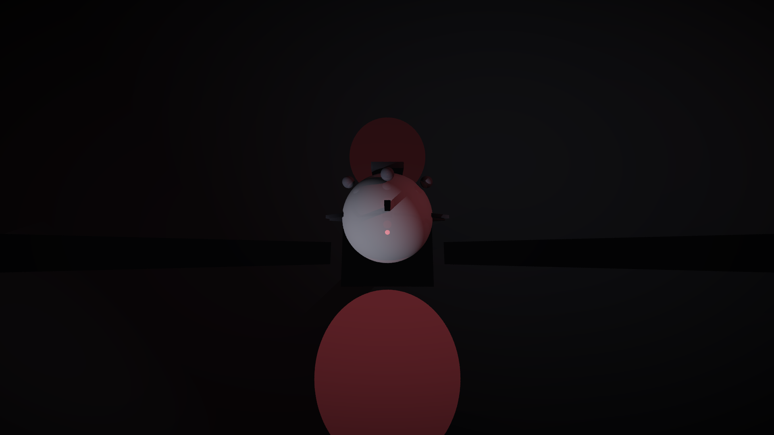
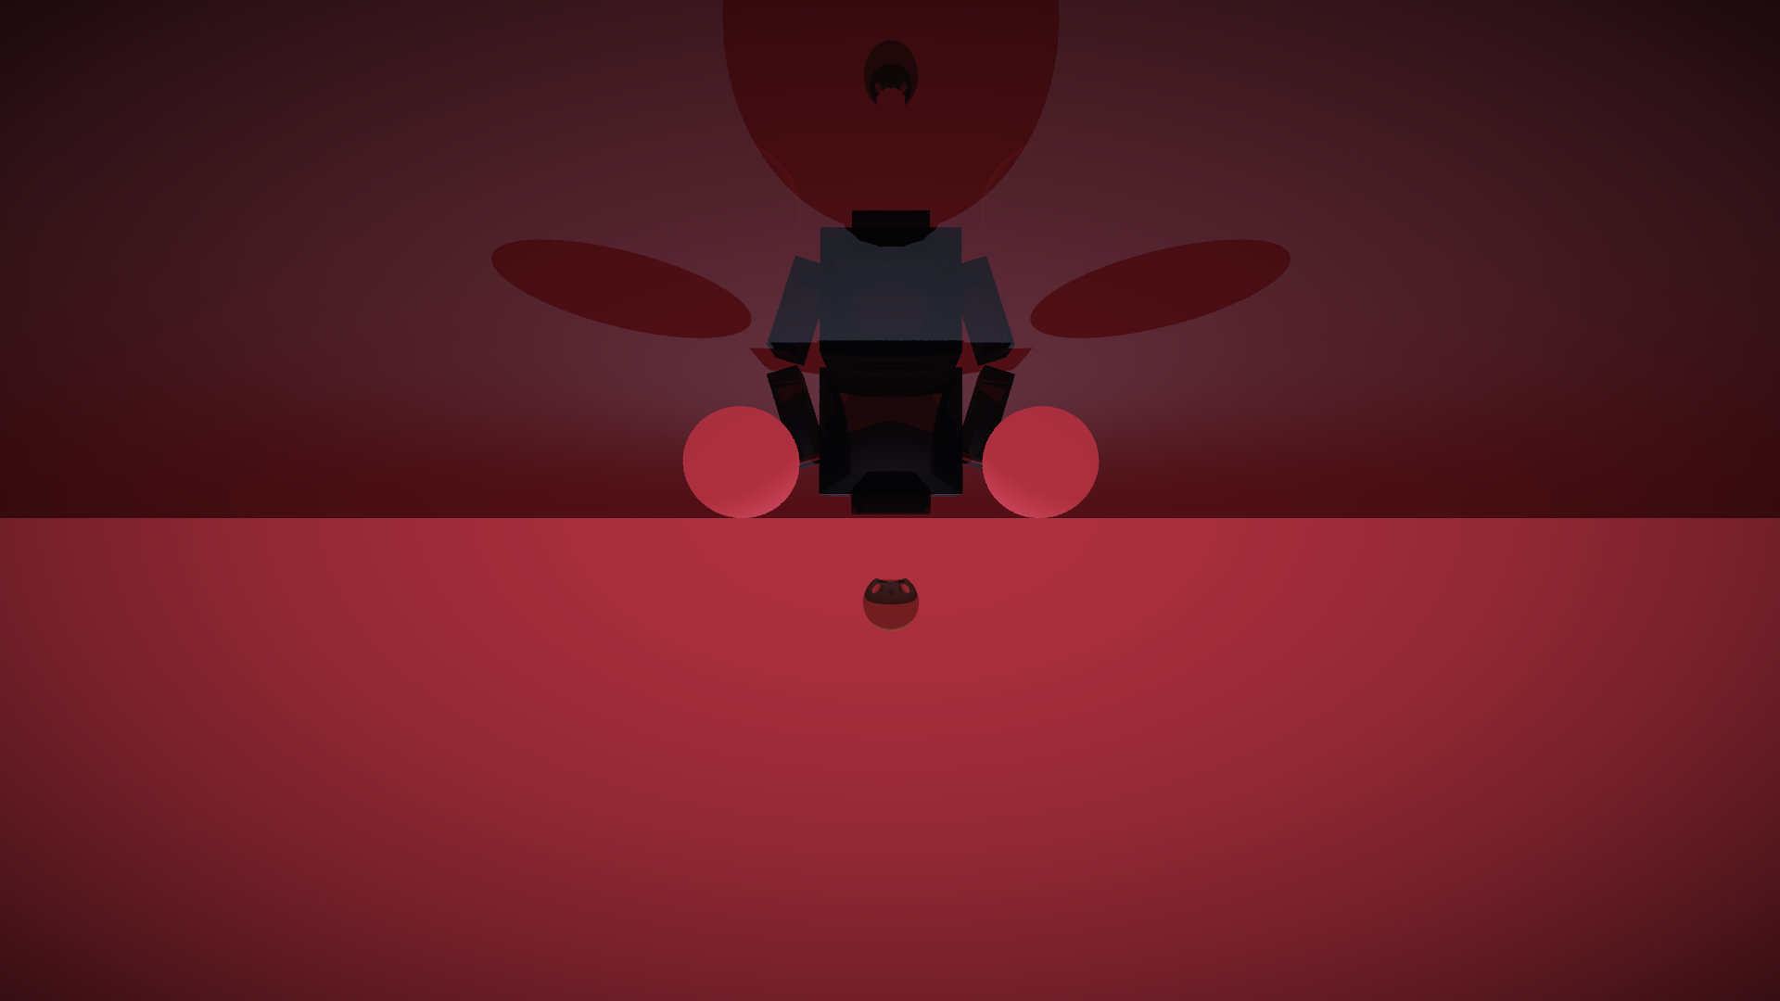
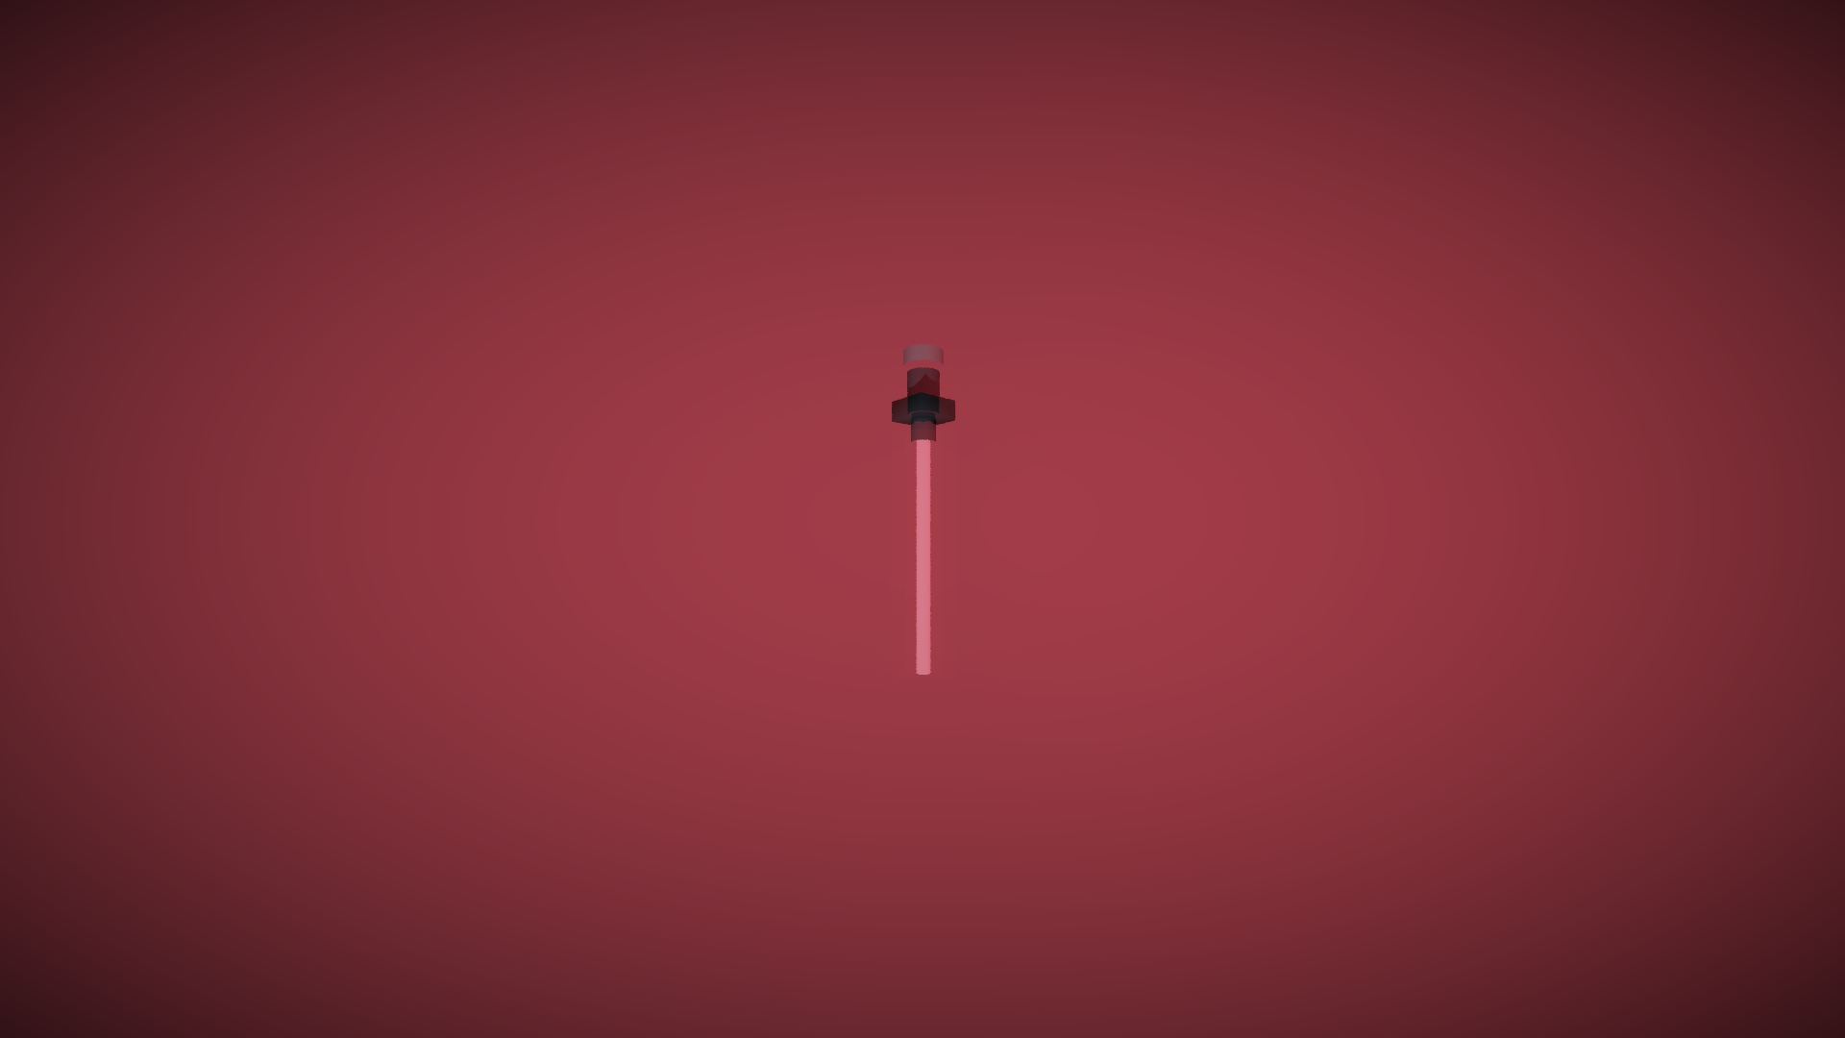
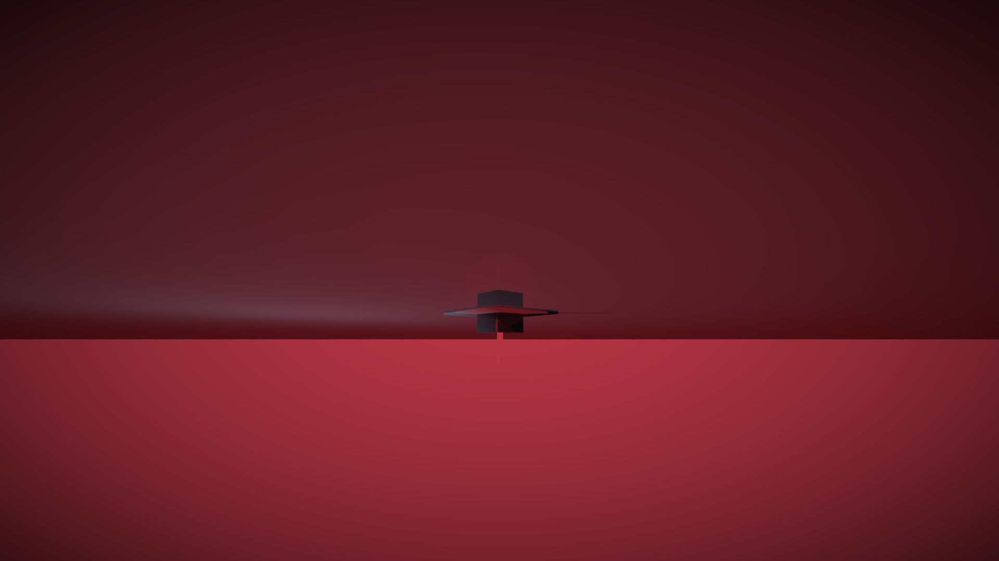
CRAFT · VISUAL IDENTITY
3D — a raytracer
we wrote ourselves.
Eight scenes, one vectorized numpy raytracer built from scratch — no external 3D software, no stock renders.
SIGIL · WARSHIP · HELMET · PLANET · PROBE · THRONE · BLADE · CITADEL
OBSIDIAN · CRAFT
09

Slide 10
CRAFT · IRON PROTOCOL
One design
system.
#050507
#0b0b12
#1e1e2e
#e8e4d8
#8a8a94
BASE
PANEL
HAIRLINE
BONE
STEEL
#e01e37
#ff2a44
#f4a300
#3ddc84
#9fb4d8
ACTION
ALERT
WARN
POS
DATA
TYPOGRAPHY — CINZEL COMMANDS · RAJDHANI OPERATES · PLEXMONO REPORTS
ORDER IS PEACE
SIGHTING LOG // SECTOR 9 // 02:41:07 · AUTHENTICATE · DISPATCH · HUNT
MOTION: scramble titles · magnetic buttons · count-ups · radar sweep · WebAudio UI sounds
OBSIDIAN · CRAFT
10

Slide 11
THE TEAM
Three operatives.
One doctrine.
AP
AC
JK
ANUJ PHULERA
AARAV CHOUDHARY
JEEHAAN KWATRA
DEVELOPER · AI · BACKEND
VISION · MARKETING · IDEAS
DESIGN · MEDIA · PITCH
Builds the engine — zero-latency systems, the AI that makes the hunt computable.
Saw the decay of the old order and imagined something absolute.
Forges the aesthetic — every pixel, frame and blade of the sigil.
IDEATION · ENGINEERING · DESIGN · FILM · PITCH — ALL IN-HOUSE
OBSIDIAN · TEAM
11

Slide 12
THE ROAD AHEAD
The net
expands.
2
PROBE MESH
fleet-wide probe telemetry with live alerts
3
VOICE COMMAND
talk to the mainframe — the terminal listens
4
SECTOR SIMULATION
AI-generated Jedi behavior for training
5
CITIZEN NETWORK
anonymous tip portal feeding the grid
OBSIDIAN · ROADMAP
12

Slide 13
THE HUNT NEVER ENDS
UNTIL THE LAST EMBER IS COLD
OBSIDIAN · IMPERIAL SECURITY NETWORK
ANUJ PHULERA · AARAV CHOUDHARY · JEEHAAN KWATRA
PASSPHRASE: FOR THE EMPIRE — TRY THE DEMO
TS '26 CREATIVE PRELIMS · SUBMISSION READY

