Slide 1

Forecasting Flight Delays: A Data-Driven Approach Using Weather and Flight Data
Team_5-4: Jane Su, Daelyn Bergsman, Ahmad Allaou, Ricky Salinas

Slide 2




Team
Ricky
Daelyn
Ahmad
Jane

Slide 3
Outline
Project Description
Feature Selection and Creation
Summary Visual EDA
Handling Missing Data
Modeling Pipelines
Results
Conclusion

Slide 4
Project Description
Data Description
The dataset comprises three main components:
Flight Data: This includes details about each flight, such as departure and arrival times, flight numbers, carrier information, origin, and destination airports.
Weather Data: Hourly weather information corresponding to the flight's origin airport, including temperature, wind speed, precipitation, visibility, and other relevant weather metrics.
Station Data: Information about weather stations, which helps associate weather data with corresponding flights based on geographic proximity.
Task to be Tackled:
The primary task is to develop a predictive model that can accurately forecast whether a flight will be delayed by more than 15 minutes, based on the available flight and weather data. This involves preprocessing the data, engineering relevant features, selecting appropriate machine learning algorithms, and evaluating the model's performance.

Slide 5
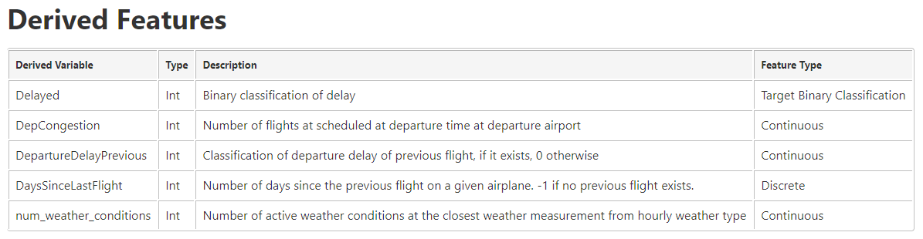
Feature Selection and Creation
Features were chosen based off of recency to the flight, and relevance in modern aviation.
Weather based features were restricted to hourly features, and most flight features regarding airline, airport, and airplane details were used as categorical features.
Several features were derived to give more information not present in the raw data. These include features based off of previous flights, airport conditions, and summary weather conditions.
Notes:
The team made sure to select features based on relevancy to our target of predicting delays given that we must work within the 2 hour window. Because of this, we focused on recency and whether we belieevd the data would have a direct impact on flight delays. For the weather data we stuck to hourly information, focusing on temperature, precipitation, wind, and visibility. For airplane features we focused on categorical features such as airplane, airline, and airport, along with scheduled departure time.
After that we derived additional features to get more from the dataset, such as looking at the time since the previous flight, and if it was delayed at departure time. In addition we derived summary feature such as number of adverse weather conditions, and number of scheduled flights at time of departure in the given airport to represent congestion.

Slide 6
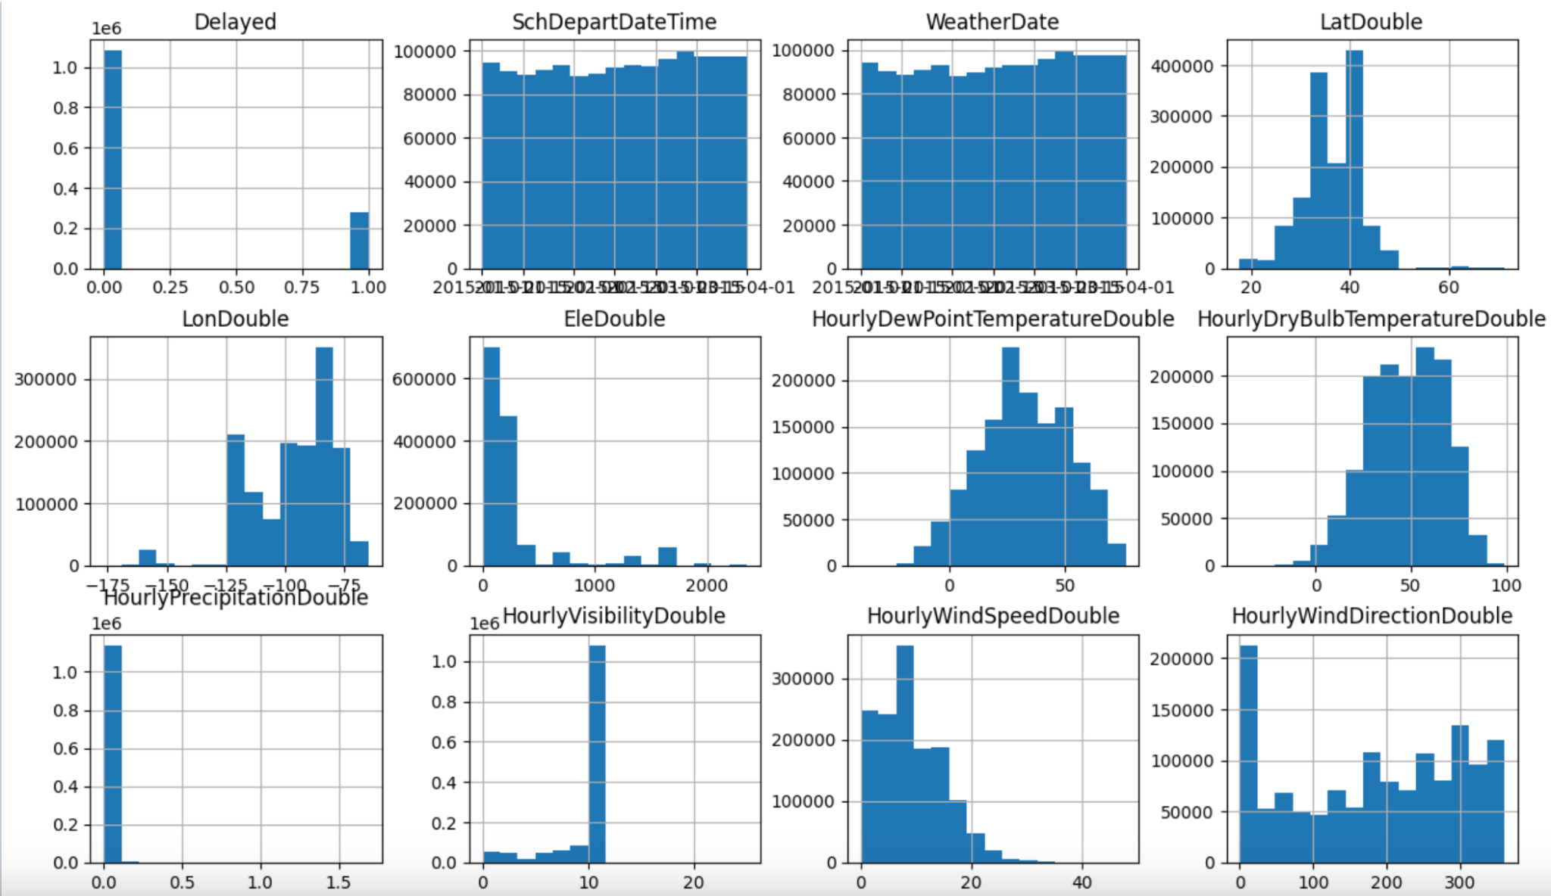
EDA - Feature Distribution
Notes:
One of our first summary visuals was the creation of histograms to show the distribution of our features, and inform us regarding the proportion of binary variables in an visualization. Unsurprisingly many variables are not normally distributed by typically heavily skewed.

Slide 7
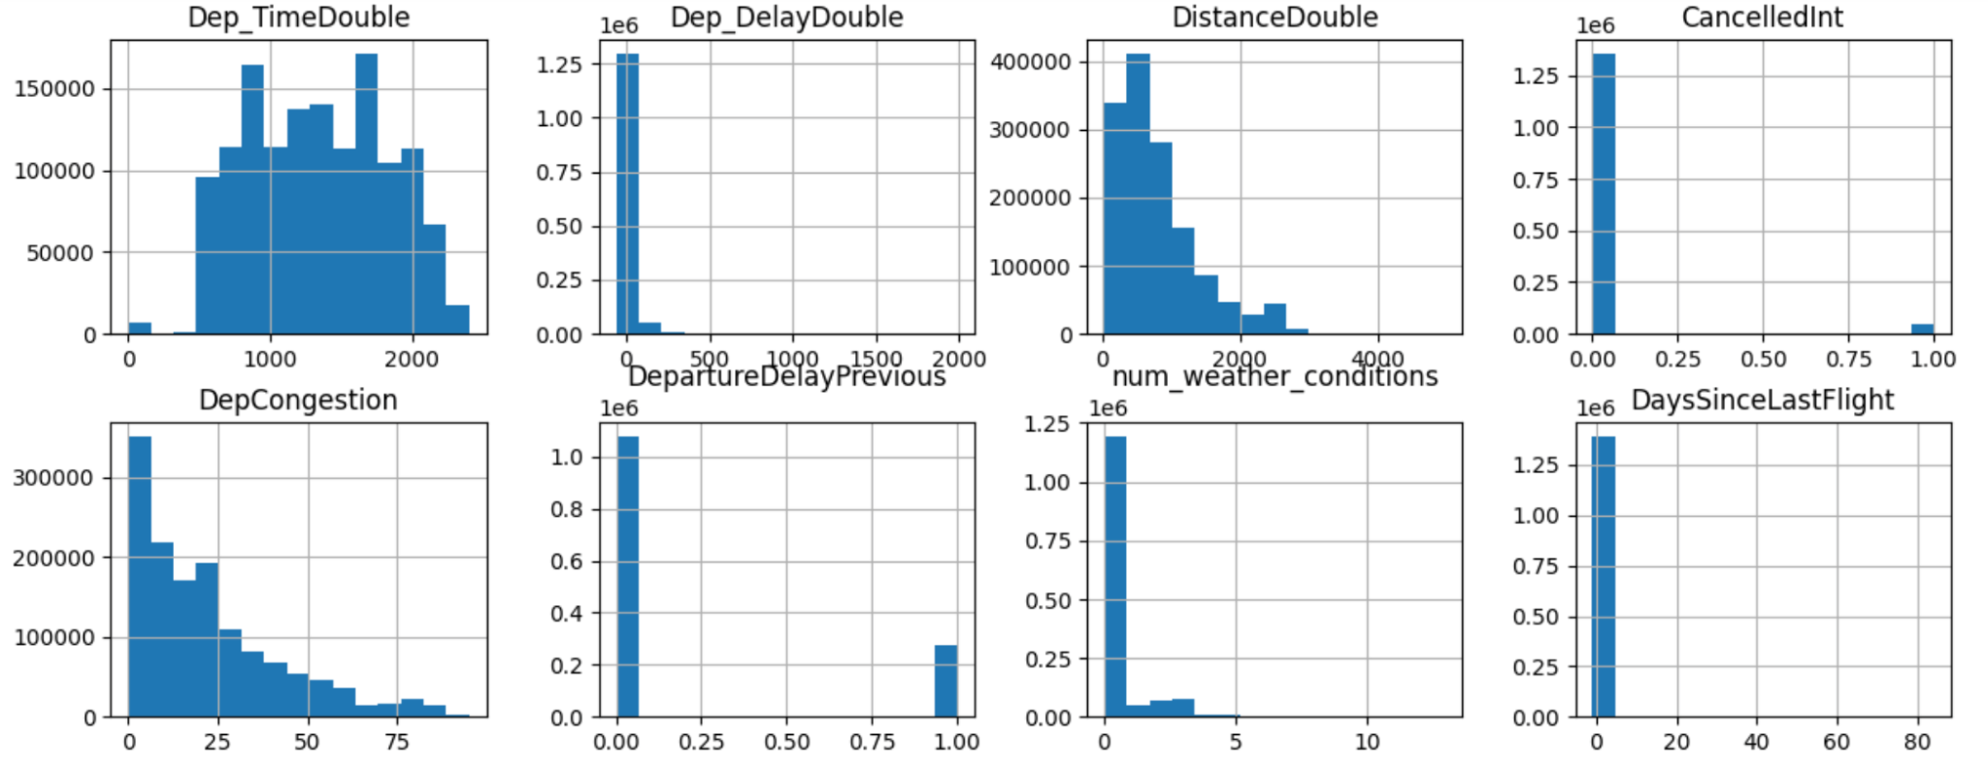
EDA - Feature Distribution
Notes:
Our derived features were especially skewed, possibly in part due to the relatively small size of the 3 month dataset. Understanding the number of cancelled flights was also critical to data cleaning later.

Slide 8
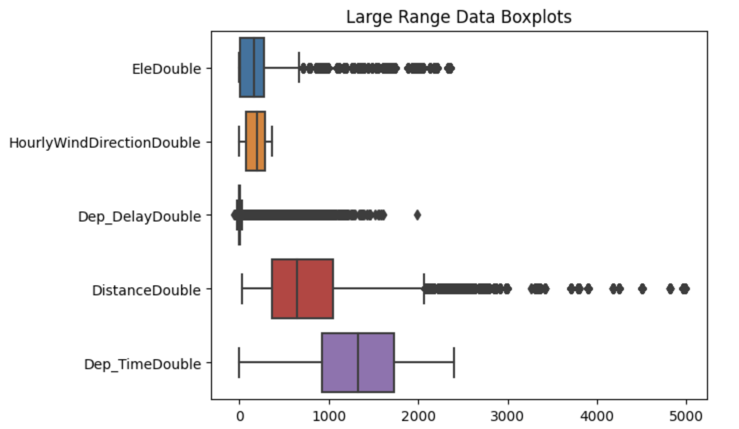
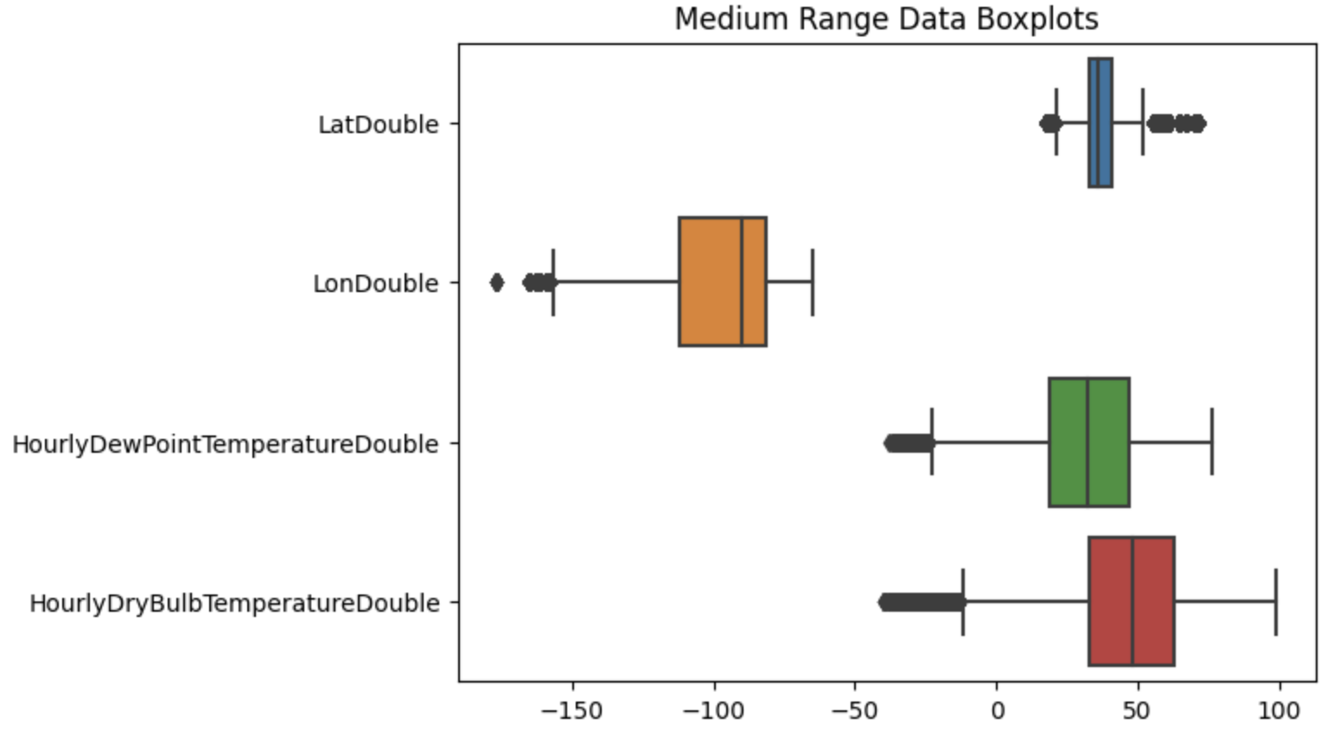
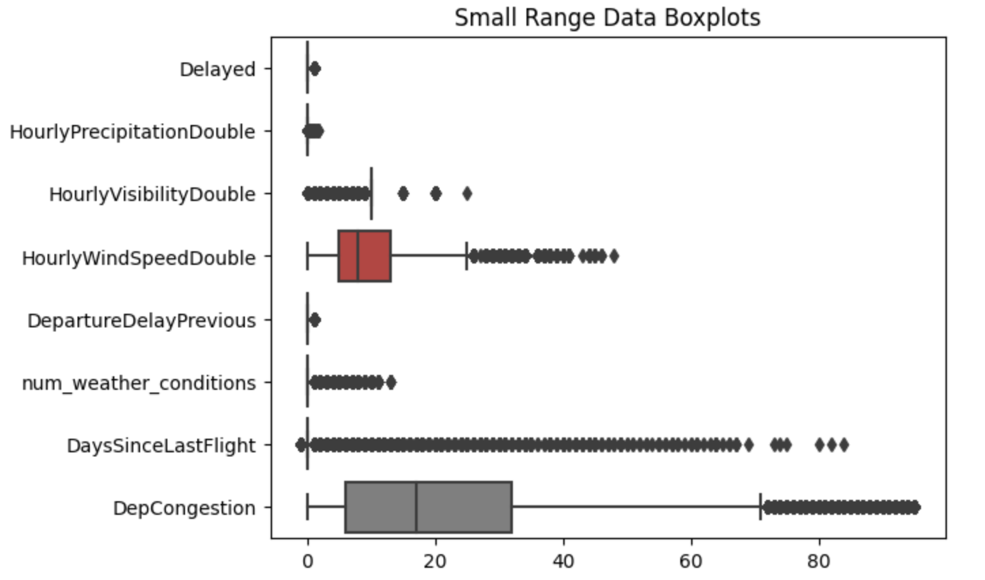
Notes:
We created boxplots to further look at the distributions, as well as medians and quartiles. We split them into 3 categories based on their scale. Once again we see the skew of some of our variables.

Slide 9
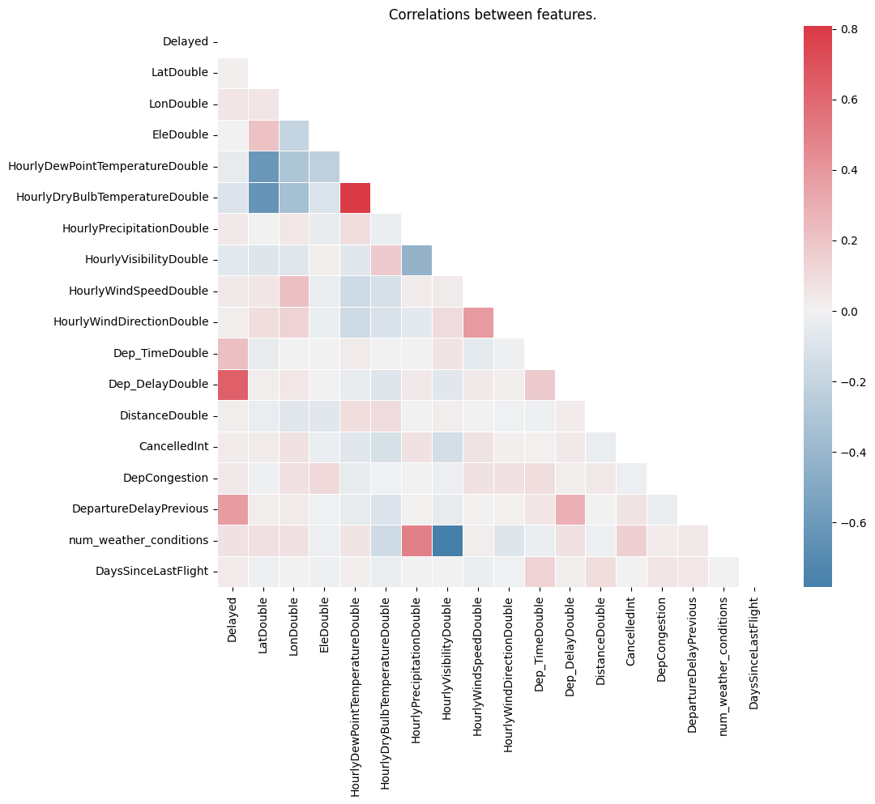
Notes:
Finally a correlation matrix gave us a better indication of which features to keep, and confirm that we are not including too many extraneous features.

Slide 10
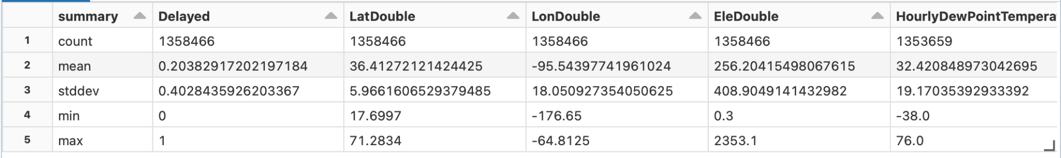
Missing Data Handling
Null values have been handled primarily with absent values in weather data, which can occur due to a lack of equipment at specific weather stations to fully capture all reading measurements.
Temperature and wind speed missing values replaced by the averages across data.
Precipitation and wind direction missing values replaced by 0 due to their frequency.
Visibility missing values replaced by the standard of 10 miles for a clear day.
Notes:
Ricky

Slide 11
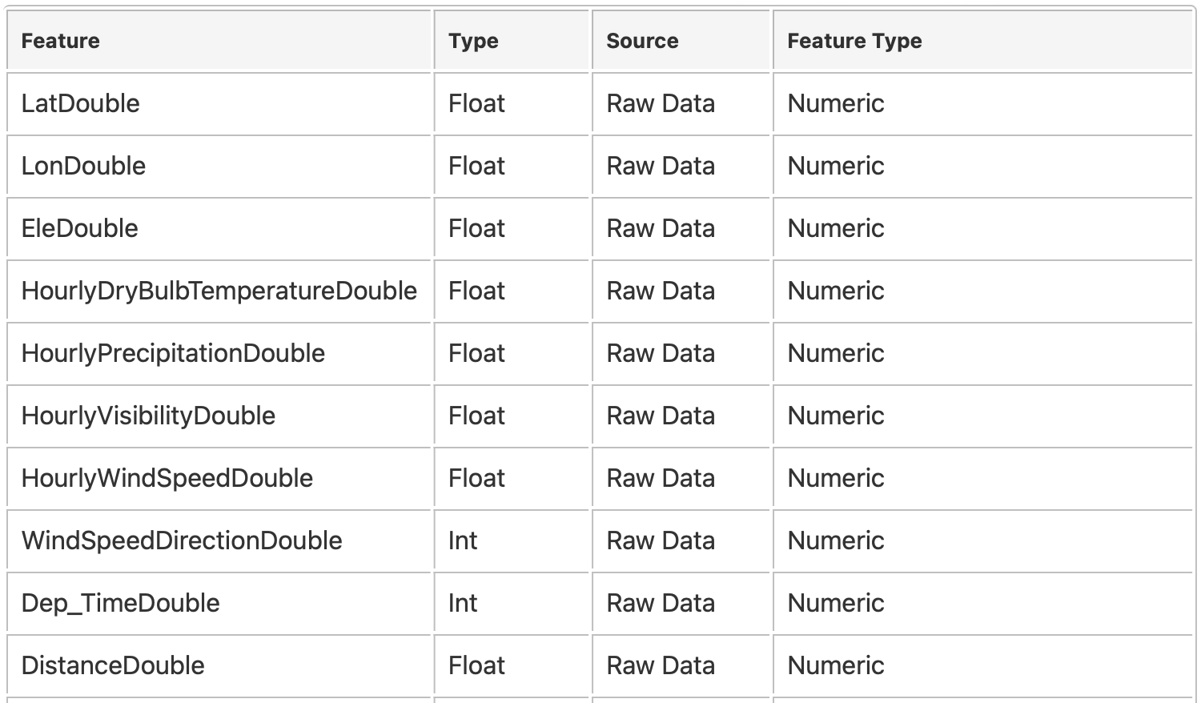
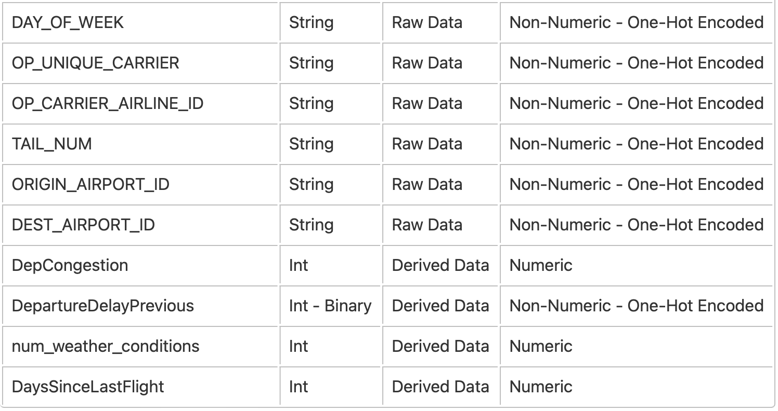
Final Feature Selection for Modeling
Notes:
Ricky
7 Categorical Features
13 Continuous Features
20 Total Features

Slide 12
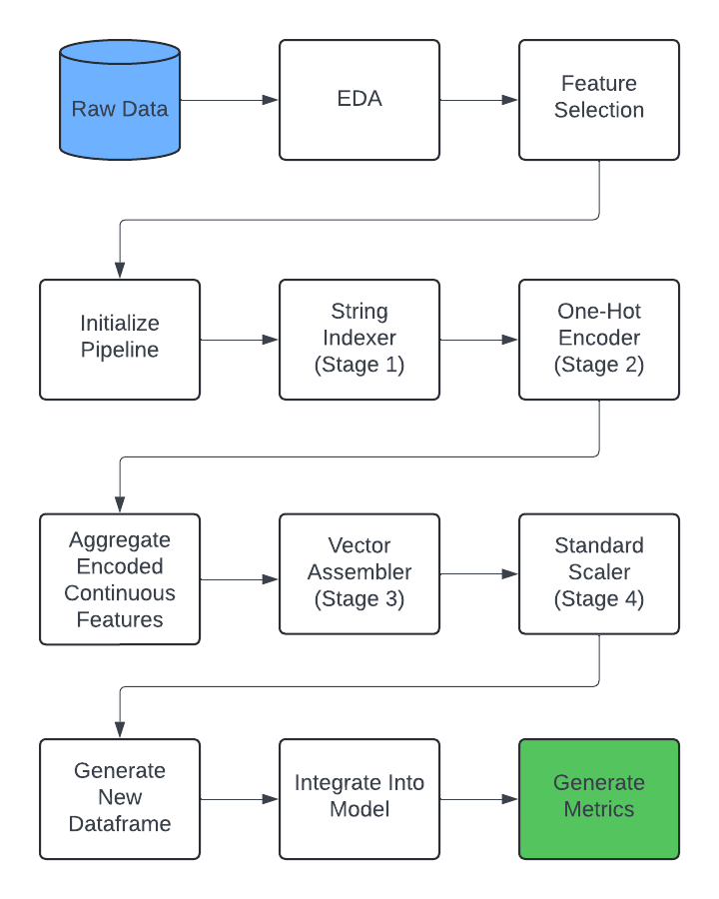
Pipeline Overview
Starting with a cleaned dataset, the pipeline adds in additional features, such as the time since the last flight, if the flight has been cancelled before. Then it performs steps as follows:
An indexer is initialized. The categorical column is pushed into the StringIndexer, which takes each category and assigns it an index.
An encoder is then used to take the list of indices and convert them into a vector of binary outputs. These are passed along with the continuous variables into the vector assembler.
A standard scaler scales then puts the values of the feature into a smaller scale

Slide 13
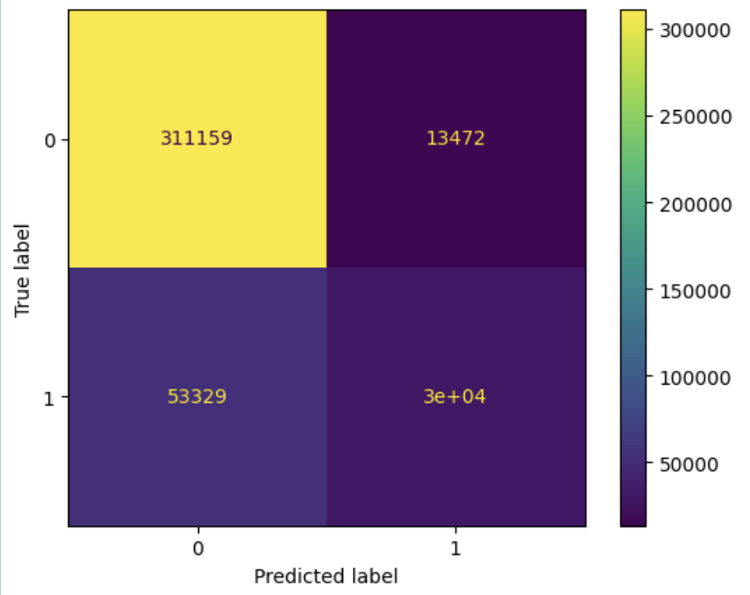
Logistic Regression Testing Results
Metrics:
Accuracy: 0.84
F1 Score: 0.47
Precision: 0.69
Recall: 0.36
Additional Metrics:
True Positives: 29901
False Positives: 13472
True Negatives: 311159
False Negatives: 53329

Slide 14
Conclusion
Goal: predicting flight delays exceeding 15 minutes by integrating weather data with flight information.
Hypothesis: machine learning pipelines with custom features could accurately forecast such delays.
Result: showed that the logistic regression model could predict flight delays with reasonable accuracy of 83%, demonstrating the potential of machine learning in this domain. However, there is room for improvement in precision and recall, particularly for delayed flights.
Future work: balance data, explore more sophisticated models, additional features, and different definitions of flight delays to enhance predictive performance.

