Slide 1
Omlet w/ webRTC
UI design
Kookmin univ.
SeulGi Choi

Slide 2
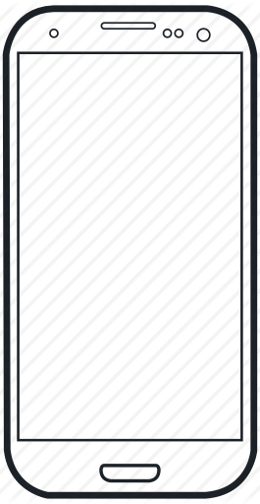
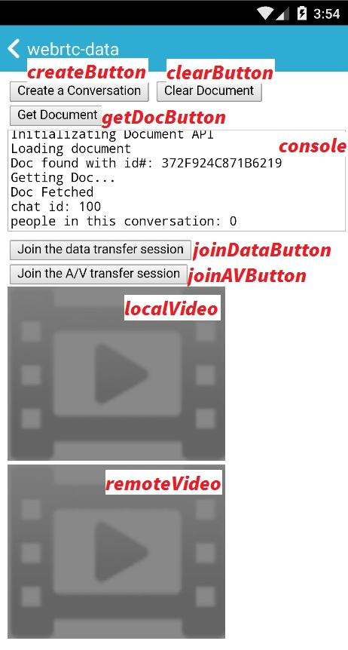
Original Base Design
Request for webRTC
Log for debugging
Entering for data sharing
Entering for video calling

Slide 3
Proposal New Design
Send Request
Video Calling
File Sharing

Slide 4
Proposal New Design
Send Request
Video Calling
File Sharing

Slide 5



Proposal New Design
My Screen
draggable
Other’s Screen
Finish Calling Button
Flip Button
Mute Button

