Slide 1
Nobel Prize Trends (1901–2023)
Stakeholder Insights & Interactive Dashboard

Slide 2
Project Goals
- Analyze Nobel Prize data (1901–2023)
- Explore demographic and geographic trends
- Deliver insights via interactive dashboard

Slide 3
Dataset Overview
- Source: Nobel Prize dataset
- Time span: 1901–2023
- Features: Year, Category, Birth Country, Sex, Motivation
- Derived: decade, is_female, is_us_born

Slide 4
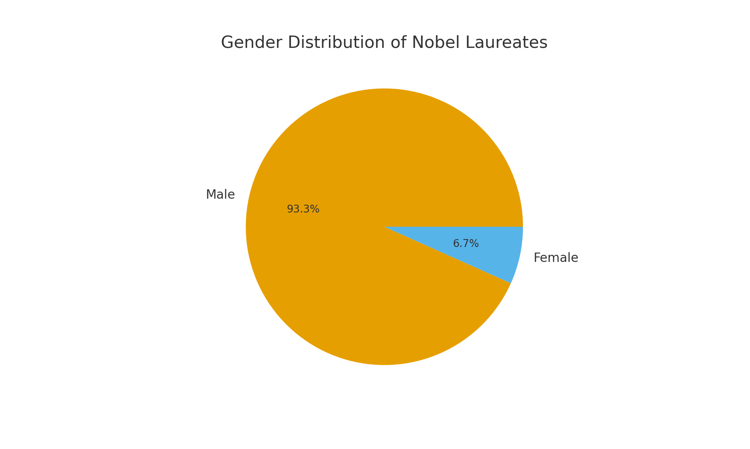
Gender Distribution

Slide 5
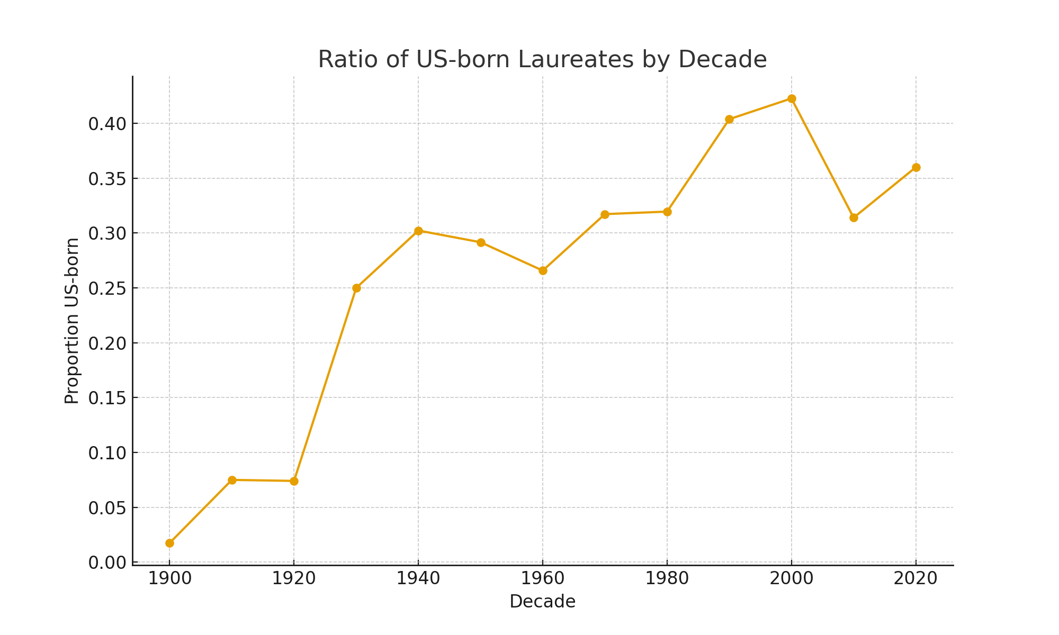
US-born Laureates Over Time

Slide 6
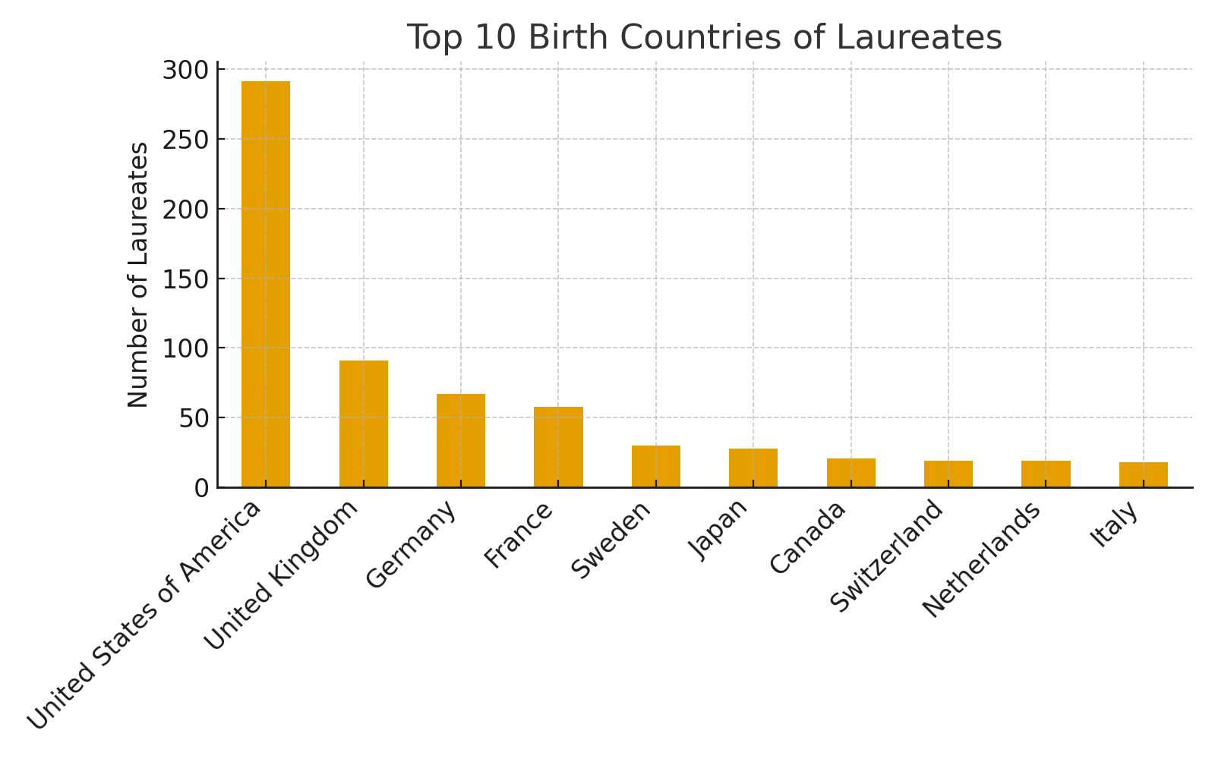
Top Countries of Birth

Slide 7
• Filter by category and decade
• Gender trends visualization
• US-born laureates ratio
• Top countries analysis

Slide 8
- Enrich dataset with affiliations & socioeconomic data
- Build predictive models
- Enhance dashboard with laureate search & interactive maps

Slide 9
Thank you!
Explore the dashboard & GitHub repo

