Slide 1
Narrating FAIR: recognising and rewarding FAIR practices and the use of narrative CVs
Samantha Ahern and Vicki Yorke Edwards

Slide 2
Session Aims
Recognise benefits of FAIR practices
Recognise FAIR on Narrative CVs
Construct an example Narrative CV for your area demonstrating FAIR
Express ways forward in recognising and rewarding FAIR in your context
Diagram showing multiple data types

Slide 3
Why should we care?

Slide 4
Case studies of good practices in FAIR
Use examples relevant to your context

Slide 5
Narrative CVs and FAIR

Slide 6
Background
Royal Society: Resume for Researchers – Developed as part of the Changing Expectations programme – ‘standardised short format CV that emphasises the wider contributions to the research system’ – Designed to recognise the broader contributions to the scientific endeavour
UKRI: Résumé for Research and Innovation (R4RI) – Shows evidence of a wider range of skills and experience than a traditional academic CV when applying for UKRI funding opportunities. – Halfway between a CV and cover letter - provides the space to explain the context of your achievements. – In use in all funding opportunities on the UKRI Funding Service that require track record information.

Slide 7
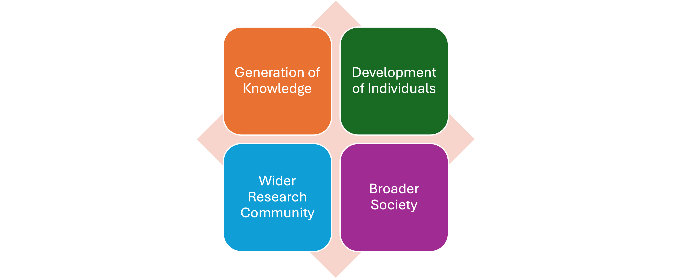
Modules
4 component modules of Narrative CVs

Slide 8
## Contribution to Generation of Knowledge
Contribution to the generation of new ideas and hypotheses
Key skills used to develop ideas and test hypotheses.
Approach to communicating ideas and research results, both written and verbally.
Funding that has been won and any awards received.
It can include a small selection of outputs, with a description of why they are of particular relevance and why they are considered in the context of knowledge generation.

Slide 9
Generation of Knowledge: Example outputs
open data sets,
software,
publications, commercial, entrepreneurial or industrial products,
clinical practice developments,
educational products,
policy publications,
evidence synthesis pieces,
and conference publications that have been generated.

Slide 10
Contribution to the Development of Individuals
Expertise provided which was critical to the success of a team or team members including project management, collaborative contributions, and team support.
Teaching activities, workshops or summer schools in which you were involved (for undergrads, grads and post-grads as well as junior colleagues), and the supervision of students and colleagues.
Mentoring of members in your field and the support provided to the advancement of colleagues, be it junior or senior.
Establishment of collaborations, from institutional (maybe interdisciplinary) to international.
Exertion of strategic leadership, shaping of the direction of a team, organisation, company or institution.

Slide 11
Contribution to the Wider Research Community
Various activities engaged in to progress the research community.
Various commitments including editing, reviewing, refereeing, committee work and contributions to the evaluation of researchers and research projects.
Organisation of events that have benefited your research community. It can highlight contributions to increasing research integrity, and improving research culture (gender equality, diversity, mobility of researchers, reward and recognition of researchers’ various activities).
Appointments to positions of responsibility such as committee membership and corporate roles within your department, institution or organisation, and recognition by invitation within your sector.

Slide 12
Contribution to Broader Society
Examples of societal engagement and knowledge exchange. It can include engagement with industry and the private sector.
Engagement with the public sector, clients and the broader public.
Positive stakeholder feedback, inclusion of patients in processes and clinical trials, and other impacts across research, policy, practice and business.
Efforts to collaborate with particular societal or patient groups.
Efforts to advise policy-makers at local, national or international level and provide information through the press and on social media.

Slide 13
Synergies with FAIR
Knowledge – Open publication of data, software and research outcomes
Development – Determining metadata schema for a project – Training others in open scholarship practices
Research Community – Contributing to national, and international standards – Editing or reviewing open access publications – Being on data access committees
Society

Slide 14
What would FAIR look like on a Narrative CV for your discipline?
Co-Design Activity

Slide 15
Discussion: opportunities and blockers for use in shortlisting and promotion processes

Slide 16
What are your next steps?

