Slide 1






Situated Cognition 360 Editor 2021
DEPARTMENT OF COMPUTER SCIENCE
COMP0016, 2020-21 - Team 11
UCL, GOSH and Avanade
Client: Mrs Sheena Visram, Dr Dean Mohamedally, Mr. Fergus E.Kidd and Mr. Chris Lloyd-Jones
Supervisors: Mr Steven Hirschmann, Dr Dean Mohamedally, Dr Graham Roberts, Dr Yun Fu
Zixuan Ding
Min Wang
Szu-Han Chen
kelly.ding.19@ucl.ac.uk
min.wang.19@ucl.ac.uk
Szu-han.chen.19@ucl.ac.uk

Slide 2
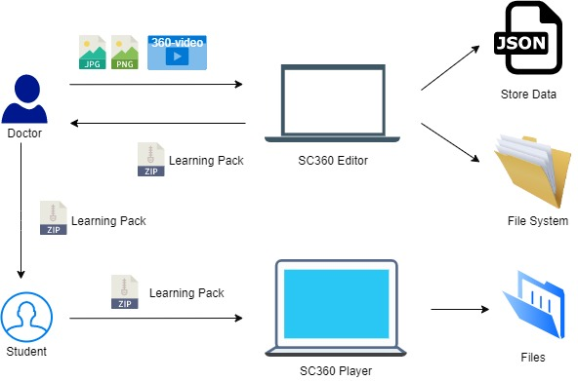
Abstract
DEPARTMENT OF COMPUTER SCIENCE
COMP0016, 2020-21 - Team 11
360-Video Editor
to provide better learning experience for medical training sessions
Project Type: Desktop App, VR
Main Technologies:
Allows users to annotate the 360-video by adding hotspots.
Hotpots allow switching to other videos.
Overall hotspots and video tree-structure allows navigation throughout the project.

Slide 3
Functional MoSCoW List
DEPARTMENT OF COMPUTER SCIENCE
Achievements
COMP0016, 2020-21 - Team 11
ID | Requirements | Priority | State | Contributors
1 | Adding hotspots by click | Must | ✓ | Zixuan
2 | Hotspots at static positions | Must | ✓ | Zixuan
3 | Adding name and text to hotspot | Must | ✓ | Zixuan
4 | Photos attached to hotspots | Must | ✓ | Zixuan
5 | Hotspots details store to json files | Must | ✓ | Min
6 | Hotspots details read from json files | Must | ✓ | Min
7 | Basic player functionalities for editor- progress bar, play button, sound button | Must | ✓ | Szu-Han
8 | Hotspots only appears at certain time period | Should | ✓ | Zixuan
9 | Hotspots can be deleted | Should | ✓ | Zixuan
10 | Switch to other videos and switch back | Should | ✓ | Zixuan
11 | Outcome of editor delivered as a pack | Should | ✓ | Min, Zixuan
12 | Rename and organise the files attacked to hotspots | Should | ✓ | Zixuan

Slide 4
ID | Requirements | Priority | State | Contributors
13 | When jumping back from the branched video, the video player is at the previous time spot and facing the previous hotspot | Could | ✓ | Zixuan
14 | Timeline showing the hotspots attached to videos | Could | ✓ | Min
15 | Timeline showing the hotspots of all branches | Could | ✓ | Min
16 | Separate player that can unpack the package produced by the editor | Could | ✓ | Zixuan
17 | Separate player that can view everything produced by the editor | Could | ✓ | Zixuan
18 | Basic player functionalities for separate player- progress bar, play button, sound button | Could | ✓ | Szu-Han
19 | Hotspots and its photos and branches can be renamed | Would | ✓ | Zixuan
20 | Timeline can navigate the users to the timespots | Would | ✓ | Min, Zixuan
21 | Timeline can be updated after adding hotspots | Would | ✓ | All
22 | Player would delete the pack generated from the package | Would | ✓ | Zixuan, Szu-Han
23 | Own Logo for the project | Would | ✓ | Szu-Han
Key Functionalities (must have and should have) |  | 100% completed
Optional Functionalities (could have) |  | 100% completed

Slide 5
Non-Functional MoSCoW List
DEPARTMENT OF COMPUTER SCIENCE
Achievements
COMP0016, 2020-21 - Team 11
Next page

Slide 6
ID | Requirements | Priority | State | Contributors
1 | The software needs to be precise and accurate about the information it helds. | Must | ✓ | All
2 | Safe and Secure: Files and its relative information would be held secure | Must | ✓ | All
3 | The whole system should be held offline. | Must | ✓ | All
4 | User-Friendly: Files should be held in an organized and understandable way. | Must | ✓ | Zixuan
5 | User-Friendly: Reduce the probability for the users to lost their work by accident | Should | ✓ | Zixuan
6 | There should be help pages/ guidance on the page to help the user. | Should | ✓ | Szu-Han
7 | The software should be designed to deliver the files it produces easily. | Should | ✓ | Min, Zixuan
8 | Clear and understandable interface | Could | ✓ | Szu-Han
9 | Buttons with clearer and more understandable icons | Could | ✓ | Szu-Han
10 | All the icons should of the same style. | Would | ✓ | Szu-Han
11 | The panels display the information clear. | Would | ✓ | Szu-Han
Key Functionalities (must have and should have) |  | 100% completed
Optional Functionalities (could have) |  | 100% completed

Slide 7
Contribution Distribution
DEPARTMENT OF COMPUTER SCIENCE
COMP0016, 2020-21 - Team 11
Work packages | Zixuan | Min | Szu-Han
Client liaison | 33% | 33% | 33%
Requirement analysis | 33% | 33% | 33%
Research | 70% | 10% | 10%
UI Design | 20% | 20% | 60%
Programming | 55% | 35% | 10%
Testing | 33% | 33% | 33%
Development blog | 75% | 10% | 15%
Website Editing | 30% | 10% | 60%
Video Editing | 20% | 10% | 70%
Paper | 70% | 30% | 0
Use case paper | 0 | 100% | 0
Overall contribution | 40% | 30% | 30%
Roles | Programmer, Researcher, Report Editor | Programmer, Report Editor, Tester | UI Designer, Tester, Website Editor

Slide 8
Application URL
DEPARTMENT OF COMPUTER SCIENCE
COMP0016, 2020-21 - Team 11
Software:
Editor:
https://github.com/Apperta-IXN-for-the-NHS/SC360Editor2021/tree/main/EditorBuild
Player:
https://github.com/Apperta-IXN-for-the-NHS/SC360Editor2021/tree/main/PlayerBuild
Project Website: http://students.cs.ucl.ac.uk/2020/group11/index.html
GitHub Source Code:
https://github.com/Apperta-IXN-for-the-NHS/SC360Editor2021/
Development Blog: https://ucl-comp0016-2020-team-11.github.io/

