Slide 1

Situated Cognition 360 Editor
Building an editor with layers and interactive timeline hotspots that apply situated cognition 360 videos to a handful of human factors training sessions during a series of emergency scenarios.
By Team 11

Slide 2
GATHERING USER REQUIREMENTS
From NHS Clinicians
From Medicine Students
Was there a video editor for clinicians to annotate the 360-videos using hotspots and teach the students using that?
No.
If no, would like to have an editor to provide 360-videos and notes to students?
Sure, that will help a lot.
Why or why not?
There are limited opportunities for students to work in the real environment and there’s limited videos provided online. An interactive 360-video could provide the students with real situations and practice their problem-solving skills.
What features do you look for?
In the first place, the quality of the videos should be high, and the hotspots should at a static location. The precision is the most important thing. Secondly, I would have the editor to be easy to use, since I do not have much time working on editing videos. It should also generate the subtitles automatically and I can edit it as well. Eventually, I would like to keep my files stored organized so that I can see whether I missed out something.
Could you please talk about the difficulties you face in your studies?
The contents are hard, and I am extremely worried that I my mind will be empty when I go into the real process.
Have you tried to solve this?
I looked up videos and documentaries online, but they didn’t help a lot.
So what kind of help do you need?
I would like to know more about what the real situation looks like, and what kind of thing may happen in the real process, so I will be confident when I am facing them one day.
Did you talk to your teacher about this?
Yes, and he gave me loads of materials, which are very helpful. But I have to set up my own way to organize them, and there’s still parts missing, and I need to talk to him again.
Did you watch videos from other countries?
I tried to, but I only know English and sometimes the translation is not very good so this may lead to misunderstanding. So I gave up on this.

Slide 3
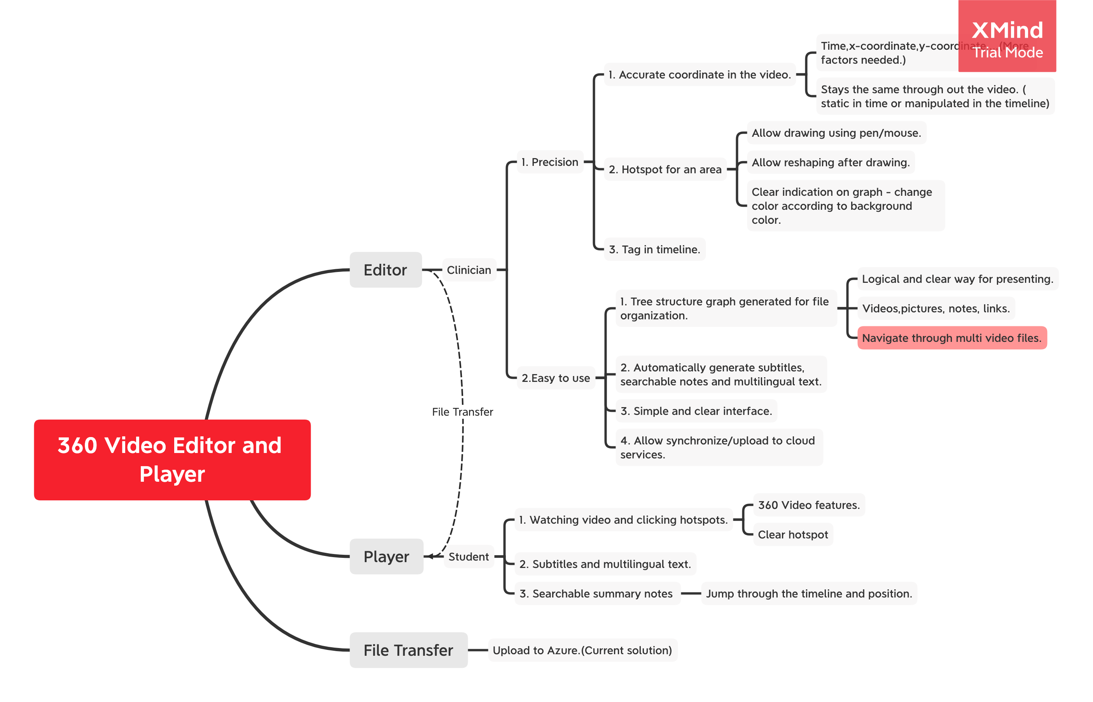
GATHERING USER REQUIREMENTS

Slide 4
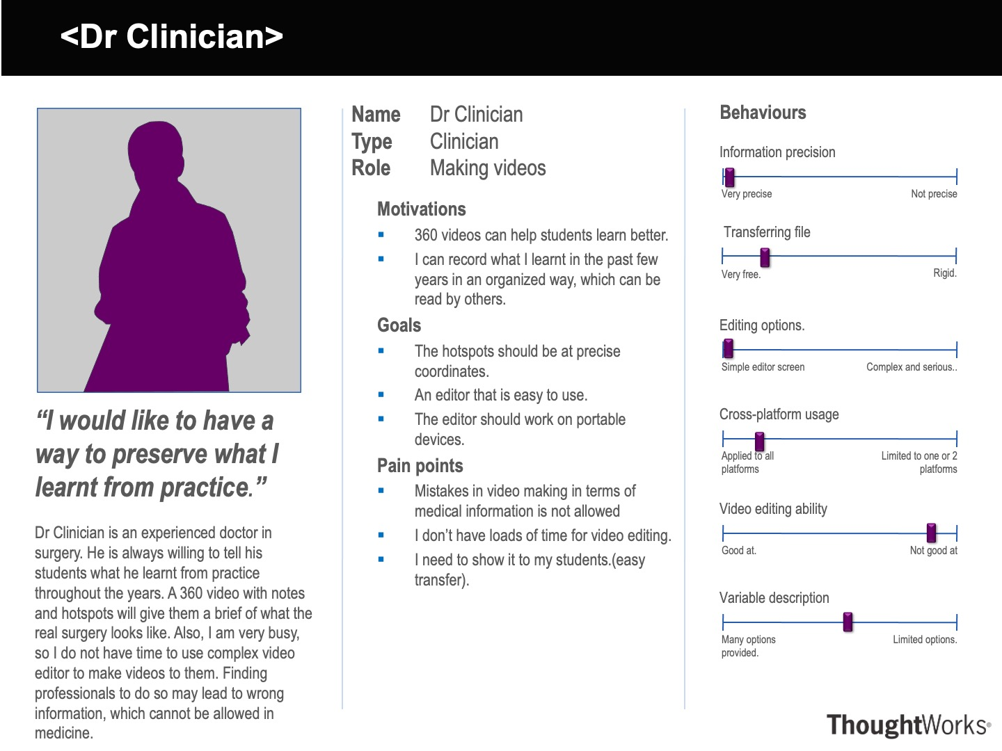
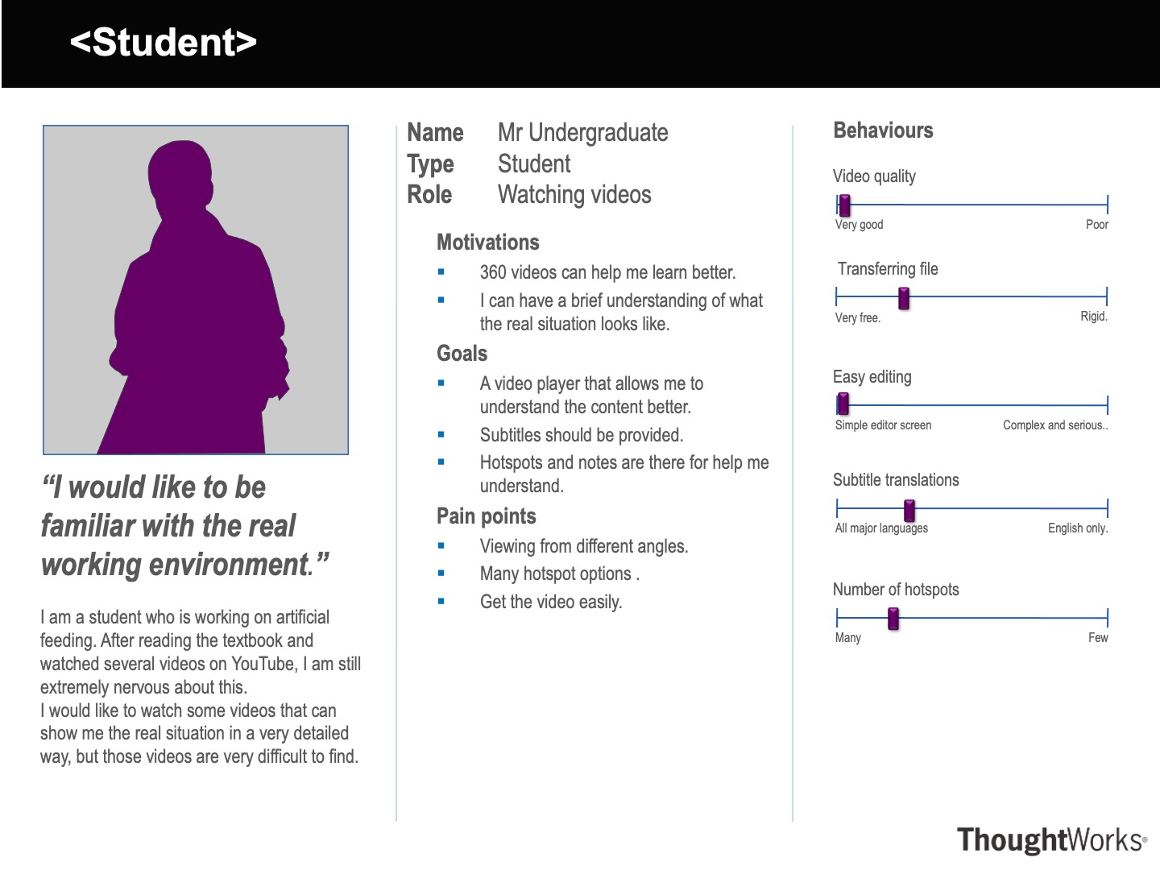
PERSONAS
SCENARIOS
Dietitian – The person who edit the video.
My clinical background is as a Dietitian and I specialised in a field known as artificial feeding. This is where a patient receives nutrition via a feeding tube as they are unable to eat and drink due to an unsafe swallow. This can either be via a tube into their stomach (NG feeding is an example), or via a tube that delivers nutrients into their blood stream (this is known as TPN). I think medical students need to be more familiar with real working environment and knowledge from textbooks are not enough.
360 videos may help, so students can watch the surgeries from all visions. The 360 video would be edited with hotspots to notes, pictures and other videos. And the file arrangement should be logical and organised. I would like to edit the video with a friendly editor, because I am not good at editing videos. Also, I would like to have all the hotspots at a precise location, since a small mistake will lead to a horrible disaster in medicine. I would like to circle the part or point out a point on the screen and add a hotspot to it which provides several options for the students. All these different options will link to different videos and pictures, to show the consequence of that action. Eventually, I would like to upload the video to a reliable online platform so that his students can watch it.
Student - The person who watched the video.
I am a student who is working on artificial feeding. After reading the textbook and watched several videos on YouTube, I am still extremely nervous about this.
But luckily, my teacher provided us a set of 360-videos and it helps me understanding the real situation and tells me what results I will have if I am slightly wrong in several steps. The 360-video makes me feel that I am working in the real environment and I can interact with the video by clicking the hotspots. Also I can navigate through the videos by subtitles and hotspots, even there’s a translation of subtitles so that I can watch videos provided by clinicians from other countries.

Slide 5
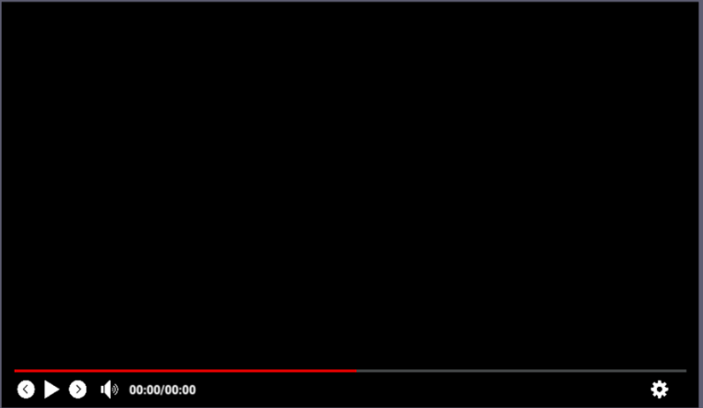
Video Player UI
The group last year already build a 360-video player for students to watch 360 videos, and the video editor we build will also include this player in the main interface.

Slide 6
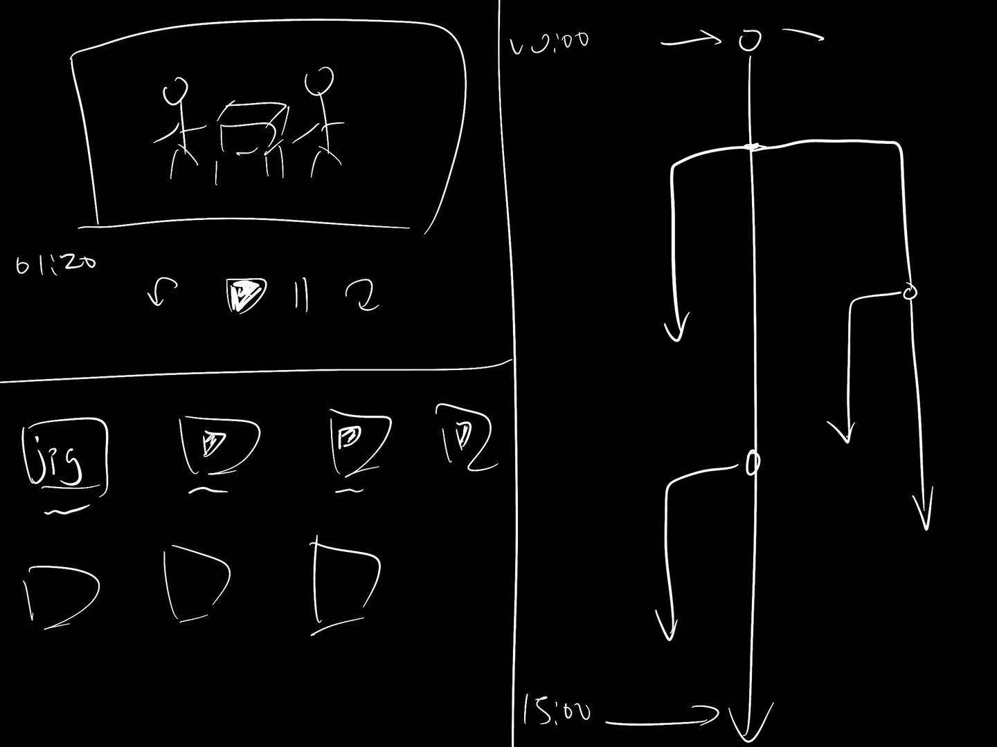
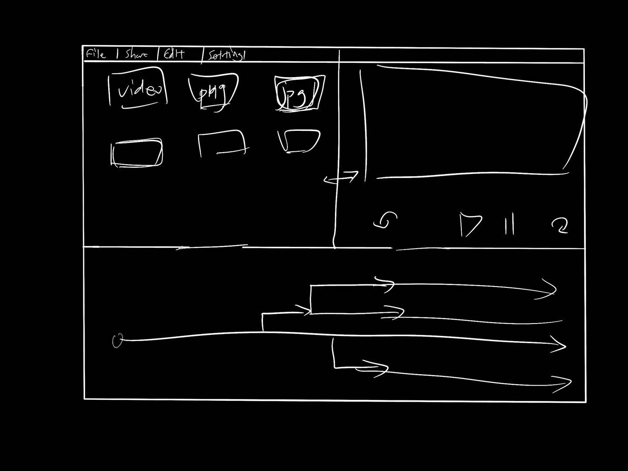
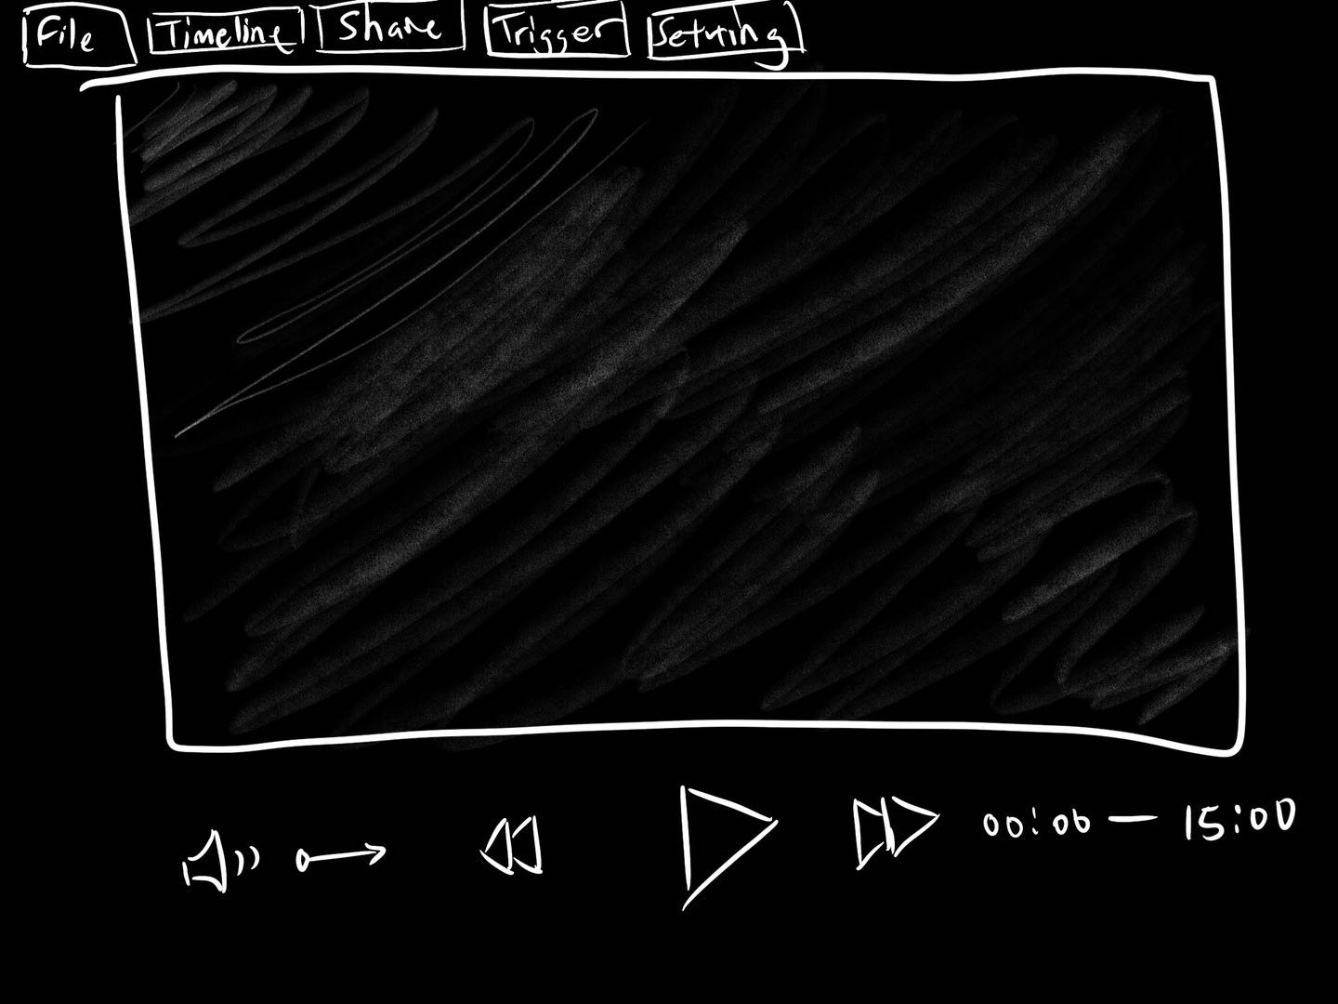
SKETCHES – Sketch 1
We came up with several sketches in the beginning after the requirements are confirmed. Which some are based on existing similar video editor and some are new ideas on our own.

Slide 7
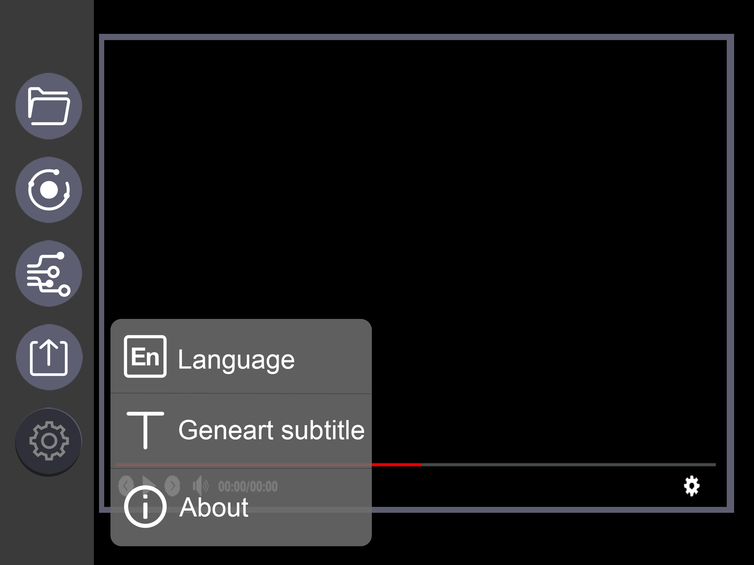
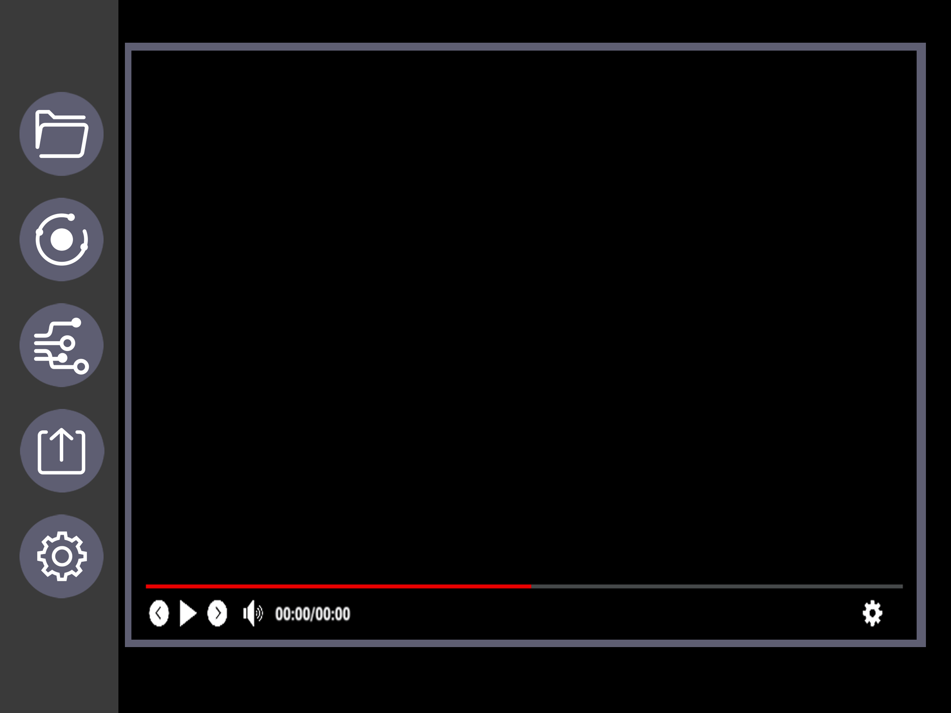
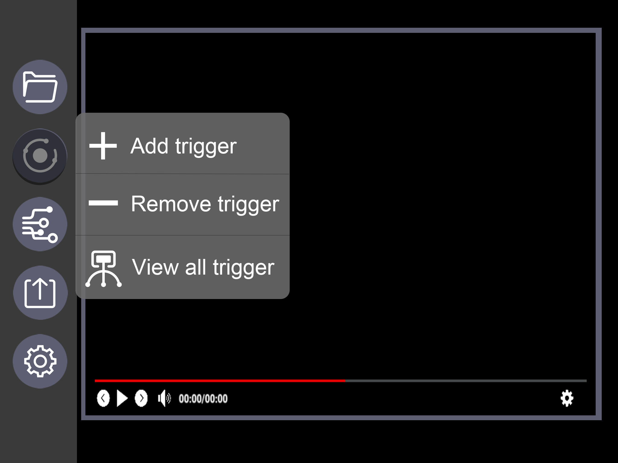
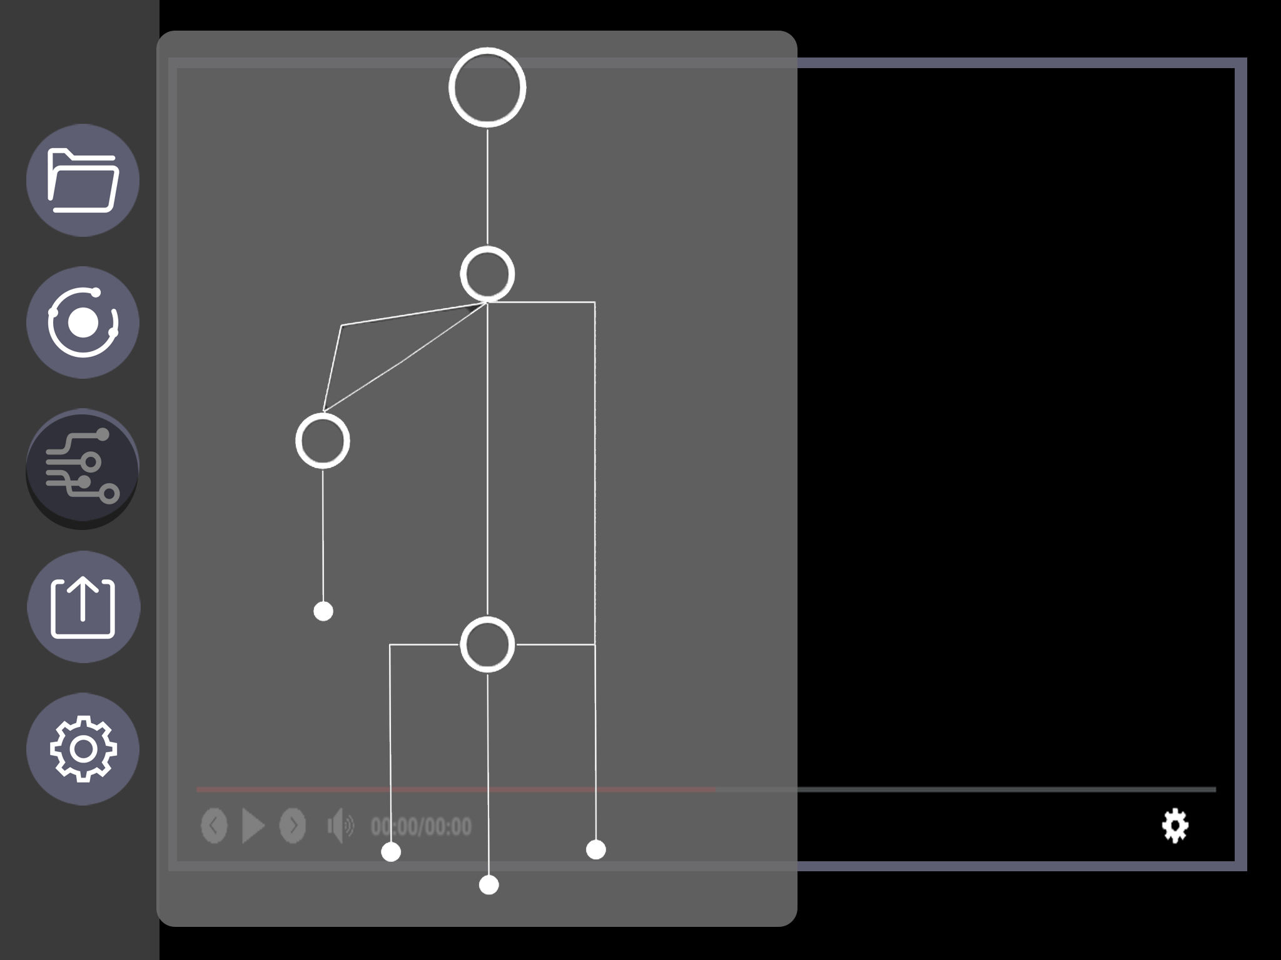
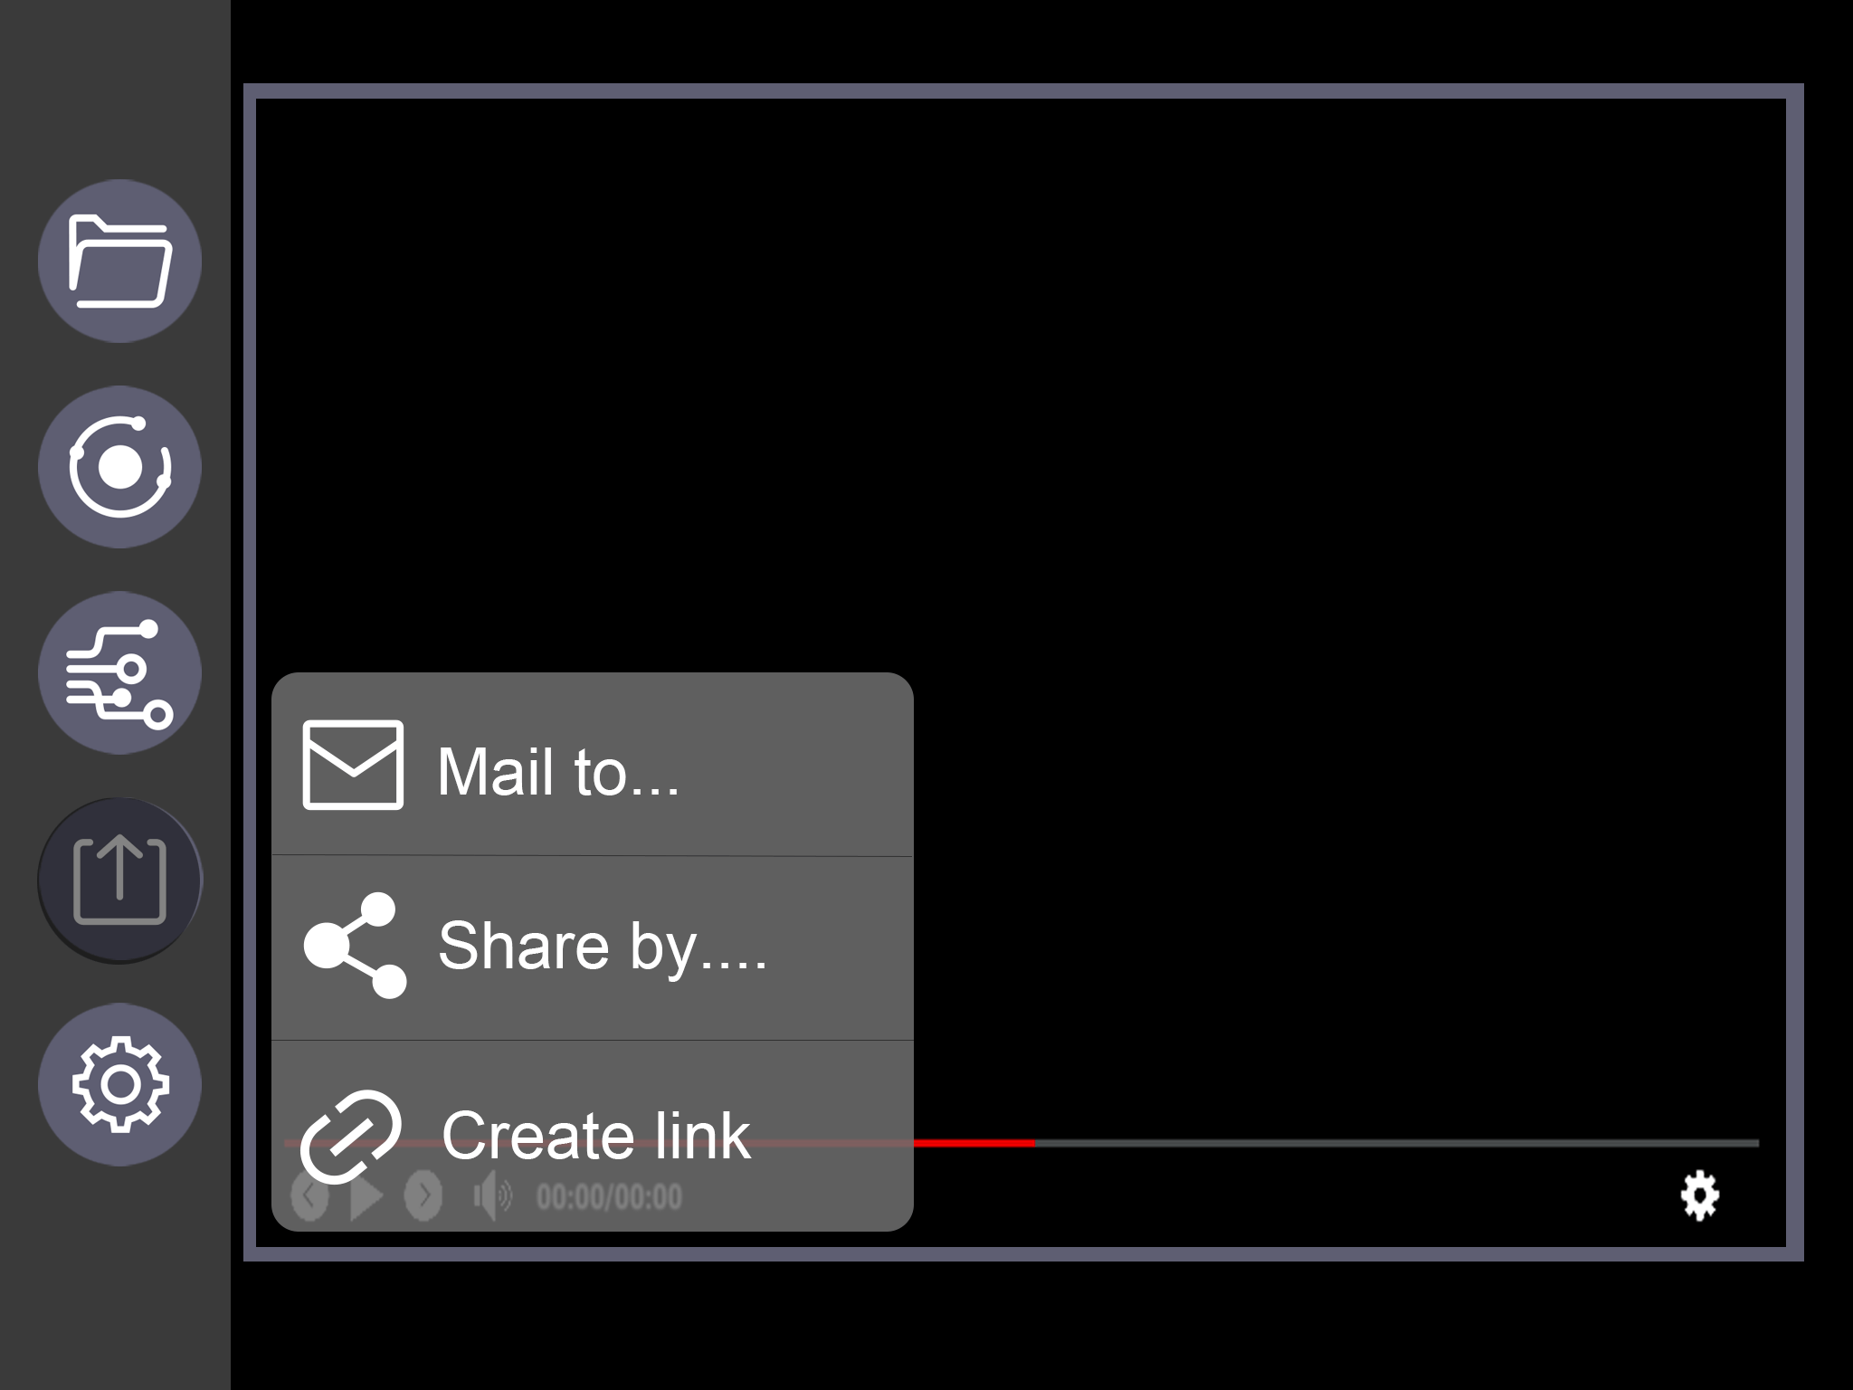
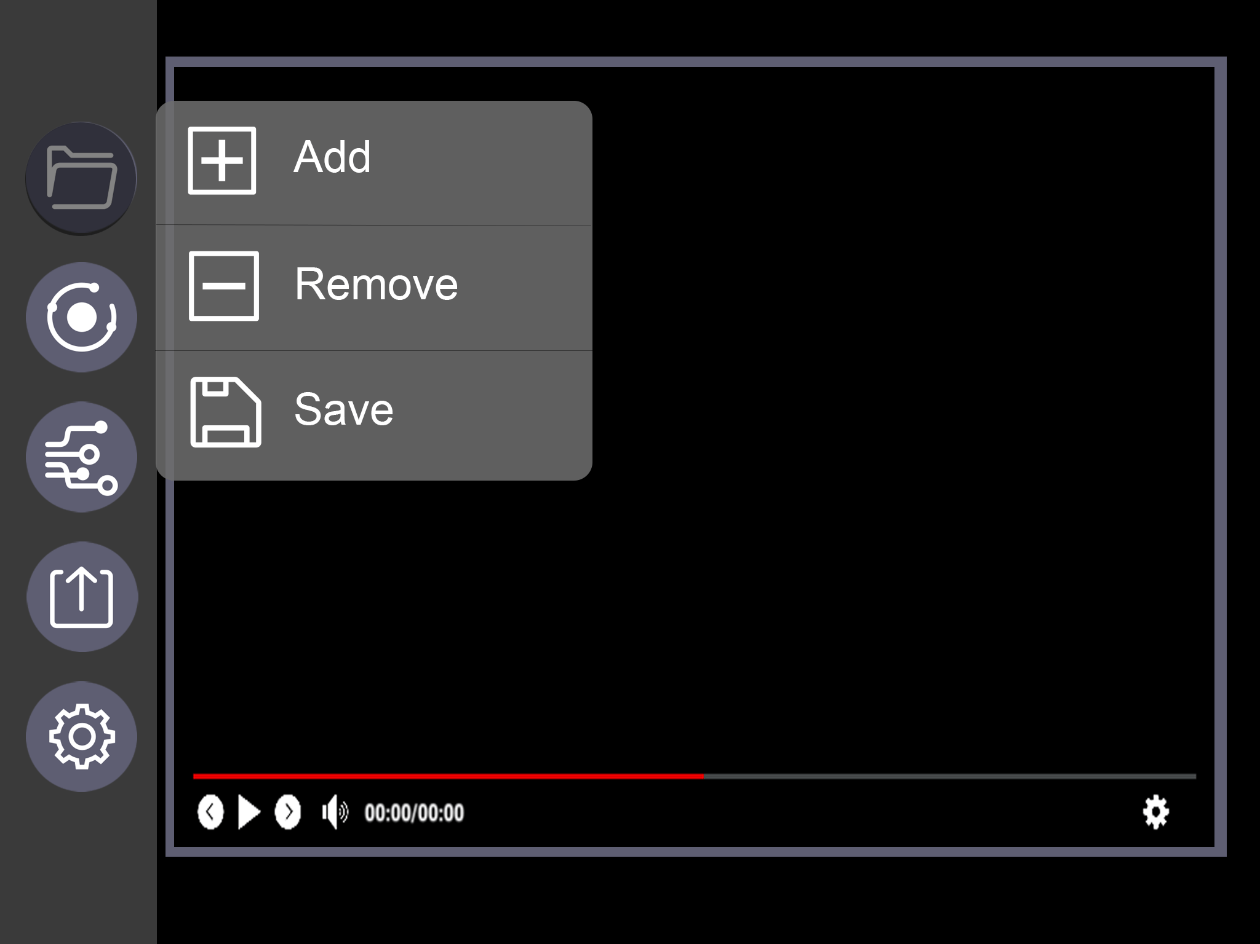
Prototype - Clinician
We decided the UI should be convenient on mobile end, thus build a clear and simple prototype by Photoshop.

Slide 8
EVALUATION OF PROTOTYPE
Heuristic | Problem | Solution | Severity
Necessity of button | The ‘remove trigger’ button is not needed since the trigger should be removed by clicking it and choose the delete option. | The button for deleting trigger should be removed. | 2
Clear display | The tree displaying the file arrangement tree should not be a pop-up window, it should be placed below the editor window. | The tree should be placed below the editor window and it should be always displayed. | 1
Design should help reduce the possibility of deleting file by mistake | The button for remove file should be placed at a safer place, so that the user is less possible to remove the whole edited file by mistake. | The button should be placed elsewhere, or made smaller. | 2

Slide 9
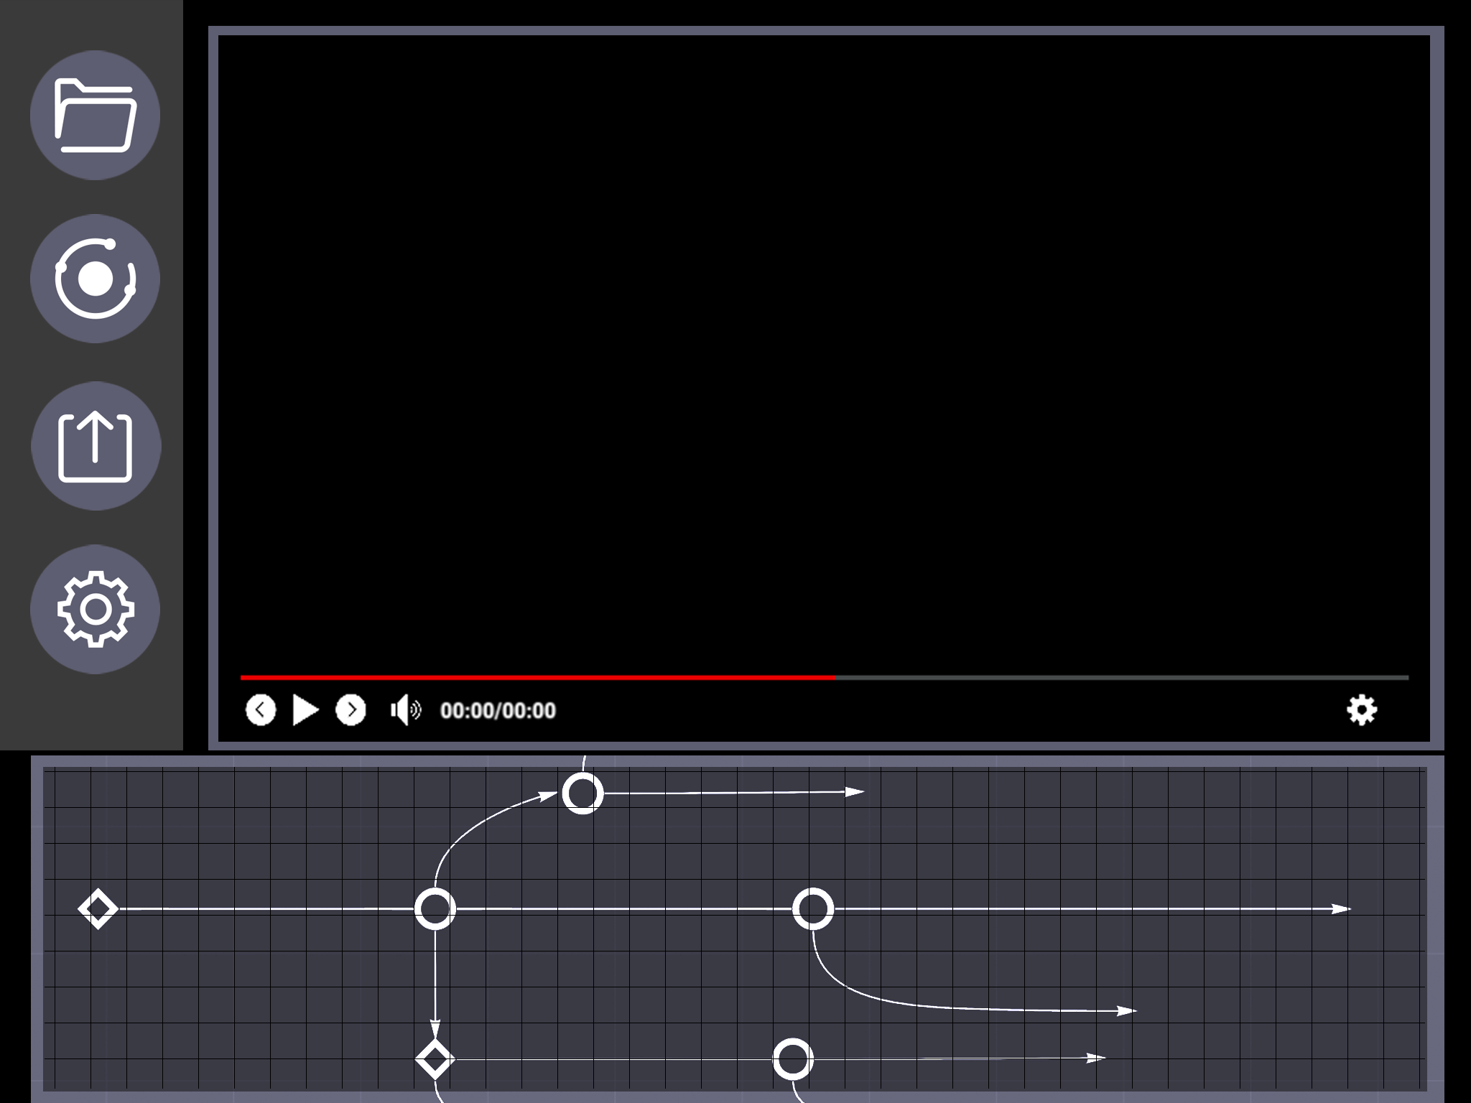
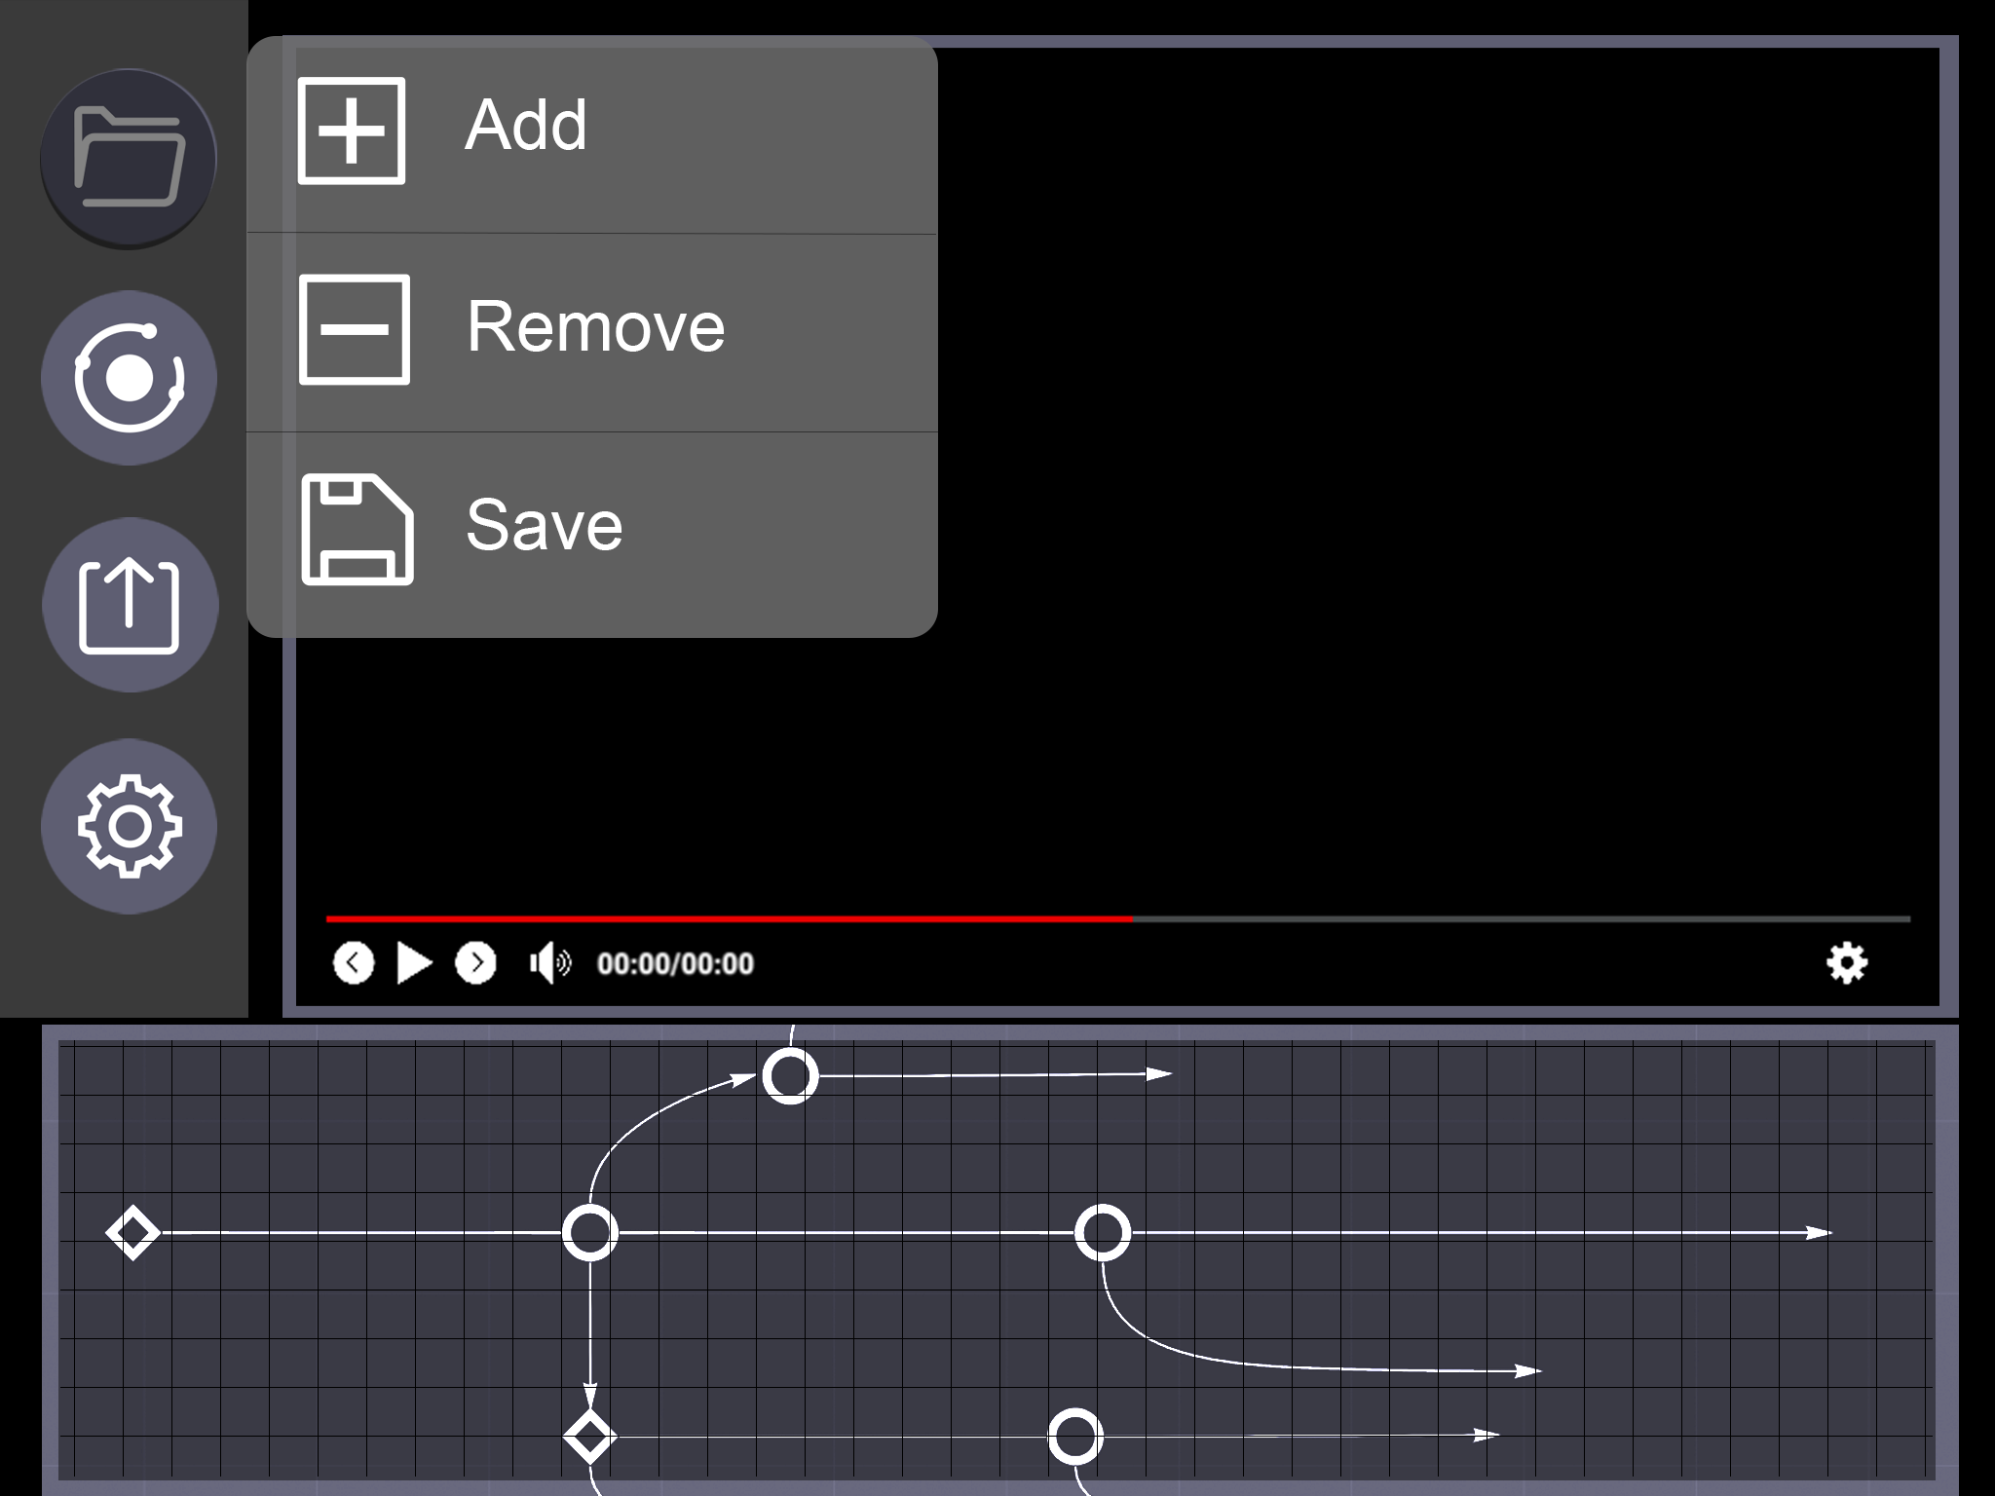
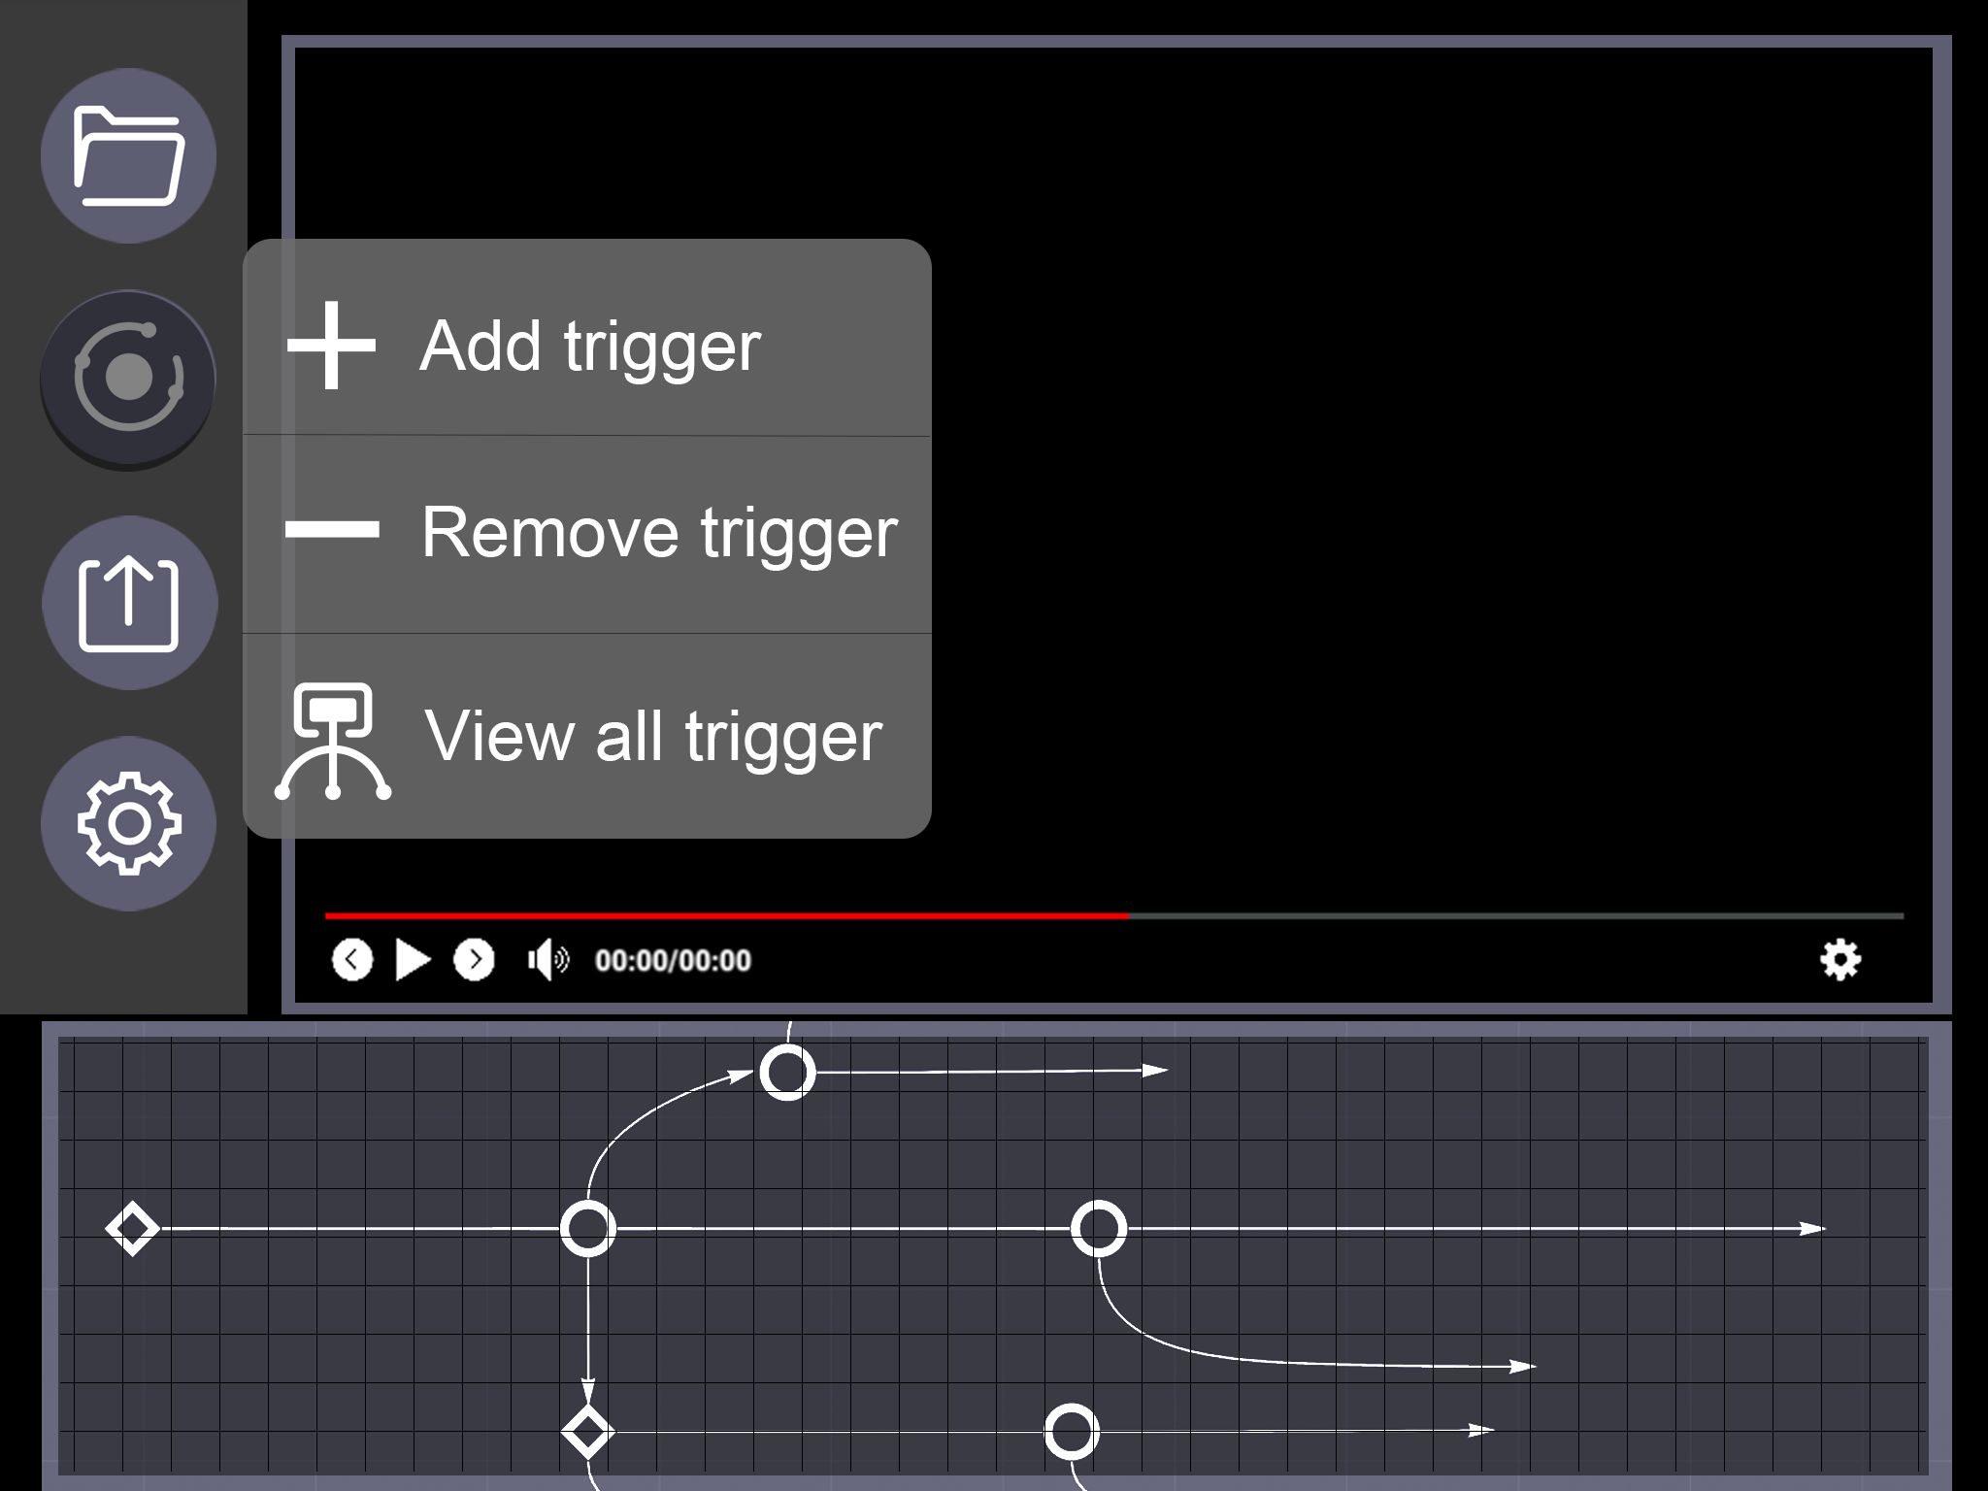
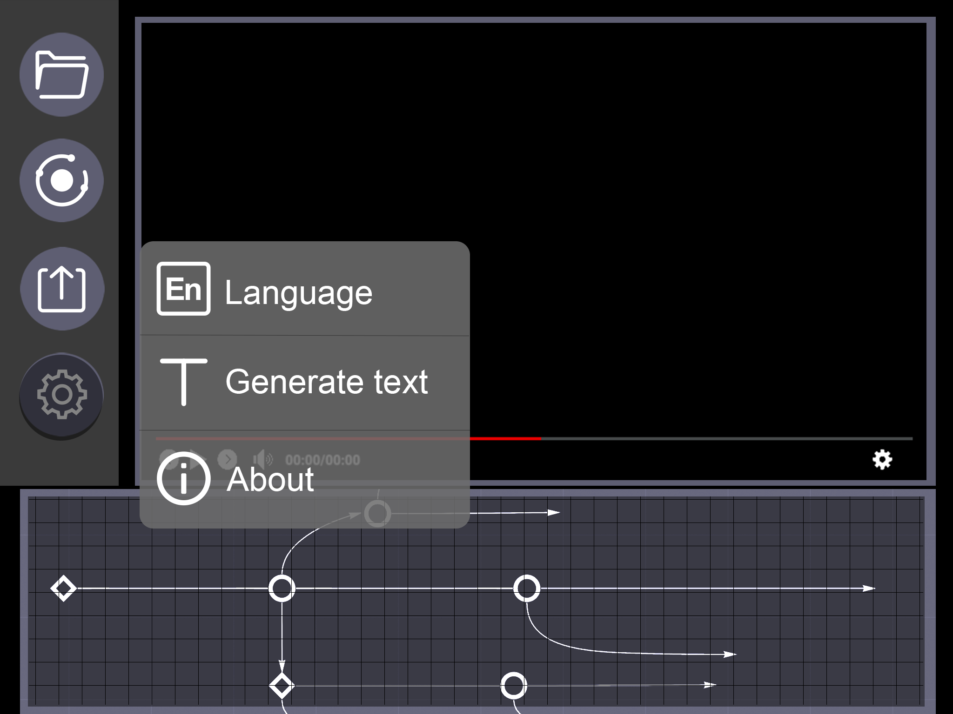
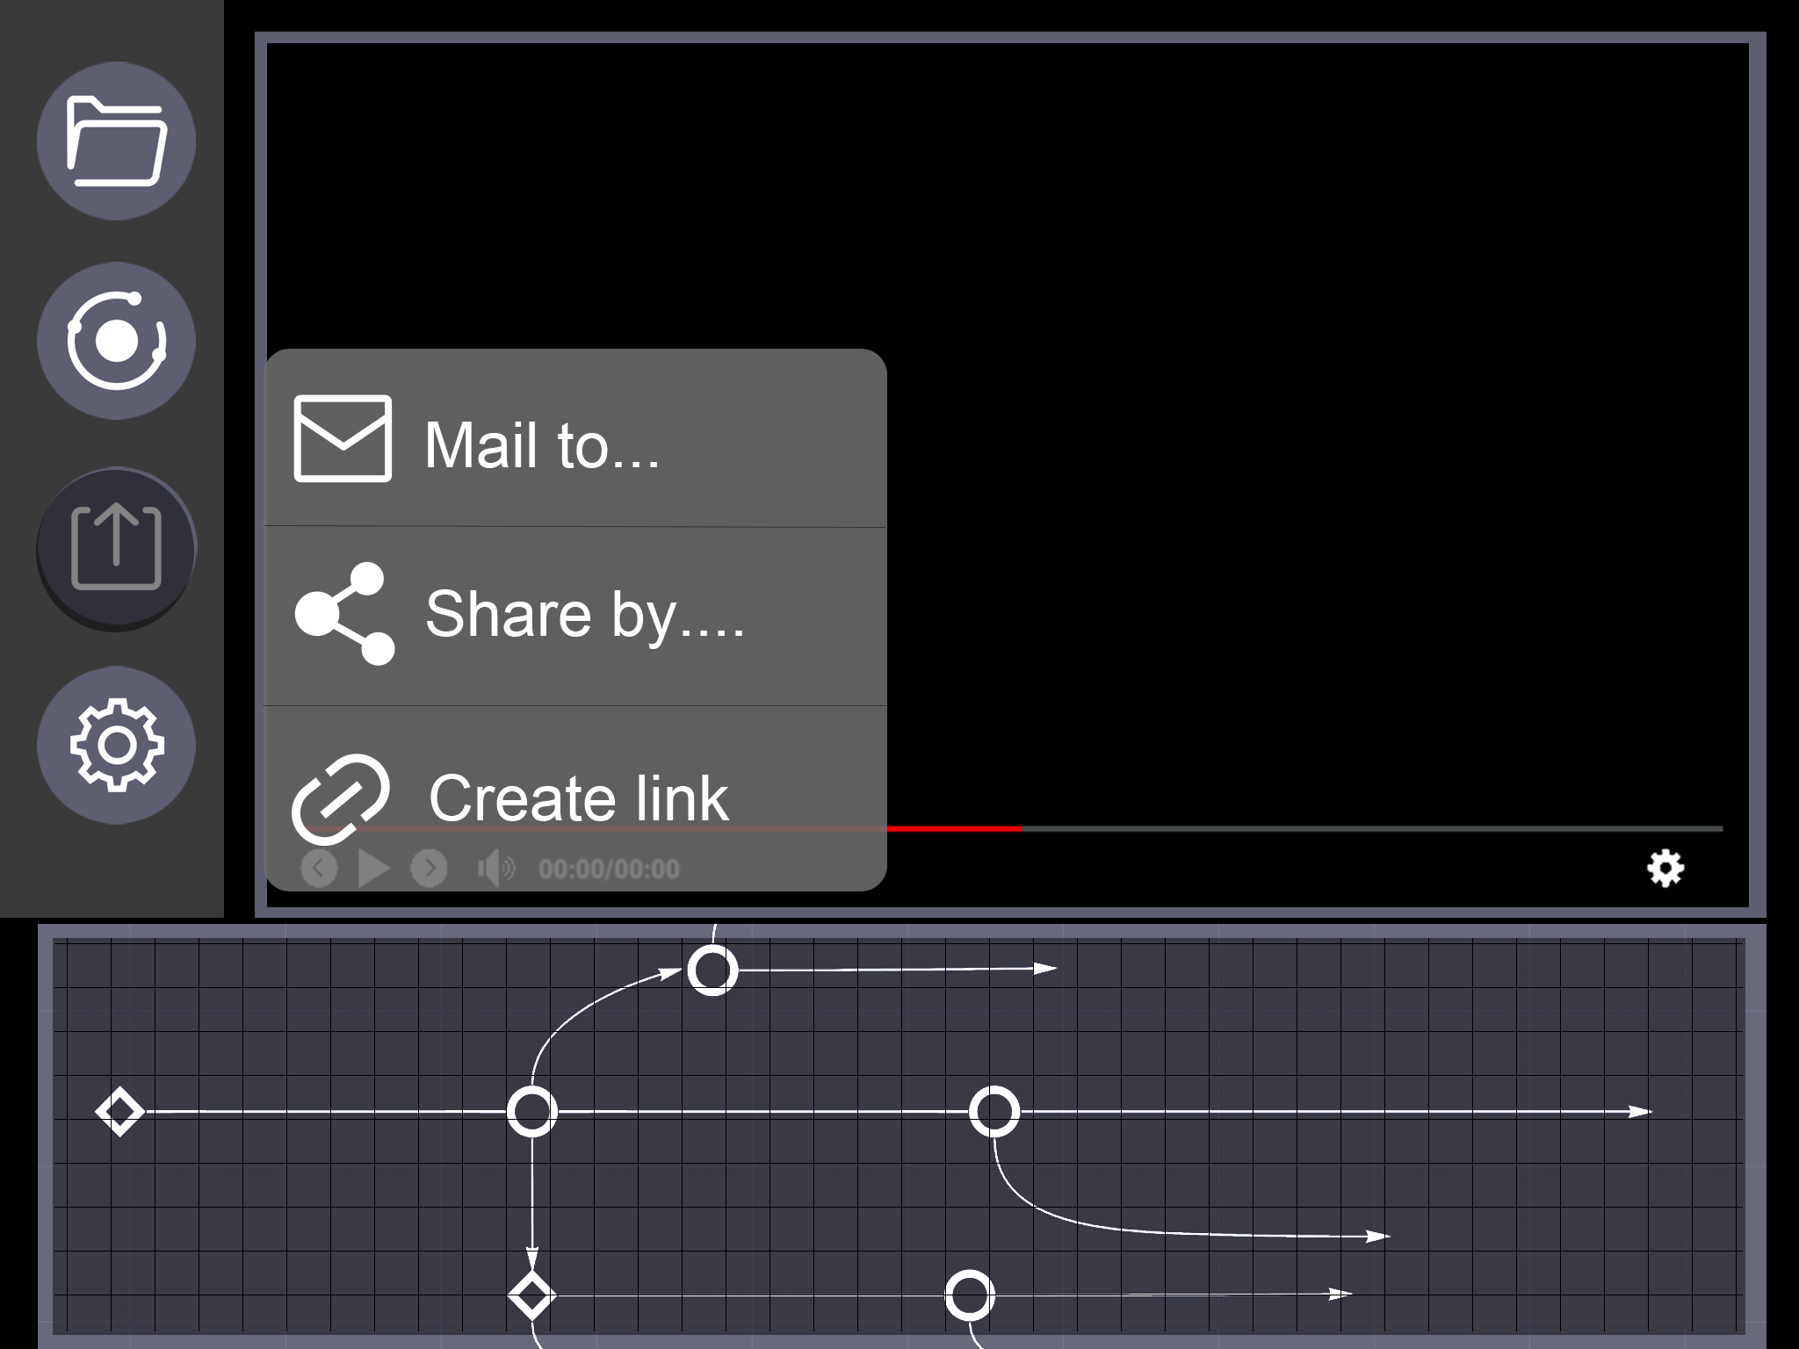
Improved Prototype
We improved our project according to the clients respond and evaluation results, and build an interactive version on website Invision. Check it out through the link: https://invis.io/BHZCVI6P8AT#/437092551_Main

