Slide 1


UCL Particle Physics Masterclass 2025
International Masterclasses
Hands-on particle physics

Slide 2
About today’s masterclass
Learn about particle physics
Get a taste of physics research
Analyse real data from CERN
Talk to physicists
Ask us questions!
Think of questions for the event moderators at CERN.
Collaborate with other students internationally

Slide 3
Schedule
09.30 – 09.45 | Registration and Welcome
09.30 – 10.00 | Introduction and getting started
10.00 – 10.30 | Lecture and Q&A session
10.30 – 13.00 | Hands-on exercises (with break)
13.00 – 14.00 | Lunch (not provided!)
14.00 – 14.45 | Hands-on exercises (continued)
14.45 – 15.00 | Discussion of results
15.00 – 16.00 | Video conference with CERN and masterclass students in other countries
16.00 – 16.15 | Summary, Q&A
Breaks are allowed!

Slide 4
Getting started
https://www.hep.ucl.ac.uk/masterclass/2025/
The “Z Path” task.
Event Display software: Hypatia

Slide 5
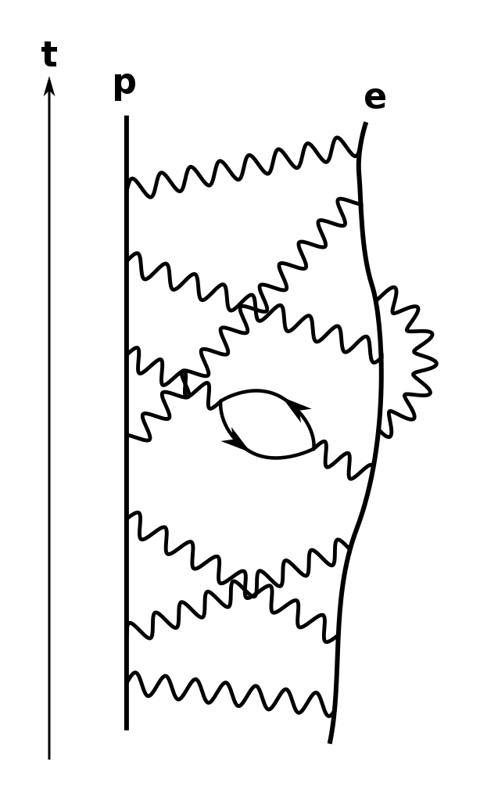
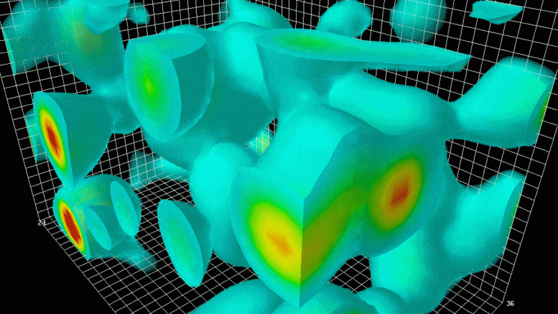
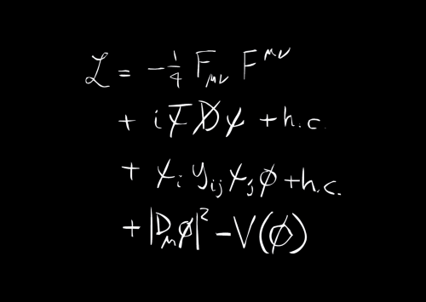
The Standard Model

Slide 6
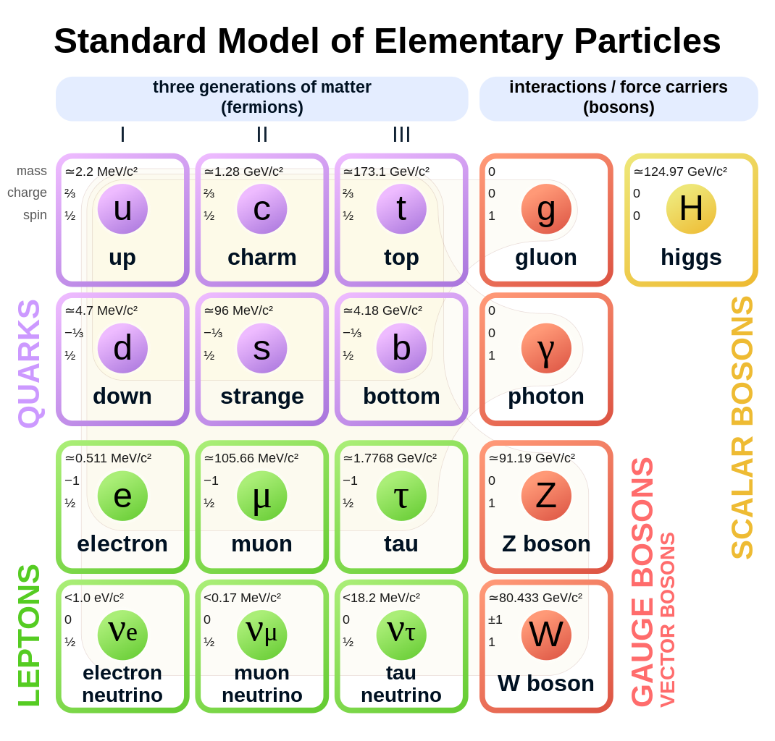
The Standard Model

Slide 7
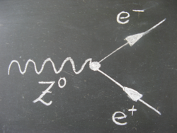
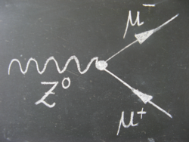
The Z Boson

Slide 8
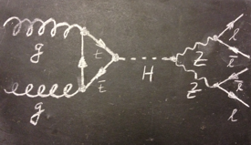
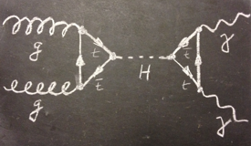
The Higgs boson

Slide 9
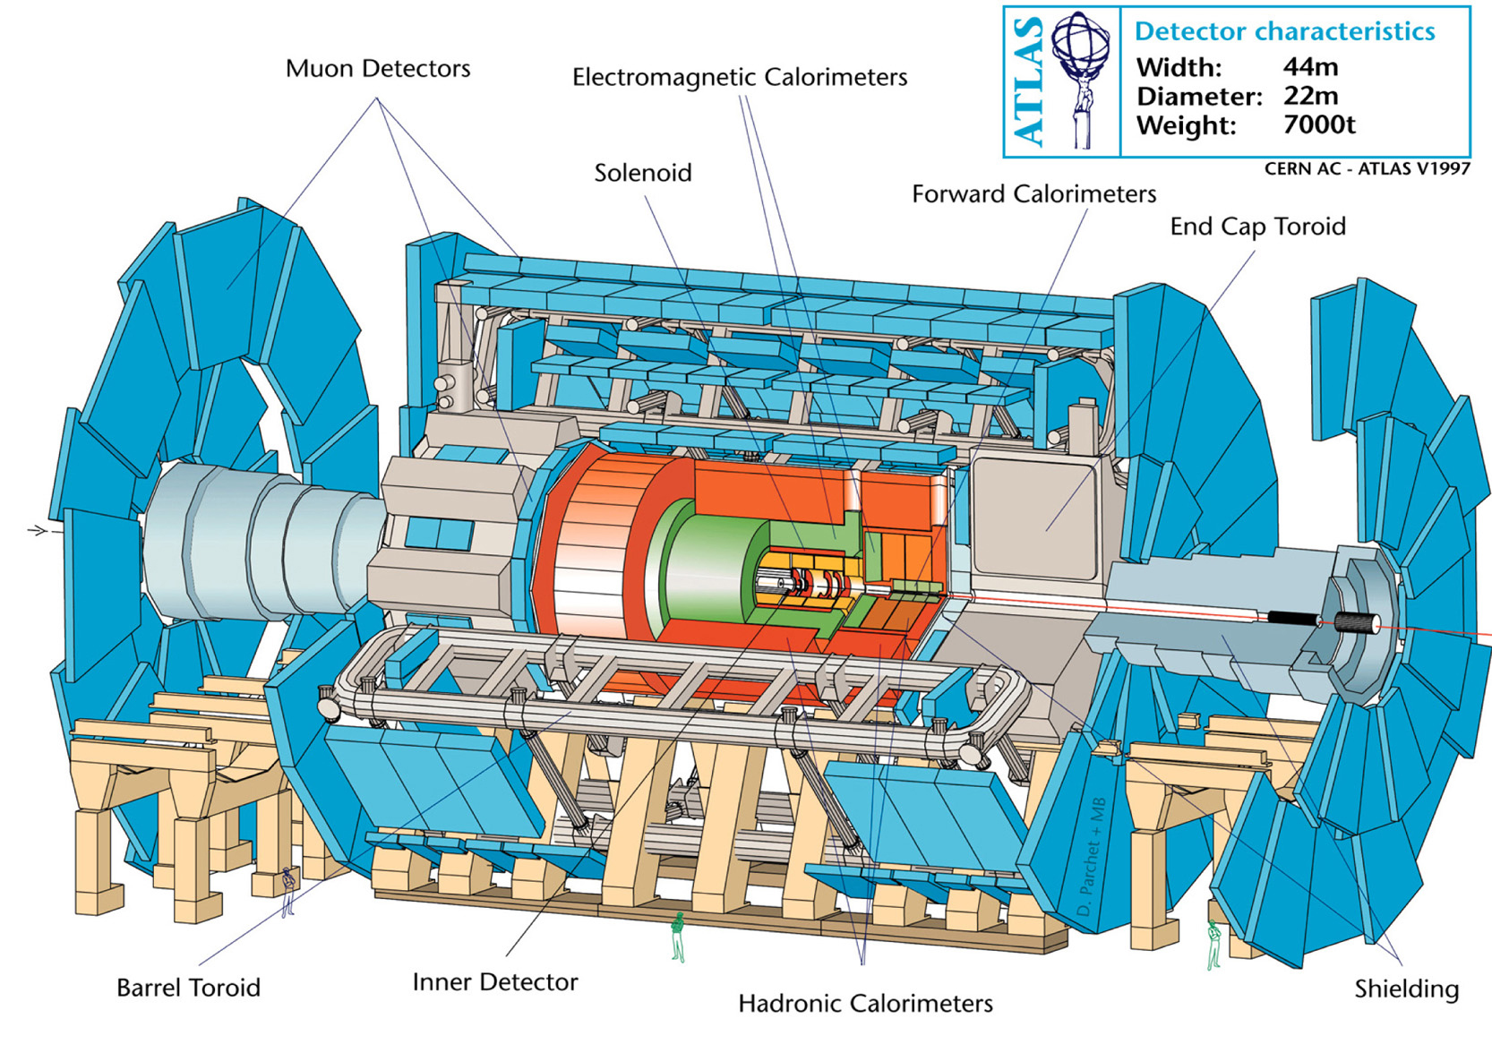
The ATLAS detector

Slide 10
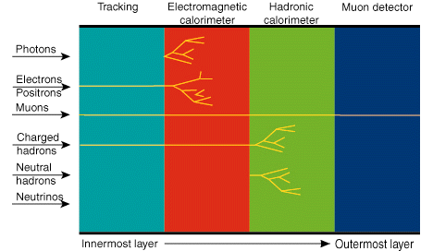
Particle signatures

Slide 11
Practice: identifying particles
See “Particle footprint visualization”.
And “Practice” if time allows.
Refer to the “cheat sheet” linked from https://www.hep.ucl.ac.uk/masterclass/2025/

Slide 12
Practice: identifying events
Download and classify “exercise 2” data.
Check answers in “Identifying Events: Practice!”

Slide 13
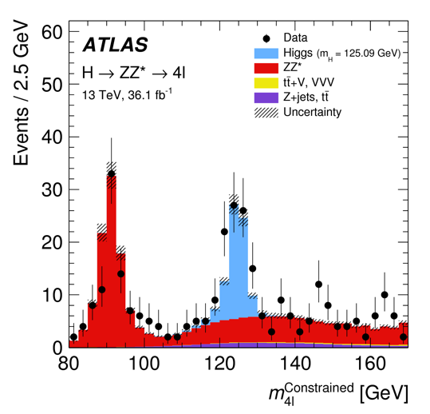
Invariant mass
We don’t just look at individual events.
We plot histograms using many (selected) events, and look for peaks.
We use the “invariant mass” of the Higgs candidate.

Slide 14
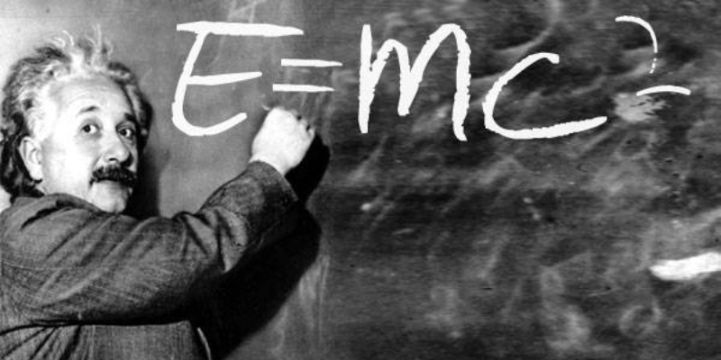
Invariant mass
Calculate the mass of a particle using the mass, momenta and energy of the particles it decays into.
Hypatia does the calculations for us.

Slide 15
Demo / practice
Exercise 2 events or one of allocated data sets.

Slide 16

Analysing your own data

Slide 17
Saving and loading your work

Slide 18
Viewing your results

Slide 19
Exporting your results

Slide 20
Combining our results
Upload results: http://cernmasterclass.uio.no/OPloT/
Combine with other groups for larger statistics.

Slide 21
Discussion of histograms
What do the peaks mean?
Are they where we expect them?
Can we see evidence of the Higgs boson?
Who would like to answer some questions in the video conference?

Slide 22
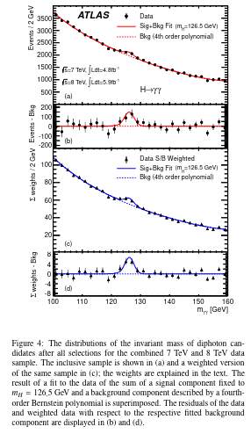
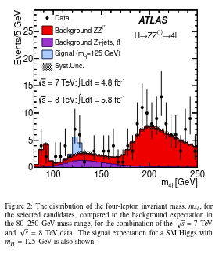
Higgs discovery 2012

Slide 23
Videoconference
Hosted by moderators at CERN.
Also groups joining from Athens, Göttingen, Maputo, Rio de Janeiro and Sheffield.
Moderators will ask each group some questions.
Your chance to ask them questions.

Slide 24
Thank you!

