Slide 1
Latest trends on alcohol consumption in Scotland from the Alcohol Toolkit Study
Jamie Brown, Loren Kock

Slide 2
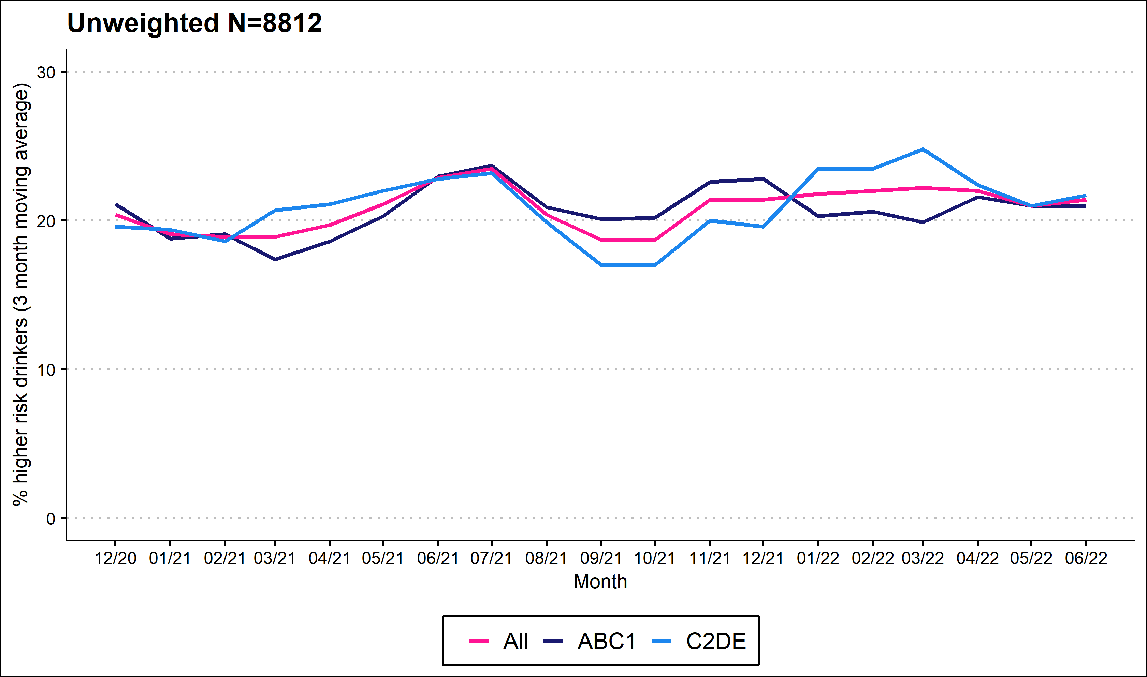
Prevalence of increasing and higher risk drinking (AUDIT)

Slide 3
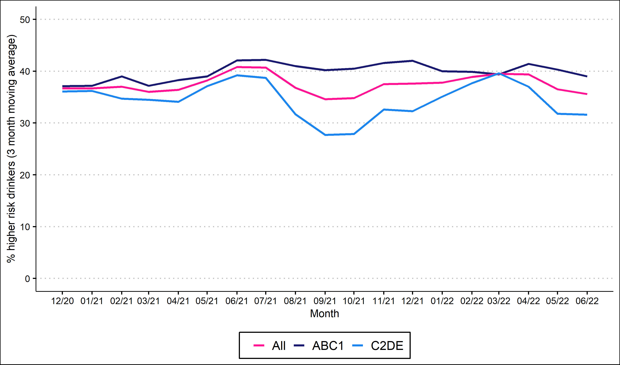
Prevalence of increasing and higher risk drinking (AUDIT-C)

Slide 4
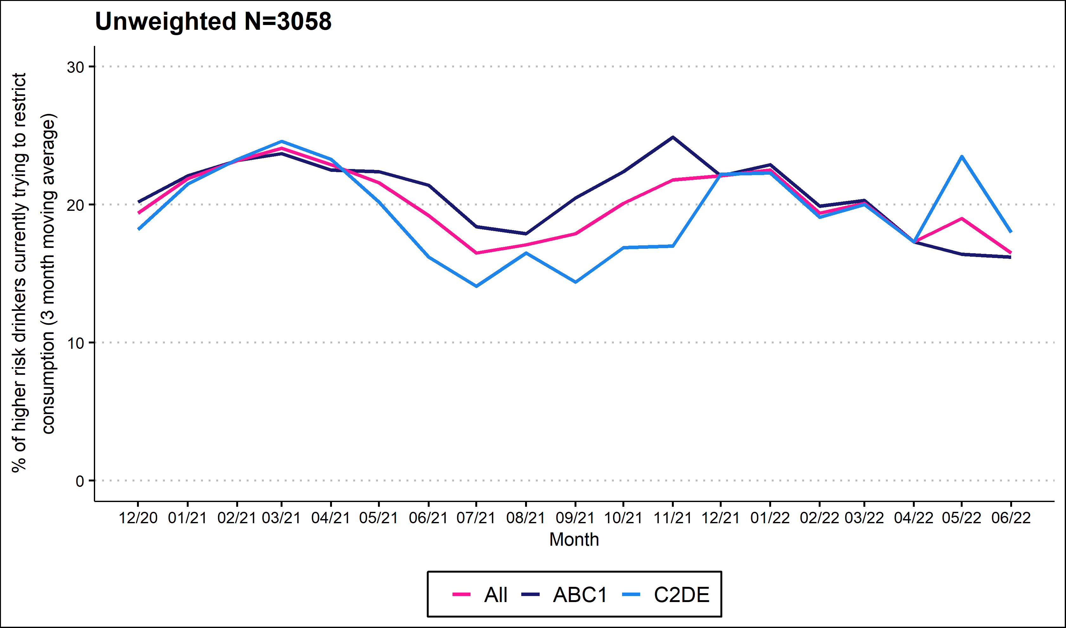
Currently trying to restrict consumption

Slide 5
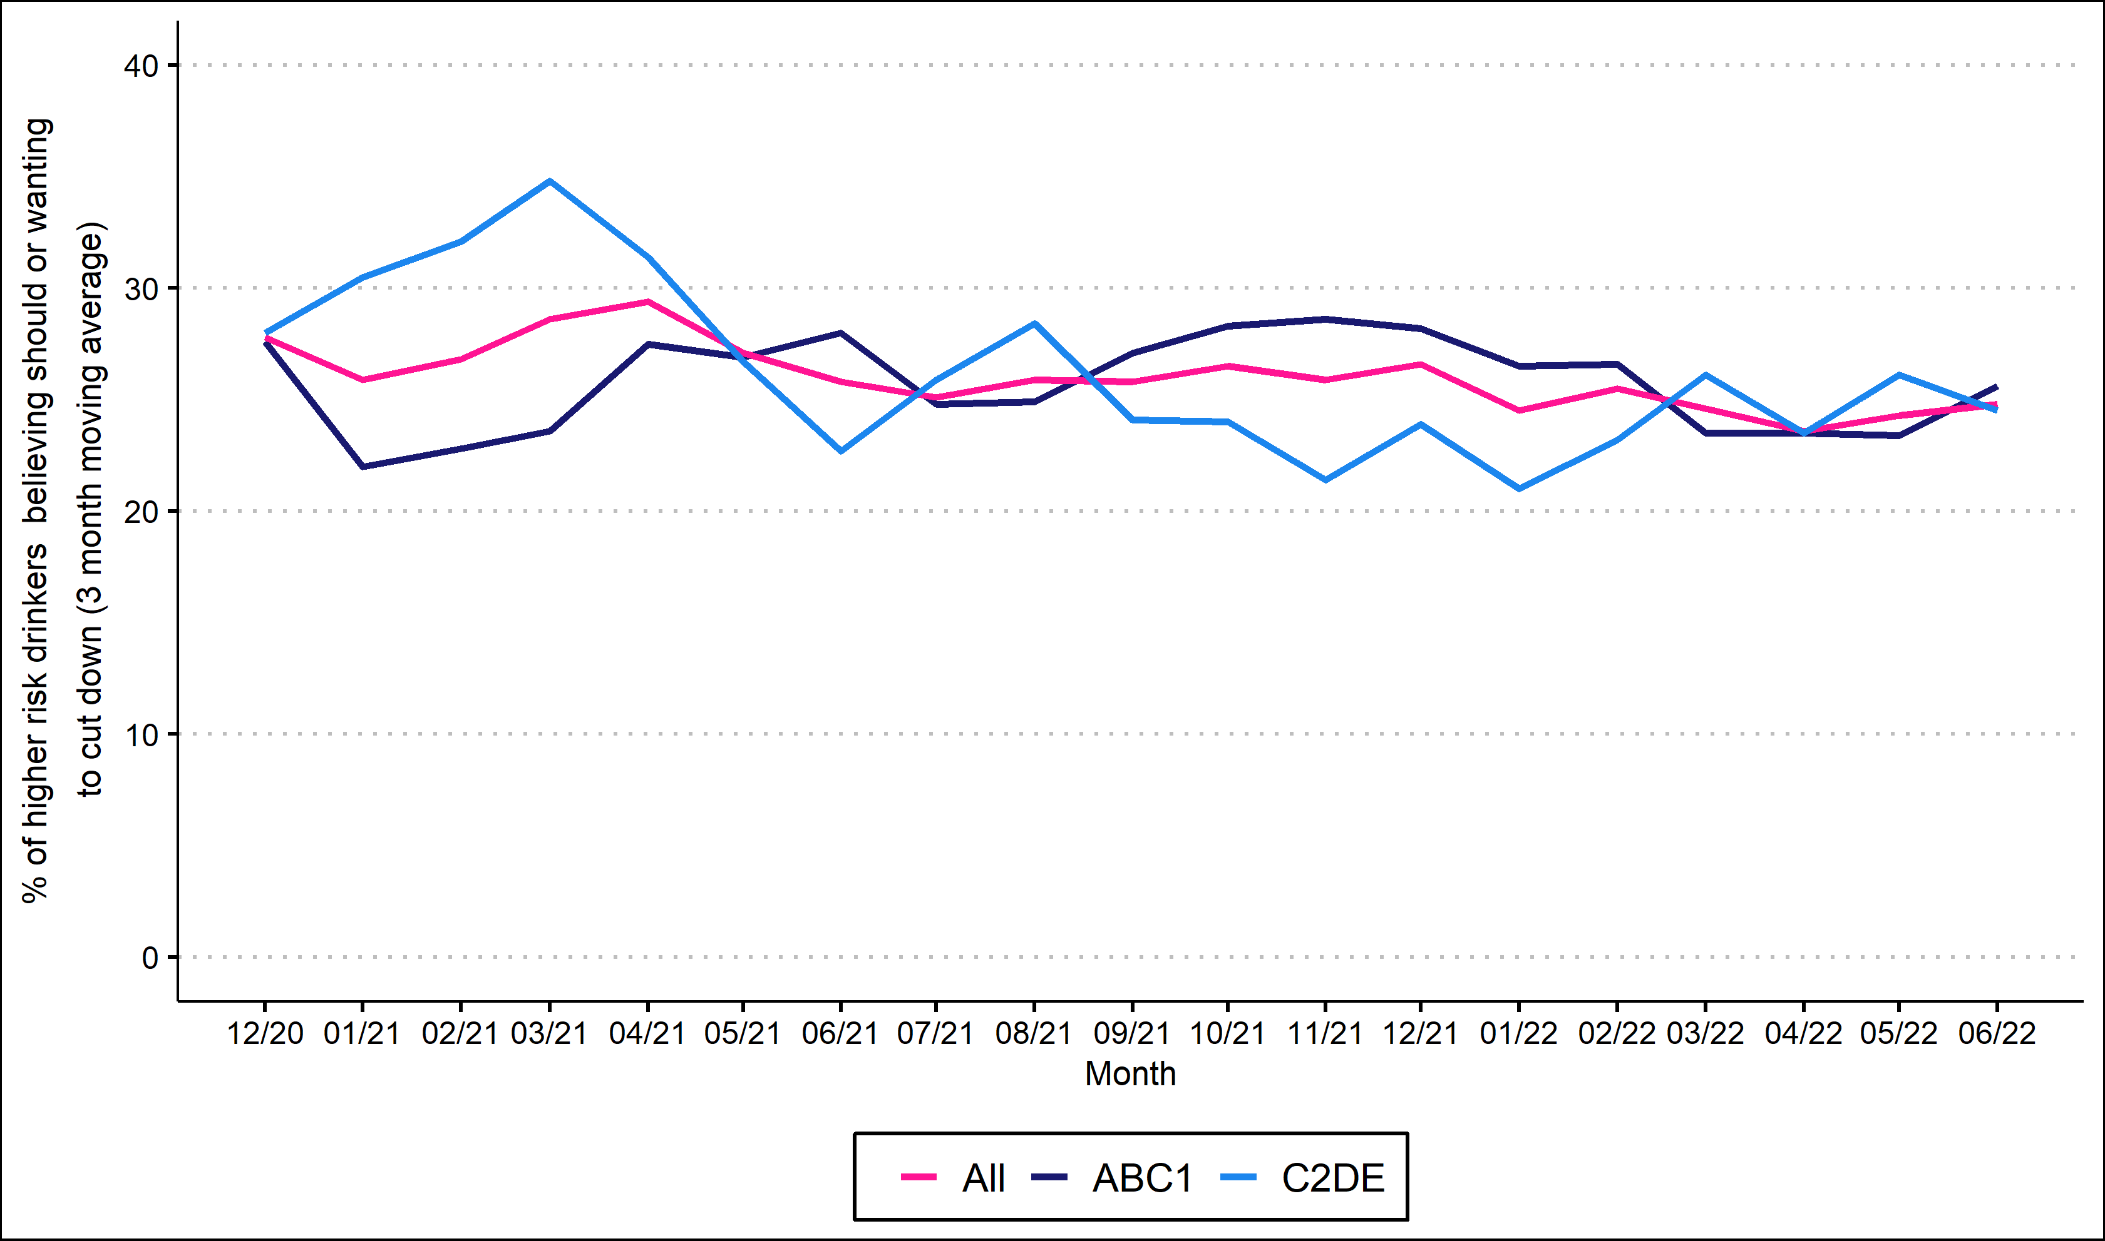
Motivation to cut down

Slide 6
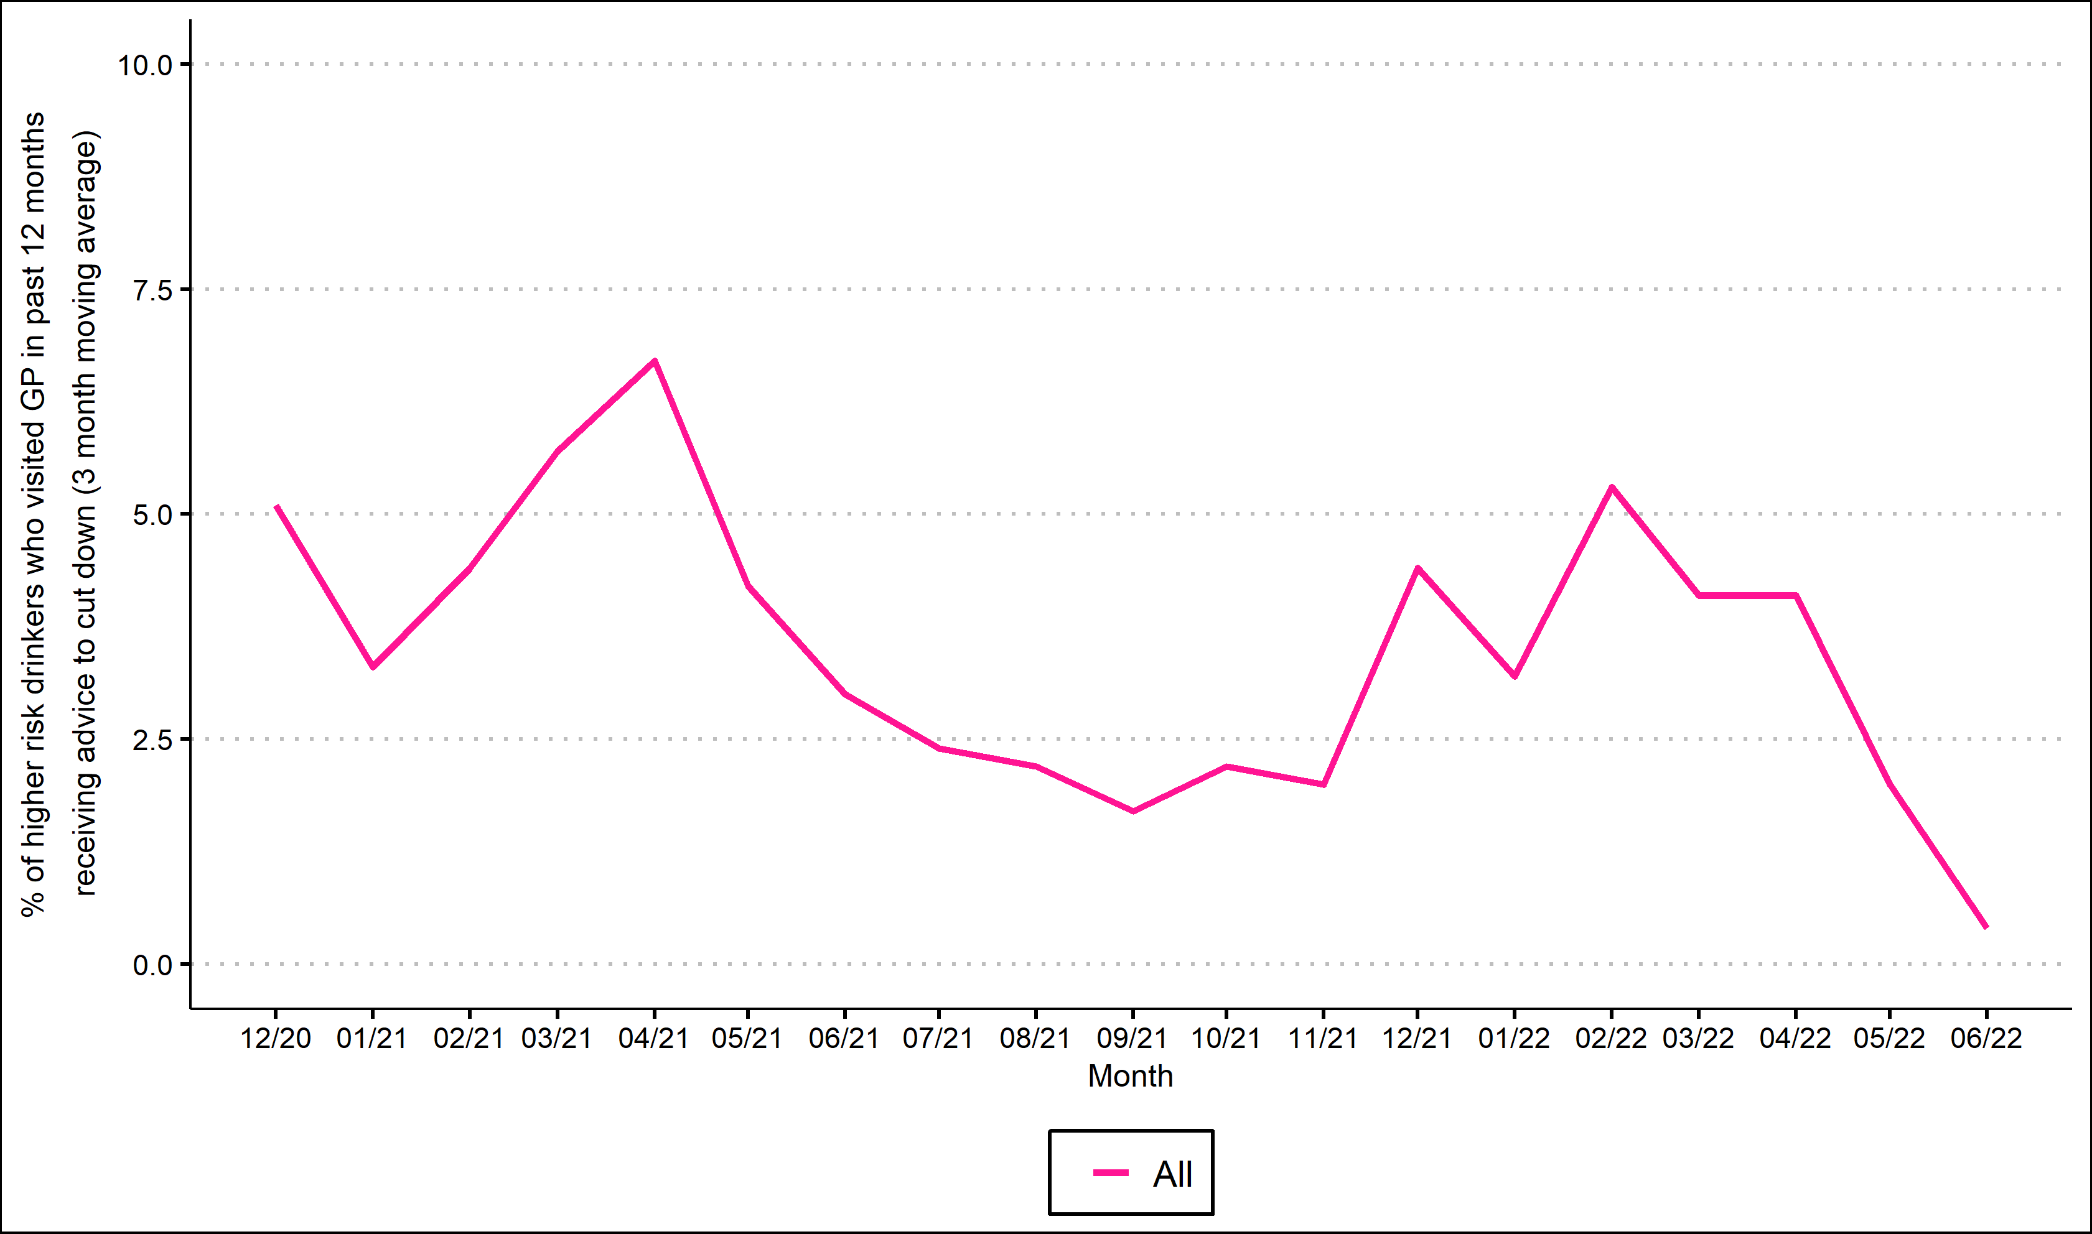
GP advice to cut down

Slide 7
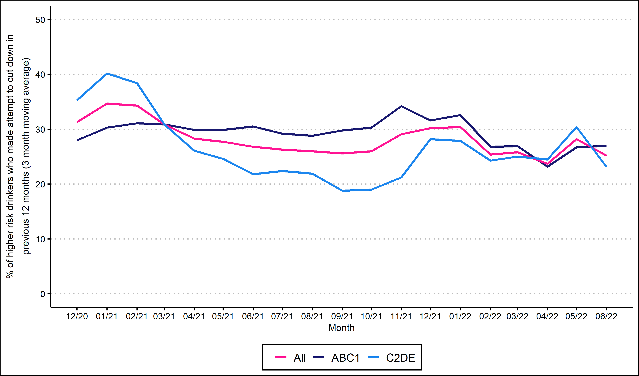
All past-year attempts to cut down or stop

Slide 8
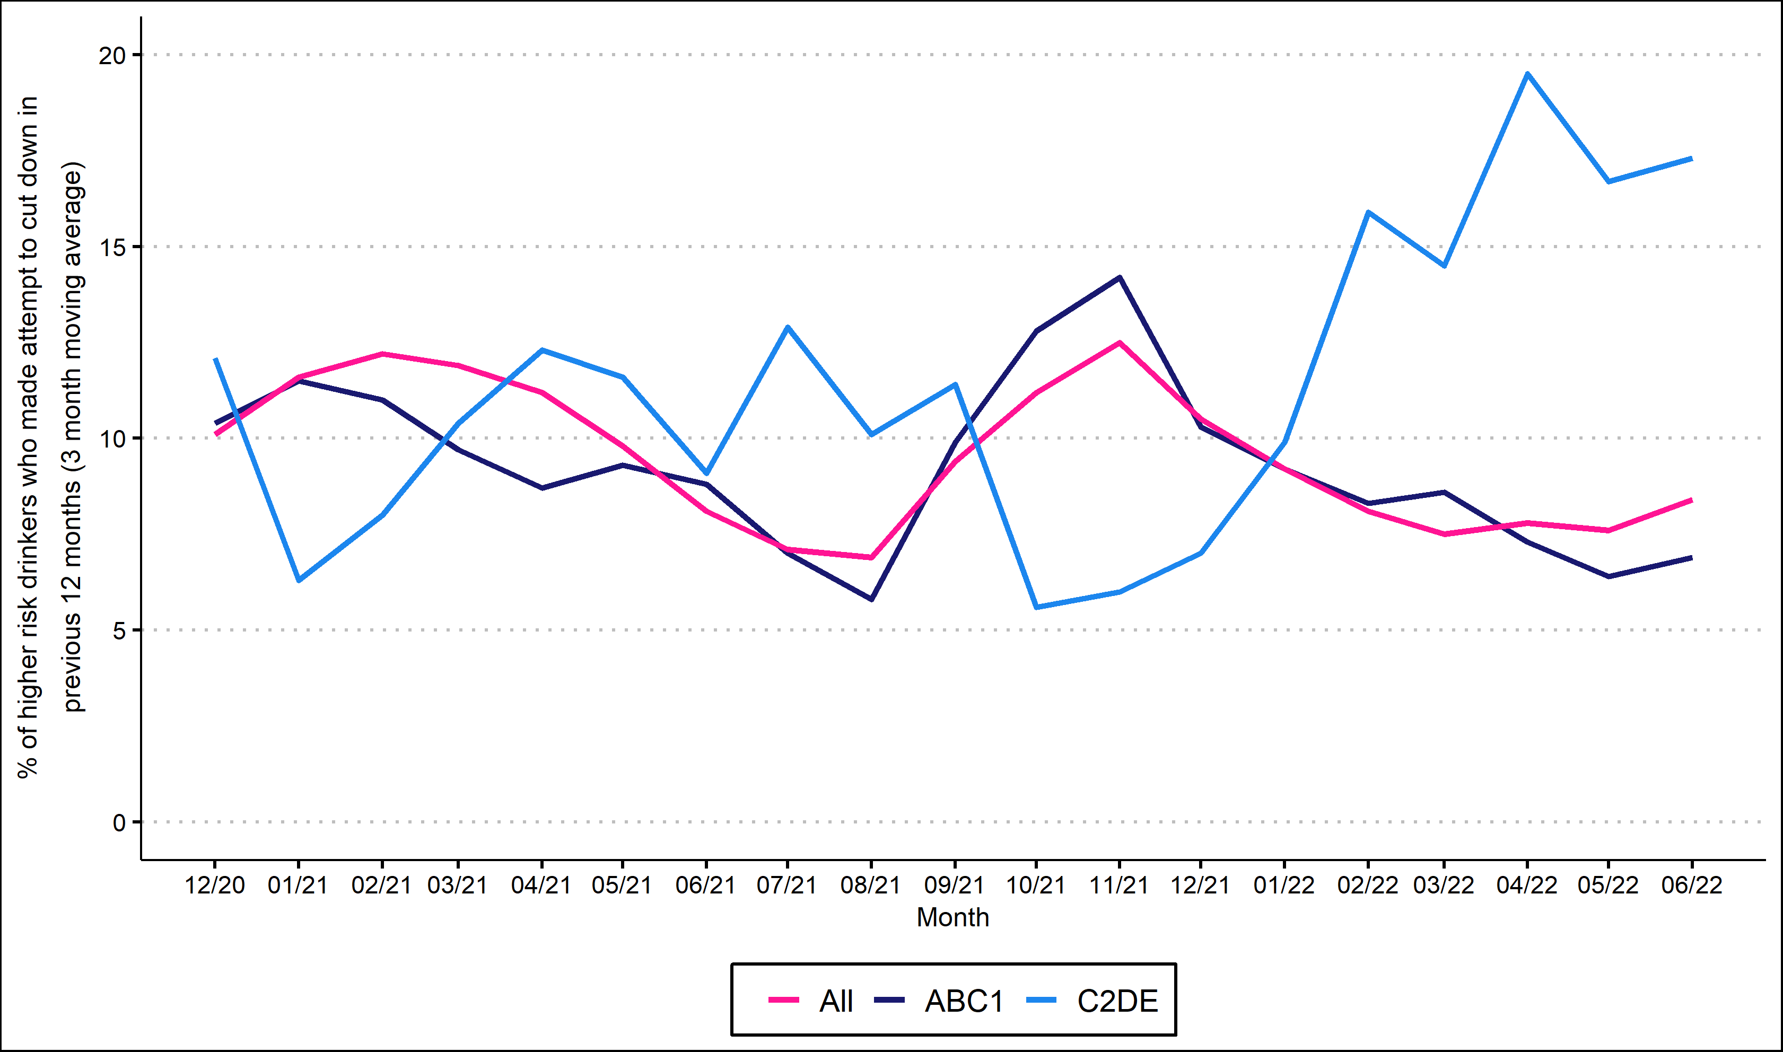
Serious past-year attempts to cut down or stop

Slide 9
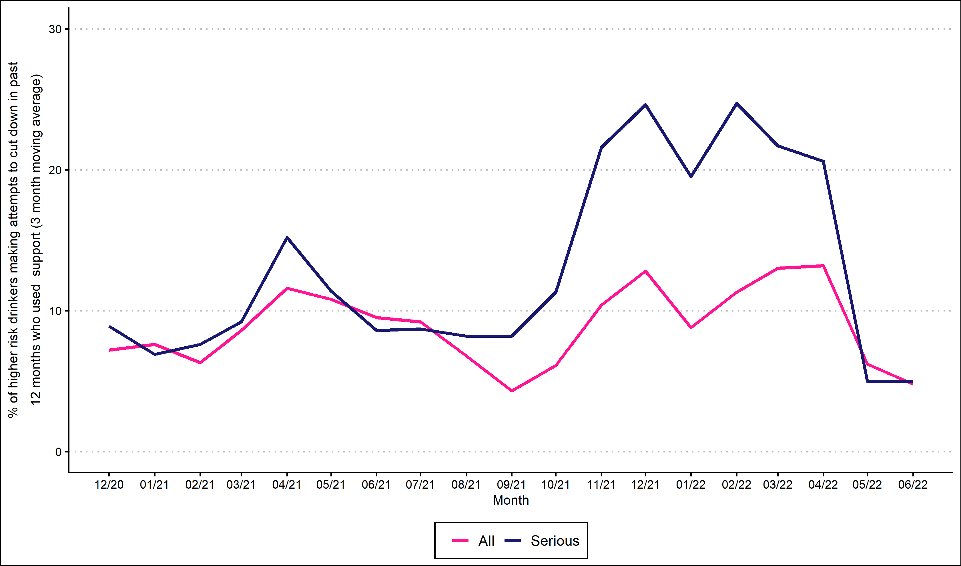
Support in past-year attempts

Slide 10
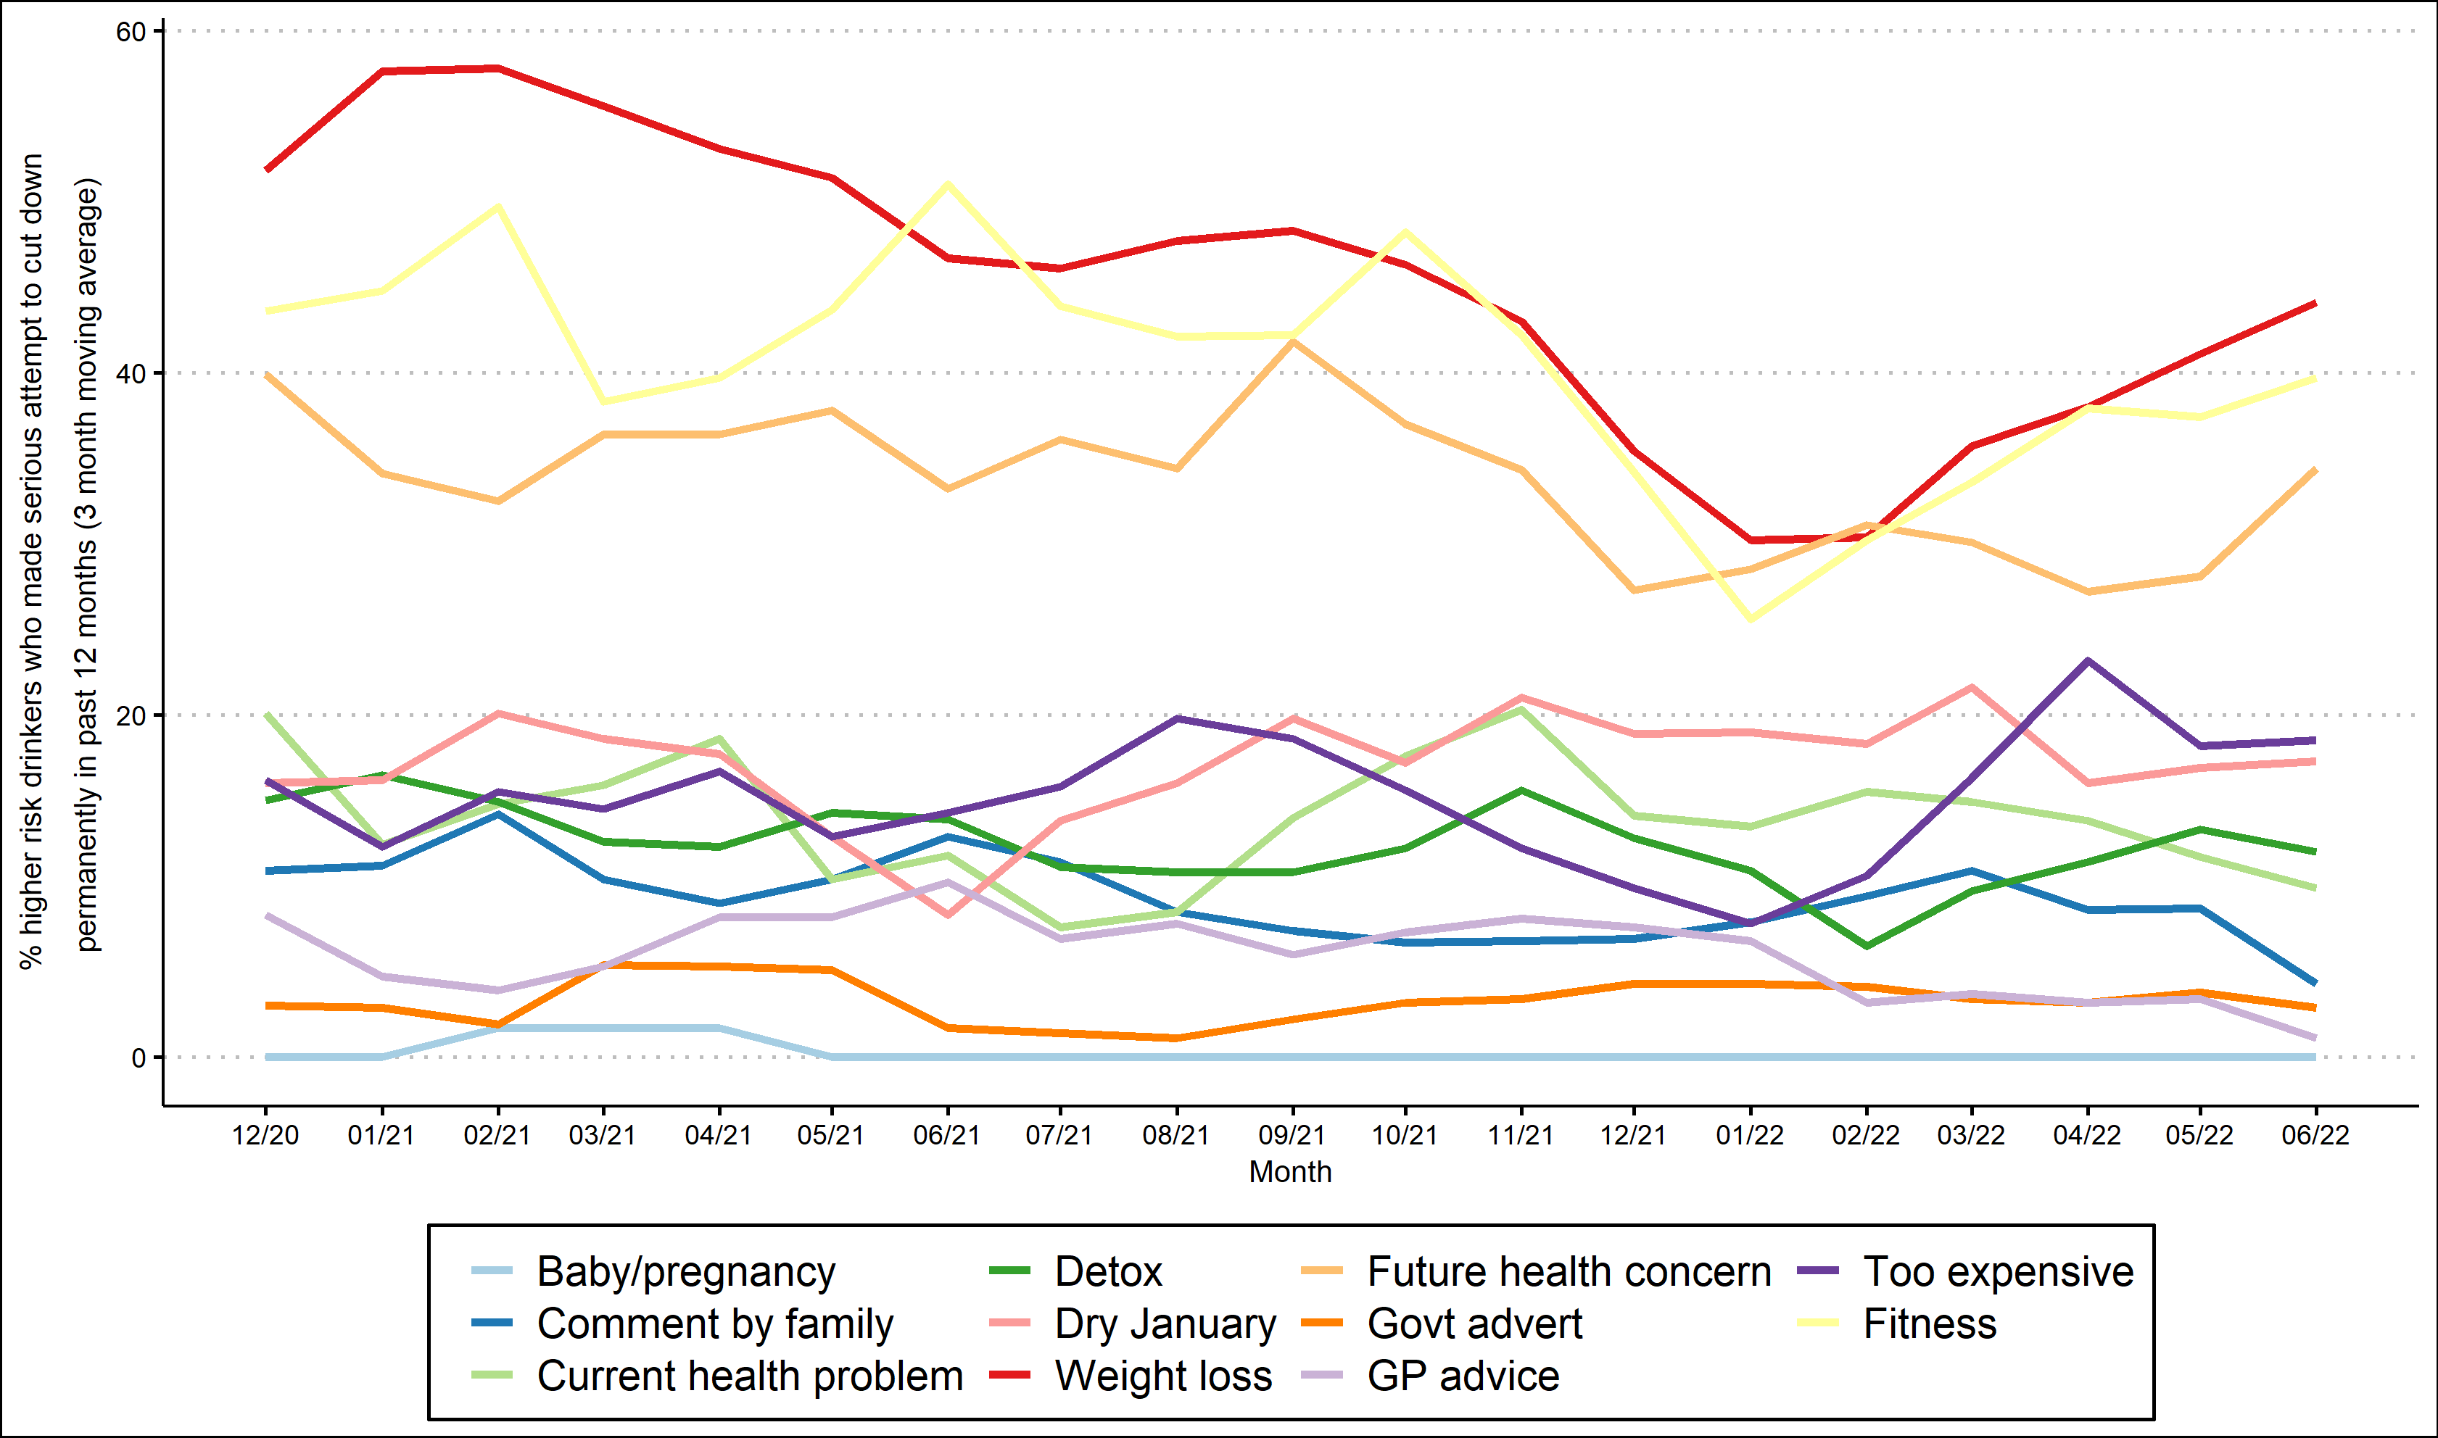
Triggers for past-year attempts

Slide 11
Methods
Data collected during monthly household survey
Each month involves a new representative sample of 400-450 adults (16 and over)
Due to pandemic, surveys are conducted by telephone (rather than face-to-face) and among adults aged 18 and over between April 2020-December 2021.
Kock, et al., 2021. Protocol for expansion of an existing national monthly survey of smoking behaviour and alcohol use in England to Scotland and Wales: The Smoking and Alcohol Toolkit Study. Wellcome Open Research. 6:67
More information (and access to the data underlying each graph) will be available online soon.

