Slide 1
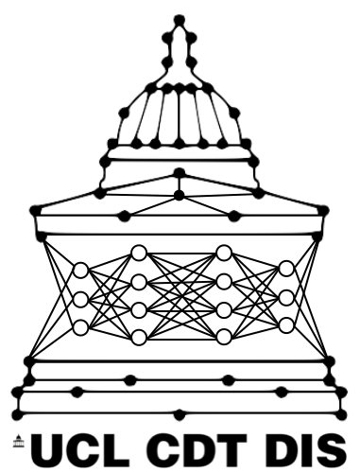


Exploration of the Simulacrum Artificial Patient-Like Cancer Data
Katya Richards, Jeremy Ocampo, Ishan Khurana, Cathal Sweeney

Slide 2

Intro
Simulacrum is a newly available synthetic cancer dataset
Can explore cancer data without confidentiality concerns
Models can be submitted to run on real data

Slide 3
Results
One of the first python-based data science tools for Simulacrum. Allows user to:
quickly explore dataset
convert medical codes into human readable format
construct patient pathways
Unsupervised clustering of patient pathways
All publicly available on Github [https://github.com/UCL-simulacrum/EDA]

Slide 4
Technical terms
NCRAS: National Cancer Registration and Analysis Service
SACT: Systemic Anti-Cancer Therapy (e.g. chemotherapy)
Regimen: prescribed course of medical treatment
Cycle: period of chemotherapy treatment
Pathway: collection of all medical events associated with a patient, beginning at diagnosis

Slide 5
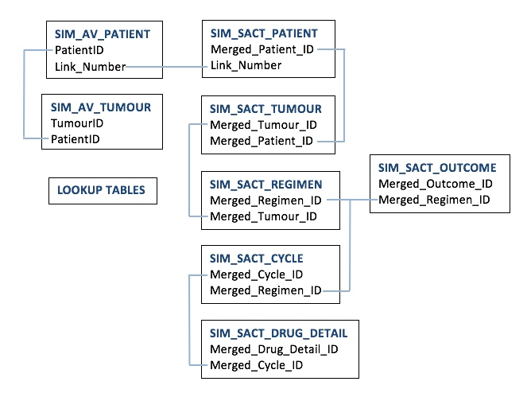
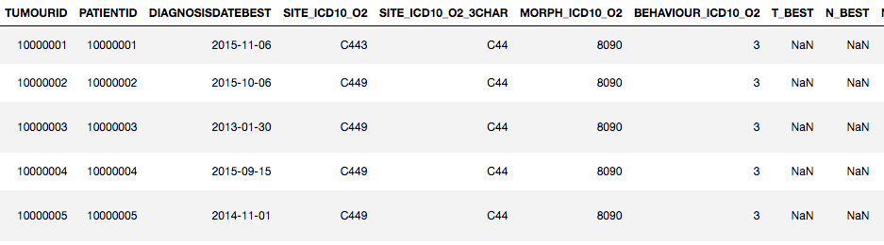
The dataset
Eight tables, can be linked together
Exact same structure and naming as real NCRAS data
Mimics statistical distribution of real cancer data (including flaws)
Notes:
NCRAS : National Cancer Registration and Analysis Service
Names have “sim_” prepended to emphasise that it is simulated
Doesn’t contain any surgical or radiotherapy info, may in the future

Slide 6
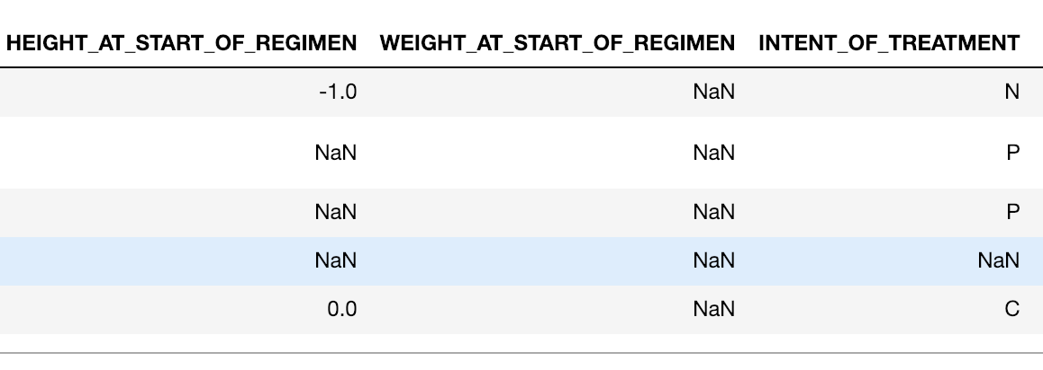
Dataset challenges
Lots of NaNs (incomplete data)
Misspelling of drug names (e.g. Ibritinib, Ibrutanib, Ibrutinib)
Nonsense data e.g. patients listed as “Alive” can have a “Death Cause”
Is the above result of simulation?

Slide 7
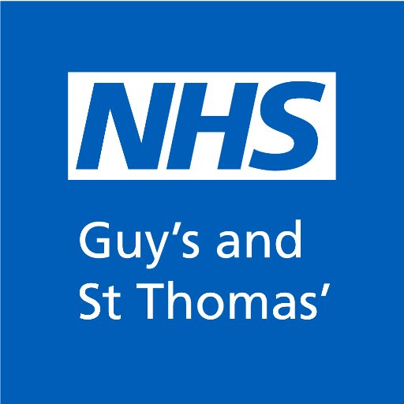
Collaboration
Health data is not our area of expertise
Visited team at Guy’s and St Thomas health informatics
Gave us insight into how data is collected, sources of errors

Slide 8
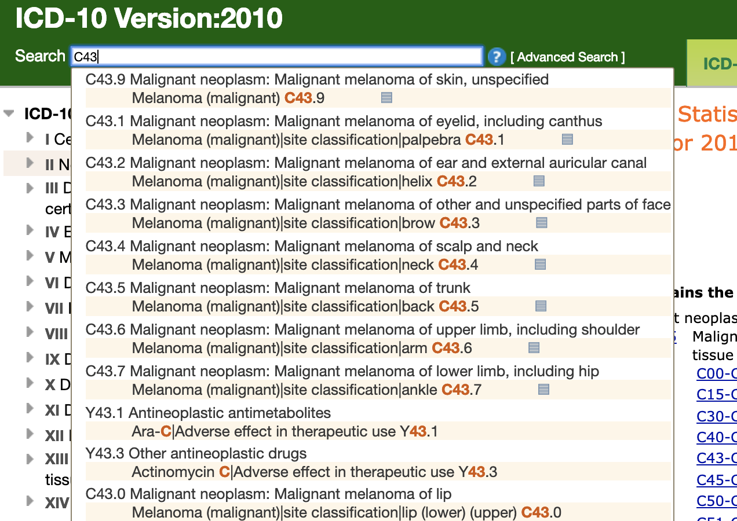
Exploration tools
[ https://icd.who.int/browse10/2010/en#/II ]

Slide 9
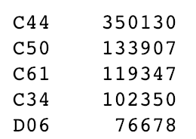
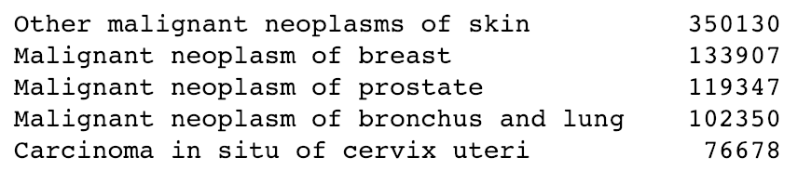
Exploration tools
Python library of look up tables

Slide 10
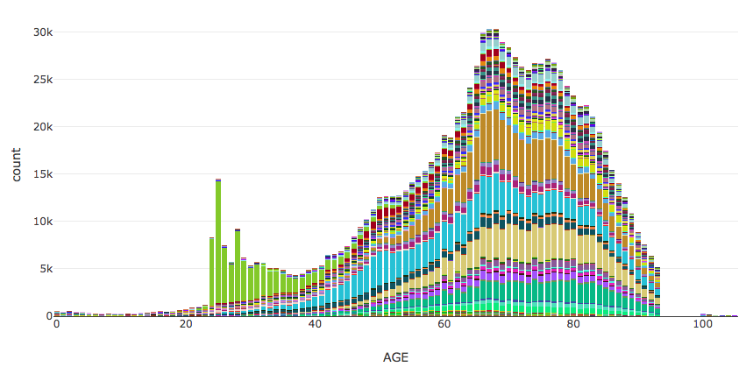
Data Exploration
prostate
breast
lung
cervical : ~50% of max count

Slide 11
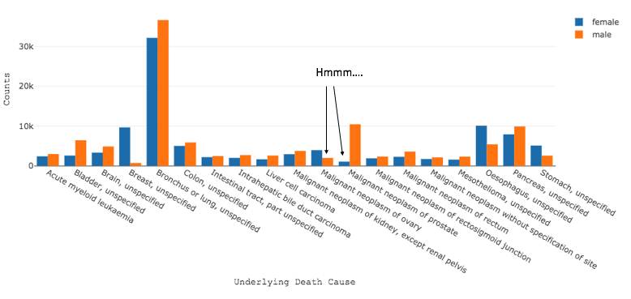
Data Exploration
Notes:
Mention gender anomalies

Slide 12
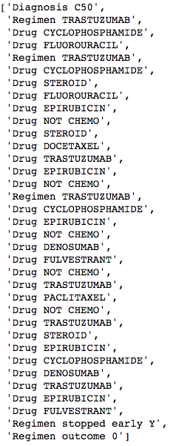

Example
patient pathway:
What are the structures of these pathways?
This is just a sequence of events,
It’s similar to sentences
let’s experiment with some sequence/NLP models!
Notes:
:D Reiterate goal of project
After cleaning data, merge the 8 tables to get a full pathway.
Want to learn structure

Slide 13
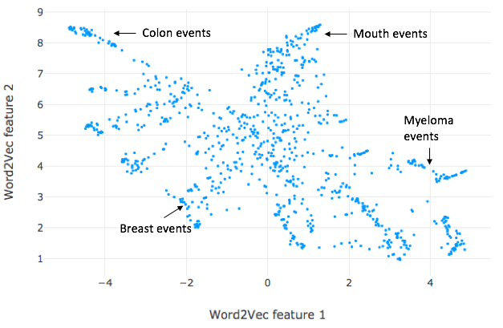
1. Use Word2vec to give each event a vector
2. The direction/size of the vector is such that similar vectors
or events share similar contexts/meaning e.g. drugs that are
used in breast cancer will be close together.
Events in the Word2vec space
This is a way to describe the events in “numbers” so that
you can actually make models with it.
Notes:
An idea we tried from Andre who worked on a similar dataset in the past was to use word2vec on the pathways.
Read rest of slide
Mention vectors are actually 100D but reduced by umap

Slide 14

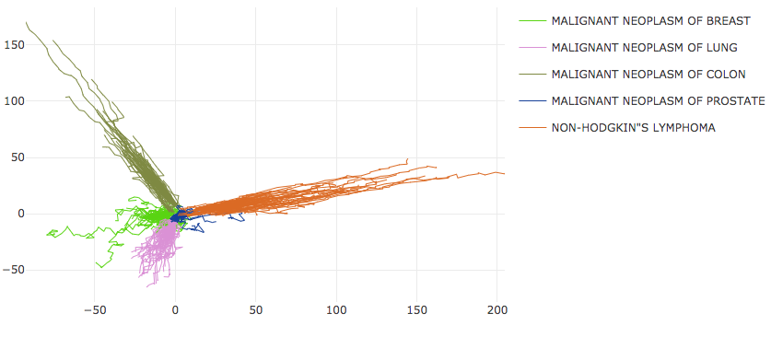
1. Add up all events for each pathway
2. Plot resulting paths
3. Different cancers results in different pathways...
Each line is a
patient pathway
Pathways in the Word2vec space
Cancer type:
Notes:
You can use the word2vec representation to visualize all the pathways
By adding up all the events, read slide
Different cancers go off in different directions

Slide 15
Looks like they clustered well according to cancer type ..
Let’s just work on one of the cancers.
We want to cluster based on:
1. Ordering of events
2. Combination of events
3. Frequency of events
With a basic model and with as little manual work.

Slide 16
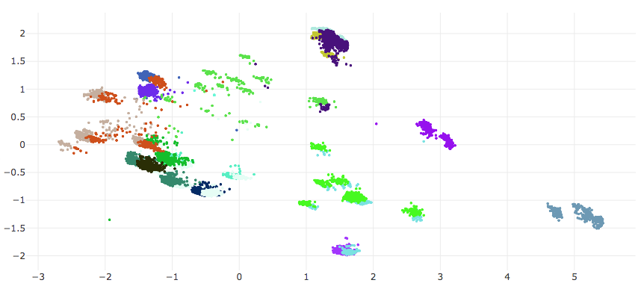
Breast cancer pathway clustering
Each point represents a pathway
Each colour is a cluster
treatment before diagnosis
99% completed treatment
mostly FEC regimen
disease/toxicity
region
combination of drugs:
Tamoxifen
Letrozole
Anastrozole
cyclophosphamide region
Notes:
Here is a plot of the clusters that we found
Each point represents a pathway, each colour represents a different cluster
The annotations describe what distinguishes each cluster
This gives us an overview of the different types of pathways for breast

Slide 17
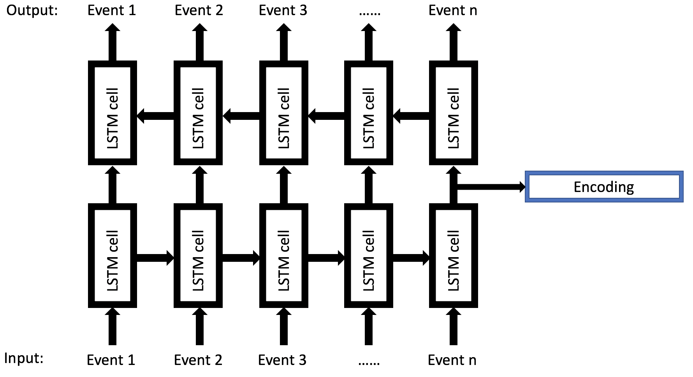
Clustering method :
1. Unsupervised learning with a
Recurrent-Neural-Net (RNN)
2. Learned features are extracted
for each pathway
3. These features are then clustered
with KMeans clustering
['Diagnosis C50',
'Regimen TRASTUZUMAB',
'Regimen TRASTUZUMAB',
'Drug EPIRUBICIN',
'Drug CYCLOPHOSPHAMIDE',
'Drug CYCLOPHOSPHAMIDE',
'Drug TRASTUZUMAB',
'Drug FLUCONAZOLE',
'Drug DOCETAXEL',
'Drug EPIRUBICIN',
'Drug NOT CHEMO']
[86.2,
40.7,
-12.8,
-42.0,
59.8,
34.4,
... ,
42.4,
63.6,
-11.6,
31.0,
-9.2]
Pathway Encoding
Notes:
How did we cluster, there are 3 basic steps
Unsupervised: We are trying to find “labels” to the pathways
RNN: commonly used for sequence data/NLP.
Extract the encoding information for each pathway e.g. length of pathway, come combination of drugs.
Cluster these encodings

Slide 18
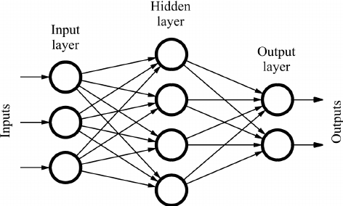
Feedforward Neural Net:
Recurrent Neural Net (RNN):
Feedforward neural net unrolled across
time.
In a cell is a set of weights like
a feedforward NN, and memory from
the past.
You are reusing the same weights in
each cell.
2 inputs: the event and the output
from the last cell.
Long short term memory cell (LSTM):
Internal state of memory inside the cell is such that
it can “remember” long sequences, e.g. in a sentence
“My dog ate a lot, ……………………… , the dog was full”
The information in the beginning is retained through till the end of the RNN.
There are parameters (gates) in the LSTM cell that allows it to forget/remember this information.
Notes:
RNN explained in one slide
Normal feedforward nn inputs hidden layer and output and you train the layers
A RNN

Slide 19
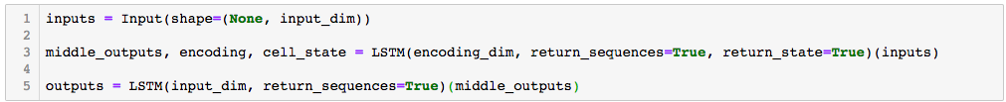
Autoencoder: A NN that learns a representation for a set of pathways.
typically for dimensionality reduction, by training the network to ignore signal “noise.” - Wiki
Basic LSTM autoencoder structure :
Advantages :
1. Can extract information on ordering
and combination of events.
2. Sequence length independent
3. Short training time ~1min for 18000
patients
4. Basic structure and no fine-tuning
means it’s less likely to overfit
to the inaccuracies of the simulation
5. Minimize manual labour e.g. manually
finding a metric for ordering
of events
decoder
encoder
Extract
Notes:
What is an autoencoder,

Slide 20
Dimension reduction with PCA of extracted features 150D -> 2D:
Treatment before diagnosis
99% completed treatment
Mostly FEC regimen
disease/toxicity
region
Combination of drugs:
Tamoxifen
Letrozole
Anastrozole
Cyclophosphamide region
Future uses:
1. Supervised learning to predict the cluster of a patient
i.e. what their pathway will look like
2. Can we generate pathways that have the best outcomes?
3. Can we generate pathways that lead to toxicity/death that are not obvious, in this way
preventing that pathway?

Slide 21
Questions?

Slide 22
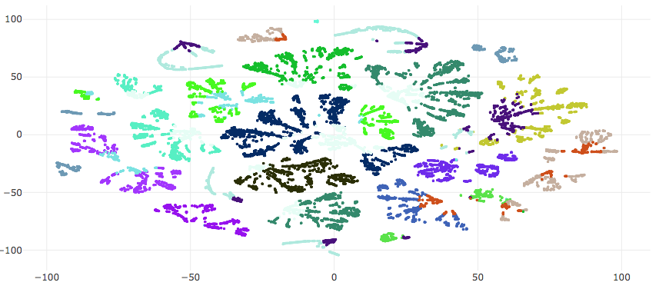
Each point is the
encoding of a pathway
Each colour is a cluster
Input vector for event n
Dimension reduction with TSNE
[1.01,
-1.11,
0.07,
...,
-0.82,
1.13,
-0.26,
days]
The branches form if you
append the number of days
that has passed for a given
event onto it’s input vector
Hypothesis:
As you go along a branch
you are going through “time”

