Slide 1
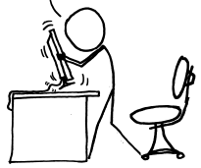
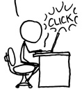
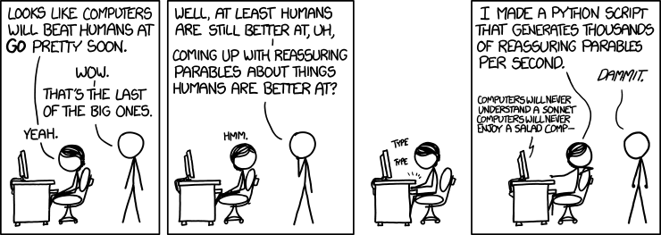
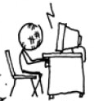
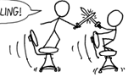

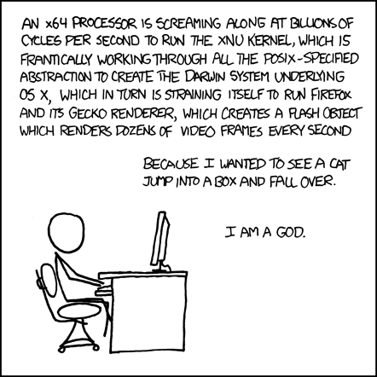
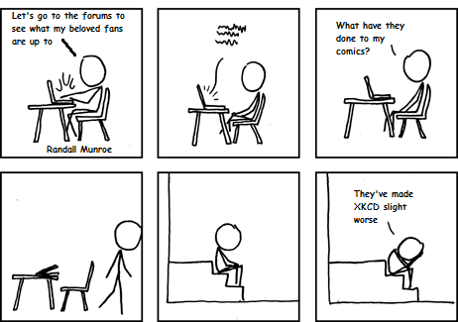
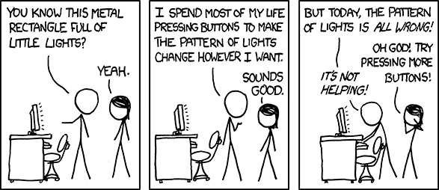
Version Control
with
Git

Slide 2
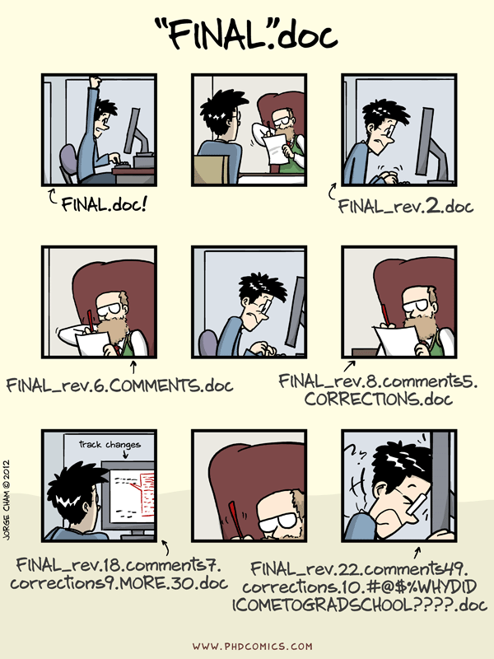

Slide 3
Glossary

Slide 4
Glossary
Version Control: A tool for managing changes to a set of files.

Slide 5
Why use Version Control?

Slide 6
Why use Version Control?
Better kind of backup

Slide 7
Why use Version Control?
Better kind of backup
Collaborative work – conflicts, merging, branching…

Slide 8
Why use Version Control?
Better kind of backup
Collaborative work – conflicts, merging, branching…
Help understand what happened

Slide 9
Why use Version Control?
Better kind of backup
Collaborative work – conflicts, merging, branching…
Help understand what happened
Restoring older code versions

Slide 10
Why use Version Control?
Better kind of backup
Collaborative work – conflicts, merging, branching…
Help understand what happened
Restoring older code versions
Ability to revert when I make a mistake

Slide 11
Why use Version Control?
Better kind of backup
Collaborative work – conflicts, merging, branching…
Help understand what happened
Restoring older code versions
Ability to revert when I make a mistake
Maintain several versions of the code at a time

Slide 12
Why use Version Control?
Better kind of backup
Collaborative work – conflicts, merging, branching…
Help understand what happened
Restoring older code versions
Ability to revert when I make a mistake
Maintain several versions of the code at a time
Jenkins needs it - and we need Jenkins!

Slide 13
Git != GitHub

Slide 14
Git != GitHub
Git: Version Control system tool to manage source code history.
GitHub: Hosting service for Git repositories. It also provides extra functionality like fork, issue tracking, etc.

Slide 15
Ways of working with Git
Git solo (sans GitHub)
Git solo on GitHub
Git in teams (no conflicts)
Git in teams with conflicts

Slide 16
Glossary
Version Control: A tool for managing changes to a set of files.

Slide 17
Glossary
Version Control: A tool for managing changes to a set of files.
Repository: A storage area where a version control system stores old revisions of files and information about who changed what, when.

Slide 18
Basic Git Workflow
The basic Git workflow goes something like this:
1 | You modify files in your working directory
2 | You stage the files, adding snapshots of them to your staging area
3 | You do a commit, which takes the files as they are in the staging area and stores that snapshot permanently to your Git directory

Slide 19
Glossary
Version Control: A tool for managing changes to a set of files.
Repository: A storage area where a version control system stores old revisions of files and information about who changed what, when.

Slide 20
Glossary
Version Control: A tool for managing changes to a set of files.
Repository: A storage area where a version control system stores old revisions of files and information about who changed what, when.
Staging Area: The staging area is a file, generally contained in your Git directory, that stores information about what will go into your next commit.

Slide 21
Glossary
Version Control: A tool for managing changes to a set of files.
Repository: A storage area where a version control system stores old revisions of files and information about who changed what, when.
Staging Area: The staging area is a file, generally contained in your Git directory, that stores information about what will go into your next commit.
Changeset: A group of changes to one or more files that are committed to a version control repository in a single operation.

Slide 22
Glossary
Version Control: A tool for managing changes to a set of files.
Repository: A storage area where a version control system stores old revisions of files and information about who changed what, when.
Staging Area: The staging area is a file, generally contained in your Git directory, that stores information about what will go into your next commit.
Changeset: A group of changes to one or more files that are committed to a version control repository in a single operation.
Commit: To record the current state of a set of files (a change set) in a version control repository. If a commit contains changes to multiple files, all of the changes are recorded together.

Slide 23
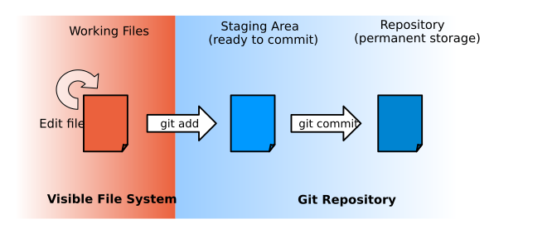

Slide 24
Let’s get started…
Tools we’ll use in these exercises
Git
GitHub
SmartGit
Bash (yes, we’ll first try to do things in Linux, mwa ha ha)

Slide 25
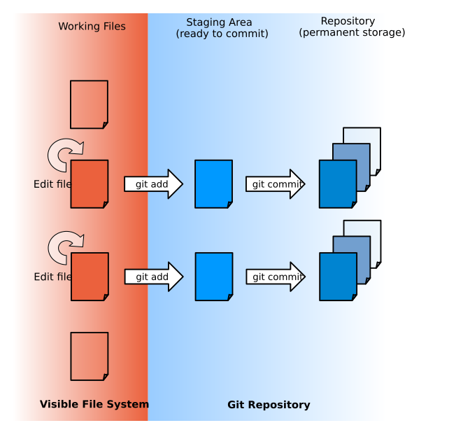

Slide 26
Glossary
Version Control: A tool for managing changes to a set of files.
Repository: A storage area where a version control system stores old revisions of files and information about who changed what, when.
Staging Area: The staging area is a file, generally contained in your Git directory, that stores information about what will go into your next commit.
Changeset: A group of changes to one or more files that are committed to a version control repository in a single operation.
Commit: To record the current state of a set of files (a change set) in a version control repository. If a commit contains changes to multiple files, all of the changes are recorded together.

Slide 27
Glossary
Version Control: A tool for managing changes to a set of files.
Repository: A storage area where a version control system stores old revisions of files and information about who changed what, when.
Staging Area: The staging area is a file, generally contained in your Git directory, that stores information about what will go into your next commit.
Changeset: A group of changes to one or more files that are committed to a version control repository in a single operation.
Commit: To record the current state of a set of files (a change set) in a version control repository. If a commit contains changes to multiple files, all of the changes are recorded together.
Remote: an alias for a different repository from which you may wish to pull or push code.

Slide 28
Glossary
Version Control: A tool for managing changes to a set of files.
Repository: A storage area where a version control system stores old revisions of files and information about who changed what, when.
Staging Area: The staging area is a file, generally contained in your Git directory, that stores information about what will go into your next commit.
Changeset: A group of changes to one or more files that are committed to a version control repository in a single operation.
Commit: To record the current state of a set of files (a change set) in a version control repository. If a commit contains changes to multiple files, all of the changes are recorded together.
Remote: an alias for a different repository from which you may wish to pull or push code.
Origin: default name of the remote git repository you cloned from.

Slide 29
Undoing things
Tools we’ll use in these exercises
Git
GitHub
SmartGit
Bash (yes, we’ll first try to do things in Linux, mwa ha ha)

Slide 30
Glossary
Version Control: A tool for managing changes to a set of files.
Repository: A storage area where a version control system stores old revisions of files and information about who changed what, when.
Staging Area: The staging area is a file, generally contained in your Git directory, that stores information about what will go into your next commit.
Changeset: A group of changes to one or more files that are committed to a version control repository in a single operation.
Commit: To record the current state of a set of files (a change set) in a version control repository. If a commit contains changes to multiple files, all of the changes are recorded together.
Remote: an alias for a different repository from which you may wish to pull or push code.
Origin: default name of the remote git repository you cloned from.

Slide 31
Glossary
Version Control: A tool for managing changes to a set of files.
Repository: A storage area where a version control system stores old revisions of files and information about who changed what, when.
Staging Area: The staging area is a file, generally contained in your Git directory, that stores information about what will go into your next commit.
Changeset: A group of changes to one or more files that are committed to a version control repository in a single operation.
Commit: To record the current state of a set of files (a change set) in a version control repository. If a commit contains changes to multiple files, all of the changes are recorded together.
Remote: an alias for a different repository from which you may wish to pull or push code.
Origin: default name of the remote git repository you cloned from.
HEAD: a bookmark pointing to the latest change in the current branch.

Slide 32


Slide 34


