Slide 1
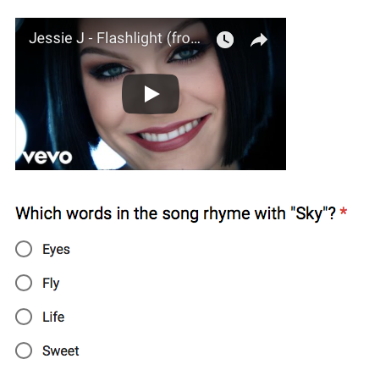

/songs
/songs/<id>
/songs/<id>/lyrics
/songs/<id>/lyrics?start=1:00&end=1:30
ORM
Rhyme Detection
/words/<word>
/words/removeStopWords
/words/<word>/confusingWords
/words/compare?word1=<w1>&word2=<w2>
Akka-http
/users/<id>
/users/login
/users/<id>/logout
/users/<id>/scores
Lyrics
DB
Users DB
Words DB
WordNet

