Slide 1
STIR
Software for Tomographic Image Reconstruction
http://stir.sourceforge.net

Slide 2
Contents
10:30-11:00 Kris Thielemans
Introduction to STIR - History - version 2.1
11:00-11:25 Charalampos Tsoumpas
PET Quantification using STIR
11:25-11:40 Nikolaos Dikaios
Image Reconstruction and Motion Correction Using STIR
11:40-11:55 Nikolaos Karakatsanis
Contribution of STIR to GATE simulation studies for the evaluation of radionuclide imaging systems
Q&A session

Slide 3
STIR: Part I
What is it and how did it happen?

Slide 4
STIR objectives
Open Source software for image reconstruction and data manipulation in medical imaging (but currently only PET)
Research enabler
Extendable and modular

Slide 5
STIR current features
Users’ perspective
  PET (2D/3D)
  Support for any cylindrical PET scanner
  Analytic and iterative 3D reconstruction algorithms
    FBP, SSRB, OS-MAP-OSL (including MRP), OS-SPS
  Various utilities (e.g. precorrection. ROI, …)
  Multi-platform (Unix, Linux, Windows, MacOS X)
  Test suite
Developers’ perspective
  Object-oriented (C++) and modular
  Fully (?) documented (doxygen)

Slide 6
History: PARAPET
European Union funded project (ESPRIT), 3 years (end March 2000)
Aim: Implementation and Evaluation of Reconstruction algorithms for fully 3D PET with feasible run-time
  Algorithm development, parallel hardware
Partners
  Hammersmith Hosp. - MRC, London, UK,
  Terry SPINKS
  Brunel Univ, Dept of Math. Sciences, London, UK,
  Gautam MITRA
  Ospedale San Raffaele (HSR), Milan, Italy,
  Maria Carla GILARDI
  Technion - Israel Inst of Techn, Optimization Center, Haifa, Israel,
  Aharon BEN-TAL, Roni LEVKOVITZ
  ELGEMS Ltd., Haifa, Israel,
  Michael WILK
  Geneva Univ Hosp (HUG), Div. of Nucl. Med., Geneva, Switzerland,
  Christian MOREL
  Parsytec GmbH, Aachen, Germany,
  Carsten RIETBROCK, Stefan KAISER, Volkmar FRIEDRICH

Slide 7
PARAPET Programmers
  Zverovich, Alexey (Brunel)
  Zibulevsky, Michael (MOC)
  Zaidi, Habib (HUG)
  Valente, Patrick (Brunel)
  Thielemans, Kris (MRC)
  Sauge, Damien (HUG)
  Sadki, Mustapha (Brunel)
  Pagani, Elizabetta (HSR)
  Mustafovic, Sanida (MRC)
  Labbe, Claire (HUG)
  Jacobson, Matthew (MOC)
  Hague, Darren (Brunel)
  Gordon, Ekaterina (MOC)
  Belluzzo, Damiano (HSR)

Slide 8
STIR over the years
PARAPET is Dead, Long Live STIR!
Time line
  Stir 1.0 (December 2001)
  Stir 1.4 (January 2006)
  Stir 2.0 (June 2009)
  Stir 2.1 beta (now)
  Current Users
  Registrations ~ 700
  Announcements mailing list ~ 190 subscribers
  Users’ mailing list ~ 160 subscribers
  Developers’ mailing list ~ 65 subscribers

Slide 9
STIR 2.0 changes w.r.t. 1.x
  Objective function hierarchy
  (Poisson, sinogram vs list mode)
  IO factories
  (easier to add new file formats)
  External contributions:
  Basic support for SimSET
  P. Aguiar (Univ of Barcelona, Spain), C. Tsoumpas, N. Dikaios (NTUA, Greece) and K. Thielemans
  Initial version for parallelisation of OSMAPOSL using MPI
  T. Beisel and S. Lietsch (Univ of Paderborn, Germany)
  3D boxes and wedges as shape
  C. R. Schmidtlein and A. S. Kirov

Slide 10
Main new features in STIR 2.1
  3D scatter estimation
  Parametric image reconstruction
  (kinetic modelling)
    Indirect method (Patlak only at present)
    Direct from sinograms (Patlak-model, but ready for other linear models)
  OSSPS emission reconstruction algorithm

Slide 11
Some Results
Illustrative

Slide 12


Regularisation and object-dependent resolution
EMML with spatially invariant inter-filtering
Results from S. Mustafovic and K. Thielemans

Slide 13
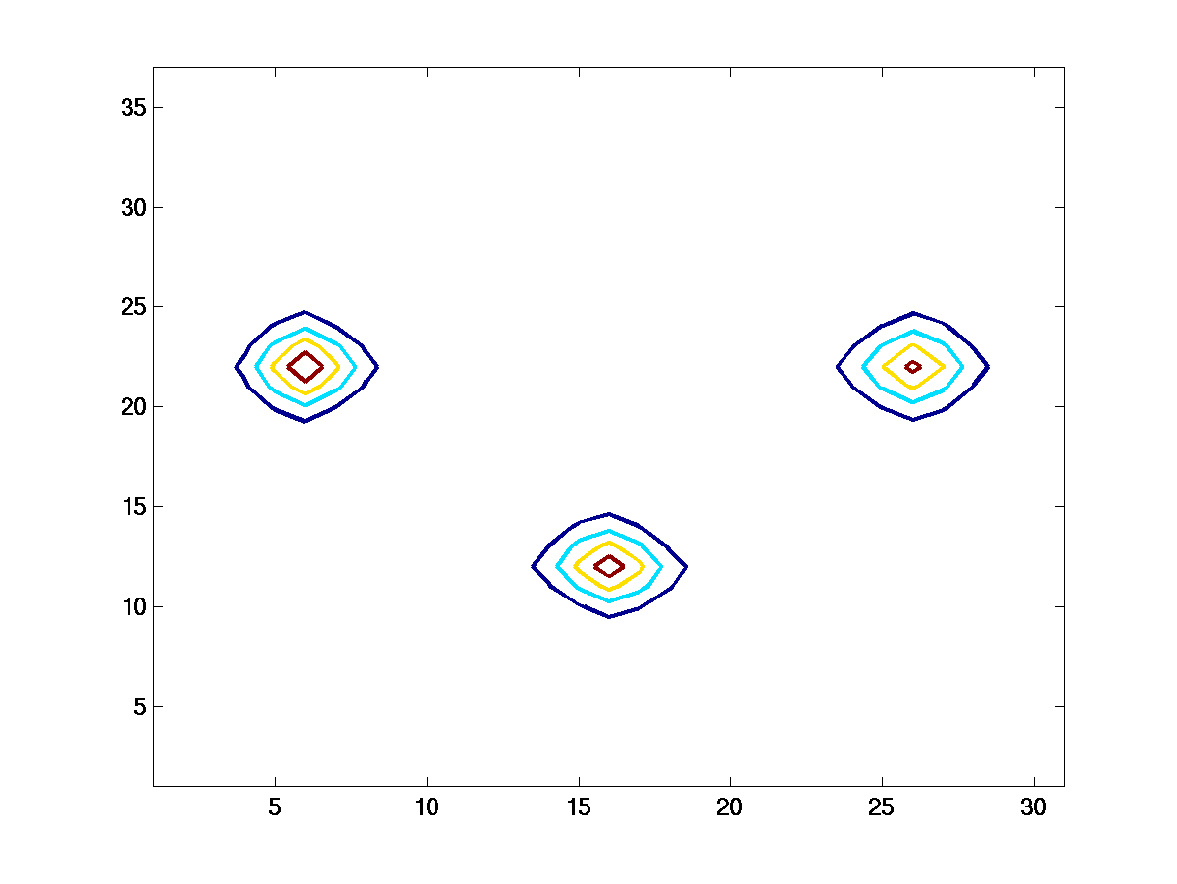
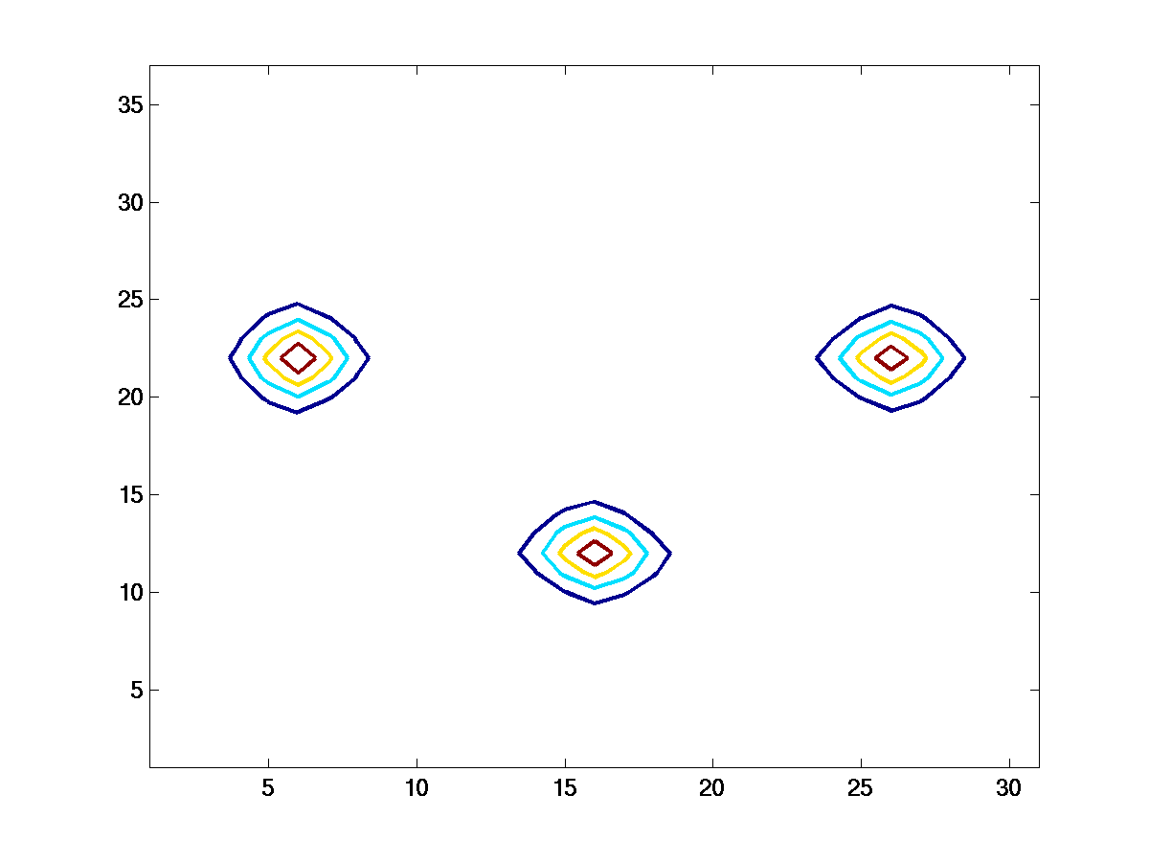
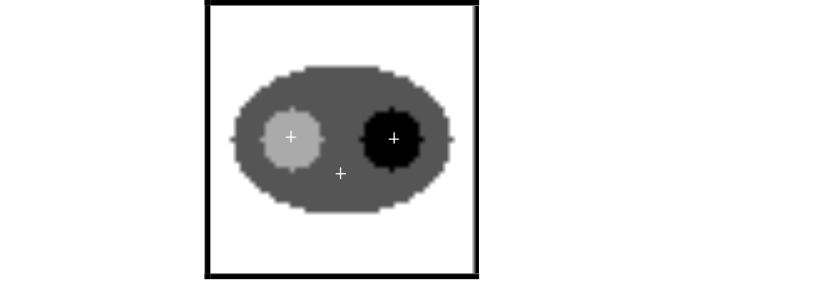
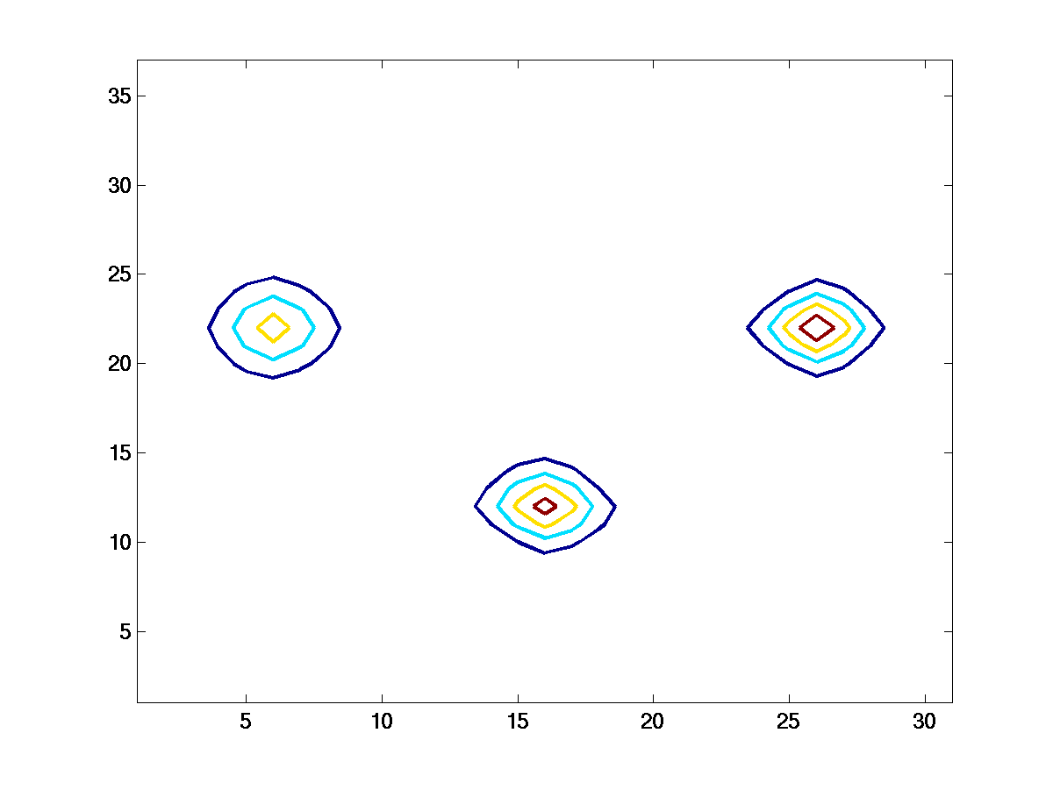
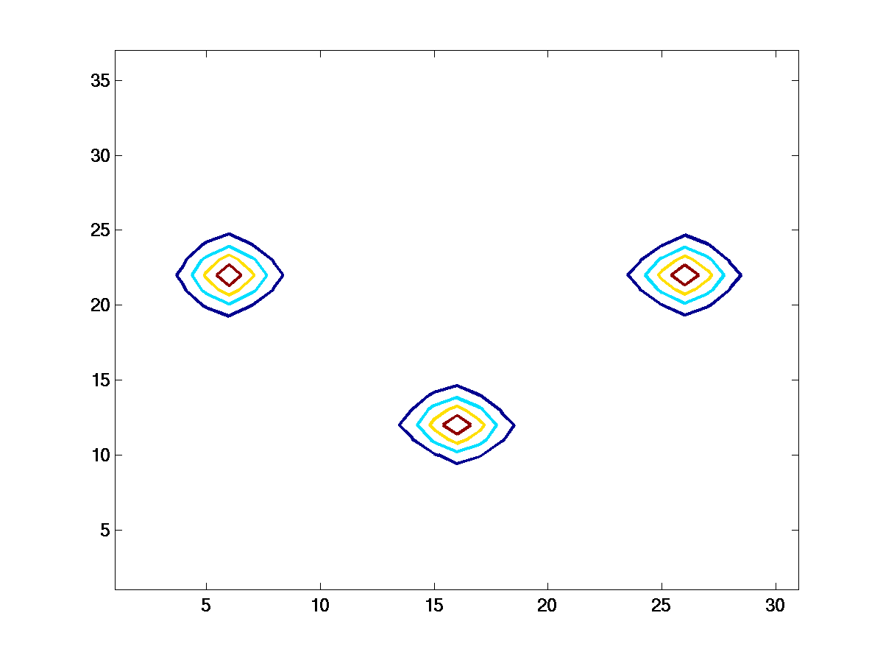
LLIR (Localised Linear Impulse Response)
Non-varying QP
Certainty Based QP
MAP
OSEM-IF
SPS-IF
Inter-iteration filtering
Results from S. Mustafovic and K. Thielemans

Slide 14
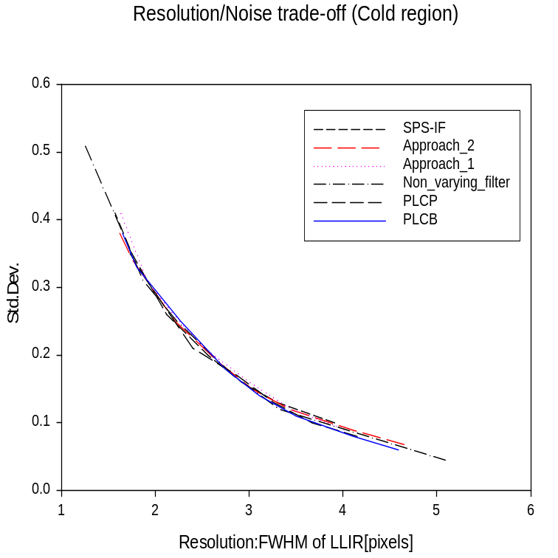
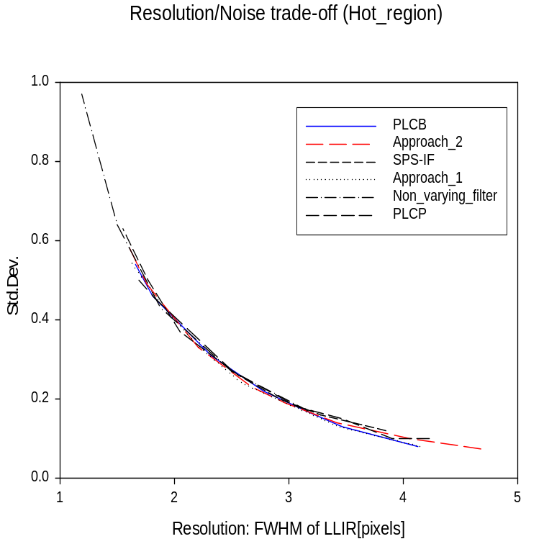
Noise vs. Variance Trade-Off for different regularisation schemes
pixel variance vs. FWHM
Results from S. Mustafovic and K. Thielemans

Slide 15
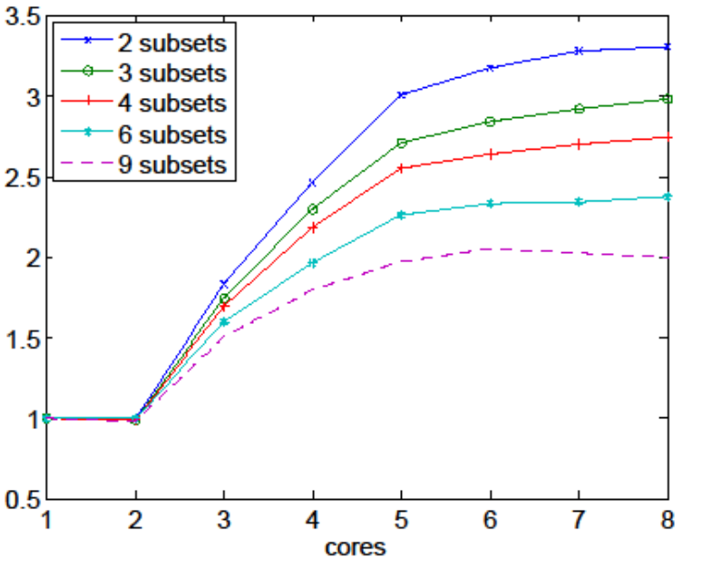
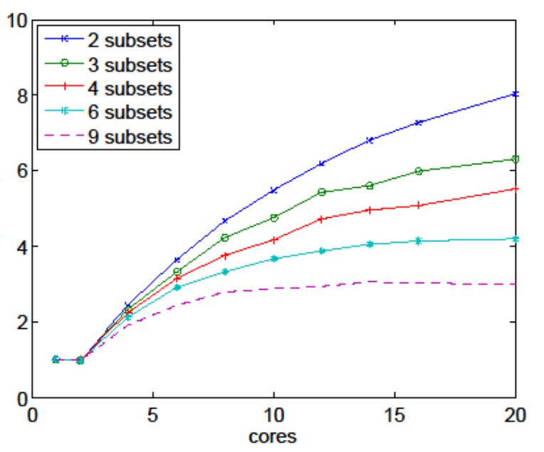

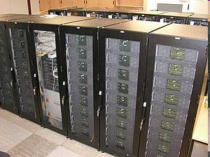
Parallel implementation of OSMAPOSL
Implemented in MPI (Message Passing Interface)
Note different axes
Example parallel architectures
Shared Memory
Distributed Memory
_{Intel Xeon Clovertown System}
Xeon DP based ‘ARMINIUS‘ cluster
Shared memory (8 GB, FSB connected)
Short communication distances
Restricted number of nodes (8)
Distributed memory (900 GB, InfiniBand connected)
Long communication distances
Extendable number of nodes (400 available)
Results from T. Beisel et al

Slide 16
Example timings
Single forward projection of a 32 ring scanner (288x288 sinograms):
Intel® CoreTM Duo CPU T2300 @ 1.66GHz (my laptop)
 | #elems | Gcc 3.4 | Gcc 4.3
Span 9, mash 2 | ~1 | 70 | 34
Span 3, mash 1 | ~5 | 290 | 144
Span 1, mash 1 | ~7.5 | 625 | 345
Intel® Xeon ® CPU X5355 @ 2.66GHz
 | #elems | Gcc 3.4 | Gcc 4.3
Span 9, mash 2 | ~1 | 20
Span 3, mash 1 | ~5 | 84
Span 1, mash 1 | ~7.5 | 230

Slide 17
STIR: part II
Software Overview

Slide 18
STIR content (highlights)
Data structures
    e.g. n-dimensional arrays, images, sinograms, list mode data …
Registries and Parsing classes
    For setting/saving parameters at run-time
Reconstruction classes
    Analytic: FBP, 3DRP; SSRB
    Iterative: OSEM, OSL (including MRP), OS-SPS
      all sharing common code-base
      either 2D/3D sinograms (list mode data soon)
      inclusion of terms for normalisation, attenuation, scatter and randoms
Utilities
    pre-correction, filtering, arithmetic processing of image or sinogram data, ROI evaluation etc.

Slide 19
Object-oriented programming
Principle
  self-contained objects with public ‘interface’
    hide internal data-structure
      complex.real(), complex.imag(),
      complex.norm(), complex.phase()
  inheritance allows specialisation
      Car -> SportsCar -> F1-Car
      Car.drive(distance)

Slide 20
Object-oriented programming
Advantages
  modularity & robustness:
  each class can be developed/tested ‘independently’
  flexibility:
  data-representation can be adapted to situation
  generality:
  ‘generic’ programming in terms of base-classes
  extendability:
  new extensions can benefit from old code by inheritance
  ease-of-use for the ‘user’

Slide 21
Example code
//////////////// read in data
shared_ptr<ProjData> proj_data_sptr =
ProjData::read_from_file(input_filename);
shared_ptr<ProjDataInfo> proj_data_info_sptr =
proj_data_sptr->get_proj_data_info_ptr()->clone();
shared_ptr<DiscretisedDensity<3,float> > density_sptr =
read_from_file(filename);
density_sptr->fill(0);
/////////////// back project
BackProjectorByBinUsingInterpolation back_projector;
back_projector.set_up(proj_data_info_sptr, density_sptr);
back_projector.back_project(*density_sptr, *proj_data_sptr);
/////////////// output
OutputFileFormat<DiscretisedDensity<3,float> >::default_sptr()->
write_to_file("output", *density_sptr);

Slide 22
Templates
Single definition of a function/class independent of type with optimal run-time
template <typename T>
T max(const T x, const T y)
{ return x>y ? x : y; }
template <typename targetT>
class OSMAPOSLReconstruction;

Slide 23
STIR is Open Source

Slide 24
License
PARAPET license
  No restrictions, but give credit to PARAPET partners
Lesser GNU Public License (LGPL) for library
  ‘free’, redistribution: source code most be available and modifications have to be included (and LGPL’ed)
GNU Public License (GPL) for applications
  LGPL+ redistribution: whole application must be GPL
Free, but NO warranty

Slide 25
How to get it?
Email registration process via
http://stir.sourceforge.net
Join mailing lists
  Stir-announce
  Stir-users
  Stir-devel

Slide 26
How to contribute?
Software
  Copyright transfer to Hammersmith Imanet Ltd. We will then distribute the code under LGPL license
Time
  Help out on mailing lists

Slide 27
STIR
Software for Tomographic Image Reconstruction
http://stir.sourceforge.net
Notes:
The Developers mailing list is used to discuss implementation details and new additions to the library. So, people subscribed to this list are more than users, i.e. they might (at some point) use STIR to build their own programs. For some of these, I know they will contribute code back to us. Examples of this are
I ‘outsourced’ the development and testing of our implementation of the FORE algorithm (based on previous work during PARAPET) to Heidelberg.
Scatter correction code has been contributed by Rossendorf (but needs to be integrated into STIR)
The Crystal Clear Collaboration is contributing their List mode format library (used on the ClearPET scanner, but also in the OpenGate Monte Carlo simulator).

