Slide 1
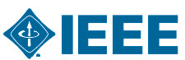

Satellite Workshop on Open Source Software in Medical Imaging
Saturday, 7th November 2015
IEEE NSS MIC, San Diego

Slide 2
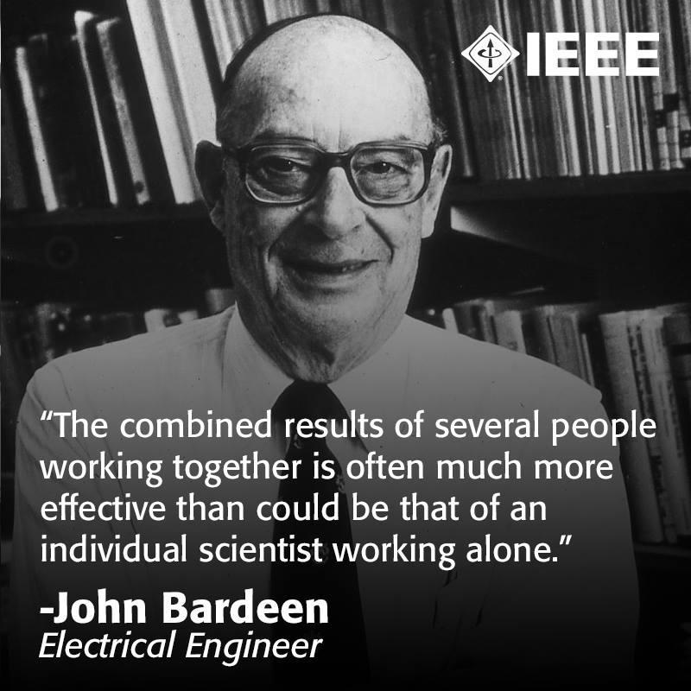
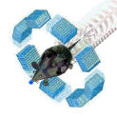


Open Source: a matter of vision
Common platform for research
Common platform for development
Interaction with other packages
Rigorous validation & testing by the community
Speeds up scientific discoveries & technological evolution
Great examples with demonstrated impact
GATE

Slide 3
13:00 – 16:30 Software Focused on Image Reconstruction
(13:00) Open Source Software Focused on Image Reconstruction (Tsoumpas, Leeds)
(13:05) STIR: Software for Tomographic Image Reconstruction (Thielemans, London)
(13:35) Occiput: Unified PET, MR and SPECT Reconstruction
(Pedemonte, Boston)
(14:05) CASTOR: Customizable and Advanced Software for Tomographic Reconstruction (Merlin, Brest)
(14:35) A Python Library For Inverse Problems
(Adler, Stockholm)
(15:05) The ASTRA Toolbox: Fast and Flexible Tomographic Reconstructions (van Aarle, Antwerp)
(15:35) Gadgetron: An Open Source Framework for Medical Image Reconstruction (Hansen, Bethesda)
(16:05) Discussion

Slide 4
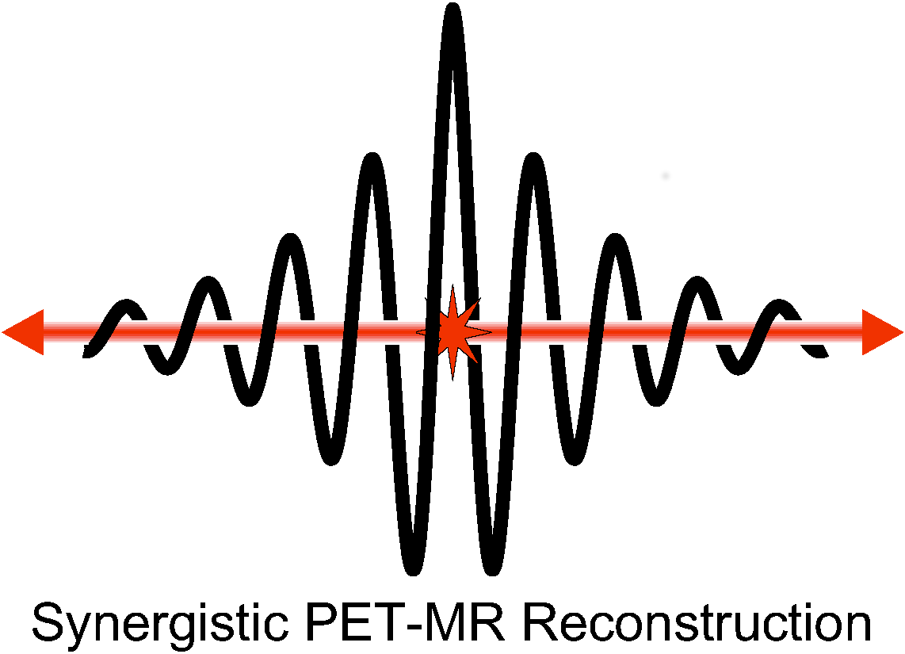
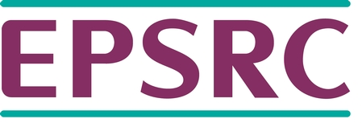

Acknowledgments
CCP PET-MR
Coffee & Cookies available thanks to kind sponsorships by General Electric Global Research Center & EPSRC CCP-PET-MRI
Thanks to the IEEE NSS-MIC organizing committee & support team

