Slide 1
Introduction to Programming with Python – Basics
Swapnil Sayan Saha and Noor Nakhaei
PhD Students, ECE and CS
swapnilsayan@g.ucla.edu,
noornk@ucla.edu
Note: modified from original LACC slides by Dr. Lucas Wanner, Prof. Mani Srivastava, Dr. Mark Gottscho, Dr. Bharathan Balaji, Wojciech Romaszkan, Aishwarya Sivaraman, Lev Tauz, Ankur Sarker, Sandeep Singh Sandha and Shuyang Liu
Slides taken from UCLA-LACC Intro module

Slide 2
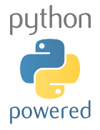
Why do we choose Python?
Relatively simple syntax.
Relatively easy to debug.
Availability of open-source tools and modules/libraries for eclectic applications with large development community.
Platform agnostic (runs anywhere).
Broad application spectrum, e.g. web applications / frameworks, standalone applications, video games, data science, artificial intelligence, machine learning, embedded systems etc.
Notes:
Show the Python’s advantages. Compare them with English to make Python more familiar to students.

Slide 3

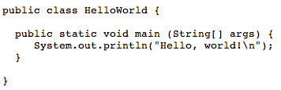
How simple is Python?
To print “Hello world!” on screen, C, Java and Python need to do:
C:
Java:
Python:
Notes:
Compare C, Java and Python’s ways to print “Hello world!”. This proves that Python gives the simplest way to print it.

Slide 4





Find Python around you
Python is used everywhere!
Web applications (server side):
YouTube
Facebook
Dropbox
Pinterest
MoinMoin, a popular wiki engine
Notes:
Show the web applications in Python.

Slide 5



Find Python around you
Python is used everywhere!
Applications (client side):
Original BitTorrent client, along with several derivatives
Ubuntu Software Center, a graphical package manager
Dropbox (desktop application)
Mercurial
Notes:
Show the applications written in Python.

Slide 6


Find Python around you
Python is used everywhere!
Web frameworks:
Google App Engine
Django
Notes:
Show the web frameworks written in Python.

Slide 7


Find Python around you
Python is used everywhere!
Video games:
Civilization IV
Battlefield 2
Notes:
Show the video games written in Python.

Slide 8
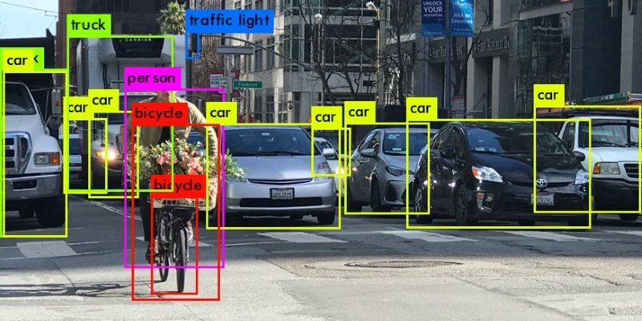


Find Python around you
Python is used everywhere!
Machine Learning:
Pytorch
Tensorflow
Notes:
Show the video games written in Python.

Slide 9
Getting Python
Python Official Website: http://www.python.org
Lots of “packages” that add capabilities to the basic language and “tools” that make writing, running, and debugging easier
Free and commercial “distributions” that bundle core Python with useful packages and tools and simplify installation, e.g.
Anaconda: https://store.continuum.io/cshop/anaconda/
Enthought Canopy: https://www.enthought.com/products/canopy/
Browser-based Python (limited functionality)
http://www.tutorialspoint.com/ipython_terminal_online.php
http://www.tutorialspoint.com/execute_python_online.php
http://repl.it/languages/Python
http://pythonfiddle.com

Slide 10
Free Python Learning Material on the Web
Official Tutorial: https://docs.python.org/2/tutorial/
TutorialsPoint: http://www.tutorialspoint.com/python/index.htm
Google: https://developers.google.com/edu/python/
LearnPython: http://www.learnpython.org
Code Academy: http://www.codecademy.com/en/tracks/python
And many many more…

Slide 11
Jupyter Notebooks and Google Collab
Jupyter Notebook App is an application running inside the browser. It allows you to edit and run code via a web browser.
It is a document that contains code ( e.g. python) and text elements.
For this course, we will be using Jupyter notebooks (.ipynb files) with Google Collab.
How to use Google collab?
https://www.youtube.com/watch?v=RLYoEyIHL6A
Importing Jupyter notebooks in Collab from Github: https://www.youtube.com/watch?v=jjdBbqV7q8s

Slide 12

Python Basics: Variables, Types & Operators
What is a Variable?
A variable is a place in memory, which has a name, and where you can store a value (a number, phrase, etc.).
Assigning Values to Variables:
Python variables are declared automatically when you assign a value to a variable.
The equal sign ( = ) is used to assign values to variables.
Values may be of different “types”
Common Data Types: int, str, float, bool, list, dictionary
Operators perform arithmetic and logical operations over variables and values.
Notes:
In computing, memory refers to the state information of a computing system, as it is kept active in some physical structure. By design, the term “memory” refers to temporary state devices, whereas the term “storage” is reserved for permanent data.

Slide 13
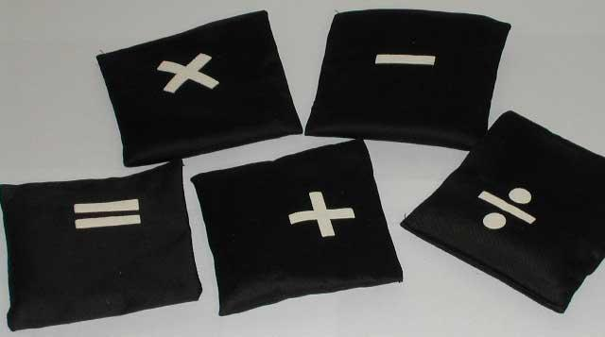
Python Operators
What is an operator?
Python operators are very similar to the mathematical operators we use everyday. For example, +, -, *…
Notes:
Introduce Python operators.

Slide 14
Python Basic Operators
Python Operator Types:
Arithmetic Operator
Comparison Operators
Logical (or Relational) Operators
Assignment Operator
Notes:
The basic python operator types.

Slide 15

Python Arithmetic Operators
Assume variable a holds 10 and variable b holds 20 then:
Addition | a + b = 30
Subtraction | a - b = -10
Multiplication | a * b = 200
Division | b / a = 2
Reminder | b % a = 0
Exponent | a ** b = 10²⁰
Notes:
Show how the arithmetic operators work with the examples in the table.

Slide 16
Python Arithmetic Assignment Operators
Assume variable a holds 10 and variable b holds 20 then:
Addition | a += b | a=30
Subtraction | a -= b | a = -10
Multiplication | a *= b | a = 200
Division | b /= a | b = 2
Reminder | b %= a | b= 0
Exponent | a **= b | a = 10²⁰
Notes:
Show how the arithmetic operators work with the examples in the table.

Slide 17



Python Comparison Operators
Assume variable a holds 10 and variable b holds 20 then:
Equality | a == b = False
Inequality | a != b = True
Less than | a < b = True
Greater than | a > b = False
Less than or equal | a <= b = True
Greater than or equal | a >= b = False
Notes:
Show how the comparison operators work with the examples in the table.

Slide 18
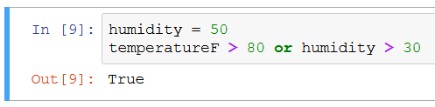
Python Logical Operators
Assume variable a holds True and variable b holds False then:
Logical AND | a and b = False
Logical OR | a or b = True
Logical NOT | not a = False
Notes:
Show how the comparison operators work with the examples in the table.

Slide 19
Python Data Types
In computer programming, a data type is a classification identifying one of various types of data, just like in real life we separate words “Hello!” and numbers “12345”.
Standard Data Types in Python:
Numbers, e.g., 1000
String, e.g., “Hello world!”
Boolean e.g. True or False
List, a container e.g., [365, 12, 30] or [“hi”, “every”, “body”]
Dictionary, a key-indexed container.
Notes:
We introduce the five standard data types in Python here. In the following slices, we will study them in more detail.

Slide 20
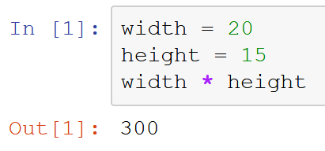
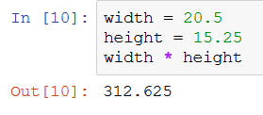
Python Types: Numbers
Numbers
Store numeric values,
Example:
In this example, “width = 20” defines variable width to be 20, and “height = 15” defines height to be 15. This sort of number is called integer or int.
After initializing width and height, we can calculate width * height as shown in the example.
To use real numbers (also called float / double),, add a dot:
Notes:
Provide an example for number variables.

Slide 21
Warm-up
Start up the Jupyter notebook in Google Collab
Do the “Warm-up” part (instructions included)

Slide 22
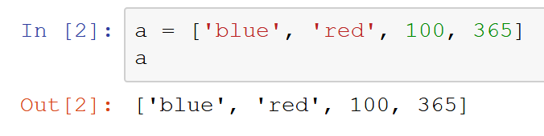
Python Types: Lists
Lists:
Lists are the most versatile of Python’s compound data types. A list contains items separated by commas and enclosed within square brackets.
Example:
In this example, we assign four items to list a. The items are string ‘blue’, string ‘red’, number 100, and number 365.
We print a’s items in the second command, and get its four items printed.
Note that items in the list have different types (string and int) – this is not common among programming languages.
Notes:
Show the concept of lists, and show an example.

Slide 23
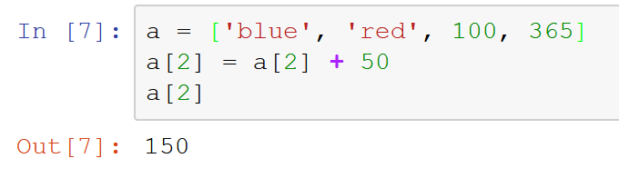
Python Types: Lists
Lists:
It is possible to change individual elements of a list.
Example:
In this example we modify the third element in the list by adding 50 to its value
We then print the third element by using name[index]
Note that list’s subscript starts from 0
Notes:
Another example for list variables.

Slide 24
Python Types: Lists
Lists:
Many “operations” and “methods” available for lists:
+ sort, concatenate, insert, sum and many more at: https://docs.python.org/2/tutorial/datastructures.html#more-on-lists
Is the value in the list? | 100 in a = True
Is the value not in the list? | ‘yellow’ not in a = True
Length of the list | len(a) = 4
Index of an element | a.index(‘red’) = 1
Append element | a.append(10)
Reverse the list | a.reverse()
Notes:
Another example for string variables.

Slide 25
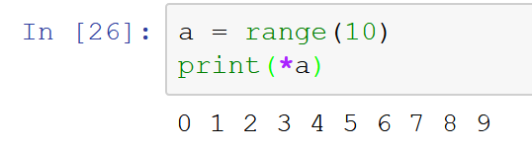
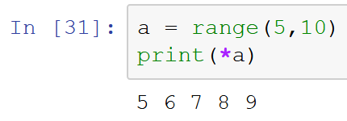
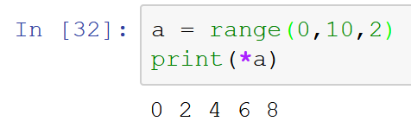
Python Types: Range
Creating number sequences:
range(n) for integer n > 0 returns the list [0, 1, … n-1]
range(m,n) returns the list [m, m+1, … n-1]
range(m,n,o) returns the list [m, m+o, … n-1]
Notes:
Another example for list variables.

Slide 26
Exercise # 1
Go to Exercise 1 section in your Jupyter Notebook
Given a list L = [2, 3, 4, 5, 6]
Print the second item in this list.
Get the sum of all the values in this list.
Append value 7 after value 6 into the list.
Using range, print all the even numbers from 4 to 12.
Look at https://docs.python.org/2/tutorial/datastructures.html#more-on-lists for various methods available for list data type

Slide 27
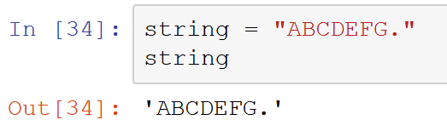
Python Types: Strings
Strings:
Strings in Python are identified as a contiguous set of characters in between quotation marks.
A String is a list of characters or char data types where each char specifies the symbol.
Example:
In this example, we assign “ABCDEFG.” to variable string. And we print string. The result we get is still “ABCDEFG.”
You can use double “ or single ‘ quotation marks for strings in Python, they are equivalent.
Notes:
Show the concept of strings, and show an example.

Slide 28
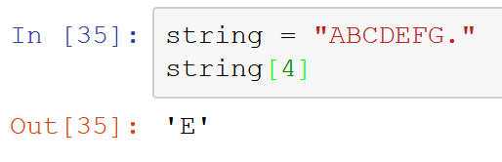
Python Types: Strings
Strings:
Strings can be subscripted (indexed). This is because they are essentially lists of characters.
Example: In the string defined as str = “ABCDEFG.”, we query the fifth letter in this string.
Because it’s a list, first letter has index 0
Notes:
Another example for string variables.

Slide 29
Python Types: Strings
Strings:
Many “operations” and “methods” available for strings:
and many more at https://docs.python.org/2/library/stdtypes.html#string-methods
Is the letter in the string? | ‘A’ in string = True
Is the substring in the string? | ‘CDE’ in string = True
Length of the string | len(string) = 8
Index of a letter (first) | string.index(‘A’) = 0
Append element | string + “Z” = “ABCDEFG.Z”
Make lowercase | string.lower() = “abcdefg.”
Notes:
Another example for string variables.

Slide 30
Exercise # 2
Go to Exercise 2 section in your Jupyter Notebook
Given a string S: “This is an example string”
Print the fifth letter in the string.
Capitalize all letters.
Replace spaces with hyphens (a bit more advance).
Look at https://docs.python.org/2/library/stdtypes.html#string-methods for various methods available for list data type

Slide 31
What will we cover on Monday?
Review of basics if necessary
Computer fundamentals
Python concepts:
Splicing
Dictionaries
Control Flow and Decision Making
Loops
Functions
Python Modules and Namespaces
Recursion
Assignments

