Slide 1
Deep Hyperspectral Imager
EE202A/ CS213A- Embedded Systems – Presentation
Members: Project Mentors:
Aman Srivastava Mani Srivastava
Shoban Narayan Ramesh
Shreya Ramaprasad

Slide 2
Objective
To create an imaging device that augments an RGB with additional modalities : RF, acoustic, depth and thermal.
Each of these modalities provide different information about the scene and the project aims to create a platform to fuse these multimodal images.
The end goal of the project is to have a platform which allows to visualize multi-modal images and train them for object detection.
Applications of Multi-modal imaging
Person recognition: Optical + Acoustic + Depth
Surveillance under low ambient lighting conditions (Night Vision)

Slide 3
State of the Art [1] Multimodal medical image fusion algorithms have shown notable achievements in improving clinical accuracy of decisions based on medical images. Some of the medical image fusion approaches include: Morphological Fusion of CT and MRI image. Make use of morphological operators such as opening , closing. A sequence of operations help to identify scale specific features. Wavelet Extract the detail information from one image and inject it into another. Neural networks They make use of some visible features in the images for calibration [1] ‘A.P. James, B. V. Dasarathy, Medical Image Fusion: A survey of the state of the art, Information Fusion, 2014’ [2] ‘Spatial Fusion of Different Imaging Technologies Using a Virtual Multimodal Camera Sebastian P. Kleinschmidt(B) and Bernardo Wagner’

Slide 4
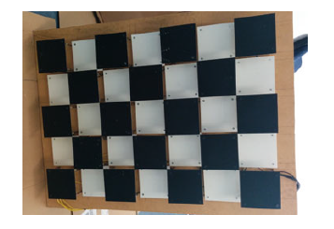
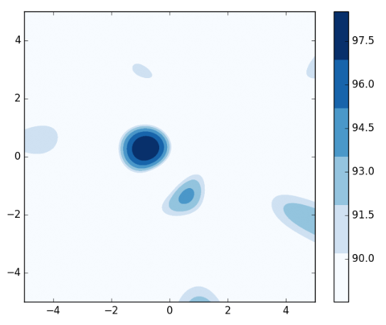
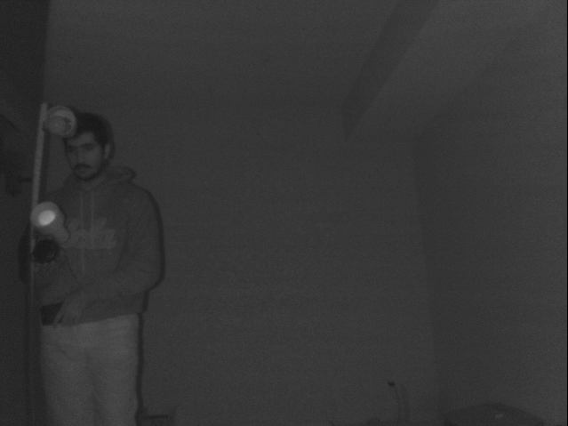
State of the Art …….Continued
Multimodal imaging is also relevant for agricultural applications.
A combination of thermal and visible imagery for estimating canopy temperature
and identifying is presented in [3]. For aligning the used images, feature
points as the tips of leaves are selected manually from the thermal and visible
image
[3] Lowe, D.G.: Distinctive image features from scale-invariant keypoints. Int. J. Comput.
Vis. 60(2), 91–110 (2004)
Why can’t the State of the Art be used ?
Make use of priori knowledge of existing corresponding structures across the images. Search for similar patterns in the two images
Differentially heated checkerboard to
Calibrate thermal and RGB cameras

Slide 5
Approach and Results
Overall Approach
Map a source of sound in 3D space by making use of Beamforming micro phone arrays.
Obtain RF, thermal and depth images of the scene.
Calibrate the imaging sensors in a way that they cover a specific field of view in the scene.
Integrate the imaging sensors into a single platform.
Train the hyperspectral imaging platform for object detection.
Results
We have been able to:
Localise a sound source in 2D space using a circular microphone array and obtain an acoustic map of the scene.
Obtain IR and Depth images of the scene.
Calibrate the imaging sensors and acoustic sensor to cover a specific field of view in the scene.
Fuse and visualise the images using Python libraries.

Slide 6
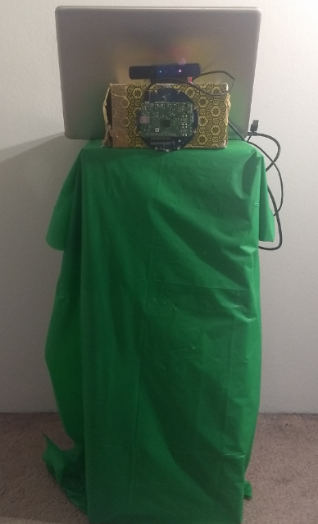
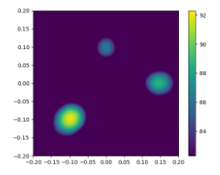
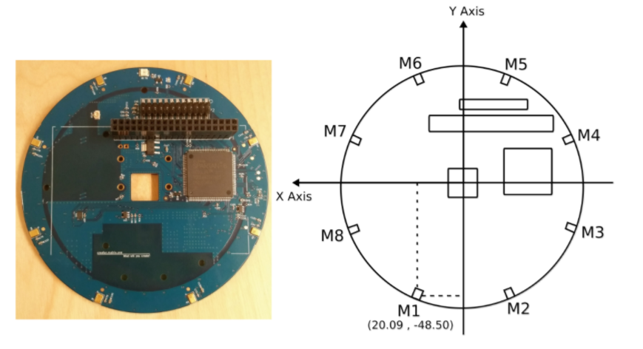
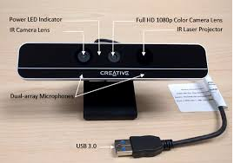
Implementation
Hardware Components
Matrix Creator – Microphone array
NVIDIA Jetson TX2 – Embedded Platform
Intel RealSense – Depth, RGB and IR Camera
FLiR Dev Kit- Thermal Camera
Software
Acoular Acoustic beamforming framework
Setup
Matrix Creator
Intel Realsense
Beamforming result from Acoular

Slide 7
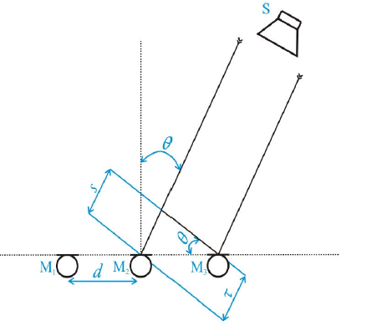
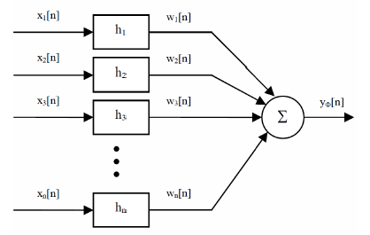

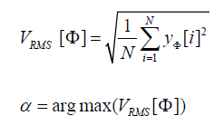
Sound Localization- Matrix Creator
Output from Matrix
8 bit Pulse Code Modulated values (Intensity of sound) from 8 microphone channels sampled at 16KHz .
Basic Beamformer for sound source Localisation
Delay and add beamforming algorithm.
Output signal is calculated for different angles. The angle corresponding to maximum intensity is the
direction of arrival.
Sound intensity when plotted for different values of the angle gives an acoustic map.

Slide 8
Understanding Localization Results
Acoular Images- At different depths gives different frames with co-ordinates according to real sense view angles.
The Output frame of matric is a cone originating from matrix and extending in Z axis(depth).
We can cut the cone at specific depth to receive frames according to the depth frame required.

Slide 9
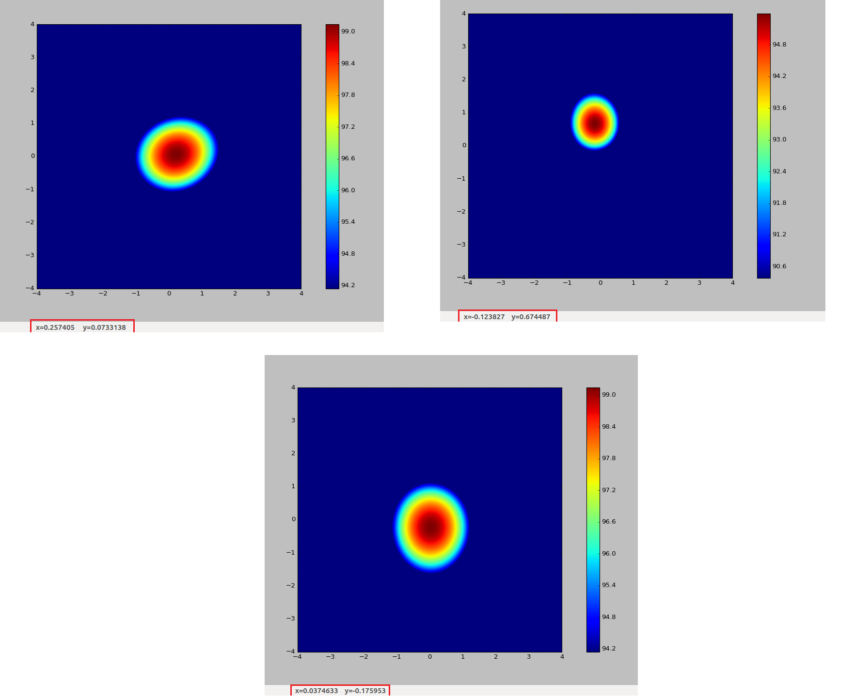
Ground Truth – Matrix Results
Depth(m) | y co-ordinate(m) | Observed y co-ordinate (m) | Error along x direction (m) | Angular error in deg | x co-ordinate (m) | Observed x co-ordinate (m) | Error along y direction (m) | Angular error in deg
0.8 | -0.2 | -0.17 | 0.03 | 1.07 | 0 | 0.037 | 0.037 | 1.32
1.5 | 0.8 | 0.674 | 0.126 | 2.4 | -0.3 | -0.124 | 0.1762 | 3.361
1 | 0.05 | 0.073 | 0.023 | 0.658 | 0.20 | 0.257 | 0.057 | 1.63
Angular error= (tan⁻¹((error/2)/distance))
Avg Ground truth = 1.376(along y), 2.10(along x)

Slide 10

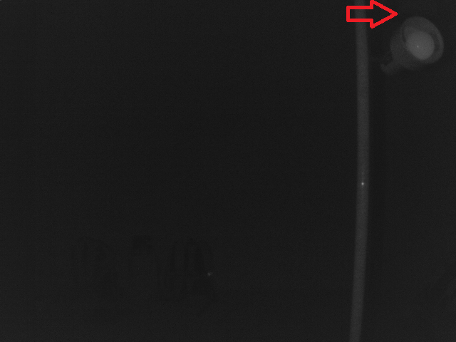
RealSense IR and Depth Images
Error values for depth +-8cm(max)

Slide 11
Frame Size and Calibration
Field of view: Intel Realsense
Vertical Field of View: 55 Deg
Horizontal field of View: 71.5 Deg
Field of view: Matrix
Azimuthal plane range: -pi/2 to pi/2
Polar plane range: -pi/2 to pi/2
Frame Size: 1.43mx1.04mx1m (Limited by IR camera)
Displacement between the centre of the IR camera and Matrix: 8cm

Slide 12
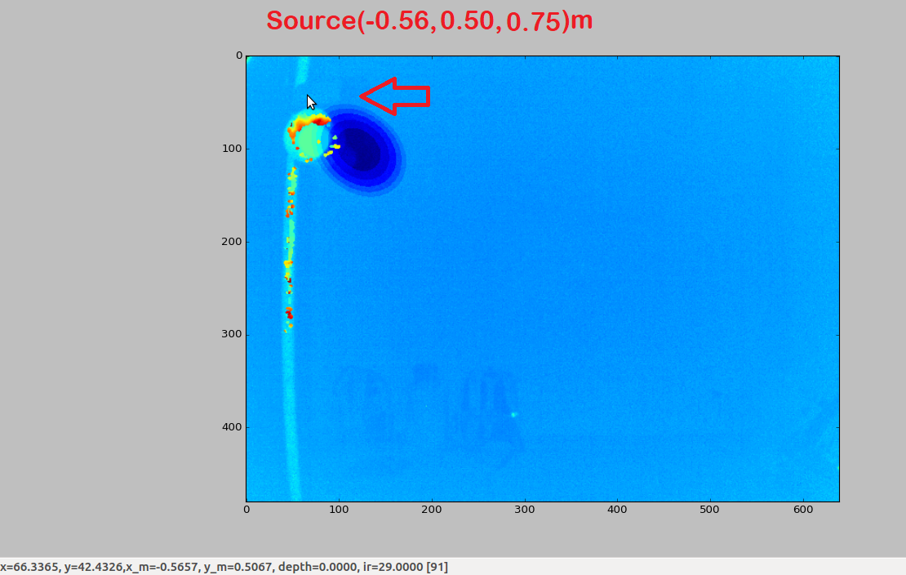
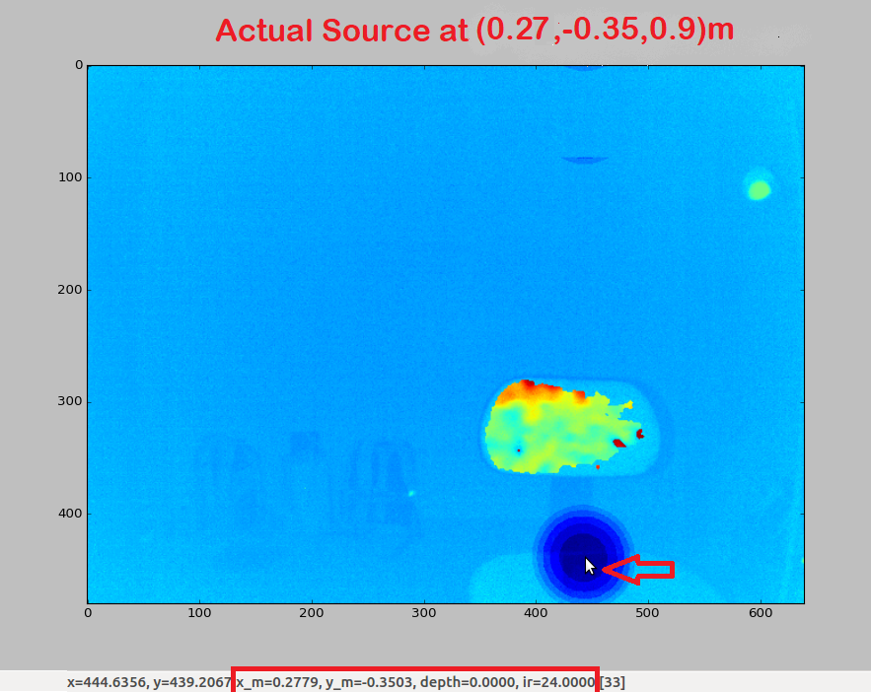
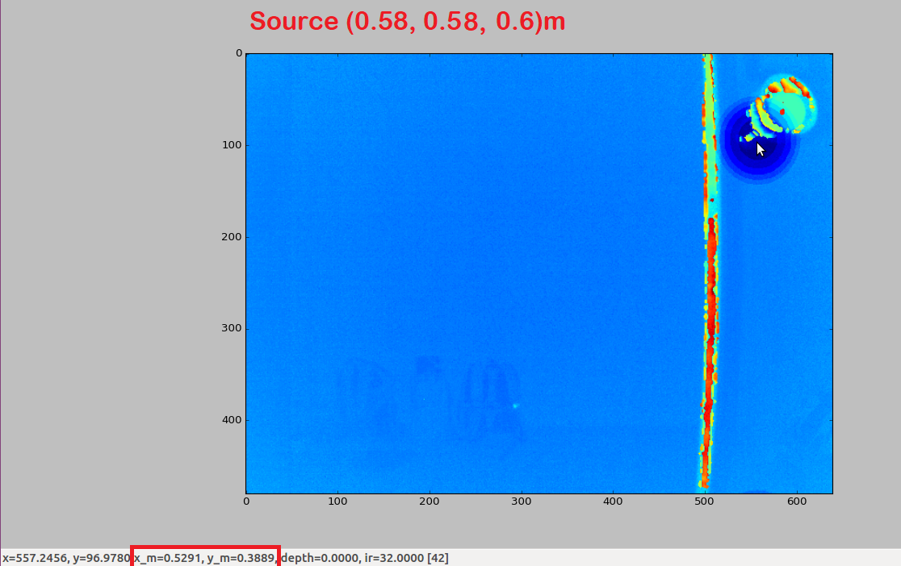
Multimodal Images - Results

Slide 13
Calibration Algorithm for Sound, Depth and RGB image
Algorithm that processes depth data from Real Sense image uses the same to find the audio source.
Audio image from Acoular is a sparse matrix and can be adjusted to frames at different depth.
Data clustering in depth image to identify different objects along with depth data.
Depth of different objects used to get Acoular frame limited to object depth.
Data clustering in Acoular image to find location of sound source.
Object location and sound source comparison to confirm the sound source.

Slide 14
PseudoCode for object identification
Depth_Object_identify_Func (){ num_obj = 0; // counts number of objects visited_ pixels = matrix_zero (image_size); //copy of image with visited pixels dictionary map; // maps object number → set of points(pixels) for(i=0 → X axis size) for(j=0→Y axis size) { if(visited_ pixels[i][j] == 0 && image[i][j]!=0) run_object_identify (visited_pixels, image, num_obj, i, j, map, depth); num_obj++; }
run_object_identify(visited_pixels, image, num_obj, i, j, map, depth) { if(visited_pixels[i][j]==1) return; if(image[i][j]!=0) depth = image[i][j]; map[num_obj].add((i,j)); visited[i][j]=1; run_object_identify(visited_pixels, image, num_obj, i+1, j, map, depth); run_object_identify(visited_pixels, image, num_obj, i, j+1, map, depth); }

Slide 15
Jetson TX2 Setup Details & FLiR Dev kit
JETSON TX2
Static IP : 169.254.0.23
Remote Desktop Password : UCLA
FLIR DEV KIT
Enabling SPI and I2C on Raspberry Pi 3.
Pylepton package for Flir dev kit.
Image from FLiR is of dimension 60x80.
Image needs to be superscaled for specific resolution.

Slide 16
What didn’t work
Integrating sensors with Jetson Tx2.
Missing Patches for Intel Real sense Package on Jetson board.
Output video Format not compatible on Jetson.
Enabling SPI and I2C on Jetson for Flir Devkit.
Obtaining thermal data from FLiR module.
Power up issue for FLiR from Raspberry Pi.

Slide 17
Future Works
Implementing Calibration algorithm for sound to depth mapping in any frame.
Implementing Object detection using ANN and multimodal image data.

Slide 18
References and Acknowledgement
Jerad Lewis, “Application note for AN-1140 Beamforming Microphone Arrays”
Joe C. Chen, Kung Yao, Ralph E. Hudson, “Acoustic Source Localization and Beamforming: Theory and Practice”,EURASIP Journal on Applied Signal Processing 2003:4, 359–370
Nick Schneider, Florian Piewak, “RegNet: Multimodal Sensor Registration Using Deep Neural Networks”
‘Spatial Fusion of Different Imaging Technologies Using a Virtual Multimodal Camera Sebastian P. Kleinschmidt(B) and Bernardo Wagner’

Slide 19
Thank You

