Slide 1
Understanding the Impact of Route Reflection in Internal BGP
Ph.D. Final Defense
presented by Jong Han (Jonathan) Park
July 15th, 2011

Slide 2
Research Overview
Internal Border Gateway Protocol and Route Reflection
Understanding the Impact of BGP Route Reflection
- Understanding BGP Next-hop Diversity (2nd author, Global Internet Symposium 2011)
- A Comparative Study of Architectural Impact on Next-hop Diversity (under submission to IMC’11)
- Quantifying i-BGP Convergence inside large ISPs (under submission to IMC’11)
BGP Route Reflection Protocol Diagnosis
- Investigating Occurrence of Duplicate Updates in BGP Announcements (PAM’10, Best Paper)
Others (listed as 2nd author) on BGP Performance
- Route Flap Damping with Assured Reachability (AINTEC’10)
- Explaining Slow BGP Table Transfers: Implementing a TCP Delay Analyzer (under submission to IMC’11)

Slide 3
Motivation
Route reflection was added to the routing architecture to fix a few critical problems
Despite the wide adoption of RR, a systematic evaluation and analysis on the impact of route reflection is missing, which can be helpful in:
Understanding of the protocol performance and enhancements
More realistic simulations
Designing the future routing protocols
This work is to fill in the void

Slide 4
Outline
Introduction to Internal BGP and Route Reflection
Understanding BGP Path Diversity and the Impact of Route Reflection
Understanding BGP Convergence inside Large ISPs

Slide 5


Introduction to full-mesh i-BGP
AS4
AS3
AS1
e-BGP
AS2
i-BGP
This router is no longer needed. Remove!
Total number of i-BGP routers in AS1 = 4 = N
Total number of sessions = N(N-1)/2
Number of additional sessions for an additional i-BGP router = N

Slide 6
Full-mesh i-BGP does not scale
City 1
City 2
City 3
Large ISPs have hundreds or even more than a thousand routers internally
Full mesh leads to a high cost in provisioning
Adding or removing a router requires reconfigurations of all other routers

Slide 7
Addressing the scalability problem of full-mesh i-BGP
Two solutions are suggested in 1996
AS confederations (RFC 1965)
Route reflection (RFC 1966)
This work focuses on route reflection
Dominant solution
Main concerns shared with AS confederation
Path diversity reduction
Convergence delay

Slide 8

Route reflection solves scalability problem
client 2
client 1
route reflector
AS1
client 4
e-BGP
client 3
AS2
i-BGP
Total number of i-BGP routers = 5 = N
Total number of sessions = 4
Number of additional sessions for an additional i-BGP router = 1

Slide 9


Large ISP revisited with hierarchical RR
Route reflection substantially reduces the total number of sessions
Route reflection can be deployed hierarchically to reduce even more

Slide 10
Negative Impact of BGP route reflection
Negative side effects
Routing performance
Path diversity [Uhlig, Networking’06]
Convergence
Others
Robustness to failures
Internal update explosion [McPherson,APNIC talk, 2009]
Optimal route selection [Vutukuru, Infocom’06]
Routing correctness
Data forwarding loop [Griffin, Sigcomm’02]
Route oscillations [McPherson, Internet Draft, 2000]

Slide 11
Outline
Introduction to Internal BGP and Route Reflection
Understanding BGP Path Diversity and the Impact of Route Reflection
Understanding BGP Convergence inside Large ISPs

Slide 12
Definitions
Next-hop POP and AS
Next-hop Point-of-Presence (i.e., city in which the next-hop router is located) and AS that the ISP uses to reach a given external destination
BGP Next-hop Diversity
Number of distinct next-hops to reach a given external destination as used simultaneously inside a given ISP

Slide 13
Why do we care about path diversity?
Higher path diversity
More flexibility in traffic engineering and load balancing
Higher availability
Current IETF efforts to increase BGP diversity
Diverse-path, Add-path, and External-best

Slide 14
Path diversity reduction due to route reflection
RTR2
AS1
RTR1
RR
AS2, p
RTR3
RTR4
p: NH = RTR1, ASPATH = AS2
p: NH = RTR4, ASPATH = AS2
p: NH = RTR1, ASPATH = AS2
p: NH = RTR4, ASPATH = AS2
RTR1, RR
ALL
OTHERS
p: NH = RTR4, ASPATH = AS2

Slide 15
Main questions to answer
What degree of BGP next-hop diversity do existing ISPs have now?
Does route reflection deployment reduce BGP next-hop diversity?

Slide 16

Data collection settings
ISP_{FM}
ISP_{RR}
backbone sub-AS
Collector
AS₁
i-BGP full-mesh
AS₁₁
Collector
AS₂
AS_{i}
AS₂₂
AS_{ii}
Sub
AS
Sub
AS
Sub
AS
Node type:
BGP router
1st level reflector
2nd level reflector
3rd level reflector
Session type:
confederation BGP
i-BGP reflector to client
i-BGP peer
e-BGP peer
ISP_{FM}: Tier-1 ISP with full-mesh i-BGP backbone routing infrastructure
ISP_{RR}: Tier-1 ISP with route reflection i-BGP backbone routing infrastructure

Slide 17
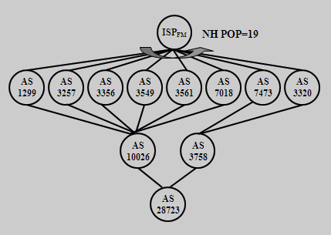
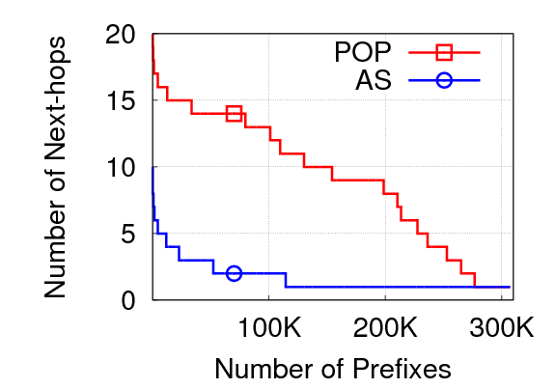
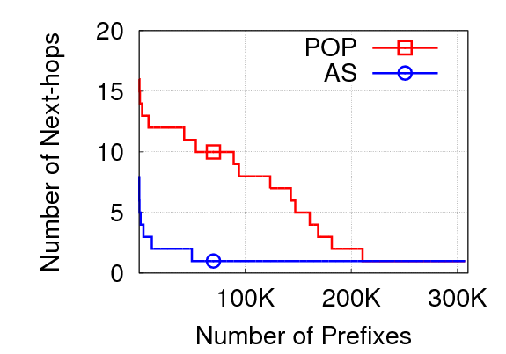
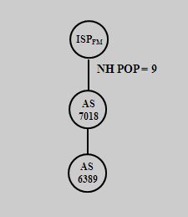
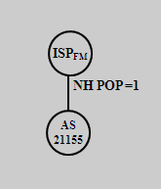
BGP next-hop diversity of the 2 ISPs
ISP_{FM}
ISP_{RR}
Common observations
A small number of prefixes with a very high degree of next-hop diversity
Prefixes with very low degree (diversity=1) of next-hop diversity
A few large groups of prefixes with the same moderate degree of next-hop diversity
A significant number of prefixes (more than 90% and 65% respectively) have multiple next-hop POPs and ASes
Overall, ISP_{RR} has relatively lower next-hop diversity, compared to ISP_{FM}

Slide 18
Inferring external connectivity
AS3
R2
AS1
R3
R1
AS2, p
R4
In the absence of failures, the reachability through R2 is not visible
If the current best path fails, the path through R2 will be explored

Slide 19
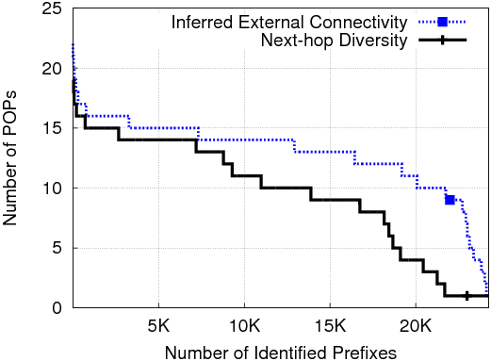
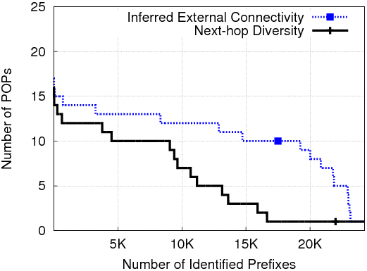
Inferred external connectivity vs. next-hop POPs
ISP_{FM} (during 1st week of June 2010)
ISP_{RR} (during 1st week of June 2010)
The external connectivity is not the main reason for the difference

Slide 20
Paths can be hidden due to path preference
7 BGP path attribute values used by a BGP router in BGP best path selection
First 4 are independent from the i-BGP topological location of the given router
LOCAL_PREF
AS_PATH length
ORIGIN
MED
The rest 3 attribute values change depending on the i-BGP topological location of the given router
Prefer e-BGP over i-BGP
IGP cost
Router ID

Slide 21
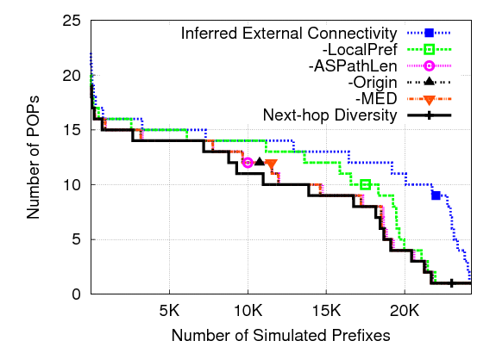
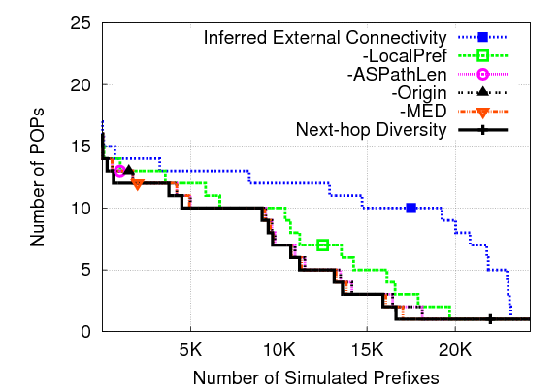
Diversity reduction by the first 4 BGP path attributes
ISP_{FM} (during 1st week of June 2010)
ISP_{RR} (during 1st week of June 2010)
The first 2 criteria of BGP path selection hides the majority of the path diversity
About 16% and 10% reduction for ISP_{FM} and 34% and 7.6% reduction for ISP_{RR} by (1) LOCAL_PREF and (2) AS_PATH length respectively

Slide 22
Summary
The overall next-hop diversity varies widely, depending on the topological location of origin AS for a given prefix
The difference in the overall next-hop diversity is due to i-BGP topology-independent factors
More specifically, the first 2 BGP best selection criteria hides up to 42%
Next-hop diversity reduction by ISP_{RR}’s hierarchical RR is less than 3.3%
Main reason. significant reduction by the i-BGP topology-independent factors already

Slide 23
Outline
Introduction to internal BGP and Route Reflection
Understanding BGP Path Diversity and the Impact of Route Reflection
Understanding BGP Convergence inside Large ISPs

Slide 24
Definitions
Event
Change in routing information to reach a given external prefix
Monitor
Router from which i-BGP data is collected within a given ISP
i-BGP convergence
Convergence of all monitors inside a given ISP for a given event

Slide 25
Why do we care about i-BGP convergence?
BGP suffers from slow convergence
May cause severe performance problems in data delivery [TON’01, Labovitz] [Infocom’01,Labovitz] [IMC’03,Mao] [Sigcomm’06,Wang] at inter-AS level
Virtually no measurement studies exist on BGP convergence inside an ISP

Slide 26
Increased convergence delay in i-BGP RR
AS1
RTR 3
RTR 4
Update path
RR2->RTR1
RR1->RTR1
RR2->RR1->RTR1
RR1->RR2->RTR1
Not reachable
RR1
RR2
RTR 1
RTR 2
There is no path to prefix p!
1. Delay due to hierarchy
- additional path distance
- additional processing delays
2. Delay due to route reflector redundancy
- increased # of control paths
AS2, p

Slide 27
Main questions to answer
What does i-BGP convergence look like?
What is the impact of route reflection convergence delay?

Slide 28
Data collection settings
ISP_{FM}
ISP_{RR}
backbone sub-AS
AS₁₁
Collector
AS₁
i-BGP full-mesh
Collector
AS₂
AS_{i}
AS₂₂
AS_{ii}
Sub
AS
Sub
AS
Sub
AS
Node type:
BGP router
1st level reflector
2nd level reflector
3rd level reflector
Session type:
confederation BGP
i-BGP reflector to client
i-BGP peer
e-BGP peer
ISP_{FM}: the collector is a member of the i-BGP full-mesh
ISP_{RR}: the collector is a client of the 2nd level route reflectors

Slide 29
Inferring best path selection for peers in i-BGP full-mesh
Path₂ to prefix p
RTR2
AS1
SelectBestPath(Path1,Path2)
Which path does RTR3 use?
LOCAL_PREF
AS_PATH length
ORIGIN
MED
E-BGP over I-BGP
IGP cost to the path
Router ID (tie breaker)
Collector
RTR3
RTR1
Path₁ to prefix p
Q: Best path used by RTR3 to reach prefix p?
A: Use geographical information of the routers to approximate IGP cost
in the BGP best path selection

Slide 30
High-level view of quantifying i-BGP convergence
monitor₁
T = 60 seconds
collector
Event Identification
(update clustering)
monitor_{n}
event e
event e
T
Event Classification
(Determine Type & Scale)
METRICS
1. Duration(e)
2. NumUpdates(e)
3. NumPaths(e)
S
path preference

Slide 31
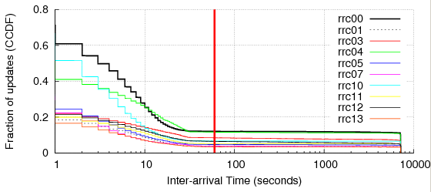
Event identification: time-based update clustering
Example of update arrivals for a given beacon prefix
7200 seconds
Time
X = 60 seconds
ISP_{FM}
Fraction of updates (CCDF)
7200 seconds
Inter-arrival times of beacon prefix updates during June 2010 (seconds)

Slide 32
Event classification: adding type information
p₀
p₁
p_{n}
Time
[IMC’06 Oliveira]
The last update from the previous event
Updates generated from a monitor in an event
Event_{M}
p₀ = p_{n}
p₀ != p_{n}
p₀ = … = p_{n}
Path Disturbance
Path Change
Same Path
I_{dist}
I_{down}
I_{up}
I_{long}
I_{short}
I_{equal}
I_{spath}
ISP_{FM} 8.9% 3.0% 3.1% 35.8% 40.1% 0.3% 8.8%
ISP_{RR} 15.7% 4.9% 4.6% 29.7% 31.9% 0% 13.2%

Slide 33
Event classification: adding scale information
Event Scale
Se = (# of POPs observed the event) / (total # of monitored POPs)
Event Scale Types
Local Event: only one POP inside the ISP observes the event
AS-wide Event: all POPs inside the ISP observe the event
Others: non-local or non-AS-wide events

Slide 34
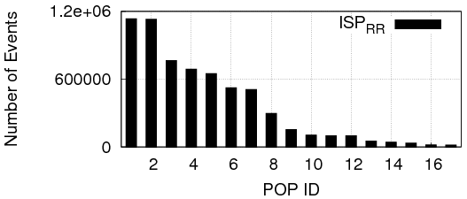
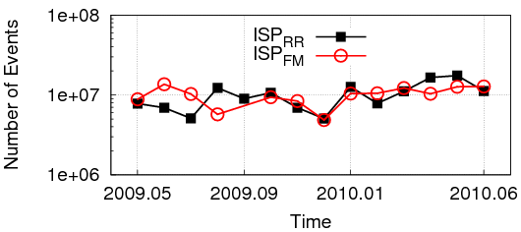
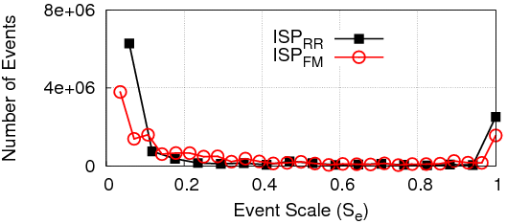
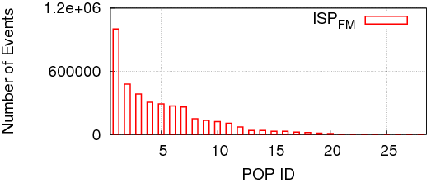
Identified events from ISP_{RR} and ISP_{FM}
Number of Identified Events per Month
Scale of Events During June 2010
The total number of events gradually increases as it fluctuates
Most of events are either local or AS-wide in their scale
Local events are observed in all POPs

Slide 35
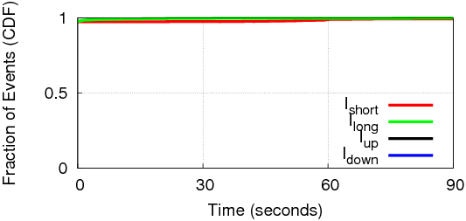
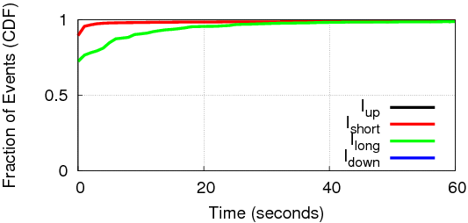
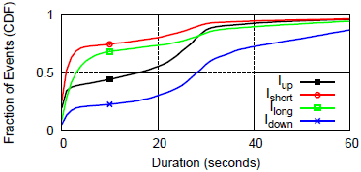
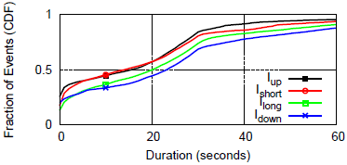
Event characteristics
ISP_{RR}
ISP_{FM}
Local Events
AS-wide Events
The majority of local events converge within 1 second
97% and 72% for ISP_{RR} and ISP_{FM} respectively
Difference due to the different delays of the neighboring ASes
AS-wide event duration differs between the two ISPs
Due to the delayed updates via different paths

Slide 36
How Much Delay Does Route Reflection Add to the Overall i-BGP Convergence?

Slide 37
Case studies in ISP_{RR}: estimating the additional delay caused by route reflection
Additional delays due to route reflector redundancy
Identify the superfluous updates generated purely due to route reflector redundancy
What is the additional convergence time solely contributed by these updates?
Additional delays due to hierarchy
Compare the direct and RR paths between all monitors in the backbone routing infrastructure inside ISP_{RR}

Slide 38
Superfluous update example
ISP_{RR}
How many superfluous updates?
What is the additional delay caused by these updates?
BR1
BR2

Slide 39
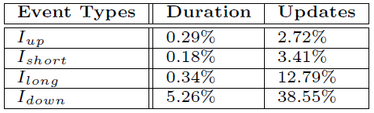
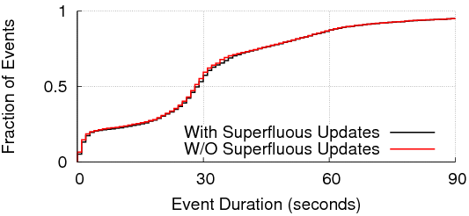
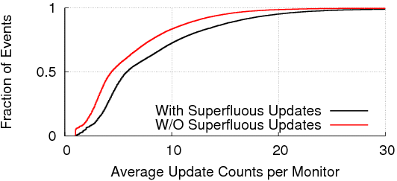
Superfluous updates due to route reflector redundancy and its Impact on convergence
The amount of superfluous updates is not significant in most cases
Convergence duration: 0.3%, 0.2%, 0.4% and 5.3% for I_{up}, I_{short}, I_{long} and I_{down} increase
Number of updates: 3%, 4%, 13%, and 40% increase for I_{up}, I_{short}, I_{long}, and I_{down} increase

Slide 40

Is there routing plane path stretch in the top 2-levels of route reflection inside ISP_{RR}?
A
B
Distance_{Direct}(AA,BB) =
where r_{i} is a router in the order detected by traceroute
Distance_{RR}(AA,BB) =
AA
BB
Distance_{Direct}(AA,B) + Distance_{Direct}(B,BB)
Measure the physical path length and latency for RR paths using traceroute and ping
Repeat the measurement for direct paths and compare with RR paths

Slide 41
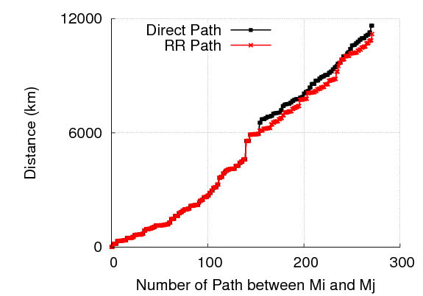
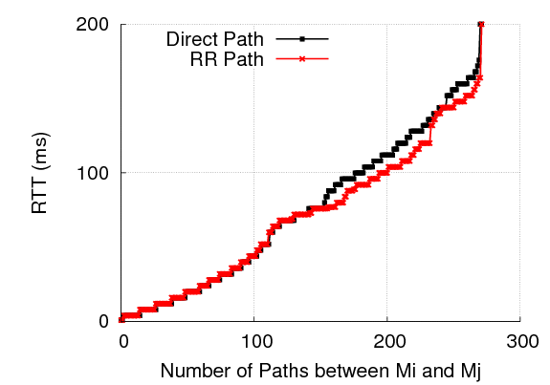
Path distance and latency of direct and RR paths
In case of ISP_{RR}, RR paths are shorter with less latency
i.e., the RRs are aligned well with the shortest physical paths

Slide 42
Summary
Defined, quantified, and analyzed i-BGP convergence
i-BGP routing events mostly are local or AS-wide in their scale
Local events: mostly lasts less than 1 second
AS-wide events: the duration is longer and mostly depends on external factors
Our case study of ISP_{RR} shows
RR does increase the number of updates and convergence duration
However, the amount is not significant
Additional 0.3%, 0.2%, 0.4%, and 5.3% increase in the duration of I_{up}, I_{short}, I_{long}, and I_{down}
RR topology design can mitigate the additional delays

Slide 43
Thank you.

Slide 44
Backup Slides

Slide 45
Paths can be hidden due to path preference
AS3
R2
AS1
R3
R1
AS2, p
R4
In BGP, a less preferred path is not announced by the border routers
In this example, external connectivity: 3 POPs, next-hop diversity: 2 POPs

Slide 46
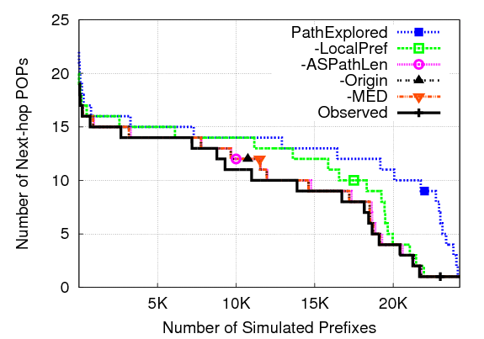
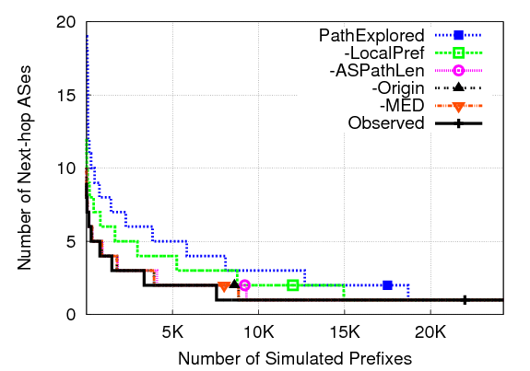
Topology-independent diversity reduction in ISP_{FM}
LOCAL_PREF and AS_PATH length are the two main impacting attributes that hide paths
About 16% and 10% respectively

Slide 47
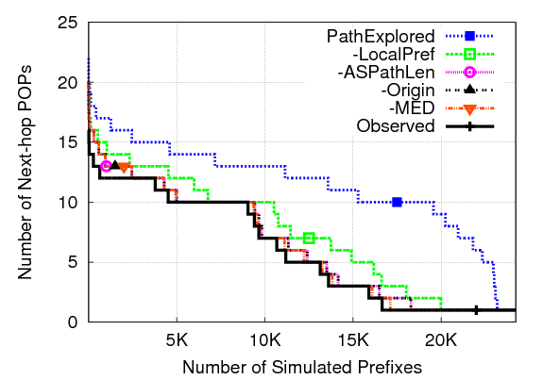
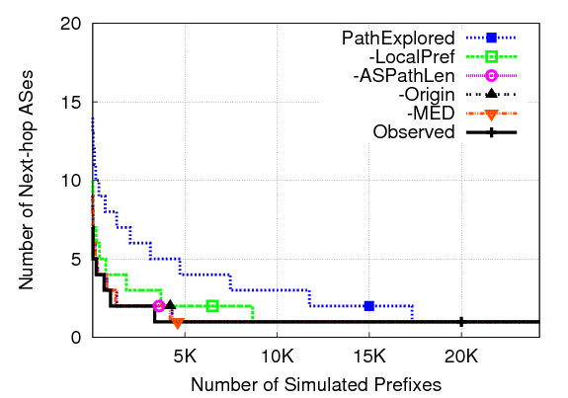
Topology-independent diversity reduction in ISP_{RR}
Significant reduction mostly due to the LOCAL_PREF value
About 34% and 7.6% by LOCAL_PREF and AS_PATH length respectively

Slide 48
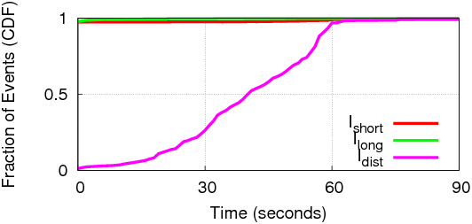
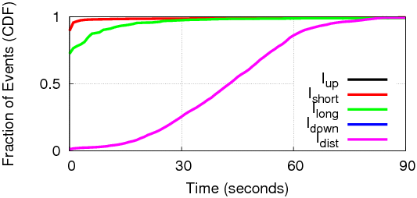
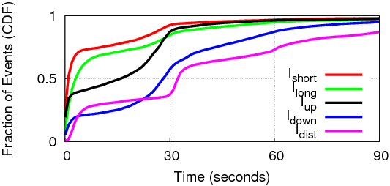
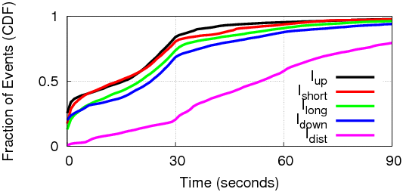
Event characteristics
ISP_{RR}
ISP_{FM}
Local Events
AS-wide Events
The majority of local events converge within 1 second
97% and 72% for ISP_{RR} and ISP_{FM} respectively
i-BGP convergence duration differs between the two ISPs
Due to the difference in connectivity and delayed updates via different paths

Slide 49
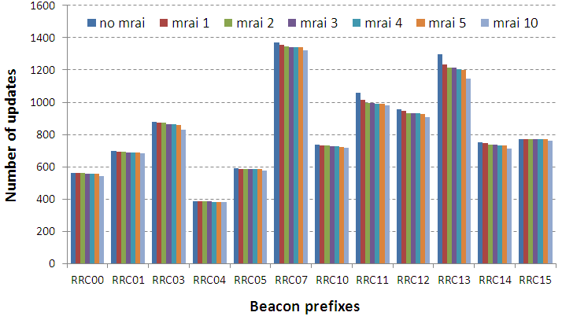
Update reduction in full-mesh i-BGP
Setting
Data: NTT i-BGP data from 20100601
Apply different MRAI timers to the monitor-collector session and calculate the reduction for beacon prefixes
Observation
Higher MRAI timer leads to update reduction, and the update reduction is not significant

Slide 50
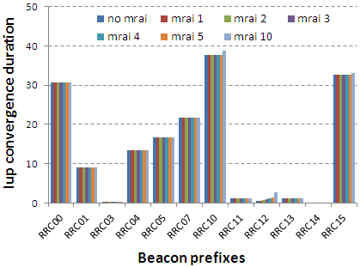
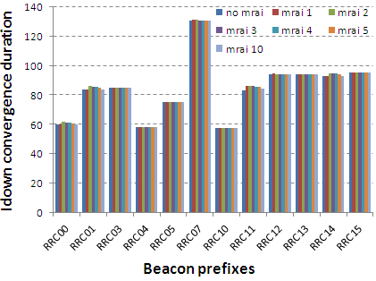
Increased convergence time in full-mesh i-BGP
Setting
Data: NTT i-BGP data from 20100601
Apply different MRAI timers to the monitor-collector session and calculate the convergence duration for beacon prefixes
Observation
The increased convergence time is proportional to the MRAI timer used

Slide 51
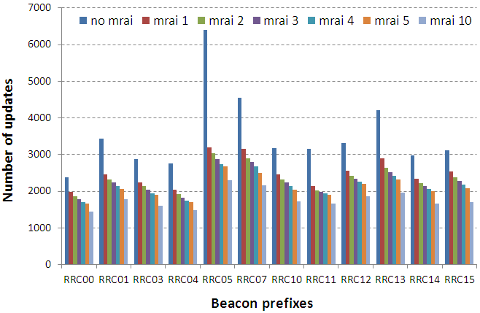
Update reduction in i-BGP HRR
Setting
Data: Level3 i-BGP data from 20100603
Apply different MRAI timers to the monitor-collector session and calculate the reduction for beacon prefixes
Observation
Reduction MRAI timer with 1 second effective enough; the update propagation and the internal path exploration for a given external path is mostly under 1 second within the ISP

Slide 52
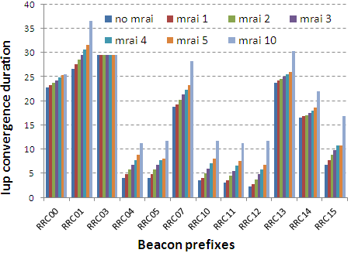
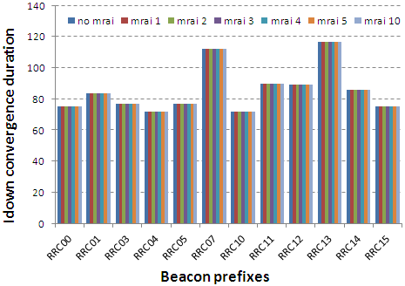
Increased convergence time in i-BGP HRR
Setting
Data: Level3 i-BGP data from 20100603
Apply different MRAI timers to the monitor-collector session and calculate the convergence duration for beacon prefixes
Observation
The increased convergence time is proportional to the MRAI timer used in Iup

