Slide 1



Algorithms
Alexander Graening, Brian Wang, Ziqi Wang, Wojciech Romaszkan
agraening, wangbri1, wangzq312, wromaszkan@ucla.edu
We thank historical contributors: Tianmu Li, Santadeep Pal, Dr. John Lee, Dr. Rani Ghaida. Dr. Abde Ali Kagalwalla and Dr. Yasmine Badr. Some slides materials are based on Introduction to Algorithms by Cormen et al. and Algorithms, 4th Edition by Robert Sedgewick and Kevin Wayne

Slide 2
What is an Algorithm?
An algorithm is a well-defined set of computational steps that takes an input and produces some output.
Algorithm
INPUT
(problem)
OUTPUT
(solution)
x
1
2
3
4
5
y = x²
y
1
4
9
16
25

Slide 3
Introductory Material
Link to materials: https://github.com/UCLA-LACC-21/M2_Algorithms
We will be using exercises on LeetCode: https://leetcode.com/

Slide 4
Agenda for Module 2
Part 1:
Introduction to Algorithms
Data Structures
Part 2:
Search Algorithms
Time Complexity
Part 3:
Sorting Algorithms
Part 4:
Graph Algorithms
Algorithmic Techniques

Slide 5
Agenda for Module 2
Part 1:
Introduction to Algorithms
Data Structures
Part 2:
Search Algorithms
Time Complexity
Part 3:
Sorting Algorithms
Part 4:
Graph Algorithms
Algorithmic Techniques

Slide 6
Agenda
What sort of problems are solved with algorithms?
Common Data Structures in Programing
Linked List, Queue, Stack, Tree, Graph
Search Algorithms
Sequential Search
Time Complexity and Space Complexity
Binary Search [Exercise ]
Sorting Algorithms
Bubble Sort [Exercise ]
Insertion Sort
Selection Sort
Quick Sort
Merge Sort [Optional Exercise ]

Slide 7
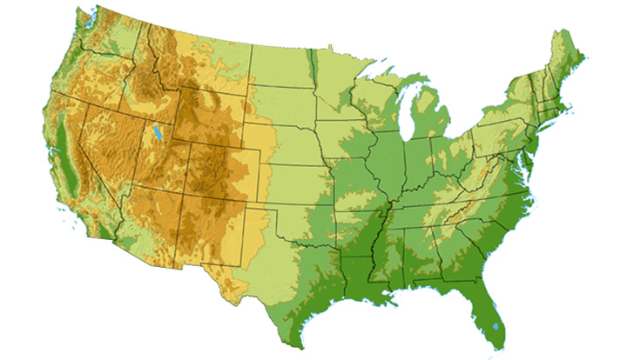









What sort of problems are solved with algorithms?
DS3 (45 Mbps)
OC3 (155 Mbps)
OC12 (622 Mbps)
OC48 (2.4 Gbps)
Seattle
Tacoma
Stockton
Cheyenne
Chicago
New York
Pennsauken
Relay
San Jose
Kansas City
Roachdale
Wash. DC
Anaheim
Atlanta
Fort Worth
Orlando
Internet - Manage and manipulate data
E.g., (1) search engines, (2) finding good routes on which data will travel

Slide 8
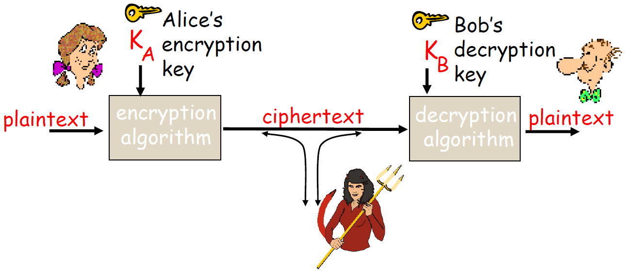
What sort of problems are solved with algorithms?
ujner@ si emosewa¡
Algorithms are awesome!
Algorithms are awesome!
Data security – cryptography
Encryption algorithm
→ computational steps to transform plaintext to ciphertext
Decryption algorithm
→ computational steps to transform ciphertext back to plaintext

Slide 9
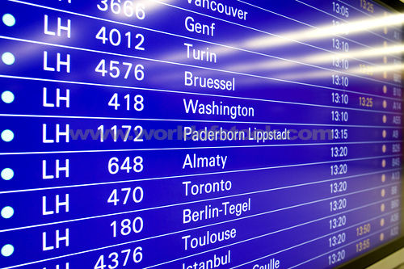
What sort of problems are solved with algorithms?
Scheduling problems
Example: Flight scheduling
Crew preferences
Airplane types
Weather
Fuel Costs
Delays
From http://www.worldofstock.com/slides/TRA2599.jpg

Slide 10
Agenda
What sort of problems are solved with algorithms?
Common Data Structures in Programing
Linked List, Queue, Stack, Tree, Graph
Search Algorithms
Sequential Search
Time Complexity and Space Complexity
Binary Search [Exercise ]
Sorting Algorithms
Bubble Sort [Exercise ]
Insertion Sort
Selection Sort
Quick Sort
Merge Sort [Optional Exercise ]

Slide 11
Why are Data Structures Important?
Different data structures are good for different problems or different algorithms.
Characteristics of an ideal data structure
Fast to access the data you need
Fast to add or remove items
Arrays
Linked lists and variants
Graphs and trees

Slide 12

The Simplest Data Structure
Array (This is the simplest structure.)
- Keep track of the starting point of the array in memory.
- To access item 4, just count over from the starting point.
- This works for checking what is stored in the array or changing the value.
- What happens if I want to make the array bigger?
- What if I want to find an entry with a specific value? (Check all items.)
- Arrays are an excellent structure if you know how many items you want to store and you know where they will be.
MyArray
…
 |  |  | 6 | 1 | 4 | 3 | 4 | 23 | 1 | 15
…
Photo.png
WordDocument.docx
Address in memory
MyArray
…
 |  |  | 6 | 1 | 4 | 3 | 4 | 23 | 1 | 15
…
 |  |  | 0 | 1 | 2 | 3 | 4 | 5 | 6 | 7
Photo.png
WordDocument.docx
WordDocument.docx
MyArray
…
 |  |  | 6 | 1 | 4 | 3 | 4 | 23 | 1 | 15 | 8
…
Photo.png
WordDocument.docx

Slide 13
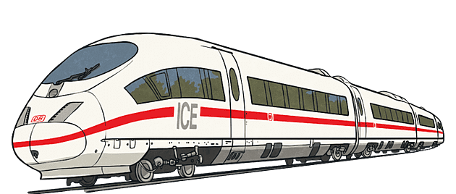

Linked Lists
Head
6
1
4
3
4
23
1
15
8
NULL
Unlike arrays, this data structure makes it easy to increase the number of items you are storing.
NULL
6
4
3
1
4
23
1
15
NULL
8
NULL

Slide 14
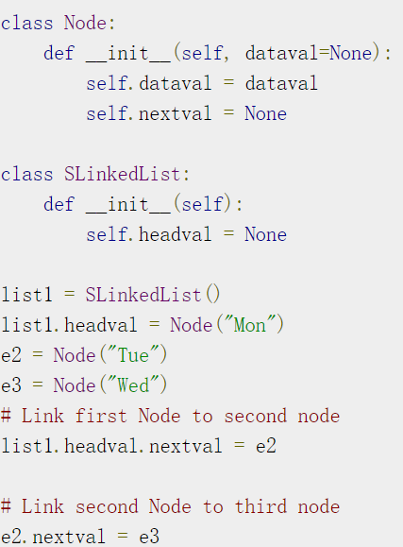
Linked List Implementation
Mon
Tue
Wed
Mon
Tue
Wed
Mon
Tue
Wed

Slide 15

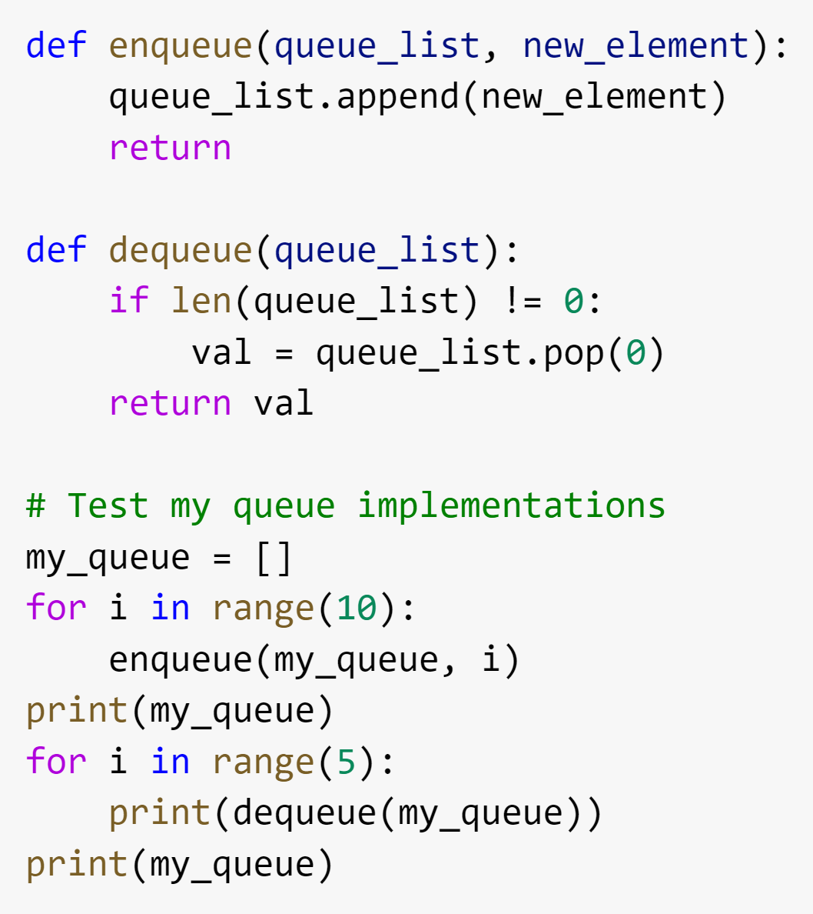
Waiting in a Queue
Queue: A First In First Out List
What will the output be?
Figure source: https://en.wikipedia.org/wiki/Queue_(abstract_data_type)

Slide 16
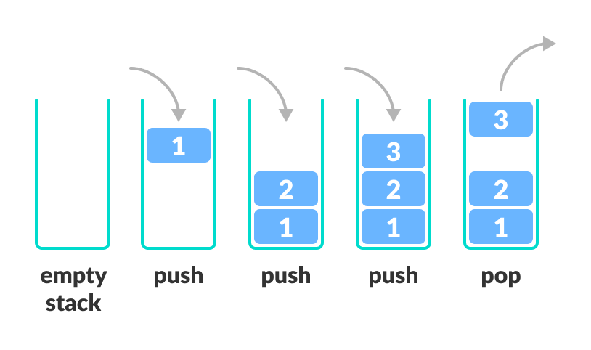
Stacks
A Last In First Out (LIFO) list
The only difference is you remove the most recent element.
Exercise: How to convert the code for a queue into code for a stack?
Figure source: https://www.programiz.com/dsa/stack

Slide 17
Exercise
How would you convert the code for a queue into code for a stack?
Queue
Stack

Slide 18
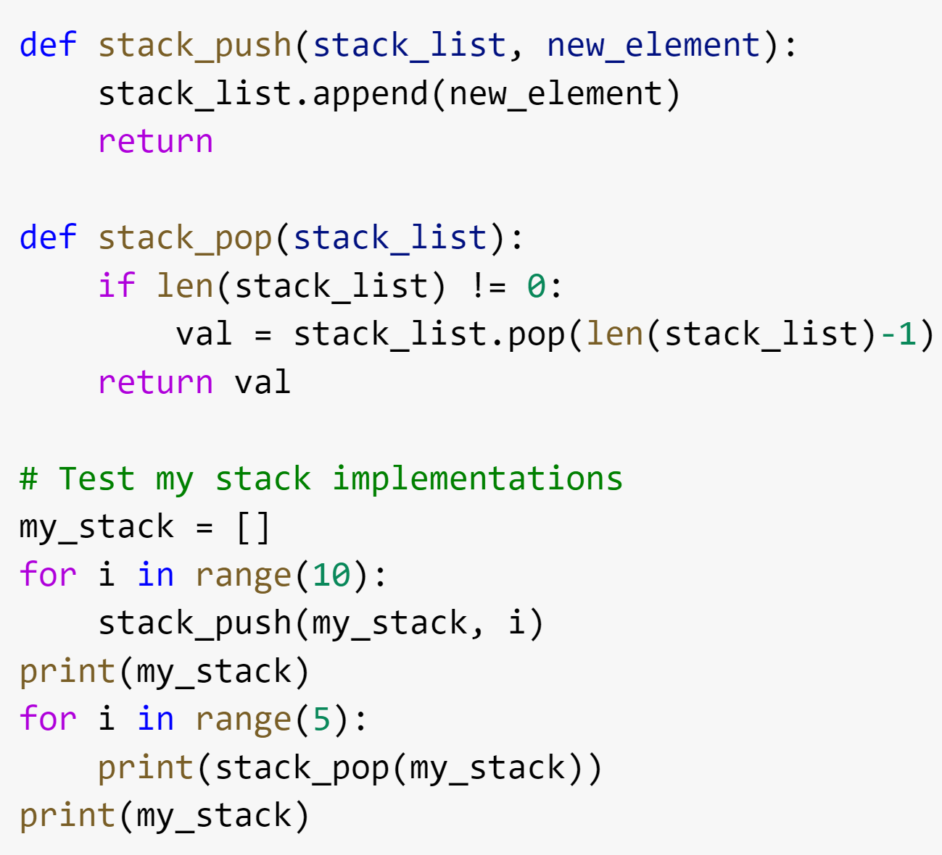
Solution
How would you convert the code for a queue into code for a stack?
Queue
Stack

Slide 19
Graphs
Structure of nodes and connections between those nodes
There is a large family of algorithms for handling graphs. We will talk a little bit about graph algorithms later in this module and the 5th module is dedicated to graphs.
A
B
JFK
C
LAX
LAX
STL
D
E
HNL
DFW
FTL

Slide 20
Trees
Hierarchical tree structure, with a root node and child nodes that may form their own subtrees.
This is represented as a set of linked nodes.
Each node other than the root node must have exactly one parent node.
A
B
C
D
E
F
G
H
I
J
K
L
M

Slide 21
Binary Search Trees
Special type of tree with no more than two child nodes per parent.
The left child must be less than or equal to the parent.
The right child must be greater than the parent.
How would I determine if the value 7 exists in the binary search tree?
4
3
15
1
4
6
23
1

Slide 22
Summary of Data Structures
What we covered:
Array
Linked Lists
Queue (First In First Out)
Stack (Last In First Out)
Graph
Tree
Binary Search Tree
There are many other structures that we did not cover…
Heap
Hash
Strings
etc.
Many programming languages have libraries to handle the specific implementation details for common data structures.

