Slide 1



Algorithms, Part 1
Alexander Graening, Brian Wang, Ziqi Wang, Wojciech Romaszkan
agraening, wangbri1, wangzq312, wromaszkan@ucla.edu
We thank historical contributors: Tianmu Li, Santadeep Pal, Dr. John Lee, Dr. Rani Ghaida. Dr. Abde Ali Kagalwalla and Dr. Yasmine Badr. Some slides materials are based on Introduction to Algorithms by Cormen et al. and Algorithms, 4th Edition by Robert Sedgewick and Kevin Wayne

Slide 2
Introduction
Welcome to Algorithms!
The study of Algorithms is the study of solving problems efficiently.
We are assuming Python as the default programming language for these lectures, but what you learn will also be applicable in any language you use in the future.
Some exercises will be on Google Collab and some will be on LeetCode.
Link to GitHub materials:
https://github.com/UCLA-LACC-21/M2_Algorithms
Link to LeetCode:
https://leetcode.com/

Slide 3
Agenda for Module 2: Algorithms
Part 1:
Introduction to Algorithms
Data Structures
Part 2:
Search Algorithms
Time Complexity
Part 3:
Sorting Algorithms
Part 4:
Graph Algorithms
Overview of Algorithmic Techniques

Slide 4
Agenda for Module 2: Algorithms
Part 1:
Introduction to Algorithms
Data Structures
Part 2:
Search Algorithms
Time Complexity
Part 3:
Sorting Algorithms
Part 4:
Graph Algorithms
Overview of Algorithmic Techniques

Slide 5
What is an Algorithm?
An algorithm is a well-defined set of computational steps that takes an input and produces some output.
Algorithm
INPUT
(problem)
OUTPUT
(solution)
x
1
2
3
4
5
y = x²
y
1
4
9
16
25

Slide 6
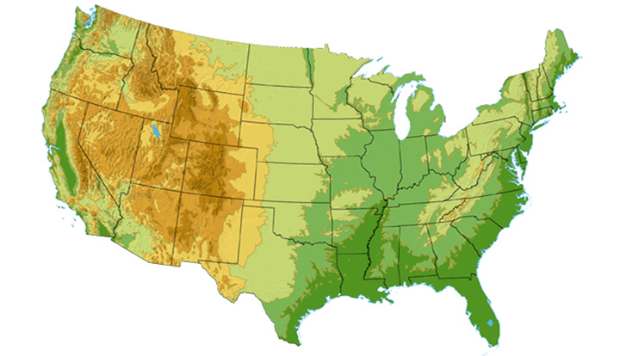









What sort of problems are solved with algorithms?
DS3 (45 Mbps)
OC3 (155 Mbps)
OC12 (622 Mbps)
OC48 (2.4 Gbps)
Seattle
Tacoma
Stockton
Cheyenne
Chicago
New York
Pennsauken
Relay
San Jose
Kansas City
Roachdale
Wash. DC
Anaheim
Atlanta
Fort Worth
Orlando
Internet - Manage and manipulate data
E.g., (1) search engines, (2) finding good routes on which data will travel

Slide 7
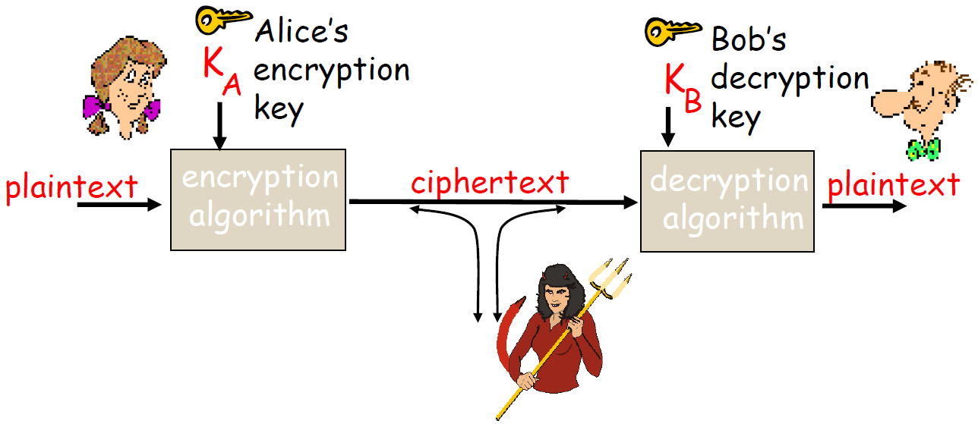
What sort of problems are solved with algorithms?
ujner@ si emosewa¡
Algorithms are awesome!
Algorithms are awesome!
Data security – cryptography
Encryption algorithm
→ computational steps to transform plaintext to ciphertext
Decryption algorithm
→ computational steps to transform ciphertext back to plaintext

Slide 8

What sort of problems are solved with algorithms?
Scheduling problems
Example: Flight scheduling
Crew preferences
Airplane types
Weather
Fuel Costs
Delays
From http://www.worldofstock.com/slides/TRA2599.jpg

Slide 9
Agenda for Module 2: Algorithms
Part 1:
Introduction to Algorithms
Data Structures
Part 2:
Search Algorithms
Time Complexity
Part 3:
Sorting Algorithms
Part 4:
Graph Algorithms
Overview of Algorithmic Techniques

Slide 10
Why are Data Structures Important?
Different data structures are good for different problems and different algorithms.
Some characteristics of an ideal data structure:
Fast to access the data you need
Fast to add or remove items
Arrays
Linked lists and variants
Graphs and trees

Slide 11

The Simplest Data Structure
Array (This is the simplest structure.)
- Keep track of the starting point of the array in memory.
- To access item 4, just count over from the starting point.
- This works for checking what is stored in the array or changing the value.
- What happens if I want to make the array bigger?
- What if I want to find an entry with a specific value? (Check all items.)
- Arrays are an excellent structure if you know how many items you want to store and you know where they will be.
MyArray
…
 |  |  | 6 | 1 | 4 | 3 | 4 | 23 | 1 | 15
…
Photo.png
WordDocument.docx
Address in memory
MyArray
…
 |  |  | 6 | 1 | 4 | 3 | 4 | 23 | 1 | 15
…
 |  |  | 0 | 1 | 2 | 3 | 4 | 5 | 6 | 7
Photo.png
WordDocument.docx
WordDocument.docx
MyArray
…
 |  |  | 6 | 1 | 4 | 3 | 4 | 23 | 1 | 15 | 8
…
Photo.png
WordDocument.docx

Slide 12


Linked Lists
Head
6
1
4
3
4
23
1
15
8
NULL
Unlike arrays, this data structure makes it easy to increase the number of items you are storing.
NULL
6
4
3
1
4
23
1
15
NULL
8
NULL

Slide 13
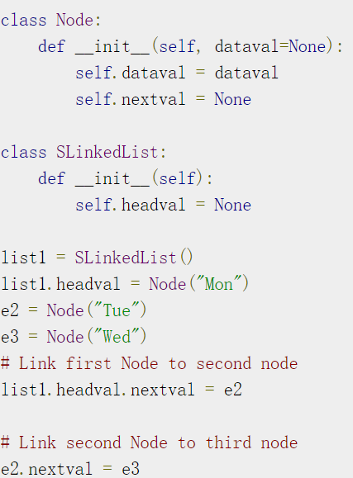
Linked List Implementation

Slide 14
Aside: What is a Class in Python?
Class – You can define your own “object” type.
Attributes – Variables that are associated with the object.
Functions – Functions that can apply to this object only.
Classic example: Book class
Attributes:
Title
Author
Content
Etc.
Functions:
Read
Put away
Bookmark
A linked list node has attributes to store the node data and the location of the next item.

Slide 15
Linked List Implementation
Mon
Tue
Wed
Mon
Tue
Wed
Mon
Tue
Wed

Slide 16
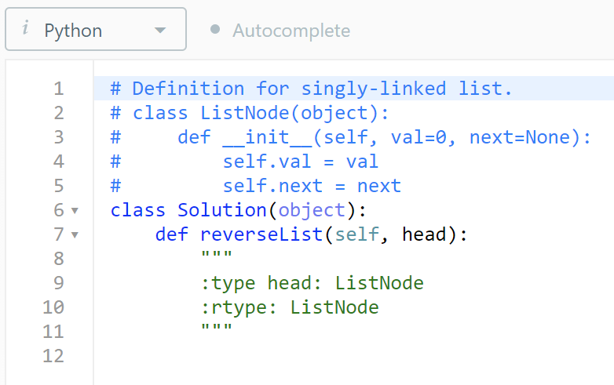
Reverse Linked List Exercise
https://leetcode.com/problems/reverse-linked-list/
Head
6
1
4
3
4
23
1
15
NULL
6
1
4
3
4
23
1
15
Head
NULL

Slide 17
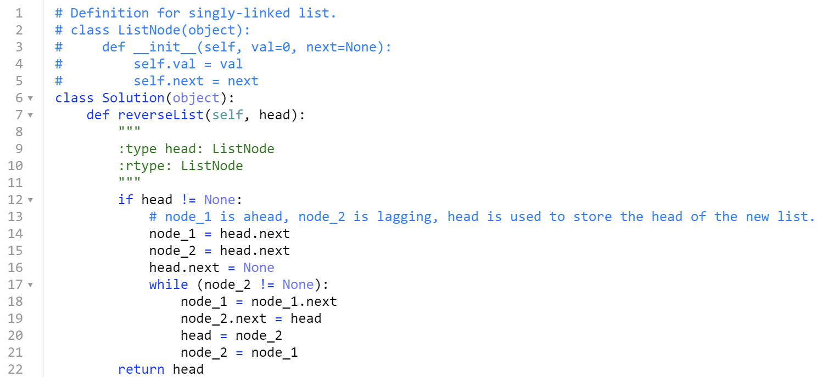
One Possible Solution
Head
Head
Head
Head
Head
Head
Head
6
1
4
3
4
23
1
15
Head
NULL
NULL

Slide 18

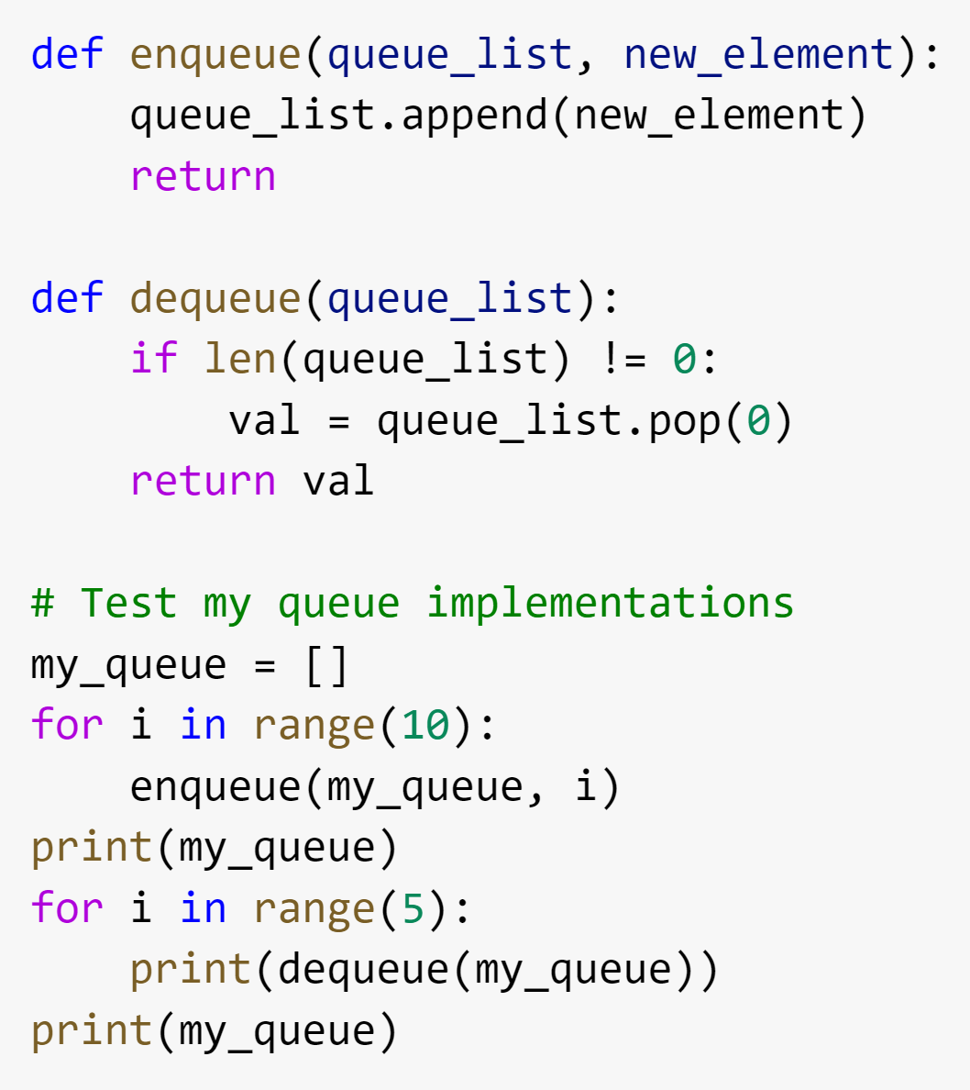
Waiting in a Queue
Queue: A First In First Out List
What will the output be?
Figure source: https://en.wikipedia.org/wiki/Queue_(abstract_data_type)

Slide 19

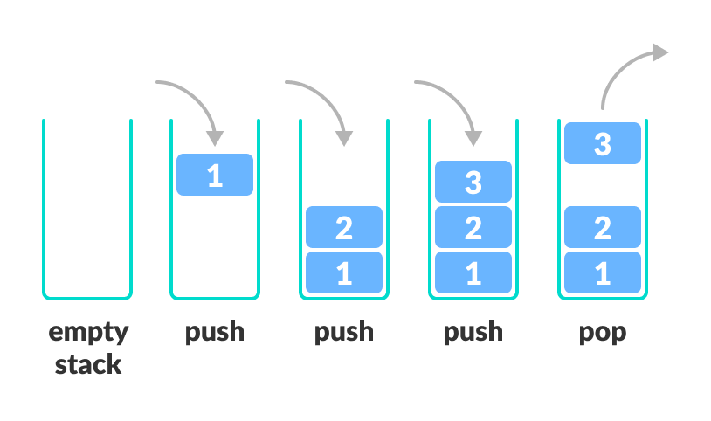
Stack
Stack: A Last In First Out (LIFO) list
The only difference is you remove the most recent element.
Exercise: How to convert the code for a queue into code for a stack?
Figure source: https://www.programiz.com/dsa/stack

Slide 20
Exercise
How would you convert the code for a queue into code for a stack?
Queue
Stack

Slide 21
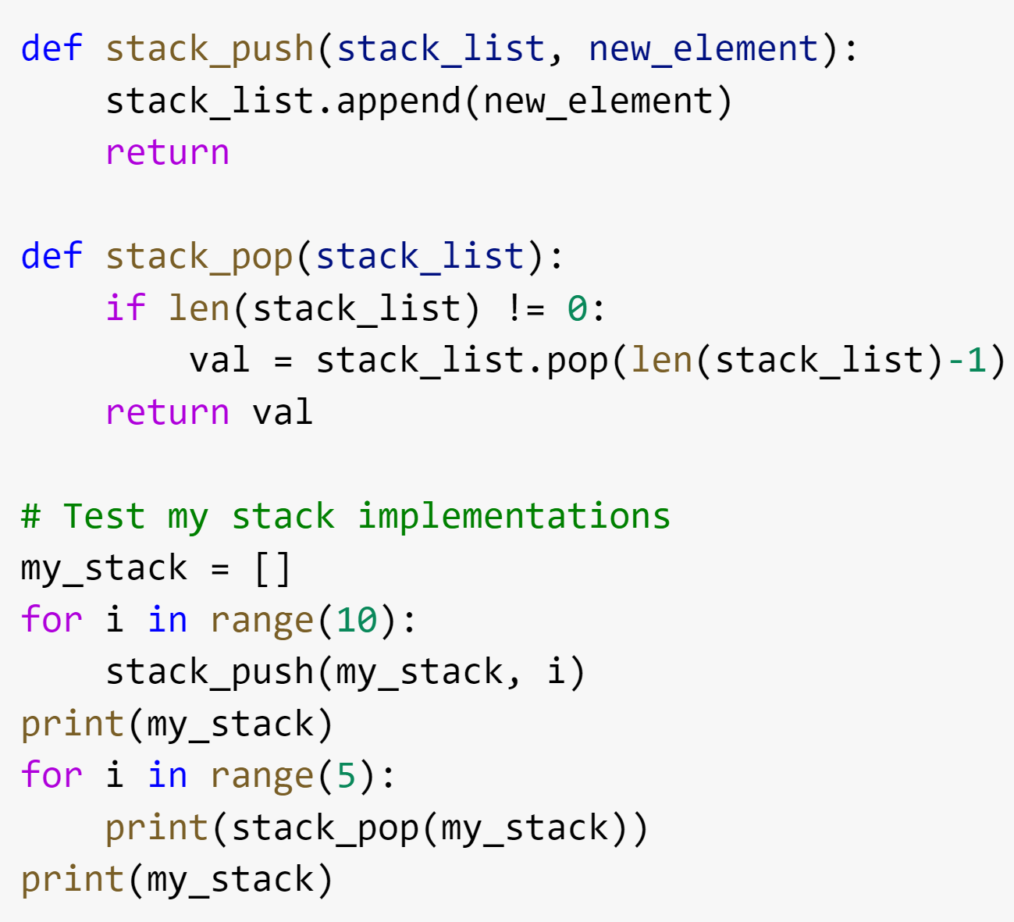
Solution
How would you convert the code for a queue into code for a stack?
Queue
Stack

Slide 22
Graphs
Structure of nodes and connections between those nodes
There is a large family of algorithms for handling graphs. We will talk a little bit about graph algorithms later in this module and the 5th module is dedicated to graphs.
A
B
JFK
C
LAX
LAX
STL
D
E
HNL
DFW
FTL

Slide 23
Trees
Hierarchical tree structure, with a root node and child nodes that may form their own subtrees.
This is represented as a set of linked nodes.
Each node other than the root node must have exactly one parent node.
A
B
C
D
E
F
G
H
I
J
K
L
M

Slide 24
Binary Search Trees
Special type of tree with no more than two child nodes per parent.
The left child must be less than or equal to the parent.
The right child must be greater than the parent.
How would I determine if the value 7 exists in the binary search tree?
4
3
15
1
4
6
23
1

Slide 25
Tree Exercise: In-order Traversal
Print out the values of the nodes in order from left to right.
For our binary search tree, the result would be:
1, 1, 3, 4, 4, 6, 15, 23
Not all binary trees are ordered like this.
Results should be based on position, not value.
There are other examples on the explanation on LeetCode
https://leetcode.com/problems/binary-tree-inorder-traversal/
Some python notation you may find useful:
empty_list = []
combined_list = list1 + list2
list_with_appended_value_3 = original_list.append(3)
4
3
15
1
4
6
23
1

Slide 26
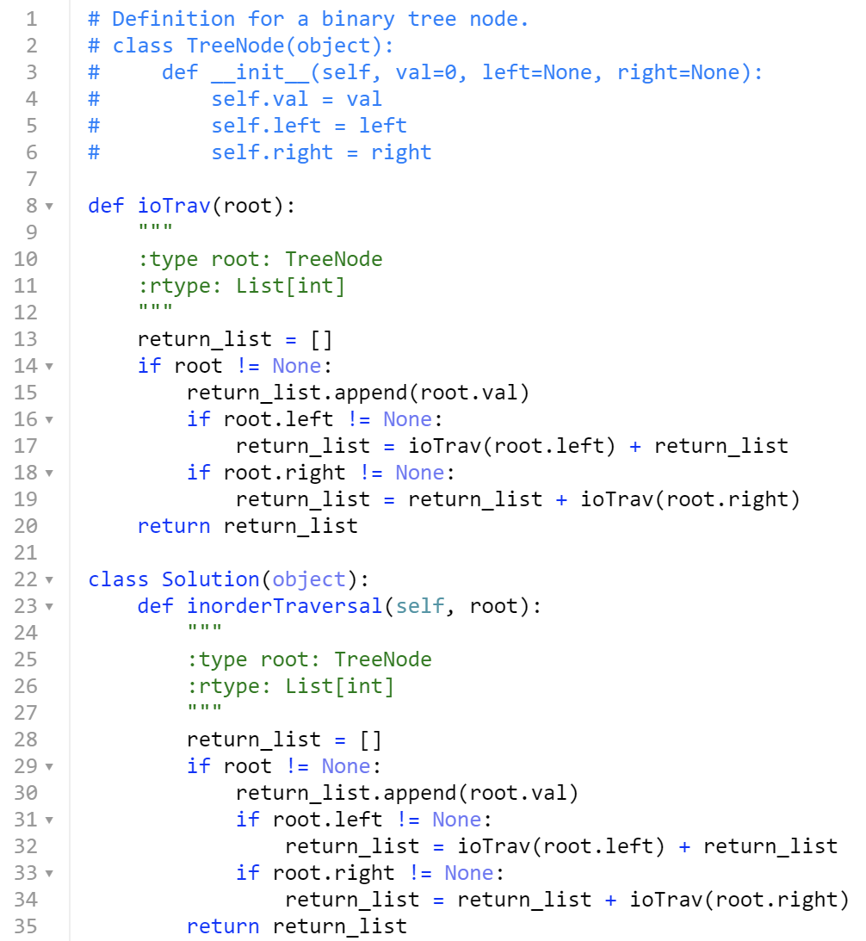
One Possible Solution

Slide 27
Summary of Data Structures
What we covered:
Array
Linked Lists
Queue (First In First Out)
Stack (Last In First Out)
Graph
Tree
Binary Search Tree
There are many other structures that we did not cover…
Heap
Hash
Strings
etc.
Many programming languages have libraries to handle the specific implementation details for common data structures.

