Slide 1
Agenda for Module 2
Part 1:
Introduction to Algorithms
Data Structures
Part 2:
Search Algorithms
Time Complexity
Part 3:
Sorting Algorithms
Part 4:
Graph Algorithms
Algorithmic Techniques

Slide 2

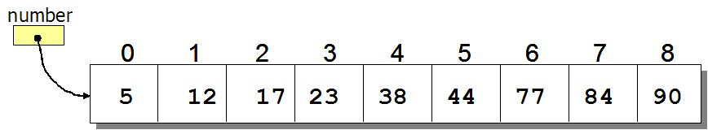
Search Algorithms
How to search for an element in a list?
Sequential search: Go through each element and check if it is the required element
Best case?
Worst case?
Source: http://www.spinachandyoga.com/how-to-deal-with-a-long-to-do-list-with-zen/
Source: http://www.csit.parkland.edu/~mbrandyberry/CS1Java/Lessons/Lesson27/BinarySearch.htm

Slide 3
Evaluating Algorithms
How do we know whether one algorithm is better than another?
for i = 0 to n
a = 1
for i = 0 to n
for j = 0 to n
a = 1
Which one runs faster?
Notes:
One way we determine whether an algorithm is better than another is by seeing how fast the algorithm runs.
Note to self – ask them which one runs faster, maybe set up a poll

Slide 4
Time-Complexity: Upper Bound O-notation
for i = 0 to n
a = 1
for i = 0 to n
for j = 0 to n
a = 1
O(n)
O(n²)
Algorithm X executes in 10n² + n / 3.7 + 22 steps → O(n²)
Algorithm Y executes in 100n log n + 14n + 22 steps → O(n log n)
Which algorithm runs faster?
Algorithm Y
Notes:
Explain Big O notation – worst case running time of an algorithm. There are other ways of measuring time complexity, but we don't cover them here
Explain how time complexity is dominated by the largest term, which simplifies time complexity estimation

Slide 5
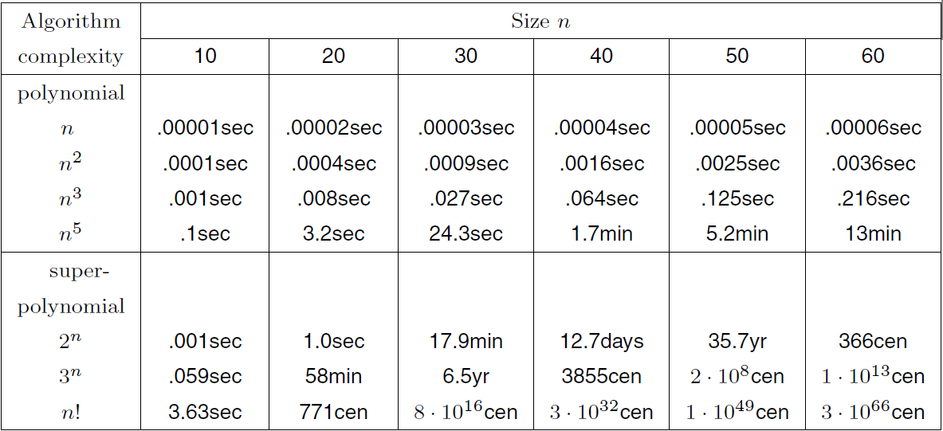
Running Time Comparison
Notes:
Why is this important?

Slide 6
Running Time Comparison

Slide 7
Running Time Comparison

Slide 8
Running Time Comparison
Good
Bad!
Notes:
Note – time complexity lets us characterize of how fast an algorithm can run, with the larger time complexity being worse for running time.

Slide 9
Search Algorithms
How to search for an element x in a list?
Sequential search: Go through each element and check if it is the the required element
Best case?
Worst case?
What if the list is sorted?
Can we do better?
YES
BINARY SEARCH
Source: http://www.spinachandyoga.com/how-to-deal-with-a-long-to-do-list-with-zen/

Slide 10
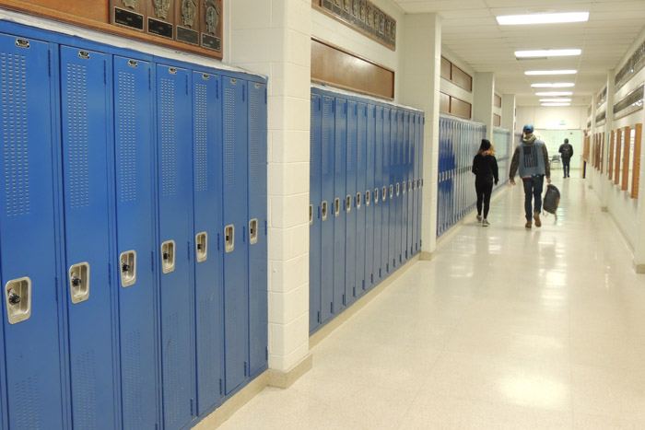
Binary Search Problem
Problem: You are looking for your school locker, which is number 151. At one end of the hallway, the lockers start at 100, and they end on 199 on the other side of the hallway.
What is the best way to search for your locker?
Notes:
You should also set up a poll question for this.

Slide 11
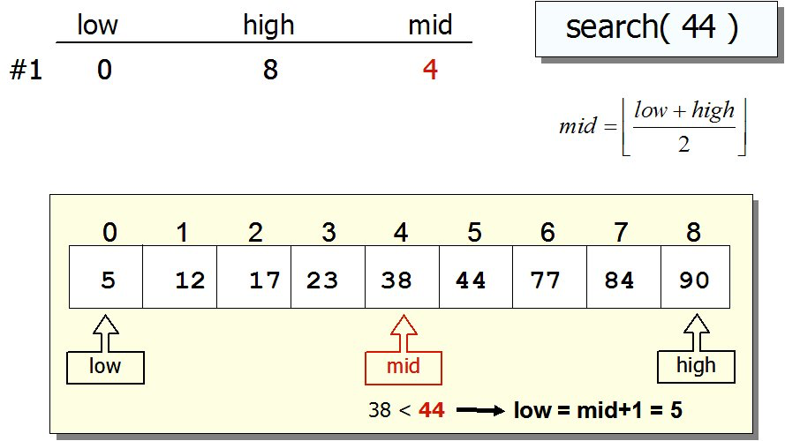
Search Algorithms: Binary Search
If list is sorted:
Split list into two halves. If x is greater than element in the middle, then discard the left half. Otherwise discard the right half. Repeat until you find x.
Source: http://www.csit.parkland.edu/~mbrandyberry/CS1Java/Lessons/Lesson27/BinarySearch.htm

Slide 12
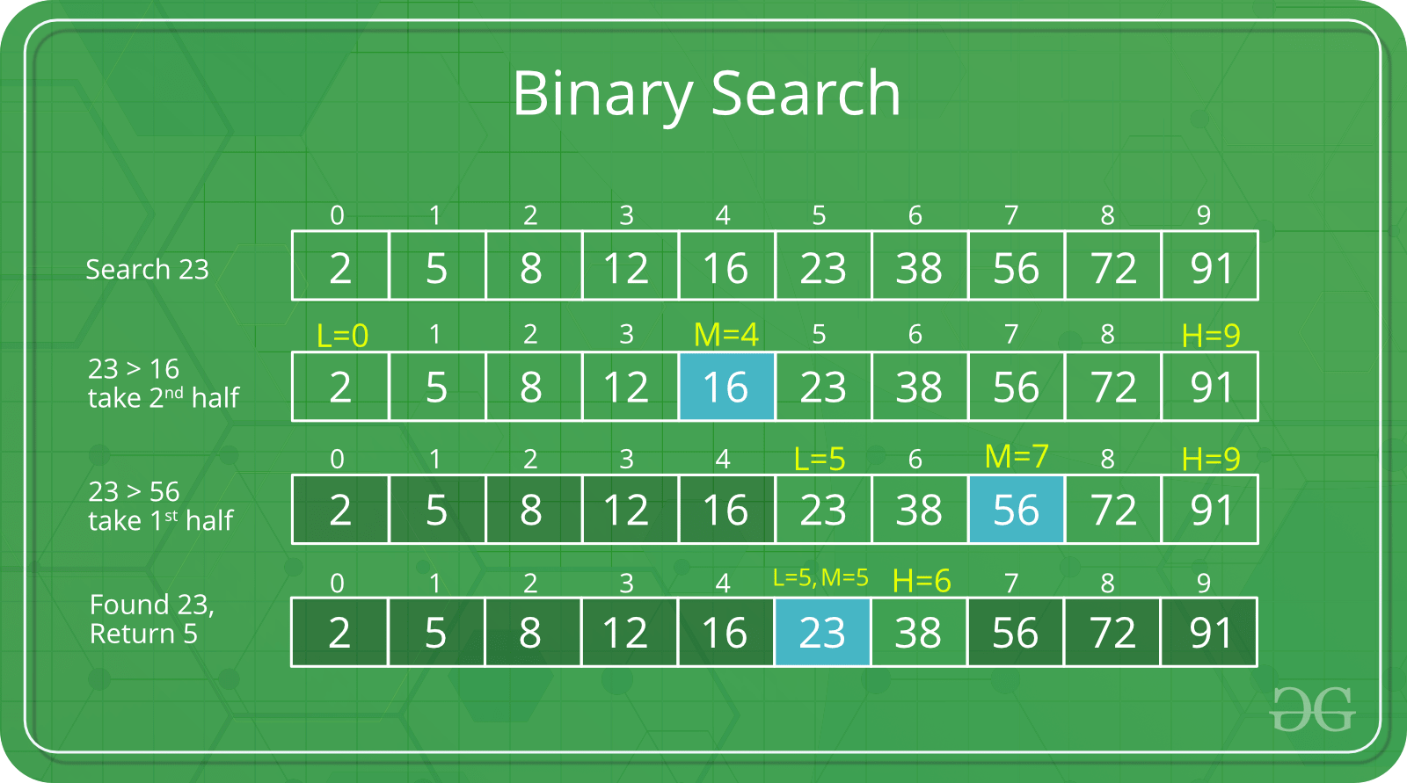
Search Algorithms: Binary Search
If list is sorted:
Split list into two halves. If x is greater than element in the middle, then discard the left half. Otherwise discard the right half. Repeat until you find x.
Sourcehttps://www.geeksforgeeks.org/binary-search/

Slide 13
Search Algorithms: Binary Search
If list is sorted:
Split list into two halves. If x is greater than element in the middle, then discard the left half. Otherwise discard the right half. Repeat until you find x.
Sourcehttps://www.geeksforgeeks.org/binary-search/

Slide 14
Search Algorithms: Binary Search
If list is sorted:
Split list into two halves. If x is greater than element in the middle, then discard the left half. Otherwise discard the right half. Repeat until you find x.
Sourcehttps://www.geeksforgeeks.org/binary-search/

Slide 15
Search Algorithms: Binary Search
If list is sorted:
Split list into two halves. If x is greater than element in the middle, then discard the left half. Otherwise discard the right half. Repeat until you find x.
Sourcehttps://www.geeksforgeeks.org/binary-search/

Slide 16
Search Algorithms: Binary Search
Running time?
First, consider sequential search:
How many elements remain after each iteration?
10, 9, 8, 7 … 1 -> ( O(n) )

Slide 17
Search Algorithms: Binary Search
Running time?
First, consider sequential search:
How many elements remain after each iteration?
10, 9, 8, 7 … 1 -> ( O(10) )
Now consider binary search:
How many elements remain after each iteration?
10, 5, 2, 1 -> ( O(4) )

Slide 18
Search Algorithms: Binary Search
Running time?
First, consider sequential search:
How many elements remain after each iteration?
10, 9, 8, 7 … 1 -> ( O(10) )
Now consider binary search:
How many elements remain after each iteration?
10, 5, 2, 1 -> ( O(4) )
What if we had 20 elements?
20, 10, 5, 2, 1 -> ( O(5) )

Slide 19
Search Algorithms: Binary Search
Running time?
First, consider sequential search:
How many elements remain after each iteration?
10, 9, 8, 7 … 1 -> ( O(10) )
Now consider binary search:
How many elements remain after each iteration?
10, 5, 2, 1 -> ( O(4) )
What if we had 20 elements?
20, 10, 5, 2, 1 -> ( O(5) )
Every iteration we cut the list down in half ( N, N/2, N/4 … 1 )
So it is log(n) time!

