Slide 1
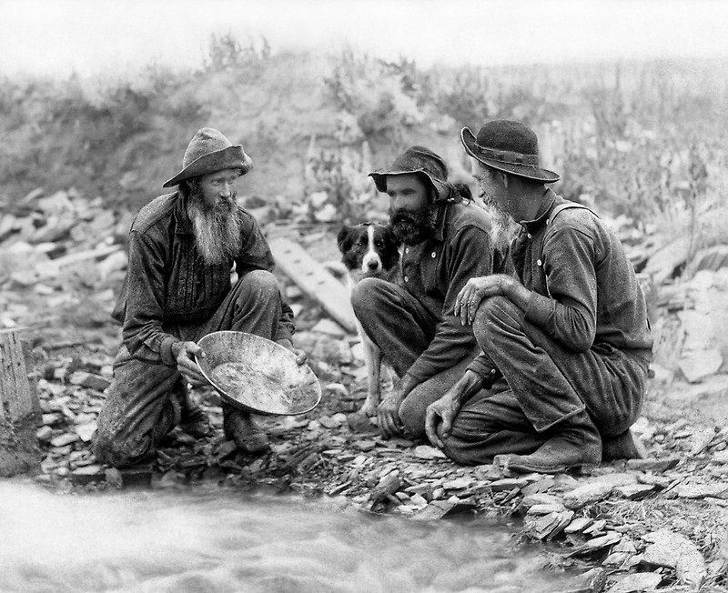
Text-Mining from Scratch with Python
Alina Arseniev-Koehler, Bernie Koch, + Ian Peacock

Slide 2
What is text mining?
Text is unstructured data. It doesn't mean much to a computer when fed in raw.
Text mining is the process of first cleaning text data (i.e., translating it to something a computer will understand) and then mining the cleaned data to discover something about it.
All files for today here: https://osf.io/cr8gm/files/

Slide 3
Examples of Text Mining
1) Detecting the sentiment of tweets with "Sentiment Analysis.” Are tweets with positive sentiment re-tweeted more than those with negative sentiment?
2) Finding themes in large quantities of interview data using "Topic Modeling"
3) Detecting gendered biases in news data with "Word2Vec"
4) Detecting when Facebook posts refer to celebrities with "Named Entity Recognition." Which celebrity-mentions garner the most "likes" ?
5) Predicting whether blogs are written by men and which are by women using a classifier (e.g., Naive Bayes). Is writing style gendered?
6) Does use of the “thoughts and prayers” predict partisan identity or being a recipient of NRA funds? (e.g., use Naive Bayes)

Slide 4
From a .txt file to a story
We start with the most difficult part of text mining: clean and pre-process text-data
Cleaning: reading in the raw data, reorganizing it in Python so it is structured in a way that matches your needs (e.g., a list of sentence, or a list of documents, or one big list of words)
Pre-processing: For example, make all lowercase, remove punctuation, stemming, tokenizing, remove "stopwords"
After cleaning, get to know the data, like any analyses:
Some ways to get to know text data include:
reading small chunks, visually inspect to make sure it is cleaned correctly
looking at the most(or least) common words
looking at how common certain words are that are related to your text-mining goals/hypotheses
Then, apply your text-mining techniques:
NLP Techniques
part-of-speech taggging (POS)
named entity recogntion (NER)
#Unsupervised Analytic Methods
hierarchical clustering
k-means clustering
topic modeling
clustering with doc2vec
#Supvervised Analytic Methods (Classification)
nearest neighbor classifiers
decision trees
rule-based classifiers
probabilistic classifiers such as naive bayes
##Modeling Language as Vectors
##Word2Vec, FastText, GloVe, and other variants

Slide 5
From a .txt file to a story
After cleaning, get to know your data:
Read small chunks, visually inspect to make sure it is cleaned correctly
How much data do you have?
What are the most(or least) common words?
How common are certain words are related to your goals/hypotheses?

Slide 6
From a .txt file to a story
Apply your text-mining analyses or techniques:
NLP Techniques
part-of-speech tagging (POS)
named entity recognition (NER)
Unsupervised Analytic Methods
hierarchical clustering to find “groups of similar documents”
k-means clustering to find “groups of similar documents”
topic modeling to find “themes”
Supervised Analytic Methods (Classification)
ML approaches: nearest neighbor classifiers, decision trees, naive bayes
rule-based classifiers
Notes:
ML= machine learning

Slide 7
From a .txt file to a story
Apply your text-mining analyses or techniques:
Modeling language
Vector-models, such as Word2Vec, FastText, Doc2Vec, Paragraph2Vec, GloVe, and other variats
Combination of techniques:
Cluster Doc2Vec vectors
For a thorough review of text mining concepts, see:
Allahyari, Mehdi et. al. "A Brief Survey of Text Mining: Classification, Clustering and Extraction Techniques." 2017. ArXiv.

Slide 8

Battleplan
Part I: Programming Basics (String Operations)
Part II:
Regular Expressions (Files, Looping)
NLTK (pre-processing and NLP)
Naive Bayes

Slide 9
Regular Expressions
Perform find and replace tasks at large scale
Find, identify, and mark sentences, paragraphs, and cases containing words, parts of words, or any sequence of characters (numbers and symbols included)
Can also be helpful for finding fuzzy matches or close matches
Extract important numerical information like zip-codes, dates, emails, or phone numbers from tricky blocks of text that follow no clear pattern
This can be especially useful when doing things like web-scraping

Slide 10
Pre-processing and NLP
Tokenizing: Chop up or tokenize texts into smaller units that maintain meaning, while also reducing information that are potentially superfluous
Stemming: Reduce words to their core or stem to find patterns that might not be as apparent with different conjugations, prefixes, and suffixes
Remove stopwords: Remove common words, such as conjunctions or prepositions, that might be of little value in helping to analyze documents or match parts of text
Part-of-Speech Tagging: Tag lexical categories or different parts of speech such as nouns, verbs, pronouns, etc
Named Entity Recognition: Tag common entities which may be more than one word, such as “New York City” or “UCLA”.

Slide 11
Unsupervised and Supervised Analyses
Supervised: PREDICT/DETECT/CLASSIFY
Develop algorithms to recognize different parts or sequences of speech such as questions or answers
Predict the presence or absence of some class or theme in the document given the features of a document
Unsupervised: CLUSTER
Find clusters of words that may strongly cohere together or hang around a central concept
Compare two or more words, sentences, or documents and see how similar they are

