Slide 1
E-Books:
MARC Fields
Notes:
MARC Fields used for cataloging monographic e-resources

Slide 2
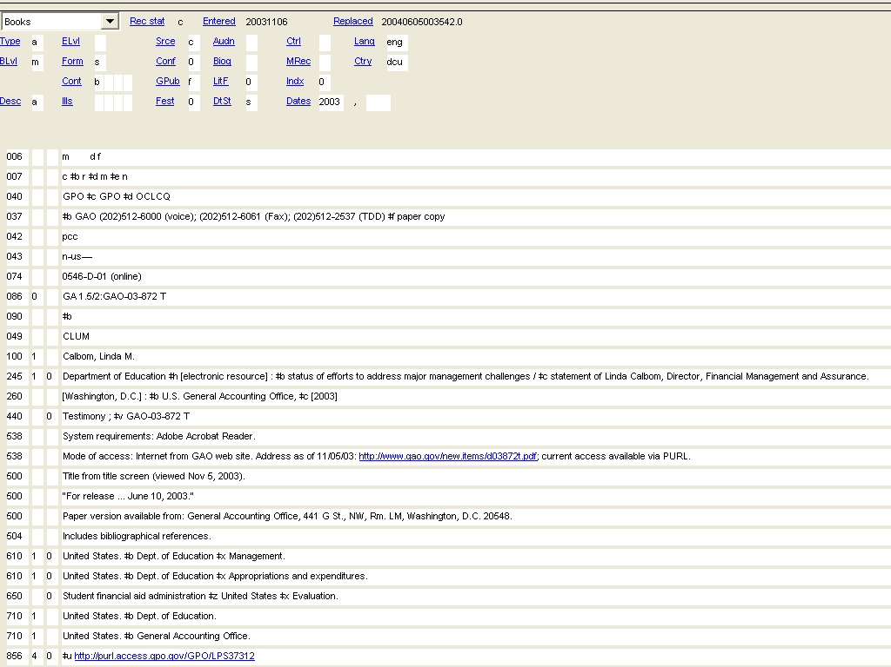
Notes:
Real-live record of an E-Book (a PDF)
Some obvious markers (should have):
Form fixed field – s, electronic resource
006 – Computer file
007 – Nature of document in terms of its being an electronic resource
245 $h --[electronic resource]
538 – Mode of access
500 – Source of title—viewed date.
856 – URL address {MOST IMPORTANT!}

Slide 3
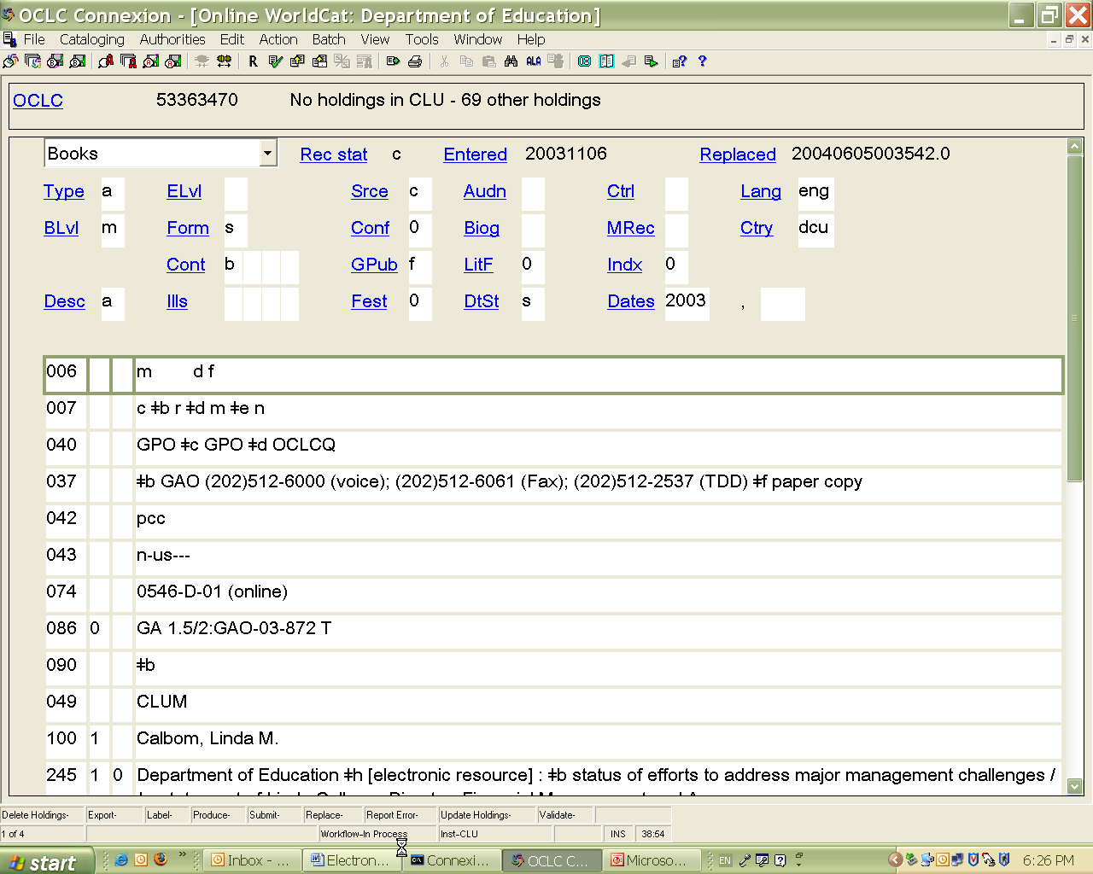
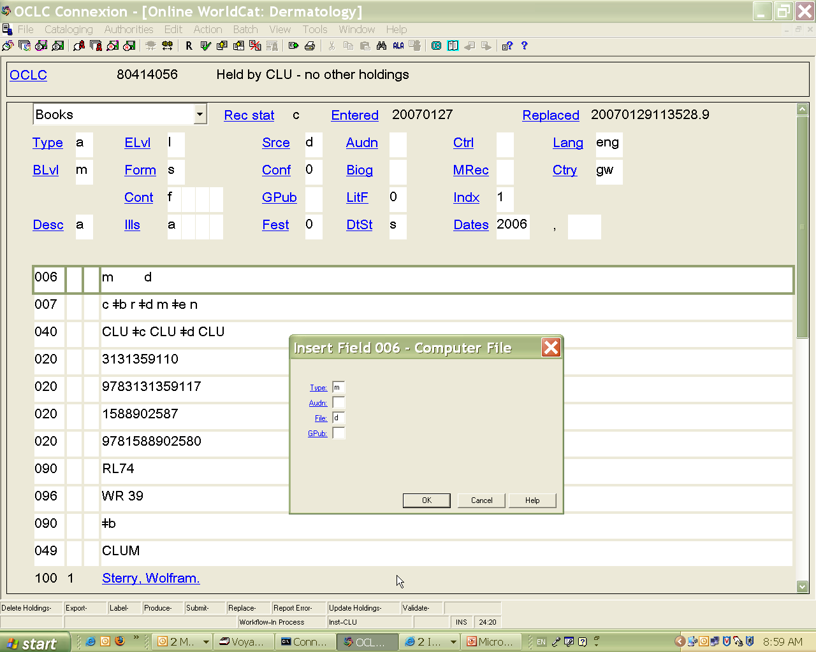
E-Books: Fixed Fields
Workform: Books
Form: s
Field 006: Computer File
006 |  |  | m d
Required fields:
Type: m (Computer file)
File: d (Document)
Required, if applicable:
GPub: {f, i, s, etc.}
Menu options:
Edit
→ Field 006
→ Insert (or Edit) → Computer Files
Notes:
Workform:
If cataloging from scratch, when picking out a workform, remember: E-Books simply Monographs in electronic form; so choose “Books” workform—very familiar!
Because E-Books are monographs, can just fill out fixed values the same as for print—with one exception: Form: always “s” (Electronic resource); otherwise, everything else the same.
006:
Always need 006 to convey that it’s a Computer File. At least 2 values:
m (always) in Type fixed field: Computer file
d (typically) in File fixed field: Document {c Representational; e Bibliographic data; m Combination}
Government Publication, if applicable; same value as in Workform: GPub.
To add 006, pull down options from menu, and you’ll get a box that allows to fill in information.
To edit 006, same process

Slide 4
E-Books: Variable Fields
Field 007:
007 |  |  | c ǂb r ǂd m ǂe n
‡a | Category of material | Mandatory/Mandatory | c : Electronic resource
‡b | Specific material designation | Mandatory/Mandatory | r : Remote
‡d | Color | Mandatory/Mandatory | b : Black-and-white c : Multicolored g : Gray scale m : Mixed
‡e | Dimensions | Required if applicable/ Required if applicable | n : Not applicable
‡f | Sound | Required if applicable/Required if applicable | a : sound n : Not applicable
Notes:
007
Always need 007 to convey that it’s electronic resource and for describing type of electronic resource.
Typically looks like this, but differing standards for what’s required
MARC?: c-r;
OCLC Bib Formats & Standards: 1st 3 values (a, b, d) – Mandatory; next 2 (e, f) – Required if applicable; after – Optional
Most records I’ve seen have these 4 values;
All examples in Rules & Tools have these 4;
We’ve decided on these 4
‡a Category of material: always c – electronic resource
‡b Specific material designation – remote (For tangible Elec. Res. (CD) ‡b o)
‡d Color – several options depending on the resource (Rules & Tools: “Use “m” for Web pages and sites with mixtures of text and images in B&W, gray scale, and color. Use “c” for colored images (digitized color photos, etc.) Use gray scale for black-and-white PDF and ASCII text documents, etc.”)
‡e Dimensions: For tangible Elec. Res. (CD) ‡e g – for 4 ¾ in. Dimensions not make sense for electronic resources – n: Not Applicable.
Even though Req. if Appl. and Not Appl., people tend to code it anyway
‡f Rare for monographs. But might be common in Music cataloging????

Slide 5
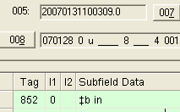
E-Books: Variable Fields
Field 050:
050 |  | 4 | HG3881.5.W57
Class number only. Omit cutter and date.
Field 049:
049 |  |  | CLYY
Overlay, if necessary.
Field 245, subfield h:
245 | 0 | 0 | Dermatology ǂh [electronic resource] : ǂb the profession, the philosophy, the way of life / ǂc edited by W. Sterry.
Field 260, subfield c:
260 |  |  | Stuttgart ; ǂa New York : ǂb Thieme, ǂc c2006.
Field 300: {OPTIONAL, only for PDF files}
300 |  |  | xx, 192 p. : ǂb digital, PDF file
1 electronic text : ǂb HTML file
Notes:
090
Add call number, but only class number. Don’t need to cutter. Everything before the $b.
049
Always code CLYY—no matter the subject matter or branch.
Most resources free. But if licensed, or if for any other reason, overlay necessary, make sure hldgs record has proper coding.
Should have “in” in 852. If not, do appropriate overlay coding in 049 or change holdings record.
245
Always add $h in 245 to designate “electronic resource”
260
Pointing out 260 $c only because it depends on the type of electronic resource. For monographs, use. For IRs, mostly won’t use.
300
300 field is an optional field. Most records, don’t use. We’ve decided to let people use, if they thought it helpful.
But only for PDF’s
There’s an option that some libraries like to use that says: 1 electronic text $b HTML file, but we’ve decided that this option should never be used.
So again: 300 field, if you choose to use it, do only for PDF’s, not websites or databases.

Slide 6
E-Books: Variable Fields
Field 538:
538 |  |  | System requirements: Adobe Reader.
For PDF files only.
538 |  |  | Mode of access: World Wide Web.
Field 500:
500 |  |  | Title from PDF title page (viewed on Oct. 16, 2003).
500 |  |  | Title from table of contents page (viewed on Apr. 1, 2005).
500 |  |  | Title from PDF caption (viewed on Aug. 22, 2004).
500 |  |  | Title from home page (viewed on Feb. 5, 2007).
For more examples, see the OLAC guidelines for Source of title notes.
http://ublib.buffalo.edu/libraries/units/cts/olac/capc/stnir.html
Field 530:
530 |  |  | Also available in print.
Notes:
538
For electronic resources, always include 538 designating the mode of accesses—for E-Books and IRs: the World Wide Web.
If you have a PDF, might also want additional 538 describing System Requirements—Adobe Reader
“Systems Requirements” note before “Mode of Access” note.
500
Also include 500 describing source of title.
Examples here in typically accepted form. More examples on OLAC
530
If you know another version of the resource exists, include this information in a 530.

Slide 7
E-Books: Variable Fields
Field 520:
520 |  |  | Provides fast, easy information-finding on a variety of general topics listed alphabetically. Gives suggestions for evaluating web sites and the information they contain and uses this criteria for inclusion of the sites selected. A sampling of topics includes acronyms, dictionaries, exchange rates, polls, resume writing, tax information, zip codes. Designed for University of Colorado, Boulder, librarians and clientele, but wide application for identification of useful electronic sites.
For more examples, see the OLAC guidelines for Summary notes.
http://ublib.buffalo.edu/libraries/units/cts/olac/capc/summnotes.html
Field 506:
506 |  |  | Access restricted to subscribers.
Field 856:
856 |  |  | ǂu http://www.richmondfed.org/publications/economic_research /working_papers/years.cfm/2006/
Notes:
520
Provide to summarize the resource.
For examples on formatting 520 fields, see OLAC
506
If resource is licensed, might want to provide note informing about access restrictions
856
Claudia covered

Slide 8
006 |  |  | m d
007 |  |  | c ǂb r ǂd m ǂe n
042 |  |  | pcc
050 |  | 4 | HG3881.5.W57
049 |  |  | CLYY
245 | 0 | 0 | Dermatology ǂh [electronic resource] : ǂb the profession… / ǂc edited by …
260 |  |  | Stuttgart ; ǂa New York : ǂb Thieme, ǂc c2006.
300 |  |  | xx, 192 p. : ǂb digital, PDF file
538 |  |  | System requirements: Adobe Reader.
538 |  |  | Mode of access: World Wide Web.
500 |  |  | Title from PDF title page (viewed on Oct. 16, 2003).
530 |  |  | Also available in print.
520 |  |  | Provides fast, easy information-finding on a variety of general topics listed alphabetically….
506 |  |  | Access restricted to subscribers.
856 | 4 | 0 | ǂu http://www.richmondfed.org/publications/economic_research /working_papers/years.cfm/2006/

