Slide 1
Session 3: Original Cataloging
  How are fixed fields coded for serials?
  What is the chief source for a serial?
  How do I determine the main entry for serials?
  What title information should be included in
  the record?
Notes:
References
The trainers may want to review the following pages:
CONSER Cataloging Manual, Modules 3-7
CONSER Editing Guide, Section E, Fields 100-247
CONSER Standard Record Documentation and
relevant Library of Congress Rule Interpretations, found at:
http://www.loc.gov/catdir/cpso/conser.html
Warm Up Exercises
See Appendix F for suggestions.
Questions for the Session:
The objectives of this session are to help the participants create an original catalog record for a serial title and in the process explain the key points in cataloging serials. To that end, the material in the session is focused on answering these questions:
How are fixed fields coded for serials?
What is the chief source for a serial?
How do I determine the main entry for serials?
What title information should be included in the record?

Slide 2
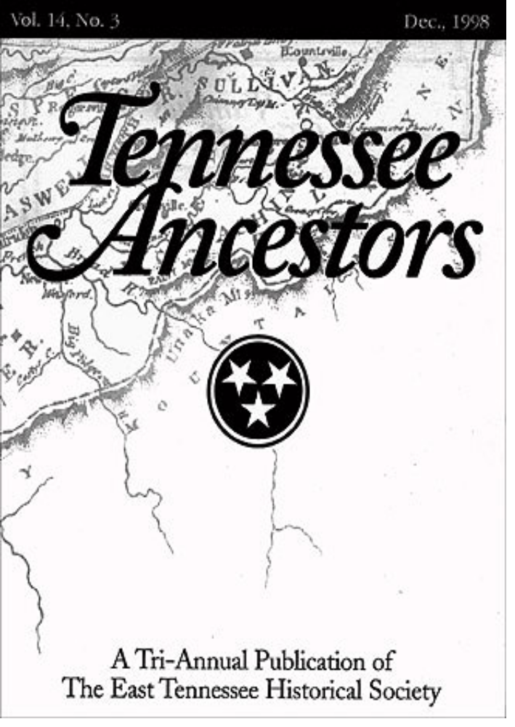
Serial example:
Vol. 14, No. 3 Dec., 1998
Cover
Notes:
[Note: This slide contains animation. Designation flies in.]
The next three slides show three pages found in an issue of Tennessee Ancestors which give different presentations of the title information.
We will examine these pages to determine which is the chief source of title information.
.

Slide 3
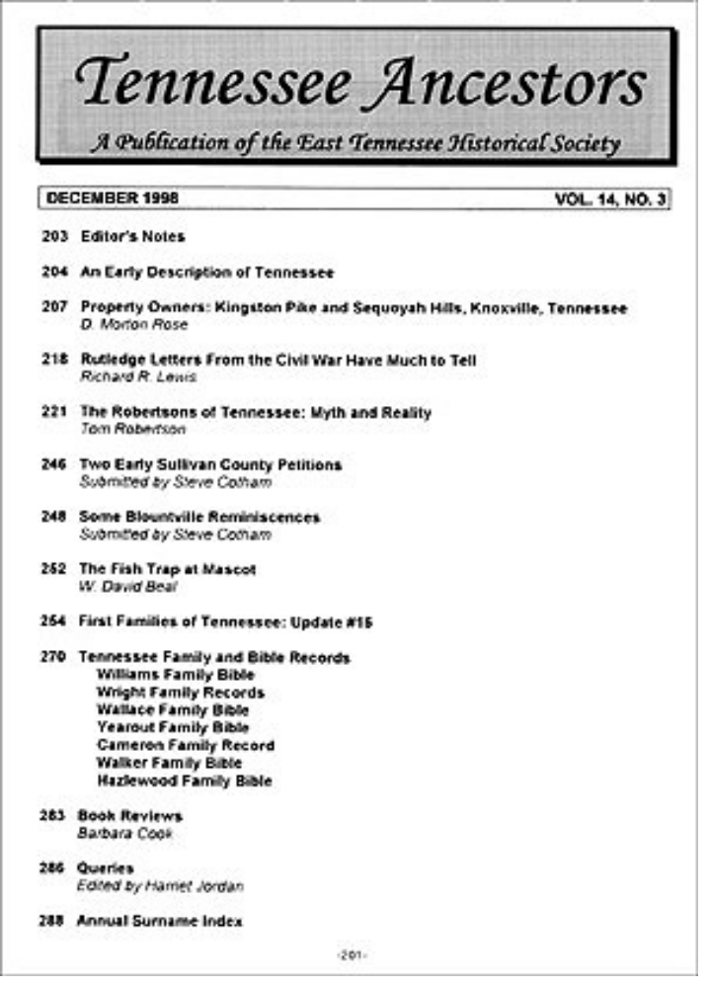
Serial example:
DECEMBER 1998 VOL. 14, NO. 3
Table of Contents
Page 201 (first page)
Notes:
[Note: This slide also contains animation.]
First page (p. 201) is a table of contents for December 1998, Vol. 14, No. 3.

Slide 4
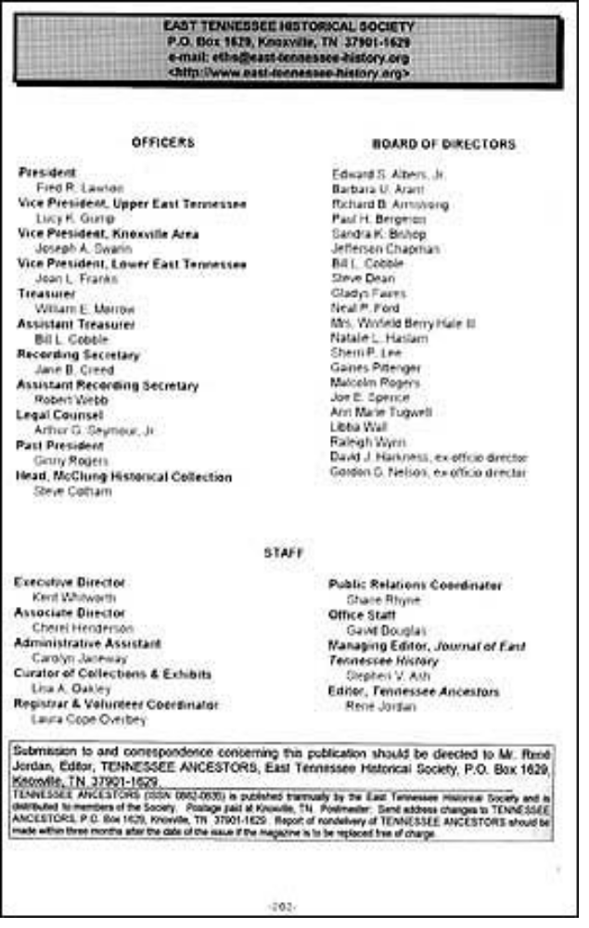
Serial example:
East Tennessee Historical Society
P.O.Box 1629, Knoxville, TN
Tennessee Ancestors (ISSN 0882-0635)
is published triannually by the East
Tennessee Historical Society ...
Verso of Table of Contents
Page ( P. 202)
Notes:
[Note: This slide also contains animation.]
Verso of page 201 is an editorial page. This page contains a masthead title (at bottom).
At bottom: Tennessee Ancestors (ISSN 0882-0635) is published triannually by the East Tennessee Historical Society and is distributed to members of the Society.

Slide 5
Key Elements in the Fixed Field
Publication status = currently published, “dead,”
or unknown
Beginning/ending dates = base this on year(s) in 362;
when combined dates,
use the last (e.g. 1993/1994)
OPTIONAL codes:
  Frequency = how often the serial is published
Regularity = is the frequency regular or not
Notes:
Our example, Tennessee Ancestors, is a print periodicals, so if we were cataloging this title, the Bibliographic Level would be coded as “s” (serial) and the serial fixed fields would be used.
Appendix H gives common values for the fixed field for serials. Full instructions and values are found in the CONSER Editing Guide.
Publication status: Code to indicate whether the title is currently published, dead or unknown (c, d or u).
Beginning/ending dates: Input the year(s) from the 362 field; for multiple dates use the later date (e.g., 1994 for 1993/1994).
NOTE: Since the implementation of the CONSER Standard Record in July 2007, coding for Frequency and Regularity is optional. (The default coding in the OCLC continuing resources cataloging template is a fill character for both of these elements.) In records created prior to July 2007, you will see these elements coded.
Frequency: Code to indicate how often the serial is published
Regularity: Code to indicate if the frequency is regular or not

Slide 6
More Elements in the Fixed Field
Original alphabet = NSDP or ISSN Canada
use only
Type of continuing = monographic series,
resource newspaper, periodical,
or none of the above
Entry convention = all current serial records
are coded as “0” for
successive entry
Notes:
Note to trainers: Explain to class that names of some of the fixed field bytes have been changed to reflect the expansion of the serials format to cover all continuing resources, e.g. integrating resources. For this workshop, we are only discussing the appropriate fixed field codes for serials.
Original alphabet or script or title: NSDP or ISSN Canada use only
Type of continuing resource: Code to indicate if the serial is a monographic series, a newspaper, a periodical, or none of the above. (Note: the former name for this byte was “Type of serial.”)
Entry convention: All current records are coded as “0” (successive entry). (Note: the former name for this byte was “Successive/Latest entry.”)

Slide 7
Sample Record Fixed Field Coding
Publication status c (current)
Beginning/ending dates 19uu, 9999
Frequency ■ (optional)
Regularity ■ (optional)
Type of continuing p (periodical)
resource
Entry convention 0 (successive entry
Notes:
In the case of Tennessee Ancestors, the fixed field would be coded as shown on this slide.
Note: Remember that the coding for Frequency and Regularity is now optional according to the guidelines for the CONSER Standard Record.

Slide 8
Basis of the Description: Which Issue?
The first issue (if available)
  362 1- $a Began with v. 1, no. 1 (May 2002).
    [Former practice:]
    362 0- $a Vol. 1, no. 1 (May 2002)-
The earliest available issue
Always state source of description
    500 -- $a Description based on v. 14, no. 3
    (Dec. 1998).
    500 -- $a Description based on first issue.
Notes:
Base the description on the first issue, if available. Input the chronological designation of the first issue in the 362 field. (Please note that the chronological designation is not the imprint date (AACR2 12.0B1, LCRI 12.0B1).
Note that the example shows two different kinds of 362 fields, formatted and unformatted; we will return to this in just a few minutes.
If the first issue is not available, then select the earliest issue in hand, i.e., the one with the lowest numeric or earliest chronological designation. In this case, unless you have information about the first issue, there will be no 362 field in your catalog record.
Always include a 500 “Description based on” note, whether or not you have the first issue or later issue(s) in hand. If you do have the first issue, the DBO note can state simply “Description based on first issue.”
NOTE: The method for recording information about the issue you are describing is very different since the implementation of the CONSER Standard Record. Take another look at the first bullet with the formatted and unformatted 362 fields. You will see both in shared catalog records, so I’m going to take a few minutes to discuss their former and current uses …

Slide 9
Former Practice: Pre-CSR
If cataloging from first issue:
  362 0- Formatted numbering statement
  No 500 “Description based on” note
If not cataloging from first issue:
  No 362 0- Formatted numbering statement
  500 “Description based on” note
If not cataloging from first issue, but have information about it:
  362 1- Unformatted numbering statement (note)
  500 “Description based on” note
Notes:
Prior to the implementation of the CONSER Standard Record, serials cataloging (and MARC tagging) depended on the issues available.
[Compare/contrast former practice and CSR]

Slide 10
For Example …
Have first issue:
  362 0- $a Vol. 1, no. 1 (Jan. 2001)-
Don’t have first issue:
  500 -- $a Description based on Vol. 1, no. 2
  (Apr. 2001).
Don’t have first issue, but have information about it:
  362 1- $a Began with v. 1, no. 1 (Jan. 2001).
  500 -- $a Description based on Vol. 1, no. 2
  (Apr. 2001).
Notes:
NOTE: In traditional AACR2 serials cataloging, the existence of the 362 field (whether formatted or unformatted) as well as the addition of a 500 “Description based on” note varies from record to record, depending on what piece or pieces the cataloger has in hand.
Current CONSER practice, which follows the guidelines for the CONSER Standard Record, is as follows:
362 is always in unformatted note style (but still only include it when you have the first issue or have information about it).
500 “Description based on” note is always included, even if you have the first issue.

Slide 11
Chief Source:
What Source Within the Issue?
Title page
Title page substitutes (preferred order):
    analytical title page (for series)
    cover
    caption
    masthead
    editorial pages
    colophon
    other pages
Note chief source (even if title page)
  Combine with “Description based on” note:
  Description based on first issue; title from cover.
  Description based on Jan. 2003; title from t.p.
Notes:
AACR2 instructs that the title page is the chief source of information (AACR2 12.0B1); however, many periodicals and other types of serials lack title pages altogether. A true title page does not contain text, tables of contents, editorial matter, etc. If no source in a publication fits this definition, choose a title page substitute in the order of preference shown here.
Selection of a chief source of title information according to AACR2 rules provides for a fixed point of reference during the lifetime of a serial which can be understood by any cataloger using the record. It also allows for recognition of a title change in the future.
As with the “Description based on” note, with the implementation of the CONSER Standard Record, catalogers now always note the chief source used for the title, even if it is the title page. This is another change from former practice. In effect, the inclusion of cataloger-type notes regarding the issue(s) consulted and the source of the title is no longer dependent on what the cataloger has in hand.
[Note: Most of the definitions for the sources are in the glossary in the appendices.]

Slide 12
Main Entry
Decision process:
  Does it fit one of the categories in AACR2
  21.1B2?
  If not, what is the title?
  Does this record need a uniform title?
Notes:
The main entry is the primary access point under which the serial will be cited. The main entry is used for single entry citations, such as in check-in files, or union lists. For serials, the choice of main entry is important in that changes in the main entry may require a new record.
Main entry for serials is almost always either title main entry or corporate body main entry. A serial will rarely be entered under a personal name.
[Note: the next slide contains information on 21.1B2.]

Slide 13
AACR2 Chapter 21.1B2
Categories Most Often Used for Serials
A. Works of an administrative nature
  (e.g., annual reports, directories, etc.)
C. Works that reflect the collective thought of a body
  (e.g., reports of commissions, etc.)
D. Collective activity of a body
  (e.g., conference proceedings)
Notes:
There are five categories given under rule 21.1B2.
Note that it is the nature of the contents and not the nature of the title that determines the main entry.
Category a is the one that most often applies as it includes most annual reports, financial reports, directories, etc. of a body.
Category c includes reports of commissions that are frequently serials, particularly reports that are mandated by a government.
Category d covers conference proceedings and the reports of annual meetings.
Other categories:
Category b applies to legal, religious and governmental works. Many legal publications are serials, so this category will often be applied if one is working with legal materials.
Category e covers the works of performing groups and is rarely applicable.

Slide 14
Main Entry
Entry under corporate body:
    110 2- $a International Centre for Settlement
    of Investment Disputes.
    245 10 $a Annual report / $c ICSID.
Entry under title (most common):
    245 00 $a Look Japan.
    245 00 $a Adobe magazine.
Notes:
Rule 21.1B2 categories most likely to apply to serials:
Category a includes those of an administrative nature dealing with the body itself, its policies, procedures, finances, operations (e.g., annual reports). This is the most commonly applied category for serials.
Category b deals with legal works, many of which are serials.
Category c includes works that record the collective thought of the body (e.g., reports of commissions or committees)
Category d covers conference proceedings, which are often serials.
Entry under title is the most common choice.

Slide 15
Main Entry
Entry under uniform title (LCRI 25.5B):
  Optional for CONSER Standard Record
    130 0- $a Network (Bristol, England)
    130 0- $a Network (Friends of the Earth)
  Required (even for CONSER Standard Record)
    130 0- $a Bulletin (Florida Orange Growers)
    130 0- $a Bulletin (Friends of the Earth)
Entry under personal author (rare):
  100 1- $a Gresham, Don.
  245 14 $a The country music newsletter.
Notes:
Uniform titles:
Prior to the implementation of the CONSER Standard record, entry under uniform title was called for in the case of two different serials with identical titles, both entered under title. The place of publication is usually used as the qualifier to distinguish the two serials, but a corporate body, frequency or physical format can also be used.
This form of uniform title, known as a differentiating uniform title, is governed by LCRI 25.5B and is used to distinguish different serials from one another. This is different from uniform titles known as collocating uniform titles, that are meant to bring together different versions of a work, such as musical recordings, legal materials, or versions of the Bible.
According to the guidelines for the CONSER Standard Record, most distinguishing uniform titles for serials are optional, except for these exceptions:
To distinguish one monographic series from another
When the title consists only of a generic term or a generic term plus a frequency word.
See LCRI 25.5B and CONSER Cataloging Manual, Module 5, for the history of how differentiating uniform titles have been applied to serial records.
Personal authorship is extremely rare for serials and is used only when the publication is so closely identified with one person that it is doubtful it would continue without them.

Slide 16
Title Proper: 245 $a, $n, $p
Title proper includes subfields $a (title), $n (numbering of section), and $p (name of section)
Importance of the title proper:
  used to determine major changes
  used in links
    245 00 $a OAH newsletter.
    245 04 $a The bookman. $n Part B.
    245 00 $a Journal of physics. $n E,
    $p Scientific instruments.
    245 00 $a Country profile. $p China,
    Mongolia.
Notes:
The title proper is transcribed from the chief source (see AACR2 12.1 and LCRIs).
The title proper may include subfields #a, #n and #p when present.
The choice of title proper is more important for serials than it is for monographs, because a change in the title proper may require a new record.

Slide 17
Title Proper
Omit variable data
  On piece: In record:
  5th Annual report Annual report
  The 1994 Directory The … directory
In our example:
    245 00 $a Tennessee ancestors.
    500 -- $a Description based on v. 14, no. 3
    (Dec. 1998); title from cover.
Notes:
Serial titles may contain variable data, such as the numbering that will only apply to that issue. Because the serial record must represent the entire serial, variable data is omitted from the title. Other data, such as prices or names of officials may also be omitted when they are likely to change on future issues.
The punctuation and capitalization may be changed as necessary, according to Appendix A in AACR2.
If the typography or layout of the words in the chief source causes doubt about what the publisher intends the title to be, consult other presentations of the title in the piece, such as the masthead or editorial page. (AACR2 12.1B3 and LCRI 12.1B3)
In our example, the title would be transcribed as:
245 00 #a Tennessee ancestors.
Remember to always add the combined “Description based on” and “Source of title” notes, as shown in our example as well.

Slide 18
Title Transcription Challenges
How would you transcribe these titles?
MIT’s
Technology Report
Government of Canada
Publications
du Gouvernement du Canada
ARL
Newsletter
Notes:
Use these examples to explain that publishers often pose challenges for the serials cataloger in determining how to transcribe the title. Explain that catalogers often must look elsewhere in the piece to determine whether or not to transcribe the name of a corporate body in the title (rule 12.1B3) and the difference between names that are grammatically linked (as in the MIT example) or not.
The Canadian example is one in which the word is meant to be read twice and thus is repeated according to 1.1B5.
(You may substitute other examples if you like.)

Slide 19
Other Title Information
Transcribe when considered useful:
  To provide clarification of the title proper
  245 00 $a Focus : $b a journal of legal studies.
  or
  245 00 $a Focus.
  500 -- $a “A journal of legal studies.”
  To “explain” the title proper (LCRI 12.1E1)
  245 00 $a Nature Conservancy : $b [newsletter].
“Cataloger’s judgment”
Notes:
Generally, other title information is not included in serial records unless it helps to clarify or in some way support the title proper. The subtitle is usually omitted because it can change frequently; however, when the title proper is very general, catalogers have a choice of including it. Transcribe the subtitle as other title information (245 $b) or as a quoted note (500).
Other title information may be needed to explain the title proper, as in the case here where the title consists only of a name of a corporate body.
There is no preferred way to handle other title information, although the guidelines for the CONSER Standard Record limit the cases where such information is necessary in the catalog record. This is an example of one of the areas where cataloger’s judgment comes into play.

Slide 20
Other Title Information
Initialisms/acronyms and parallel titles:
  Current practice (CSR):
    Record as 246 only
  Former practice:
    Recorded in 245 $b and 246 (variant title)
Statements of responsibility:
  Current practice (CSR):
    Not required to transcribe
  Former practice:
    Recorded in 245 $b (if part of subtitle) or $c
Notes:
According to guidelines for the CONSER Standard Record, record initialisms/acronyms not chose as the title proper in 246 13 (formerly would be coded in 245 $b). Record parallel titles as 246 11 (formerly would be coded in 245 $b).

Slide 21
Statement of Responsibility
Usually a prominently placed corporate body
appearing in conjunction with the title:
  News and events
  Art Institute of Chicago
Current practice (CSR): Not required
  National name authority record must exist
  If no name authority record, follow former practice and transcribe in 245 $b or $c
  245 00 $a News and events / $c Art Institute of
  Chicago.
Notes:
Before the implementation of the CONSER Standard Record, prominently placed corporate bodies appearing on the chief source were recorded in statements of responsibility in serial records, and added entries were made. According to the guidelines for the CONSER Standard Record, as long as an added entry is backed by a national name authority record (i.e., in the LC/NACO Authority File), the statement of responsibility is not required.
However, if there is no LC/NACO authority record, the corporate body must be transcribed so that usage can be traced for future authority work, as seen in our example here.
Generally, personal editors are not included in statements of responsibility, as they change over time. If the editor is considered of historical significance and important for access, he/she may be given in a note and an added entry made.

Slide 22
Variant Titles: Field 246
Titles that appear elsewhere on piece:
    245 04 $a The miner & workman's advocate.
    246 13 $a Advocate (running title)
Other forms of the title:
    245 04 $a The miner & workman's advocate.
    246 13 $a Miner and workman's advocate
Parallel titles:
    245 00 $a Japan report.
    246 11 $a Nihon
Notes:
Title added entries are generally made for other titles that the publication might bear (cover title, fluctuating titles, parallel titles, running titles, etc.) or for portions of titles and any variations of titles (initialisms, titles with ampersands, etc.) when these might reasonably be taken by a user as the true title. Variant titles also include minor title changes.
The guidelines for the CONSER Standard Record simplify the coding for the 246 field. For any variant titles found on the piece, including initialisms/acronyms not chosen as the title proper, use indicators 13 as shown in the first two bullets.
For parallel titles found on the chief source of the item described, used 246 11.
Appendix G in your manuals contains a list of indicator values for field 246, and although many of them are not used in current practice, they are still valid and will be found in many serial records.

Slide 23
Variant Titles
Variant titles:
    245 00 $a Freeport daily journal.
    246 1- $i Alternate issues published with title:
    $a Chicago daily telegraph
    245 00 $a Los Angeles design world.
    246 1- $i Issues for Nov. 2006- have title:
    $a LA design world
Titles that do not appear on any pieces:
    245 00 $a Tennessee ancestors.
    246 1- $i Popularly known as: $a Tenn an
Notes:
For any other title for which you wish to generate a note, use 246 1_ and input the text of the note in #i. This is commonly used for alternating titles and for minor title changes, as shown in the examples under the first bullet.
Title added entries may also be made for works commonly known by titles that do not appear on any pieces (LCRI 12.7B4).
For example, if Tennessee ancestors were popularly known as Tenn an, a 246 could be added to the record.

Slide 24
Sample Record (current practice):
Type: a Elvl: Srce: Gpub: Ctrl: Lang: eng
Blvl: s Form: Conf: ■ Freq: ■ Mrec: Ctry: tnu
S/L: 0 Orig: EntW: Regl: ■ Alph:
Desc: a SrTp: p Cont: DtSt: c Dates: 19uu, 9999
245 00 $a Tennessee ancestors.
500 - - $a Description based on v. 14, no. 3 (Dec. 1998);
title from cover.
Notes:
So far, our original record for Tennessee ancestors would look like this if cataloged according to current practices, following the guidelines for the CONSER Standard Record.

Slide 25
Sample Record (former practice):
Type: a Elvl: Srce: Gpub: Ctrl: Lang: eng
Blvl: s Form: Conf: 0 Freq: t Mrec: Ctry: ust
S/L: 0 Orig: EntW: Regl: r SSN: Alph:
Desc: a SrTp: p Cont: DtSt: c Dates: 19uu, 9999
245 00 $a Tennessee ancestors : $b a tri-annual
publication of the East Tennessee Historical Society.
500 - - $a Description based on: Vol. 14, no. 3 (Dec. 1998);
title from cover.
Notes:
You may see existing cataloging for Tennessee ancestors that looks more like this.
To note:
Fixed field values for Freq and Regl
Transcription of other title information in 245 #b
Slight difference in grammar of “Description based on” note. (CSR guidelines removed the colon in the case where the sentence was a natural-language sentence.)

Slide 26
Summary
Base the description on the chief source of the first or earliest available issue in hand
The chief source is the title page or its substitute (cover, caption, etc.)
Most serials are entered under title
Uniform titles are sometimes used to distinguish different serials with the same title (entered under title)
Record the title proper as it appears on the chief source, except for capitalization, punctuation and omissions
Record other title information when considered useful
There are important differences between the CONSER Standard Record and former practice

Slide 27
Session 3: Exercises
Notes:
Instructions for exercises:
Use the workforms provided in Appendix D to record the cataloging data from the information provided in the following pages.
Select the chief source.
Select and tag a main entry, if any.
Transcribe and tag the title proper.
Make any title added entries thought useful.
Indicate any other title-related notes thought appropriate (i.e., source of title, DBO).
[Note: Examples 1-3 are easy. Example 4 is more difficult.]

Slide 28
Answers: Example 1
Chief Source: cover
Type: a ELvl: Srce: d GPub: Ctrl: Lang:
BLvl: s Form: Conf: ■ Freq: ■ MRec: Ctry:
S/L: 0 Orig: EntW: Regl: ■ Alph:
Desc: a SrTp: Cont: DtSt: Dates: ,
245 00 $a Bells and bellringing.
500 -- $a Title from cover.

Slide 29
Exercises: Example 2
Chief source: caption at the top of page [1]
Type: a ELvl: Srce: d GPub: Ctrl: Lang:
BLvl: s Form: Conf: ■ Freq: ■ MRec: Ctry:
S/L: 0 Orig: EntW: Regl: ■ Alph:
Desc: a SrTp: Cont: DtSt: Dates: ,
110 2- $a Illinois State Genealogical Society.
245 10 $a Newsletter.
246 13 $a ISGS
500 -- $a Description based on v. 20, no. 1 (Jan./Feb.
1999); title from caption.
Notes:
Suggestion to trainers: talk through how to decide whether the main entry is a corporate entry. (Publication contains financial statements, meeting schedule and is about the organization.)

Slide 30
Exercises: Example 3
Chief source: cover
Type: a ELvl: Srce: d GPub: Ctrl: Lang:
BLvl: s Form: Conf: ■ Freq: ■ MRec: Ctry:
S/L: 0 Orig: EntW: Regl: ■ Alph:
Desc: a SrTp: Cont: DtSt: Dates: ,
110 2- $a Art Institute of Chicago.
245 14 $a The Art Institute of Chicago annual report.
-- $a Description based on 1981/82; title from cover.
500 -- $a Latest issue consulted: 2001/02.

Slide 31
Exercises: Example 4
Chief Source: cover of 1966 edition
Type: a ELvl: Srce: d GPub: Ctrl: Lang:
BLvl: s Form: Conf: ■ Freq: ■ MRec: Ctry:
S/L: 0 Orig: EntW: Regl: ■ Alph:
Desc: a SrTp: Cont: DtSt: Dates: ,
245 00 $a California information almanac.
500 -- $a Description based on 1966 ed.; title from cover.

