Slide 1
Basic Serials Cataloging Workshop
Serials Cooperative Cataloging Training Program
(SCCTP)
© 2008 The Library of Congress

Slide 2
Workshop goals
Identify serials and distinguish them from
monographs and integrating resources
Become familiar with MARC 21 tags used for serials
Create original serials cataloging records
Identify “appropriate” serial copy and needed
edits
Introduce the cataloging of electronic serials
Notes:
Welcome to the SCCTP Basic Serials Cataloging Workshop! This is a two-day course that will cover some of the basic principles associated with the creation of original cataloging records and the identification and editing of serials copy.
We’ll discuss what makes serials different, how they fit into the bigger picture of “continuing resources,” and how to identify them.
The workshop will cover both print and electronic serials.
Please note that there are other SCCTP courses that may be of interest to you:
The SCCTP Advanced Serials Workshop provides a more complete course on original cataloging of serials
The SCCTP Electronic Serials Cataloging Workshop provides a more focused course on online serials
The SCCTP Integrating Resources Workshop covers the cataloging of loose-leafs, Web sites, and databases
The SCCTP Serial Holdings Workshop covers the creation of holdings records

Slide 3
Session 1: Introduction
  Where do serials fit in the world of continuing resources?
  How does serials cataloging differ from the cataloging of monographs and integrating resources?
  What are the current conventions and practices?
  What tools are available?
Notes:
References
CONSER Cataloging Manual, Modules 0, 1
Guidelines for the CONSER Standard Record
The objectives of this session are to introduce the workshop and its goals, point out the basic differences between serials and other cataloging, note the role of standards, introduce the concepts of the CONSER Standard Record, and point out some helpful resources for serials catalogers.

Slide 4
Serials, Seriality, and Continuing Resources
Serials are one category of “continuing resource”
Integrating resources are the other category
Both exhibit seriality because they are issued or updated over time and can change
They are issued in a different manner and thus, the cataloging rules for them differ
Notes:
Continuing resources are bibliographic resources that have no predetermined conclusion and include both serials and integrating resources. Integrating resources is a category of materials that includes updating loose-leafs, Web sites, and databases.
The similarity between serials and integrating resources is that they both exhibit seriality, a quality that relates to their issuance over time and their ability to change.
As an example, a Web site that is updated daily has more similarities to a daily serial or newspaper than to a book.
The difference between serials and integrating resources is the form in which they are issued. Serials are issued in a series of parts; integrating resources are issued in one updated part. Because of this, the rules for them differ in some ways. But the rules for both are included in Chapter 12 of AACR2.
In the next session we will discuss the definition of a serial and how it differs from monographs and integrating resources.

Slide 5
Representation of Bibliographic Resources in AACR2
Finite resources
Continuing resources
Monographs
Integrating resources
Serials
Multi-parts
Updates remain
discrete
Updates do not remain discrete
Notes:
This model shows a representation of bibliographic resources in AACR2 which are first broadly separated into finite resources and continuing resources. Finite resources include monographs and multi-parts.
Note that multi-parts, even though they are incomplete, are not considered to be continuing resources and are cataloged as monographs.

Slide 6
Serial Cataloging Records
Reflect the whole publication
Are dynamic because they incorporate changes over time
Are cooperative creations (e.g., one library may create the record, another may update it)
Are important to the overall control of the serial and often are essential to other records (holdings, check-in)
Notes:
(Note: these characteristics really apply to any continuing resource; the distinction here is with monographs records)
Important aspects about serial records are:
The cataloging record should represent the whole publication (not any individual issue). For this reason, detail related to a single issue is not usually included.
Serial records are dynamic; i..e., no record is necessarily ever finished. Almost anything can change: their title, the publishing information, frequency, form of numbers, etc.
Some changes – such as title changes – are handled by making a new record according to “successive entry” cataloging rules. Less important changes are handled in notes.
Serial records are most often cooperative creations; i..e., no single cataloger will necessarily have all the issues or information in hand to catalog any run completely. The record may be created by a cataloger in one library but updated by another.
With current ILSs, bibliographic records for serials play an important role in the overall control of the serial, including purchase orders, check-in records, holdings, and item records. The bibliographic record is central to these and is essential in some systems.
-

Slide 7
Successive Entry Cataloging
Convention applied to all serials cataloged according to AACR2
Any major change results in the creation of a new (successive) record
Records are linked using 780/785 fields
Notes:
Successive entry records:
Successive entry convention calls for the creation of a new record each time a major change occurs. Major changes include some changes in title, changes of main entry, and changes in the physical format. Major and minor changes will be covered in session 7.
In successive entry cataloging, the preceding record is “closed out” and a linking field (785) is added to it. A linking field (780) is also added to the record for the successive title. The links are designed to bring together the records in the OPAC.

Slide 8
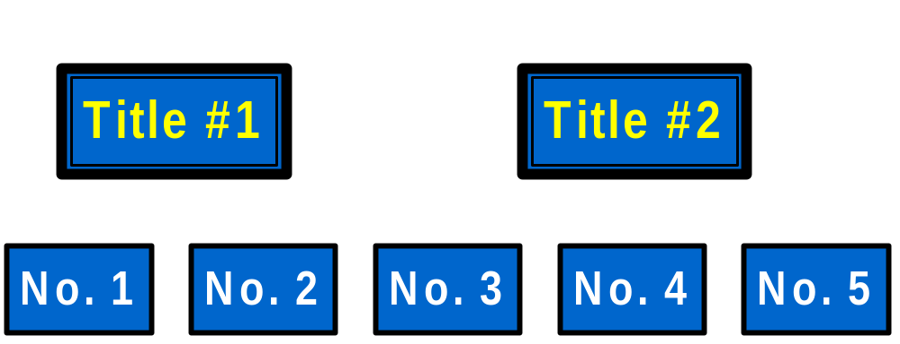
A Many to Many Relationship
Cataloging
Records
Serial
Issues
Notes:
As a result of successive entry, the relationship of a serial’s cataloging record(s) to the ongoing issues of the publication itself often entails one or more cataloging records to many individual issues, not one cataloging record to one issue, as with most monographs.

Slide 9
Successive Entry Record
Type: a Elvl: Srce: d Gpub: Ctrl : Lang: eng
Blvl: s Form: Conf: 0 Freq: b Mrec: Ctry: m
S/L: 0 Orig: EntW: Regl: r Alph:
Desc: a SrTp: p Cont: DtSt: d Dates: 1987,2000
010 -- $a sn87-109
022 -- $a 0892-2462
130 0- $a World (Boston, Mass.)
245 14 $a The world : $b journal of the Unitarian Universalist Association.
260 -- $a [Boston, MA] : $b Unitarian Universalist
Association, $c [1987]-
362 0- $a Vol. 1, no. 1 (Jan./Feb. 1987)-
362 1- $a Ceased in 2000.
780 00 $t Unitarian Universalist world $x 0041-7122
785 00 $t UU world $x 1532-7450
Notes:
Here is an example of a successive entry record. In this case, there is an earlier title (field 780) and a later title (field 785).
S/L in the fixed field = 0, which means successive entry

Slide 10
Standards
AACR2 and Library of Congress Rule Interpretations (LCRIs)
MARC 21
  http://www.loc.gov/marc/
CONSER
  http://www.loc.gov/acq/conser/
OCLC or other utility
Local standards, practices, etc.
Notes:
Standards for record creation and editing exist at several levels:
AACR2 and LCRIs
MARC21 definitions for tagging and coding
CONSER program cataloging standards and practices
OCLC or other utility input standards
Local standards, practices, etc.
The single best incentive for producing records that meet the MARC21, CONSER, and OCLC requirements is that the creation of more records at these levels in the utilities means that there will be more records shared and thus more cost effective and efficient library cataloging operations since copy cataloging for serials is faster and cheaper than original cataloging.
Records created at these levels do not preclude many desirable local options such as title and name added entries of local interest, etc.
Many policy decisions about local standards have implications beyond the realm of cataloging rules and practices – they touch on acquisitions issues, binding policies, check-in activities, staffing, public access, etc.

Slide 11
Useful Cataloging Tools
CONSER Cataloging Manual (CCM)
CONSER Editing Guide (CEG)
CONSER Standard Record (CSR) documentation:
  http://www.loc.gov/catdir/cpso/conser.html
Cataloger’s Desktop
Notes:
[Note: Appendix A contains a list of tools for serials catalogers. The trainer may wish to select a number of titles from the bibliography to present to the participants.]
The CONSER Cataloging Manual (CCM) and the CONSER Editing Guide (CEG) are available from the Library of Congress, Cataloging Distribution Service (CDS) both in print and on Cataloger’s Desktop. Updates to these manuals and to the Guidelines for the CONSER Standard Record are also available free online.
Cataloger’s Desktop is an online tool that provides Web access to AACR2 and LC’s other most heavily used cataloging publications, including CONSER documentation and Library of Congress Rule Interpretations. It is available by subscription through the Cataloging Distribution Service.

Slide 12
Summary
Serials are one type of continuing resource
Serials are dynamic publications that exhibit many variations over the course of their publication history
There are many useful tools in print and online to assist serials catalogers

