Slide 1
Session 2
Tools and Decisions
Notes:
SCCTP Integrating Resources Cataloging Workshop -- December 2008
Instructor Manual – February 2005
Session 2: Tools and Decisions
Page <number>

Slide 2
Session 2
What tools can help?
What decisions need to be made?
Notes:
Session 1: Introduction
Instructor Manual – February 2005
SCCTP Integrating Resources Cataloging Workshop
Page <number>
In this session we will discuss the tools that will enable you to catalog E-IRs, and primarily the cataloging manual designed for cataloging integrating resources by the PCC: “Integrating resources: a cataloging manual”.
I’ll briefly go over the organization of the manual, discuss also briefly some of the new content, and at the end of this session we will discuss some of the decisions that need to be made before you start to catalog an E-IR.
Session 2: Tools and Decisions
SCCTP Integrating Resources Cataloging Workshop -- December 2008

Slide 3
Tools
PCC documentation:
Integrating Resources: a cataloging manual
http://www.loc.gov/catdir/pcc/bibco/irman.pdf
Based on:
AACR2, 2nd ed. (esp. Chapters 1, 9 & 12)
And corresponding Library of Congress Rule Interpretations (LCRIs)
Notes:
These slides lists the primary resources that catalogers need to consult for original cataloging of integrating resources. The tool specifically aimed at IRs is the PCC document: Integrating resources : a cataloging manual, which is now Appendix A of the BIBCO participants manual, and will be module 35 of the CONSER cataloging manual. But freely available and downloadable from the PCC, CONSER Website. [they can bring it up on their laptops, PCs]
It brings together the relevant rules for IRs from AACR2 and the corresponding LCRIs, ostensibly to allow the cataloger to find the rules in one place.
Caveat: IR manual is still a “working draft”
Session 2: Tools and Decisions
SCCTP Integrating Resources Cataloging Workshop -- December 2008

Slide 4
Other tools
MARC 21 Format for Bibliographic Data (Cataloger’s Desktop, http://www.loc.gov/marc/bibliographic/ecbdhome.html)
OCLC (Including Bibliographic formats and Standards http://www.loc.gov/marc/bibliographic/ecbdhome.html)
Notes:
Session 2: Tools and Decisions
SCCTP Integrating Resources Cataloging Workshop -- December 2008

Slide 5
Tools continued
Internet Archive (http://www.archive.org/web/web.php)
OLAC CAPC Source of Title Note for Internet Resources (http://www.olacinc.org/capc/stnir.html)
Notes:
The Internet Archive, sometimes called, Wayback machine, has become a very useful tool especially for integrating resources that allow the cataloger to view a kind of a snapshot of what the resource used to look like in previous incarnations or “iterations”.
The Online Audio Visual Catalogers (OLAC) Cataloging Policy Committee (CAPC) resource mentioned here is also a useful reference for describing source of title notes in a more standard way.
We’ll return to these two resources after discussing the IR manual.
Session 2: Tools and Decisions
SCCTP Integrating Resources Cataloging Workshop -- December 2008

Slide 6
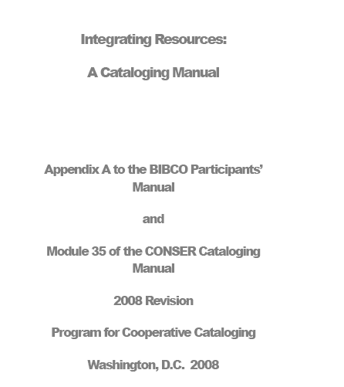
IR manual
Notes:
Front of the manual
One thing that should be mentioned up front is that what we are working with at present is what is called a “working draft”. It has been recently revised, but it hasn’t been gone through yet with a fine-toothed comb to work out every update that might need to occur.
Session 2: Tools and Decisions
SCCTP Integrating Resources Cataloging Workshop -- December 2008

Slide 7
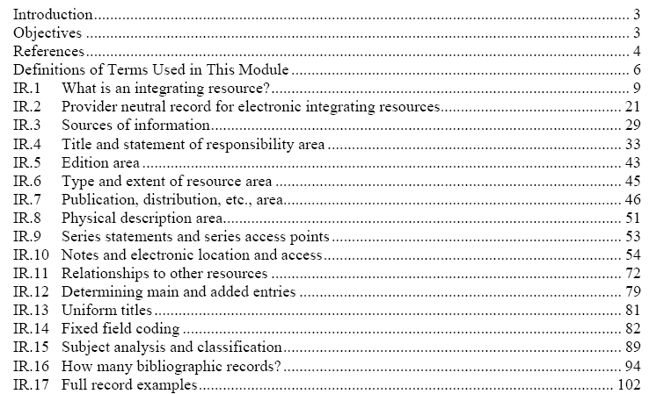
IR manual: structure: table of contents
Notes:
Notice that the “sections” or “chapters” are designated by “IR” plus a number. These designations can be a useful way to navigate the manual in addition to the page numbering.
The introductory material, highlighted in orange, provides a definition and rationale behind IRs as a cataloging concept, bibliographical references, glossary, and the objectives of the manual.
The areas highlighted in red:
IR 1, What is an integrating resources, has already been covered by Valerie.
IR.2, Provider neutral record for E-IRs we will discuss today.
The highlighted blue areas, IR. 4-10 reflect AACR2 order (Sources of information through area 7 notes)
The areas in green deal with main and added entries, the use of uniform titles, and linking relationships to other resources
The remaining areas, IR 14-17 provide useful reference. Note IR.17 consists of full record examples.
Session 2: Tools and Decisions
SCCTP Integrating Resources Cataloging Workshop -- December 2008

Slide 8
IR manual: structure: table of contents
Notes:
Lets take a look at the objectives.
Session 2: Tools and Decisions
SCCTP Integrating Resources Cataloging Workshop -- December 2008

Slide 9
IR manual: objectives
Define “integrating resource”
Instruct: IR bibliographic record creation
Instruct: updating bibliographic record
Distinguish IR from mono- or serial cataloging
Inform: special considerations in the cataloging of integrating resources
Notes:
The objectives section stipulates the scope of the manual:
it should help the cataloger understand the concepts of what constitutes an IR
creating bibliographic records for IRs, including applying appropriate MARC21 fields
and updating the bibliographic record when the IR changes
areas where integrating resource cataloging differs from monograph or serials cataloging
and special considerations in the cataloging of integrating resources.
Session 2: Tools and Decisions
SCCTP Integrating Resources Cataloging Workshop -- December 2008

Slide 10
IR manual: what’s new?
Essentially 3 major areas:
Provider neutral policy (IR.2)
Better explanation of language versions policy (IR. 4.2.1)
Option to apply CONSER standard record
Notes:
These are the three areas that have substantial new content.
We won’t be getting into the CSR material, but those of you who are serials catalogers and wish to apply the policy should know that you can and that where the option can be applied is listed in each applicable area of the manual.
Session 2: Tools and Decisions
SCCTP Integrating Resources Cataloging Workshop -- December 2008

Slide 11
IR manual: what’s new: “Provider neutral”
In the manual: IR.2
Scope:
E-IRs “that are available simultaneously from two or more different electronic service providers (one of which may or may not be the original publisher or society) but are essentially the same resource and consist of the same content”
Notes:
Are any of you familiar with the “Aggregator neutral” policy for serials cataloging? [can discuss a little if they are]
[students can follow in manual]
The policy is applied when the same resource is available by two or more providers.
Therefore, for a resource such as Agricola, available via the National Library of Medicine (original publisher) and via OVID, one record will be created.
Session 2: Tools and Decisions
SCCTP Integrating Resources Cataloging Workshop -- December 2008

Slide 12
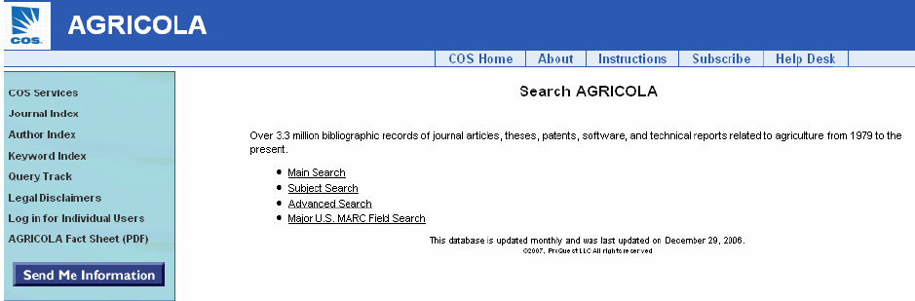
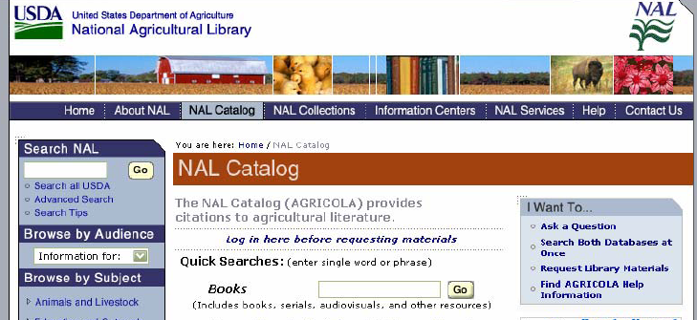
IR manual: what’s new: “Provider neutral”
Notes:
Here we see the example of Agricola via the National Agricultural Library interface and the one offered via the provider, Community of Science.
Session 2: Tools and Decisions
SCCTP Integrating Resources Cataloging Workshop -- December 2008

Slide 13
IR manual: what’s new: “Provider neutral”
Section IR2 of the manual:
Has statement of scope
Features of E-IR provider neutral policy
  Applicable to all provider versions
  Added entries only for original producer/society (e.g., for Agricola: National Agricultural Library)
  Note indicating provider version cataloging is based on:
  500 Title from home page (Community of Science, viewed Nov. 18, 2008)
Notes:
This section of the manual contains:
Statement of scope already quoted from in a previous slide
Describes features of the E-IR provider neutral record:
-the record is applicable to all provider versions and added entries are given only to the original producer/society that created the resource.
-The cataloger indicates in a note the version upon which the record is based.
Session 2: Tools and Decisions
SCCTP Integrating Resources Cataloging Workshop -- December 2008

Slide 14
IR manual: what’s new: “Provider neutral”
Section IR2 of the manual cont’d:
Field by field table for record creation
Guidelines: consolidation of duplicates
Types of resources
Example of Agricola IR
Notes:
Furthermore, this section of the manual provides
--MARC field by field guidelines in table format for record creation
--guidelines for record consolidation and duplicate deletion
--examples of resources and their original producers or societies vs their service providers or hosts
--an example using Agricola, a resource produced originally by the National Agricultural Library:
-showing a recent OCLC search results screen which illustrates the current problematic proliferation of these provider-based records
-Mockup of consolidated record based on provider neutral policy
-screen images of two different Web interfaces of Agricola
Session 2: Tools and Decisions
SCCTP Integrating Resources Cataloging Workshop -- December 2008

Slide 15
IR manual: what’s new: language versions
IR.4.2.1 “Online integrating resource in multiple languages” [section under review]
  Is the full content of the site available in another language?
  Separate ISSNs assigned to each language version?
  Language version have edition/version statements? (e.g., CNN en Español; CNN Türk.com)
Notes:
The IR manual has section IR.4.2.1 (Part of IR4, title and statement of responsibility) “Online integrating resources in multiple languages” which has been revised to give better guidance on the common situation when you find that the Web resource you are about to catalog appears to be offered in more than one language.
The section, still under review like the entire manual, poses several questions such as:
--Is the full content of the resource available in another language? Or does the alternate language version only consist of tables of contents or summaries? Or is the alternate language content merely an interface for navigating or searching a web site?
--Have separate ISSNs been assigned to the language versions
--Are formal edition statement associated with the language versions, such as “German ed.”, etc.
If the answer is affirmative for any of the three questions on the slide, you would prefer to enter separate records for each langauge version.
Session 2: Tools and Decisions
SCCTP Integrating Resources Cataloging Workshop -- December 2008

Slide 16
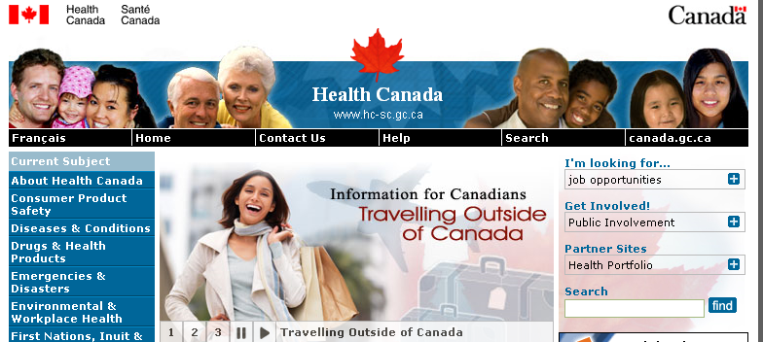
IR: Language versions: example
Notes:
Canadian government Web sites are mandated by law to be fully available in both official languages, English and French, so catalogers can create separate records, one for each language version.
Session 2: Tools and Decisions
SCCTP Integrating Resources Cataloging Workshop -- December 2008

Slide 17
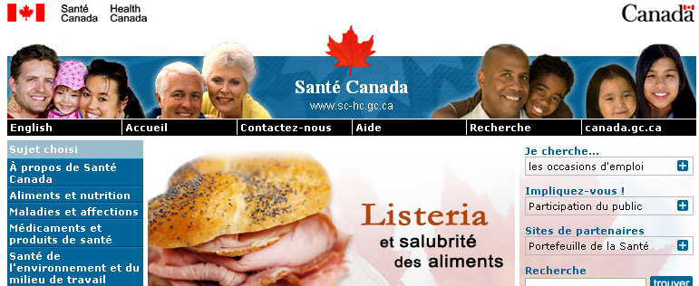
IR: Language versions: example
Notes:
And here is the French version of the same Web site.
Session 2: Tools and Decisions
SCCTP Integrating Resources Cataloging Workshop -- December 2008

Slide 18
Internet Archive: what it is
Internet Archive (http://www.archive.org/web/web.php)
Search by using URL
Search by keywords
Notes:
Internet Archive, sometimes called Wayback machine, takes snapshots of internet resources throughout their existence so that older iterations of a Web resource may be viewed. This can be useful to see how a resource’s title may have changed over the years, have other entities issued it over the years, and of course, it may provide information as to when it began.
You can search by copy/pasting or typing in the URL for the particular resource
OR, you can search by keywords. The advanced search allow you to select specific search criteria such as “Title” or “Creator”, etc.
Session 2: Tools and Decisions
SCCTP Integrating Resources Cataloging Workshop -- December 2008

Slide 19
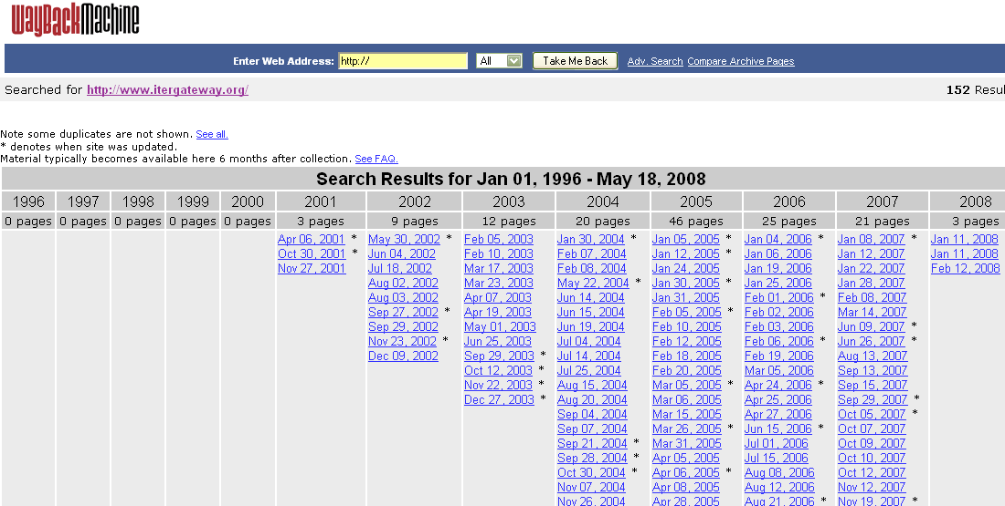
Internet Archive: searching example: www.itergateway.org
Notes:
It works best for independent resources, such as the example above, ITER: gateway to the Middle Ages and Renaissance. Here you get a nice display of the archive and an apparent indication of when the resource began. The results in this slide are from inserting the URL for searching.
Warning: even clicking on some of the archive links will not necessarily retrieve useful results.
Exercise: search http://www.debbiesbook.com/
Session 2: Tools and Decisions
SCCTP Integrating Resources Cataloging Workshop -- December 2008

Slide 20
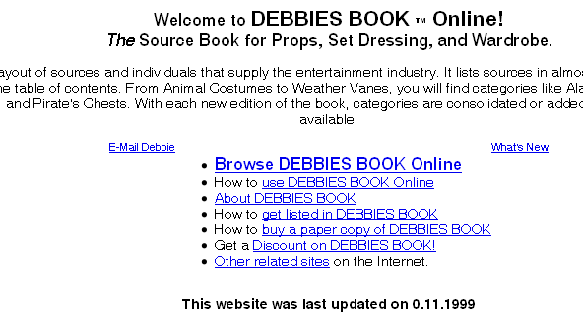
Internet Archive: example
Notes:
This is what the site looked like previously
Session 2: Tools and Decisions
SCCTP Integrating Resources Cataloging Workshop -- December 2008

Slide 21
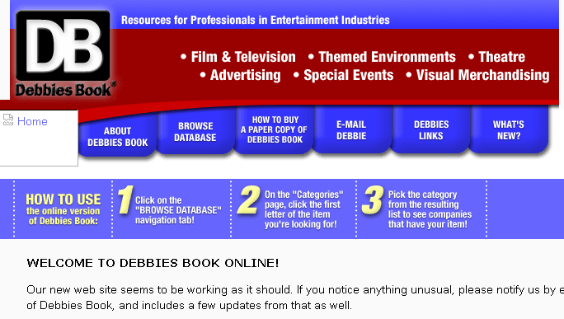
Internet Archive: example
Notes:
The later version has a slight change of title which is added to the 245. The older title is placed in a 247 field.
Session 2: Tools and Decisions
SCCTP Integrating Resources Cataloging Workshop -- December 2008

Slide 22
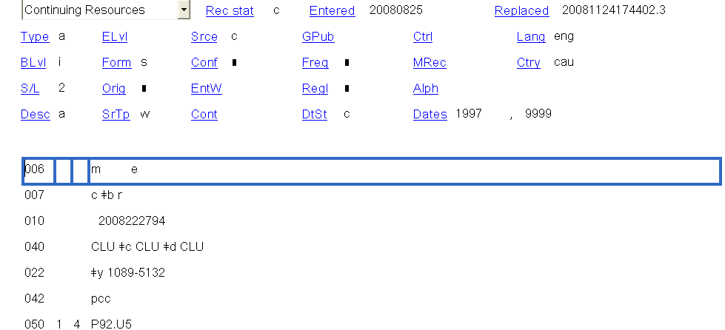
Internet archive example
Notes:
Here is the 2nd half of the record with the old title in the 247 field.
Session 2: Tools and Decisions
SCCTP Integrating Resources Cataloging Workshop -- December 2008

Slide 23
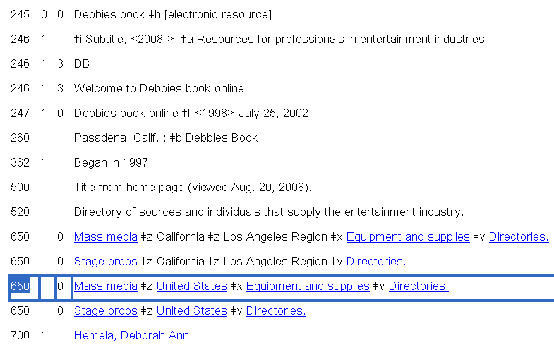
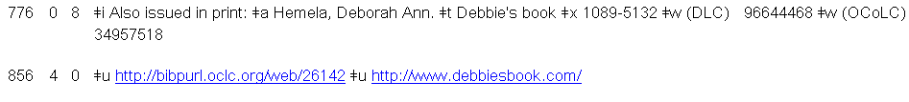
Internet archive example

Slide 24
First steps in original cataloging [1]
1. What aspect/part of the resource are you cataloging?
  E.g., the whole or a part of a larger resource --See LCRI 1.0
2. What is the type of issuance of that aspect?
  For the purposes of this workshop, integrating entry is the type of issuance we are dealing with.
Notes:
This and the following slide list four very important initial determinations and decisions that catalogers must make before proceeding to create a new bibliographic record for a resource.
The first two steps listed on this slide come from LCRI 1.0: DECISIONS BEFORE CATALOGING: What Is Being Cataloged?
Step 1: This is critical for all resources, but in a way especially for Web resources because of their usual highly “granular” nature; it is crucial to decide what level of a granular Web site you are cataloging and to maintain consistency within your bibliographic description for that level. Normally, at the point of cataloging, it should have already been decided by a selector what it is that you are actually cataloging: the Web site or a part of Web site, etc.
Step 2: This is equally critical before starting to catalog an online or loose-leaf format resource.
Since we are dealing in this workshop with integrating resources, all of the examples used from here on have already been determined to be integrating resources.
Session 2: Tools and Decisions
SCCTP Integrating Resources Cataloging Workshop -- December 2008

Slide 25
First steps in original cataloging [2]
3. What is the primary content of the resource?
  E.g., textual, cartographic, visual, sound, computer file
  Affects which Type of Record and 008 / OCLC workform you use
4. Which iteration do you have?
  First, last, or other iteration
  Affects especially how you record dates of publication
Notes:
Step 3.
The primary content of an online resource may vary. Most Web sites and databases will have primarily textual content, but others will have cartographic, image, sound, computer program, and other types of primary content.
This determination is important because it affects the MARC Type of Record code selected, and, in OCLC, the kind of original workform selected.
Step 4.
It is useful from the very start of the cataloging process to know what iteration of a resource you have. Normally, viewing a current Web resource, you are obviously looking at the latest iteration.
For most online integrating resources the cataloger will rarely be viewing the first iteration of the resource, and will rarely have a way to clearly identify a first iteration even if they happen to be viewing it. Of course, the Internet Archive should be able to give the cataloger some glimpse into the past of a resource.
Session 2: Tools and Decisions
SCCTP Integrating Resources Cataloging Workshop -- December 2008

Slide 26
First steps in original cataloging [3]
5. Is the resource distributed by more than one provider?
  Generally applies to a database
6. Has this resource changed over time?
7. Is this related to other resources?
8. How to describe this resource: Integrating resource
  PCC or non-PCC?
  Apply CONSER standard record options?
Notes:
5. This is usually the case for abstracting and indexing services that are offered via differing packages by different suppliers such as OCLC, Ovid, etc.
6. This can sometimes be determined by the Internet archive.
Clues for this can be that it bears a similar title to another known resource or that the Web site itself describes the resources’ relationship to anther resource in a related field, perhaps the publisher/producer is known to produce similar products, etc.
Will the record be a national CONSER or BIBCO record? If so, will it apply the CSR options?
Session 2: Tools and Decisions
SCCTP Integrating Resources Cataloging Workshop -- December 2008

Slide 27
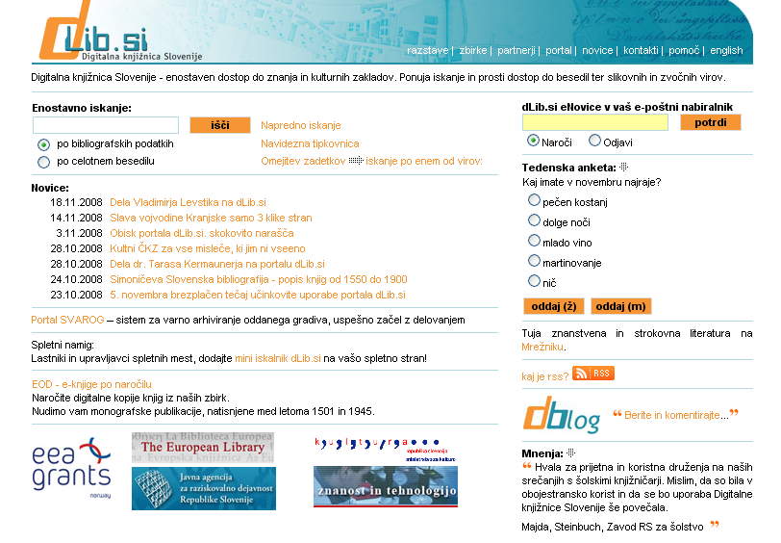
Example: Dig. Lib. Slovenia: http://www.dlib.si/dlib.asp
Notes:
This example, the Digital Library of Slovenia, illustrates the issue of more than one language. It has both a Slovene and an English interface. However, most of the content—the journals, articles, etc.—are either in one or the other language, so there is essentially one, uniform content. The language versions are essentially interfaces to enable navigation around the site in either language.
Another issue that could be addressed by the example is granularity: there is a kind of news section that is updated and its content is available fully in both languages. However, most cataloging agencies would be interested in cataloging either the entire site or the separate journal titles that reside there. The full text journal receive separate serials cataloging
Session 2: Tools and Decisions
SCCTP Integrating Resources Cataloging Workshop -- December 2008

Slide 28
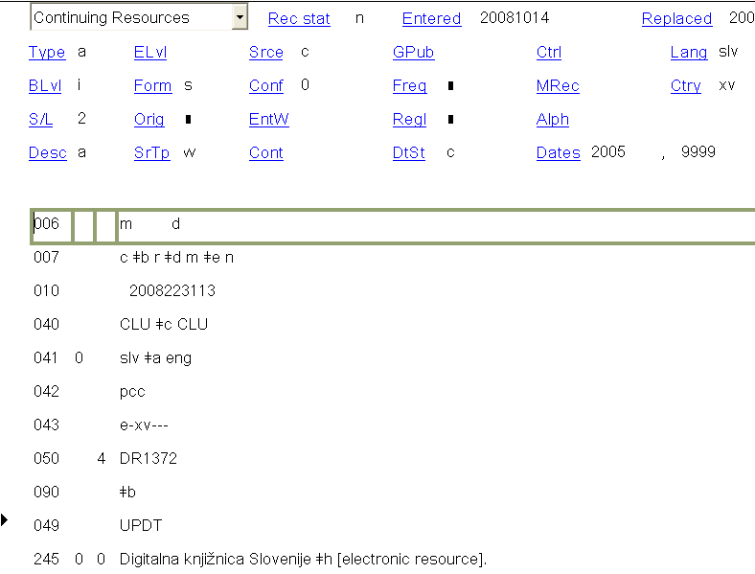
Example
Notes:
Here is the first half of the MARC record with new 245
Session 2: Tools and Decisions
SCCTP Integrating Resources Cataloging Workshop -- December 2008

Slide 29
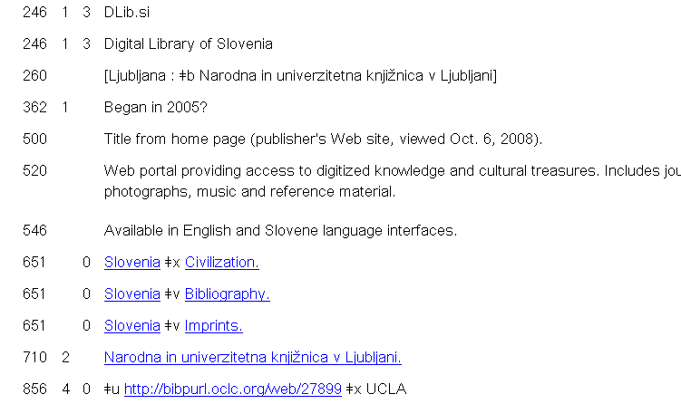
Example
Notes:
Here is the 2nd half of the record with the old title in the 247 field.
Session 2: Tools and Decisions
SCCTP Integrating Resources Cataloging Workshop -- December 2008

Slide 30
Examples
What aspect/part of the resource are you cataloging?
Is the resource an integrating resource or not (type of issuance)
What is the primary content of the resource (text, cartographic)?
Which iteration do you have?
Is the resource distributed by more than one provider?
Has this resource changed over time?
Is it related to other resources (e.g., was it previously a serial)?
How to describe this resource: Integrating resource
Notes:
Now, take another look at the e-resources you used for Session 1. How would you answer these questions, knowing what you know so far?
[5 minutes]
Session 2: Tools and Decisions
SCCTP Integrating Resources Cataloging Workshop -- December 2008

Slide 31

Exercise
Notes:
Check the Internet Archive for your resource. How far back does the archive show the resource? How has the resource changed over time?
[5 minutes]
Session 2: Tools and Decisions
SCCTP Integrating Resources Cataloging Workshop -- December 2008

