Slide 1
Connexion Constant Data Forms for e-Resources Cataloging
2/8/2007 vb
Notes:
For those of you who like to use cue sheets, this segment demonstrates the OCLC Connexion equivalent: Constant Data Forms. We do not have the Connexion Client available at this workstation, so I’ve made screen prints.
I will cover three uses for Constant Data forms:
(1) To create an original-cataloged bib record
(2) To use constant data as a cue sheet
(3) To extract metadata & compare constant data to result (Actually, point #3 is a specific instance of #2, but I just wanted to remind everyone of this OCLC tool)

Slide 2
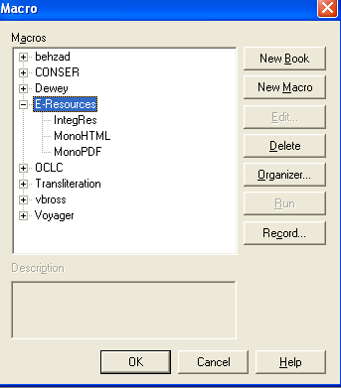
Build a Record from Scratch
Step 1: Press <ctrl-alt-shift-g>
Notes:
One use of Constant Data Forms is for original cataloging of e-monographs & e-IRs. The first step is to call up the list of macros (if you have not added them to function keys)

Slide 3
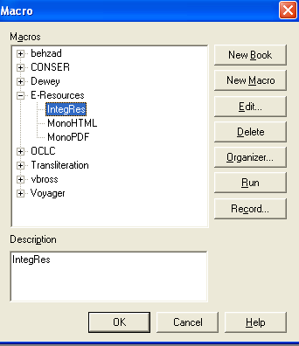
Step 2: Select the macro & alt-r
(or press “run”)
Notes:
Highlight the type of resource you are cataloging and press “run”

Slide 4
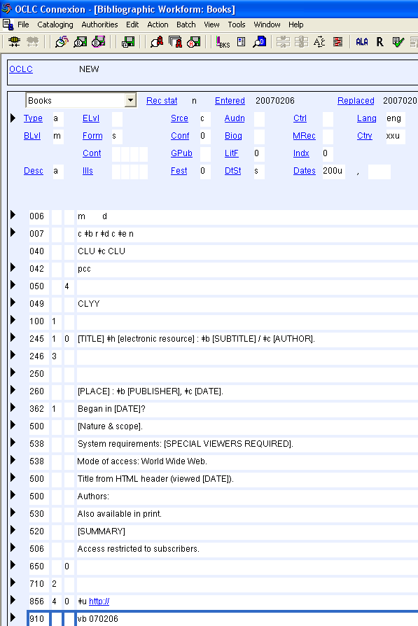
Result: Workform with 049, 910
Notes:
Then, catalog your resource.

Slide 5
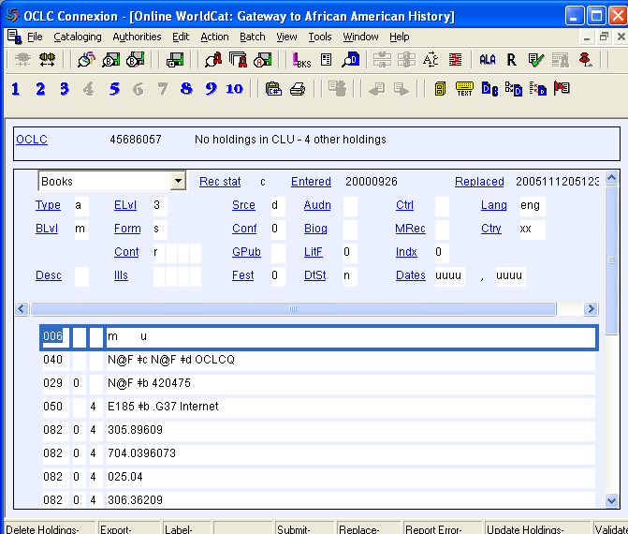
Compare Record to Constant Data Form
Step 1: Retrieve Record in OCLC
Notes:
Another use of Constant Data Forms is to compare an OCLC record to the “ideal” record. First, retrieve the OCLC record you wish to use. If you will need to consult more than one record, “pin” the records (Shift-F4)

Slide 6
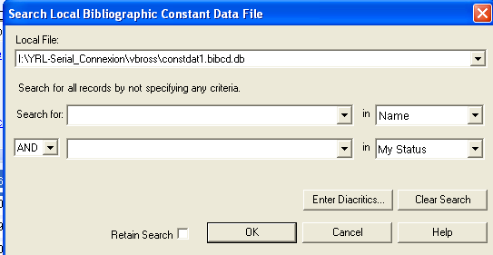
Step 2: <ctrl-ℓ> + <ok> to see Forms
Notes:
Call up the list of constant data forms

Slide 7
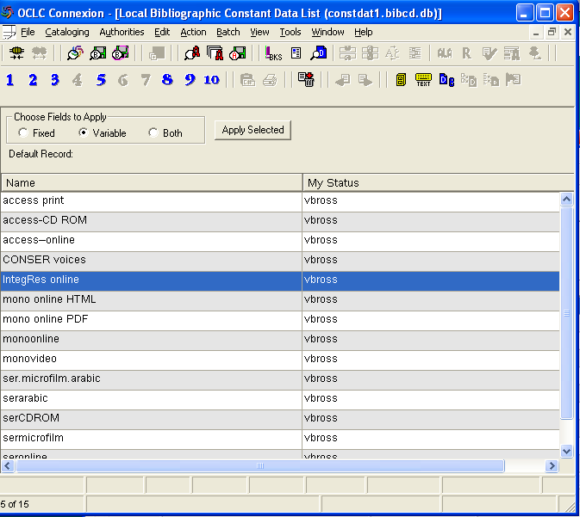
Step 3: Highlight the Form to Use &
Press <Enter>
Notes:
Highlight the form you wish to use as the “ideal” & press <Enter> to retrieve it. In this case, you need to be careful NOT to edit/save this form unintentionally.

Slide 8
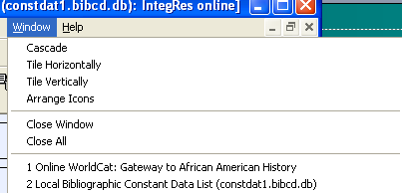
Step 4: From the Menu, Tile Vertically
(alt-w, t)
Notes:
Tile the records vertically

Slide 9
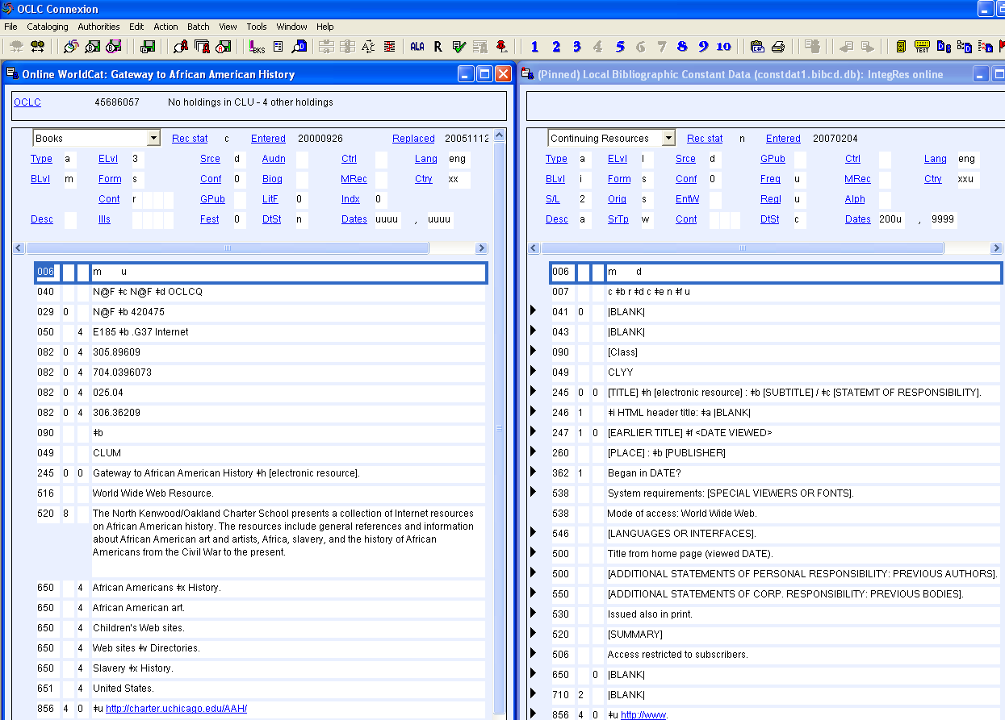
Edit the OCLC Record
Notes:
Be sure that the OCLC record is highlighted before editing fields, to avoid inadvertently editing the Constant Data Record.

Slide 10
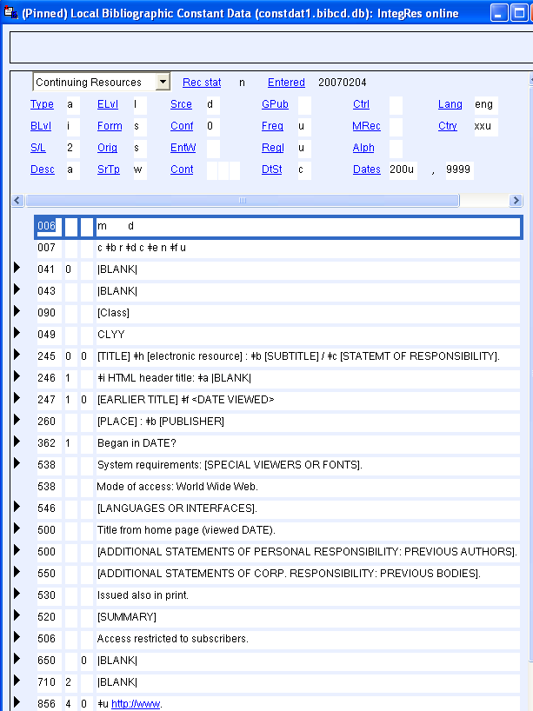
OCLC “Extract Metadata” & Compare
Step 1: Retrieve Constant Data Form
(Ctrl-ℓ + Highlight + <Enter>)

Slide 11
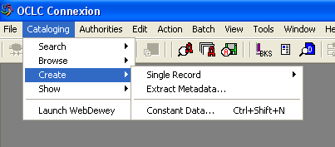
Step 2: From Main Menu, Choose
“Create” + “Extract Metadata”

Slide 12
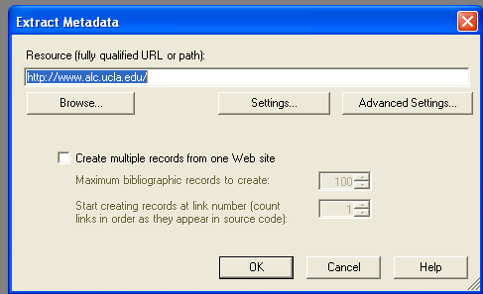
Step 3: Enter the URL in the Box

Slide 13
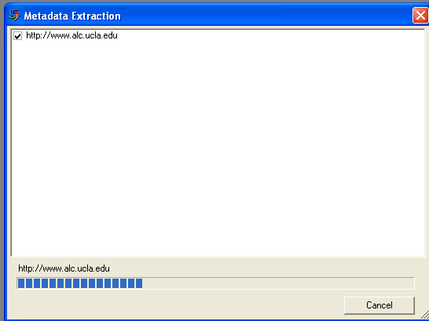
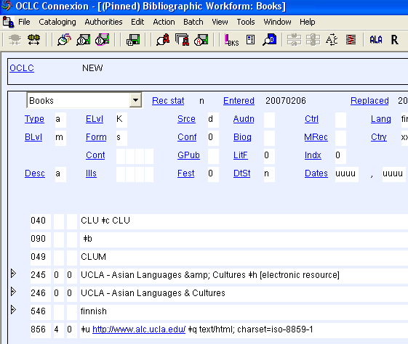
Step 4: Wait for the Program to Finish

Slide 14
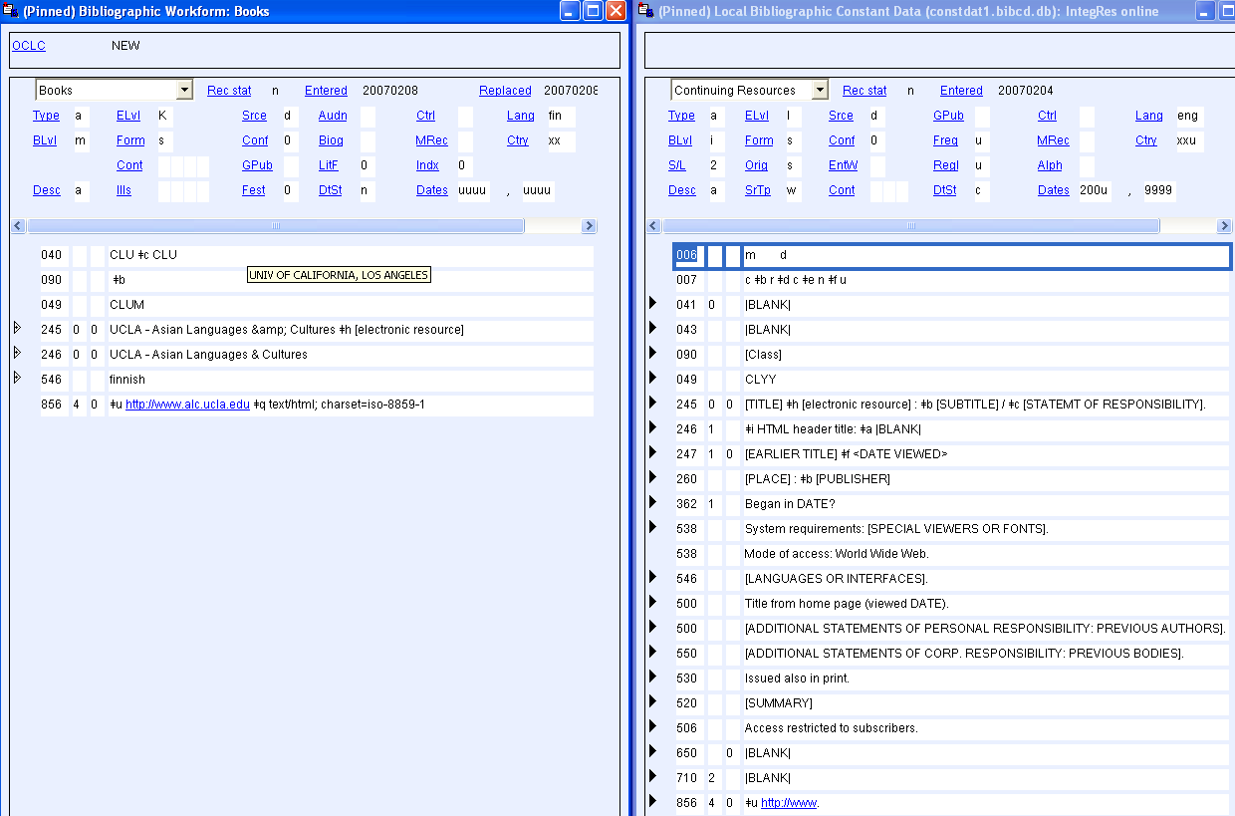
Step 5: Use Vertical Tile to Display Template & Brief Record
Notes:
Choose (from Main Menu) Window, Vertical tile. Or, use the shortcut alt-w,t. Check to make sure that the OCLC-created record is highlighted.

Slide 15
Summary of Shortcut Keys
Create an original-cataloged bib record
  Ctrl-alt-shift-g: Retrieve macro window
  Select the template: IntegRes (online integrating resource); MonoHTML (online HTML monograph); MonoPDF (online PDF monograph)
  Alt-r: run the macro
Use constant data as a cue sheet
  Ctrl-ℓ + Highlight + <Enter>: Call up list of Constant Data Forms
  Shift-F4 (to pin constant data) [optional]
  Alt-w, t (to tile vertically)
Extract metadata & compare constant data to result
  Ctrl-ℓ + Highlight + <Enter>: Call up list of Constant Data Forms
  Shift-F4 (to pin constant data) [optional]
  From menu: Cataloging—Create/extract metadata
  Alt-w, t (to tile vertically)

Slide 16
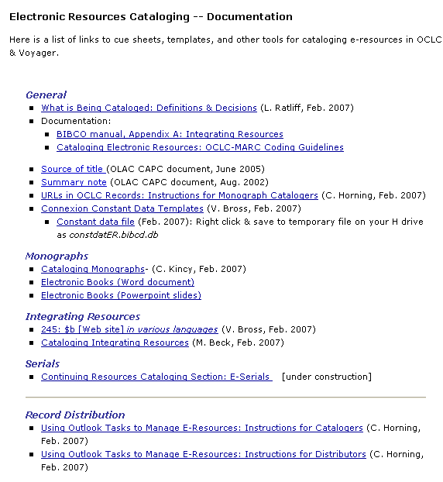
E-Resources Cataloging Web Site
http://unitproj.library.ucla.edu/cataloging/erc_cataloging/index.cfm
Notes:
For more information on cataloging e-monographs, please visit the E-Resources Cataloging Web site.

