Slide 1
Context for Cataloging
October 17, 2007

Slide 2
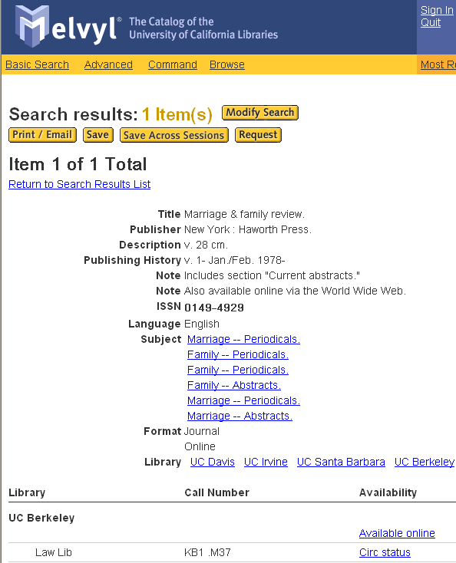
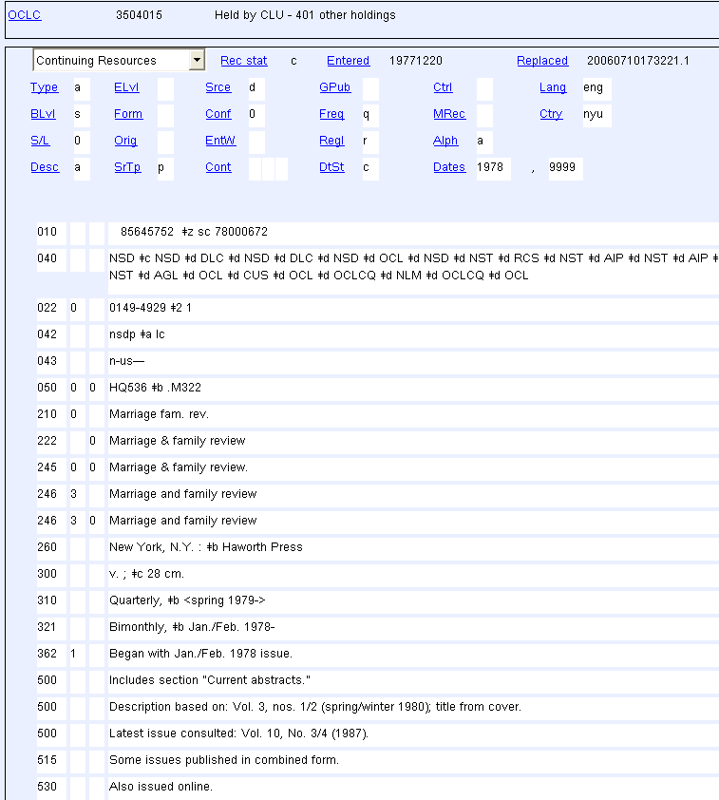
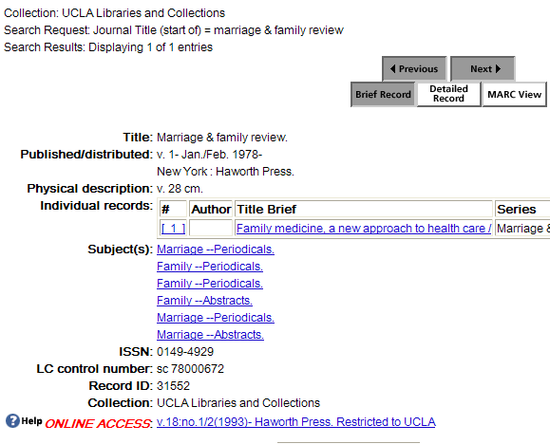
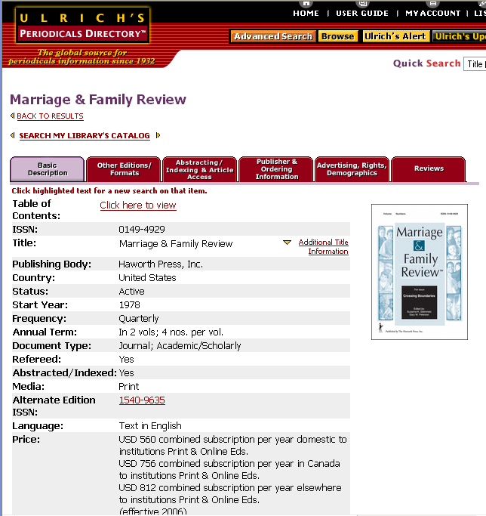
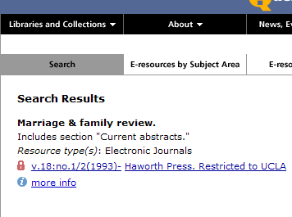
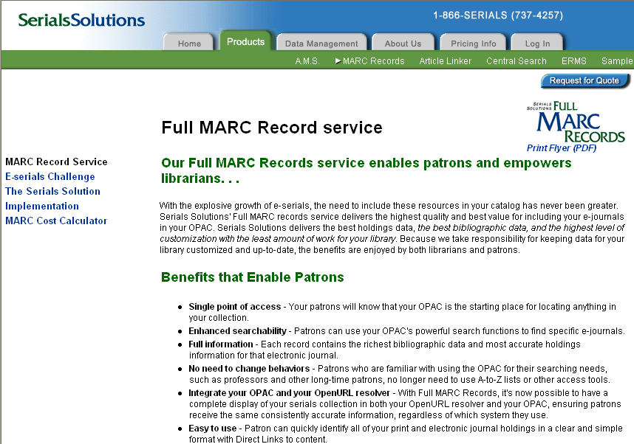
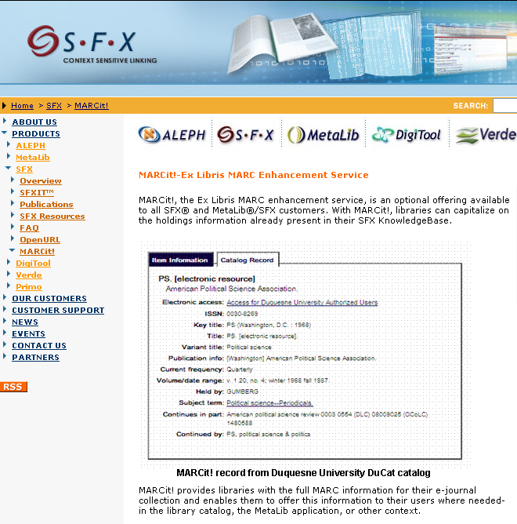
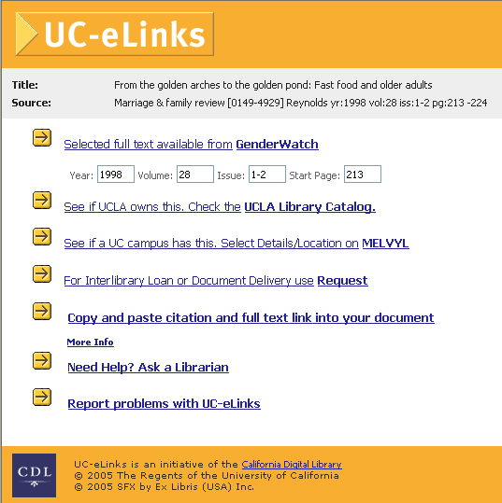
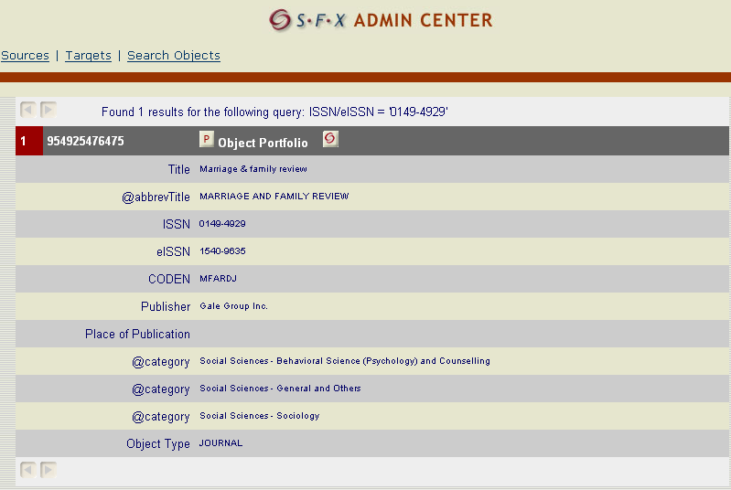
Local CONSER Context
CONSER RECORD
Voyager
Ulrich’s
1
4
ERDb
Serials Solutions
The MARC Cycle
2006
2
3
SFX
Knowledgebase
UCLA SFX
Notes:
TO CHANGE: As this diagram shows, the CONSER record is re-distributed to various communities, including Ulrich’s, Serials Solutions, SFX. The SFX Knowledgebase (which includes records derived from the CONSER record) is downloaded to the UC SFX server; that data is used to generate the UC e-links menu, which points to the local catalog record and to Melvyl (among other services). Someone, a public services librarian, for example, notices that the local record/Melvyl record is out of date. The Cataloger goes back to revise the CONSER record– and the cycle continues.

Slide 3

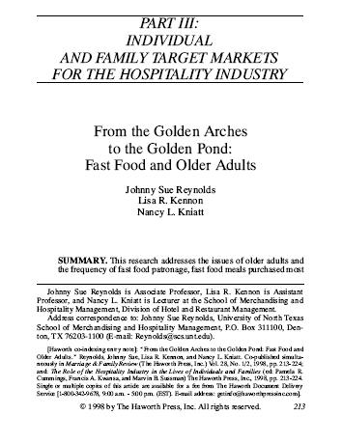
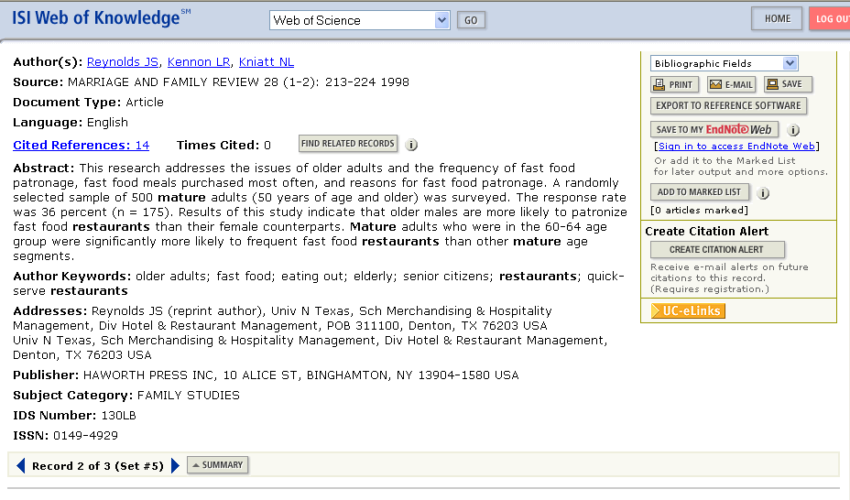
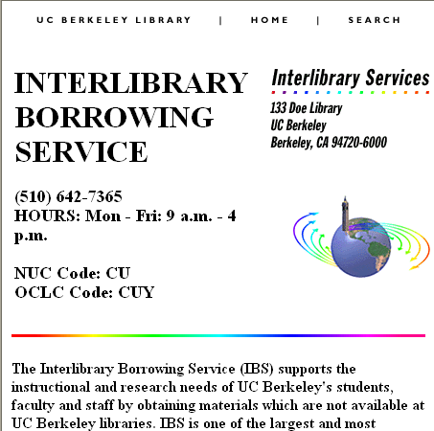
Local Research Context
1
4
The Citation Cycle
2006
2
3
http://ucelinks.cdlib.org:8888/sfx_local?sid=SCP:SCP&genre=article&__char_set=utf8&
issn=0897-6546
Notes:
The story: It all starts with a question. In researching the question, various A&I services are consulted. The A&I services include a link to UC e-links, which sends such data as ISSN or citation title in the form of an OpenURL query to the UC e-Links service. UC e-Links performs a look-up and creates a menu of responses. The responses include pointers to the full text, a pointer to the local catalog, a pointer to Melvyl, and a pointer to “Ask a Librarian” or ILL services. In the end, the various responses (a copy of the article, a display of library holdings, an ILL form) are sent back to the person who asked the question.

