Slide 1
Session 8: Electronic Serials
What is an electronic serial?
What is the chief source for electronic serials?
What fixed fields are appropriate for electronic serials?
How do other elements of descriptive cataloging differ?
Notes:
References
CONSER Cataloging Manual, Module 30-31
CONSER standard record documentation
Warm Up Exercises
See Appendix F for suggestions
Questions
The object of this session is to point out those areas where cataloging electronic serials differs from print serials. Only those fields where there are differences will be covered. To this end, the following questions:
What is the chief source for electronic serials?
Which fixed fields and/or formats are appropriate for electronic serials?
How do other elements of descriptive cataloging differ?

Slide 2
What is an Electronic Serial?
Same definition applies (must have successive discrete issues or parts, numbering, no predetermined conclusion)
LCRI 1.0 gives more guidance
Some things may differ, however:
  May have numbered articles
  Numbering may be different
  Bibliographic information may be scattered
Many are distributed as part of aggregations
Notes:
In determining whether or not an electronic resource is a serial, apply the definition, paying close attention to whether there are successive discrete parts or not. This is the primary difference between serials and integrating resources, such as Web sites. The parts may be issues or numbered articles, particularly in the case of online serials. According to LCRI 1.0, cumulative CD-ROMs are considered to be serials, even though only the latest one is retained.
Numbering for ejournals may differ from that of printed serials and you may have to look further for all of the information; however, many electronic serials are very straightforward and not difficult to catalog.
Many electronic serials, particularly online, are acquired in large collections of titles, called aggregations. In some aggregations, the journal is not a distinguishable entity; in others it is.
This sessions covers the basics of cataloging both direct and remote access serials that are issued individually.
The SCCTP Electronic Serials Cataloging Workshop focuses in more detail on online serials.

Slide 3
What is not an Electronic Serial?
The following are integrating resources:
  Updating Web sites
    CONSER Web site
  Updating databases
    ProQuest
  Online public access catalogs
    OCLC Worldcat
Notes:
Many electronic resources are not serials. Those that are intended to be updated fall under the category of integrating resources. The SCCTP Integrating Resources Workshop will cover these resources.

Slide 4
Direct and Remote Access Serials
Direct access serials are those published on a carrier, such as a disc, that is intended to be inserted into a computer. Examples include serials on floppy disks, CD-ROM, DVD-ROM.
Remote access electronic serials are those accessed via the Internet, email, etc. They are commonly called online serials. Examples include electronic journals, newsletters, newspapers.
Notes:
This session covers both direct and remote access serials. Most direct access serials are now on CD or DVD-ROM, but there are still serials contained on floppy disks. CD-ROMs and DVD-ROMs intended to be accessed by a network can also considered to be direct access resources, if one is creating a record based on the actual disc the library has received.
A primary difference between direct and remote access is the lack of a physical carrier for remote access resources and the fact that no 300 field is given for them.
Most online serials are accessed via the World Wide Web. Some newsletters and other serials are distributed via email or other means.

Slide 5
Format and Fixed Fields
Language material:
  008 (serial fixed field)
  006 (electronic resource) (1st byte “m”)
  007 (electronic resource physical description
  (1st two bytes “c” and normally “o” [CD-ROM])
Programs, games, fonts, numeric data, computer-oriented multi-media online systems and services:
  008 (electronic resource fixed field; not serial!)
  006 (serial)
  007 (electronic resource physical description)
Notes:
Choosing the Format and Fixed Fields
- Electronic serials may use either the serials format or the electronic resource file format depending on the nature of the work in hand.
- If the item is essentially language material, the serials format is used and an 006 fixed field (1st byte “m”) and 007 (1st two bytes “c” and commonly “o” [optical disc]) are added to account for the electronic resource characteristics.
- If, however, the item is essentially computer software (including programs, games, fonts); numeric data; computer-oriented multi-media; and online systems and services, the electronic resource format is used and an 006 fixed field is added to account for the serial characteristics. Consult the CONSER Editing Guide or MARC 21 formats for more information.
- The 006 field is mandatory in all records for electronic serials, whether it contains the electronic resource characteristics when the serials fixed field is used, or the serial characteristics when the computer file fixed field is used. {Mention in OCLC “help 006”}

Slide 6
Form of Item, Original Item
At present, CONSER is not treating any online serial as an electronic reproduction because of the difficulty of determining what the original form is.
The current CONSER practice for coding records for textual electronic serials is:
008/23 (Form of item) Form: s
008/22 (Form of original) Orig: ■ (CSR)
Notes:
Code "s" for "electronic" in the serial 008 was implemented in spring 2000 for "form of item" (008/23) and "form of original item" (008/22).
Used in the same way that codes for microfilm and microfiche are currently used 008. OCLC added the new code "s" to the 008/23 on existing records in spring 2000.
At present CONSER is not treating any online serial as an electronic reproduction because of the difficulty of determining what the original form is. It’s possible the original form was print or electronic; or it may be that both formats are issued simultaneously as different format editions.

Slide 7

CD-ROM Example: Disc Label
CD-ROM 4 covering 1972-1996
ISBN 2-503-50782-4
© Database by the International Medieval Institute, University of Leeds
© Publication rights by Brepols N.V.
Notes:
A sample CD-ROM will be used to discuss the cataloging of direct access serials through out this session.

Slide 8
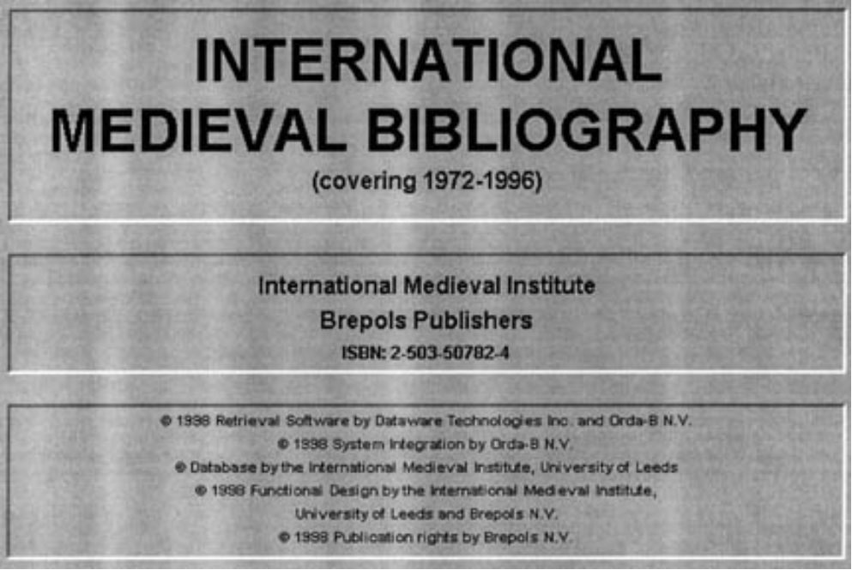
CD-ROM: Title Screen
© Database by the International Medieval Institute, University of Leeds
© Publication rights by Brepols N.V.
Notes:
Direct Access Electronic Serials
The title screen shown here.

Slide 9
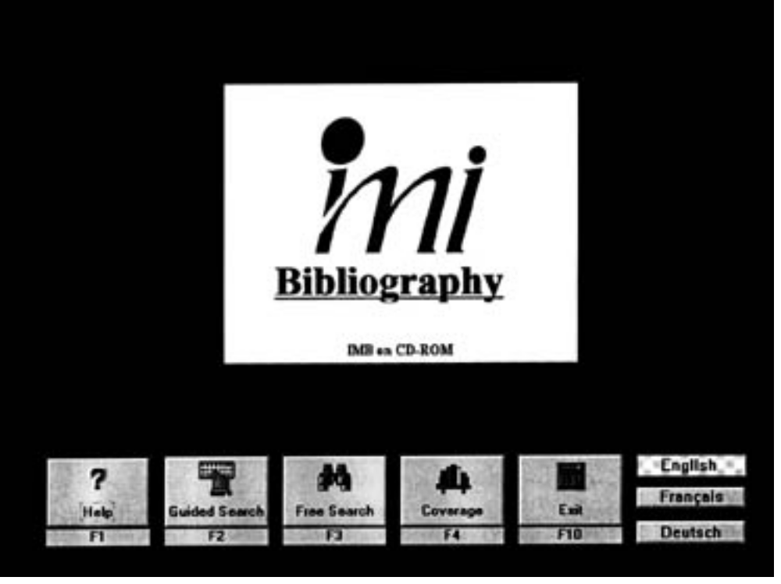
CD-ROM: Main Menu (3 Languages)
imi Bibliography
IMB on CD-ROM
Notes:
This screen shows that the disc can be viewed in multiple languages.

Slide 10
Basis of the Description and Chief Source
Describe from the earliest (12.0B1)
Prefer the carrier or its label as chief
source (12.0B2)
Other sources:
    Title screen or other internal sources
    Accompanying information
    Container
Notes:
Basis of the description and chief source of information
Use the first or earliest available issue as the basis of the description.
- The preferred chief source for direct access electronic resources according to AACR2 12.0B2 is the carrier or its label. This is because, for serials, the discs will be checked in and it is important to be able to read the current title without having to load the disc.
- Other sources that may be used are the title screen or other formally presented internal evidence (e.g., main menus, program statements, etc.). Following are definitions of external sources:
Carrier or its label Any permanently affixed label added by the publisher, creator, etc., to a compact disc, a floppy disk, a magnetic tape reel, etc.
Information issued by the publisher, Any accompanying
creator, etc., with the file documentation
Container Any information printed on the container, i.e., disk box, jewel box, a box containing both disks and manual, etc.

Slide 11
Main Entry and Added Entries
Same as for print equivalent:
  Print version:
  245 00 $a International medieval bibliography
  CD-ROM version:
  245 10 $a International medieval bibliography
  $h [electronic resource].
Notes:
Main and Added Entries (1xx/7xx fields)
- Main and added entries for electronic resources are determined in the same way as for print serials (see AACR2 21.1B2).
- If a serial publication ceases publication altogether in one format and continues in electronic form, the record for the old title is closed off and a new one is created.
-CSR=no uniform title to distinguish identical title proper.

Slide 12
Title Statement
Title transcribed from chief source
Add GMD $h [electronic resource]
Make added entries in 246 for variant titles found in other internal or external sources
Always add a note on title source (with DBO):
    500 -- $a Description based on …; title from disc
    label.
Notes:
Transcribing the Title and Variants
- The title proper is transcribed as usual from the chief source (e.g., disc label, or other source).
A general material designator (GMD) is added in 245 $h for the physical format.
- Added entries in field 246 are also made for any significant variants of the title proper found on the disc label, packaging, etc.
- The source of title is always indicated in a 500 note for all electronic resources (along with DBO as per CSR). For example,
500 -- $a Description based on …; title from disc label.
-

Slide 13
Our Example So Far:
245 00 $a International medieval bibliography
$h [electronic resource].
246 13 $a IMI bibliography
246 1- $i English menu screen has title: $a IMB on
CD- ROM
246 1- $i German menu screen has title: $a IMB auf
CD- ROM
246 1- $i French menu screen has title: $a IMB sur
CD- ROM
500 -- $a Description based on CD-ROM 4 (covering 1972-1996); title from disc label.
Notes:
For our sample record, we have the title taken from the disc label. We also have title variants, one found also on the disc label, and others in different sources in different languages. Use 246 indicators “13” in most cases unless a note is required as in this example. A parallel title (i.e., found on the chief source) is coded “246 11”. The source of title note has been combined with the Description based on note.

Slide 14
Edition Statement
Edition statements:
  250 -- $a CD-ROM ed.
Note if source not same as title proper:
  250 -- $a Compact disc ed.
  500 -- $a Ed. statement from user’s guide.
Note: field 256 (computer file characteristics)
is not used for serials
Notes:
Edition Statement (250 field)
- Many serial computer files are electronic forms of existing print titles issued in a different medium and bearing some form of edition statement to that effect. For example,
250 -- $a CD-ROM ed.
- In other cases, there may be different editions for various platforms such as a MS-DOS edition, a Macintosh edition, or a Windows edition.
- If the source of the edition statement is not the same as the source of the title proper, add a 500 note to explain where the statement was found. For example,
250 -- $a Compact disc ed.
500 -- $a Ed. statement from user’s guide.
- Note that field 256 is not currently used for serials because it is not useful.

Slide 15
Publication Information
Place and publisher same as for print equivalents
Publication dates are not required in $c
  260 -- $a [Leeds, England] : $b International Medieval Institute : $b Brepols Publishers
Retrospective discs may be published out of
chronological order
  362 1- $a Began with 1892/1992.
  500 -- $a First published in 1989; retrospective
  disc for 1892/1992 issued in 1993.
Notes:
Publishing statement (260 field)
- Place of publication and publisher information is usually taken from the chief source or its substitute; i.e., title screens, disc labels, etc.
- Publication dates are not required in 260, $c, but dates are often part of the 362 field.
- If the discs of a direct access electronic serial are published out of chronological order, add a 500 note to describe the discrepancy per LCRI 12.7B11.2. See example above.

Slide 16
Physical Description: Required $a only for Discs, etc.
Extent of item ($a required) contains SMD for the type of electronic resource as given in AACR2 9.5B
Conventional terminology may be used:
    300 -- $a CD-ROMs
      300 -- $a DVD-ROMs
      300 -- $a floppy disks
Sound and color ($b not required):
    300 -- $a CD-ROMs : $b col.
    300 -- $a floppy disks : $b sd., col
Notes:
Physical Description
- The extent of item (300 $a required only for direct access e-resources (CSR)) contains only the specific material designation (SMD) for the type of electronic resource, as given in AACR2 9.5B. Note that there is an option to give popular terminology and the Library of Congress and CONSER will follow this option.
NOT REQUIRED:
-Note physical characteristics, generally only sound and color, in 300 $b (AACR2 9.5C). If the electronic resource produces sound, give “sd”; if the electronic resource – not just the title screen – is encoded to display in two or more colors, give “col”:
- Note other physical characteristics information concerning the number of sides used, recording density and sectoring if considered important (AACR2 9.5C2):

Slide 17
Physical Description: Optional $c
Diameter of the disc (or disk), as specified
in AACR2 9.5D
    CD-ROMs & DVD-ROMs:
  300 -- $a CD-ROMs ; $c 4 3/4 in.
  300 -- $a DVD-ROMs ; $c 4 3/4 in.
    Floppy disks:
  300 -- $a floppy disks ; $c 3 1/2 in.
In our example, the 300 field would look like:
    300 -- $a CD-ROMs ; $c 4 3/4 in.
Notes:
- OPTIONAL dimensions: Note the diameter of the disc (or disk) in inches to the next highest
¼ inch in 300 $c, as specified in AACR2 9.5D:
-

Slide 18
Numbering
If information regarding the first issue is available:
    362 1- $a Began with disc 1 (1785/1979).
    500 -- $a Description based on first issue; title from disc label.
A “Description based on” note is always used:
    500 -- $a Description based on CD-ROM 4 (1972/1996); title from disc label.
Notes:
Numbering (362 field)
- Numbering may be problematic for electronic serials because of the fact that serials are appearing in electronic form long after they were first published. All or only some of the issues may be available and in some cases the publisher will continue to digitize back issues after the serial is first issued. Thus, the coverage goes backwards as well as forwards!
- For direct access electronic serials, record the designation in the 362 unformatted note field if information regarding the first issue is available. Always use a “description based on” (DBO) note regardless of whether or not the 362 note is present and add the source of title note at the end of the DBO after a semicolon.
-for captions use standard abbreviations or transcribe as found.
-for numbers transcribe as found or convert to Arabic numerals

Slide 19
Required Notes
Source of title
“Description based on”
“Latest issue consulted” if applicable:
500 -- $a Latest issue consulted: Disc 8
(1979/2000).
System requirements:
  538 -- $a System requirements: Windows Vista.
Our example:
  538 -- $a System requirements: Windows XP.
Notes:
Required Notes
Source of title (AACR2 9.7B3 says to always give for e-resources) and “Description based on” notes:
-These are used as in print serial records (i.e., always required).
Use a “Latest issue consulted” note if later issues are in hand at the time of cataloging
Systems Requirements Note (AACR2 9.7B1):.
- For direct access e-resources, the 538 system requirements notes are required only to describe required operating system or computer make/model (example in slide).
- Serial catalogers should keep in mind that system requirements information is outdated quickly and is difficult to keep up-to-date in records.

Slide 20
System Requirements
Multiple platforms (2 notes):
  538 -- $a System requirements for Windows: Microsoft Windows XP or later.
  538 -- $a System requirements for Macintosh: MAC OS X v10.4 or later.
Notes:
- If a direct access title is issued for use with multiple platforms and cataloged on one record, provide a 538 note for each platform if information regarding required operating systems or computer models/makes is available. See example in slide.

Slide 21
Completed CD-ROM record
Type: a ELvl: Srce: d GPub: Ctrl: Lang: eng
BLvl: s Form: s Conf: ■ Freq: ■ MRec: Ctry: enk
S/L: 0 Orig: ■ EntW: i Regl: ■ Alph:
Desc: a SrTp: Cont: DtSt: c Dates: 19uu,9999
006 $a [m ]
007 $a c $b o
041 0 $a eng$a fre $a ger
245 00 $a International medieval bibliography $h [electronic resource].
246 13 $a IMI bibliography
246 1- $i English menu screen has title: $a IMB on CD-ROM
246 1- $i German menu screen has title: $a IMB auf CD-ROM
246 1- $i French menu screen has title: $a IMB sur CD-ROM
260 -- $a [Leeds, England] : $b International Medieval Institute : $b Brepols
Publishers
300 -- $a CD-ROMs
500 -- $a Description based on CD-ROM 4 (covering 1972-1996); title from disc
label.
538 -- $a System requirements: Windows XP.
546 -- $a User interface and guide in English, French, and German.
710 2- $a University of Leeds. $b International Medieval Institute.
776 1- $i Also issued in print: $t International medieval bibliography $x 0020-7950
$w …
Notes:
Things to note:
Serial fixed field, ER 006 and 007
GMD in 245
300 SMD
link to print version (776)
Language note and added entries (546 and 246)
System requirements in 538 (only when necessary to record operating system or computer model/make.

Slide 22
Remote Access Electronic Serials
Resources issued in designated parts for an indefinite period in electronic format
Typically accessed by means of a browser via the Internet
No physical carrier
Notes:
Remote Access Electronic Serials
Definition
- Remote access electronic serials are works issued in designated parts for an indefinite period of time, in electronic format, and typically accessed by means of a browser (Netscape, Internet Explorer, etc.) via the Internet in contrast to direct access electronic serials which are issued on CD-ROMs, floppy disks, etc.
AACR2 9.0A1:
“Remote access is understood to mean that no physical carrier can be handled. Remote access can only be provided by use of an input-output device (e.g., a terminal), either connected to a computer system (e.g., a resource in a network), or by use of resources stored in a hard disk or other storage device.”

Slide 23
Types of Online Serials
E-serials “born digital,” that is, originally published online
  Some of these may later appear in cumulated print format
Reproductions, republications, simultaneous editions of print titles
  Issued by original print publisher, a contracted third party or as part of a digital library project
Notes:
Types of electronic serials selected and cataloged by libraries include (but are not limited to!):
Scholarly online serials which provide a means of self publishing and access to preprint manuscripts. Often “born digital” originally appearing on the Web, sometimes later issued in print (related versions such as print are secondary to the online version.) These may not contain traditional volume and issue numbering- sometimes the only designation available is the numbering on individual articles.
Digitized versions of serials
scholarly titles included in aggregator databases or indexes
popular or commercial magazines

Slide 24
Types of Online Serials
Titles that are part of a database of aggregated titles:
  May vary in completeness of reproduction and coverage of issues
  May be the most predominate type of e-serial that libraries purchase and need to control
Notes:
The term “aggregator database” refers to the packaging of a large number of digitized titles into a searchable database. The content and characteristics of such packages vary widely but for serials it has meant that there is a great deal of overlap in titles contained in these products and differences in the extent of available issues among them.
CONSER and OCLC developed guidelines for the retention/creation of one record to represent all online versions of a title with a separate record for the print. This has come to be known as the “aggregator neutral record”.
Can anyone in the class mention other types of e-serials? Newspapers? ‘Zines or E-zines? Overlay journals? Government serials?

Slide 25
Aggregator-Neutral Record
CONSER/OCLC guidelines:
  If no record exists (and not using single record approach): create a record
      Based on publisher Web site if readily available or on the version you have
  If a record exists, use that record (even though it might not represent the aggregator you have)
      Add your URL (if authorized or report addition to OCLC)

Slide 26
Aggregator-Neutral Record
CONSER/OCLC guidelines:
  For existing records, do not add notes, added entries, etc. for the aggregator/provider
  If multiple records exist:
      Select one (prefer CONSER record)
      Add your URL
      Report duplicates to OCLC

Slide 27
Online E-Serial Example
Journal home page at: http://mason.gmu.edu/~hcr/
WELCOME TO THE HISPANIC CULTURE REVIEW
    We are happy to present the Web edition of our
three latest issues of the Hispanic Culture Review, a
review published one or two times a year by students
of George Mason University. Its many issues have
introduced essays, fiction and poetry written in English
or Spanish focusing on topics related to the Hispanic world.
We hope that you will enjoy our on-line issues and we are
looking forward to your correspondence.
Make checks or money orders payable to: Hispanic Culture Review and mail to:
    Hispanic Culture Review
George Mason University
c/o Department of Modern and Classical Languages
Mail Stop $3E5
Fairfax, VA. 22030
U.S.A
Notes:
Sample online serial
This the home page for the journal. Note that the title is “Welcome to the Hispanic Culture Review”

Slide 28
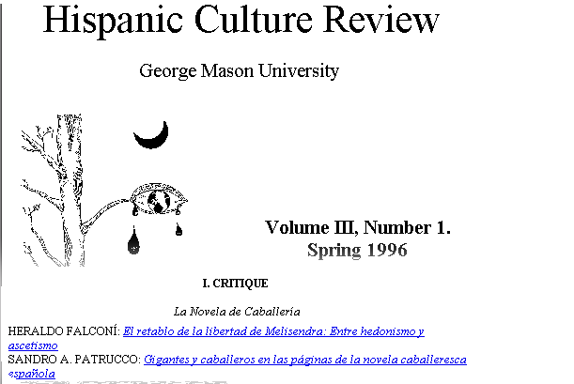
Earliest Online Issue
Notes:
Above: contents screen of the earliest online issue.

Slide 29
Sources of Information
Basis of the description
  First or earliest issue for:
    Title and statement of responsibility (245)
    Edition (250)
    Beginning numbering/date if available (362)
    Item described (500 DBO)
    Publication information (260, $a, $b)
  Other issues or parts for:
    Series
    Notes (e.g., Latest issue consulted)
    Standard number and availability
Notes:
Digitized versions of long published print titles are typically made available beginning with more recent issues or a recent span of issues rather than the first issue- so in these cases the basis of description is of necessity the earliest issue available online.
Information for notes and series may come from any source, such as the “latest issue consulted note”.

Slide 30
Chief Source of Information
9.0B1: The chief source of information for electronic resources is the resource itself. Take the information from formally presented evidence (e.g. title screen(s), main menus, program statements, initial display(s) of information, home page(s), the file header(s) …
If the information presented in these sources varies in degree of fullness, prefer the source that provides the most complete information.
So the source of title proper should be the most complete presentation of title (AACR2 9.0B1) in conjunction with the first or earliest available issue (AACR2 12.0B1).
Notes:
9.0B1 states that we are free to select the appropriate chief source from the resource itself, preferring a source that provides the most complete information.
12.0B1 tells us to generally prefer the first (or earliest) issue or part over a source associated with the whole serial or with a range of more than one issue or part.
So the source of title proper should be the most complete presentation of title (AACR2 9.0B1) in conjunction with the first or earliest available issue (AACR2 12.0B1).
Always give a note on the source of title

Slide 31
Main and Added Entries
Make decisions about 1XX main entry and 7XX added entries as you would any serial
Uniform title only for generic titles and monographic series:
130 0 $a Monthly bulletin (Reserve Bank of Zimbabwe :
Online)
245 10 $a Monthly bulletin $h [electronic resource].
On record for print version:
130 0 $a Monthly bulletin (Reserve Bank of Zimbabwe)
245 10 $a Monthly bulletin.
Notes:
Main and added entries for remote access serials are made in the same way as with other serials. Create uniform titles only for titles that consist of generic terms such as “report” or “annual review”, etc., or that are monographic series. This is a departure from past practice, so you will continue see many records with uniform titles with non-generic titles; they are not being retrospectively removed.

Slide 32
Aggregator/Provider Names
Per the aggregator-neutral guidelines don’t include the name of an aggregation as part of:
  uniform titles
  550 issuing body notes
  710’s
  4XX/8XX series statements/series added entries
The record will represent all online versions of the title
Notes:
Per the aggregator-neutral guidelines: don’t include the name of an aggregation as part of a uniform title, 550, 710s or 4XX/8XX series statement or entry fields, since the record will represent all online versions of the title. “Provider”=synonym of “Aggregator”. Examples: OCLC, EBSCO, Springer, Elsevier, JSTOR, Project Muse, etc.

Slide 33
Title Added Entries
Be liberal with title variants in field 246; there may be many variants on an online serial
For the aggregator-neutral record, make added entries for variants on other provider versions with the wording:
246 1 $i Issues from some providers have title: $a [Title]
Notes:
Varying form of title 246
Code the 246 using indicators 13 in all cases except when a note is required (1- $i) or for parallel titles (11)
Records created according to guidelines for aggregator neutral record may have a 246 that shows the title as it is presented by another aggregator, perhaps a slightly different form of some sort.

Slide 34
Title Proper
Construct as for print. Note provision in 1.1B1 to omit introductory words, such as “welcome to”
Add GMD $h [electronic resource] (same as with direct access)
Always: DBO note with source of title, source of description (provider), and date the resource was viewed for cataloging
500 $a Description based on issue 4 (May 2007); title from table of contents screen (JSTOR, viewed Oct. 27, 2007).
Notes:
Title statement (245 field)
- Construct the title as you would any other serial title.
- Note that some online electronic journals have introductory pages, splash pages, and the like, that include phrases such as “Welcome to”. These are typically not considered title screens and you should look for other sources of the title. If necessary, omit the introductory words according to 1.1B1 and give an added entry for the complete title.
246 13 $a Welcome to ImprovisAsians Online!
- In our sample record the journal home page says: “Welcome To The Hispanic Culture Review,” but clearly from the introductory paragraph and the individual online issues the title is: Hispanic Culture Review. Thus, it is best to select the page associated with the first issue as chief source and take the title from that source.

Slide 35
Title Proper
More title source notes:
500 $a Title from contents screen (publisher’s Website, viewed Jan. 27, 1999).
500 $a Description based on Vol. 5, no. 1 (Jan. 1995); title from contents (OCLC FirstSearch, viewed June 10, 2003).
Notes:
Give the title source, source of description (e.g. publisher Website, or a specific aggregator being used as the source of description) and the date viewed.

Slide 36
Edition Statement
Example: 250 -- Web ed.
Generally don’t consider separate file formats to be separate editions, e.g., articles of a serial available both as HTML and PDF formatted documents.
Notes:
Edition Statement (250 field)
Record edition statements as found. The example on this screen denotes the Web version of a print serial.
- For online electronic serials, do not consider different file formats to be different editions; e.g., articles available both as HTML and PDF formatted documents.

Slide 37
Numbering
If first issue is online:
  362 1 $a Began with v. 1, no. 1 (Jan. 1995).
If beginning/ending numbering of the print version is known:
362 1 $a Print began with vol. 3, no. 1 (Jan. 1984).
Notes:
Numbering
If the first issue is available, use an unformatted 362 “1”
Per the aggregator neutral guidelines, provide beginning and/or ending numbering or dates of the related print version if available, to justify coding of fixed field dates. In the example the FF for Date 1 can be coded 1984, even though that issue is not yet available online.

Slide 38
Numbering
DBO note, whether first issue is available or not
First issue not known/available:
500 $a Description based on: Vol. 3, no. 1 (spring 1996); title
from contents screen (publisher’s Web site, viewed
Jan. 27, 1999).
First issue available:
362 1 $a Began with Band 10, Nummer 12 (Mai 2005).
500 $a Description based on first issue; title from PDF title
page (Springer, viewed Oct. 10, 2006).
500 $a Latest issue consulted: Band 14, Nummer 24 (Okt.
2007) (viewed Nov. 23, 2007).
Notes:
Description based on note (500), Numbering (362 field)
As with other types of serials, always provide a description based on note, whether the first issue is available or not. Also provide a latest issue consulted note if a range of issues are available to better indicate that the record has been updated and if the serial is currently published. To the LIC also add the date viewed and the provider if different from the 500 DBO.

Slide 39
Numbering
FF: Date 1: 2006
362 1- $a Print began with volume 1, number 1 (Aug. 2006).
500 – $a Description based on v. 10, no. 2 (Feb. 2007); title from PDF title page (Eastview, viewed Nov. 10, 2007).
500 – $a Latest issue consulted: vol. 15, no. 3 (Aug. 2007) (viewed Nov. 10, 2007).
Notes:
Example where the first print issue is known but not yet online.

Slide 40
Our Example So Far
245 00 $a Hispanic culture review $h [electronic resource].
246 1 $i Title on homepage: $a Welcome to Hispanic culture review
500 -- $a Description based on v. 3, no. 1 (spring 1996); title from contents screen (publisher’s Website, viewed Jan. 27, 1999).

Slide 41
Notes
Required:
500 $a Description based on …; title from … ([provider], viewed [date]).
538 $a Mode of access: [if available other than via the World Wide Web]
550 $a Issued by: …, [date-] [Interim: for new corp. body]
776 08 $i … version: $t [Title]
Local options:
506 – Restrictions on Access Note
Institution-specific information should not be given on shared records
516 – Type of Computer file or Data Note
Not often used on shared record for titles in aggregator packages because this data can vary.
Notes:
Notes (5xx fields)
Required notes:
- A DBO 500 with Source of Title note is always given
500 -- $a Description based on …; title from home page.
- The 538 Mode of Access note is required only if the online resource is available by means other than the WWW.
-Issued by note: interim for when a new body becomes responsible for a serial so that the effective date can be recorded. There is a MARBI proposal for an applicable date subfield of the 710.
-Note in $i 776 plus the normal subfields (a, s, t …)
Optional notes:
- 506 typically applies to remote access serials or locally networked electronic resources with specific licensing agreements. Under the guidelines for the aggregator neutral record, these notes will not appear on the CONSER national catalog record. Be sure not to put purely local notes in shared records!
- 516 has been used to indicate the various file formats available at the web site. This type of data varies for titles in aggregator packages, so won’t generally appear in shared record. Avoid vague phrases like: Text (electronic journal)…

Slide 42
Electronic Location and Access (856)
Internet access:
856 40 $u http://www.chinfo.navy.mil/navpalib/navnews/navnews.html
Email access:
856 00 $z email subscription $u mailto:listproc@air.harvard.edu $i subscribe $f mini-air
Notes:
Electronic Location and Access (856 field)
- Field 856 is used to record information required to locate and access a remote access electronic serial.
- Use of this field may vary depending on the local catalog system; e.g., it may appear as a hot link in the OPAC or simply display as input. Examples:
Internet access:
856 40 $u http://www.chinfo.navy.mil/navpalib/news/html
Email access:
856 00 $z email subscription: $u mailto: listproc@air.harvard.edu $I subscribe $f mini-air

Slide 43
Electronic Location and Access (856)
Note that the second indicator provides information on the relation of the address (URL) to the item being described.
-0 = resource being described
-1 = version of resource
-2 = related resource
When a portion of the resource is available online, use 2nd indicator 0 and $3
856 40 $3 Table of contents and selected articles
$u http://www.viam.com/
Notes:
The second indicator shows the relation of the URL to the resource being cataloged. If the URL is for the resource being described, 0 is used. If the URL is for a version of the resource being described, 1 is used. This is used for URLs added to print or other format serials for online versions. When the URL is for a related work that is not the resource itself or another physical version of it, use 2. This might be a related Web site.
If a portion of the resource, such as the tables of contents, is available online, consider this to be the resource itself, and use 2nd value 0. But use $3 to show the portion of the resource that is available.
For full instructions on coding and inputting the 856 field see the CONSER Edition Guide, Field 856.

Slide 44
Multiple Records (print version)
Type: a ELvl: Srce: d GPub: Ctrl: Lang: eng
BLvl: s Form: Conf: ■ Freq: ■ MRec: Ctry: vau
S/L: 0 Orig: ■ EntW: Regl: ■ Alph:
Desc: a SrTp: p Cont: DtSt: c Dates: 199u,9999
041 0- $a eng $a spa
042 -- $a lcd
050 14 $a PS508.H57 $b H57
245 00 $a Hispanic culture review.
260 -- $a Fairfax, Va. : $b George Mason University
310 -- $a Semiannual
500 -- $a Description based on v. 1, no. 2 (spring 1991); title from t.p.
500 -- $a Latest issue consulted: Vol. 8, no. 1 (winter 1998).
546 -- $a English and Spanish.
650 -0 $a American literature $x Hispanic American authors $v
Periodicals.
650 -0 $a Hispanic American literature (Spanish) $v Periodicals.
710 2- $a George Mason University.
776 08 $i Online version: $t Hispanic culture review
856 41 $u http://mason.gmu.edu/%7Ehcr/
Notes:
Single or Multiple Records?
- CONSER has developed an option that allows catalogers to provide access to the remote version via the print record. Note that the remote version is not considered to be ‘cataloged’ in such cases as information that can be given about the remote version is limited.
- If a library opts to catalog each title separately, additions are made to the print record and a new record for the remote access version is made.
-In the record for the original:
- Note the availability of the online version in field 530 or $i of 776
- Add a 730 title added entry when the title of the online version differs
- Link to the online record with field 776
- Provide the location of the online version in field 856 (if not already present in the record)
{Trainers: note that the 856 is given in the print record so that another library can use the record as copy for the single record approach}

Slide 45
Multiple Records (online version)
Type: a ELvl: Srce: d GPub: Ctrl: Lang: eng
BLvl: s Form: s Conf: ■ Freq: ■ MRec: Ctry: spa
S/L: 0 Orig: ■ EntW: Regl: ■ Alph:
Desc: a SrTp:p Cont: DtSt: c Dates: 1996,9999
006 $a [m ]
007 $a c $b r
041 0- $a eng $a spa
245 00 $a Hispanic culture review $h [electronic resource].
260 -- $a Fairfax, Va. : $b George Mason University
310 -- $a Semiannual
500 -- $a Description based on v. 3, no. 1 (spring 1996); title from contents
screen (publisher’s Website, viewed Jan. 27, 1999).
500 -- $a Latest issue consulted: Vol. 24, no. 1 (winter 2007).
546 -- $a English and Spanish.
650 -0 $a American literature $x Hispanic American authors $v
Periodicals.
650 -0 $a Hispanic American literature (Spanish) $v Periodicals.
710 2- $a George Mason University.
776 08 $i Print version: $t Hispanic culture review
856 40 $u http://mason.gmu.edu/%7Ehcr/
Notes:
In the record for the online version:
- Describe the online version using all appropriate fields
- It is not required to add a 730 title added entry when the title of the online version differs, since it will duplicate the 776 linking field.
- Link to the paper record using field 776 with $i linking note.
- Give appropriate 856 fields
Note: that in this record, the Form is coded as value ‘s’ for electronic.
Also, the 362 “Print began with” option cannot be used because the first print issue is not known/listed in print version record.

Slide 46
CONSER Single Record Option
Type: a ELvl: Srce: d GPub: Ctrl: Lang: eng
BLvl: s Form: Conf: ■ Freq: ■ MRec: Ctry: vau
S/L: 0 Orig: ■ EntW: Regl: ■| Alph:
Desc: a SrTp:p Cont: DtSt: c Dates: 199u,9999
041 0- $a eng $a spa
042 -- $a lcd
090 -- $a PS508.H57 $b H57
245 00 $a Hispanic culture review.
260 -- $a Fairfax, Va. : $b George Mason University
310 -- $a Semiannual
-- $a Description based on v. 1, no. 2 (spring 1991); title from title page.
500 -- $a Latest issue consulted: Vol. 8, no. 1 (winter 1998).
546 -- $a English and Spanish.
650 -0 $a American literature $x Hispanic American authors $v
Periodicals.
650 -0 $a Hispanic American literature (Spanish) $v Periodicals.
710 2- $a George Mason University.
776 08 $i Online version: $t Hispanic culture review
856 41 $u http://mason.gmu.edu/%7Ehcr/
Notes:
If the CONSER option to use a single record is used:
- Note the availability of the online version in $i of 776
- Identify its electronic location in field 856
- Optionally, a computer file 007 may be added for the online version
For more information, consult the CONSER cataloging manual, 31.2.3.

Slide 47
Summary
Base the description on the first online issue or disc/disk
Always give DBO plus title source note
Online serials:
  prefer the source for the title that has the most complete information
  Include aggregator/provider information only in source of title note for online serials
  Give electronic location (856)
  Single or separate record approach?
Direct-access serials: Prefer the carrier and its labels as chief source for direct access

Slide 48
Session 8: Exercises
Notes:
Exercises
In part A, participants should indicate whether the situation calls for a new record or not and indicate their reasons. The emphasis in this section is simply on recognizing when a new record is required.
In part B, participants should complete the abbreviated workforms to indicate the tagging and coding of the relevant bibliographic data. The emphasis is on closing out the old record and tagging and coding the new record.

Slide 49
Exercises: Part A
Example 1: This is a serial because:
- Enumeration and chronology appear on the home page and link to the current issue.
- The March/April issue is available so there are clearly designated issues.
Example 2: This is not a serial because:
- There are no designated issues. The only date is the date of updating. This is an integrating resource, despite the fact that it calls itself a journal and a magazine.

Slide 50
Exercises: Part B, Example 1
Type: a ELvl: I Srce: d GPub: Ctrl: Lang: eng
BLvl: s Form: s Conf: ■ Freq: ■ MRec: Ctry: pau
S/L: 0 Orig: ■ EntW: Regl: ■ Alph:
Desc: a SrTp: p Cont: DtSt: c Dates: 1994,9999
006 $a [m ]
007 $a c $b r
245 00 $a Cultronix $h [electronic resource].
260 $a Pittsburgh, PA : $b English Dept., CMU
362 1 $a Began with issue 1 (fall 1994).
500 $a Description based on first issue; title from
table of contents (publisher’s Website,
viewed Feb. 4, 1999).
856 40 $u http://eserver.org/cultronix/
Notes:
Note: There is no print equivalent for this journal.

Slide 51
Exercises: Part B, Example 2
Type: a ELvl: I Srce: d GPub: Ctrl: Lang: eng
BLvl: s Form: s Conf: ■ Freq: ■ MRec: Ctry: nju
S/L: 0 Orig: ■ EntW: Regl: ■ Alph:
Desc: a SrTp: p Cont: DtSt: c Dates: 199u,9999
006 $a [m ]
007 $a c $b r
245 00 $a Science fiction weekly $h [electronic resource].
260 -- $a Somerset, NJ : $b Science Fiction Weekly
310 -- $a Biweekly
500 -- $a Description based on v. 2, issue 20 (May 6, 1996);
title from table of contents (publisher’s Website, viewed Feb. 4, 1999).
500 -- $a Latest issue consulted: Vol. 5, no. 5 (Feb. 1, 1999) = issue 94.
856 40 $u http://www.scifiweekly.com
Notes:
Note: There is no print equivalent for this journal. This is a born digital serial, there is no print version.

Slide 52
Exercises: Part B, Example 3
Type: a ELvl: I Srce: d GPub: Ctrl: Lang: eng
BLvl: s Form: s Conf: ■ Freq: ■ MRec: Ctry: flu
S/L: 0 Orig: ■ EntW: Regl: ■ Alph:
Desc: a SrTp: p Cont: DtSt: c Dates: 1996,9999
006 $a [m ]
007 $a c $b r
245 00 $a Retro $h [electronic resource].
260 -- $a Nokomis, FL : $b Retro
310 -- $a Monthly
1- $a Began with Mar./Apr. 1996.
500 -- $a Description based on first issue; title from table of
contents (publisher’s Website, viewed Jan. 28,
1999).
856 40 $u http://www.retroactive.com/
Notes:
Note that several other print journals have the same title but that there is no paper version of this title.

Slide 53
Exercises: Part B, Example 4
Type: a ELvl: Srce: d GPub: Ctrl: Lang: eng
BLvl: s Form: Conf: 0 Freq: m MRec: Ctry: mau
S/L: 0 Orig: EntW: Regl: r Alph: a
Desc: a SrTp: p Cont: DtSt: c Dates: 1992,9999
010 -- $a 92-660054 $z sn 92-31
007 -- $a c $b r $d c $e n $f u {optional}
022 0- $a 1060-5967
037 -- $b Worth, POB 55420, Boulder, CO 80322-5420 $c $15.00 (U.S.)
$a $21.00 (Can.)
040 -- $a NSDP $c NSDP $d MH $d DLC $d NST $d InU $d GU
042 -- $a nsdp $a lc
043 -- $ an-us---
050 00 $a HG4501 $b .W67
082 00 $a 332.6/0973/05 $2 20
210 0- $a Worth $b (Boston Mass.)
222 -0 $a Worth $b (Boston, Mass.)
Notes:
Note that this title is issued in both print and an online version.
This slide shows the single record approach.

Slide 54
Part B, Example 4 (continued)
245 00 $a Worth.
260 -- $a Boston, MA : $b Capital Pub. Co., $c c1992-
300 -- $a v. : $b ill. ; $c 28 cm.
310 -- $a Monthly, $b 1994-
321 -- $a Bimonthly, $b 1992-1993
362 0- $a Vol. 1, no. 1 (Feb./Mar. 1992)-
500 -- $a Title from cover.
515 -- $a Issue for Feb./Mar. 1992 called also Premiere issue.
530 -- $a Also issued online as: Worth online.
650 -0 $a Investments $z United States $v Periodicals.
650 -0 $a Mutual funds $z United States $v Periodicals.
650 -0 $a Investments $v Periodicals.
650 -0 $a Mutual funds $v Periodicals.
740 0- $a Worth online.
780 00 $t Investment vision $x 1055-2375 $w (DLC) 91640692 $w (OCoLC)22272186
856 41 $u http://www.worth.com/
Notes:
Note that this title is issued in both print and an online version.
This slide shows the single record approach.

Slide 55
Separate Records: Online Version
Type: a ELvl: I Srce: d GPub: Ctrl: Lang: eng
BLvl: s Form: s Conf: ■ Freq: ■ MRec: Ctry: mau
S/L: 0 Orig: ■ EntW: Regl: ■ Alph:
Desc: a SrTp: p Cont: DtSt: c Dates: 1992,9999
006 $a [m ]
007 $a c $b r
245 00 $a Worth online $h [electronic resource].
260 -- $a [Boston, Mass.] : $b Capital Pub. Ltd. Partnership
310 -- $a Monthly
362 1- $a Print began with v. 1, no. 1 (Feb./Mar. 1992).
500 -- $a Description based on February 1999 issue;
viewed Jan. 28, 1999).
776 08 $i Print version: $t Worth $x 1060-5967 $w …
856 40 $u http://www.worth.com/
Notes:
This slide shows the separate record approach.

Slide 56
Separate Records: Print Version
Type: a ELvl: Srce: d GPub: Ctrl: Lang: eng
BLvl: s Form: Conf: 0 Freq: m MRec: Ctry: mau
S/L: 0 Orig: EntW: Regl: r Alph: a
Desc: a SrTp: p Cont: DtSt: c Dates: 1992,9999
010 -- $a 92-660054 $z sn 92-31
022 0- $a 1060-5967
037 -- $b Worth, POB 55420, Boulder, CO 80322-5420 $c $15.00 (U.S.) $a $21.00 (Can.)
040 -- $a NSDP $c NSDP $d MH $d DLC $d NST $d InU $d GU
042 -- $a nsdp $a lc
043 -- $ an-us---
050 00 $a HG4501 $b .W67
082 00 $a 332.6/0973/05 $2 20
210 0- $a Worth $b (Boston Mass.)
222 -0 $a Worth $b (Boston, Mass.)
245 00 $a Worth.
260 -- $a Boston, MA : $b Capital Pub. Co., $c c1992-
300 -- $a v. : $b ill. ; $c 28 cm.

Slide 57
Separate Records: Print Version, Cont’d
310 -- $a Monthly, $b 1994-
321 -- $a Bimonthly, $b 1992-1993
362 0- $a Vol. 1, no. 1 (Feb./Mar. 1992)-
500 -- $a Title from cover.
515 -- $a Issue for Feb./Mar. 1992 called also Premiere issue.
650 -0 $a Investments $z United States $v Periodicals.
650 -0 $a Mutual funds $z United States $v Periodicals.
650 -0 $a Investments $v Periodicals.
650 -0 $a Mutual funds $v Periodicals.
776 08 $i Also issued online: $t Worth online $w …
780 00 $t Investment vision $x 1055-2375 $w (DLC) 91640692 $w (OCoLC)22272186
856 41 $u http://www.worth.com/

