Slide 1
SCTPG/SCCTP
Integrating Resources
Cataloging Workshop
December 4-5, 2008
Melissa Beck
Peter Fletcher
Valerie Bross

Slide 2
Session 1
Introduction to Integrating Resources
Notes:
Session 1: Introduction
Instructor Manual – February 2005
SCCTP Integrating Resources Cataloging Workshop
Page <number>
Optional Warm Up Exercises
Ask the class what they know about integrating resources.
Ask how many are monographs catalogers? serials catalogers? How many catalog both?
How many catalog or have cataloged updating Web sites and databases?
How many catalog or have cataloged updating loose-leafs?
Instructor References
The trainer may want to review the following documents for this session:
LCRI 1.0 – See Appendix C, which contains the entire text of this LCRI.
AACR 2002 Glossary definitions for Monograph, Continuing resource, Serial, Integrating resource, Iteration
Also helpful may be general familiarity with FRBR Functional Requirements for Bibliographic Records Final Report / IFLA Study Group on the Functional Requirements for Bibliographic Records. (K.G. Saur, 1998). Available online in HTML at http://www.ifla.org/VII/s13/frbr/frbr.htm and in PDF at http://www.ifla.org/VII/s13/frbr/frbr.pdf.

Slide 3
Welcome
Introductions
Logistics
Overview of Schedule

Slide 4
Outline of the workshop
Session 1: Introduction to online IRs
Session 2: Tools & Decisions
Session 3: Original cataloging of IRs
Session 4: Finding and Working With Cataloging Copy
Session 5: Modifying Records for Integrating Resources
Session 6: Case studies
Notes:
Session 1: Introduction
Instructor Manual – February 2005
SCCTP Integrating Resources Cataloging Workshop
Page <number>

Slide 5
Session 1
Introduction to workshop
What is an online integrating resource?
How does an e-IR differ from other forms of issuance?
Notes:
Session 1: Introduction
Instructor Manual – February 2005
SCCTP Integrating Resources Cataloging Workshop
Page <number>
Goals for this first session of the day.
This is what we will be covering in this current session.
Participants' Goals:
You might ask the participants if they have any additional or more specific goals or areas they especially want to learn about in this session.

Slide 6
Integrating Resources
Definition
  A bibliographic resource that is added to or changed by means of updates
  that do not remain discrete and
  [that] are integrated into the whole
  Can be finite updating or continuing indefinitely.
Notes:
Session 1: Introduction
Instructor Manual – February 2005
SCCTP Integrating Resources Cataloging Workshop
Page <number>
The AACR2 definition of an integrating resource is…
As noted in the previous slides, existence or absence of discrete parts after the resource is updated is the key to the difference between serials and integrating resources.
IR Manual: 1.1-1.4

Slide 7
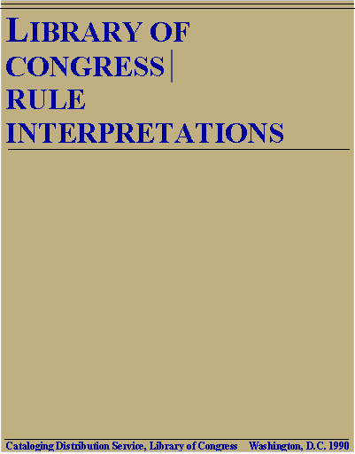
Updating Loose-leaf
Notes:
Session 1: Introduction
Instructor Manual – February 2005
SCCTP Integrating Resources Cataloging Workshop
Page <number>
This workshop will not cover print loose-leaf publications—but they are included in the definition.

Slide 8
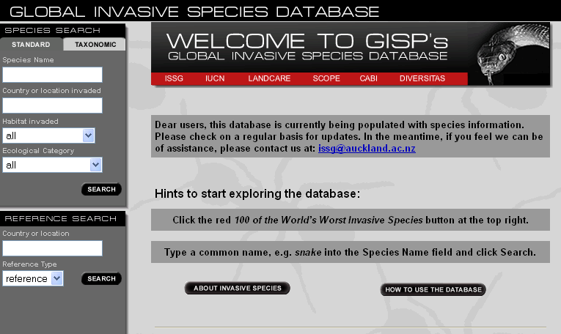
Updating Database
Notes:
Session 1: Introduction
Instructor Manual – February 2005
SCCTP Integrating Resources Cataloging Workshop
Page <number>
The Global Invasive Species Database is a Web site with an interface to a database.

Slide 9
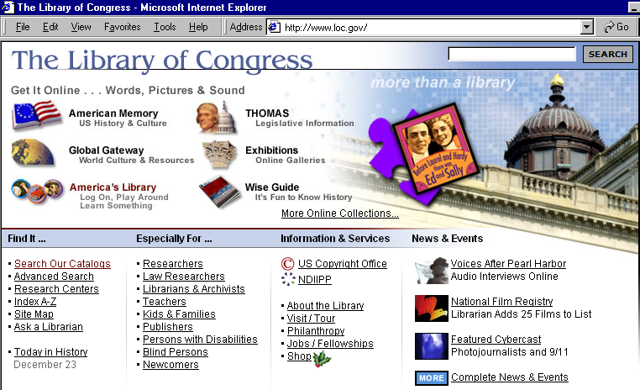
Updating Web Site
Notes:
Session 1: Introduction
Instructor Manual – February 2005
SCCTP Integrating Resources Cataloging Workshop
Page <number>
The Library of Congress Web site is a portal to many services and resources, including documents, images, databases, audio files, video files.

Slide 10
Three major types of IRs
Updating Loose-leaf
  Examples: AACR2, CONSER Editing Guide, LCRIs, many law reporters and legal loose-leaf services
Updating Database
  Examples: OCLC WorldCat, ProQuest, Books in Print online, Epicurious
Updating Web Site
  Examples: LC Web site, CONSER Web site, University of Washington Web site
Notes:
Session 1: Introduction
Instructor Manual – February 2005
SCCTP Integrating Resources Cataloging Workshop
Page <number>
Conclusion: Here are additional examples of each of these categories of integrating resources

Slide 11
Examples
Notes:
Take a look at the resources you will be working on for original cataloging (session 3a). All of these could be considered integrating resources. Why?

Slide 12
Continuing resource
Definition
A bibliographic resource that has no predetermined conclusion.
Umbrella concept used to group serials and integrating resources.
Provides a collective term
Title for AACR2 Chapter 12
Notes:
Session 1: Introduction
Instructor Manual – February 2005
SCCTP Integrating Resources Cataloging Workshop
Page <number>
Now, let’s see how integrating resources fit into the AACR2 conceptualization of resources. First, we need to consider the concept of “continuing resources.” A continuing resource is a bibliographic resource that has no predetermined conclusion. The key is “no predetermined conclusion.”
[Note: RDA does not include a definition of Continuing resource in the glossary; the rules do not combine serials and integrating resources as a collective category.]

Slide 13
Representation of bibliographic resources in AACR2
Finite resources
Continuing resources
Monographs
Integrating resources
Serials
Multi-parts
Parts remain discrete
Updates do not remain discrete
Notes:
Session 1: Introduction
Instructor Manual – February 2005
SCCTP Integrating Resources Cataloging Workshop
Page <number>
This slide depicts how these types of resources are represented in AACR2.
For electronic resources, the electronic aspects are still covered by the rules in chapter 9, while the continuing aspects are covered by the rules in chapter 12. Catalogers of electronic integrating resources use both chapters for description.

Slide 14
Integrating resources & serials
The primary difference:
  Serials: issued in discrete parts
  Integrating resources: issued with updates that do not remain discrete
Notes:
Session 1: Introduction
Instructor Manual – February 2005
SCCTP Integrating Resources Cataloging Workshop
Page <number>
The existence or absence of discrete parts after the resource is updated is the key to the difference between serials and integrating resources.

Slide 15
Integrating resources & monographs
The primary differences: Monographs
  Single item: Fixed, static
  Multipart: issued in discrete parts
Notes:
Session 1: Introduction
Instructor Manual – February 2005
SCCTP Integrating Resources Cataloging Workshop
Page <number>
The essential differences between integrating resources and monographs are shown here.
For many monographs, the resource is static—unchanging over time. In contrast, integrating resources are updated over time. In some cases, the integrating resource may be updated for a finite period—but all IRs involve some change over time. [We’ll see an example of a finite updating IR shortly.]
Multipart monographs, like integrating resources, are issued over time—but the new parts are separate, not integrated into the whole; and there is a predetermined conclusion.

Slide 16
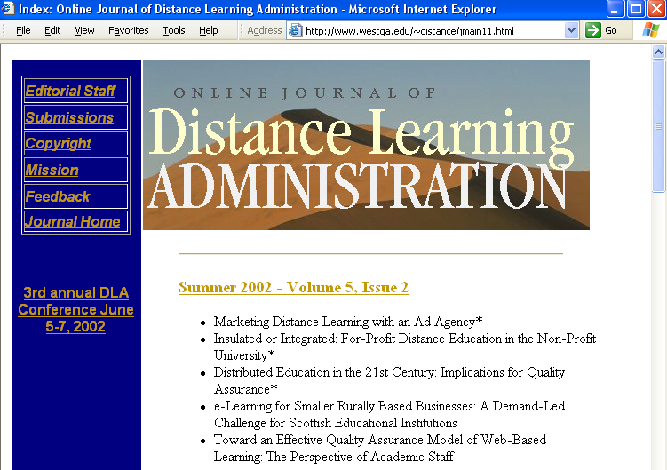
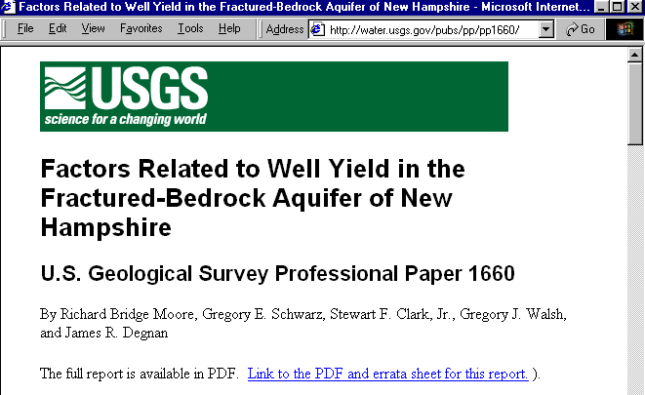
Resource may be mono or serial
Online monographic document
Online journal
Notes:
Session 1: Introduction
Instructor Manual – February 2005
SCCTP Integrating Resources Cataloging Workshop
Page <number>
This is a very important point to emphasize for the workshop participants as a reminder:
Not all online resources are integrating!
There are lots of online monographs and online serials.
If time permits, you might ask workshop participants to name some examples of each, especially of online monographs vs. online IRs. Examples of the former include e-books, government documents, reports, etc., especially those in pdf format; digitized images, digital sound and video recordings, etc.

Slide 17
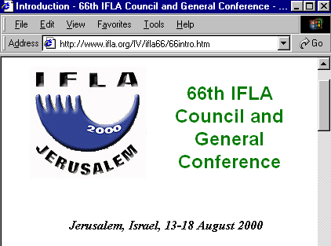

Finite Updating Web Site
Notes:
Session 1: Introduction
Instructor Manual – February 2005
SCCTP Integrating Resources Cataloging Workshop
Page <number>
Here is one additional twist to the story: This is an example of a finite integrating resource: a Web site for the the 2000 Annual IFLA Conference: updated with new content, integrated into whole, but has predetermined conclusion (intended that updates will cease).

Slide 18
Iteration
Definition
An instance of an integrating resource
either as first published
or after it has been updated.
Notes:
Session 1: Introduction
Instructor Manual – February 2005
SCCTP Integrating Resources Cataloging Workshop
Page <number>
One more concept: Because We may contrast an “iteration” of an integrating resource--which does not remain discrete, with an “issue” of a serial--which remains discrete and usually bears numbering.

Slide 19
Exercises

Slide 20
Instructions
For each of the resources, answer the questions:
Is this a monograph, a serial, or an integrating resource?
Why or why not?

Slide 21
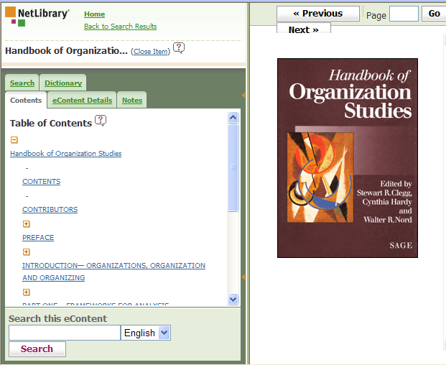
Resource A http://www.netlibrary.com/

Slide 22

Resource B http://www.ala.org/ala/eventsandconferencesb/annual/2008a/home.cfm

Slide 23
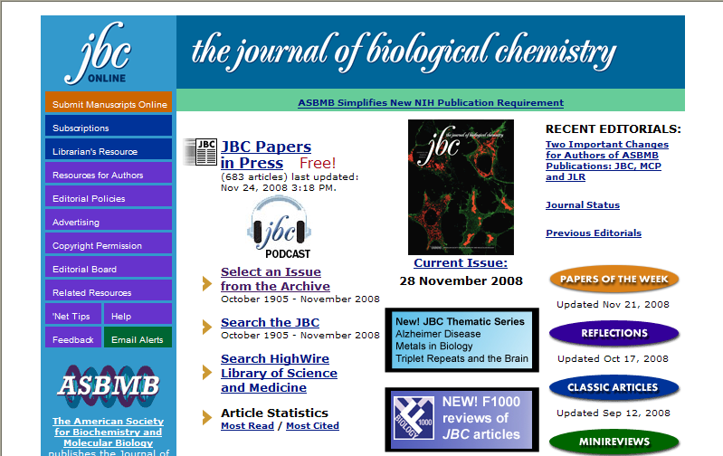
Resource C http://www.jbc.org/

Slide 24
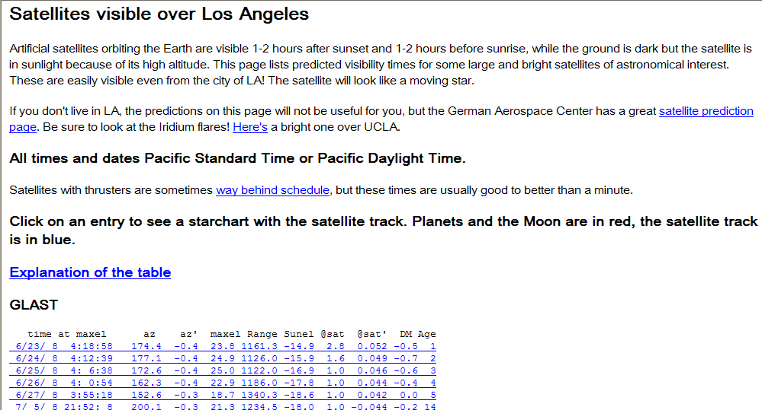
Resource D http://www.astro.ucla.edu/~wright/sats.html

Slide 25
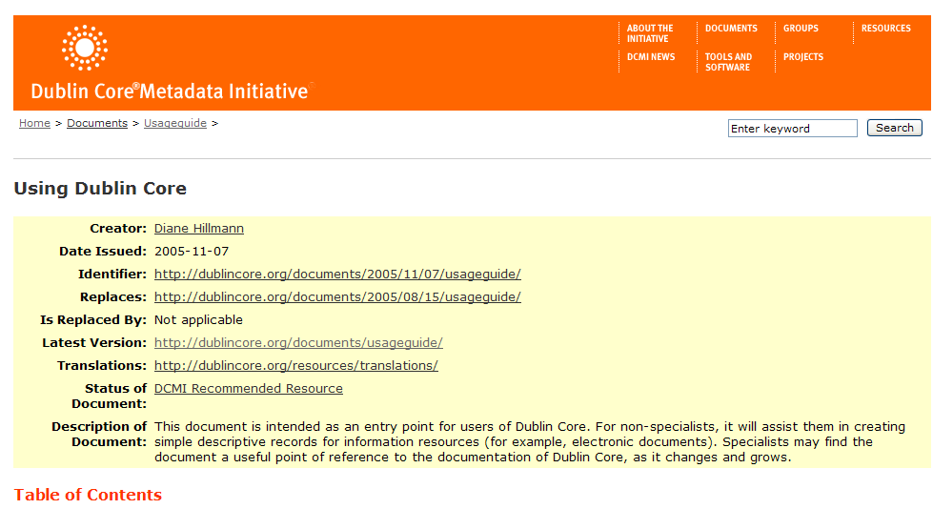
Resource E http://dublincore.org/documents/usageguide/

Slide 26
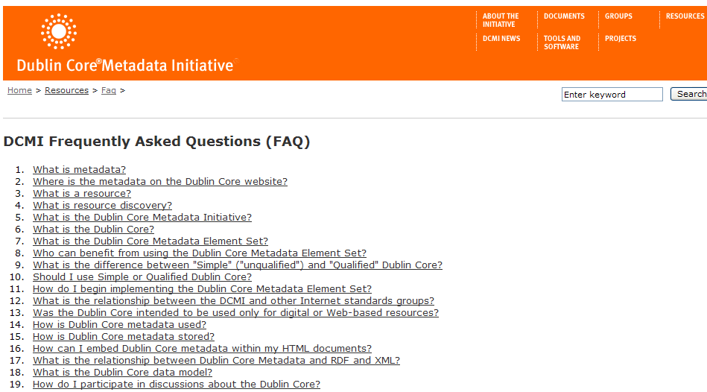
Resource F http://dublincore.org/resources/faq/

Slide 27
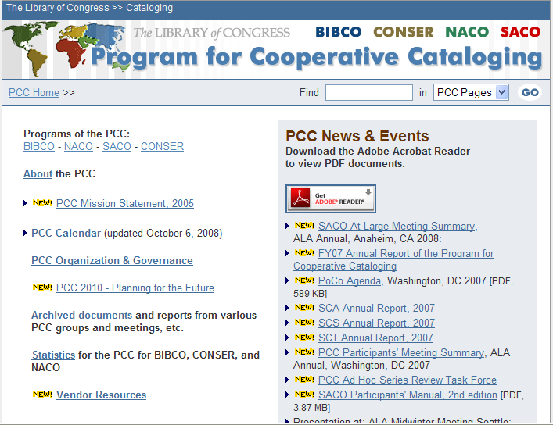
Resource G http://www.loc.gov/catdir/pcc/

Slide 28
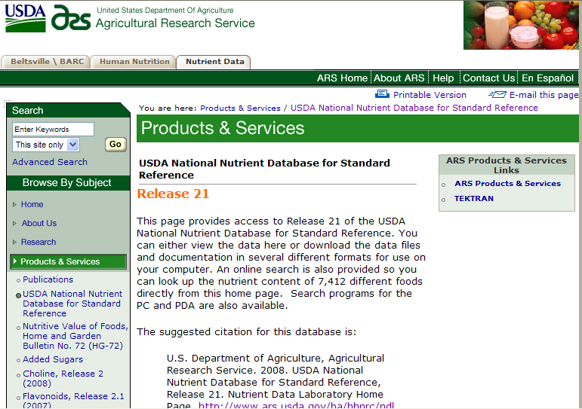
Resource H http://www.ars.usda.gov/ba/bhnrc/ndl

