Slide 1
Exercises for 1, 3a, and 3b
Notes:
Sessions 1 and 3: Exercises
SCCTP Integrating Resources Cataloging Workshop -- December 2008

Slide 2
Instructions
Create an original record for an online integrating resource.
Use the workforms in Appendix G
Concentrate on descriptive cataloging; include subjects/classification if you have time
Use Appendix A for MARC21 tagging; OR: Use MARC21 format online

Slide 3
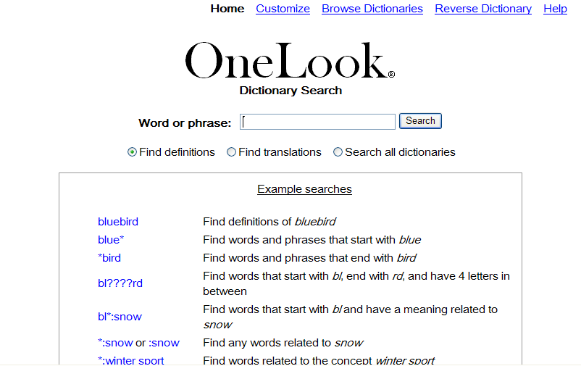
#1. One-Look Dictionary Search http://www.onelook.com
Notes:
OCLC 51177487
Dictionary
Need to convert to BLvl “i”
Sessions 1 and 3: Exercises
SCCTP Integrating Resources Cataloging Workshop -- December 2008

Slide 4
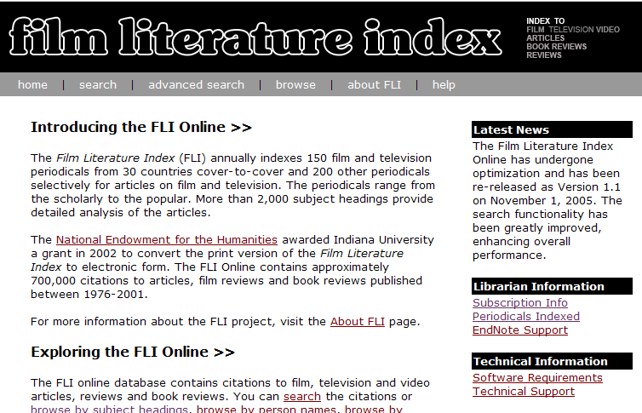
#2. Film literature index http://webapp1.dlib.indiana.edu/fli/index.jsp
Notes:
OCLC 67612216
filmography
Convert to BLvl “i”
Note 776 for print version
Sessions 1 and 3: Exercises
SCCTP Integrating Resources Cataloging Workshop -- December 2008

Slide 5
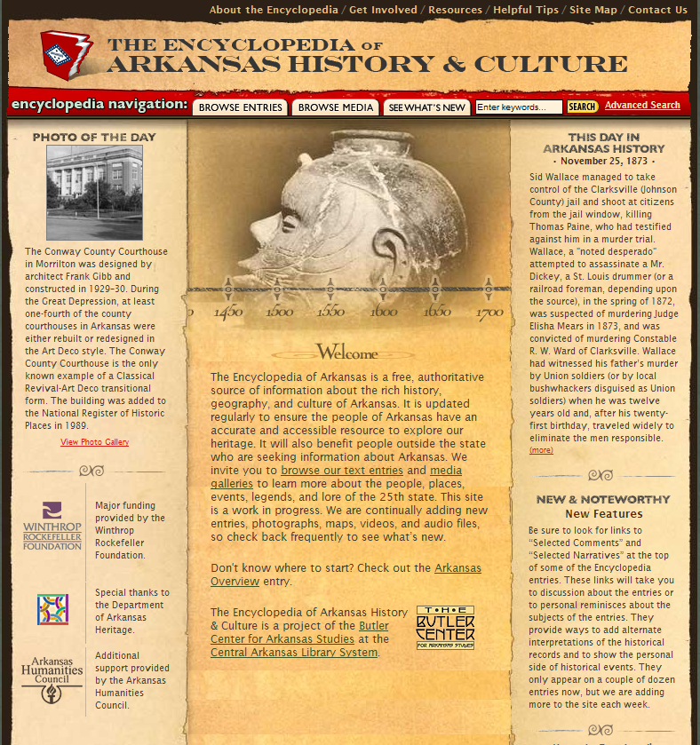
#3. Encyclopedia of Arkansas history & culture http://www.encyclopediaofarkansas.net/
Notes:
OCLC 213371132
Sessions 1 and 3: Exercises
SCCTP Integrating Resources Cataloging Workshop -- December 2008

Slide 6
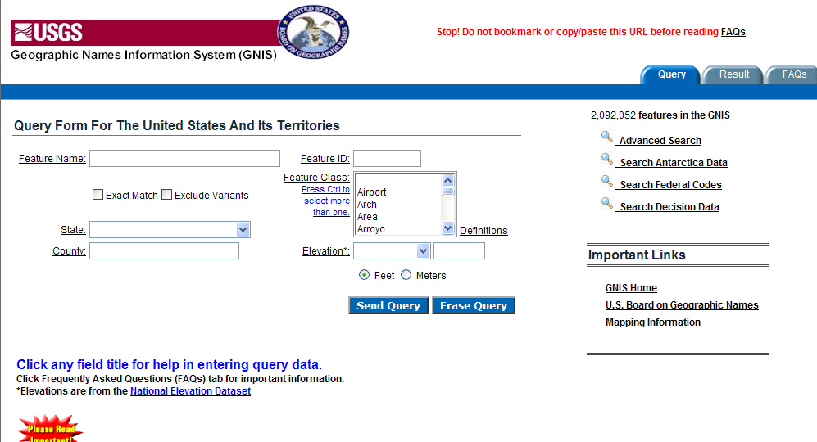
#4. Geographic Names Information System http://purl.access.gpo.gov/GPO/LPS1507
Notes:
OCLC 35152405
Type m
Sessions 1 and 3: Exercises
SCCTP Integrating Resources Cataloging Workshop -- December 2008

Slide 7
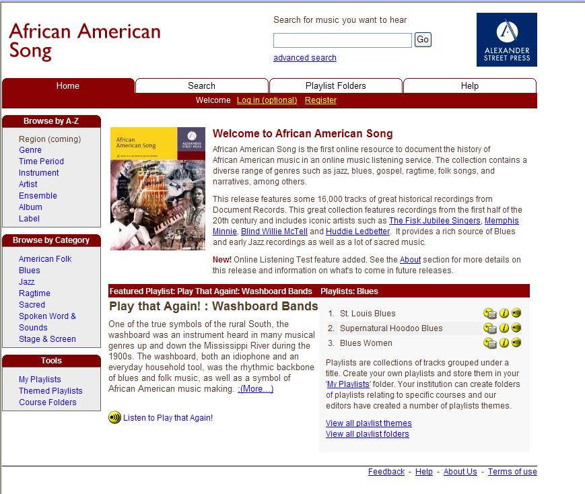
#5. African American song http://uclibs.org/PID/110097
Notes:
OCLC 63193327
Type “j”
Commercially-produced Web site with sound files
Sessions 1 and 3: Exercises
SCCTP Integrating Resources Cataloging Workshop -- December 2008

Slide 8
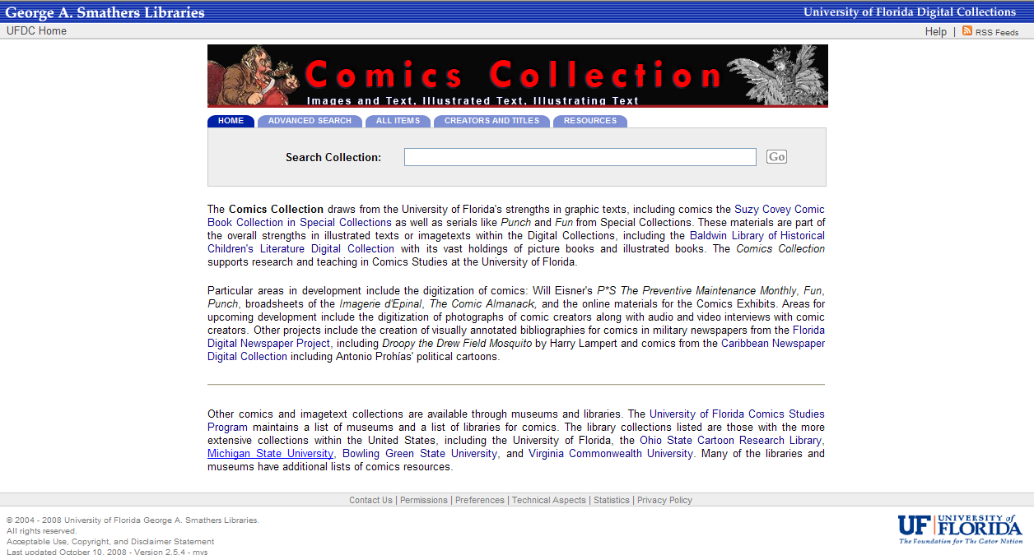
#6. Comics Collection http://www.uflib.ufl.edu/UFDC/?c=punch
Notes:
OCLC 244440616
Cataloged as text; could be cataloged as visual materials (k: 2-dimensional non-projected graphic)
Sessions 1 and 3: Exercises
SCCTP Integrating Resources Cataloging Workshop -- December 2008

Slide 9
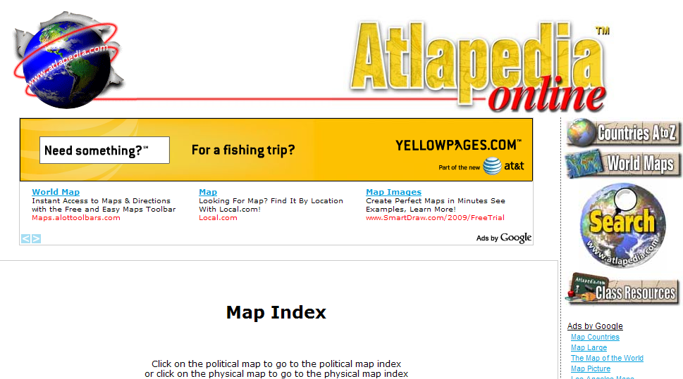
#7. Atlapedia online http://www.atlapedia.com/
Notes:
OCLC #53253777
Cartographic (Type e)
Sessions 1 and 3: Exercises
SCCTP Integrating Resources Cataloging Workshop -- December 2008

Slide 10
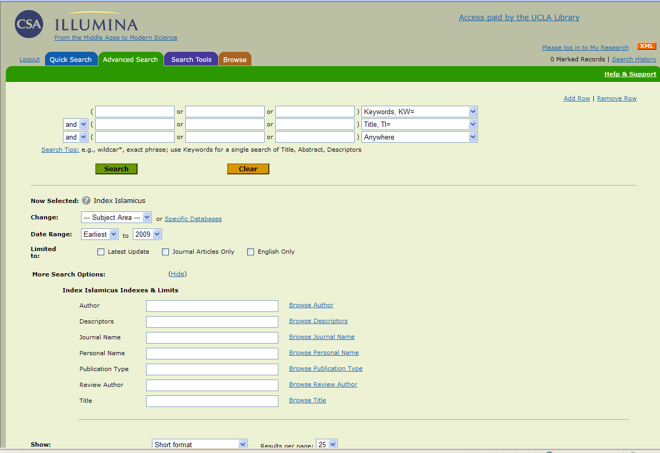
#8. Index Islamicus http://uclibs.org/PID/105590
Notes:
OCLC 52431288
Commercially produced A&I
Licensed index to bib citations
Sessions 1 and 3: Exercises
SCCTP Integrating Resources Cataloging Workshop -- December 2008

Slide 11
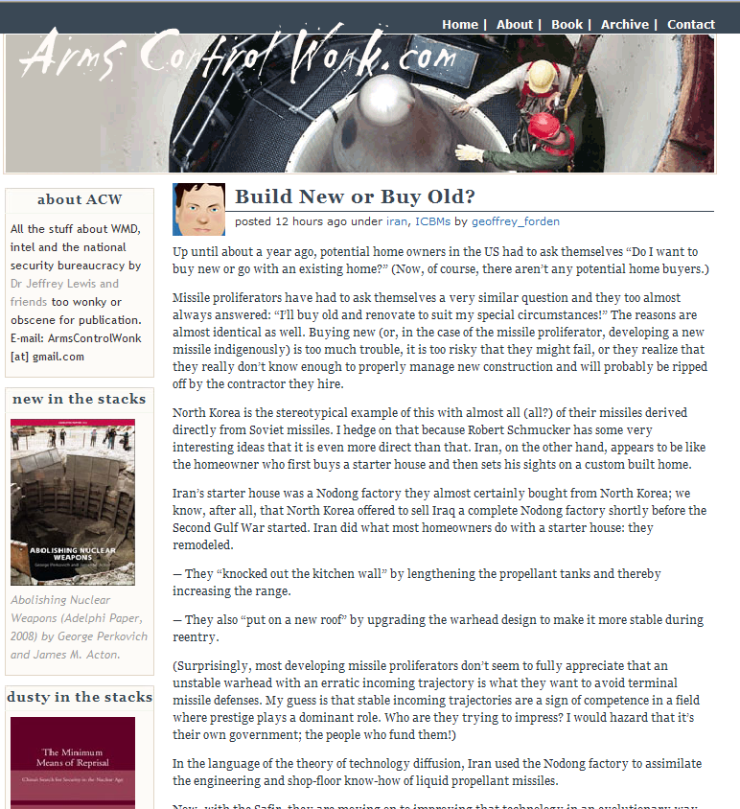
#9. ArmsControlWonk.com http://www.armscontrolwonk.com/
Notes:
OCLC 259342699
Blog
Sessions 1 and 3: Exercises
SCCTP Integrating Resources Cataloging Workshop -- December 2008

Slide 12
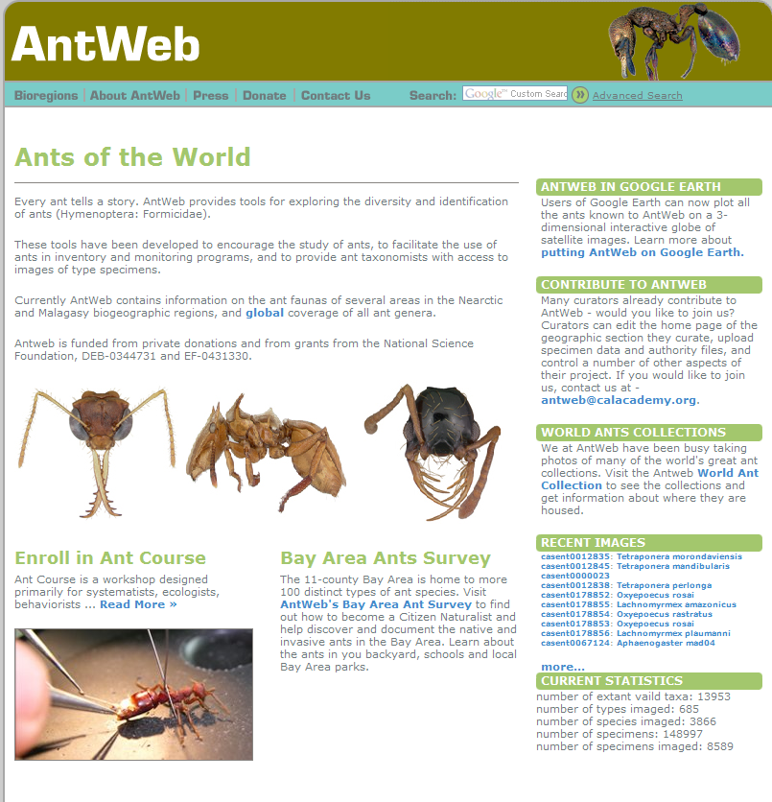
#10. AntWeb http://www.antweb.org/index.jsp
Notes:
OCLC 53231633
Web site
Sessions 1 and 3: Exercises
SCCTP Integrating Resources Cataloging Workshop -- December 2008

Slide 13
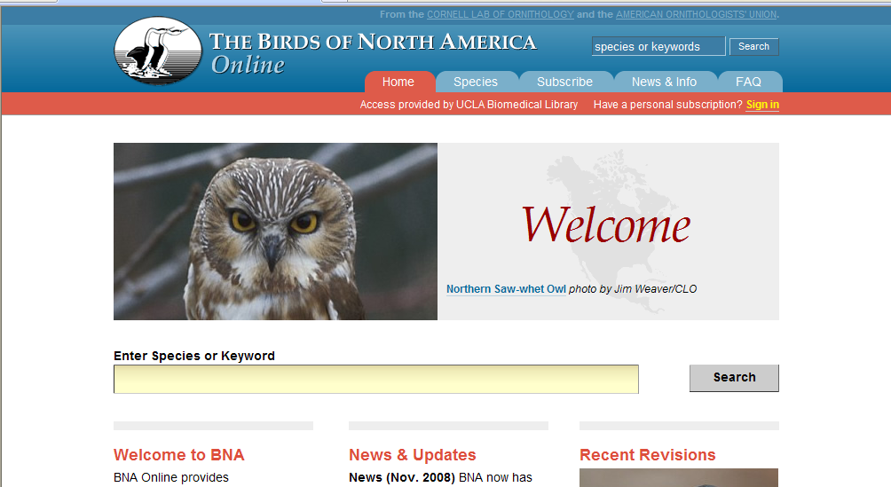
#11. Birds of North America online http://bna.birds.cornell.edu/bna
Notes:
OCLC 64552393
Sessions 1 and 3: Exercises
SCCTP Integrating Resources Cataloging Workshop -- December 2008

Slide 14
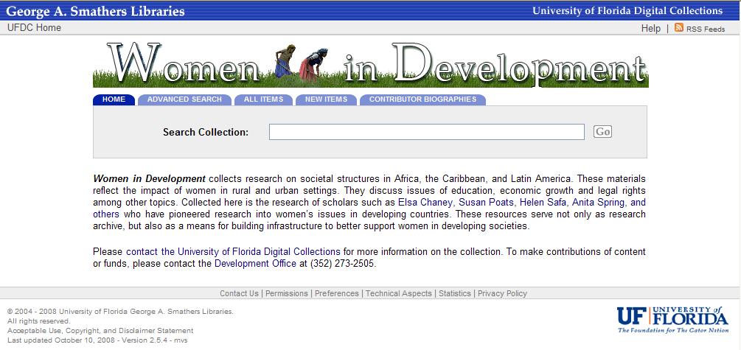
#12. Women in Development http://www.uflib.ufl.edu/UFDC/?c=wid
Notes:
OCLC 251491019
Sessions 1 and 3: Exercises
SCCTP Integrating Resources Cataloging Workshop -- December 2008

Slide 15
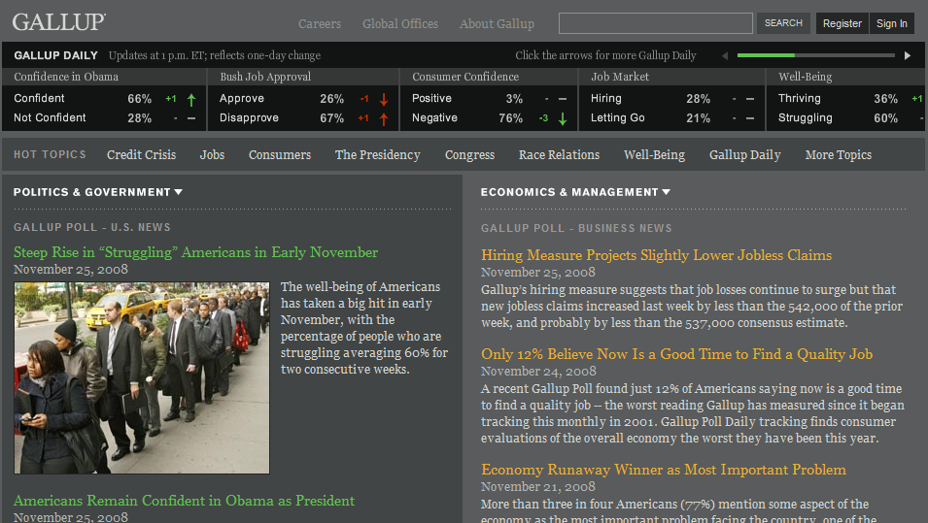
#13. Gallup Organization http://www.gallup.com
Notes:
OCLC 51177488
Sessions 1 and 3: Exercises
SCCTP Integrating Resources Cataloging Workshop -- December 2008

Slide 16
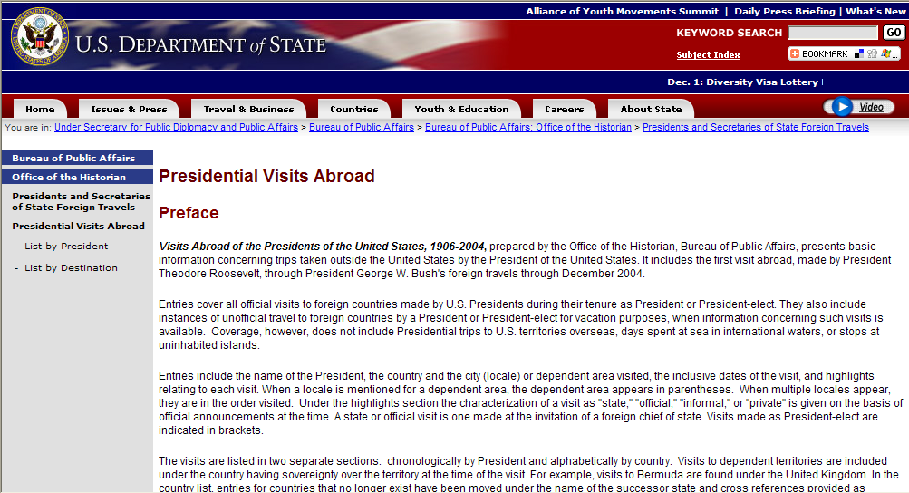
#14. Presidential visits abroad http://purl.access.gpo.gov/GPO/LPS37346
Notes:
OCLC 48656581
Sessions 1 and 3: Exercises
SCCTP Integrating Resources Cataloging Workshop -- December 2008

Slide 17

#15. IraqSlogger http://www.iraqslogger.com/
Notes:
OCLC 172904374
Sessions 1 and 3: Exercises
SCCTP Integrating Resources Cataloging Workshop -- December 2008

Slide 18
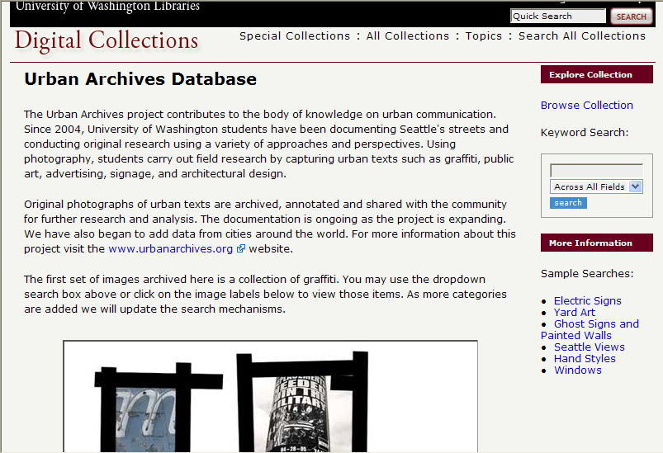
#16. Urban archives database http://content.lib.washington.edu/uaweb/index.html
Notes:
OCLC 62510013
Sessions 1 and 3: Exercises
SCCTP Integrating Resources Cataloging Workshop -- December 2008

Slide 19
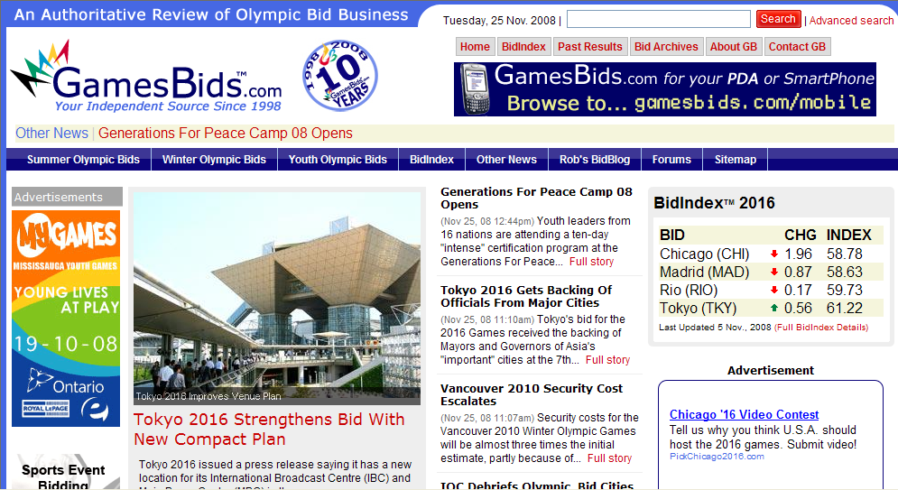
#17. GamesBids.com http://www.gamesbids.com/
Notes:
OCLC 70342372
Sessions 1 and 3: Exercises
SCCTP Integrating Resources Cataloging Workshop -- December 2008

Slide 20

#18. Curating the city http://www.curatingthecity.org/html-wilshire_curating.jsp
Notes:
OCLC62332301
Sessions 1 and 3: Exercises
SCCTP Integrating Resources Cataloging Workshop -- December 2008

