Slide 1
Session 3a
Original Cataloging of Integrating Resources
Notes:
Optional Warm Up Exercises
Ask the participants: For those who have cataloged updating Web sites and online databases, what kinds of problems have you encountered? How does it compare with cataloging print and other tangible resources? What aspects have you found the most challenging? How about updating loose-leafs? For those who haven’t yet cataloged these resources, what do you think your first steps to cataloging a Web site would be?
Instructor References
The Instructor is advised to review and consult the following for this session:
Primary sources:
AACR2, 2002 Revision, Chapters 12 and 9 and the corresponding LCRIs
MARC 21 Format for Bibliographic Data: Leader, 006, 007, and 008 fields, especially for Books, Continuing Resources/Serials, and Computer files/Electronic resources
OCLC Bibliographic Formats and Standards: Fixed Fields and Control Fields 006 and 007, especially for Books, Continuing Resources/Serials, and Computer files/Electronic resources
Information on new rules, significant changes, and implementation of new MARC tags:
Library Of Congress Implementation of the 2002 Edition of AACR2 - Significant Changes / Cataloging Policy And Support Office: http://lcweb.loc.gov/catdir/cpso/aacr2002.html
OCLC Technical Bulletin 247, Section 1 “Coding Practice for Integrating Resources”: http://www.oclc.org/technicalbulletins/247/#1
RLG Technical Note: “How MARC 21 Updates 2 and 3 Affect the RLG Union Catalog”: http://www.rlg.org/marcupdate02.html
Information on Leader and control field coding for electronic resources:
Library of Congress: Guidelines for Coding Electronic Resources in Leader/06: http://lcweb.loc.gov/marc/ldr06guide.html
Cataloging Electronic Resources: OCLC-MARC Coding Guidelines by Jay Weitz: http://www.oclc.org/connexion/documentation/type.htm

Slide 2
Goals for Session 3
Learn the basics of original cataloging of integrating resources
  With a focus on electronic integrating resources
Understand how to apply the new AACR2 rules for integrating resources
  Primarily chapter 12, but also chapter 9 for electronic IRs (or appropriate format-specific chapter)
Understand how to apply MARC21 coding practice for integrating resources
Notes:
Object:
The object of this session is to give an overview of cataloging integrating resources, with a focus primarily on electronic IR (updating Web sites and databases)
The session covers both AACR2 rules and MARC tagging, with a focus on the AACR2, 2002 rev. for cataloging updating online resources and updating loose-leafs.
Note: there is more material on cataloging updating loose-e-leafs and loose-leaf services in optional Session 6.
Additional materials needed: instructors and participants should have Appendix A out of their binders and ready for reference when or if needed during session 2.
Participants' Goals:
You might ask the participants if they have any additional or more specific goals or areas they especially want to learn about in this session.

Slide 3
Outline of Session 3
Session 3a:
MARC leader and control fields
Bibliographic description: basis, chief source
Title, Edition, Publication data,
Session 3b:
Bibliographic description: continued
Linking entries
Access points
Session 3 Exercises
Notes:
Session 3 is the longest in the workshop and is therefore split into two sections.
Instructors may wish to take the lunch break at some point other than this session division.
It is important for instructors to be familiar with the order and flow of material in this session; this may also be important to explain to participants right at the start so as to avoid confusion:
Note on the order of presentation:
The session covers MARC leader and control fields in general first --but only what is different for integrating resources (compared to other forms of issuance) or what is especially important for cataloging electronic IRs.
Refer to Appendix A for more detailed lists of MARC codes.
The coverage of bibliographic description follows the order of AACR2 rules, with a few exceptions:
Variant title notes and entries (MARC 246) are covered immediately after title proper (MARC 245) rather than with the notes area.
The use of some MARC fixed field coding is not covered in the beginning MARC section but instead is covered at the same time as the associated variable fields in the bibliographic description section, where they will make more sense: namely, Type of date and Dates codes are covered along with Area 4 dates of publication (260 $c); and Frequency and Regularity codes along with Area 7 Frequency note (310/321).
The bibliographic description section is based on AACR2 chapters 12, 1, and 9, and include MARC tagging.
Note on Examples used in Session 2:
The last three resources used in the Session 1 Exercises will be used periodically throughout Session 2a-b; and final complete records will be given for each of the three at the end of Session 2b: one Web site, one database, and one loose-leaf.
A variety of other examples will be used where needed to illustrate different aspects not covered by the three main resources selected as examples.

Slide 4
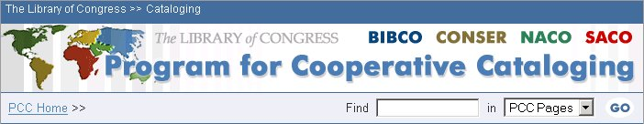
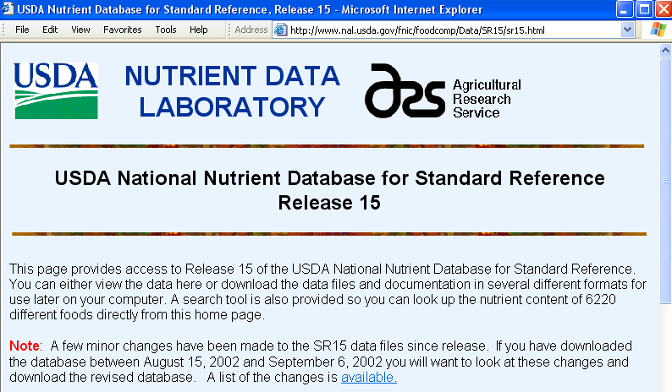
Cataloging Examples
Notes:
Session 2 covered questions a cataloger would ask in preparation for cataloging.
Now we will be using that information to code the record. These two resources will be used as shared models for coding the various fields of a record: The Program for Cooperative Cataloging Web site and the USDA Nutrient Database.
As we code the shared examples, please fill in the cataloging form for the resource that you are cataloging.

Slide 5
MARC Leader and Control Fields
Type of record (OCLC “Type” = Leader/06)
  Primary content
Bibliographic level (OCLC “BLvl” = Leader/07)
  Type of issuance
Control fields 006 and 008 (OCLC fixed fields)
  Fixed length coded data elements for different types of material (e.g., books, maps, computer files, etc.)
Control field 007
  Physical characteristics fixed field
Notes:
First, the cataloger must select the Type of record and Bibliographic level codes appropriate for the resource. In OCLC this equals which workform you select. For text-based online resources this will virtually always be the Continuing Resources workform, but for non-text resources, use the workform specific to that format.
Select the Type of record code appropriate for the predominant content of the resource, regardless of its electronic carrier.
Select the Bibliographic level code for its type of publication.
The 008 positions and OCLC workform are automatically determined by the Type and BLvl combination.
Select the appropriate 006 fields to add to the record to code for the significant aspects not covered by the Leader and 008.
Add one or more 007 fields for the electronic and other aspects of the resource (such as cartographic, sound, image, etc.)

Slide 6
Type of record (OCLC: Type)
Select code for primary content of resource
  Regardless of physical carrier (print, electronic, etc.)
For example:
  a – Language material
    Includes primarily textual Web sites & databases, disregarding incidental images, search software, etc.
  m - Computer file
    Restricted to computer software, computer-manipulable numeric data, computer-oriented multimedia, online systems or services
  e – Cartographic material
  k – Still images (“two-dimensional non-projectable graphic”)
  g – Moving images (“projected medium”)
  j – Musical sound recordings
Notes:
This slide lists only six of the many possible Type of record codes (=Ldr/06) for online integrating resources. Code “a” for language material is the most common for Web sites and databases.
Session 6 will go into the use of various codes in more detail. It includes additional guidelines to assist in making this determination
Additional information for instructors:
Heads up: The Session 2 exercises include one Type a and one Type m resource
More information on some of the codes:
a – Language material
Use code “a” for Web sites and databases that consist primarily of electronic text, disregarding incidental images, hyperlinks, and search software.
m - Computer file
Use code “m” for Web sites and databases that consist of one of the following: computer software, computer-manipulable numeric data, computer-oriented multimedia, online systems or services.
e – Cartographic material
Use code “e” for Web sites and databases that consist primarily of cartographic content, including digital maps, online interactive atlases, etc.
k - Two-dimensional nonprojectable graphic
Use code “k” for Web sites and databases that consist of digital images, including digitized photographs, etc.
Web resources consisting mostly of HTML text with incidental images, hyperlinks, and/or search software are considered predominately textual and coded Type “a”.
[recall that a book with pictures is still cataloged as text, not as image material, as would be a photograph or a poster]
Note the restricted scope of Type “m”: it applies now only to four categories of electronic resource.

Slide 7
Bibliographic level (OCLC: BLvl)
m – Monograph
s – Serial
i – Integrating
All updating loose-leafs, updating Web sites, and updating databases are integrating
Notes:
For textual integrating resources, we use Continuing Resources 008. For older records, you will still find instances with the fixed field for a the Books 008 [“format” and workform in OCLC]. Session 4 will discuss this in depth, when we look at working with copy.
This is Leader position /07
For further information on implementation by the utilities see:
OCLC Bibliographic Formats and Standards 3.11 Guidelines for Integrating Resources http://www.oclc.org/bibformats/en/specialcataloging/default.shtm
Reminder: records for integrating resources with Type = a (Language material) will have a Continuing resource 008. However, records for integrating resources with other Type values will have the 008 for that Type. For example, records with Type = m (Computer file) will have the Computer file 008 and records with Type = e (Cartographic material) will have the Maps 008.

Slide 8
Electronic resources elements: Fixed Field/006
Form of item (OCLC: Form and Orig)
  Code “s” – Electronic
  Use this code for all electronic resources in:
    “Form of Item” (008/23; 006/06)
    “Form of Original Item” (008/22; 006/05)
Type of computer file (OCLC: File)
  See Appendix A for list of codes
  Use this code in Electronic resources/Computer files 008 or 006
  [Will cover use of different codes in Session 5 of this workshop]
Notes:
This slide lists two 006/008 elements unique to electronic resources
1. Form of item code "s" for "electronic“:
Used in the same way that codes for microfilm and microfiche are currently used in those 008 bytes. OCLC added the new code "s" to the 008/23 on existing records in spring 2000.
Best practice for electronic integrating resources is to always code Form of item as “s”.
Note: the Form of item byte positions for MAP, VIS are different from other types of resources: 008/29; 006/12
Type of computer file code:
This code will always be used in all records for electronic resources in either the 008 or 006.
See Appendix A for a complete list of codes.
We will cover the application and use of these codes in Session 5.

Slide 9
Continuing resources elements: Fixed Field/006
  Frequency
  Regularity
  Type of continuing resource
  (formerly: Type of serial)
  ISSN center
  Form of original item
  Form of item
  Nature of entire work
  Nature of contents
  Government publication
  Conference publication
  Original alphabet or script of title
  Entry convention
  (formerly: Successive/latest entry)
Notes:
This slides lists the remaining Continuing Resources 006/008 elements
Reminder: formerly called Serials 006/008 in MARC 21; now applies to both serials and integrating resources.
They will be used in either the 006 or 008.
We want to look especially at Frequency, Regularity, Type of continuing resource, Form of item and original item, and Entry convention.
See Appendix A for a complete list of all fixed-length elements unique to Continuing resources, with lists of all possible codes/values.

Slide 10
Frequency (Freq) and Regularity (Regl)
Frequency codes:
Examples of selected codes; see Appendix A for complete list.
blank - No determinable frequency (irregular)
d - Daily
k - Continuously updated
(= more frequently than daily)
m - Monthly
q - Quarterly
u - Unknown
w - Weekly
Regularity codes:
r - Regular
n - Normalized irregular
x - Completely irregular
u - Unknown
Notes:
These two Continuing resources elements are always used together and in conjunction with the 310 frequency note in the body of the bibliographic record.
The Frequency element contains numerous codes for different frequencies. Only a few are given on this slide for space reasons! See Appendix A for a complete list of codes.
We will cover their use later in Session 2b in conjunction with the Frequency note in area 7 of the bibliographic description.
The “Frequency” element is used for frequency of issues for serials and for frequency of updates for integrating resources.
Heads up for instructors:
In case participants raise this issue or notice the difference, instructors will want to know ahead of time that the definition of MARC 21 Frequency code “k” uses the term “Continuously updated” while the examples in AACR2 use the term “Continually updated.” Either variant is acceptable in the 310 since no specific wording is prescribed by AACR2 (AACR2 examples are illustrative, not prescriptive).
The term “continuously” accords with the established MARC standard (Frequency code wording) and the examples in AACR2 are not prescriptive as to wording.
But it may be argued that “continuously” implies the notion of constantly, without interruption, while “continually” implies the notion of periodically, with great frequency, in which case “continually” is likely to more technically correct for most updating Web resources to which this frequency statement is relevant. Some online services may, however, actually be “continuously” updated in the narrower sense of this term.
But until one term is used consistently in AACR2 and MARC 21, or one term is given preference in LCRIs or other guidelines, there is no official basis for preferring one term over the other. This workshop may not be the best time or place to get caught up in arguing about these semantics, since there is so much material to go through and workshop participants will not be able to resolve the issue in any definitive way.

Slide 11
Type of continuing resource
(OCLC: SrTp)
Codes for integrating resources:
  d - Updating database
  l - Updating loose-leaf
  w - Updating Web site
Codes for serials:
  m - Monographic series
  n - Newspaper
  p – Periodical
  blank – None of the others
Notes:
Three values for integrating resources have been added to the four existing serials values.
When cataloging integrating resources, the cataloger simply needs to select code “d”, “l”, or “w” for this element.
008/21; 006/04

Slide 12
Entry convention (OCLC: S/L)
Codes for serials:
  0 - Successive entry
  1 - Latest entry
Code for integrating resources:
  2 – Integrating entry
    Record is cataloged under its latest (most recent) title and/or responsible person or body.
    A new record is made only when there is a major change in edition, or it is determined that there is a new work, or for mergers and splits.
Notes:
The cataloging convention used for dealing with changes in bibliographic data elements in continuing resources.
Serials cataloged according to AACR2 use the Successive entry convention.
Serials cataloged prior to AACR2 used the Latest entry convention.
Integrating resources, starting with the implementation of AACR2 2002 Revision, are cataloged using the Integrating Entry convention. The definition on this slide is taken directly form the MARC 21 Format for Bibliographic Data.
Note that Integrating entry is basically the same convention as Latest entry, but the name distinguishes this AACR2 cataloging convention used for integrating resources from the pre-AACR2 cataloging convention used for serials.
Note also that this element was called “Integrated entry” with the first MARC 21 documentation and may still be called by that name in printed MARC 21 documentation and in OCLC and other current documentation.
Additional information for instructors for optional sharing or in case someone asks:
The definitions of the Entry convention codes for serials are:
0 - Successive entry: New bibliographic record created with major change in title proper, or when corporate body main entry or corporate body uniform title qualifier changes.
1 - Latest entry: Item is cataloged under its most recent title or issuing body (pre-AACR cataloging rules).

Slide 13
007 – Physical description control field
Computer files/Electronic resources 007 elements:
$a – code “c” for category “Computer file”
$b – code “r” for specific type “Remote access”
$d – select correct code for color aspects of resource
$e – code “n” for dimensions “Not applicable”
$f – select correct code for sound aspects of resource
$g → $l – Optional (used primarily for archival control)
Notes:
The 007 is organized by bytes or character positions in MARC 21 and by subfields in OCLC.
Of the five required codes in the Computer files/Electronic resources 007, three are always the same for remote-access electronic resources;
only color and sound need to be determined; the correct code selected from the list (see list of codes in Appendix A)
The final six codes ($g-$l) were added to this field several years after the original set; they are optional and are really intended to be used for special archival control of digitized resources and not for ‘regular’, non-archival cataloging.
Note that LC codes only subfields $a and $b.

Slide 14
Example 1: Leader and control fields for updating Web site
Type: a ELvl: I Srce: d GPub: f Ctrl: Lang: eng
BLvl: i Form: s Conf: 0 Freq: MRec: Ctry: dcu
S/L: 2 Orig: s EntW: Regl: x Alph:
Desc: a SrTp: w Cont: DtSt: c Dates: 199u,9999
006 ER: Audn: File: d GPub: f
007 ER: c $b r $d m $e n
Notes:
This is the first of four examples of leader and control field coding for integrating resources. The first three examples are for the three resources selected to represent integrating Web sites and databases throughout Session 3.
What to point out in Example 1:
Type of Record is “a” because the Web site consists primarily of textual, document-like content. Bibliographic Level is “i”.
008 for Continuing Resources is used; Type of Continuing Resource (SrTp) is coded “w” for “updating Web site”; Entry Convention (S/L) is “2” for Integrating Entry. Note that we will return to the use of the Frequency and Regularity elements in Session 2b.
006 for Electronic Resources (abbreviated as ER on slide for space reasons) has been added; File = type of computer file: coded “d” for “document”.
007 for Electronic Resources (Computer files) has also been included.
Explanations on format of records used in examples:
There is no convenient established way to illustrate the 006 fields since they display in OCLC as character strings which are not human eye friendly! Therefore these examples in the workshop use the OCLC mnemonic tags that appear when adding the 006 in OCLC CatME or Connexion.
Most often they will follow the pattern they take in Connexion, but not always: where they do not exactly look the same but have been included as they are largely for space reasons.

Slide 15
Example 2: Leader and control fields
for updating database
Type: a ELvl: I Srce: d GPub: f Ctrl: Lang: eng
BLvl: i Form: s Conf: 0 Freq: MRec: Ctry: mdu
S/L: 2 Orig: s EntW: Regl: x Alph:
Desc: a SrTp: d Cont: DtSt: c Dates: 199u,9999
006 ER: Audn: File: d GPub: f
007 ER: c $b r $d m $e n
Notes:
What to point out in Example 2:
Everything is the same for this database that consists of primarily textual, language material content, except for the Type of Continuing Resource (SrTp) code “d” for “updating Database.”
Additional information from Steve Miller (2004):
The USDA National Nutrient Database for Standard Reference example used throughout Session 2 may need clarification for instructors (and participants): individual releases might themselves be non-integrating (i.e., non-updating); each new release gets a new URI: e.g., the current one for Release 16 is: http://www.nal.usda.gov/fnic/foodcomp/Data/SR16-1/sr16-1.html and each can be downloaded and kept until the next release
But the database as a whole does appear to be integrating in that each new release appears to completely replace the previous one, which is not longer accessible, and consists of updated content of the same database.
The problem with this as an example is that it is somewhat complicated, especially with the changing URL –but that may not be a bad thing, since the Web site example used throughout Session 2 is pretty straightforward.

Slide 16
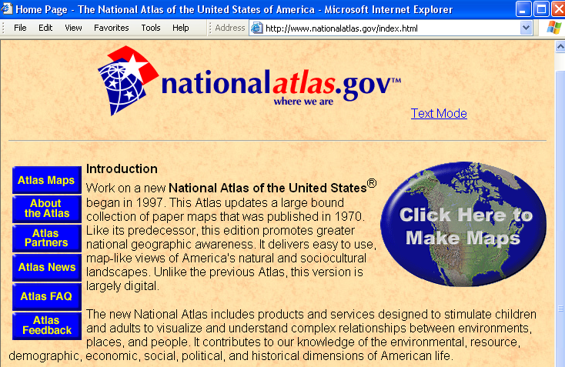
Example 3: Leader and control fields
for updating cartographic Web site
Type: e ELvl: I Srce: d Relf: bac Ctrl: Lang: eng
BLvl: i Form: s GPub: f SpFm: z MRec: Ctry: vau
CrTp: e Indx: Proj: DtSt: c Dates: 1997,9999
Desc: a
006 ER: Audn: File: c GPub: f
006 CR: Freq: Regl: x SrTp: w Orig: s Form: s EntW: Cont: GPub: f Conf: 0 Alph: S/L: 2
007 ER: c $b r $d m $e n
007 MAP: a $b d $d c $e z $f n $g z $h n
Notes:
This is an example of an online integrating resource that has primarily cartographic content.
What to point out in Example 4:
Type = “e” (map/atlas/cartographic content), along with BLvl i = Maps 008 / fixed fields.
006s for ER and CR added; SrTp = w for updating Web site.
Two 007s: one for ER, the other for Maps (cartographic resources)

Slide 17
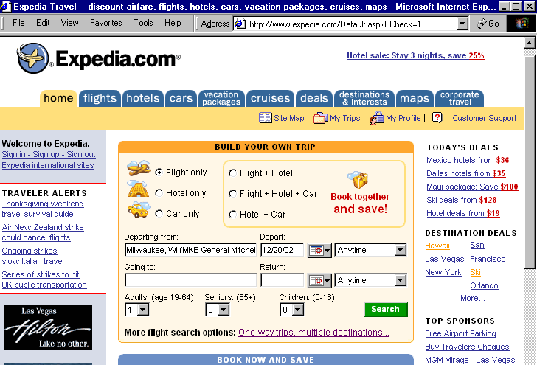
Example 4: Leader and control fields
for updating online service Web site
Type: m ELvl: I Srce: d Audn: Ctrl: Lang: eng
BLvl: i File: j GPub: MRec: Ctry: wau
Desc: a DtSt: c Dates: 199u,9999
006 CR: Freq: k Regl: r SrTp: w Orig: s Form: s EntW:
Cont: GPub: Conf: 0 Alph: S/L: 2
007 ER: c $b r $d m $e n
Notes:
This is an example of an online service that falls into one of the categories for Type of record code “m” – primarily Computer file/Electronic resource material.
What to point out in Example 5:
Type = “m” (computer file content -- resource includes significant computer programs in addition to data)
File (Type of computer file) = j for Online system or service
No 006 for Electronic resources/Computer files is added because these codes are already present in the 008.
006 for Continuing resources is added and SrTp is again “w”.
007 for ER is present.
____________________
Pause: this is a good time to take a brief pause and ask if there are any questions about the leader and control field material covered so far.
You may need once again to remind participants that:
Frequency and Regularity and Dates codes will be covered later in Session 2
Appendix A is a MARC Coding guide that includes complete lists of elements and codes
Session 5 includes additional guidelines on the selection of Type of Record and Type of Computer File codes for electronic resources.

Slide 18
12.0B1b. Bibliographic Description
Basis of the description
Areas based on current iteration:
Title and statement of responsibility
Edition
Publication, distribution, etc.
  Except dates
Physical description
  Optional for remote e-resources
Series
Area based on first and/or last iteration(s):
Dates of publication, distribution, etc.
Areas based on all iterations and any other source:
Note
Standard number and terms of availability
Notes:
We turn now to AACR2 2002 and bibliographic description.
This slide depicts the basis of description for integrating resources; it is based on AACR chapter 12, 2002 revision.
All areas of description are based on the current iteration of the resource, except for dates of publication, notes, and standard numbers.
Within chapter 12, most rules have separate sections that apply to (A) serials and (B) integrating resources.
Each area of description for integrating resources also has rules for both (1) how to record the information in the area and (2) how to deal with changes to information in that area in later iterations of a resource.
Important note: “last” iteration in the rule for the basis of description for Dates of publication means the final iteration of a resource that has ceased being updated (a “dead” publication); it does not mean the “latest” iteration of a resource that is still being actively updated (a “current” publication).
Important Reminder: this session is dealing only with the rules for original cataloging; Session 4 will cover the rules for how to deal with changes in later iterations.

Slide 19
12.0B2b. Chief Source of Information
Printed integrating resources:
  Title page or title page substitute
Nonprint integrating resources:
  Follow directions in subrule .0B in the relevant chapter
For electronic integrating resources: Rule 9.0B:
  The chief source of information is the resource itself
  Take the title proper from formally presented evidence
  If the title information presented in these sources varies in degree of fullness, prefer the source that provides the most complete title information
Notes:
For online electronic integrating resources:
12.0B2 refers us back to 9.0B1 for electronic integrating resources.
9.0B1 states that we are free to select the appropriate chief source from anywhere within the entire resource itself, but preferring a source that provides the most complete information.
So the source of title proper should be the most complete formal presentation of title.

Slide 20
Title and statement of responsibility
Title proper (245 $a, $n, $p)
GMD ($h)
Parallel titles ($b)
Other title information ($b)
Statements of responsibility ($c)
Note: the MARC subfield codes given above reflect the most common situations, but there are other situations where the data elements in a title and statement of responsibility require different coding and/or arrangement.
Notes:
We will proceed area by area through the eight areas of description.
This slide serves simply as an introductory slide for those that follow by listing the components of Area 1.
Note: the MARC subfield codes given in the slide reflect the most common order, but there are exceptions. See the MARC 21 format for specific questions about coding and arrangement. An example of using a somewhat different coding is where $n and $p may occur after $b.

Slide 21
Common sources of title proper in online integrating resources
Formal title display on home page screen
  May be HTML text, graphic (image file), or both; may appear in more than one form
HTML header title
  Displayed in browser title bar (also viewable by selecting View → Source)
Sources of “formally presented” titles include:
  title screen, main menus, program statements, initial display of information, home page, the file header including “Subject:” lines, encoded metadata (e.g., TEI headers, HTML/XML meta tags)
Notes:
The first two listed on the slide are the two most common places in which to find the title of a Web site or online database, but they are not exhaustive.
The 2001 amendments to AACR included examples with the terms “home page” and “HTML header”. Although examples in AACR are not prescriptive, these may still offer guidance in how to word notes.

Slide 22
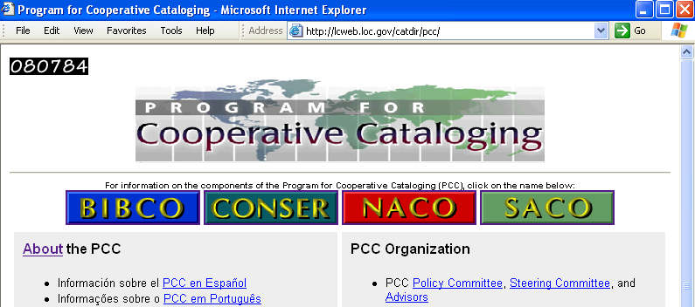
Source of title proper example 1
Home page title display (graphic) and HTML header title are identical
245 10 Program for Cooperative Cataloging $h [electronic resource] : $b [Web site].
Notes:
This slide depicts the two most common sources for title information for Web resources.
In this instance the main formal “title display” at the top of the home page screen is a graphic file rather than HTML text.
One reason this may be significant is that search engines, robots, spiders, etc. can only read text, not the content of image files.
They can read the content of the HTML source coded title, and in fact most search engines weigh this heavily in retrieving search results and in indexing the resource.
In this instance the title display on the home page and in the HTML header are identical.
The title proper is transcribed into the MARC 245 field and the GMD [electronic resource] is always added in subfield $h immediately after the title proper.
Note that for all electronic resources, the GMD “electronic resource” is always added in square brackets immediately after the title proper --in subfields $a (plus $n and/or $p if applicable).
Note: Rule 12.1E1 requires the cataloger to add a brief explanatory addition as other title information when the title of a continuing resource consists solely of a name.

Slide 23
Source of title proper example 2
Home page title display (HTML text) and HTML header title are not identical
245 00 USDA national nutrient database for standard reference $h [electronic resource].
Notes:
Our database example shows an instance in which the title on the home page screen is different from the title in the HTML header display: it includes the word “National.” Also, the title on this home page is HTML text rather than a graphic file, as in the previous example --this is not really significant for title transcription, but worth noticing for reasons stated on the previous slide.

Slide 24
1.1B1 & 12.1B1-4.
Transcription of title proper
Do not transcribe introductory words not intended to be part of the title, such as “Welcome to”; instead give the title with these words in a note (1.1B1)
Correct obvious typographic errors and give title as it appears in a note (12.1B1)
When title appears in full and in the form of an acronym or initialism, choose the full form (12.1B2)
  e.g., Program for Cooperative Cataloging instead of PCC
If resource is a part of another resource and bears both the common title and its own section title, give both in that order, separated by a period (12.1B4)
  Will not often apply to online resources: see LCRI 12.1B4
Notes:
This is a condensation of what are probably the most significant rules that will be new for transcribing title information for integrating resources; it does not include all the rules nor the full text of the rules stated here.
1.1B1 is especially noteworthy for IR in addressing online resources that begin with “Welcome to.”
LCRI 12.1B4 for updating remote electronic resources states that “what appears at first to be a common title may instead be a statement of responsibility, the name of the parent electronic resource, or another component of the resource. If in doubt, do not consider it to be a common title.”

Slide 25
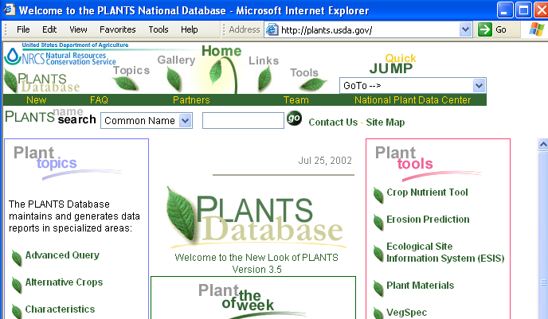
Transcription of title proper example 1
“Welcome to …” in HTML header title
245 04 The plants national database $h [electronic resource].
246 1_ $i Title in HTML header: $a Welcome to the plants national database
246 1_ $i Title on home page: $a Plants database
Notes:
If you are selecting the HTML header as the chief source --because it is the fuller form [it includes the words “… PLANTS National …” (which are transcribed in lowercase)]-- then the title would be recorded like this, omitting “Welcome to.”
You might also omit “Welcome to the” and begin the title with “Plants.”
Note the main display title which appears more than once is simply “Plants database” and could be a legitimate selection, even though technically it presents a less full form of the title.

Slide 26
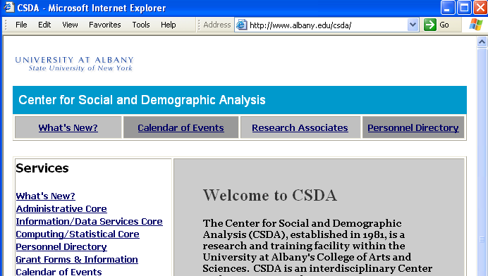
Transcription of title proper example 2
Title appears in full and in form of acronym
245 10 Center for Social and Demographic Analysis $h [electronic resource] : $b [Web site].
246 1_ $i Title in HTML header: $a CSDA
Notes:
Always select the full form when the title appears in both forms in the resource.

Slide 27
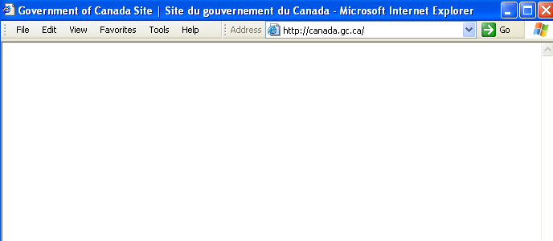

Parallel title example
245 00 Government of Canada site $h [electronic resource] = $b Site du gouvernement du Canada.
246 31 Site du gouvernement du Canada
Notes:
An example of a parallel title on the home page of an updating Web site.
Note: the HTML header has been chosen as the source of title in this example since it presents a slightly fuller form of the title than that displayed on the home page.
Note also that title variants may also have parallel titles, and that these can be recorded as such in 246 as well:
246 1_ $i Title on home page: $a Government of Canada = $b Gouvernement du Canada
246 31 $a Gouvernement du Canada
NOTE: CONSER Standard record guidelines: For CSR records, the second 246 would be coded 246 13

Slide 28

Over to you…
Notes:
Now, you’ll have a few minutes to code the title proper information for your own resource

Slide 29
Transcription of other title information: 12.1E1b
Per 2004 update to AACR2, always include:
  Acronym if full form is title proper
  If contains statement of responsibility or publisher, etc.
  Supply information if title proper is only name of body
If important: Transcribe; or use quoted note
Do not transcribe (12.1E):
  Currency of the contents
  Frequency of updating
Notes:
A departure from previous practice for cataloging Web sites and databases under rules for monographs is that chapter 12 gives catalogers the option of choosing NOT to transcribe other title information for integrating resources if not one of the three situations in the 2004 update and if not considered to be important; and we are directed to not transcribe it when it consists only of words relating to the currency of the contents or the frequency of updating.
This has long been a practice with serials cataloging, and it is a valuable application to integrating resources since other title information is often subject to greater change than titles proper.
A good instance of how the rules now take into account the continuing, changing nature of updating resources.
We do still always transcribe parallel titles and statements of responsibility that appear in the chief source, however, regardless of whether “considered important” or not.
CONSER Standard Record: Not required unless title proper is name of body

Slide 30
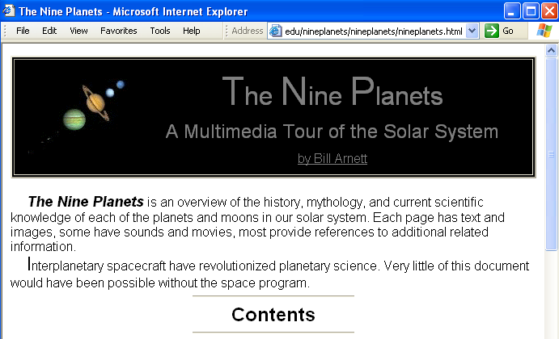
Other title information and statement of responsibility example
245 14 The nine planets $h [electronic resource] : $b a multimedia tour of the solar system / $c by Bill Arnett.
Notes:
An example of a subtitle that may be judged important for transcription or quoted note, and the less common case of a statement of personal responsibility.
Note for instructors in case anyone asks: although this might appear to be an online monograph, it is in fact an updating Web site. A linked page lists the updates:

Slide 31
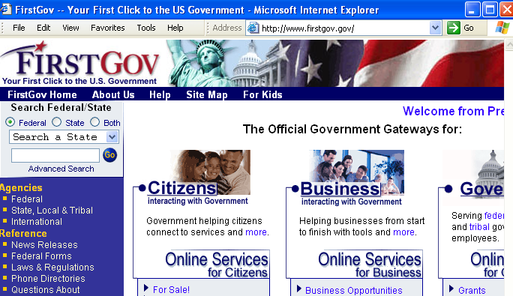
Other title information for transcription?
245 00 FirstGov $h [electronic resource].
OR:
245 00 FirstGov $h [electronic resource] : $b your first click to the U.S. government.
Notes:
Here is an example of a case in which a cataloger might choose to not transcribe other title information. We often find this sort of thing in online integrating resources, where the wording is not quite the same as a fixed subtitle on the title page of a book. If not transcribed, it could be given in a note if judged important enough.
Participants' thoughts?
[The workshop creator’s preference is to neither transcribe nor give in a note]
If given as a note, it may be given in field 246 with first indicator 0 (display note, but do not index in browse title index):
246 0_ $i Subtitle: $a Your first click to the U.S. government
This presents an opportunity to review with participants that fact that data elements that are defined as notes in AACR2 are often tagged in various MARC fields other than 5XX fields. Some fields such as 246 may serve two functions: as notes and as added entries, or as one or the other, depending on the indicator value.
Reference information from MARC 21 Format for Bibliographic Data:
246 first indicator - Note/added entry controller
A value that indicates whether an added entry for the title is to be generated.
0 - Note, no added entry
1 - Note, added entry
2 - No note, no title added entry
3 - No note, added entry

Slide 32
Variant forms of title:
1.7B4, 12.7B4.1, 9.7B4, 21.30J2
Make notes on titles borne by the item other than the title proper (12.7B4.1, 9.7B4)
Make notes on titles by which the resource is commonly known if considered to be important (1.7B4, 12.7B4.1)
If considered important for access, make an added entry for any version of the title that is significantly different from the title proper (21.30J2 & LCRI)
In MARC record: 246 field can serve as both note and added title entry.
Notes:
It is quite common for Web resources to bear different titles and different variations of a title. With Web resources catalogers should be generous with the use of 246 title variants.
One thing new in 2002 for non-serial resources is that we can also include the title by which a resource is commonly known, even when it does not appear in/on the resource itself.
Note: LCRI 21.30J offers detailed guidance on giving variant titles.

Slide 33
Title variants example
245 10 Program for Cooperative Cataloging $h [electronic resource] : $b [Web site].
246 1_ $i Commonly known as: $a PCC
Notes:
A well-known example.

Slide 34
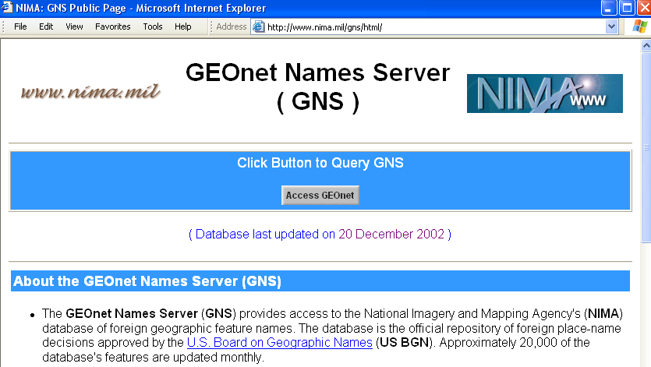
Title variants example 3
Home page title display and HTML header title differ
245 00 GEOnet names server $h [electronic resource] : $b GNS.
246 1_ $i Title in HTML header: $a NIMA : $b GNS public page
246 30 GNS
246 3_ GNS public page
Notes:
A very common situation for Web sites and online databases: the home page title display and the HTML header title are different.
In this example, the other title information (subtitles) may also be given as varying forms of the title (field 246).

Slide 35

Over to you…
Notes:
Take a few minutes to code the other title information for your own resource

Slide 36
Edition
12.2B: Transcribe an edition statement if considered to be important
  9.2B1: A statement that indicates that the electronic resource contains differences from other editions of that resource, or that names a reissue of the resource
  9.2B2: In case of doubt, take words such as edition, issue, version, etc. as indicating an edition statement
12.2B2: Do not transcribe statements indicating regular revision or frequent updating as edition statements
  Instead give as frequency information in the note area (see also 12.7B1).
Notes:
Most updating Web sites will not have edition statements; some updating databases may have edition or version or release statements. Many loose-leaf resources have edition statements.
Catalogers are given discretion in whether or not to transcribe edition statements, and are directed not to transcribe as an edition statement information that indicates regular revision or frequent updating.
Instructors might wish to note the change in the following from chapter 9 with the publication of revised chapter 12:
Added in 2001 amendments:
9.2B1. Sentence added: For frequently updated remote access electronic resources, see 9.2B8.
New rule 9.2B8: If a remote access electronic resource is frequently updated, omit the edition statement and give the information in a note (see 9.7B7)
Changed in 2002 Amendments:
Rule 9.2B8 is deleted and is now covered by rule 12.2B2. (The sentence added to 9.2B1 referring to 9.2B8 was also deleted.)

Slide 37
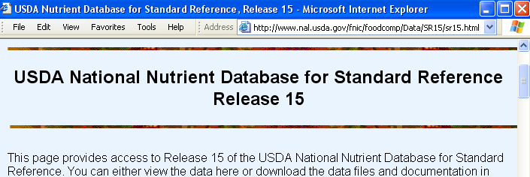
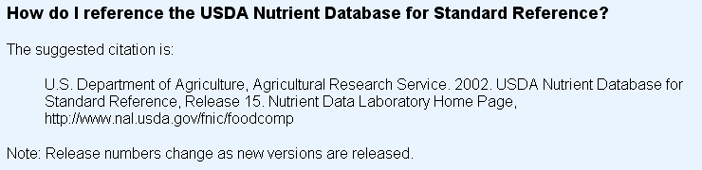
Edition statement example
Online updating database
From FAQ page
245 00 USDA national nutrient database for standard reference $h [electronic resource].
No edition statement
Notes:
This is a good example of an updating database with a release statement that changes with every new iteration. Rather than making frequent changes to the bibliographic record, it makes much more sense to take into account the changing content and not transcribe this information as an edition statement. It could, however, be given in a note, especially in an Item described (Description based on or Date viewed) note, e.g.:
500 Title from home page; description based on release 15, viewed on Jan. 15, 2003.

Slide 38
9.3. Type and extent of resource [chapter 9]: 256 Field
Eliminated with the deletion of rule 9.3 in the 2004 update to AACR2
If using existing copy: Delete if changed
Notes:
IMPORTANT: This area was eliminated from the rules with the deletion of rule 9.3 in the 2004 Update to AACR2. Generally retain the terms formerly used for this area (electronic data; electronic program(s); and, electronic data and program(s)) and any details about files, statements, bytes, etc., when using existing records for copy cataloging if the information still characterizes the resource.
Such information now can be given in a Type of computer file or data note (516 field), combined with other notes (e.g., a Summary note), or given in the 300 field if the new option in AACR2 9.5B3 is applied.
If field 256 was included in the record and the type and/or extent changes, delete the 256 field.
Note that LC never supplied this field in original cataloging but accepted it when doing copy cataloging.

Slide 39
Area 4: Publication, distribution, etc.
9.4B2: “Consider all remote access electronic resources to be published”
Record place of publication and publisher name.
  Where to look in online resources:
    Bottom of home page
    “About” page (a common hyperlink from home page)
    Publisher information page (link from home page)
    Domain name in URL may provide clues or corroboration for publisher
    Generally prefer a corporate body name as publisher
Notes:
Teaching points:
“Consider all remote access electronic resources to be published.” Relieves the cataloger of having to decide whether an Internet resource is published or unpublished, which affects cataloging treatment.
“Publication” = “making public” and distributed on the Internet.
This declaration inevitably raises questions about whether electronic reproductions and electronic originals of theses and dissertations should also be considered to be “published,” because in their tangible forms they are considered unpublished manuscripts and coded with Type of Record code “t”. This issue has not been addressed widely within the cataloging community, though such resources may well be covered by the first bullet of the slide. Instructors may want to state this, that people are aware of the issue, and that this is not a good time or place to get bogged down in debating it. Other venues such as Autocat or PCC discussion may be better so that this workshop can proceed.
The “publisher” of a remote-access electronic resource is the person or body responsible for making the resource (Web site, database) available on the Internet.
The URL domain name often provides an invaluable guide to the cataloger in selecting the body responsible for publishing the resource on the net, but cannot in and of itself be used as a source for publisher. It can often provide some clues as to who the publisher may be, and/or confirm a selection. [But some organizations, such as universities, sometimes offer space on their servers to unrelated organizations and individuals, which are the publishers and not the university. In those cases the presence of a tilde in the URL usually indicates a personal or separate organizational section on a university’s server.]
General notes on selection/transcription of place and publisher continued on next slide →

Slide 40
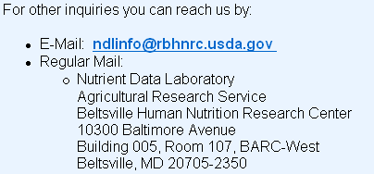
Publisher place and name example 1
On home page
Linked information page
260 Beltsville, MD : $b USDA Nutrient Data Laboratory, Agricultural Research Service
Notes:
In this example, the linked contact information page is a “sub-page” [http://www.nal.usda.gov/fnic/foodcomp/contact.html] nested within the Web site being cataloged [http://www.nal.usda.gov/fnic/foodcomp/] and is therefore part of the resource being described; for that reason the place of publication can be transcribed without brackets. The publisher name in this example is taken from the home page, but it could also be taken from the linked contact information page.
___________________________
→ General notes, continued from previous page:
In general it is preferable to select a corporate body over an individual person as “publisher.” An individual person is more likely to be the creator or author of the intellectual content and a corporate body to be the publisher.
But there are cases where an individual rather than an institution bears primary responsibility for publishing the resource, especially in cases where the domain name is a general Internet Service Provider in which an individual has their personal Web site. This may also be the case when a Web site or database resides within the personal e-space of someone on a university campus. The tilde in the URL is often a sign that the address is within an individual person’s Web space.
A practical question for consideration: how much time should a cataloger take to hunt for publisher and especially for the place that the publisher is located? Rarely will place of publication be found on the home page.
Strongly recommended: going to at least one or two other pages, especially an “about” page or clicking on the publisher name when it is a hyperlink

Slide 41
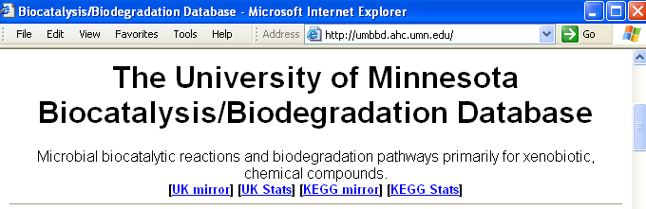
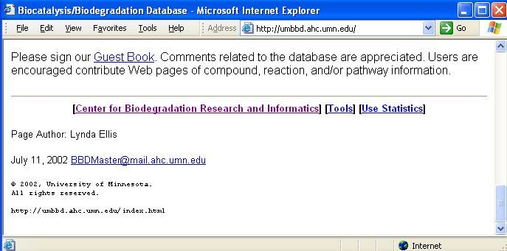
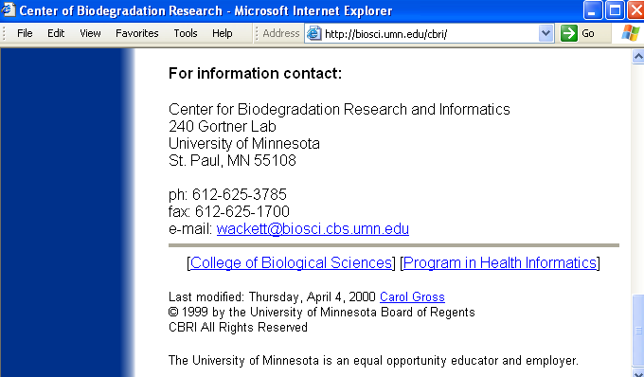
Publisher place and name example 2
Bottom of home page
Linked institution information page
260 [St. Paul, MN] : $b University of Minnesota
Notes:
This is an example of a fairly common situation: the name of the publisher is found at the bottom of the home page, but not the place.
Clicking on the name of the Center for Biodegradation Research and Informatics takes you to a Web page outside of the resource being cataloged (different URI domain name) that includes the location of the Center and the University.
Because this information appears in a resource outside of the one being cataloged, it is entered in brackets.
You may know that the University of Minnesota is located in St. Paul, but this information would still need to be entered in brackets if not found within the resource itself.
One could also debate whether the publisher should be the Center name, followed by the University name, of which it is a part. Contrast the copyright statement on the home page with the domain name in the URL.
Instructors may want to give a general reminder for all Web resource cataloging: always pay attention to where clicking has taken you and whether you are still within the resource and the level of granularity you have selected for description in your bib record.

Slide 42
Dates of publication, distribution, etc.
Beginning/ending dates: Active life span of the resource
  Beginning date = Date of publication of the first iteration of resource
  Ending date = Date of the last iteration of resource; the date it ceases to be updated
Ongoing, actively-updated resources: (viewing 1st iteration)
260 … $c 2008-
Ongoing, actively-updated resources: (otherwise)
362 1_ $a Began in 1997?
Rules: AACR2 1.4F8, 12.4F1-2; IR 7.1-7.4
Notes:
Session 2 covered the Internet Archive—a tool that can often be useful for open-access resources, for determining the likely beginning date, or for viewing resources that have been pulled (and are represented now by a “no longer maintained” page).
Although this is nothing new for serials catalogers, for many non-serials catalogers it is still a new concept that we must always be thinking in terms of beginning and ending dates for the “life span” of an updating/integrating resource. The same holds true, of course, for multipart items, which are monographic, but somehow this concept seems, surprisingly, to baffle many people new to online resource cataloging. But it may be worth pointing out that the concept of beginning and ending dates also applies to multipart monographs.
Point worth stressing: the beginning date of publication for an Internet resource is the date that it was first made publicly available on the Internet. Always beware of copyright dates which are pieces of legal information for publishers and not necessarily bibliographic publication information. Take nothing at face value when it comes to dates that appear within a resource, especially copyright dates!
The basis for the description of the beginning and ending dates of an integrating resource are the first and/or last iteration of the resource.
Obviously this will be extremely difficult to verify for most online integrating resources; the cataloger will rarely have the first iteration or know whether or not she/he has it.

Slide 43
Informal quick guide for dates: RI 1.4F8
Do you have the first iteration?
Yes:
  Give a known date, or supply an approximate date in brackets, in 260 $c
No, or not sure:
  Supply a date in brackets in 260 $c if there is an explicit statement
  If no explicit statement, state an approximate date in a 362 1_ note
  A copyright date is not an explicit statement
Notes:
IR Manual:
Note well: this slide is not a thorough statement of the rules or of all the possible variations of what may be done. It is intended as an informal, quick guide to help get to the heart of the main decisions that need to be made if following the LCRI. Instructors may wish to delete this slide if not comfortable with this; if kept, it should be made clear that this is a kind of recommended best practice guide to cut through the many complications entailed in the main and optional rules in AACR2 and is not itself a definitive expression of the actual rules.
Dates for electronic IR:
Most will be ongoing, not yet completed.
If a date can be given, it will be an “open” date, followed by a hyphen.
Most will not have an identifiable “first iteration” available.
Beginning date may be readily ascertainable even if “first iteration” not available.
May be explicitly stated (e.g., on home page or “about” page).
There may be range of copyright dates given on the home page, and when this applies to the entire resource being cataloged, the first date is very often the beginning date of resource being cataloged. But it is not an explicit statement.
Where to look for dates of publication on electronic IR:
Bottom of home page
“About” page (hyperlink from home page)

Slide 44
Dates of publication example 1
You know that you are not viewing the first iteration
There is no information anywhere within the Web site about its beginning date
260 Washington, DC : $b Library of Congress
362 1_ Began in 1990s.
008 DtSt: c Dates: 199u,9999
No terminal punctuation
Multiple dates:
beginning date approximate;
ending date indefinite
c = currently published
Notes:
What to point out:
Imagine you are originally cataloging this Web site today. You know you are not viewing the first iteration. You can find no statement about when the Web site began on the Internet, either on the home page or an about page or a couple of other places you check.
You therefore omit recording any publication date information from Area 4 (260 $c), also omitting any ending punctuation. (Omitting the comma is a new stylistic practice also for Serials catalogers, who used to end the field in these cases with a comma after the publisher name.)
You know in this case that the Web site started sometime during the 1990s. There is no prescribed way to word such a note. There are several possible variants. Other options include, but are not limited to:
Began in 1990s?
Began publication between 1990 and 2003.
Is date information as vague as this useful? Many say yes, if not in 2003, then in 2023 or 2053, etc.
The 008 dates are done the same as they were in the past; in this case the beginning date code is based on the 362 1 note.

Slide 45
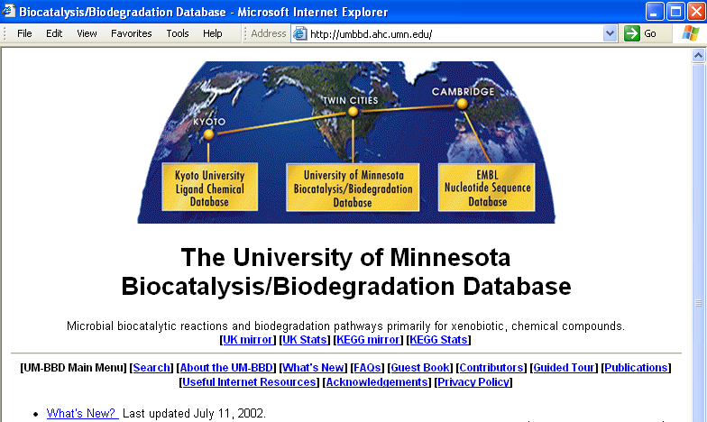
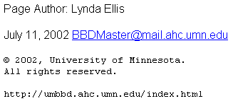
Dates of publication example 2
You know that you are not viewing the first iteration
Bottom of home page has:
© 2002
--indicates current year; not beginning date of resource!
This is not publication info.!
One option:
260 [St. Paul, MN] : $b University of Minnesota
008 DtSt: c Dates: uuuu,9999
[No 362 1_ note given]
No ending punctuation
Notes:
What to point out:
The situation is identical to the preceding slide, except that there is a date present on the home page. But this is the copyright date of the current year and cannot be taken as the date the database was first made available on the Internet! This is terribly important for catalogers to understand, especially some folks from monographic cataloging backgrounds who have the irresistible urge to transcribe any single copyright date they see ☺
As with the previous example, the cataloger has several possible options with giving or not giving a publication date note. This slide presents one valid option: not giving a note at all, in which case Date 1 could be coded “uuuu”. The next slide presents two other possible options among many.
Also we have here a statement of last update. This also tells us nothing about the beginning date of the resource. It does, however, tell us the date of the iteration we are currently viewing and would look like this:
500 Description based on home page last updated July 11, 2002, viewed on Jan. 15, 2003.

Slide 46
Dates of publication example 2:
some alternative options
260 [St. Paul, MN] : $b University of Minnesota
362 1_ Began in 1990s?
008 DtSt: c Dates: 199u,9999
260 [St. Paul, MN] : $b University of Minnesota
362 1_ Began between 1990 and 2002.
008 DtSt: c Dates: 199u,9999
There are other possible ways to word the note --if you consider that it offers useful information to catalogers and/or other catalog users in the future. If not, do not give a note.
Might a researcher in the year 2045, for example, find such information to be of some value?
Notes:
In this case you know the database had to start sometime before 2002 and you can’t pin down the beginning date beyond the 1990s in general, even though the Web did not begin as early as 1990. [But beware equating the Web with the Internet!]
The slide depicts two ways that this information might be given, if it is thought that future catalog users (which includes other catalogers!) might some day find even this kind of vague information useful.
We might imagine a researcher in, say, the year 2030, or 2045, or later, who would find this general date information meaningful: to know that the database was first published on the Internet sometime between 1990 and 2002.

Slide 47
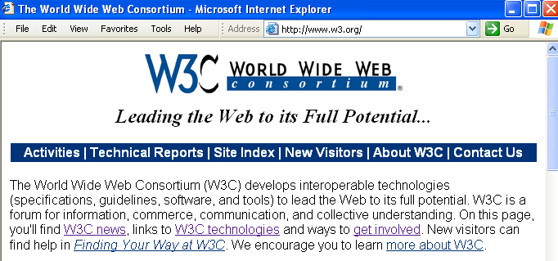
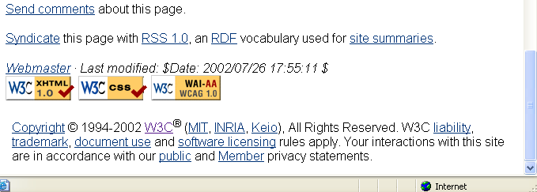
Dates of publication example 3
You know that you are not viewing the first iteration
Bottom of home page has:
© 1994-2002
--first date can be taken as probable beginning date of resource, but it is not an “explicit statement”
--second date = current year; not ending date of resource!
260 [Cambridge, Mass.] : $b World Wide Web Consortium
362 1_ Began in 1994?
008 DtSt: c Dates: 1994,9999
Or: 362 1_ Began ca. 1994.
Notes:
What to point out:
Here is an example of a case where there is a range of copyright dates and we can take the first date in a range as probably indicating the starting date of the resource, as long as we are reasonably sure that it applies to the content of the entire Web site being cataloged. But this is not an “explicit statement” that the resource did in fact begin in 1994.
Catalogers must assess each situation of a range of copyright dates on a case-by-case basis to determine if the range applies to the entire resource being cataloged and if the first date in the range can reasonably be taken to be the beginning date of the resource.
Although there are no firm guidelines for this, best practice may be to treat this as a “probable” date and indicate that in some way in the note, as with a question mark.
Remember here that we are not viewing and cataloging from the “first iteration” of the Web site.” So, if following the main AACR rule, and if applying the LCRI, we do not record this date in the publication area (260 $c) but in a note (362 1) instead.
For libraries that decide to follow the AACR2 option and not the LCRI, they can record the date in the publication area (260 $c), like this:
260 [Cambridge, Mass.] : $b World Wide Web Consortium, $c [1994?]-

Slide 48
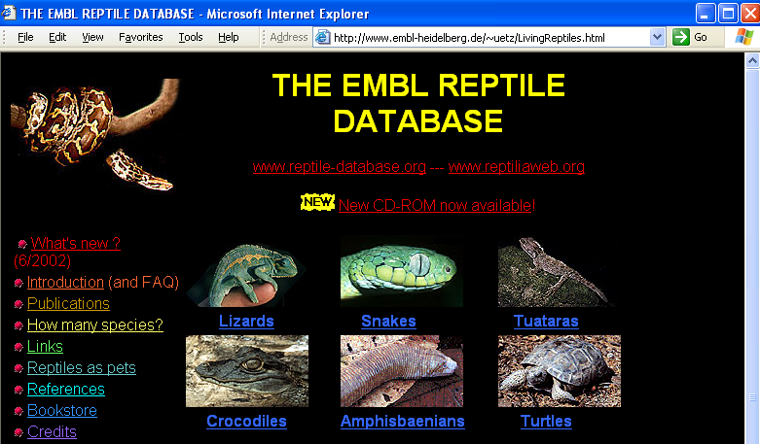
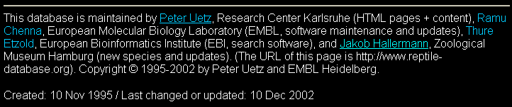
Dates of publication example 4
You know you are not viewing first iteration
Home page has explicit statement:
“Created 10 Nov 1995”
Following LCRI 1.4F8, date given in 260 $c
--in brackets because not from 1st iteration
245 04 The EMBL reptile database $h [electronic resource].
260 Heidelberg [Germany] : $b EMBL, $c [1995]-
008 DtSt: c Dates: 1995,9999
Notes:
What to point out:
In this case you once again know that you are not viewing the first iteration, but you do have an explicit statement about when the database was created. Following the LCRI, you can consider this case where you can apply the option to record the date in Area 4 (260 $c), even though it is not from the first iteration, but you must give it in brackets for that reason.

Slide 49
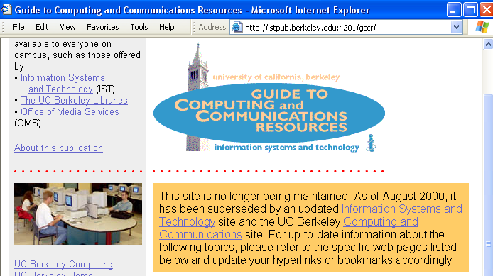
Dates of publication example 5
You are viewing the final iteration of the Web site
The ending date is explicitly stated in this last iteration
The beginning date was not known at the time of original cataloging, and the first iteration was not available.
Statement that updates have ceased as of August 2000
260 [Berkeley, Calif.] : $b Information Systems and Technology, University of California, Berkeley, $c –2000.
362 1_ Began in 1990s.
008 DtSt: d Dates: 199u,2000
d = ceased publication
Notes:
What to point out:
In this instance, the Web site being cataloged has ceased being updated and there is an explicitly-stated ending date, but no explicitly-stated beginning date.
When you view the latest revision date and see that it was some months ago, you can be reasonably certain that you are viewing the final iteration of the Web site.
In this particular case, the original cataloger did not have the first iteration available at the time of cataloging and had no precise information about when it began publication.
Important to note: the examples in Sessions 2-3 are idealized examples of how cataloging would be done according to current rules. Of course in the real world it is not like this. Session 4 addresses issues of real life copy cataloging, dealing with mixed practice and records cataloged according to different rules in the past.
Notice hyphen preceding ending date and period as closing mark of punctuation.

Slide 50
Over to you…
Notes:
Now, you’ll have a few minutes to code the title proper information for your own resource

Slide 51
Area 5: Physical description
As of the 2004 Update to AACR2, area 5 can be used for remote access resources
  Optional rules 9.5B3 and 9.5C3
  No specific PCC practice: local decision or cataloger’s judgment
  LC practice: case-by-case basis
Notes:
The 2004 update to AACR2 gives catalogers the option to include area 5 for remote access resources:
9.5B3: Optionally, record the extent of an electronic resource that is available only by remote access. Use an appropriate term preferably taken from sub rule .5B of one of the chapters of part I or a term in common usage. See also 9.5C3.
1 photograph
6 remote-sensing images
1 sound file
Web site
1 electronic text
9.5C3: When recording the extent of an electronic resource that is available only by remote access, give other details about the resource (e.g., file types) if readily available and considered to be important.
1 photograph : digital, TIFF file
69 p. : digital, PDF file
3 sound files : digital, mp3 file
1 electronic text : HTML file
If such characteristics cannot be given succinctly, give them in a note (see 9.7B10).
LC/PCC practice: There is no overall PCC decision for this option; each library should make its own decision. LC will apply the option on a case-by-case basis (LCRI 9.5B1).

Slide 52
Area 6: Series
Nothing new or different for integrating resources
Record series statements (4XX) present on the current iteration of the resource
Use MARC 440, 490, and 8XX as usual
Not very common in online integrating resources
Notes:
Record series statements as instructed in the rules.
Series statements are rare in online integrating resources [no examples could be found while searching for such for this workshop]
But they are more common in updating loose-leafs.
Note: series statements (4XX) are given only for the CURRENT iteration. (This practice is very different from what serials catalogers are used to doing -- they record in 4XX series statements that might be only on some parts of a serial, so this may cause confusion to some.)
Important note about examples on next two slides (useful to communicate to participants if not mentioned before): this and other examples in Sessions 2 and 3 of this this workshop illustrate how cataloging would be done if done today based on the 2001 and 2002 revisions to AACR2. In actuality, we will find records reflecting mixed practice: cataloging done according to many editions or iterations of AACR2, reflecting many various past practices, versions of the rules, and rule interpretations. (A separate question is to what extent records need to be upgraded to current rules when editing them. We will discuss this later in the workshop.)

Slide 53
Bib. Description for our examples so far (1-2)
008 DtSt: c Dates: 199u,9999
245 10 Program for Cooperative Cataloging $h [electronic resource] : $b [Web site].
246 1_ $i Commonly known as: $a PCC
260 [Washington, D.C.] : $b Library of Congress
362 1_ Began in 1990s.
008 DtSt: c Dates: 199u,9999
245 00 USDA national nutrient database for standard reference $h [electronic resource].
246 1_ $i Title in HTML header: $a USDA nutrient database for standard reference
260 Beltsville, MD : $b USDA Nutrient Data Laboratory, Agricultural Research Service
362 1_ Began in 1990s.
Notes:
We have now covered the first six of the eight areas of bibliographic description, everything except notes and standard numbers. These will be taken up in Session 2b, which continues this session.
This and the following slide serve as a summary and conclusion to Session 2a by giving the elements of the description for Areas 1-6, plus the MARC 008 Dates codes, for our three examples. (Recall that we looked at the MARC leader and control fields for each of these three earlier. And final complete records for each of the three will be given at the very end of Session 2b, showing the complete picture.)
What to point out in the two partial records on this slide:
008: Dates fields concur with date information given in body of record: multiple dates, Date 1 = approximate beginning date; Date 2 = “9999” to indicate indefinite conclusion
245: GMD [electronic resource] always follows the title proper; neither resource had other title information or statements of responsibility.
246: “commonly known as” variant title for one resource.
250: “Release 15” is not recorded as an edition statement for the second example.
256: Decision not to use Area 3, Type and extent of resource area (256 field).
260 $a-b: Bracketed place of publication in the first example because not taken from within the granular level of the resource being described in the record.
260 $c: No information on beginning date of publication present in either resource, and not cataloging from first iteration, therefore Area 4 (260) ends with $b and no closing punctuation.
362 1: Approximate beginning date is given in free-text note.
300: No physical description given for remote-access e-resources (Web sites and online databases).
4XX: No series statement present in either resource.
What needs to be added to our record to make it complete?
Notes, standard numbers, access points (names, subjects, etc.)

Slide 54

Over to you…
Notes:
Now, take a few minutes to look at your resource for possible series information.

