Slide 1
Session 3b
Original Cataloging, continued
Bibliographic description
Access points
Final records for two resources
Notes:
SCCTP Integrating Resources Cataloging Workshop -- December 2008
Session 3b: Original Cataloging of Integrating Resources
This session continues Session 3 and picks up where we left off.

Slide 2
Notes
This workshop covers only notes mandatory for IRs:
  Frequency (310/321)
  Nature and scope, system requirements, and mode of access (516, 538)
  Source of title proper (500)
  Bibliographic history and relationships (530, 580, 76X-78X)
  Item described (500)
MARC tagging for many notes is the same for both serials and integrating resources
  247/547 for former title proper information (rare for serials)
  310/321 for current and former frequency of updates
  362 1 for publication date information when not from first/last iteration
  550 for issuing bodies information
  530, 580, 76X-78X for bibliographic relationships and links
Notes:
SCCTP Integrating Resources Cataloging Workshop -- December 2008
Instructor Manual - February 2005
Session 3b: Original Cataloging of Integrating Resources
The remaining part of the bibliographic description is to make additional notes, those required by the rules and those judged important by the cataloger. Please look in Appendix A for the section on Notes
MARC tagging of notes:
Important Note: this workshop covers only a very few of the many notes that may apply for an integrating resource. We are looking at those specifically new for updating Web resources and loose-leafs now required by Chapter 12 (Frequency, Item Described, Bib. History & Relationships [as links]) and those mandatory and of special importance for electronic resources (Mode of access, source of title proper). Many other notes not covered are also very important, for example, the 520 summary note in electronic resource records.
Additional note: instructors may also want to mention that, unless following guidelines such as those of the CONSER program, notes should be given in AACR2 order rather than MARC tag number order, and, for electronic IRs, following the order given first in chapter 9, then in chapter 12.
Info from the PCC module on integrating resources for order of notes: LCRI 1.7B gives institutions the flexibility of providing notes in either AACR2 prescribed order or MARC 21 field order. CONSER and BIBCO participants should follow the practice that is institutionally most expedient. That is to say, if the majority of integrating resources are cataloged by serials staff, an institution may give preference to the prescribed CONSER MARC 21 field order for notes. Alternatively, if the cataloging of integrating resources is primarily the work of monograph catalogers, then AACR2 prescribed order may prevail as the preferred order.
When doing copy cataloging or updating existing records for integrating resources, add or modify notes in the most expeditious manner. Do not expend time and effort in rearranging notes to fit a certain style or convention.
ALSO:
CONSER Standard Record:
--Prefer to combine 530 note with relationship links (776 08 $i CD-ROM version: )
--Not required to give 550 note for issuing bodies.

Slide 3
Frequency note: 12.7B1
Note the frequency of updates to an integrating resource
  Fields: FF Freq/Regl; 310 (current); 321 (former)
  LCRI 12.7B1 (LC/PCC practice):
  Always give a note for known frequency of updates, even if already apparent from the rest of the description
Notes:
SCCTP Integrating Resources Cataloging Workshop -- December 2008
Session 3b: Original Cataloging of Integrating Resources
The frequency note is the first note in chapter 12 for continuing resources. It is also covered in IR Manual 10.2
Reminder: the codes in the 008 Frequency and Regularity elements are based on the content of this note (tagged in the 310 field).
Some online databases have known, explicitly-stated frequency of updates, but many do not, and the vast majority of Web sites do not. Many Web sites, however, may be known to be updated very frequently (more often or usually more often than once a day), such as most news and weather sites, or completely irregularly, as many organizational Web sites such as the BIBCO and CONSER sites.
Other notes:
Include the word “Updated” or “updates” to clarify that the frequency applies to the updates & not to the resource itself
CONSER Standard Record: FF008 may be fill characters (shift-pipe sign)
Supplier Neutral record: Include 310 if frequency reflects the original publisher AND if frequency is easily discerned.
If time: Can participants think of examples of regularly and irregularly updated Web sites and databases? When is the frequency of updates known and when unknown?

Slide 4
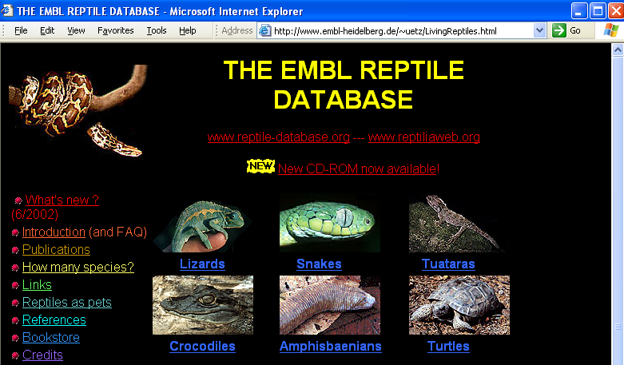
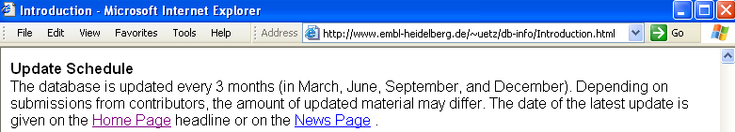
Frequency and regularity example 1
2) You know that this database is regularly updated every three months
245 04 The EMBL reptile database $h [electronic resource].
310 Updated quarterly
008 Freq: q Regl: r
Notes:
SCCTP Integrating Resources Cataloging Workshop -- December 2008
Session 3b: Original Cataloging of Integrating Resources
This is one of the relatively unusual examples in which a database has a statement of regular updating.
Note:
For CONSER Standard Record, the Fixed Field elements Frequency & Regularity are not required: If not coded, use fill characters 😐
__________________
Possible discussion questions, if time:
If there are any serials catalogers present, what is the practice of serials cataloging and statements of frequency in catalog records?
Is a statement in the resource transcribed and taken at face value?
Is a comparison made with actual frequency of recent of updates at the time of check-in and the establishment and adjustment of publication patterns and claiming of issues?
Should the cataloger of an integrating resource take a statement like this at face value?
How might they check to see if updates really are made quarterly?
How close would they need to be to quarterly, if not right on the nose, for the statement to remain basically accurate and helpful to users? [Could say “Updated four times a year.”]

Slide 5
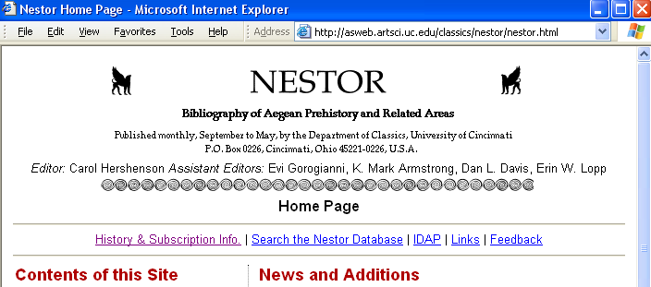
Frequency and regularity example 2
3) You know that this database is updated on a monthly basis but regularly skips certain months
245 00 Nestor $h [electronic resource] : $b bibliography of Aegean prehistory and related areas.
310 Updated monthly (except June-Aug.)
008 Freq: m Regl: n
Notes:
SCCTP Integrating Resources Cataloging Workshop -- December 2008
Instructor Manual - February 2005
Session 3b: Original Cataloging of Integrating Resources
An example of “normalized irregular” updating.
CONSER Standard Record: Code FF Freq/Regl with fill characters (shift-forward slash, “|”)

Slide 6
Frequency and regularity examples 3-5
4) You know that this Web site is updated on a very frequent basis [Regl code “k” = continuously updated; defined as “more frequently than daily”]
5) You know that this Web site is updated irregularly (no regular pattern)
Weather.com Web site [http://www.weather.com/]
310 Continuously updated
008 Freq: k Regl: r
CONSER Web site [http://www.loc.gov/acq/conser/]
310 Updated irregularly
008 Freq: _ Regl: x
6) You know that this database is updated but have no information about how often or according to a regular or irregular pattern
Global invasive species database
[No 310 present]
008 Freq: u Regl: u
Notes:
SCCTP Integrating Resources Cataloging Workshop -- December 2008
Instructor Manual - February 2005
Session 3b: Original Cataloging of Integrating Resources
Instructor note: MARC 21 has "Continuously updated“ while AACR2 uses "Continually" in 12.7B1 example. But AACR2 examples are not prescriptive. In this example the former term has been chosen for the sake of consistency with MARC 21 and CONSER documentation.
Code “k” is defined in MARC 21 as “more frequently than daily.”
If you know a resource is updated completely irregularly, code it as such; for example, the CONSER or PCC Web sites.
There has been some discussion about whether to code the regularity of continuously updated as x or r. But regularity code “x” can only be used when Freq. equals code blank, or when used to express numbers per year. Therefore “r” is the best choice. [This guidance comes from Judy Kuhagen of CPSO and Jean Hirons of CONSER, Jan. 2003]

Slide 7
Former frequency note
245 00 Library literature & information science full text $h [electronic resource].
310 Updated daily, $b <Aug. 12, 2004>
321 Updated monthly, $b <Nov. 18, 1999>
008 Freq: d Regl: r
Notes:
SCCTP Integrating Resources Cataloging Workshop -- December 2008
Instructor Manual - February 2005
Session 3b: Original Cataloging of Integrating Resources
Former frequency is tagged in field 321. This may be evident from the Internet Archive versions. The former frequency note will be covered more again in session 5.

Slide 8

Over to you…
Notes:
Take a quick look at your resource: Is the frequency easily determined?
Session 3b: Original Cataloging of Integrating Resources
SCCTP Integrating Resources Cataloging Workshop -- December 2008

Slide 9
9.7B1. System requirements/mode of access note
b) System requirements
  Note system requirements only if special software or hardware are required to access and use the resource
    538 System requirements: Requires DjVu plug-in.
c) Mode of access
  Always specify the mode of access for remote access resources
    538 Mode of access: World Wide Web.
Notes:
SCCTP Integrating Resources Cataloging Workshop -- December 2008
Instructor Manual - February 2005
Session 3b: Original Cataloging of Integrating Resources
This is the first note in Chapter 9 for electronic resources: AACR 9.7B1.
It has three distinct aspects:
[ A: Nature and scope: tagged in field 516; is optional for integrating resources.] According to IR Manual, this is 9.7B8 note
B: System requirements: tagged in field 538; is required if applicable for remote-access resources.
Used in records for remote-access resources only when special software, hardware, or peripherals are required to access and use a resource --beyond a computer with Internet access and a Web browser.
C: Mode of access: also tagged in 538; is mandatory for remote-access resources, and is normally the first note in the record.
Also noteworthy: Notes are given in MARC tag number order in CONSER records. For non-CONSER records, give notes in the order required by the utility or local system (which, for example might be: give notes in AACR2 prescribed order, regardless of MARC tagging).
Additional reminder: do not combine system requirements and mode of access notes.
CONSER practice is to use 516 and 538 System requirements only for unusual formats; and Mode of access only when access method is other then WWW.
A supplier-neutral record would only include these notes when applicable across suppliers.

Slide 10
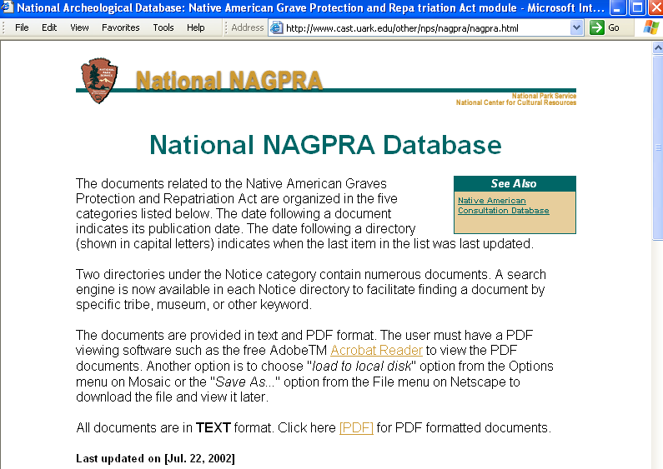
System requirements/Mode of access note
538 System requirements: Adobe Acrobat reader to view and print PDF files.
538 Mode of access: World Wide Web.
Notes:
SCCTP Integrating Resources Cataloging Workshop -- December 2008
Instructor Manual - February 2005
Session 3b: Original Cataloging of Integrating Resources
This updating database includes documents in both HTML text and PDF formats.
The user must have Adobe Acrobat Reader installed on their computer in order to view the PDF versions of the documents.
Instructors should point out that:
A “nature and scope” note is optional, but a cataloger could choose to include one such as the one given on the slide, in which case it is tagged in field 516.
The system requirements note is required in this case because more than just a computer with Internet access and a Web browser is required to access and use the PDF files that are included within this resource.
Note:
Supplier neutral: Give 516 and 538 System requirements only if true of all suppliers
CONSER: Give 516, 538 System requirements if unusual. Give 538 Mode of access if not WWW

Slide 11
Source of title proper note: 12.7B3
Follow the instructions in sub-rule .7B3 in the chapter dealing with the type of material to which the resource belongs
For remote electronic resources: 9.1B2 & 9.7B3:
  Always give source of title proper in a note
    Examples given in 9.7B3 and 12.7B3 include:
      Title from title screen
      Title from home page (viewed on Dec. 18, 1999)
        (Source of title proper note combined with item described note)
    Supplier-neutral records will show supplier as well as date viewed
      Title from main search screen (Community of sciences, viewed Aug. 22, 2007).
Notes:
SCCTP Integrating Resources Cataloging Workshop -- December 2008
Instructor Manual - February 2005
Session 3b: Original Cataloging of Integrating Resources
Both chapters 12 and 9 require the source of title proper note always be given in records for remote access electronic resources.
This note is often combined in e-resource cataloging practice with the Item Described note (alternatively referred to as the “Description based on” note). Both notes do relate to identifying the title and iteration of the resource being described.

Slide 12

Over to you…
Notes:
Take a few minutes to code these notes if needed.
Session 3b: Original Cataloging of Integrating Resources
SCCTP Integrating Resources Cataloging Workshop -- December 2008

Slide 13
Bibliographic history and relationships note: 12.7B8
Reciprocal 780 Continues/ 785 Continued by 780 04/785 07 Merged with… to form 765 Translation of/ 767 Translated as 770 Has supplement / 772 Supplement to 775 Other editions 776 Additional physical form 787 Non-specific | One-way 500 Revision of + 7XX for original resource 500 Adaption of + 7XX for original resource
Notes:
Make one-way notes for relationships covered under AACR2 21.8-21.27. These relationships express transformations of existing content.
Make reciprocal notes for relationships covered under AACR2 12.7B8. These include changes over time and simultaneous publication in different formats or editions (e.g. physician/general edition).
Because the use of linking entries is fairly complex and will require many slides, it will be deferred to session 5, rather than interrupt this section on AACR2 chapter 12 notes, followed by AACR2 access points.
Session 3b: Original Cataloging of Integrating Resources
SCCTP Integrating Resources Cataloging Workshop -- December 2008

Slide 14
Example: IR related to
Simultaneously Published in Other Formats:
776 08 $i Also available on CD-ROM: $t USDA nutrient database for standard reference $w …
Formerly Published in Other Formats:
780 00 $a Consumer and Food Economics Institute (U.S.). $t Composition of foods $w …
Notes:
Here are two examples of
Session 3b: Original Cataloging of Integrating Resources
SCCTP Integrating Resources Cataloging Workshop -- December 2008

Slide 15
9.7B22/12.7B23
Source of title; Item described note
Always give the date on which the resource was viewed for description (see also 9.7B22)
    Title from home page (viewed on Jan. 13, 2000)
    Title from search screen (Community of Science, viewed Aug. 22, 2007).
Notes:
SCCTP Integrating Resources Cataloging Workshop -- December 2008
Instructor Manual - February 2005
Session 3b: Original Cataloging of Integrating Resources
Although the last note in number order in both chapters 12 and 9, this is one of the most crucially important notes for integrating resources.
It is mandatory in all records for remote access electronic resources, but is also required in records for print integrating resources when not cataloging from the first iteration.
This note is commonly combined in e-resource cataloging practice with the Source of Title Proper, in which case it is usually worded as “viewed on …” and placed in parentheses after the source of title proper.
In print IR resource records, it is more commonly given as “Description based on…” (the same as for serials)
Both notes relate to identifying the title and iteration of the resource being described.

Slide 16
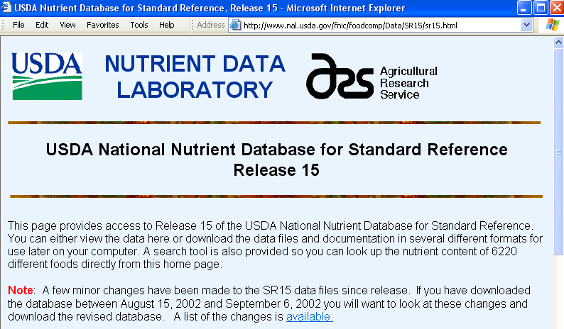
Combined source of title proper and item described notes example
245 00 USDA national nutrient database for standard reference $h [electronic resource].
500 Title from home page (viewed on Dec. 15, 2002).
Notes:
SCCTP Integrating Resources Cataloging Workshop -- December 2008
Instructor Manual - February 2005
Session 3b: Original Cataloging of Integrating Resources
This slide illustrates the two notes combined into one, and the most common form of wording for the note.
This combination note appears to be used by far the most often in WorldCat records for Internet resources.
This combined note will be used in this course in examples and exercises, but participants should be aware that they are logically two separate notes, covered by two separate rules in AACR, and that nothing requires their being combined into one.
Note that a note “Description based on” for the release number may also be added, although it is not required.

Slide 17
Area 8: Standard number and terms of availability: 12.8
Record standard numbers
Standard Number (12.8B1)
  ISBN: 020
  ISSN: 022
LCRI 12.8B1: If an integrating resource has both, give both in the catalog record.
Notes:
SCCTP Integrating Resources Cataloging Workshop -- December 2008
Instructor Manual - February 2005
Session 3b: Original Cataloging of Integrating Resources
Integrating resources may bear standard numbers such as ISBN and ISSN.
If present either or both are to be recorded in the catalog record.
Remember that a canceled or invalid ISBN that appears in a resource should be recorded in an 020 subfield $z and an incorrect ISSN that appears in a resource should be recorded in an 022 subfield $y; a cancelled ISSN, after verification by an ISSN Center that it represents a cancelled ISSN, is recorded in 022 subfield $z.

Slide 18
Access Points: Main and added entries
Determine name and uniform title entries
Based on AACR2 chapter 21
  Persons and bodies that bear responsibility for the intellectual or artistic content of the resource
  Uniform titles for resources dealing with works of literature, music, etc.
Enter in MARC 1XX and 7XX fields
  In full-level records, 7XX entries must be explained (“justified”) by being given in the descriptive part of the record (MARC 2XX-5XX)
Notes:
SCCTP Integrating Resources Cataloging Workshop -- December 2008
Instructor Manual - February 2005
Session 3b: Original Cataloging of Integrating Resources
This workshop does not go into the rules for determining main and added entries since the rules are the same as for other resources.
See LCRI 25.5B for guidance on constructing uniform titles to resolve title conflicts for integrating resources.

Slide 19
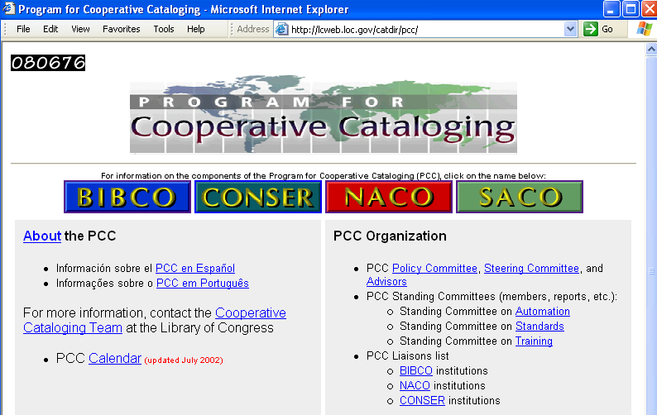
Corporate body main entry example
110 2_ Program for Cooperative Cataloging.
245 10 Program for Cooperative Cataloging $h [electronic resource] : $b [Web site].
Notes:
SCCTP Integrating Resources Cataloging Workshop -- December 2008
Instructor Manual - February 2005
Session 3b: Original Cataloging of Integrating Resources
This slide is intended to contrast with the following slide.
Both are examples of institutional or organizational Web sites.
In this case the name of the organization is given as main entry since the Web site as a whole “emanates” from the PCC and falls within the scope of rule 21.1B2a: “…of an administrative nature dealing with the corporate body itself … or its offices, staff, and/or membership (e.g., directories) …”

Slide 20
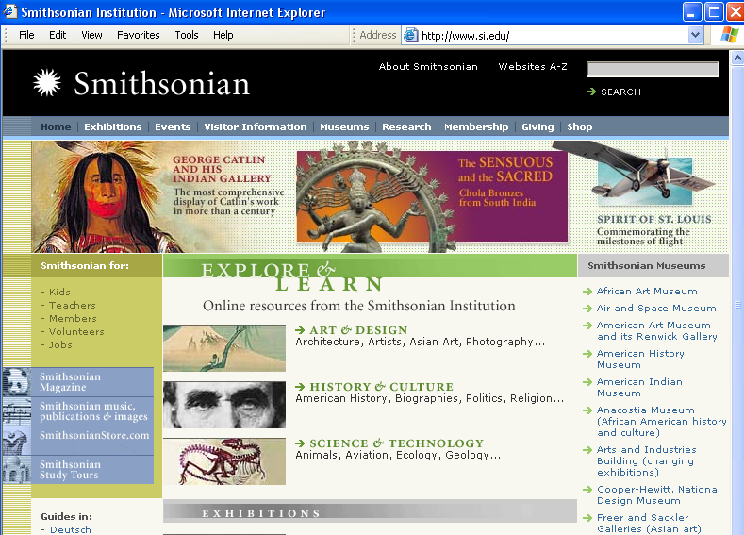
Title main entry example
245 00 Smithsonian Institution $h [electronic resource] : $b [Web site].
710 2_ Smithsonian Institution.
Notes:
SCCTP Integrating Resources Cataloging Workshop -- December 2008
Instructor Manual - February 2005
Session 3b: Original Cataloging of Integrating Resources
In this case, although the Web site as a whole “emanates” from the Institution, the predominant content of the site goes well beyond the scope of the categories given in rule 21.1B2a (“…of an administrative nature dealing with the corporate body itself … or its offices, staff, and/or membership (e.g., directories) …”)

Slide 21
Electronic location and access
MARC 856 field
  Indicators:
    First indicator = access method
    Second indicator = relationship
  Most commonly used subfields:
    Subfield $u = uniform resource identifier (URI)
    Subfield $z = public note
    Subfield $3 = materials specified note
Serves as active hyperlink from the catalog record to the online resource in Web-based catalogs
Notes:
SCCTP Integrating Resources Cataloging Workshop -- December 2008
Instructor Manual - February 2005
Session 3b: Original Cataloging of Integrating Resources
Perhaps the most crucial access point for an online resource is its electronic address.
The slides ahead look at the indicator and subfield codes
In Web-based catalogs it is the URL in subfield $u of the 856 field that serves as a ‘hotlink’ directly to the resource itself on the Internet.
A resource may have more than one electronic address and/or access method and so have more than one 856 field in the record
Reminder: do not enter institution-specific URLs into records shared on the utilities (the same as any local, copy-specific, or institution-specific notes or other information). [per IR 10.22]

Slide 22
856 indicators
Indicator 1: Access method
  0 = E-mail
  1 = FTP
  2 = Remote login (Telnet)
  3 = Dial-up
  4 = HTTP
    Used for most Web resources
  7 = Method specified in $2
    Used in records for Web resources before 1997
Indicator 2: Relationship
    Can generate display constant
  Blank = No info. provided
  0 = Resource
    Used in records for Web resources themselves
  1 = Version of resource
  2 = Related resource
  8 = No display constant generated
Notes:
SCCTP Integrating Resources Cataloging Workshop -- December 2008
Instructor Manual - February 2005
Session 3b: Original Cataloging of Integrating Resources
First Indicator: The vast majority of Web sites and databases cataloged will have first indicator 4 since their primary address will be on the World Wide Web.
It is possible that some resources may include FTP addresses for downloading files or database records, etc., but the majority will have basic HTTP addresses.
1st indicator value “4” for HTTP was established in 1997, and records cataloged before that time and not subsequently updated will have 1st indicator “7” with http specified in $2 [as was any other access method not specified by another indicator].
Second indicator:
Second indicator value “0” is used when the body of the record describes an online resource itself.
Value “1” is used more often in records for print resources that have an electronic version available online.
Value “2” is used for example in records for printed books that have a related resource available online. A common example is when a book has a table of contents available online.
This value may be used in online resource records if there is a related online resource which the cataloger thinks is important to note and provide access to, but this is relatively rare in records for updating Web sites and databases.
Value “2” is used for an online table of contents because the TOC is not an online version of the entire resource, but only of a portion of it. [See OCLC records 49383996 and 47844676 as two of many hundreds of examples cataloged by the Library of Congress.]

Slide 23
856 Examples
245 10 Program for Cooperative Cataloging $h [electronic resource] : $b [Web site].
856 40 $u http://lcweb.loc.gov/catdir/pcc/
245 00 Charta $h [electronic resource] : $b scegli charta e il biglietto tuo.
546 In Italian; includes English version.
856 40 $u http://www.charta.it/
856 40 $3 English version $u http://www.charta.it/english/index.php
245 00 OCLC firstsearch $h [electronic resource].
856 40 $u http://www.ref.oclc.org:2000 $z Requires authorization and password
Notes:
SCCTP Integrating Resources Cataloging Workshop -- December 2008
Instructor Manual - February 2005
Session 3b: Original Cataloging of Integrating Resources
Out of the numerous possible subfield codes available in the 856, the vast majority of Web resources will need to use only subfield $u for the URL (Uniform Resource Locator).
Two other commonly used subfields:
$3 : Specifies the part of the item to which the 856 applies, e.g., an online table of contents
$z : Public Note: a note pertaining to the electronic location of the source identified in the field that is in a form adequate for public display.

Slide 24
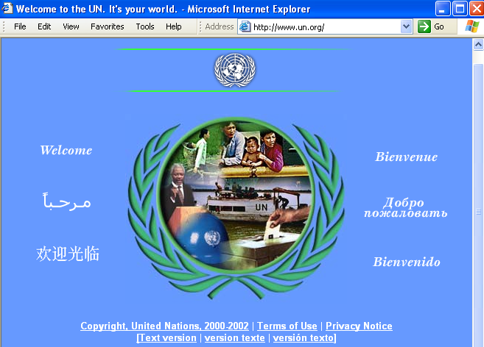
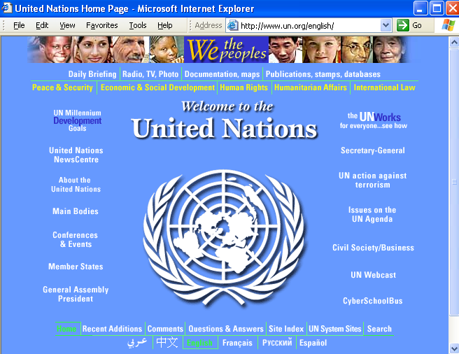
URL in 856 must match granular level of description
http://www.un.org/
= URL for whole Web site
http://www.un.org/english/
= URL for English language portion of Web site
URL in 856 40 must match granular level of resource you are selecting for description in the body of the bibliographic record.
Notes:
SCCTP Integrating Resources Cataloging Workshop -- December 2008
Instructor Manual - February 2005
Session 3b: Original Cataloging of Integrating Resources
One of the most important things for catalogers is to be sure URL in 856 40 matches the granular level of resource described in the body of bib record, if possible.
It is all too easy to be maneuvering around within a Web site and copy and paste or insert a URL for a sub-page into the 856 field, when you are really intending to catalog a higher level of granularity.
This appears too often, for example, in WorldCat records, where the URL in the 856 is for a sub-page of the resource and does not match the description in the body of the bibliographic record.

Slide 25
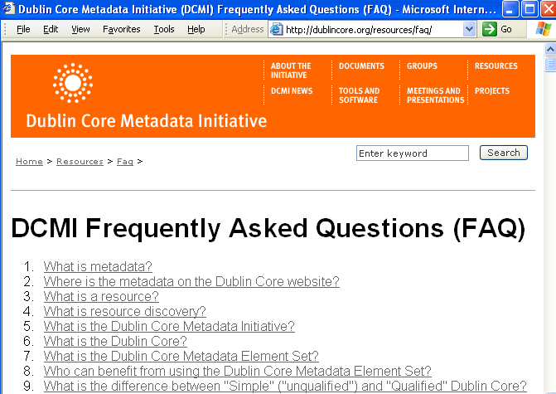
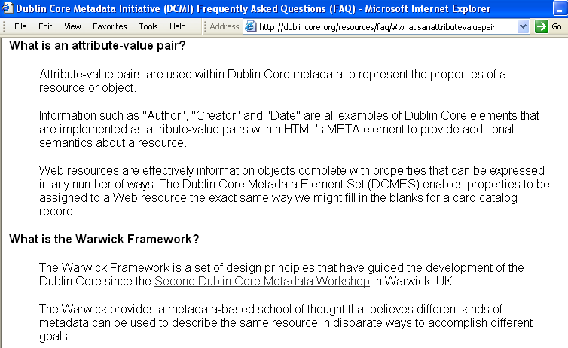
Internal bookmarks in 856 URLs must also match
http://dublincore.org/resources/faq/#whatisanattributevaluepair
= URL for bookmarked sub-section of FAQ
http://dublincore.org/resources/faq/
= URL for whole FAQ document
856 40 $u http://dublincore.org/resources/faq/
URL in 856 40 must match the level of a Web resource selected for cataloging; must not contain an internal “bookmark” to a sub-section within a page unless that is the specific section being cataloged. HTML bookmarks are indicated by the “#” sign.
Notes:
SCCTP Integrating Resources Cataloging Workshop -- December 2008
Instructor Manual - February 2005
Session 3b: Original Cataloging of Integrating Resources
This is another common variation on the same theme:
Many Web pages contain internal “bookmarks”, indicated by the pound sign, that serve as internal page hyperlinks that take the user to various points within a long page.
This FAQ is an example, where each question is bookmarked so that the user can click on the question and be taken directly there instead of scrolling down.
But again we find in too many catalog records that the cataloger has copied and pasted or inserted the bookmarked URL into the 856 instead of the base URL for the whole page.
Something to pay attention to and be aware of and double-check in original cataloging records.
There may, however, be cases in which the resource to be cataloged is at the level of a bookmark within a larger page. In those cases, the bookmark is to be included in the electronic address / URL for the resource.
The key is that the electronic address must take the user to the resource described in the body of the bibliographic record, whatever has been selected for cataloging.

Slide 26

Over to you…
Notes:
Now, you’ll have a few minutes to code the 856 for your own resource
Session 3b: Original Cataloging of Integrating Resources
SCCTP Integrating Resources Cataloging Workshop -- December 2008

Slide 27
Beyond AACR2:
Subject headings and classification
Do the same thing as for non-integrating resources, but keep in mind the changing content
  Analyze the subject content of the resource at the selected granular level
  Assign subject headings from a standard scheme
    LCSH, MeSH, etc.
  May also assign a classification number from a standard scheme
    LCC, DDC, etc.
    Class portion alone may suffice in master records
Notes:
SCCTP Integrating Resources Cataloging Workshop -- December 2008
Instructor Manual - February 2005
Session 3b: Original Cataloging of Integrating Resources
Do subject analysis and select appropriate subject headings according to an established scheme, LCSH being the most common.
Anticipate changing content as much as is reasonably possible and assign subject headings accordingly. Do not assign headings for very specific content that is likely to change.
Adding a classification number is also valuable as a subject access point, but is not required and different institutions may have different polices about supplying one in a master record. Local use of classification for online resources will vary from institution to institution as well.
It has often been recommended that the class portion alone in subfield $a of a call number field is sufficient in a master/shared record, since a cutter number is not needed for shelf arrangement. But some institutions may want complete call numbers for their local systems.
If time, instructors may wish to ask participants what they are doing with classification for online resources in their institutions.

Slide 28
Subjects: Form v. Topic
Topical subdivisions: $x
Computer network resources
Computer programs
Electronic information resources
Form subdivisions: $v
Form/genre headings: 655
655 _7 Web sites $2 local
Computer games Databases Electronic discussion groups Interactive multimedia Juvenile software | News Web sites Online chat groups Software Blogs
Notes:
Some additional words about subject subdivisions
Beware of topical vs. form subdivisions and topical vs. genre headings for online resources. There are only a few subdivisions that specifically identifies a resource as being on the Internet (e.g., $v Blogs, $v Electronic discussion groups, $v Online chat groups).
The subdivision --Computer network resources is a topical ($x) subdivision, not a form ($v) subdivision, and is therefore to be used for resources that are about Internet resources on a particular topic, not for resources that are Internet resources about a particular topic.
The subdivision $v Databases is a form subdivision that may apply to some databases with highly interactive content [see LC Subject Cataloging Manual: Subject Headings for details on the use of the form subdivisions --Databases, --Software, --Interactive multimedia, --Electronic discussion groups, and --Computer games]. Do not assign the subdivision “Databases” for e-resources that are essentially textual and not formatted as databases (e.g., conference proceedings, articles) or for reference works (directories, catalogs, dictionaries, encyclopedias, indexes)
To provide fuller access to form, catalogers may use form/genre headings 655. Note that even though the term “Web sites” is in LCSH, it refers to works about Web sites. So this is a local use of the term ($2 local)
Also see the section on subject analysis and classification in the IR manual, IR.15
Session 3b: Original Cataloging of Integrating Resources
SCCTP Integrating Resources Cataloging Workshop -- December 2008

Slide 29

Over to you…
Notes:
Take a few minutes to think about subject access for your resource.
[Depending on time, may have participants enter phrase that could be used to derive subject headings]
Session 3b: Original Cataloging of Integrating Resources
SCCTP Integrating Resources Cataloging Workshop -- December 2008

Slide 30
Final records for examples
(1) PCC Web Site
(2) USDA National Nutrient Database
Notes:
SCCTP Integrating Resources Cataloging Workshop -- December 2008
Instructor Manual - February 2005
To conclude the presentation portion of Session 2, before turning to the Exercises, let’s look at the final records for our three examples, given on the following slides.
If time, it is recommended to review all of the elements in bold face type in these records, and any other elements of interest to the instructor and/or participants,
Session 3b: Original Cataloging of Integrating Resources

Slide 31
Final Record for PCC Web Site (1)
Type: a ELvl: I Srce: d GPub: f Ctrl: Lang: eng
BLvl: i Form: s Conf: 0 Freq: u MRec: Ctry: dcu
S/L: 2 Orig: s EntW: Regl: u Alph:
Desc: a SrTp: w Cont: DtSt: c Dates: 199u,9999
006 m d f
007 c $b r $d m $e n
041 0_ eng $a spa
090 Z693.3.C66 $b P76
110 2_ Program for Cooperative Cataloging.
245 10 Program for Cooperative Cataloging $h [electronic resource] : $b [Web site].
246 1_ $i Commonly known as: $a PCC
260 [Washington, D.C.] : $b Library of Congress
362 1_ Began in 1990s.
Notes:
SCCTP Integrating Resources Cataloging Workshop -- December 2008
Instructor Manual - February 2005
Session 3b: Original Cataloging of Integrating Resources
Here is the record for the PCC Web site, starting on this slide and continuing onto the following slide.
Besides what has already been explained in previous slides about the elements shown in bold, here a few additional comments:
This record includes some content and fields that we did not go over in this session but which should be fairly obviously applicable to a complete record for the resource.
Note the additional language coding in the 041, that agrees with the 546 language note on the next screen.
Note also the presence of a classification number.
Note the corporate body main entry.
Remember that the wording of the 362 1 note could be done differently.

Slide 32
Final Record for PCC Web Site (2)
538 Mode of access: World Wide Web.
546 Chiefly English, but some information also
available in Spanish.
500 Title from home page (viewed on Dec. 2, 2002).
520 Contains information about the Program for Cooperative
Cataloging, including its governance, organization,
strategic plans, online statistics, and archived
reports from various PCC groups and meetings. Features
links to the home pages of the PCC's component
programs: BIBCO, CONSER, NACO, and SACO.
610 20 Program for Cooperative Cataloging.
650 _0 Cataloging, Cooperative.
710 2_ Library of Congress.
856 40 $u http://lcweb.loc.gov/catdir/pcc/
Notes:
SCCTP Integrating Resources Cataloging Workshop -- December 2008
Instructor Manual - February 2005
Session 3b: Original Cataloging of Integrating Resources
Here we have a 520 summary note added as well –generally a very important note for most online resources.
Note also the subject headings,added entry, and 856 field.

Slide 33
Final Record for Nutrient Database (1)
Type: a ELvl: I Srce: d GPub: f Ctrl: Lang: eng
BLvl: i Form: s Conf: 0 Freq: u MRec: Ctry: mdu
S/L: 2 Orig: s EntW: Regl: u Alph:
Desc: a SrTp: d Cont: DtSt: c Dates: 199u,9999
006 m d f
007 c $b r $d m $e n
245 00 USDA national nutrient database for standard reference $h [electronic resource].
246 1_ $i Title in HTML header: $a USDA nutrient database for standard reference
260 Beltsville, MD : $b USDA Nutrient Data Laboratory, Agricultural Research Service
362 1 Began in 1990s.
538 Mode of access: World Wide Web.
516 Searchable database.
500 Title from home page (viewed Dec. 15, 2002).
Notes:
SCCTP Integrating Resources Cataloging Workshop -- December 2008
Instructor Manual - February 2005
Session 3b: Original Cataloging of Integrating Resources
This first part of the record for the USDA National Nutrient Database is very similar to the previous one for the PCC Web site.

Slide 34
Final Record for Nutrient Database (2)
520 Offers access to food descriptions, food group data, nutrient information, and a nutrient definition file. Contains a weight file, source code information, and a description of measures used. Posts contact information for the Nutrient Data Laboratory via street address, telephone and fax numbers, and e-mail.
580 Previously issued as a print loose-leaf: Consumer and Food Economics Institute (U.S.). Composition of foods.
650 _0 Food $x Composition $v Databases.
710 2_ Nutrient Data Laboratory (U.S.)
776 08 $i Also available on CD-ROM: $t USDA nutrient database for standard reference $w (DLC) 00252195 $w (OCoLC)43564113
780 00 Consumer and Food Economics Institute (U.S.). $t Composition of foods $w (DLC) 77602784 $w (OCoLC)3913709
856 40 $u http://www.nal.usda.gov/fnic/foodcomp/Data/SR15/sr15.html
Notes:
SCCTP Integrating Resources Cataloging Workshop -- December 2008
Instructor Manual - February 2005
Session 3b: Original Cataloging of Integrating Resources
Here again we have a 520 summary note –actually edited from a longer note in the original OCLC record.
Note the corporate body name as added entry, not main entry.
The unique and especially noteworthy thing about this resource is its bibliographic relationship to two other resources, expressed as links to the records for those resources. Can participants explain what these two relationships are?

Slide 35

Back to you
Notes:
Now, take a few minutes to complete your records. I will be handing out OCLC records, so you can see how one of our colleagues at a Program for Cooperative Cataloging (PCC) cataloged the resource.
Session 3b: Original Cataloging of Integrating Resources
SCCTP Integrating Resources Cataloging Workshop -- December 2008

