Slide 1
Patent Medicine Trade Cards
“Nostrum remedium” for descriptive metadata
Training & information session
December 3, 2008

Slide 2
Project Background
Again using “UCLA Core” (loosely based on VRA Core)
About 250 to do
Project is already “live”
“Basic” descriptive metadata already provided
DLCS: Changes and enhancements based on our feedback

Slide 3
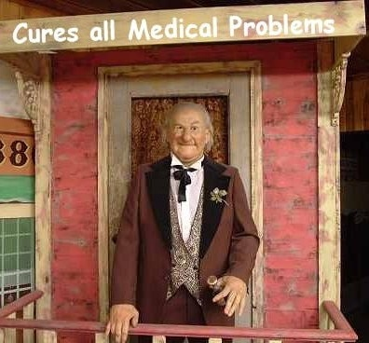
What is “Patent Medicine?”
Generally not patented.
Secret, proprietary formulas whose efficacy was questionable.
One of the first major products of the American advertising industry, starting circa 1870.
End of an era: the 1906 Pure Food and Drug Act
I Wikipedia.

Slide 4
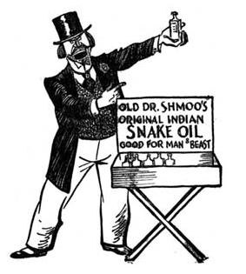
Metadata – It’s good for you!

Slide 5
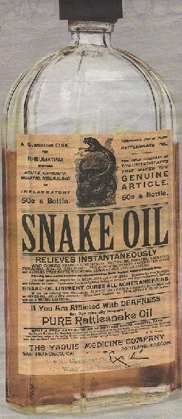
General guidelines
http://digital2.library.ucla.edu/dlcs
Login/password
Assignments
Searching & navigation
Statistics: Please keep track of time spent. We will track the other statistics.
Report DLCS problems to Claudia.

Slide 6
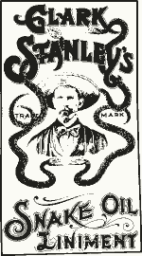
Title
Not repeatable.
Already supplied (but review!)
Always add [inscribed] or [descriptive] as a “qualifier.”
Prefer transcribed text from poster.
If you supply, no [brackets] around title.
If you change title, consider moving original title to Alternate Title.inscribed.

Slide 7
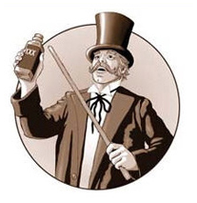
Subjects
Controlled via drop down “pick lists.”
Qualified: conceptTopic, descriptiveTopic, etc.
TGM: for “ofness” and non-medical “aboutness.”
LCSH & MeSH: for medical or drug-related “aboutness.”
Do not use LCSH or MeSH to index the images depicted on the cards; use TGM or establish local terms as needed.

Slide 8
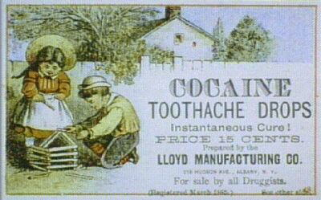
Names
Field is controlled and qualified.
Most of these will name the manufacturer (the “publisher” of the card).
Few will have personal names.
Always do authority work in LCNAF, and establish names according to AACR2 when not found in LCNAF.

Slide 9
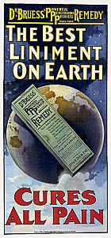
Description & Publisher
Description
  Add Description.note: Trade card held by Louise M. Darling Biomedical Library. History & Special Collections.
  Add a Description.note with a concise description of the card.
  DLP students have transcribed the significant medical or drug-related text in a Description.inscription field.
  Remember that we don’t control the display order for notes.
Publisher.placeOfOrigin
  Only used to record the card’s place of origin. Use LCNAF form.
  Use Name.publisher to record the name of the publisher (usually the manufacturer).
  Coverage.geographic will record the country of origin.

Slide 10
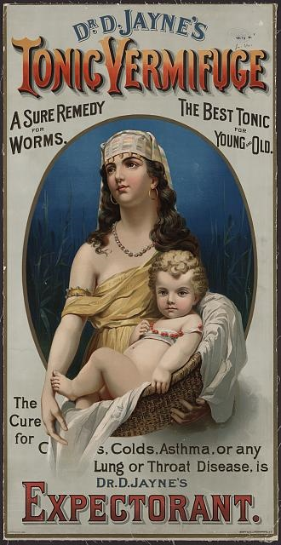
Dates
Google is your friend.
Date.creation—move & delete this field.
Add Date.publication.
Add Date.normalized.

Slide 11
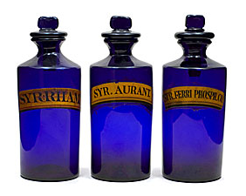
Type & Format
Type.genre: Trade cards or Brochures.
Type.typeOfResource: still image
Format.dimensions: This information needs to move to…
Format.extent. Then delete existing Format.dimensions field.
Do not convert into U.S. measurements.

Slide 12
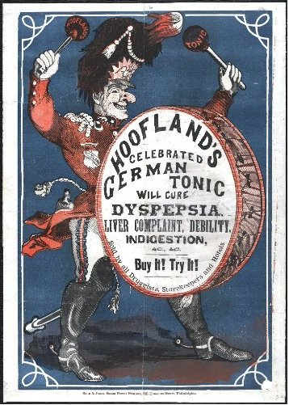
Language & Coverage
Language
Add 3-letter code for language(s) of the text.
For the few non-English cards, translation of the title or card text is optional.
Coverage
Coverage.geographic will be used to facilitate browsing multiple collections by country of origin.
For most cards, this value will be United States.

Slide 13
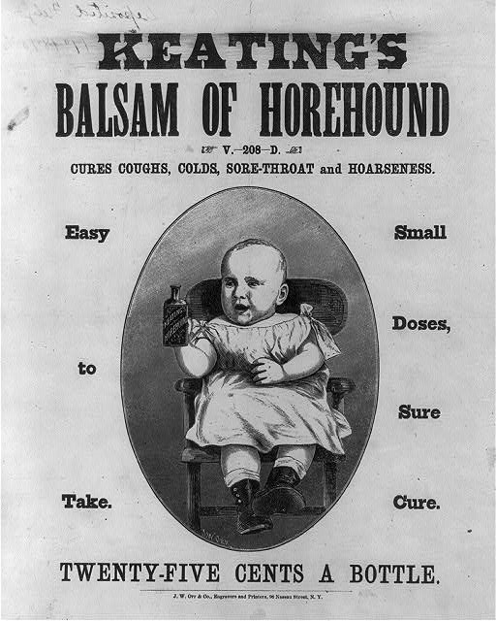
Rights
Qualified & controlled element.
1923: All cards published prior to this date are in the public domain.
Add Rights.copyrightStatus pd.
Also add Rights.publicationStatus published.

Slide 14
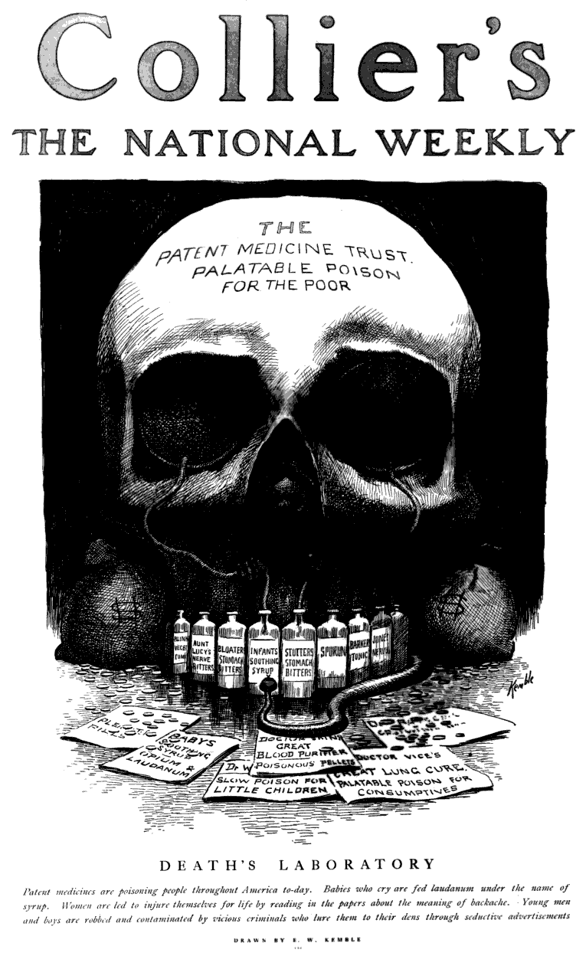
Demo: Adding Control Values

Slide 15
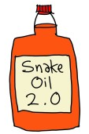
Resources
Here today, here tomorrow (NLM)
Patent Medicine Collection (Vanderbilt Medical Center)
The Toadstool Millionionaires (James Harvey Young)
The Patent Medicine Menace (Center for Drug Evaluation and Research (U.S.))

