Slide 1
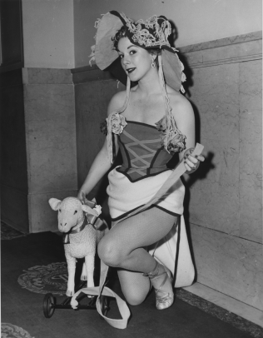
Bonnie Cashin Collection
Tuesday, March 16 2010

Slide 2
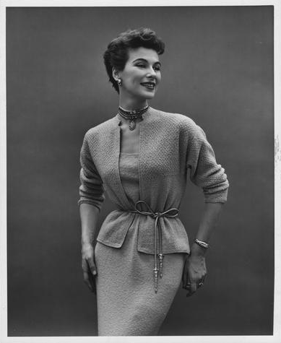
The Collection
8666 “items” (photographs, clippings, sketches, etc.)
Approximately 5000 have not been indexed at all; we will start with these
Metadata taken from finding aid

Slide 3
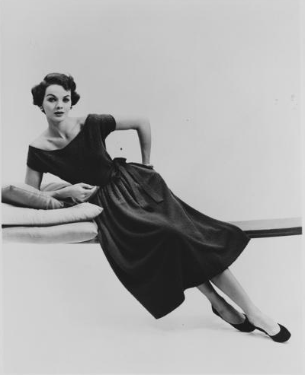
Basic Approach
ENHANCE existing metadata
Do not delete information; add to it.

Slide 4
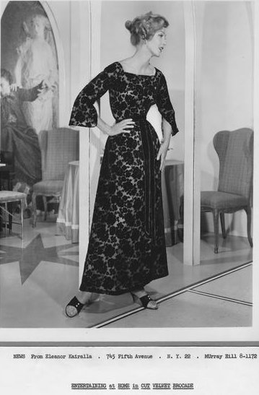
Title/Alternative Title(s)
Do not change the existing title
Exception #1: Okay to correct typos
Exception #2: Some title information may more appropriately belong in Description.note field (e.g. “See also boxes 168, 169 and 171”)
Add AltTitle(s) as necessary if “title-like” phrases are present on the item

Slide 5
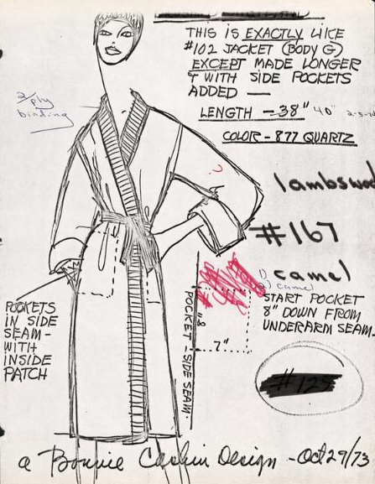
Subjects
Index type of garment(s) depicted and significant material types using Art & Architecture Thesaurus (AAT)
Be as specific as possible
General rule: Do not use LCSH terms.

Slide 6
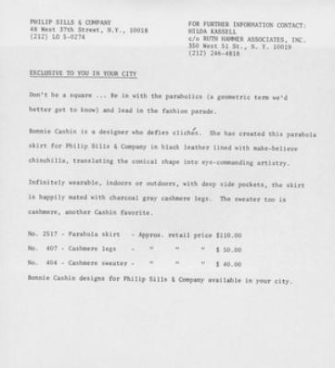
Name
Add Cashin as Name.fashionDesigner where appropriate
Manufacturers: Add as Name.manufacturer

Slide 7
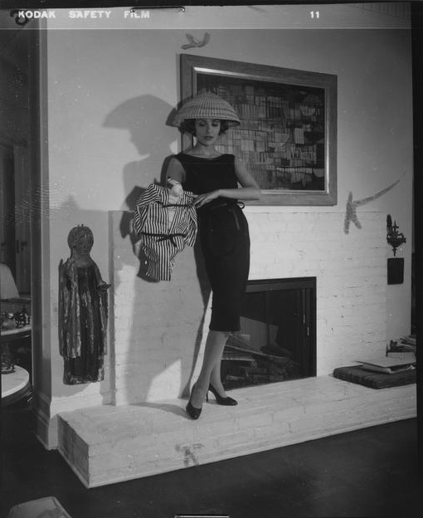
Description
Good place to preserve information you’ve moved from other fields (such as title)
Include a general description of the resource
Also use for more specific garment type terms when AAT headings are more general

Slide 8
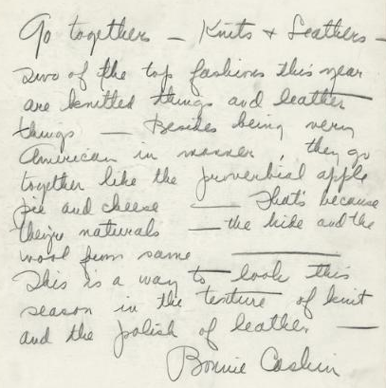
Description
Some items have text
Transcribe text if it seems significant, and if it has not already been transcribed elsewhere (e.g. AltTitle)
Example: Essay text: “Go together – Knits & Leathers. Two of the top fashions this year are…”

Slide 9
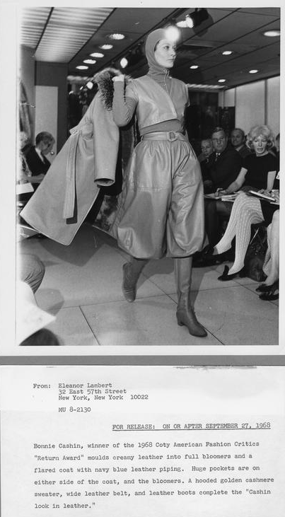
Date
Existing dates in records are from folders – often a range of dates covering the entire folder
Use that range as the Date.created if you can not determine a more specific date
Also provide a Date.normalized

Slide 10
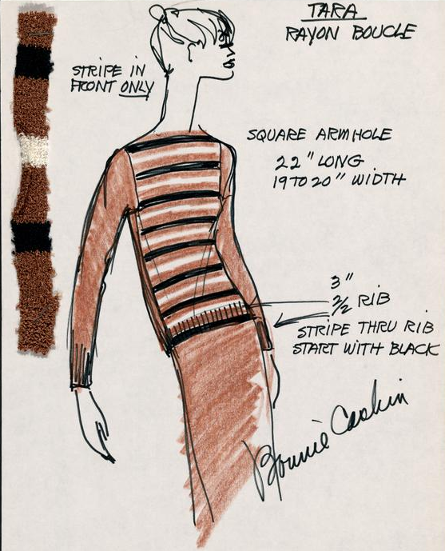
Type
Add most appropriate Type.genre term from AAT to describe the original resource (e.g. sketches, clippings (information artifacts), fashion photographs)
Do NOT use TGM or other terms that may be present; we will be cleaning those up
Type.typeOfResource should always be still image

Slide 11
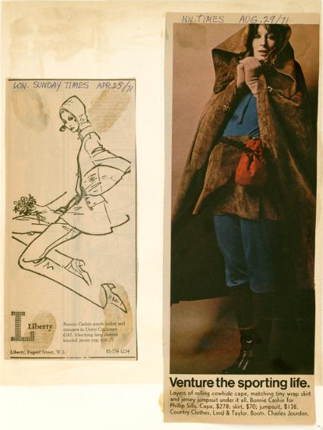
Format
Add Format.extent to describe the original resource(s)
Be sure to include number of items, and whether they are black and white or colored
Example: 1 photograph : b&w
Example #2: 2 clippings : color

Slide 12
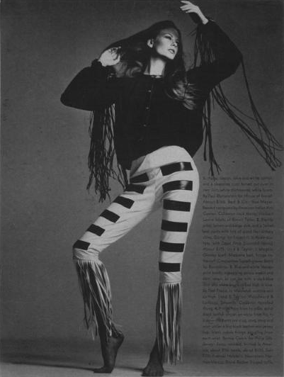
Source / Relation / Rights
Generally, do not use or edit these fields
Relation: Consult if you believe its use is justified in a specific case
Unrelated picture:

Slide 13
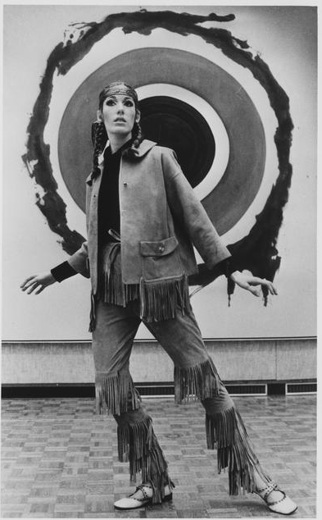
Group Cataloging Exercise!
http://ow.ly/1lj08

Slide 14
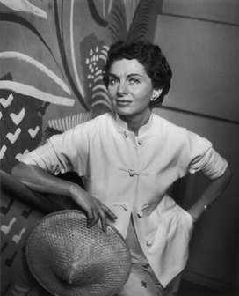
Questions?
THANK YOU!

