Slide 1
UCLA ML Reading Group Winter 2018
Week 1
T. Do

Slide 2
Sample Recidivism Survey
From Dressel & Farid (2018)

Slide 3
The defendant is a male aged 53. They have been charged with: Driving with a Suspended License. This crime is classified as a felony. They have been convicted of 15 prior crimes. They have 0 juvenile felony charges and 0 juvenile misdemeanor charges on their record. Do you think this person will commit another crime within 2 years?

Slide 4
Answer: Yes This person's race is: black

Slide 5
The defendant is a male aged 26. They have been charged with: Battery. This crime is classified as a misdemeanor. They have been convicted of 0 prior crimes. They have 0 juvenile felony charges and 0 juvenile misdemeanor charges on their record. Do you think this person will commit another crime within 2 years?

Slide 6
Answer: No This person's race is: white

Slide 7
The defendant is a male aged 38. They have been charged with: Battery. This crime is classified as a misdemeanor. They have been convicted of 0 prior crimes. They have 0 juvenile felony charges and 0 juvenile misdemeanor charges on their record.

Slide 8
Answer: No This person's race is: black

Slide 9
Now take the survey: https://goo.gl/forms/VhU9xkEu1ZRf0DM83

Slide 11
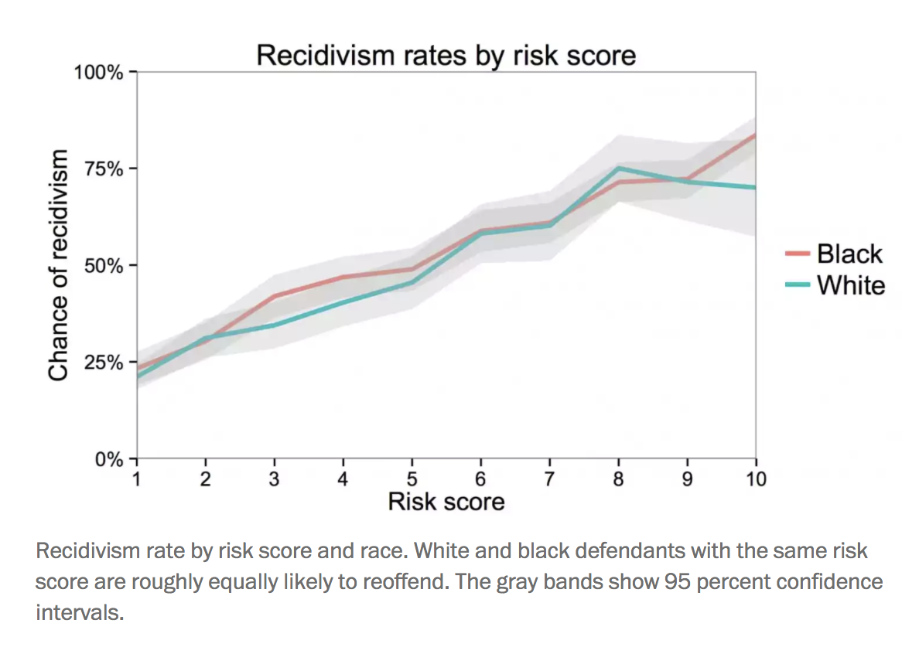
From Washington Post

Slide 12
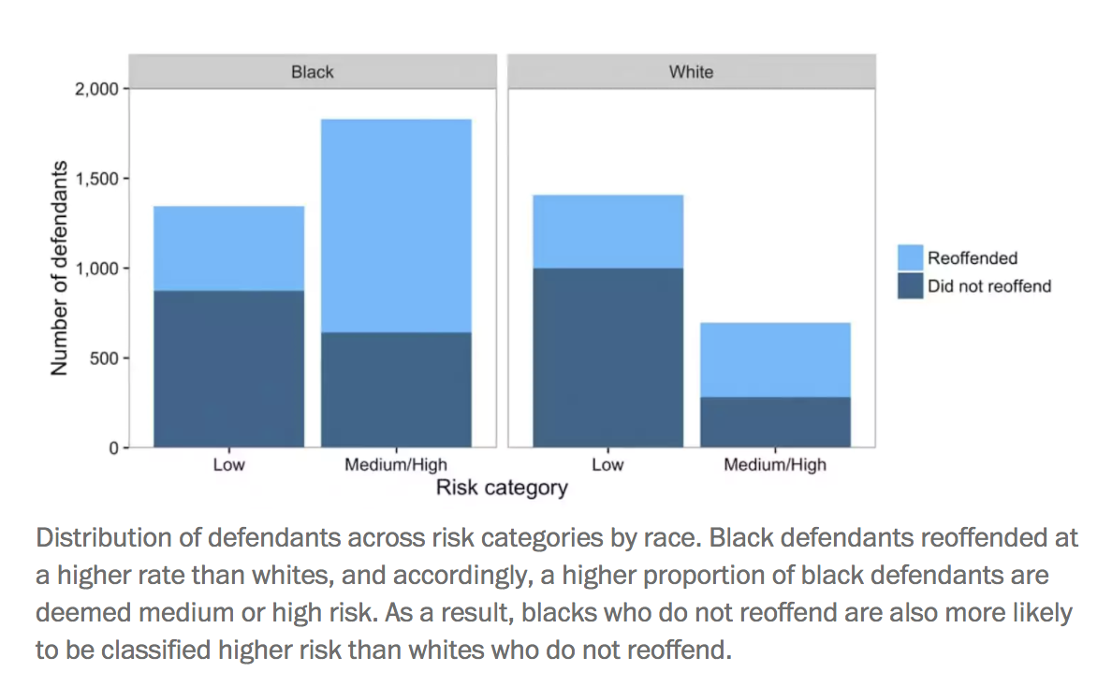
From Washington Post

Slide 13
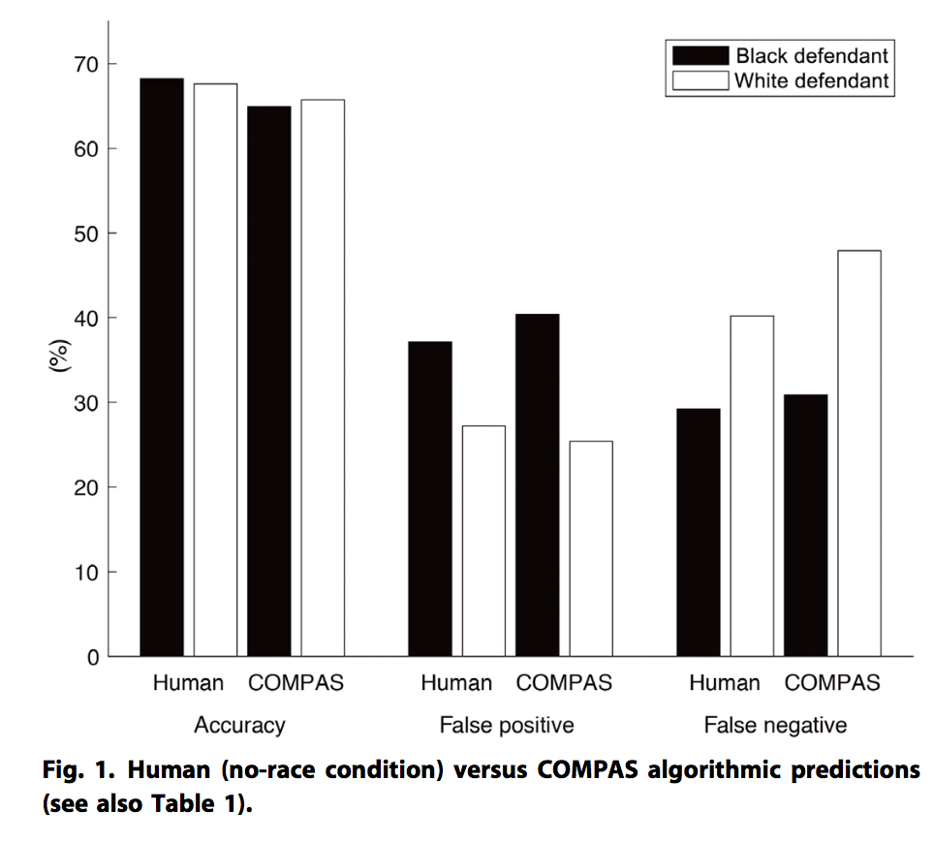
From Dressel & Farid (2018)

Slide 14
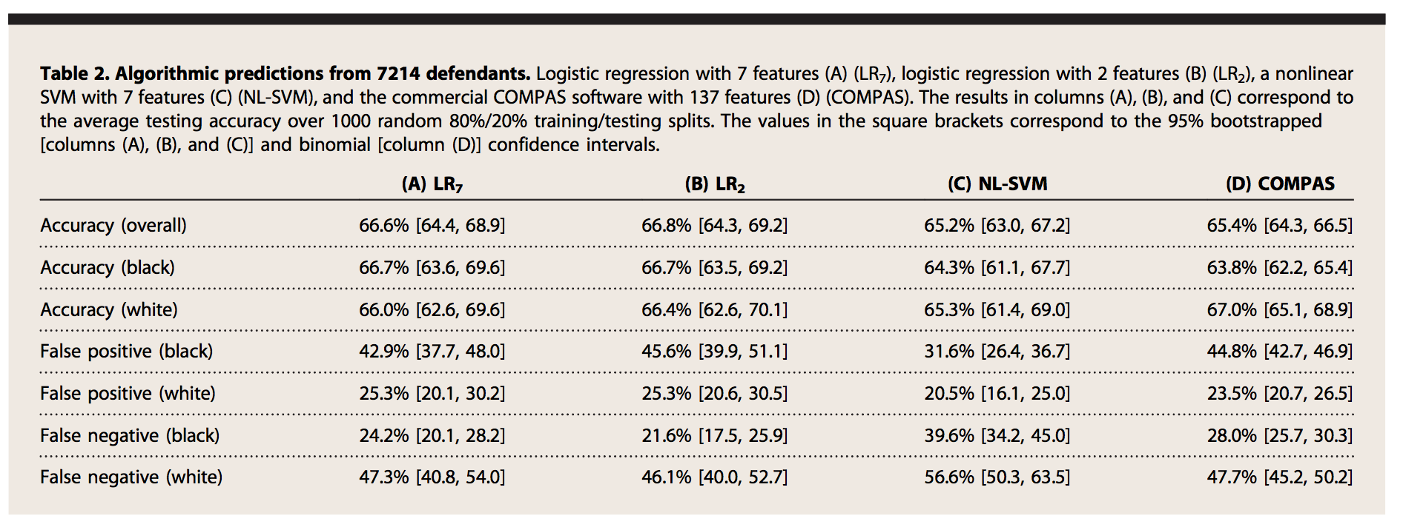
From Dressel & Farid (2018)

