Slide 1
App for child growth charts in R
Team 14
Rajan Hirani rajan.hirani.17@ucl.ac.uk
Saleh Khalil saleh.khalil.17@ucl.ac.uk
Sander Da Mata Miranda sander.miranda.17@ucl.ac.uk
COMP103P Applied Software Development
Client: Professor Tim Cole (GOSH)

Slide 2
The Problem
Children growth is visualized using charts
These charts show how weight and height vary over the first months of the baby’s life
The charts are in a particular format (LMS) with particular centile curves
The standard format of these charts is paper
With over 120,000 births in London alone this is a lot of paper!
Makes admin more complicated

Slide 3
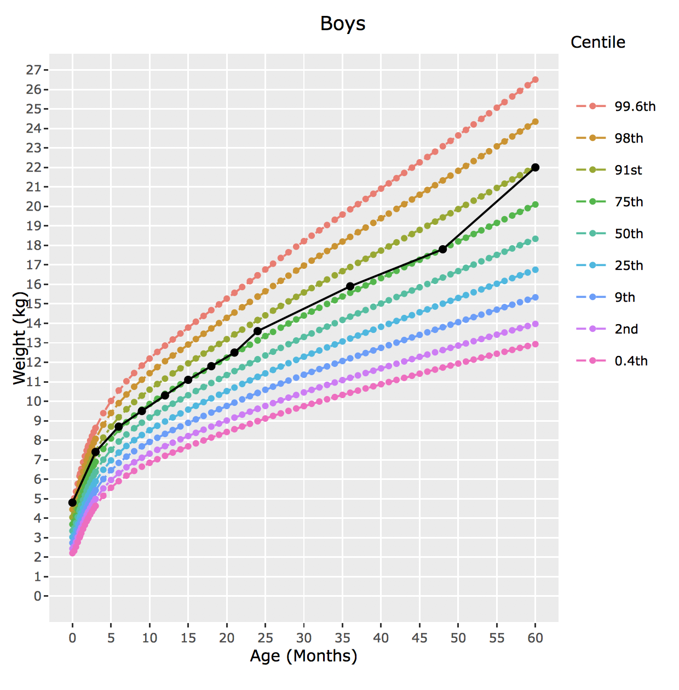
Our Goal
Create an application that can be universally accessed by doctors on all platforms
The application must do the following:
Display height/weight against age growth charts
The charts should be in LMS format
The charts must contain centile lines
Should allow the user to save the charts to a image file

Slide 4
Technologies used
We used the following technologies to implement our project:
R: we used the programming language R in order to create our front end as it contains libraries such as ‘plotly’ that easily allowed us to plot graphs.
RShiny and shiny server: we used this library in R and accompanying server in order to upload our R program to the internet.

Slide 5
Our Application
https://ucl-cs-team14.shinyapps.io/GrowthCharts/

