Slide 1
Scone Training
Course
Session 1

Slide 2
Outline
Installation and system configuration
Getting familiar with the Scone: let’s meet Clyde
Knowledge-base operations: first steps with Scone
Virtual copy: a powerful tool

Slide 3
Installation and system configuration

Slide 4
Installation and system configuration
Some requirements
  A GNU/Linux environment (or an X Window system)
  SBCL (Steel Bank Common Lisp Compiler)
  Emacs and SLIME (Superior Lisp Interaction Mode for Emacs)

Slide 5
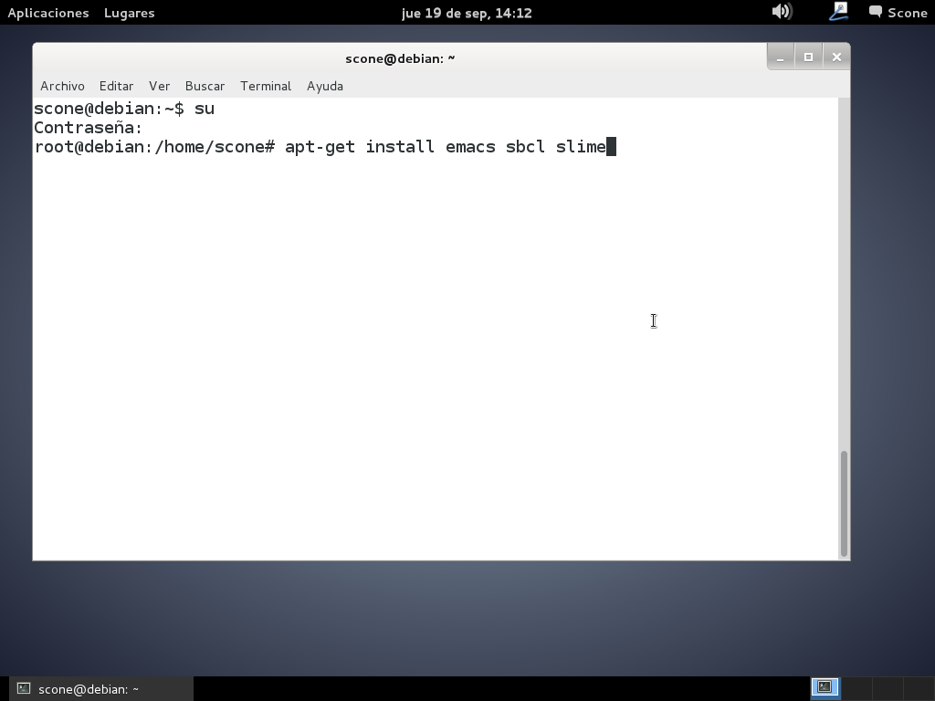
Installation and system configuration

Slide 6
Installation and system configuration
; SLIME stuff for EMACS/SBCL
(add-to-list 'load-path "/usr/share/common-lisp/source/slime/")
(require 'slime)
(slime-setup)
(defun cmucl ()
(interactive)
(setq inferior-lisp-program "lisp")
(slime))
(defun sbcl ()
(interactive)
(setq inferior-lisp-program "sbcl")
(slime))

Slide 7
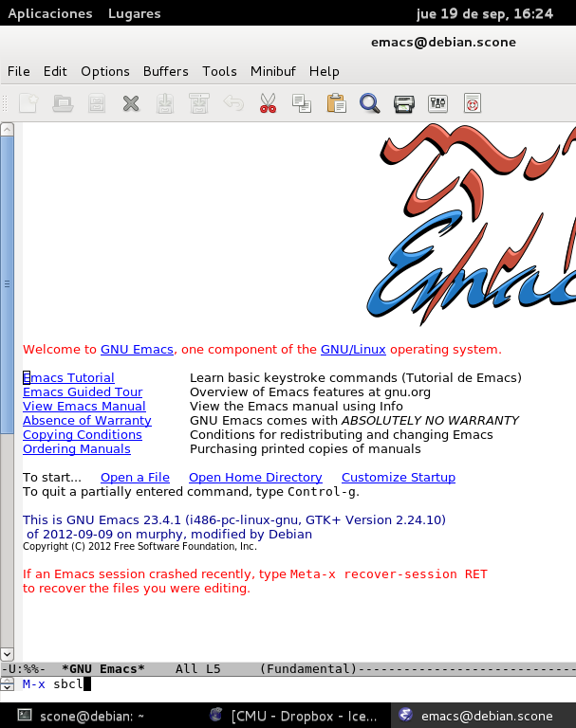
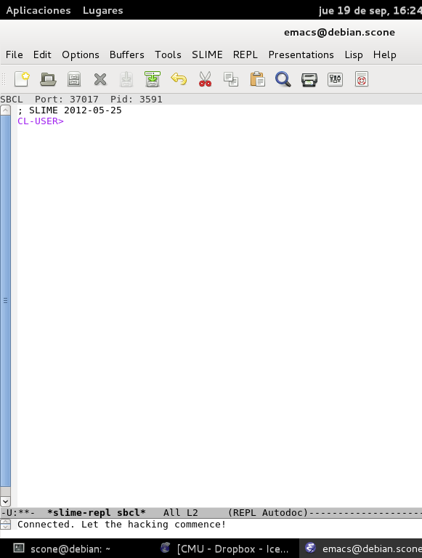
Installation and system configuration

Slide 8
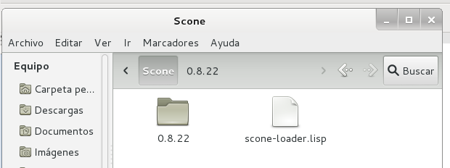
Installation and system configuration
Scone loader configuration

Slide 9
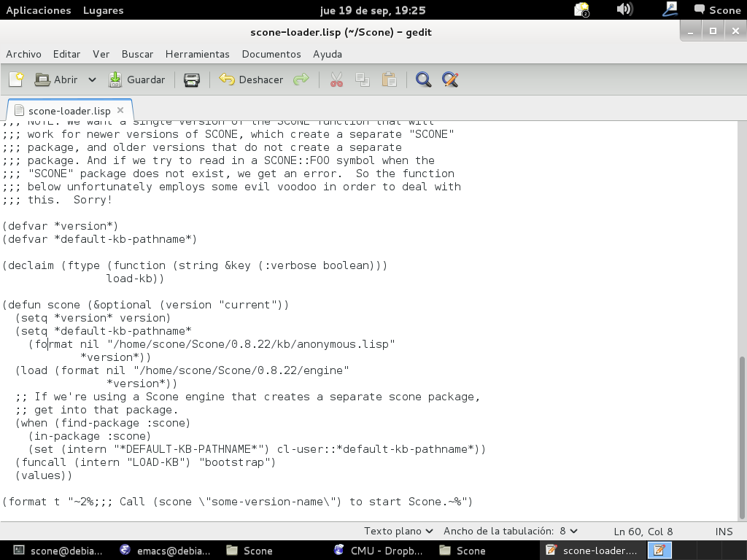
Installation and system configuration

Slide 10
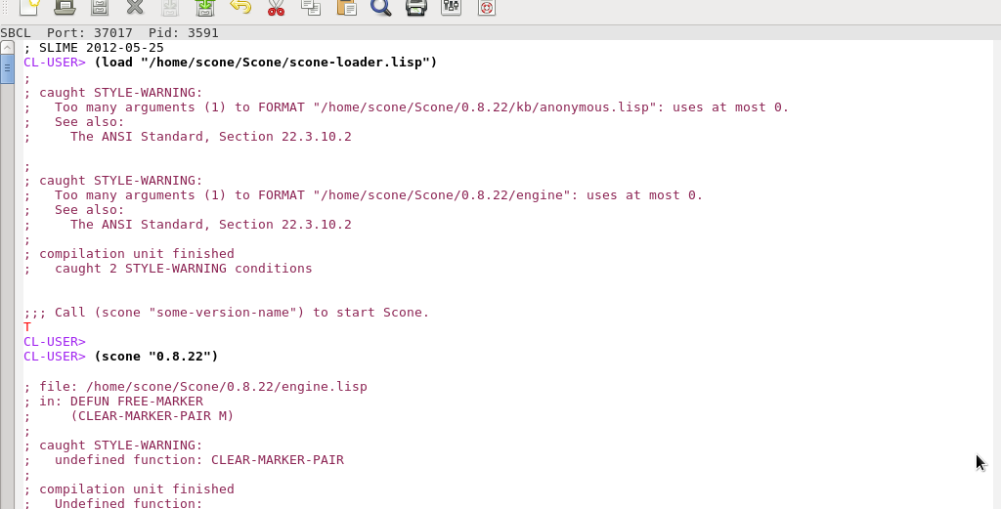
Installation and system configuration

Slide 11
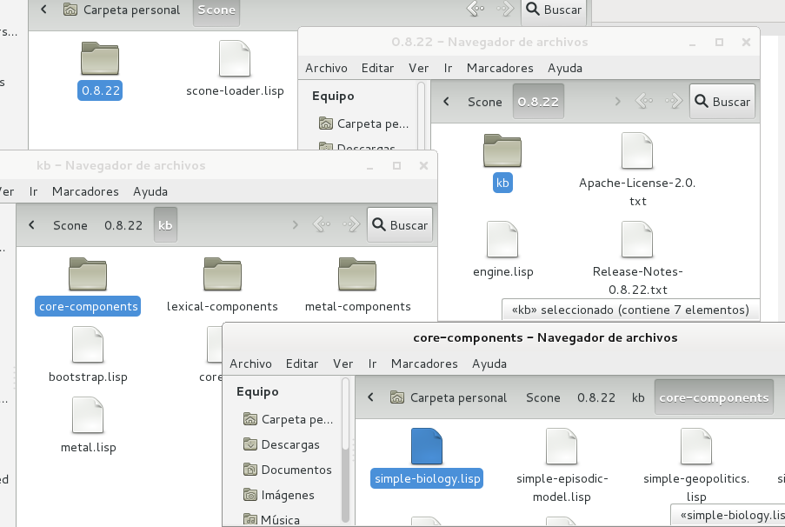
Installation and system configuration
Provide the Scone engine with some basic knowledge

Slide 12
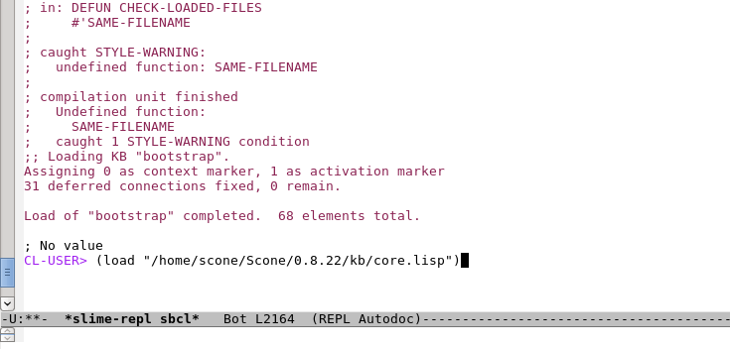
Installation and system configuration
Loading the core.lisp file

Slide 13
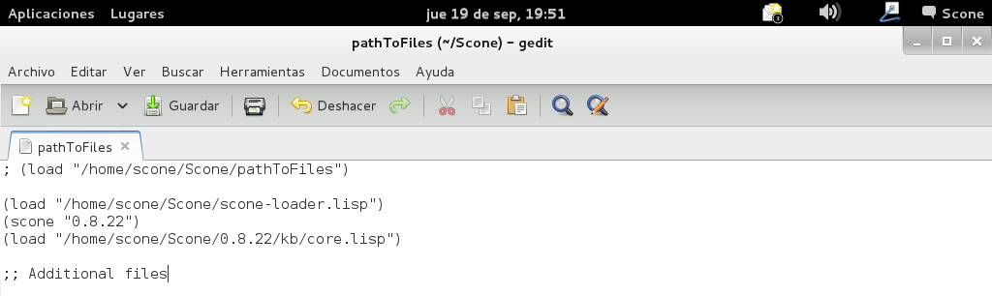
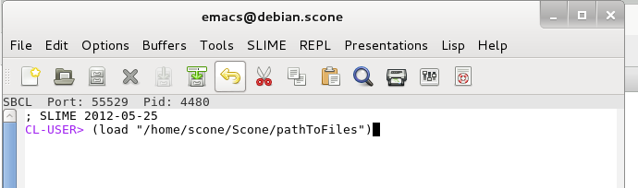
Installation and system configuration
An easier way of loading files and starting Scone

Slide 14
Getting familiar with the Scone: let’s meet Clyde

Slide 15

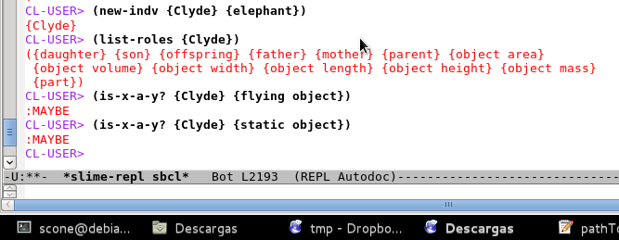
Getting familiar with the Scone: let’s meet Clyde
The role of implicit knowledge
  We know things about every elephant
  We know things about every animal
  We know things about physical objects
  Is Clyde an inanimate object?

Slide 16
Getting familiar with the Scone: let’s meet Clyde
Thing
type_of
Tangible
type_of
The semantic network scheme permits implicit properties of a node to be discovered along a large list of hierarchy types
Physical object
type_of
Animate
type_of
Animal
type_of
has_a
Vertebrate
Mother
type_of
Mammal
Father
type_of
has_a
Elephant
type_of
Clyde

Slide 17
Knowledge-base operations: first steps with Scone

Slide 18
Knowledge-base operations: first steps with Scone
CLYDE is the node that represents the elephant named Clyde.
ELEPHANT is the type-node that represents the typical elephant concept
Clyde is an elephant Virtual-copy relationship between Clyde and elephant

Slide 19
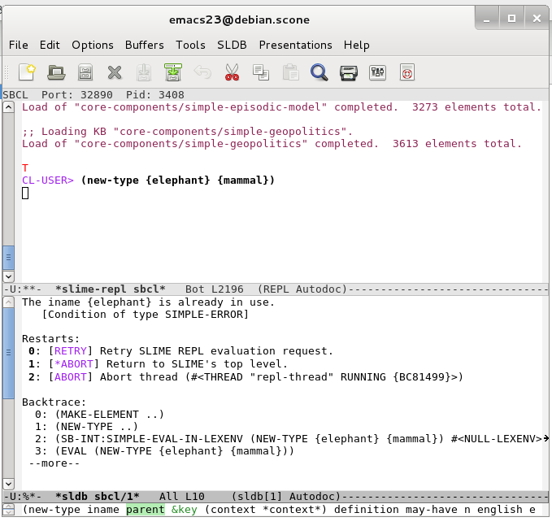
Knowledge-base operations: first steps with Scone
CL-USER> (new-type {ELEPHANT} {MAMMAL})
CL-USER> (new-indv {CLYDE} {ELEPHANT})

Slide 20
Knowledge-base operations: first steps with Scone
Thing
This node is always at the top of the hierarchy
type_of
Tangible
type_of
This is a virtual-copy link
Physical object
The virtual-copy links will always be spoken of (and will appear in diagrams) as pointing upward: MAMMAL is above ELEPHANT and below VERTEBRATE.
type_of
Animate
type_of
Animal
type_of
has_a
Vertebrate
Mother
type_of
The parent or parents of a node, meaning those nodes immediately above the given node in the hierarchy, and the ancestors of a node, meaning those nodes somewhere above the given node. Offspring and descendent are analogous, but downward in the hierarchy.
Mammal
Father
type_of
has_a
Elephant
type_of
Clyde

Slide 21
Knowledge-base operations: first steps with Scone
ANIMAL
BLOOD-TEMP
MAMMAL
WARM
Properties attached to the COW node itself, or to any node above COW in the hierarchy, are meant to apply to every cow. Properties hung from nodes below COW are meant to apply to only some cows.
PART
COW
UDDER
COLOR
COLOR
BLACK+WHITE
HOLSTEIN
JERSEY
BROWN
INDIVIDUAL
COWS

Slide 22
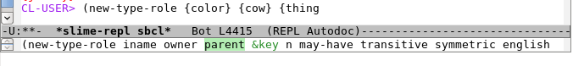
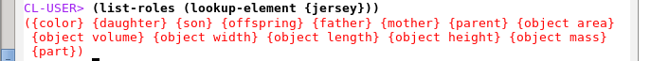
Knowledge-base operations: first steps with Scone
CL-USER> (new-type {HOLSTEIN} {COW})
CL-USER> (new-type {JERSEY} {COW})
CL-USER> (new-type-role {COLOR} {COW} {THING})
CL-USER> (list-roles (lookup-element {JERSEY})
CL-USER> (new-indv {BROWN} {COLOR})
CL-USER> (new-indv {BLACK+WHITE} {COLOR})
CL-USER> (x-is-the-y-of-z {BROWN} {COLOR} {JERSEY})
CL-USER> (x-is-the-y-of-z {BLACK+WHITE} {COLOR} {HOLSTEIN})
CL-USER> (the-x-of-y {COLOR} {JERSEY})
Argument list

Slide 23
Knowledge-base operations: the university
List all the centers/faculties, etc., emplaced in Campus Ciudad Real
List all departments teaching at ESI
List all the emplacements for the Matemáticas department
CL-USER> (list-all-x-inverse-of-y {emplacement} {Campus Ciudad Real})
CL-USER> (list-rel-inverse {ŧeach} {Escuela Superior de Informática de Ciudad Real}

Slide 24
Knowledge-base operations: the university
List all the emplacements for the Matemáticas department
CL-USER> (let ((result nil))
(dolist (university_centre (list-rel {teach} {matemáticas}))
(push
(car (list-all-x-of-y {emplacement} university_centre))
result))
result)

Slide 25
Knowledge-base operations: the university
Describe a building

