Slide 1
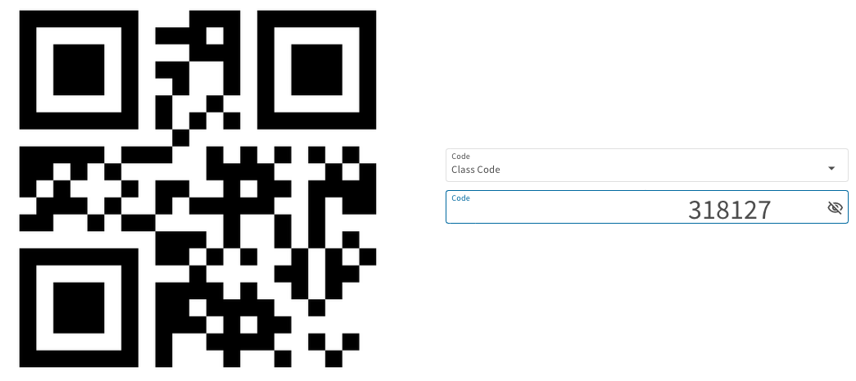
GEOG0186: Foundations of Geography I
Quantitative Skills
Computer Practicals
Registration
GROUP A
1

Slide 2
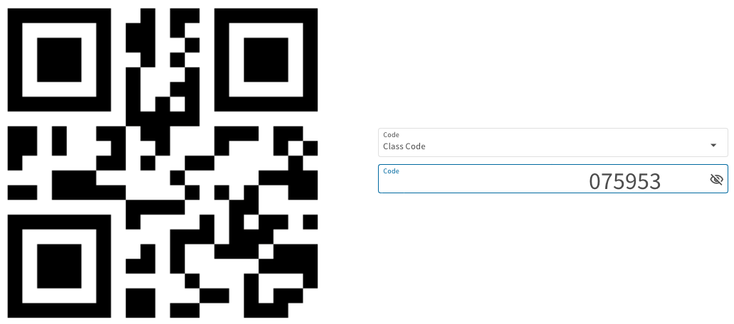
GEOG0186: Foundations of Geography I
Quantitative Skills
Computer Practicals
Registration
GROUP B
2

Slide 3
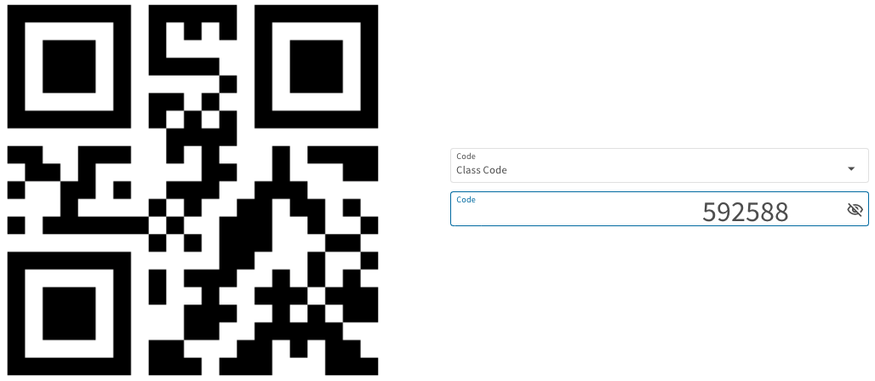
GEOG0186: Foundations of Geography I
Quantitative Skills
Computer Practicals
Registration
GROUP C/D
3

