Slide 1

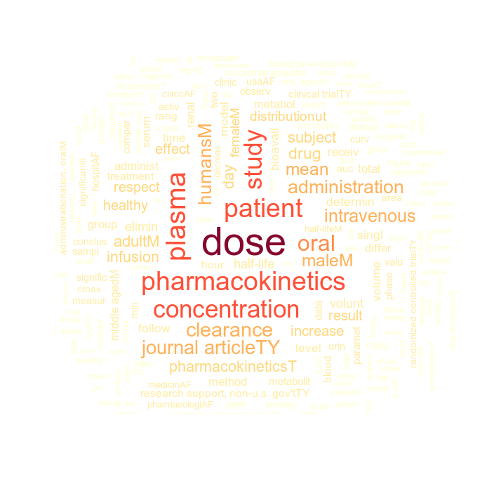
Biomedical Natural Language Processing: Applications and Software
UCL ICH Coding Club
Ferran Gonzalez Hernandez
25/03/2020

Slide 2
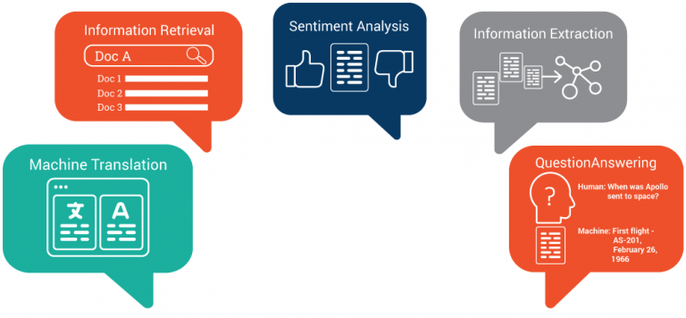
Natural Language Processing (NLP)
What is Natural Language Processing?
Terminology: text mining & NLP
Machine Learning & AI
Applications?
Speech Recognition
Email filtering
Search engines
Machine Translation
Question answering
Sentiment analysis
....

Slide 3
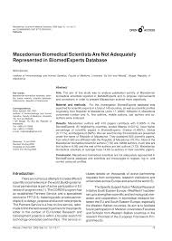
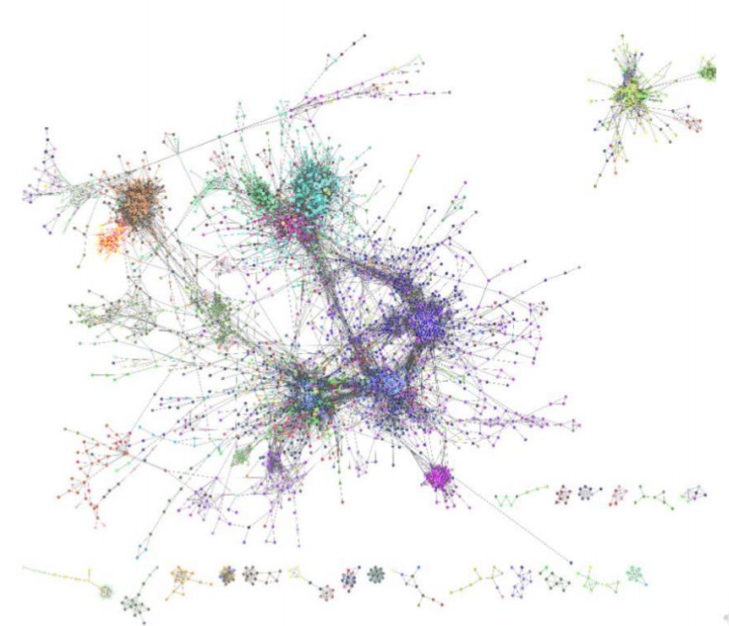
Biomedical NLP
Why can NLP be helpful?
Biomedical Literature
30M > records in PubMed
Structure Knowledge
Search engines, document classification, topic modelling,
summarisation
Infer knowledge
Relationships between genes, proteins, diseases and drugs
Hypothesis generation through knowledge graphs

Slide 4
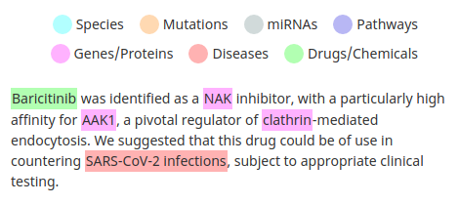
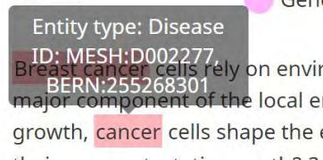
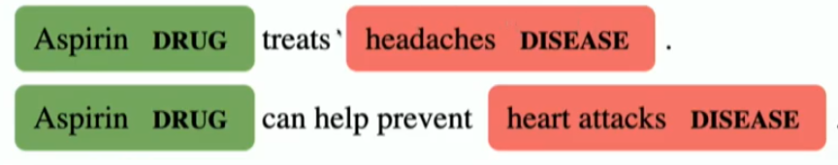
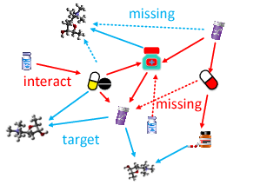
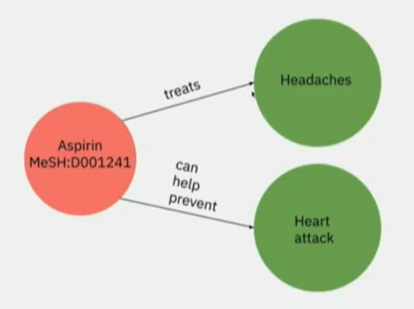
Common Tasks
Information Retrieval
Document Classification
Topic Modelling
Named-Entity Recognition (NER)
Entity Linking
Knowledge graph construction
Relationship extraction
NLP & COVID-19
https://www.thelancet.com/journals/laninf/article/PIIS1473-3099(20)30132-8/fulltext

Slide 5
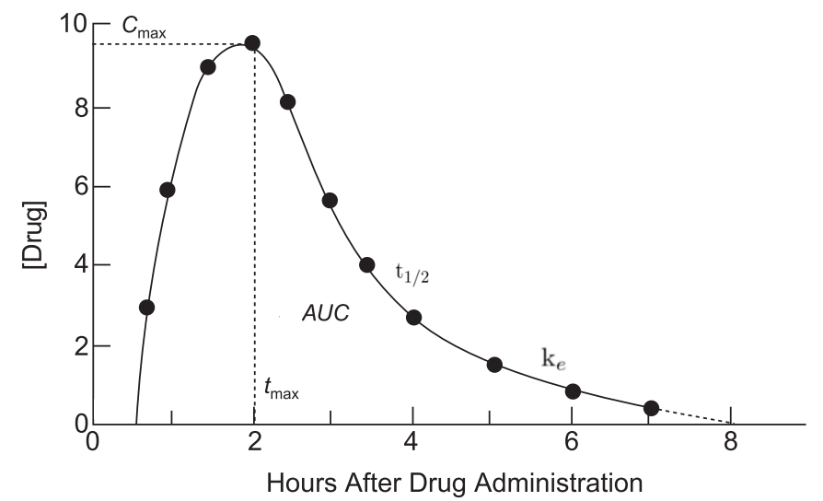
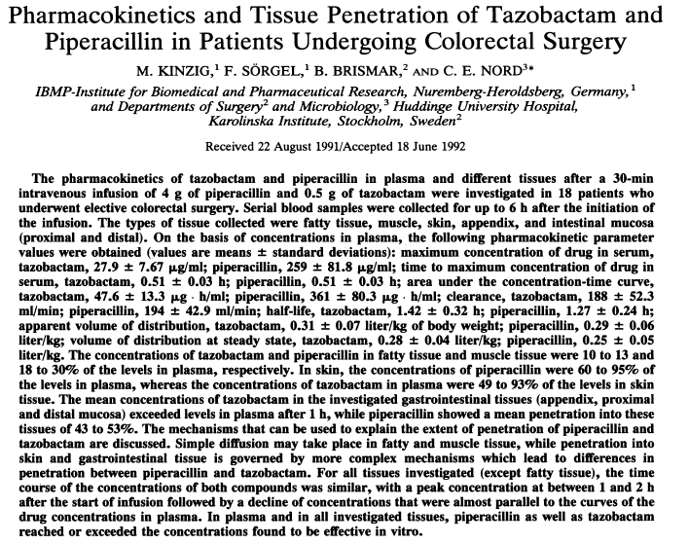
Own research
Pharmacokinetics
Value for drug development?
Parameters derived from Clinical Trials:
Identify papers reporting this information (Document Retrieval)
Locate mentions of parameters (NER) and contextual information (sentence classification)
Extract associated values (Relationship extraction)
Normalisation
Lookup table

Slide 6
NLP in a Nutshell
NLP in a nutshell
NLP
Input
Output
Target
f(x)
X
Y
Y’
“Clinical Pharmacokinetics and Dose Recommendations for Posaconazole in Infants and Children”
≠
ENCODER
DECODER
IRRELEVANT
RELEVANT
Representation
TYPES
Titles
Paragraphs
Documents
Text messages
...
Symbolic
Sparse
Dense
...
Rule-based
Logistic Regression
Decision Trees
Neural Networks
……...
Labels
Sentences
Graphs
Trees
...
Supervised
Unsupervised
Semi-supervised
...
Rule-based
Learnt
Notes:
Talk about the example of language translation. Briefly mention deep learning approaches: Difference in learnt encodings

Slide 7
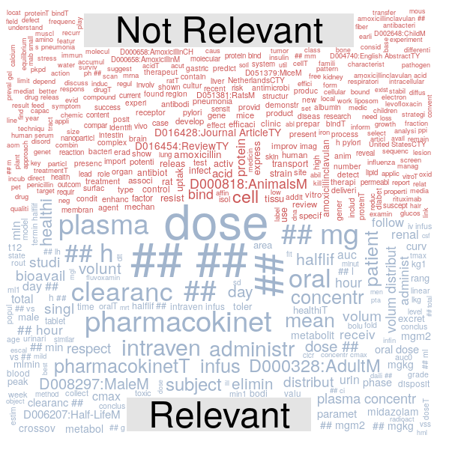
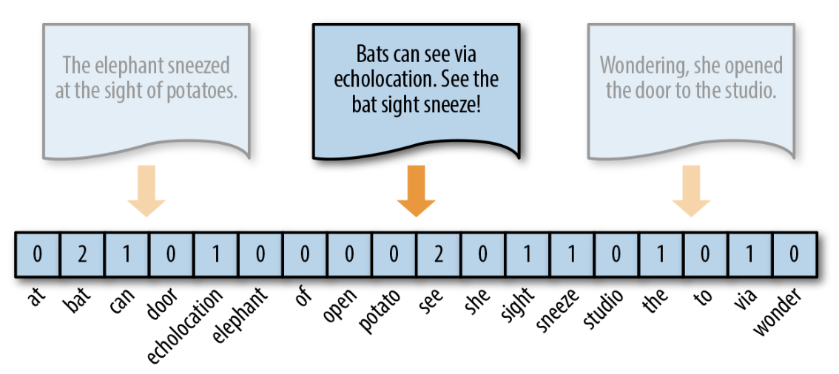
Bag of Words
BAG OF WORDS
Preprocessing
Tokenisation
Lowercase
Remove: stop-words and punctuation signs
Stemming (Porter Stemmer)
Term frequency count
How can we represent text numerically?
Let’s try it
https://github.com/UCLichCodeClub/Meeting_ICH_25Mar2020/blob/master/DocClassification.ipynb
Advantages and Limitations?
Notes:
Explain the concept of term frequency
Explain drawbacks
Explain rest

Slide 8
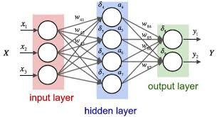
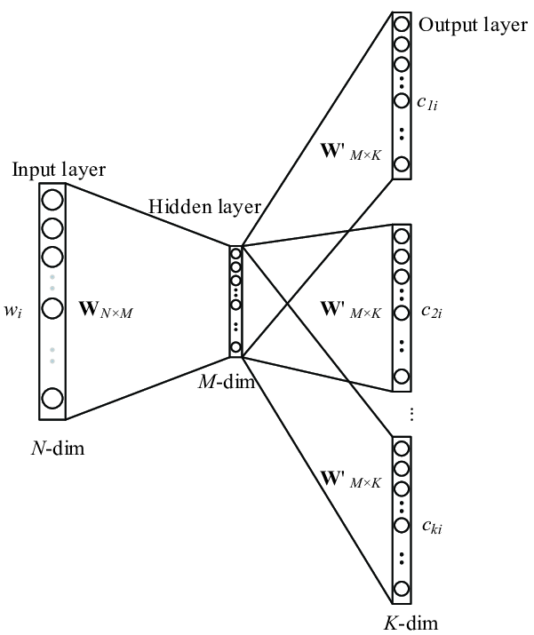
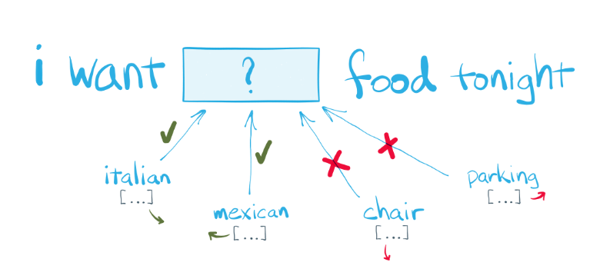
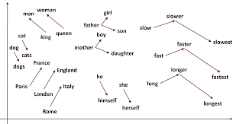
Word embeddings
BETTER REPRESENTATIONS? WORD EMBEDDINGS
Neural Networks and Deep Learning
What are neural networks?
Why are they useful?
Main applications
Language modelling
Unsupervised training
Ultimate goal: learn the weights of the model given an auxiliary task
Skip-gram
Notes:
Image from https://github.com/explosion/spacy-notebooks/blob/master/notebooks/conference_notebooks/modern_nlp_in_python.ipynb

Slide 9
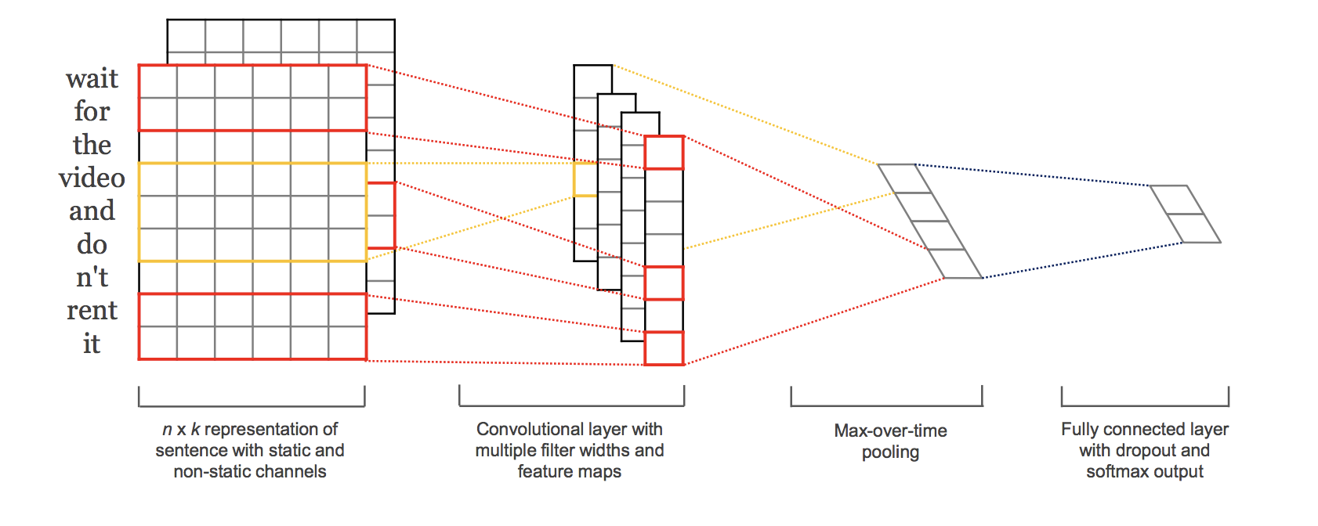
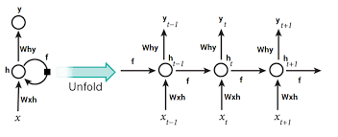
Word embeddings
Named-Entity Recognition (NER)
Task
Rule/dictionary-based approaches
Bag of words + ML classifiers
Combination of Embeddings + ML algorithms
Common neural architectures:
Recurrent Neural Networks (RNN)
Convolutional Neural Networks (CNNs)

Slide 10
Word embeddings
Some interesting resources
Biomedical NLP
https://scispacy.apps.allenai.org/
State-of-the-art Language model for automatic text completion:
https://transformer.huggingface.co/doc/gpt2-large

Slide 11
Acknowledgments
Thank you for your attention
ferran.hernandez.17@ucl.ac.uk
fhernandez@turing.ac.uk

