Slide 1
The HEC
HEC = High End Computing
This presentation is based on the guide provided by the HEC of which this contains more details if wanted:
https://answers.lancaster.ac.uk/display/ISS/High+End+Computing+%28HEC%29+help
Presentation created by: Andrew Moore
Funded by: UCREL research centre

Slide 2
What is the HEC?
Consists of:
1 login node -> The computer that is used when you login. This is slow and should not be used for any tasks other than monitoring or assigning jobs really.
CPU nodes -> Various 16 core nodes with either 64 or 128GB of memory. Various 40 core nodes with 192GB of memory.
GPU nodes -> 2
All computers/nodes are Linux based:
Good resource for learning Linux: https://robinlong-tutorials-linux.readthedocs.io/en/latest/introduction.html

Slide 3
What is the HEC?
CPU Nodes:
Various 16 core nodes with between 64 and 128GB of memory.
In total 9,900 cores and 50TB of memroy.
2 GPU nodes each containing:
3 Nvidia V100 32GB, 32 CPU cores, 192GB memory.

Slide 4
Get access?
First you need to get a login, ask your PI/Supervisor to apply for an account. See here for more details: https://answers.lancaster.ac.uk/display/ISS/Get+access+to+the+HEC
Once you have a login access via ssh using Lancaster login:
ssh username@wayland.hec.lancaster.ac.uk
See here for more details for login (windows): https://answers.lancaster.ac.uk/display/ISS/Logging+in+to+the+HEC

Slide 5
File store/File quota
Home -> 10GB -> Backup nightly -> Permanent -> $HOME
Storage -> 100GB -> No Backup -> Permanent -> $global_storage
Scratch -> 10TB -> No Backup -> Deleted after 4 weeks -> $global_scratch
Temp -> Unlimited -> No Backup -> Only exists when the job is running -> $TMPDIR
NOTE: $TMPDIR environment variable only exists when the job is running all others exist on the login node

Slide 6

File store/File quota
To check the amount of storage used run: `gpfsquota`:
The 10TB of scratch area is really useful. However files will be deleted end of day if last modified time is 4 weeks old, this point is really important as a lot of files you may have downloaded will likely have a last modified time of more than 4 weeks.

Slide 7
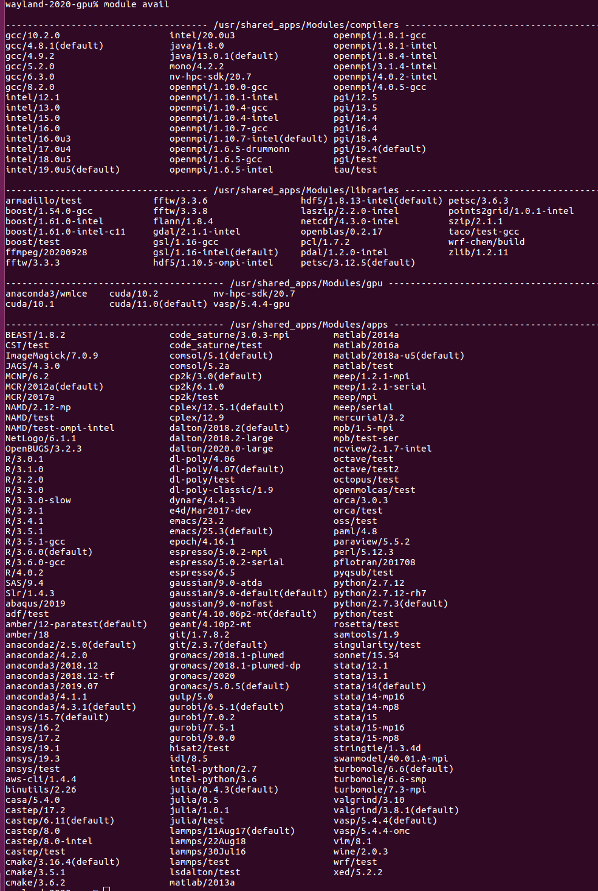

Installing Software
Pre-installed software: `module avail`
If you would like custom software installed on the HEC (including Conda environments) request it through https://helpcentre.lancaster.ac.uk before creating your own custom installation.

Slide 8
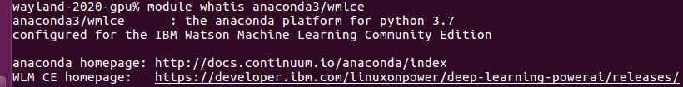
Installing Software
`module whatis anaconda3/wmlce`:
`module add anaconda3/wmlce`
`module list` -> lists all software currently being used.
More details about what that package is doing run: `module show anaconda3/wmlce`

Slide 9
Anaconda3/wmlce package
`conda --version` -> conda 4.8.2 came out 24/1/2020
`conda list` shows what packages have been installed
`source activate wmlce_env` will use all of the packages that is associated with the `wmlce_env` environment. This includes Tensorflow etc.

Slide 10
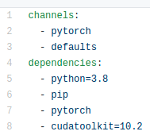
Your own conda environment
Still need to use the anaconda3/wmlce, as we need conda.
We need to specify what we want to install via an environment file and a Python requirements file.

Slide 11
Your own conda environment
`conda install pytorch cudatoolkit=10.2 -c pytorch`

Slide 12
Your own conda environment
The defaults/main channel for Linux and others:

Slide 13
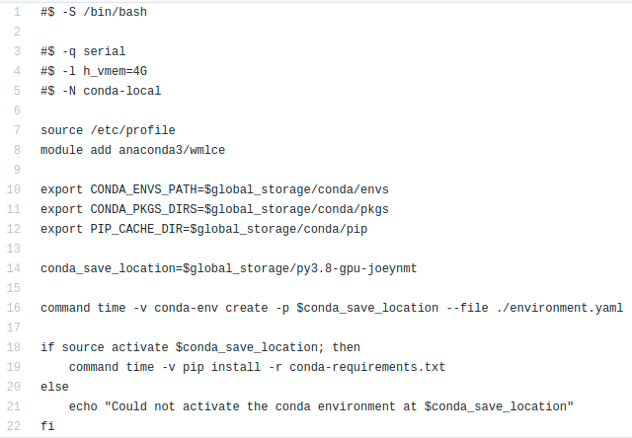
Your own conda environment
Serial – single CPU node
-l – 4GB memory
-N – name of job
File can be found here

Slide 14
Useful commands for running jobs
Jobs can be run with the `qsub` command e.g. `qsub install.com`
Check number of free slots `qslots` a more detailed view `qslots -v`
Check status of jobs `qstat`
Check CPU/Memory usage of jobs `qtop -u USERNAME` e.g. `qtop -u moorea`
Check amount of resources used and are allowed to used (only applicable to CPU nodes) `qquota` LIMITED to 350 cores and 1.64TB memory

Slide 15
GPU Example – NER tagging using SpaCy
2 GPU nodes each containing:
3 Nvidia V100 32GB, 32 CPU cores, 192GB memory.
This is broken up mainly into GPUs e.g. 6 GPUs of which if you want to use multiple GPUs a hardware limit of 3 is applied.
LIMITATION -> Only allowed to use a GPU node for 12 hours, but could use 3 GPUs for 12 hours ~ 1 GPU for 36 hours.

Slide 16
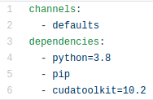
GPU Example – NER tagging using SpaCy
Install the required Conda and Python packages:

Slide 17
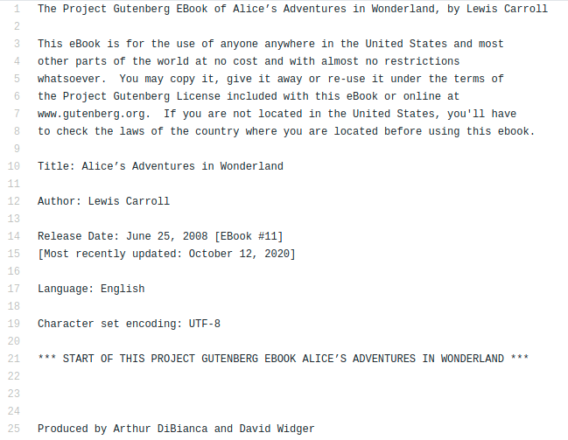
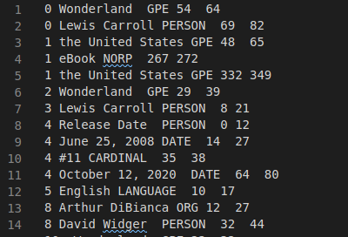
GPU Example – NER tagging using SpaCy

Slide 18
GPU Example – NER tagging using SpaCy
`tagging.py` takes 4 arguments:
Input text file to tag
File to save the TSV data too
Batch Size – 50 in this case
Use GPU or not

Slide 19
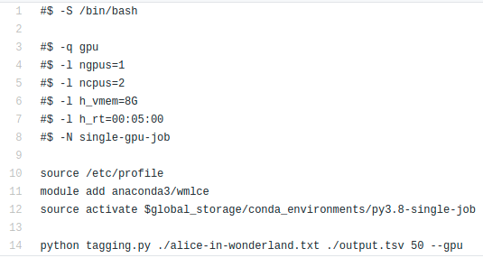
GPU Example – NER tagging using SpaCy
GPU– queue
1 GPU
2 CPUS
8GB RAM
Job has upto 5 minutes to run
File can be found here

Slide 20
GPU Example – NER tagging using SpaCy
Time taken to process Alice in Wonderland with SpaCy's small English NER model. Contains 881 paragraphs.
 | Batch Size
Hardware | 50 | 1000
CPU only | 1.8 seconds | 1.1 seconds
GPU | 12 seconds | 0.6495 seconds

Slide 21
For more NLP based HEC examples see: https://github.com/apmoore1/HEC
Thanks for listening, any questions?
Presentation created by: Andrew Moore Twitter: @apmoore94
Funded by: UCREL research centre

