Slide 1
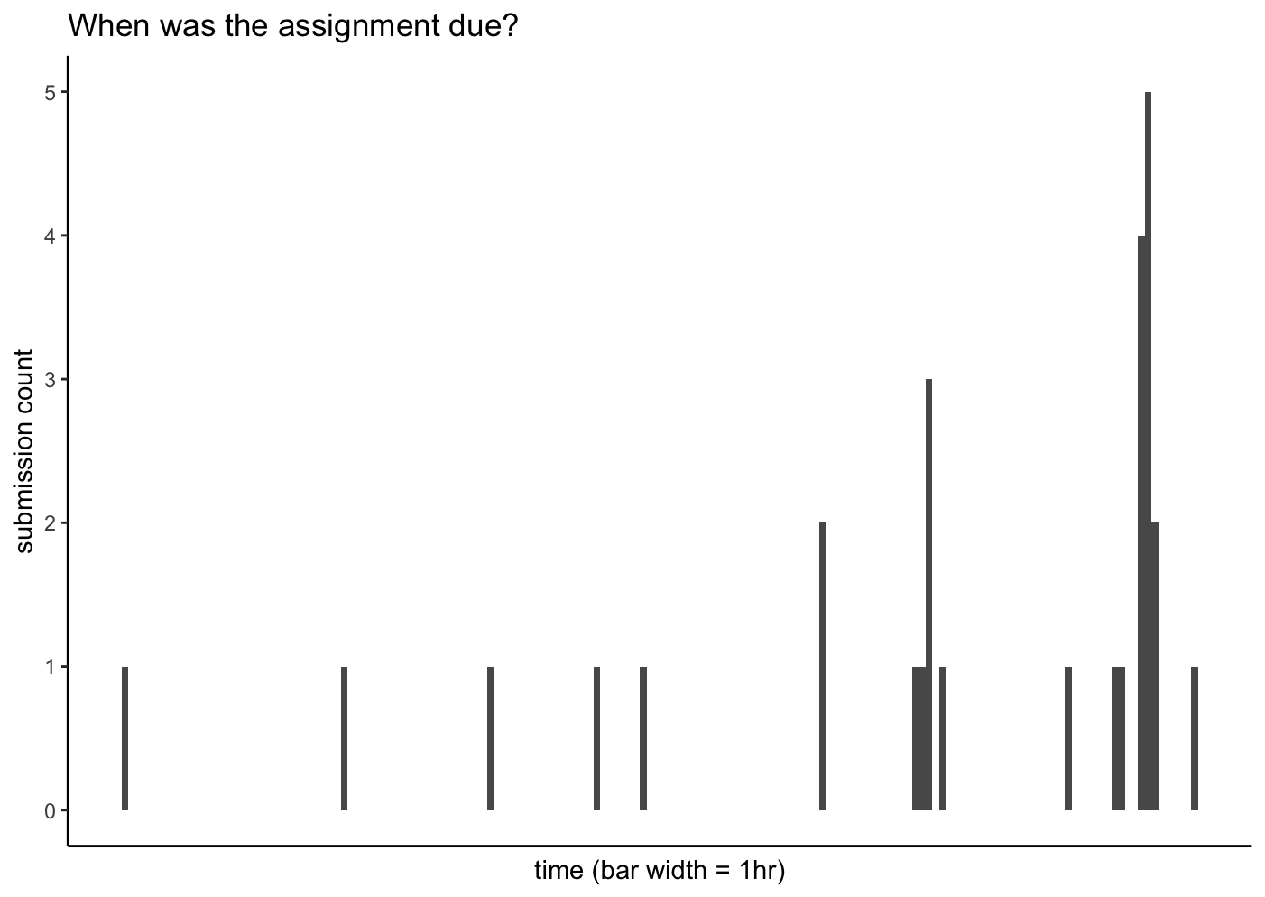

Slide 2
Introduction to SQL
EDS213 - Databases & Data Management
Week 3
Greg Janée
Research Data Services, UCSB Library
rds@library.ucsb.edu

Slide 3
Learning objectives
Understand the relationship of SQL to relational databases
Understand how local databases differ from client/server databases
Understand basic SQL syntax and statements
Be able to answer basic questions about data

Slide 4
Recap of week 1
Takeaways
Data modeling is an important part of the process of working with data
To have confidence in data, we need assurance that it matches our assumptions and expectations
Relational databases/SQL provide an opportunity (a place) to both define and constrain data
Notes:
Recall quote from week 1: “Even though the data modelling phase represents only a relatively small share of the total development effort of data systems, its impact on the final result is probably greater than that of any other phase”

Slide 5
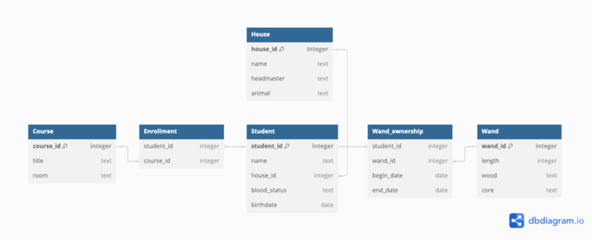
Homework answer

Slide 6
Homework answer
CREATE TABLE Snow_survey (
Site TEXT NOT NULL,
Year INTEGER NOT NULL CHECK (Year BETWEEN 2000 AND 2014),
Date DATE NOT NULL,
Plot TEXT, -- foreign key?
Location TEXT,
Snow_cover REAL NOT NULL CHECK (Snow_cover BETWEEN 0 and 100),
Water_cover REAL NOT NULL CHECK (Water_cover BETWEEN 0 and 100),
Land_cover REAL NOT NULL CHECK (Land_cover BETWEEN 0 and 100),
Total_cover REAL NOT NULL CHECK (Total_cover = 100),
Observer TEXT NOT NULL,
Notes TEXT,
FOREIGN KEY (Site) REFERENCES Site (Code),
FOREIGN KEY (Observer) REFERENCES Personnel (Abbreviation),
CHECK (Date BETWEEN Year||'-01-01' AND Year||'-12-31'),
CHECK (Total_cover = Snow_cover + Water_cover + Land_cover)
);
-- Possible primary key: (Site, Date, Plot, Location)?
Notes:
Purpose of exercise: to do a real-world task. While learning SQL you will be using a pre-prepared database that has no issues. In real life, data assessment & cleaning are commonplace.
If data has no intrinsic meaning (e.g., it’s a code of some kind), then it is possibly and even likely a foreign key
Useful to constrain year even if bounds are arbitrary
Primary key unclear, some suggested adding ID column, good idea
Still needs to be augmented with metadata, of course

Slide 7
Compare to CSV
Site,Year,Date,Plot,Location,Snow_cover,Water_cover,Land_cover,Total_cover,Observer,Notes

Slide 8
SQL’s role and nature
Standardized language
For defining, accessing, managing data in RDBMS
The only thing that is standardized
Variations in what is supported and how
Extensions: statements, functions, data types
Also serves as the API
Declarative language, not procedural
Say what you want, not how to compute it
Notes:
R joins are very similar to SQL joins, why is R procedural and SQL declarative? Read on…

Slide 9
Typical database architecture
SERVER
Scheduler
Concurrency management
Query planning:
- Algorithms
- Caching, indexes
- Statistical distribution of data
Query engine
CLIENT (you)
Memory caching
Predictive reads
Deferred writes
I/O optimization
Command line or
from program
network
I/O subsystem
Log manager
Fault recovery
Storage
Notes:
Server is an engine that is always running, anticipating multiple queries simultaneously
Tremendous amount of variability in how queries are processed; asynchronous processing
This explains way rows are not just conceptually unordered, but might be returned in different order on every query
Explains why SQL is considered declarative: RDBMS decides how to implement

Slide 10
Local vs client/server databases
Local (DuckDB, SQLite)
Storage
(Single) local file
Access
Command line tool or library open that file
No authentication, etc.
Support for SQL standard
Essentials there, but many pieces missing
Installation; management
Super easy; nil
Data portability
Great
Client/server RDBMS (Oracle, SQL Server, PostgreSQL, MySQL, …)
Storage
A mystery
Access
Command line tool or library talk over network (even on same machine)
User accounts, authentication, permissions
Support for SQL standard
Very good
Installation; management
Easy; obscure
Data portability
Weak to nil
Notes:
In real life, you are more likely to collaborate using a client/server database.
Ergo, this course is geared to giving you that experience.

Slide 11
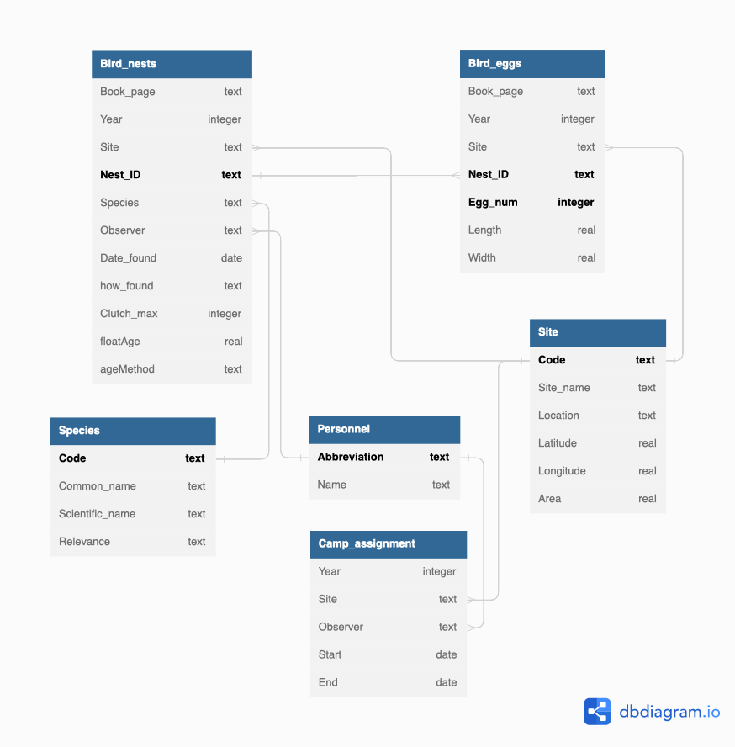
Our running example
Crow’s foot: many side of many-to-one relationship
Primary keys in bold

Slide 12
Roadmap
Today
Running SQLite
Getting help
SQL syntax
Queries, distinct, limits
Ordering
Filtering
Expressions
Set operations
NULL processing
Wednesday
Nesting, temporary tables
Aggregate functions
Grouping
Joins: inner, outer, self
Views
Week 4
Data management statements
Reading, writing data
Week 5
Triggers
Concurrency, transactions
Backups
Indexes

