Slide 1

The Dependency Hell
Free and open-source software…
Clean and clear code…
Data well-organized and documented..
devtools/sessionInfo ( )...
Still...issues with the environment
Say “it works in my machine”, one more time!

Slide 2
The Dependency Hell
Why?
Package versions don’t match
R versions don’t match
Ask yourself:
What are the packages versions used for my project?
Will my project be usable on other system or in the future?
How to deal with projects requiring different versions of a package?

Slide 3
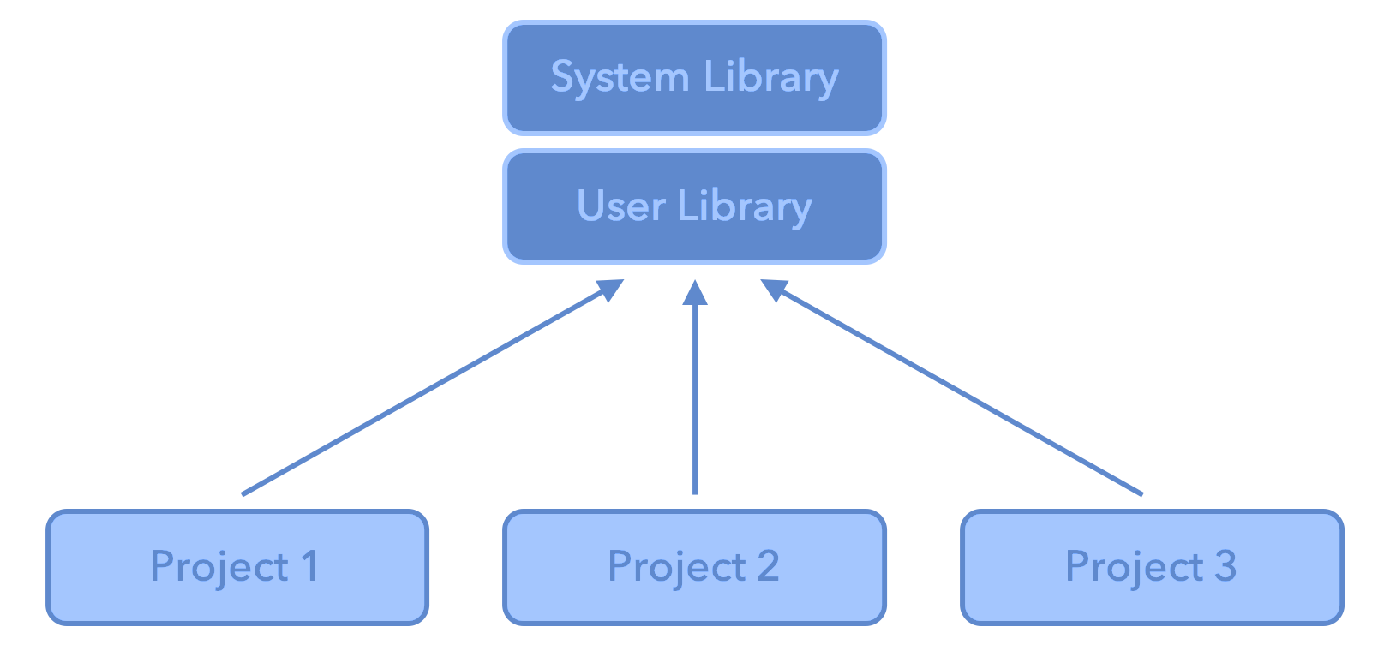
More into the problem - The R System
.libPaths gets/sets the library trees within which packages are looked for. Each R session can use multiple library paths (user and system)
Different projects, different dependencies, but calling from the same library. All projects share the same versions of installed packages.

Slide 4
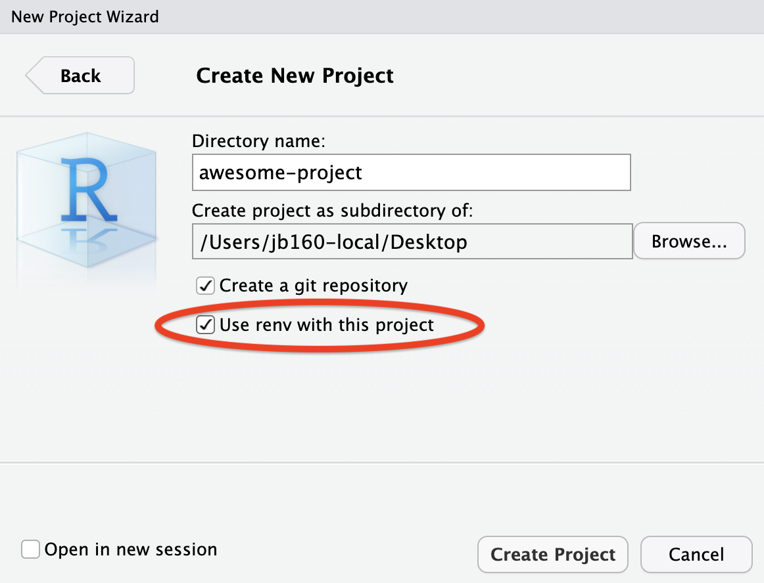
Well integrated with Rstudio
Have you ever used it?

Slide 5

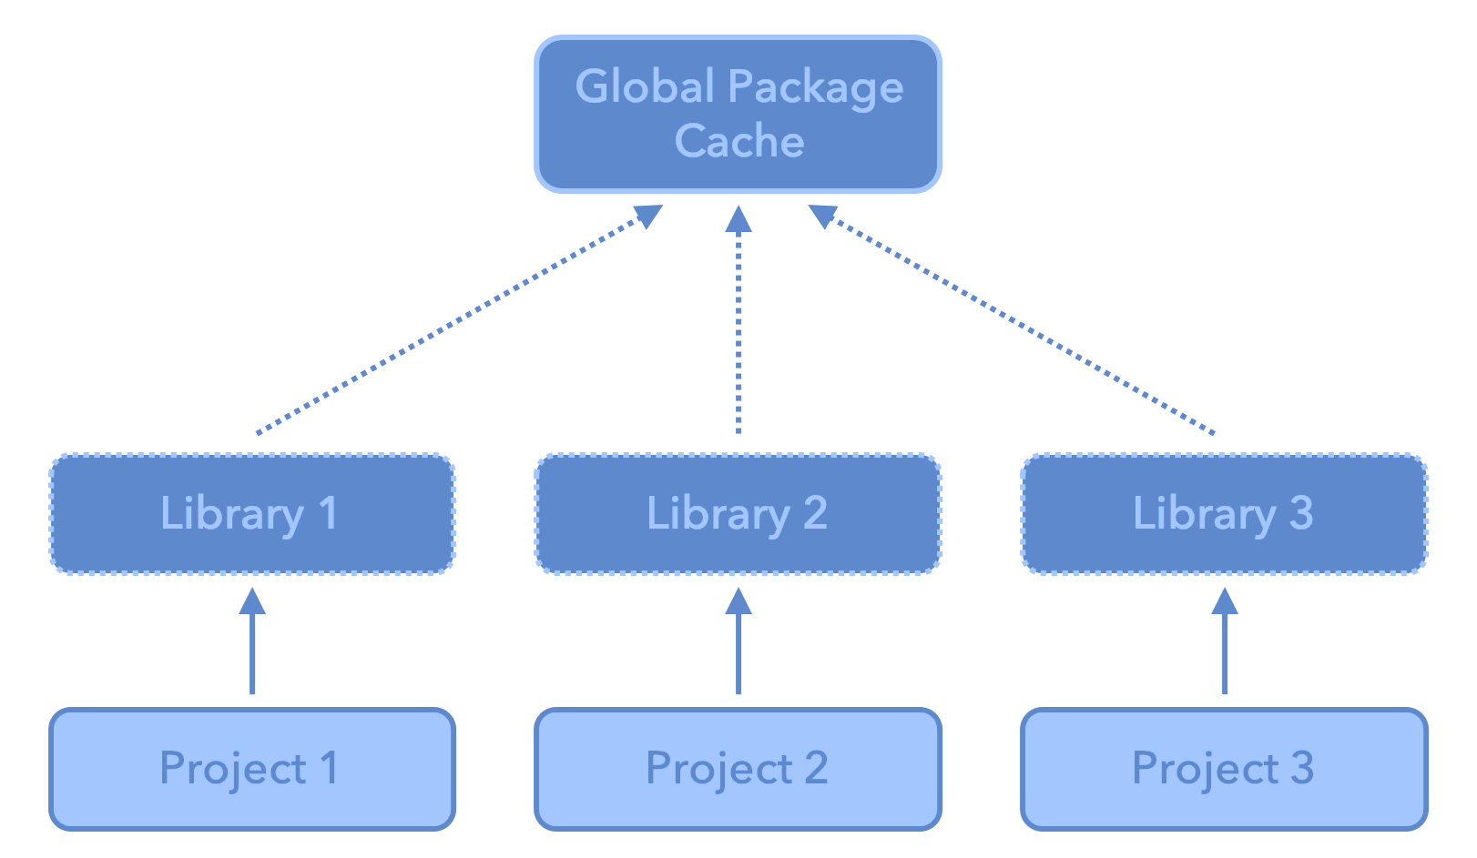
RENV
A project local library for each project

Slide 6
RENV
A dependency management toolkit for project-local libraries of R packages.
install.packages("renv")
Advantages:
Isolation: Each project gets its own library of R packages. In this way, you can upgrade and change package versions in one project without worrying about your other projects.
Portability: You can more easily share and collaborate on projects while ensuring all are sharing the same common base, by sharing a lockfile (renv.lock) which captures the state of your R packages.
Reproducibility: You can restore your R library exactly as specified in the renv.lock file.
https://rstudio.github.io/renv/articles/renv.html

Slide 7

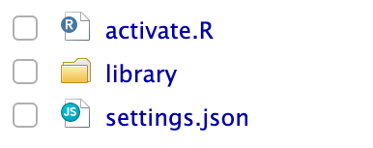

RENV Infrastructure
Used to activate renv for new R sessions launched in the project.
The activation script run by the project .Rprofile.
The private project library
Project-local settings that can be used to adjust the behavior of renv with your particular project.
The lockfile, describing the state of your project’s library at some point in time.

Slide 8
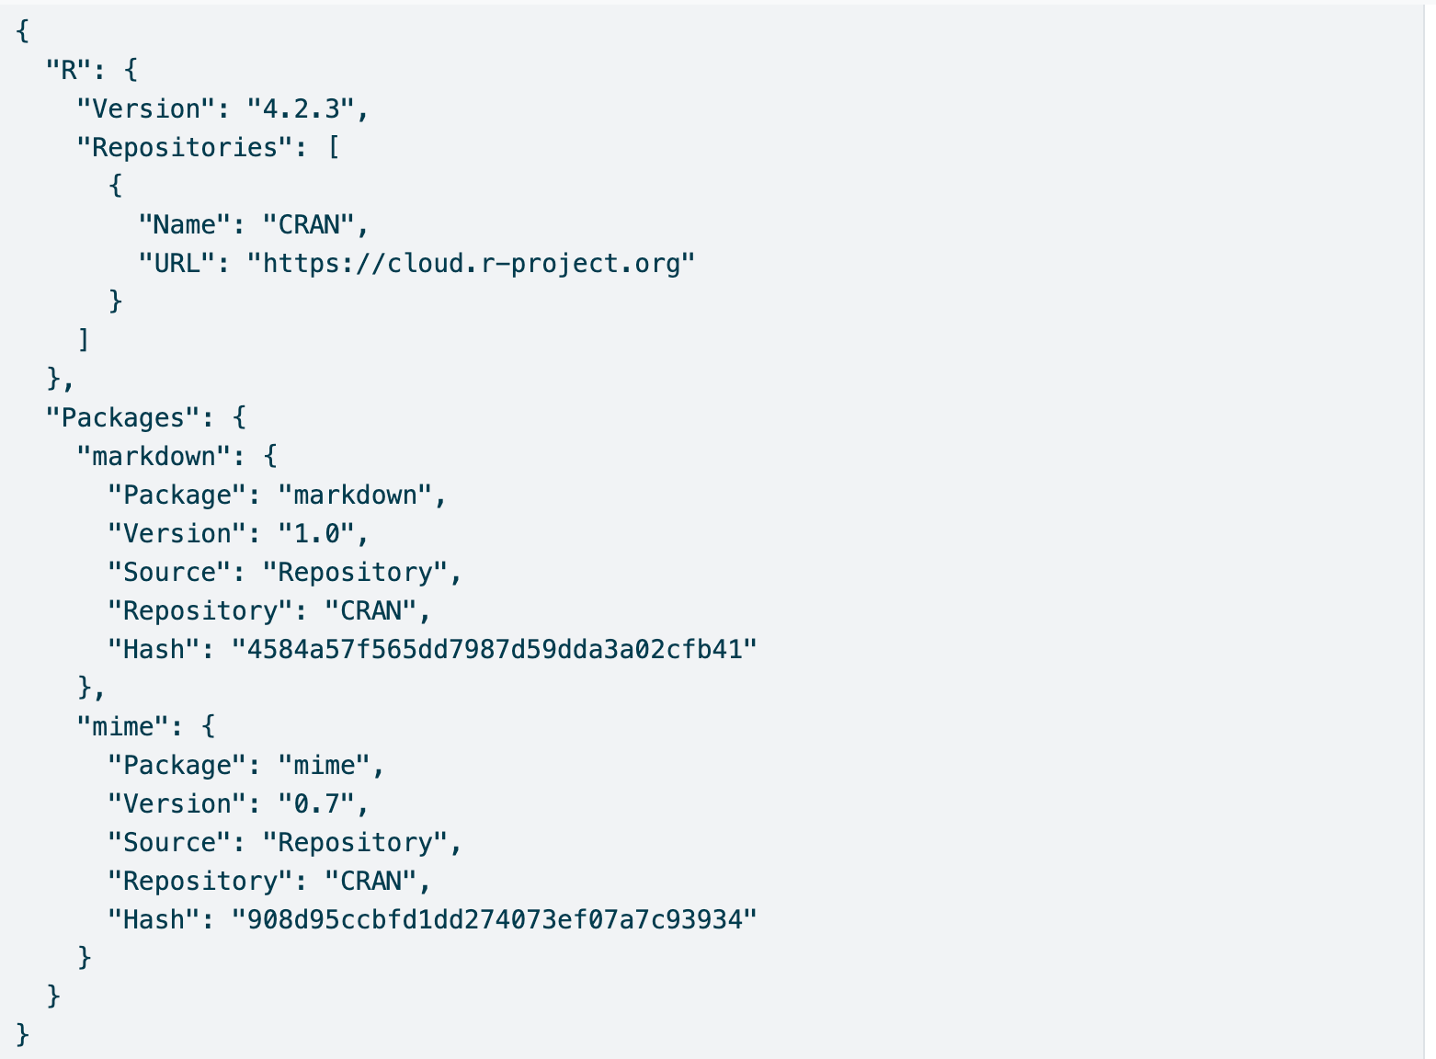
Anatomy of renv.lock file
The version of R used in that project;
The R repositories that were active when the lockfile was created;
Package records defining each R package, their version, and their installation source.
1
2
3
3

Slide 9
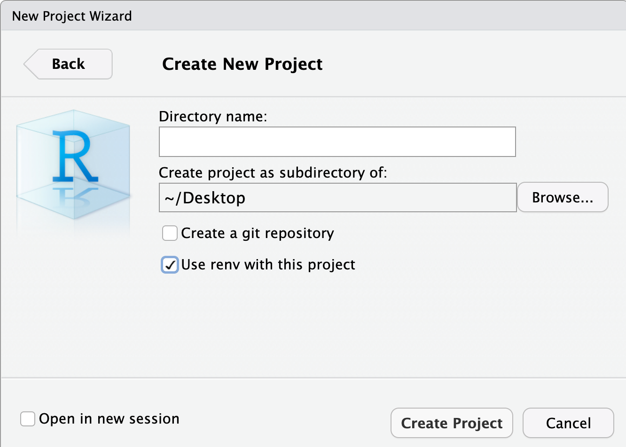
Get it right from the start

Slide 10
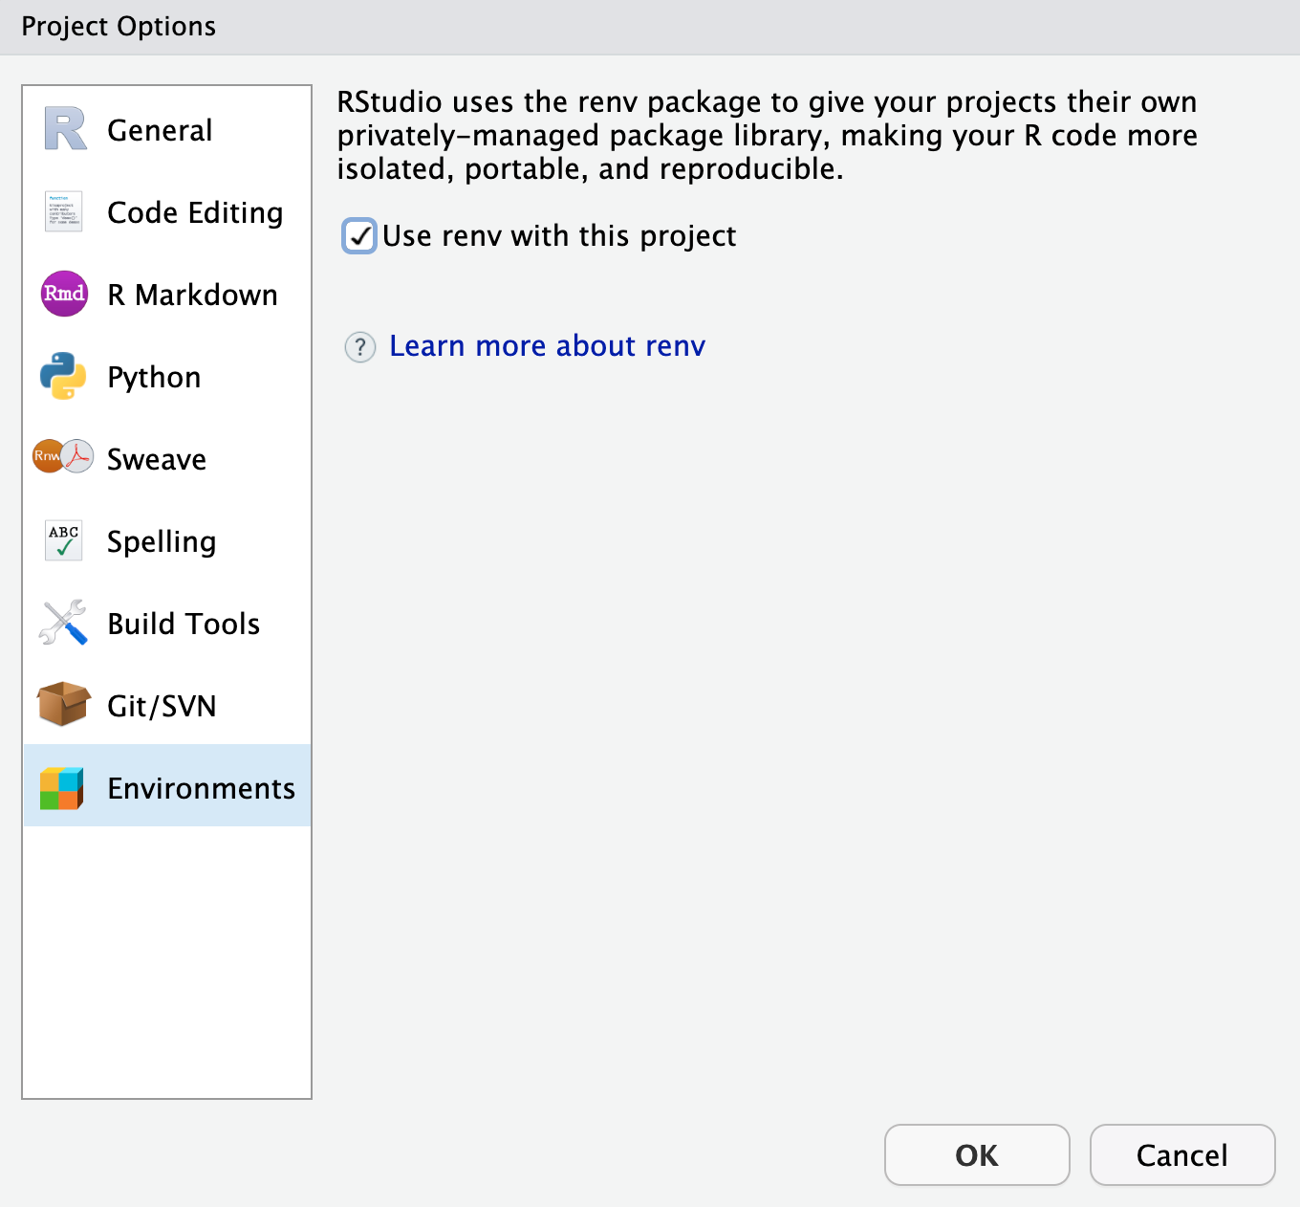
It’s never too late…

Slide 11
It’s never too late…
renv::init( )
renv::snapshot( )
renv::restore( )
Initialize a new project-local environment with a private R library
After updates, save the state of the project library to the lockfile (renv.lock)
Restore the state of your project from renv.lock. It examines your project’s R files to determine which packages are used in your project, and will include only those packages (alongside their recursive dependencies) in the lockfile.

Slide 12
Collaborating with RENV
Initialize renv in your project using renv::init( )
Share your project sources, including renv.lock, .Rprofile, and renv/activate.R and ensure that collaborators download and install the right version of renv when starting the project.
When a collaborator opens the project, renv will automatically bootstrap and download the appropriate version of renv.
If updates are made save them with renv::snapshot( )
After that, collaborators can use renv::restore( ) to restore the project library on their machine.

Slide 13
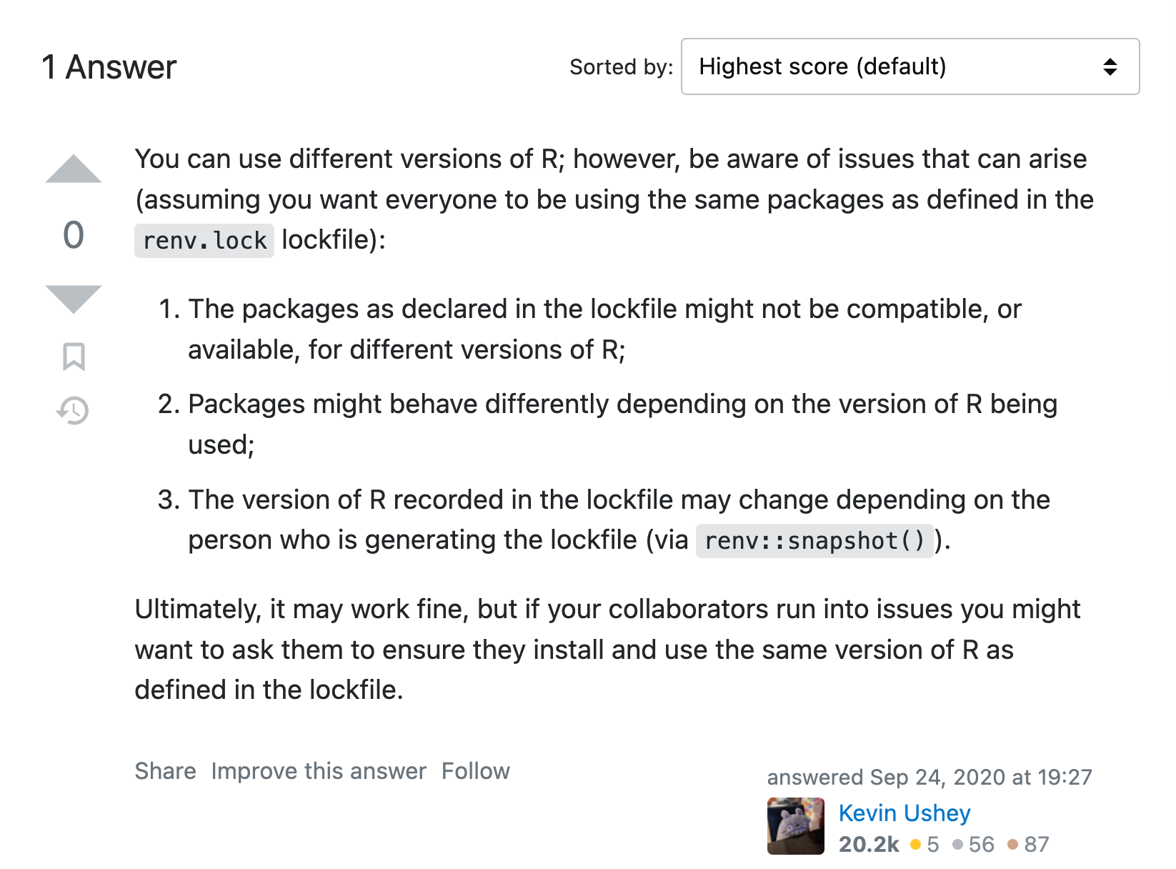
Wait…What if not the same R version?

Slide 14
…Better but still with Limitations

