Slide 1
Relational databases and data modeling
EDS213 - Databases & Data Management
Week 1
Greg Janée
Research Data Services, UCSB Library
rds@library.ucsb.edu

Slide 2
Learning objectives
Benefits of relational databases
Uses in Earth and environmental sciences
Relational data model and SQL data definition
Data modeling

Slide 3
Relational databases, the good
Fundamental form of data organization for 50 years
Remarkably stable: SQL basically unchanged for 50 years!
Mathematically rigorous basis
Open-ended query system
Support collaboration
Allow (well, require) schema definition
Correctness/consistency preserving
Fault tolerant, even replicated
Support concurrency out of the box
Turnkey performance support
Extensions for spatial objects, large corpus text, XML, JSON, etc.
Notes:
Kudos to E.F. Codd for nailing it the first time
Basis: relational algebra

Slide 4
RDBMS – the downsides
Relatively inflexible
Require more up-front investment
Require relatively heavyweight installation
But the cloud sure makes things easy
Data locked in
Multiple RDBMS vendors, both open source and proprietary
But beyond SQL, mutually incompatible
No standard on-disk storage or backup/dump formats
If database is corrupted (very rare), you’re out of luck
Notes:
Installation: separate server process, user accounts, admin user, etc.

Slide 5
RDBMS – Why in MEDS?
Both influential and integrated
Influential
Concepts in Python, R, etc., come straight from SQL
Integrated
Used in environmental web systems
Directly supported in GIS systems
Directly supported by programming environments
Notes:
GBIF, all websites really, are backed by RDBMS

Slide 6
RDBMS – When to use?
Data is complex, interrelated
Working collaboratively
Gathering data over time
Desire a single, unified view of data

Slide 7
Data modeling
Broadly: The activity of identifying data elements, articulating their semantics, and naming, organizing, and relating them in support of functional requirements
For RDBMS: identifying entities, attributes, relationships
Compared to CSV files: more expressive, rigorous
Notes:
Never possible to encode all semantics, metadata is always required, but possible to express more using SQL DDL statements

Slide 8
Data modeling importance
“To ensure accuracy in data collection and management, data collection systems have to be developed and maintained. For this, data models are needed to support data and computer systems by providing definitions and formats of data. Even though the data modelling phase represents only a relatively small share of the total development effort of data systems, its impact on the final result is probably greater than that of any other phase.” (Wohner 2022)
“Best Practice #1: Always create a data model before you start attempting to manage the data.” (Burnett 2022)
Notes:
Data model = foundation

Slide 9
Data modeling case study
“Designing and implementing a data model for describing environmental monitoring and research sites” (Wohner 2022)
What did they consider?
Naming
“One example for this was the field ‘site owner’. It was not clear to users what this exactly meant…”
Organization
“…three types of layers: (1) a set of core fields … standardised across domains, (2) a set of fields standardised within each domain, and (3) catalogue specific fields that are not and do not have to be standardized…”

Slide 10
Data modeling case study
What did they consider? (cont’d)
Interoperability with other standards
“…’site status’ was revised to utilise the WIGOS Codes registry.”
Data representation
“The description of geographic information is now realised through three separate fields: (1) the centroid/representative coordinates, …”
Business rules
“At least one contact person and metadata creator has to be linked to a site record…”
Functionality enabled
“Using the REST-API … enables potent queries by combining multiple filters.”

Slide 11
Basic unit of information: table
Represents a type of entity
Person, place, thing, event, transaction, observation
Rows represent instances of the entity
Usually unique; conceptually unordered
Columns represent attributes/properties of the entities
STUDENT
Name | House | Blood status | Birthdate | Wand length (in)
Harry Potter | Gryffindor | Half-blood | 1980-07-31 | 11
Hermione Granger | Gryffindor | Muggle-born | 1979-09-19 | 10.75
Draco Malfoy | Slytherin | Pure-blood | 1980-06-05 | 10
Ginny Weasley | Gryffindor | Pure-blood | 1981-08-11 | NULL
All data from harrypotter.fandom.com
Notes:
What entity is can be subtle, as we will see

Slide 12
Columns
Strictly typed
Good range of standard types, though with some differences by platform
Best practice: one atomic quantity
Text | Controlled vocabulary | Controlled vocabulary | Date | Real
Name | House | Blood status | Birthdate | Wand length (in)
Harry Potter | Gryffindor | Half-blood | 1980-07-31 | 11
Hermione Granger | Gryffindor | Muggle-born | 1979-09-19 | 10.75
Draco Malfoy | Slytherin | Pure-blood | 1980-06-05 | 10
Ginny Weasley | Gryffindor | Pure-blood | 1981-08-11 | NULL
Notes:
What constitutes ”atomic” depends on purpose and data types provided by system

Slide 13
Columns, cont’d
No hierarchical or grouping structures provided
RDBMS answer: more tables and relationships
NULL values
Comparable to NA in R
Represent absence of data (in tables) or unknown (in computation)
Tri-value logic: TRUE, FALSE, NULL
Integrity constraints
Value constraints
E.g., CHECK (Wand_length BETWEEN 7 AND 15)
Uniqueness
NULL values allowed or not
Notes:
Extensions provide JSON, XML support, but said support is not well-integrated with the rest of SQL

Slide 14
Primary keys
Column(s) that uniquely identify the entities, i.e., the rows
Not required by SQL, but usually conceptually necessary/applicable
STUDENT
Name | House | Blood status | Birthdate | Wand length (in)
Harry Potter | Gryffindor | Half-blood | 1980-07-31 | 11
Hermione Granger | Gryffindor | Muggle-born | 1979-09-19 | 10.75
Draco Malfoy | Slytherin | Pure-blood | 1980-06-05 | 10
Ginny Weasley | Gryffindor | Pure-blood | 1981-08-11 | NULL
Notes:
As is, Student has no primary key
Multi-column key example: (site, time) in temperature measurement table

Slide 15
Primary keys
Column(s) that uniquely identify the entities, i.e., the rows
Not required by SQL, but usually conceptually necessary/applicable
STUDENT
ID | Name | House | Blood status | Birthdate | Wand length (in)
S359 | Harry Potter | Gryffindor | Half-blood | 1980-07-31 | 11
S460 | Hermione Granger | Gryffindor | Muggle-born | 1979-09-19 | 10.75
S103 | Draco Malfoy | Slytherin | Pure-blood | 1980-06-05 | 10
S671 | Ginny Weasley | Gryffindor | Pure-blood | 1981-08-11 | NULL

Slide 16
Primary keys, cont’d
Primary key acts as referent, i.e., as target of relations
Benefits
Flexibility and independence: data can be changed without affecting relationships or related data
Non-redundancy: data can be consolidated in one place
Best practice
Primary key is numeric, or at least compact and opaque
Notes:
Presaging normalization here

Slide 17
Foreign keys
Column(s) that reference the primary key column(s) in another table
Basis for relationships
Declared and enforced: “referential integrity”
Relationship cardinalities: one-to-one, many-to-one, many-to-many
Many-to-one is most common
HOUSE
STUDENT
ID | Name | Head | Animal
H936 | Gryffindor | Minerva McGonagall | Lion
H822 | Hufflepuff | Pomona Sprout | Badger
H115 | Ravenclaw | Filius Flitwick | Eagle
H790 | Slytherin | Severus Snape | Serpent
ID | Name | House_ID
S359 | Harry Potter | H936
S460 | Hermione Granger | H936
S103 | Draco Malfoy | H790
S671 | Ginny Weasley | H936

Slide 18
Many-to-many relationship
Requires an intermediate table
STUDENT
ENROLLMENT
COURSE
ID | Name
S359 | Harry Potter
S460 | Hermione Granger
S103 | Draco Malfoy
S671 | Ginny Weasley
Student_ID | Course_ID
S359 | C465
S359 | C962
S103 | C962
S460 | C122
S460 | C465
S103 | C141
… | …
ID | Title | Room
C465 | Potions | Dungeons
C122 | Transfiguration | Room 1B
C962 | Herbology | Greenhouse
C141 | Charms | Corridor
Notes:
Enrollment primary key: whole row

Slide 19
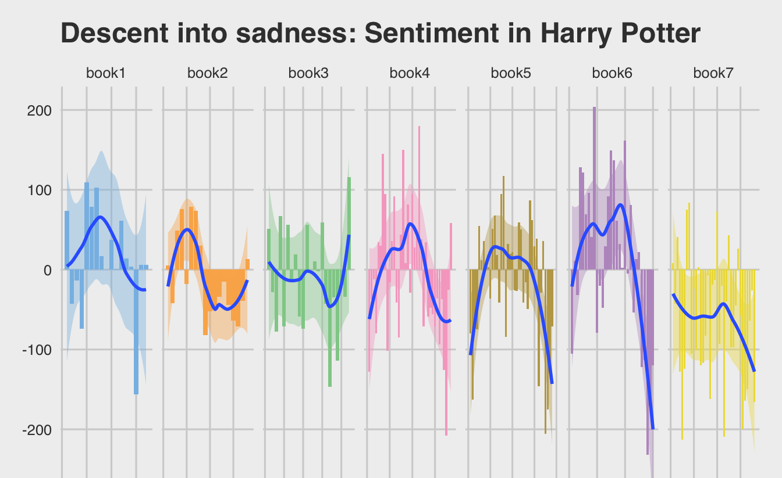
Use your data science skills for fun and profit!
https://www.tplatdata.com/blog/wordy-hallows-how-language-changes-in-harry-potter/

Slide 20
Day 1 recap
Relational databases, many advantages
Structured, expressive, consistency-guaranteeing
Lots of additional features for free: concurrency, fault tolerance, indexes for performance
The downsides
Less flexible, larger up-front cost
Data lock-in
Data modeling
Generally: defining the representation, structure, meaning of data
For RDBMS specifically, doing so using tools provided: entities (tables), attributes (columns), relationships (foreign key ➜ primary key), constraints

Slide 21
Revisiting foreign keys
Can express that a column is a foreign key
HOUSE
STUDENT
ID | Name | Head | Animal
H936 | Gryffindor | Minerva McGonagall | Lion
H822 | Hufflepuff | Pomona Sprout | Badger
H115 | Ravenclaw | Filius Flitwick | Eagle
H790 | Slytherin | Severus Snape | Serpent
ID | Name | House_ID
S359 | Harry Potter | H936
S460 | Hermione Granger | H936
S103 | Draco Malfoy | H790
S671 | Ginny Weasley | H936

Slide 22
Revisiting foreign keys
Can express that a column is a foreign key
Q: what happens if we try to delete the Gryffindor row?
HOUSE
STUDENT
ID | Name | Head | Animal
H822 | Hufflepuff | Pomona Sprout | Badger
H115 | Ravenclaw | Filius Flitwick | Eagle
H790 | Slytherin | Severus Snape | Serpent
ID | Name | House_ID
S359 | Harry Potter | H936
S460 | Hermione Granger | H936
S103 | Draco Malfoy | H790
S671 | Ginny Weasley | H936
?
?
Notes:
Correctness/consistency preservation means that the database will not allow the row to be deleted.

Slide 23
Revisiting many-to-many relationships
Requires an intermediate table
STUDENT
ENROLLMENT
COURSE
ID | Name
S359 | Harry Potter
S460 | Hermione Granger
S103 | Draco Malfoy
S671 | Ginny Weasley
Student_ID | Course_ID
S359 | C465
S359 | C962
S103 | C962
S460 | C122
S460 | C465
S103 | C141
… | …
ID | Title | Room
C465 | Potions | Dungeons
C122 | Transfiguration | Room 1B
C962 | Herbology | Greenhouse
C141 | Charms | Corridor
Notes:
Student question: Enrollment is not human readable, very technical

Slide 24
Preview of coming attractions (1)
SELECT name FROM student, enrollment, course ON … WHERE title = ‘Potions’;

Slide 25
Preview of coming attractions (2)
SELECT name FROM student, enrollment, course ON … WHERE title = ‘Potions’;
CREATE VIEW quickref AS SELECT name, title FROM student, enrollment, course ON … ;
SELECT name FROM quickref WHERE title = ‘Potions’;
quickref
name | title
Harry Potter | Potions
Harry Potter | Herbology
Hermione Granger | Potions
Hermione Granger | Transfiguration
Notes:
A view is a table, albeit a virtual one

Slide 26
Normalization
Data is “normalized” if it follows the principles we’ve been discussing
One table per type per entity
Rows are instances of the entity
Columns are attributes of the entity (and not of anything else)
Primary and foreign keys
Benefits
Data is one and only one place
Maximizes flexibility and independence
Disadvantages
More tables; complexity
Data sometimes “denormalized” for simplicity, performance
Notes:
More formally, normalization is defined by functional dependencies between columns, and there are 5 normal forms

Slide 27
Example of un-normalization
Going back to earlier incarnation of student table…
New column
STUDENT
ID | Name | House | Headmaster | Blood status | Birthdate
S359 | Harry Potter | Gryffindor | Minerva McGonagall | Half-blood | 1980-07-31
S460 | Hermione Granger | Gryffindor | Minerva McGonagall | Muggle-born | 1979-09-19
S103 | Draco Malfoy | Slytherin | Severus Snape | Pure-blood | 1980-06-05
S671 | Ginny Weasley | Gryffindor | Minerva McGonagall | Pure-blood | 1981-08-11
Notes:
Is headmaster an attribute of a student? No

Slide 28
Normalization trigger: attribute growth
When an attribute gains its own attributes, the attribute becomes an entity in its own right
We saw this with the House examples earlier
First example: House is a term from a controlled vocabulary
Second example: House is an entity which the Student table references

Slide 29
Normalization trigger: multiple values
Oops, a student can have multiple wands
No:
No:
No:
ID | Name | Wand_lengths
S359 | Harry Potter | 11, 10.75, 10, 10, 15
ID | Name | Wand_length_1 | Wand_length_2 | Wand_length_3
S359 | Harry Potter | 11 | 10.75 | 10
ID | Name | Wand_length
S359 | Harry Potter | 11
S359 | Harry Potter | 10.75

Slide 30
Normalization trigger: multiple values
Yes: promote attribute to an entity
WAND
ID | Length | Wood | Core | Owner | …
W535 | 11 | Holly | Phoenix feather | S359 | …
W876 | 10.75 | Vine | Dragon heartstring | S359 | …
W039 | 12 | Ash | Unicorn tail | S319 | …
STUDENT
ID | Name
S359 | Harry Potter
S319 | Ron Weasley
Notes:
This assumes wand has one owner; will discuss this point further in a bit

Slide 31
What is the entity?
The entity being described can be subtle
From the data we’re going to be working with:
Metadata: “List of field crew members and their active dates”
Camp_staff
Year | Site | Name | Start | End
2005 | bylo | Laura McKinnon | 2005-06-01 | 2005-08-05
2005 | bylo | Benoît Laliberté | 2005-06-05 | 2005-08-20
2006 | bylo | Ludovic Jolicoeur | 2006-06-06 | 2006-08-06
Notes:
Camp_staff was name originally given; renamed to Camp_assignment

Slide 32
What is the entity?
What is it now?
Camp_staff
Year | Site | Name | Start | End
2005 | bylo | Laura McKinnon | 2005-06-01 | 2005-08-05
2005 | bylo | Benoît Laliberté | 2005-06-05 | 2005-08-20
2006 | bylo | Ludovic Jolicoeur | 2006-06-06 | 2006-08-06
2007 | bylo | Ludovic Jolicoeur | 2007-06-07 | 2007-08-07
Notes:
Normalization is the context of an entity type, so what the entity is determines appropriateness of attributes
Naming: what is the best name for this table/entity?

Slide 33
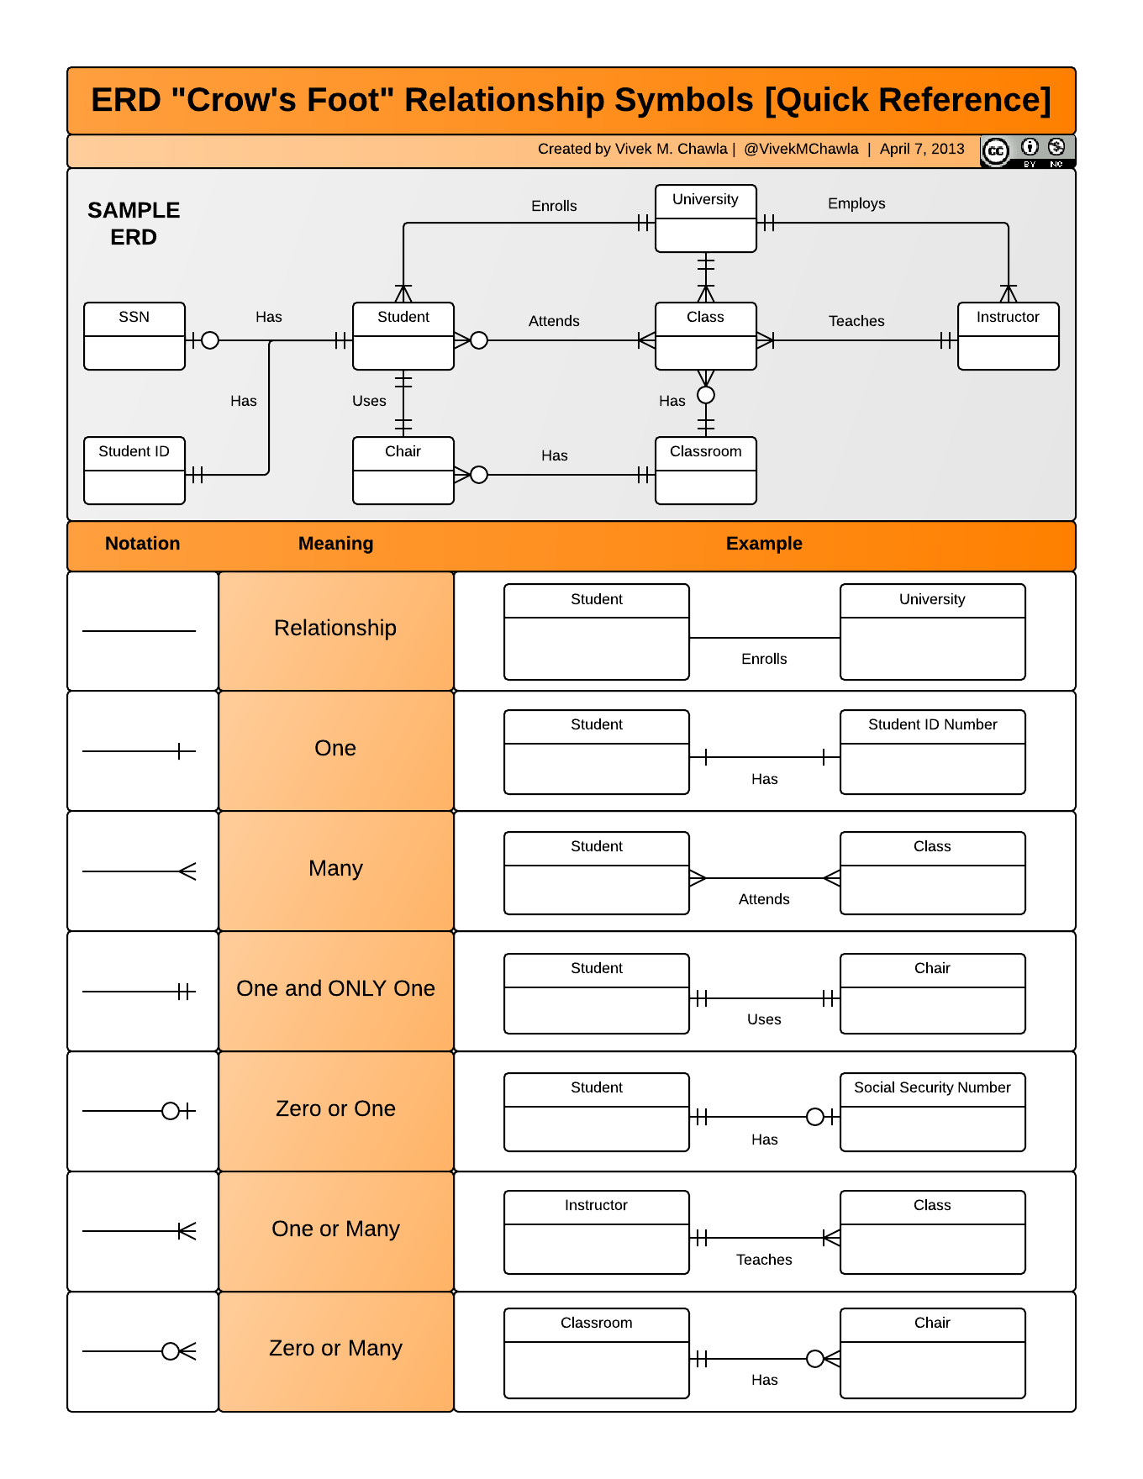
Conceptual vs physical modeling
A conceptual model describes relationships at a high level
“There is a many-to-one relationship between Student and House”
One way to indicate graphically shown at right
The physical model details how the relationship is implemented with columns, foreign keys, and intermediate tables
As we’ve seen so far

Slide 34
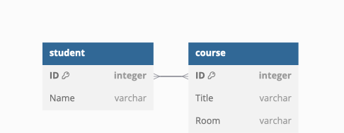
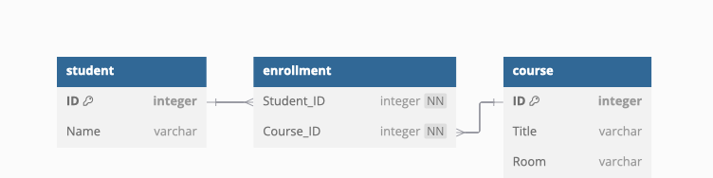
Diagramming Harry Potter
Conceptual
Physical

Slide 35
Naming best practices
Table names singular
Student, not Students or Student_body
Column name unqualified
Name, not Student_name
Ergo, can reference in SQL as Student.Name
Two approaches to key naming
Use attribute name to indicate relationship
E.g., Wand column referencing Student is named “Owner”
Use primary key name uniformly (preferred for sanity, makes joins easy)
Student_ID, House_ID, etc.

Slide 36
Art of data modeling
Balancing act between:
Fidelity of description
Functional requirements
Understandability & maintainability
Data availability

Slide 37
In-class activity
Go to goodreads.com
What’s a conceptual data model for this website?
Entities, attributes, relationships, constraints

Slide 38
Our running example
Arctic Shorebird Demographics Network (ASDN)
Arctic Data Center
https://doi.org/10.18739/A2222R68W
Multiple, related CSV files
Bird nests, bird eggs, bird captures, bird sightings, lemming counts, snow coverage, etc.
Not in database or relational form, but kinda screams relational
Real-world dataset
Reflects the challenges of managing data distributed over time, space, and people
This week: define table structure
Next week: look at cleaning data, getting CSV files into tables
Notes:
We’re not going to do a data modeling exercise, but will instead focus on how express CSV file semantics in SQL

Slide 39
Sample table: Site
“ASDN field sites are referred to by 4-letter codes in each of the data files”
import pandas as pd df = pd.read_csv("site.csv") df.info()
➜ Data columns (total 6 columns): # Column Non-Null Count Dtype --- ------ -------------- ----- 0 Code 16 non-null object 1 Site name 16 non-null object 2 Location 16 non-null object 3 Latitude 16 non-null float64 4 Longitude 16 non-null float64 5 Total_Study_Plot_Area_(ha) 16 non-null float64
len(df.Code.unique()), len(df["Site name"].unique())
➜ (16, 16)
Notes:
View in RStudio or Jupyter

Slide 40
Site table definition
CREATE TABLE Site (
Code TEXT PRIMARY KEY,
Site_name TEXT UNIQUE NOT NULL,
Location TEXT NOT NULL,
Latitude REAL NOT NULL CHECK (Latitude BETWEEN -90 AND 90),
Longitude REAL NOT NULL CHECK (Longitude BETWEEN -180 AND 180),
"Total_Study_Plot_Area_(ha)" REAL NOT NULL
CHECK ("Total_Study_Plot_Area_(ha)" > 0),
UNIQUE (Latitude, Longitude)
);

Slide 41
Sample table: Camp_assignment
Site column: “Four-letter code of site at which data were collected”
Smells like a foreign key!
site = pd.read_csv(“site.csv”) df = pd.read_csv(“ASDN_Camp_assignment.csv”) sum(~df.Site.isin(site.Code))
➜ 0

Slide 42
Camp_assignment table definition
CREATE TABLE Camp_assignment (
…,
Site TEXT NOT NULL, FOREIGN KEY (Site) REFERENCES Site (Code),
…, );

Slide 43
Why bother with constraints on data? (1)
Here’s why
Daily_pred_lemm.Team_count
Boolean column: “Did more than one person conduct the survey together?”
import pandas as pd df = pd.read_csv("ASDN_Daily_pred_lemm.csv") df.Team_count.unique()
➜ array(['n', 'y', nan, 'n ', 'N'], dtype=object)

Slide 44
Why bother with constraints on data? (2)
Bird_nests.conceal
Numeric column: “Percent of the nest concealed by vegetation”
df = pd.read_csv("ASDN_Bird_nests.csv") df.conceal.unique()
➜ array(['90', '100', '95', '80', '70', '85', '50', '20', '40', '60', '10', '30', '65', '75', nan, '0', '15', '55', '35', '200', '25', '45', '5', '-', '.', '1', '2', '3', 'unk', '4', '98', '99', '93', '58', '96', '8', '64.7', '57.2', '17.75', '17', '10.45', '4.23', '1.65', '46', '16.4', '6', '97', '17.5', '77.5', '77', '91.25', '88.5', '1.25', '3.5', '6.75', '6.5', '<1', '9', '470', '88', '87'], dtype=object)
Notes:
Notice differing number precisions, 95 vs 10.45. What’s the methodology? Also the 200 value.

Slide 45
Metaphor for data
Something that flies out of control when no longer constrained
Need help here

Slide 46
Closing thoughts
Errors in data are often unnoticed yet potentially impactful
To have confidence in data, we need assurance that it matches our assumptions and expectations
Takeaway: take advantage of opportunities to insert sanity checks
RDBMS provide tools to structure, describe, and enforce correctness of data
Databases are often used for large, long-lived datasets
Take advantage of this opportunity

