Slide 1


Databases & Data Management
EDS-213, v2026
Julien Brun, Greg Janée, Renata Curty & Annie Adams

Slide 2
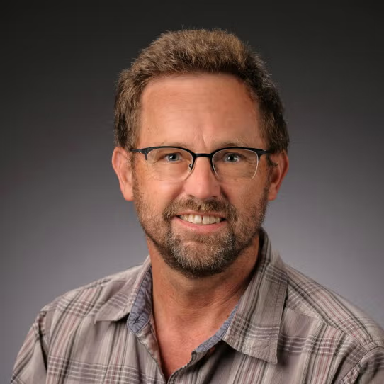
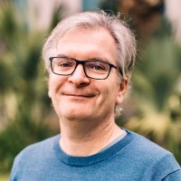
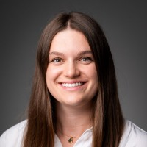
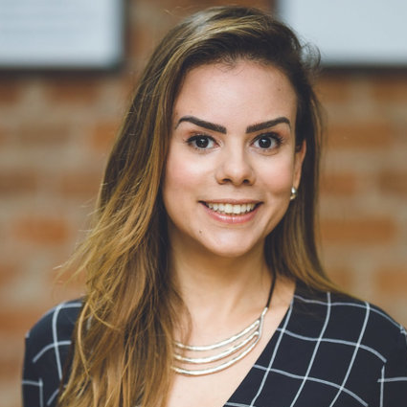
Team
Greg Janeé
Director of RDS
Julien Brun
Earth & Env. Sciences Research Facilitator
Annie Adams
Bren Lecturer
Renata Curty
Social Science Research Facilitator
gjanee@ucsb.edu
jb160@ucsb.edu
aradams@ucsb.edu
rcurty@ucsb.edu

Slide 3
Schedule
Lectures: Mon & Wed 9:30-10:45 AM (BH 1424)
Lab: Wed 1-2:20 PM (BH 3022A)
Office hours:
Greg & Julien: Mon after class
Annie: Thu 11AM-12PM

Slide 4
Resources
Course website: https://ucsb-library-research-data-services.github.io/bren-eds213/
Slack: #eds-213-data
Canvas: https://ucsb.instructure.com/courses/32934

Slide 5


Goals – Database
Understand the fundamental principles of relational databases and relational data modeling
Use SQL to retrieve, manipulate, and manage data stored in a relational database.
Demonstrate proficiency in querying, filtering, sorting, and programmatically interacting with relational databases from R and Python
Explore how those tools can be use to analyze large datasets
Become familiar with advanced database topics such as concurrency, transactions, indexing, backups, and publication.

Slide 6
Goals – Data management
Understand the role of good data documentation and metadata standards for effective data management and reproducibility
Understand the ethics of sensitive data and how to de-identify sensitive data
Evaluate ethical and responsible data management practices, including bias, data privacy, sharing, ownership, and licensing issues

Slide 7
Goals – Lab
Build your own database from data you care about
Answer some questions that you care about
Fun peer-to-peer space to experience

Slide 8
Week | Lecture | Lab
1 | Relational databases and data modeling | Finding your relational dataset
2 | Analyzing & cleaning the bird dataset (from csv) | Design the schema of your database
3 | Introduction to SQL (part 1) & DuckDB | Clean and ingest
4 | SQL part 2 + Analyzing the bird database using SQL | Data exploration and analysis using SQL
5 | I/O & data management + DuckDB and Parquet files | Visualize your data
6 | Using R & Python to query databases + bash programming | Finalize and document
7 | Capturing your computing environment + Documenting your work: metadata | Database showcases
8 | Databases advanced topics + Ethical & responsible data mgnt | -
9 | Sensitive data | Sensitive data lab
10 | Data licensing and publication | -
* Subject to minor changes as needed

Slide 9
Assessment
60% on weekly homework assignments
20% on quizzes (closed book and computer)
20% on Lab project
2 wildcards:
1x 24h extension
1x Resubmission (before week 10) NOTE: Points removed due to unfair use of AI can not be earned back this way

Slide 10
Assignments
Week | Assignment | Points
1 | Data Modeling | 100
2 | Data Cleaning | 100
3 | SQL query part I | 120
4 | SQL query part II | 120
5 | Querying Parquet files | 100
6 | Using R & Python to query a database | 100
7 | Documentation Capstone project - metadata + computing env | 50
8 |  | -
9 | Bonus problem | 100
10 | - | -
* Subject to minor changes

Slide 11
Assignments
Weekly assignments will be managed via Canvas
Available by 5PM on Wednesdays
Due by next Wednesdays 11PM

Slide 12
Assessment
4 Main criteria:
Technical concepts (database, data modeling, …)
Code quality
Code readability
Unnecessary code will be penalized
Documentation
Reproducibility

Slide 13
AI Assistant Tools
Materials (written or otherwise) submitted to fulfill academic requirements must represent a student’s efforts unless otherwise permitted by an instructor Student Guide to Academic Integrity
Disclaim the use of any coding assistant or LLMs (such as ChatGPT, Gemini, …)
Understand and explain every line of code that is submitted as part of the assignments, including unnecessary code
=> refrain from the use of AI tools and keep to practicing your skills and favoring peer-to-peer learning

Slide 14
Attendance Summary
TL;DR: Come to lecture & Lab!!
🤒 Stay home when you are sick! Be proactive and notify your instructor as soon as possible; Catch up once you are better
More info on the course website, under Syllabus

